Slide 1
CIS 422/522
2nd Half Concept Review
Stuart Faulk

Slide 2
View of SE in this Course
The purpose of software engineering is to gain and maintain intellectual and managerial control over the products and processes of software development.
  “Intellectual control” means that we are able make rational choices based on an understanding of the downstream effects of those choices (e.g., on system properties)*
  Managerial control means we control development resources (budget, schedule, personnel)
Notes:
Key idea: to gain and maintain control over the factors affected by architecture, need sound practice (effective and predictable)
Intellectual control: i.e., we know what we are doing and why.

Slide 3
Fit in the Development Cycle
Requirements
Analysis
“…The earliest artifact that enables the priorities among competing concerns to be analyzed, and it is the artifact that manifests the concerns as system qualities.”
Software
Architecture
Software
Design
Coding
System Integration
and Testing
Deployment
Maintenance and
Evolution
Notes:
Slide showing nominal fit in development cycle.
Note that SAP treats “high-level design” as encompassing more than architectural decisions (e.g., data structures)
This picture is no more accurate than a waterfall picture but gives a sense of relative placement.

Slide 4
Implications of the Definition
“The software architecture of a program or computing system is the structure or structures of the system, which comprise software components, the externally visible properties of those components, and the relationships among them.” - Bass, Clements, Kazman
Systems typically comprise more than one architecture
  There is more than one useful decomposition into components and relationships
  Each addresses different system properties or design goals
It exists whether any thought goes into it or not!
  Decisions are necessarily made if only implicitly
  Issue is who makes them and when
Many “architectural specifications” aren’t

Slide 5
Examples: These are architectures
An architecture comprises a set of
  Software components
  Component interfaces
  Relationships among them
Examples
Structure | Components | Interfaces | Relationships
Calls Structure | Programs | Program interface and parameter declarations. | Invokes with parameters (A calls B)
Data Flow | Functional tasks | Data types or structures | Sends-data-to
Process | Sequential program (process, thread, task) | Scheduling and synchronization constraints | Runs-concurrently-with, excludes, precedes
Notes:
Procedure A calls procedure B

Slide 6
This is not
Control
Process
(CP)
Prop Loss
Model
(MODP)
Reverb
Model
(MODR)
Noise
Model
(MODN)
Typical (but uninformative) architectural diagram
What is the nature of the components?
What is the significance of the link?
What is the significance of the layout?

Slide 7
Effects of Architectural Decisions
What kinds of system and development properties are and are not affected by architecture?
System run-time properties
  Performance, Security, Availability, Usability
System static properties
  Modifiability, Portability, Reusability, Testability
Production properties? (effects on project)
  Work Breakdown Structure, Scheduling, time to market
Business/Organizational properties?
  Lifespan, Versioning, Interoperability
But not functional behavior
Notes:
Slide listing some of the “what” answers.

Slide 8
Relation to Stakeholders
Many stakeholders have a vested interest in the architectural design
  Management, marketing, end users, maintenance, IV&V, Customers, etc
Important because their interests are diverse and often defy mutual satisfaction
  There are inherently tradeoffs in most architectural design choices
  E.g. Performance vs. security, initial cost vs. maintainability
Making successful tradeoffs requires understanding the nature, source and priority of quality requirements
Notes:
Slide listing some stakeholders and why understanding them is important.
I.e., people who have a stake in the outcome of the decisions made whether in terms of cost or in terms of system behavior

Slide 9
The Architectural Business Cycle
Business Goals
Hardware
Software
Marketing
other
Design decisions,
tradeoffs and constraints
Product Planning
Economic Evaluation
Development Strategy
Marketing Strategy
Prioritization
Strategic
Plan
Requirements
Capabilities
Qualities
Reusability
Stakeholder goals
ConOps or BRD
Business
Requirements
Definition
Architecture
Tradeoffs of
quality goals
Detailed
Design
SRS
Software
Requirements
Specification
Code
Traceability
Architecture
Design
Documents
Internal
Design
Documentation
Notes:
This picture illustrates the correspondence between phases of the development process and the products produced. In particular, it shows the two kinds of requirements specifications, one owned by the business side (the BRD, MRD, or ConOps) and one owned by the technical side (the Software Requirements Specification). We will discuss the purpose and content of each of these in the following weeks.
Note, however, that these indicate distinct kinds of information. Not all organizations actually develop distinct documents.

Slide 10
Implications for the Development Process
Goal: keep developmental goals and architectural capabilities in synch:
Understand the goals for the system (e.g., business case or mission)
Understand/communicate the quality requirements
Design architecture(s) that satisfy quality requirements
Evaluate/correct the architecture
Implement the system based on the architecture
Notes:
Note that we have a product for software architecture - implies that we necessarily have a process (whether we think we do or not).
To accomplish this, the organization needs a controlled and predictable process.
Business case: Understand relevant business issues (time to market)
Requirements: Understand other stakeholder concerns
Creating: Build the architecture to address needs, balance concerns
Represent: Communicate for review
Implement: Manage for conformance so you don’t have to do it over again
Ensure: Verify architectural consistency to ensure that planned properties are actualized in the system as constructed
Book will cover techniques for all of these.

Slide 11
Designing Architectures

Slide 12
Elements of Architectural Design
Design goals
  What are we trying to accomplish in the decomposition?
Relevant Structure
  How to we capture and communicate design decisions?
  What are the components, relations, interfaces?
Decomposition principles
  How do we distinguish good design decisions?
  What decomposition (design) principles support the objectives?
Evaluation criteria
  How do I tell a good design from a bad one?
Notes:
What are the parts of an architectural design strategy for a particular architecture.
These are implicit in the discussion in the book.

Slide 13
Design Means…
Design Goals: the purpose of design is to solve some problem in a context of assumptions and constraints
  Assumptions: what must be true of the design
  Constraints: what should not be true
  These define the design goals
Process: design proceeds through a sequence of decisions
  A good decision brings us closer to the design goals
  An idealized design process systematically makes good decisions
  Any real design process is chaotic
Good Design: by definition a good design is one that satisfies the design goal

Slide 14
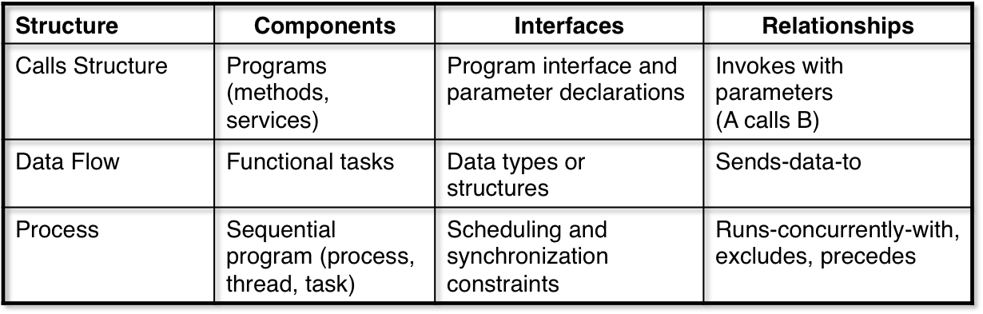
Which structures should we use?
Choice of structure depends the specific design goals
Compare to architectural blueprints
  Different view for load-bearing structures, electrical, mechanical, plumbing

Slide 15
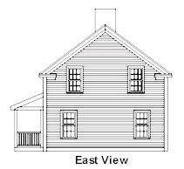
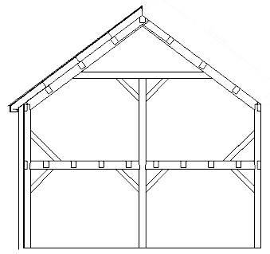
Elevation/Structural

Slide 16
Models/Views
Different views answer different kinds of questions
Designing for particular software qualities also requires the right architectural model or “view”
  Any model presents a subset of system structures and properties
  Different models answer different kinds of questions about system properties
Goal is choose a set of views where
  Structures determine key required qualities
  Consequences of related design choices are made visible

Slide 17
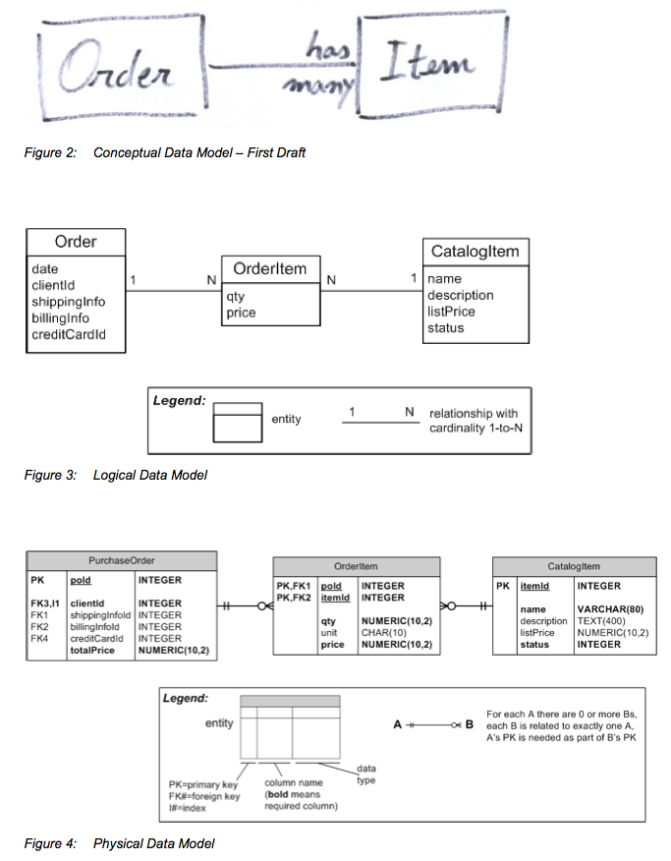
Example:
Data Model View
Data Model Architecture
  Entities: data structures
  Relations: cardinality, aggregation, generalization/specialization
  Interface: attributes
Model/communicate structure of complex data
  What data is kept?
  How is it related?
  How is it structured and accessed in the system?

Slide 18
Example:
Designing the Module Structure

Slide 19
Modularization
For large, complex software, must divide the development into work assignments (WBS). Each work assignment is called a “module.”
Properties of a “good” module structure
  Parts can be designed, understood, or implemented independently
  Parts can be tested independently
  Parts can be changed independently
  Integration goes smoothly

Slide 20
What is a module?
A module is characterized by two things:
  Its interface: services that the module provides to other parts of the systems
  Its secrets: what the module hides (encapsulates). Design/implementation decisions that other parts of the system should not depend on
Modules are abstract, design-time entities
  Modules are “black boxes” – specifies the visible properties but not the implementation
  May or may not directly correspond to programming components like classes/objects
Notes:
Why “work assignments”? How does this relate to our notions of control? Architecture recapitulates organization.

Slide 21
A Simple Module
A simple integer stack
The interface specifies what a programmer needs to know to use the stack correctly, e.g.
The secrets (encapsulated) any details that might change from one implementation to another
  Data structures, algorithms
  Details of class/object structure
A module spec is abstract: describes the services provided but allows many possible implementations
stack
peek(int)
push(int)
pop()

Slide 22

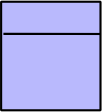

Module Hierarchy
Problem
For large systems, organize modules such that
  Every requirement is allocated to some module
  Can easily find the module providing a given capability
  When a change is required, it is easy to determine which modules must be changed
The module hierarchy defined by the submodule-of relation
Secrets
Secrets
Secrets
Secrets
Secrets
Interface
Interface
Interface
Encap-
sulated
Encap-
sulated
Encap-
sulated
Submodule-of relation

Slide 23
Modular Structure
Comprises components, relations, and interfaces
Components
  Called modules
  Leaf modules are work assignments
  Non-leaf modules are the union of their submodules
Relations (connectors)
  submodule-of => implements-secrets-of
  The union of all submodules of a non-terminal module must implement all of the parent module’s secrets
  Constrained to be acyclic tree (hierarchy)
Interfaces (externally visible component behavior)
  Defined in terms of access procedures (services or method)
  Only external (exported) access to internal state

Slide 24
Design Approach

Slide 25
Decomposition Strategies Differ
How do we develop this structure so that we know the leaf modules make independent work assignments?
Many ways to decompose hierarchically
  Functional: each module is a function
  Steps in processing: each module is a step in a chain of processing
  Data: data transforming components
  Client/server
But, these result in strong dependencies (strong coupling)

Slide 26
Information Hiding Decomposition
Approach: divide the system into submodules according to the kinds of design decisions they encapsulate (secrets)
  Group design decisions that are likely to change together in the same module
  Allocate design decisions that are likely to change independently in different modules
  Characterize each module by its secrets (what it hides)
Viewed top down, each module is decomposed into submodules such that
  Each design decision allocated to the parent module is allocated to exactly one child module
  Together the children implement all of the decisions of the parent
Stop decomposing when each module is
  Simple enough to be understood fully
  Small enough that it makes sense to throw it away rather than re-do
This is called an information-hiding decomposition
Notes:
Not the same as OO classes

Slide 27

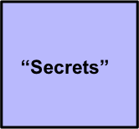
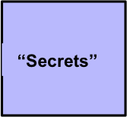

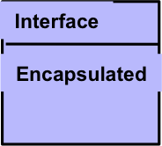
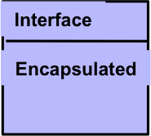
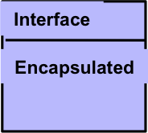
Module Hierarchy
Problem
Given a set of likely changes
Things that change together in same module
Separately in different modules
Meets design goals
Submodule-of relation

Slide 28
Takeaway
Understand the module structure design goals
Understand how the IH principle is used to decompose modules
Understand how its application results in a structure that satisfies those goals

Slide 29
Specifying Abstract Interfaces

Slide 30
Module Interface Specs
Documents all assumptions user’s can make about the module’s externally visible behavior
  Access programs, events, types, undesired events
  Design issues, assumptions
Document purpose(s)
  Provide all the information needed to write a module’s programs or use the programs on a module’s interface (programmer’s guide, user’s guide)
  Specify required behavior by fully specifying behavior of the module’s access programs
  Define any constraints
  Define any assumptions
  Record design decisions
Notes:
Put up example of interface spec.

Slide 31
Why these properties?
Module Implementer
Module User
The specification tells me exactly what capabilities my module must provide to users
I am free to implement it any way I want to
I am free to change the implementation if needed as long as I don’t change the interface
The specification tells me how to use the module’s services correctly
I do not need to know anything about the implementation details to write my code
If the implementation changes, my code stays the same
Key idea: the abstract interface specification defines
a contract between a module’s developer and its users
that allows each to proceed independently

Slide 32
Design Principles

Slide 33
What are Principles?
Principle (n): a comprehensive and fundamental rule, doctrine, or assumption
Design Principles – rules that guide developers in making design decisions consistent with overall design goals and constraints
  Guide the decision making process of design by helping choose between alternatives
  Embodied in methods and techniques (e.g., for decompositions)
Notes:
If you understand the principle, then can evaluate the heuristic.

Slide 34
Key Design Principles
Three principles covered
  Most solid first
  Information hiding
  Abstraction
Should understand
  Design guidance provided by each principle
  The result of applying the principle (e.g., from examples covered in class)
  Why principles are more effective than heuristics

Slide 35
Quality Assurance

Slide 36
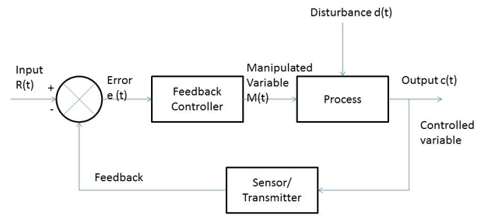
Requires Feedback-Control
Uncertainty means we cannot get everything under control then run on autopilot
Rather control requires continuous feedback
  Define ideal
  Make a step
  Measure deviation from idea
  Correct direction or redefine ideal and go back to 2

Slide 37
Increase in Software Cost-to-fix vs. Phase (1976) *
1000
1000
500
500
200
200
100
100
Relative cost to fix defect
50
50
20
20
•
•
Smaller Software Projects
10
10
5
5
2
2
1
1
Requirements Design Code Development
Requirements Design Code Development
Acceptance Operation
Acceptance Operation
test
test
test
test
Phase in which defect was fixed
* Barry Boehm - A View of 20th and 21st Century Software Engineering
COMS 510X Weiss Fall 2012 V&V

Slide 38
Quality is Cumulative
Requirements
Analysis
Are the requirements valid?
Complete? Consistent? Implementable?
Testable?
Does the design satisfy requirements?
Are all functional capabilities included?
Are qualities addressed (performance, maintainability, usability, etc.?
Do the modules work together to implement all the functionality?
Are likely changes encapsulated?
Is every module well defined
Implement the required functionality?
Race conditions? Memory leaks? Buffer overflow?
Architectural
Design
Detailed
Design
Coding

Slide 39
We need a plan!
QA activities are
  Critical to control
  Part of every phase of the project
  Time consuming, labor intensive and expensive
    Consumes significant project resources
    Cannot do everything, need to choose
Suggests need to plan QA activities
  Detect issues as early as possible
  Target highest priority/risk issues for project
  Support cost-effective use of resources

Slide 40
QA Activities
Verification and Validation

Slide 41
Validation and Verification
Validation: activities to answer the question – “Are we building a system the customer wants?”
  E.g. customer review of prototype
Verification: activities to answer the question – “Are we building the system consistent with its specifications?”
  E.g., functional testing

Slide 42
V&V Methods
Most applied V&V uses one of two methods
Review: use of human skills to find defects
  Pro: applies human understanding, skills. Good for detecting logical errors, problem misunderstanding
  Con: poor at detecting inconsistent assumptions, details of consistency, completeness. Labor intensive
Testing: use of machine execution
  Pro: can be automated, repeated. Good at detecting detail errors, checking assumptions
  Con: cannot establish correctness or quality
Tend to reinforce each other

Slide 43
Peer Review Process
Peer Review: a process by which a software product is examined by peers of the product’s authors with the goal of finding defects
Why do we do peer reviews?
  Review is often the only available verification method before code exists
  Formal peer reviews (inspections) instill some discipline in the review process
  Generally the most effective manual technique for detecting defects
Means that you should be doing peer reviews, but there are issues

Slide 44
Issues with Standard Reviews
Tendency for reviews to be incomplete and shallow
Reviewers typically swamped with information, much of it irrelevant to the review purpose
Reviewers lack clear individual responsibility
Effectiveness depends on reviewers to initiate actions
Large meeting size hampers effectiveness, increases cost
No way to cross-check unstated assumptions
Notes:
Some key issues:
1) Tends to waste people’s time: everyone not involved in an ongoing discussion is wasting man hours.
2) Won’t reveal unstated assumptions: two different reviewers may come to very different conclusions about what the requirement says but there is no way to determine this as long as neither sees the specification as defective. (I.e., neither one will speak up).

Slide 45
Active Review Method
Key idea: Works by forcing the reviewer to actually use the artifact to answer specific questions
Identify several types of review each targeting a different type of error
Identify appropriate classes of reviewers for each type of review
Assign reviews to achieve coverage
Design review questionnaires
Review consists of filling out questionnaires defining
Review process: overview, review, meet
Notes:
Question: When do we actually find errors (e.g., in a user’s manual)?
Key idea: Experience shows that we find the most errors when actually using a specification or other document. The active review process works by essentially forcing the reviewers to use the document being reviewed.

Slide 46
Examples
In practice: an active review asks a qualified reviewer to check a specific part of a work product for specific kinds of defects by answering specific questions, e.g.,
  Ask a designer to check the functional completeness by showing the calls sequences sufficient to implement a set of use cases
  Ask a systems analyst to check the ability to create required subsets by showing which modules would use which
  Ask a technical writer to check the SRS for grammatical errors
Can be applied to any kind of artifact from requirements to code

Slide 47
Takeaway
Understand when and why reviews should be used
Understand how active reviews work
Understand why they are better at detecting defects

Slide 48
Testing

Slide 49
Testing Fundamentals
Coding produces errors
  Data show 30-85 errors are made per 1000 SLOC
Testing: processes of executing the code to detect errors
In practice, it is impossible to check for all possible errors by testing
Even checking a useful subset is expensive
  40%-80% of development cost
  Must be re-done when software changes
  Potentially unbounded effort

Slide 50
Testing Fundamentals (2)
Reality: must settle for testing a subset of possible inputs
  Even extensively tested software contains 0.5-3 errors per 1000 SLOC
    Pesticide Paradox: every method used to prevent or find bugs leaves a residue of subtler bugs against which those methods are ineffectual [Beizer]
  Always a tradeoff of cost vs. errors found
Fundamental cost/benefit questions
  Which subsets of possible test cases will find the most errors?
  Which will find the most important errors?
  How much testing is enough?

Slide 51
Ideal Testing Goal
Goal: choose a sufficiently small but adequate set of test cases (input domain)
  Small enough to economically run the complete set and re-run when software changes
  “Adequate” much harder to define, generally means some combination of:
    Acceptably close to required functional behavior
    Contains no catastrophic faults
    Reliable to an acceptable level (mean time to failure)
    Within tolerance levels for qualities like performance, security, etc.

Slide 52
Number of Approaches
Fault detection vs. Confidence building
White-box vs. Black Box
Different methods for choosing “adequate” test set
  Coverage, fault-detection, operational profiles

Slide 53
Experimental Results
There is no uniformly best technique
Different techniques tend to reveal different types of faults
Multiple techniques reveal more faults (at a cost)
Cost-effectiveness of run-time testing is low, particularly compared to inspections (vast majority of tests find no errors)
  Design review: 8.44
  Code review: 1.38
  Testing: 0.17

Slide 54
Interpretation
A combination of manual and automated techniques is most cost effective
  People are better at detecting many kinds of errors than machines
  Machines are better at repetitive checks and minute details (comparing values)
Testing works best in a supporting role (checking assumptions)
  Activity of producing test cases and results double-checks other artifacts
    Is it well enough defined to write a good test case?
    Are edge cases defined? Etc.
  Gives feedback on assumptions and expectations: does the system do what we expect?

Slide 55
Development Realities

Slide 56
Developer Realities
Nothing counts but delivery
  Software product properties
    Sufficient desired functionality
    Acceptable qualities
  Process properties
    Timely
    “low cost” (acceptable ROI)
But…
  Delivery must be repeatable, usually building on legacy systems
  The target moves
  The process is done largely in the dark

Slide 57
Issues
Balancing all these factors is difficult
Easiest to come up with partial, short-term solutions
  Acceptable solution but late, over cost
  On time delivery but difficult to change, maintain
  Deliver but is not what the customer wants
  Quick fix, difficult to maintain, etc.
Results from complexity, shortsighted approach
  Huge pressure to “code first, ask questions later”
  Overall problem too complex to comprehend at once
  Focus on parts of the problem, excluding others
  Fail to look ahead (paint ourselves into a corner)

Slide 58
Software Engineering
Principles of Software Engineering provide an antidote
Helps to foresee downstream problems of poor decisions
Supports doing the right thing rather than only the most “urgent”
Provides principles and tools to keep a project in control

Slide 59
End

