Slide 1
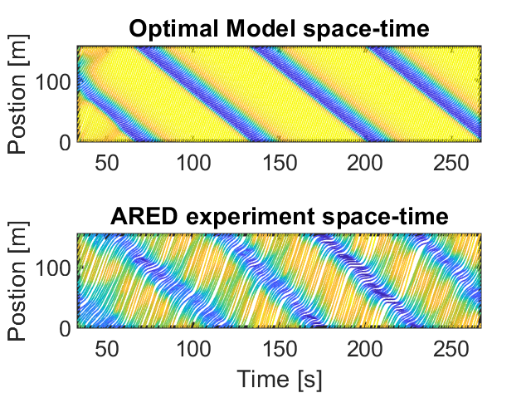
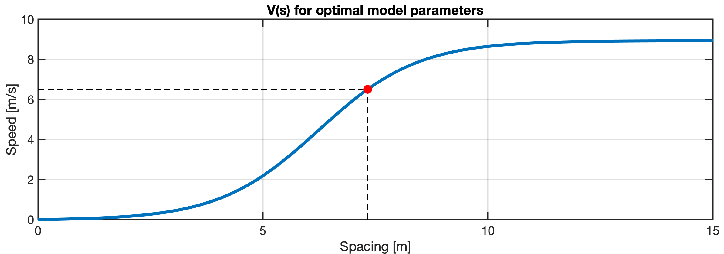

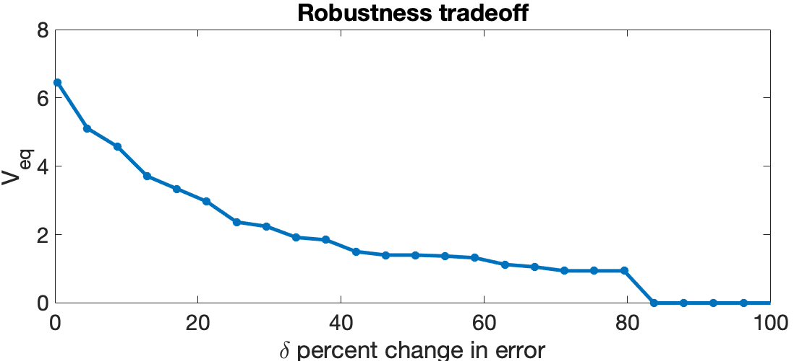

Standard Control Theoretic Design and Implementation:
System measurement and ID:
Controller Design:
Deployment and Testing
Robust/Performance-Critical Design and Implementation:
Robustness quantification:
System measurement and ID:
Deployment and Testing
Robustness design:

