Slide 1
One for All, All for One: Learning and Transferring User
Embeddings for Cross-Domain Recommendation
汇报人：阮滨
2022/12/14

Slide 2
Background
1.针对MTCDR的研究较少，现有研究大多为单目标推荐/双目标推荐
2.MTCDR中存在negative transfer的问题

Slide 3
What is CDR?
Cross Domain Rec
Single Domain Rec
Single Target Rec
Dual Target Rec
Multi-Target Rec
Target Domain
Source Domain
Source Domain
Domain1
1
1
1
0
Domain2
1
0
0
1
0
0
0
0
Target Domain
Target Domain
1
1
1
1
Domain3

Slide 4
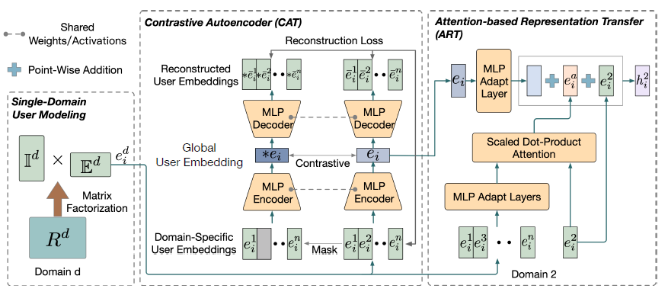
CAT-ART
Self-supervised Contrastive AuToencoder (CAT)
Generate global representation
Attention-based Representation Transfer (ART)
Transfers domain-specific user embeddings from other domains

Slide 5
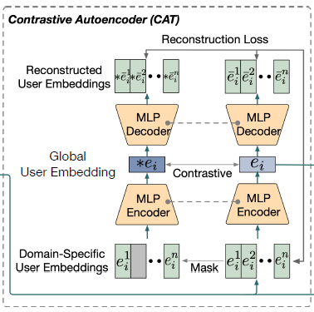

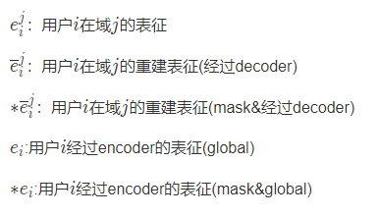

CAT-Learning
Autoencoder
通过重建用户在每个域中的用户表征来使得自编码器能捕捉关键的全局信息

Slide 6
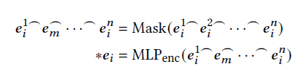

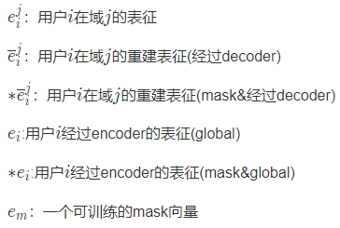
CAT-Learning
Contrast Learning
通过对比学习使得全局信息不会被某些域主导（稀疏域信息表达能力降低

Slide 7
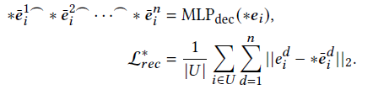

CAT-Learning
利用$∗e_{i}$来进行用户表征的重建从而获取无偏的全局用户信息

Slide 8
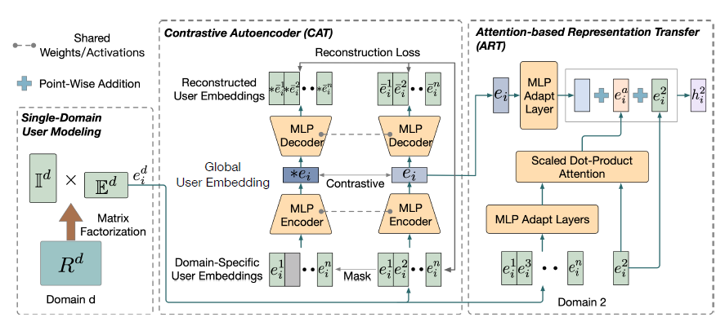
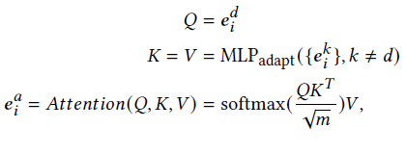

ART-Transferring
Final Embedding

Slide 9
Experiment
Dataset
Baselines
App-Installation
App-Use
Video-Short
Video-Long
Articles
Single Matrix Factorization(SMF)
Collective Matrix Factorization(CMF)
HeroGraph-L(ightGCN)
MPF
GA-MTCDR

Slide 10
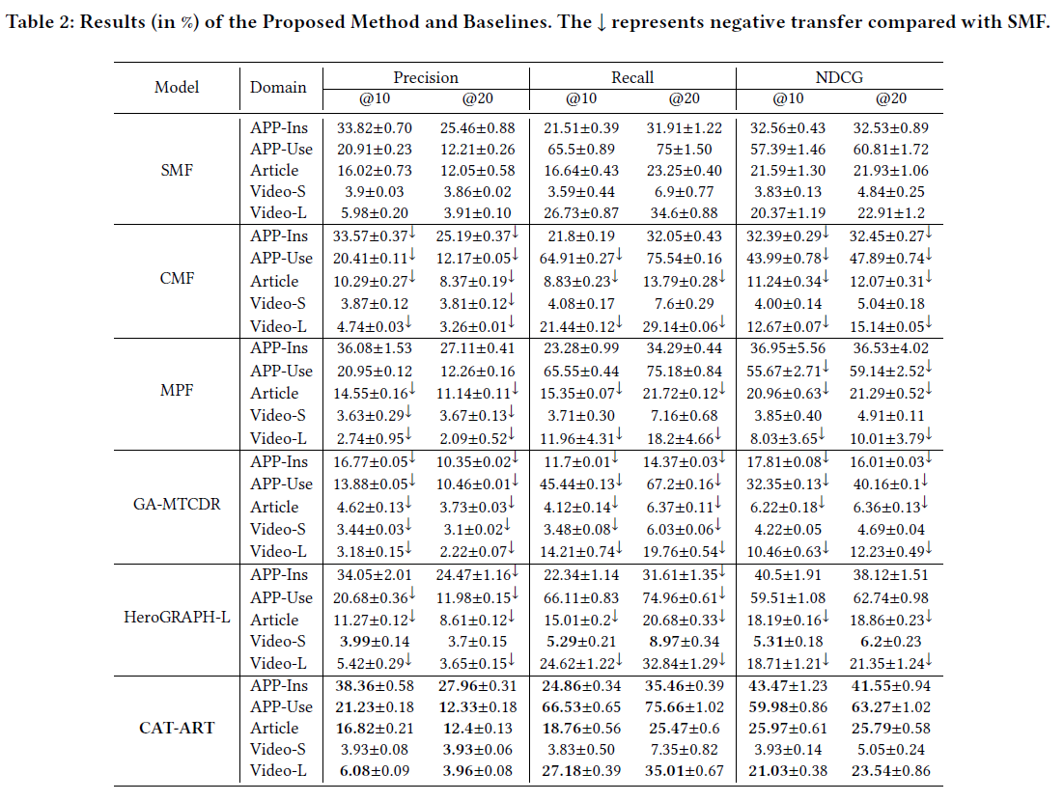
Experiment

Slide 11
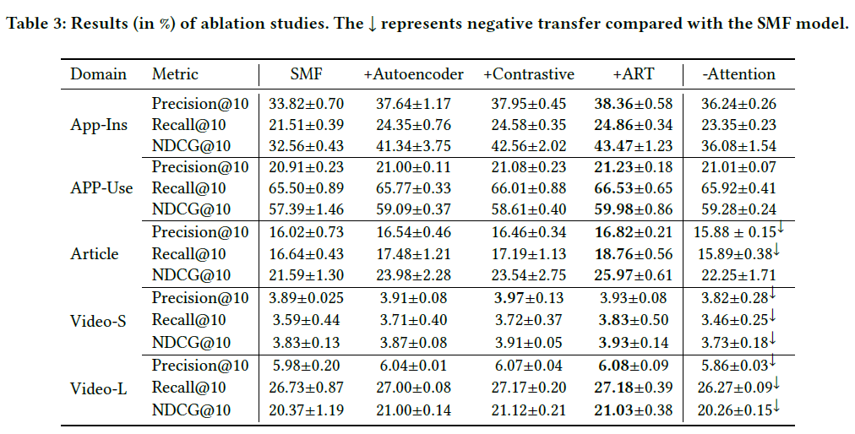
Experiment

Slide 12
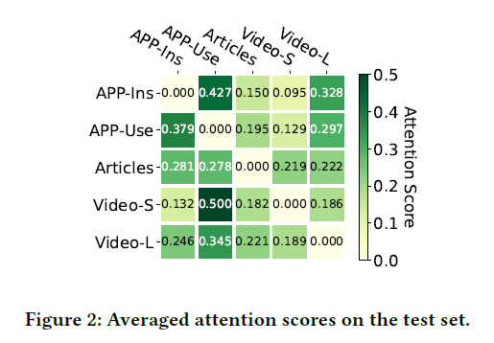
Experiment

Slide 13
THANKS

