Slide 1

Knowledge-enhanced Multi-View Graph Neural Networks for Session-based Recommendation
Qian Chen, Zhiqiang Guo, Jianjun Li*, Guohui Li
School of Computer Science and Technology,
Huazhong University of Science and Technology, Wuhan, China
October, 2022
Huazhong University of Science & Technology

Slide 2

01 Motivation
02 Methodology
03 Experiment
CONTENTS

Slide 3
01 Motivation
02 Methodology
03 Experiment
CONTENTS

Slide 4
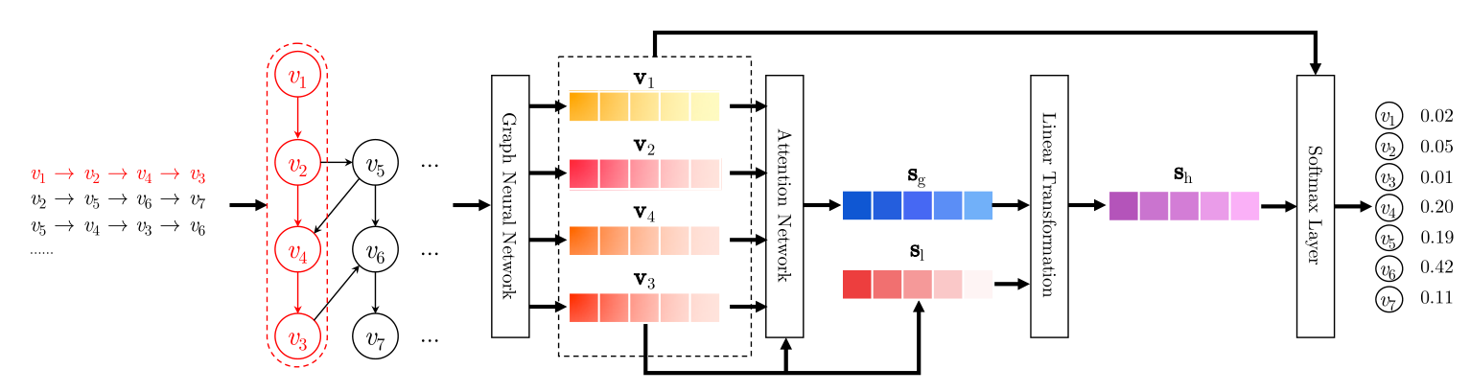
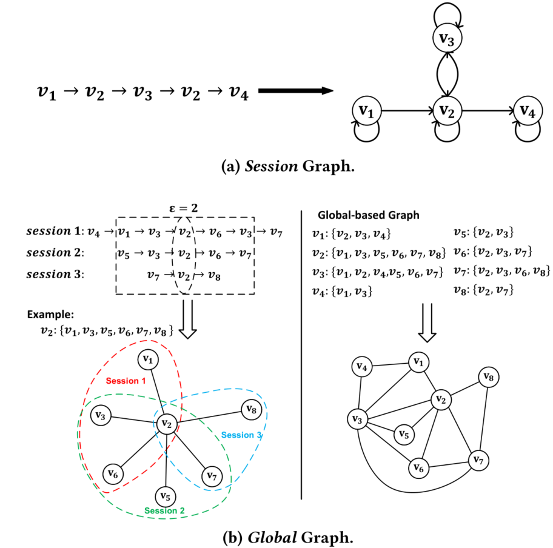
Motivation
1.1
Session-based Recommendation (SBR)
Principle: anonymous user’s historical behavior →next behavior
Methods: FPMC, GRU4Rec, SR-GNN and so on.
Input：the sequence of items anonymous user clicked.
Issue: data sparsity
Cross-Session SBR
Principle: incorporate collaborative information of other sessions to enrich the representation of current session.
Methods: CSRM, GCE-GNN, CA-TCN and so on.
Issue: strong sequence correlation, relation redundancy.
Shu Wu et al. Session-Based Recommendation with Graph Neural Network . AAAI. 2019.
KG-based Recommendation
Principle: use ground-truth properties and relations to enrich the semantic information of items.
Methods: CKE, KGAT, RippleNet and so on.
Ziyang Wang, et al. Global Context Enhanced Graph Neural Networks for Session-based Recommendation. SIGIR. 2020.

Slide 5
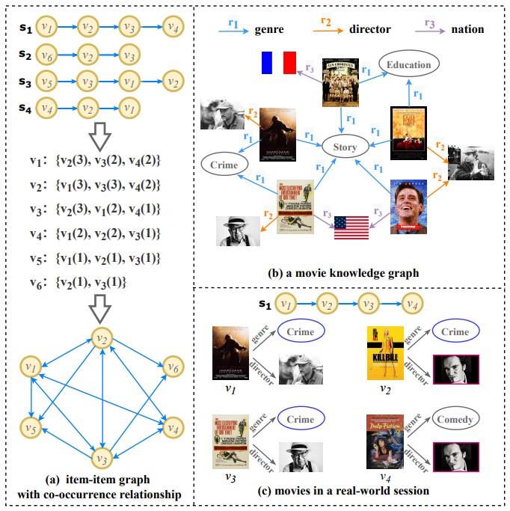
Motivation
1.2
Two extra sequence-independent item relationships
Global item-item relationship:
Use Knowledge Graph (KG) as side information to tackle the data sparsity problem.
Relations in KG is sequene-indepensent, tackle the strong sequence correlation problem.
Relations in KG is groud-truth.
Local item-item relationship:
Construct a pairwise graph to extract the relationship between any two items within a session.
Use element-wise product to capture the commonalities of items within a session.

Slide 6
01 Motivation
02 Methodology
03 Experiment
CONTENTS

Slide 7
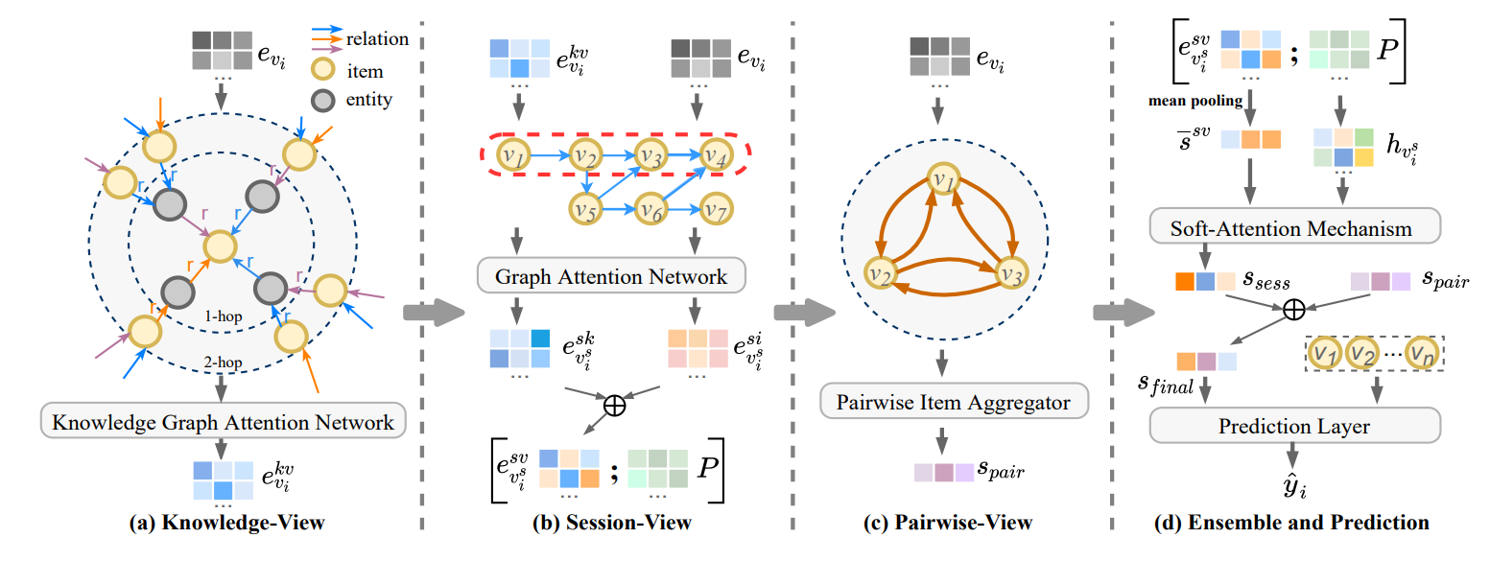
Methodology
2.1
Framework Overview：KMVG

Slide 8
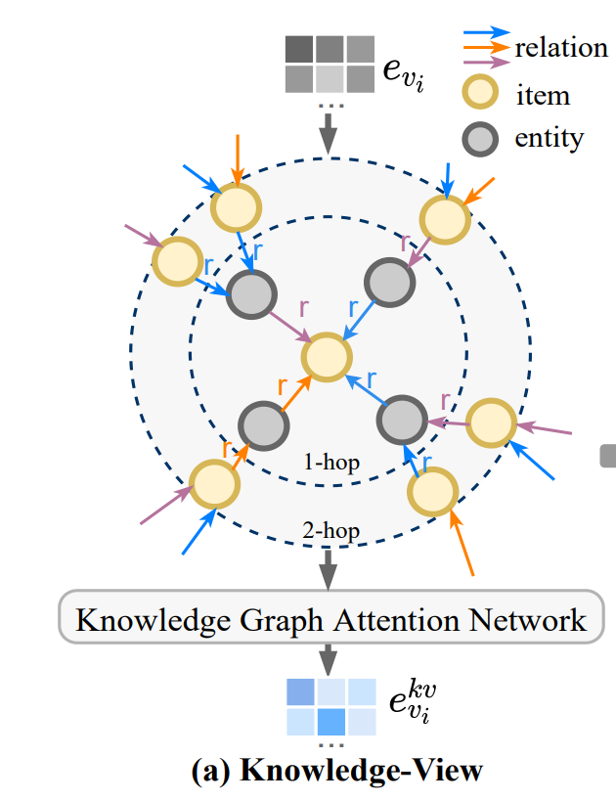
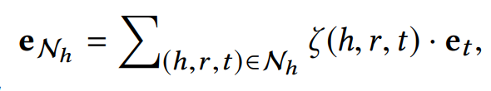
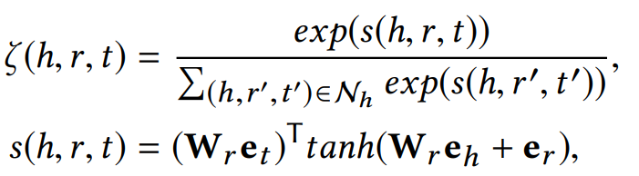

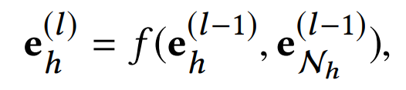
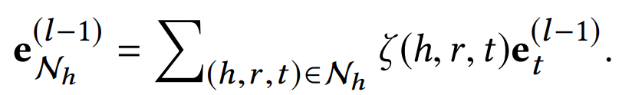
Methodology
2.2
Knowledge-View
Relational attention propagation based on KG
GCN aggregation
Multiple layers

Slide 9
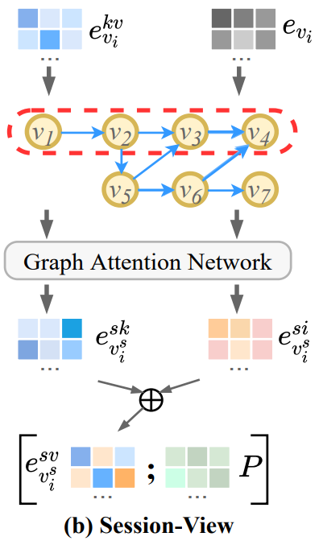
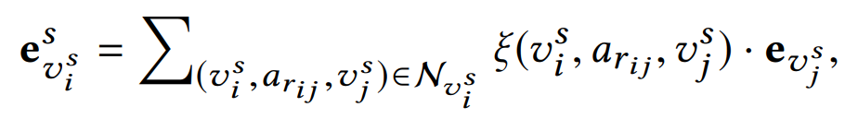
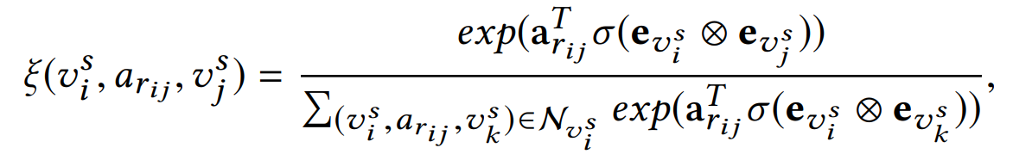
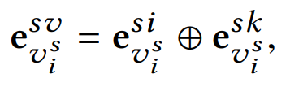
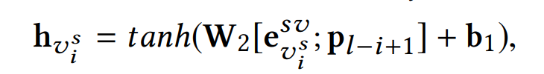
Methodology
2.3
Session-View
Graph attention network
Reversed position embedding

Slide 10
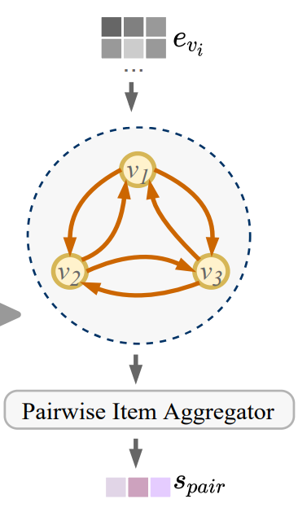
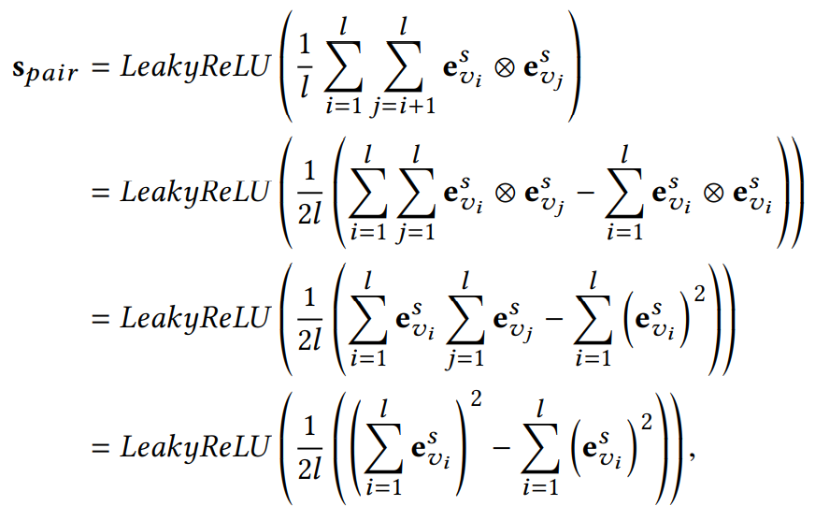
Methodology
2.4
Pairwise-View

Slide 11
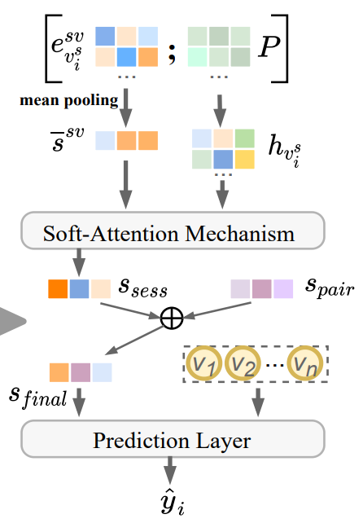
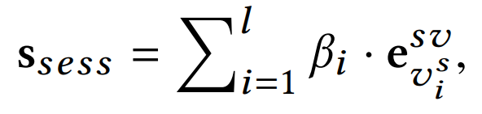
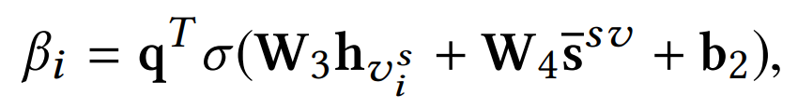

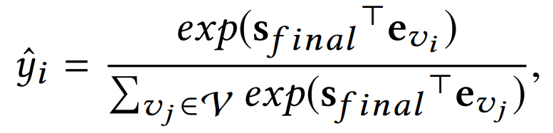
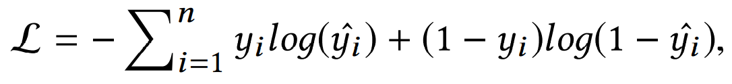
Methodology
2.5
Ensemble and Prediction
Soft-attention mechanism
Prediction
Loss function

Slide 12
01 Motivation
02 Methodology
03 Experiment
CONTENTS

Slide 13
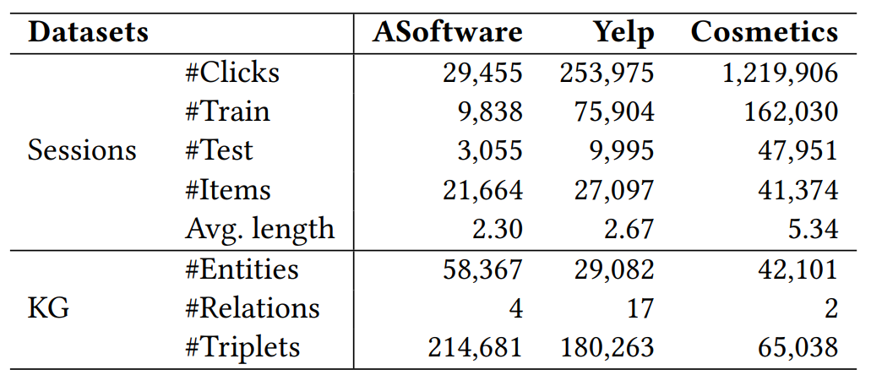
Experiment
3.1
Experimental Settings
Three public Datasets
Amazon Software (ASoftware)
Yelp
Cosmetics
Baselines
RNN-based SBR methods
GRU4Rec
NARM
GNN-based SBR methods
Metrices
Hit Rate (HR)
Normalized Discounted Cumulative Gain (NDCG)
SR-GNN
NISER+
MSGIFSR
GC-SAN
LESSR
Cross-Session SBR methods
CSRM
SR-GNN+KG
GCE-GNN

Slide 14
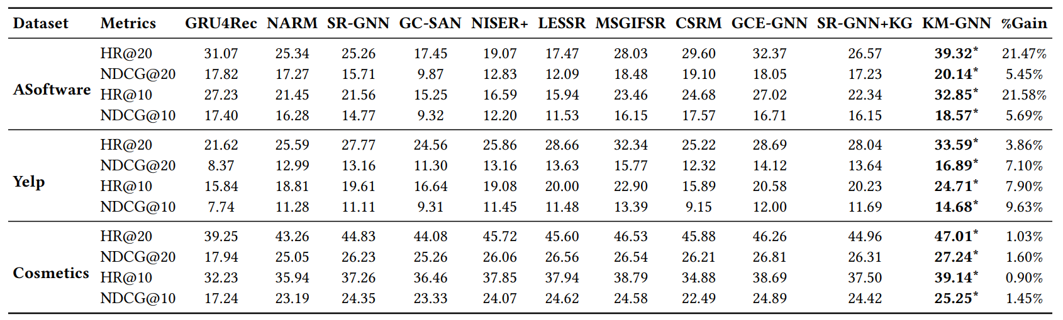
Experiment
3.2
Performance Comparison

Slide 15
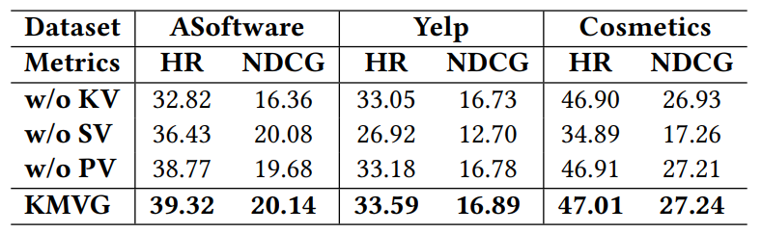
Experiment
3.3
Ablation Experiment
w/o KV vs. KMVG: decline significantly on ASoftware → the sparsity of ASoftware is very tricky, so additional information (KG) is particularly important.
w/o SV vs. KMVG: decline significantly on all the datasets → the contextual transition is very important in SBR.
w/o PV vs. KMVG: decline slightly on all the datasets → mining the commonality of items in the same session is beneficial for further enhancing session-based recommendation.

Slide 16
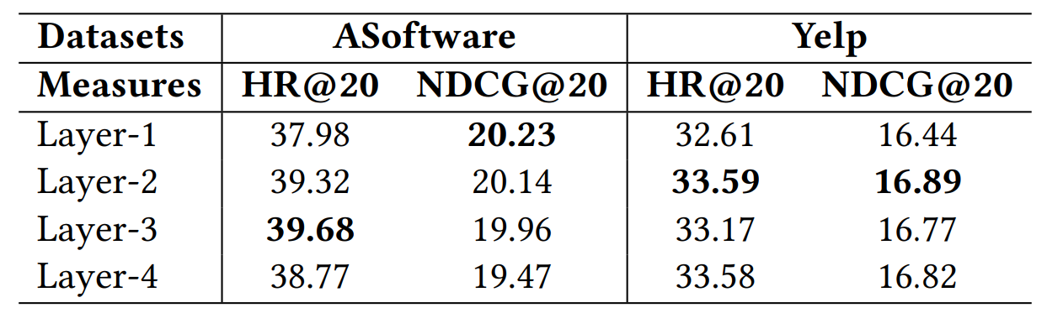
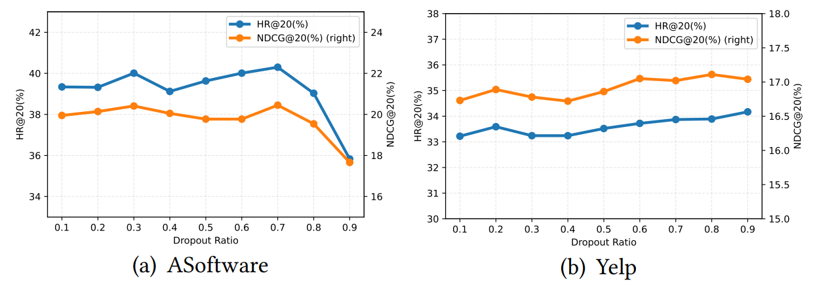
Experiment
3.4
In-depth Model Analysis
Impact of number of layers in Knowledge-View
Impact of dropout ratio in Knowledge-View

Slide 17
Thanks for your listening
Qian Chen, Zhiqiang Guo, Jianjun Li*, Guohui Li
School of Computer Science and Technology,
Huazhong University of Science and Technology, Wuhan, China
October, 2022

