Slide 1
Meetup 1: Data Science Workflow and Toolkit
George I. Hagstrom

Slide 2
What is Data Science?
. . .
Data science is a “discipline that allows you to transform raw data into understanding, insight, and knowledge”
. . .
I hear often: “Data Science is just statistics with a clever brand name”
. . .
Is this a misconception?

Slide 3
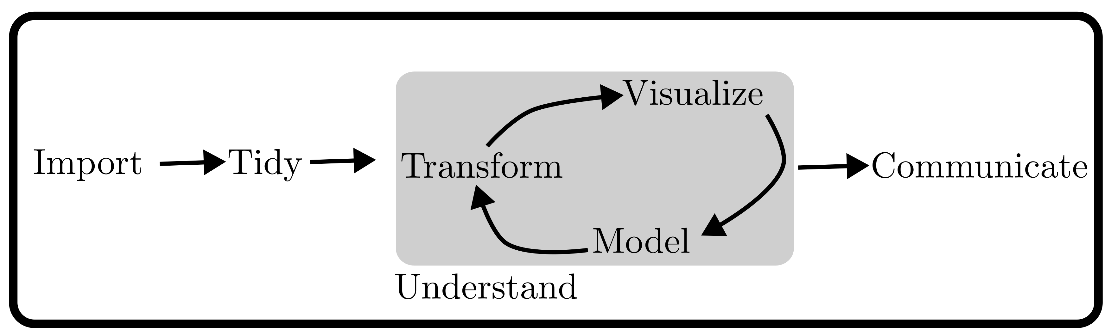
Data Science Workflow
Consider this visualization of the process for converting raw data into knowledge:
Figure from text

Slide 4
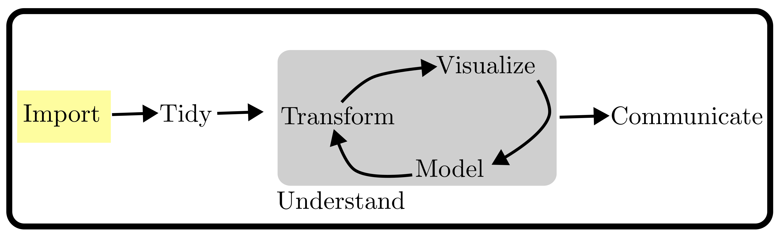
Data Science Workflow
Load the data from files into software
Consider this visualization of the process for converting raw data into knowledge:
Figure from text

Slide 5
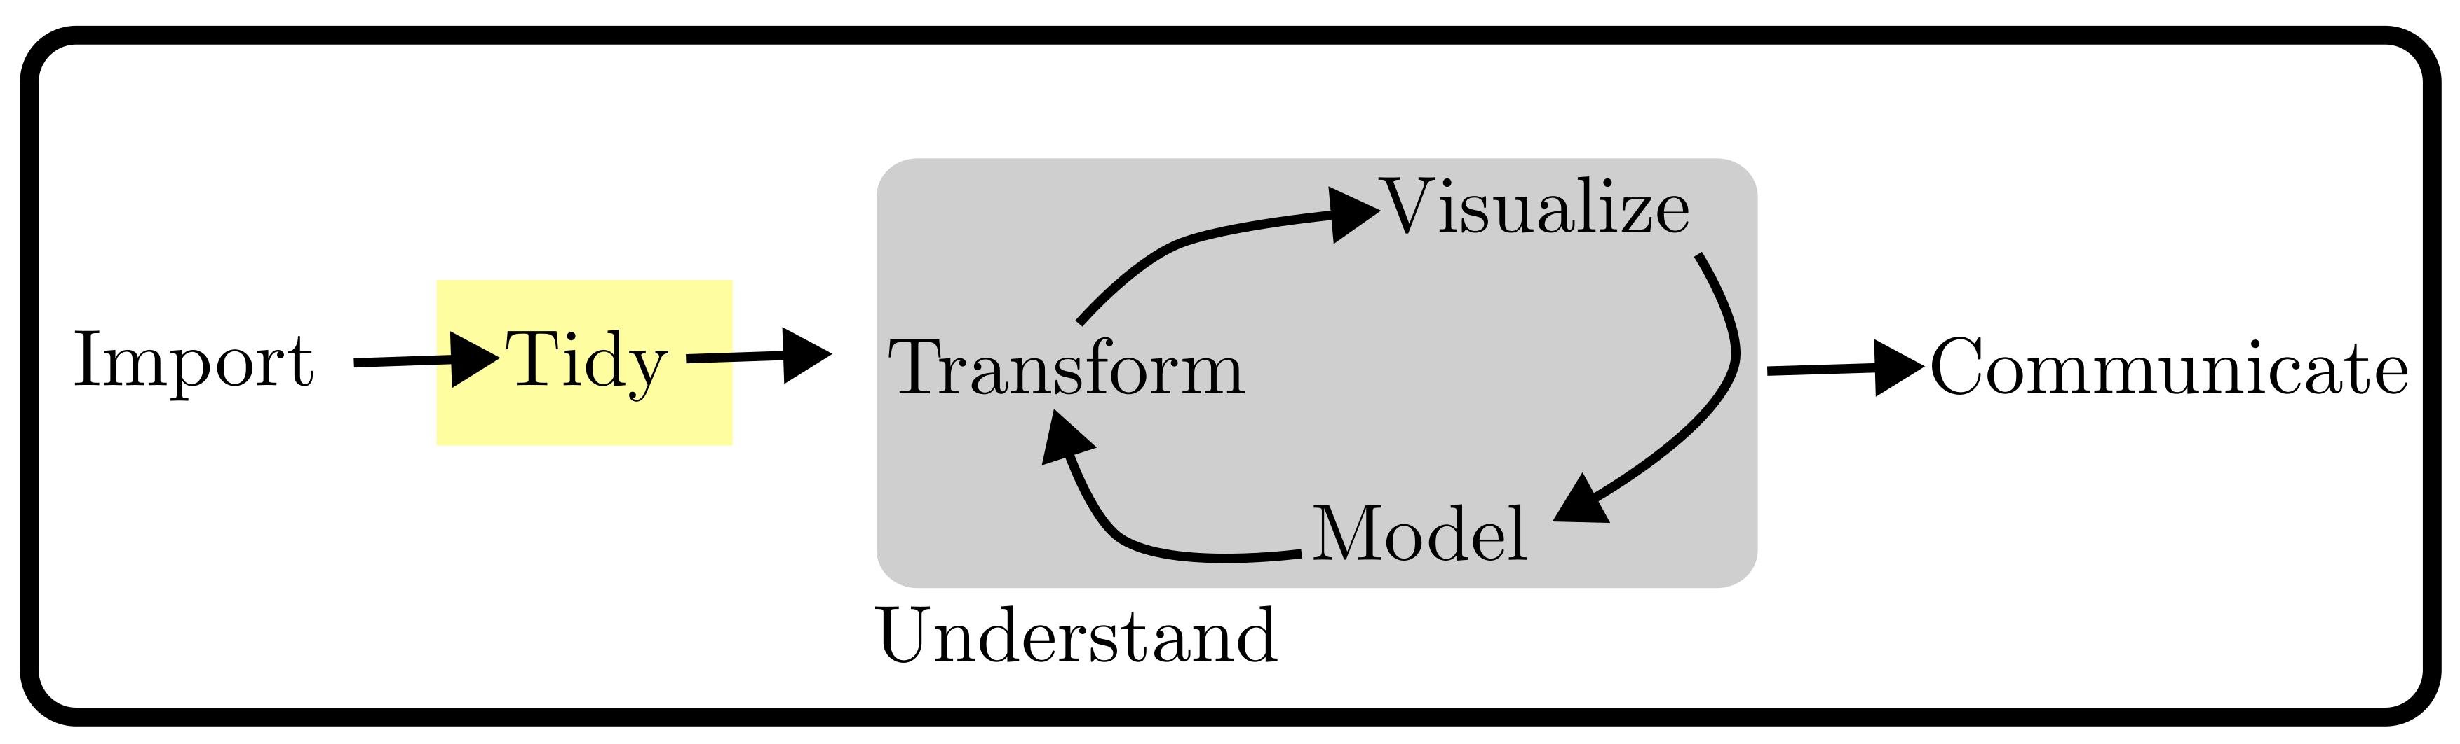
Data Science Workflow
Tidy the data so it is stored in a consistent way
Consider this visualization of the process for converting raw data into knowledge:
Figure from text

Slide 6
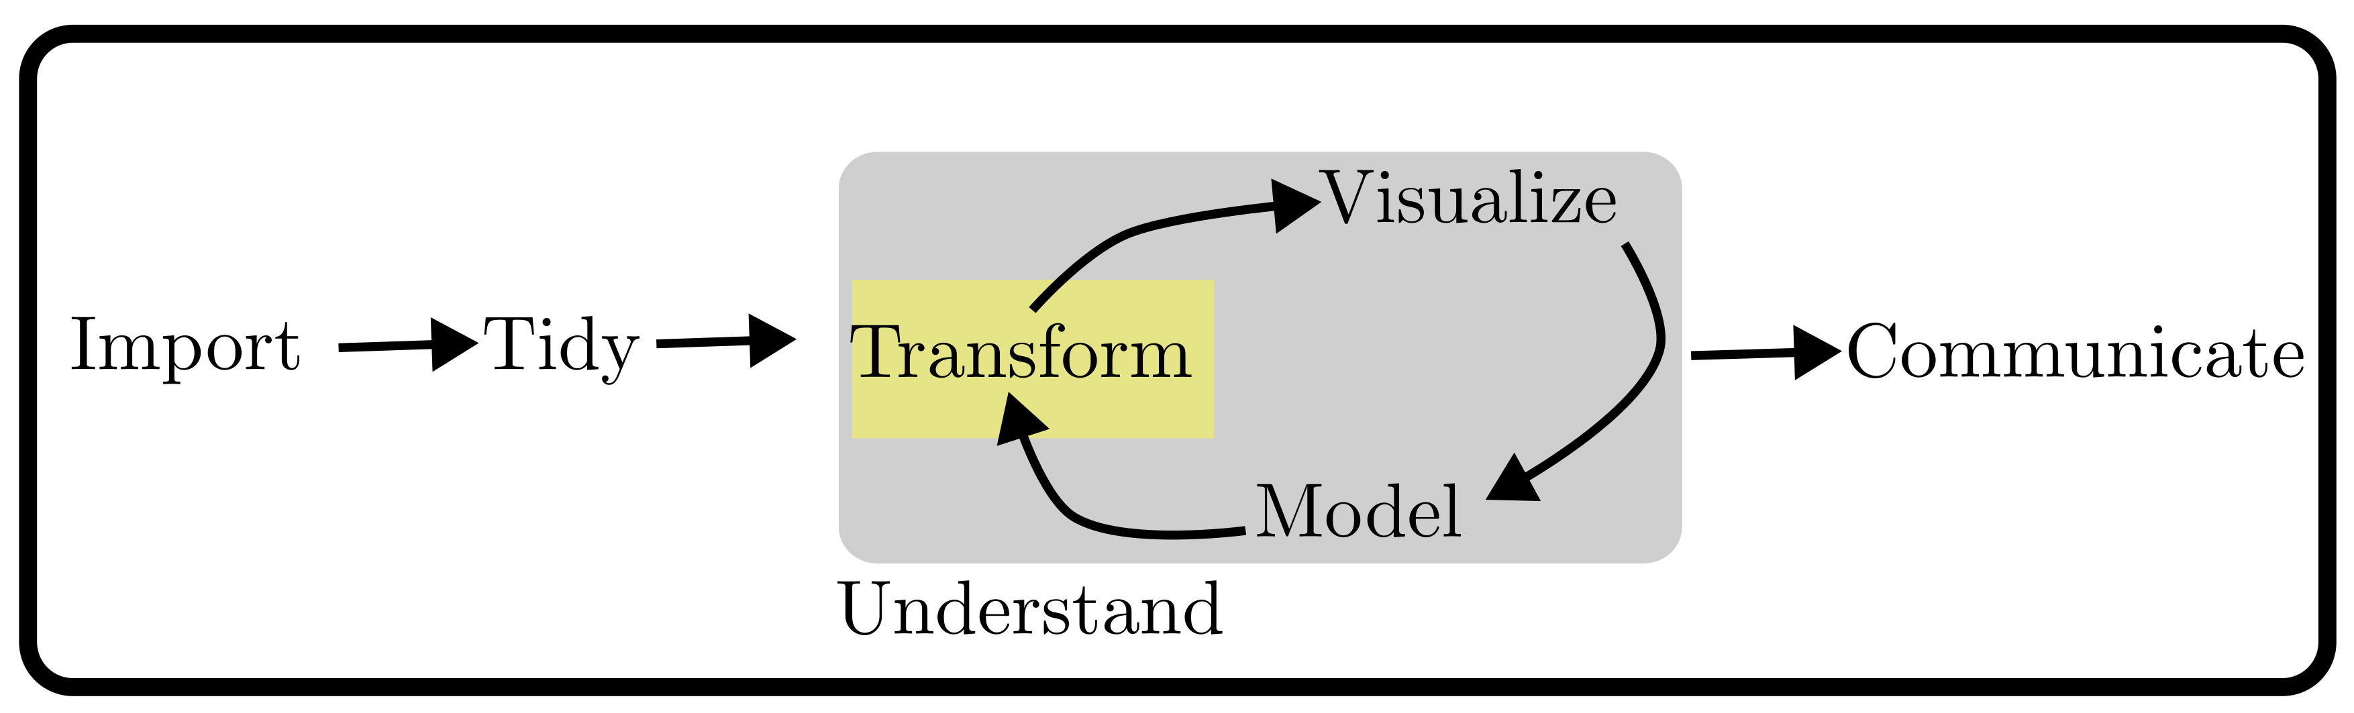
Data Science Workflow
Transform the data to focus our analysis on observations of interest
Consider this visualization of the process for converting raw data into knowledge:
Figure from text

Slide 7
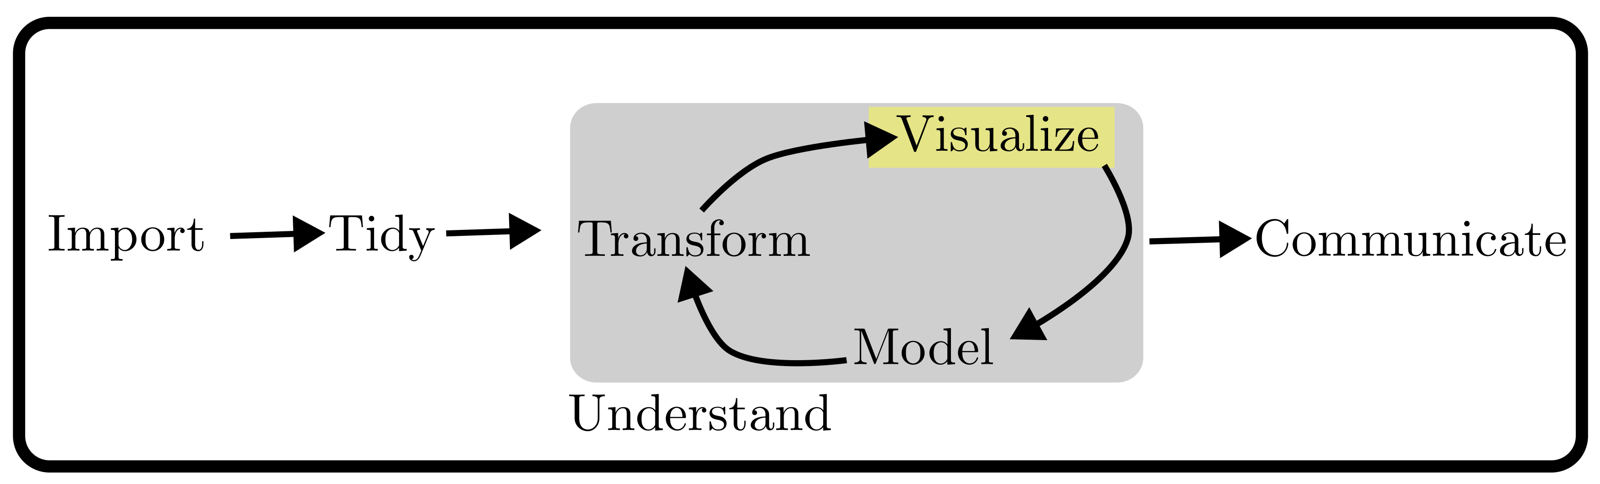
Data Science Workflow
Visualize the data to find relationships, problems, and pose questions
Consider this visualization of the process for converting raw data into knowledge:
Figure from text

Slide 8
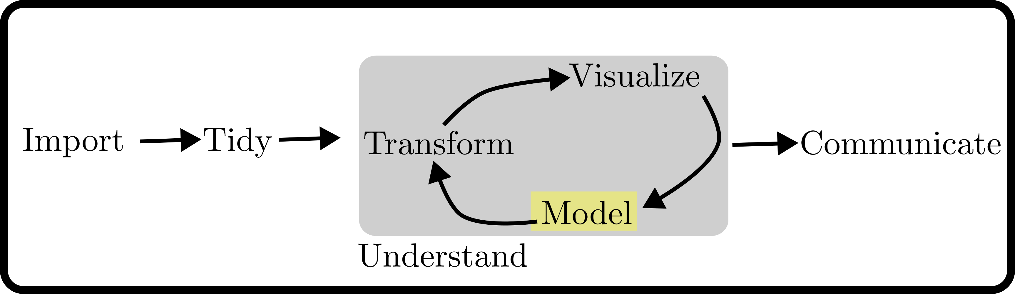
Data Science Workflow
Model the data to answer questions precisely using statistics
Consider this visualization of the process for converting raw data into knowledge:
Figure from text

Slide 9
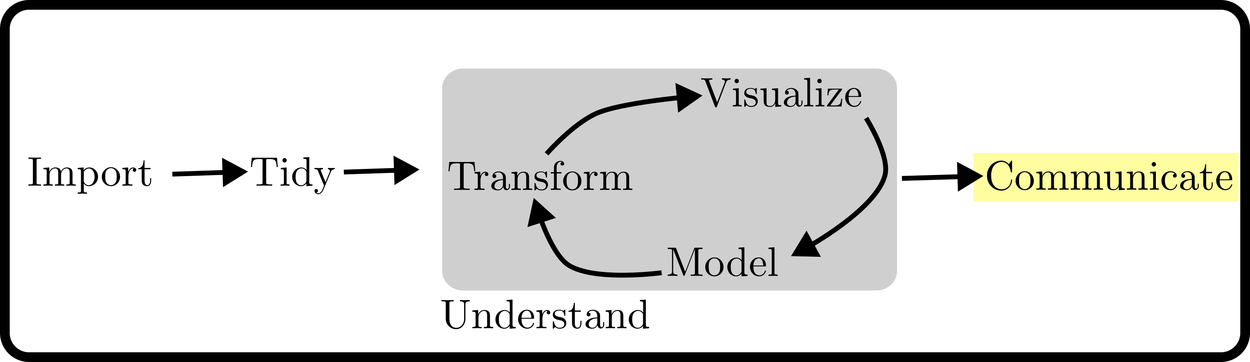
Data Science Workflow
Communicate to share results with others
Consider this visualization of the process for converting raw data into knowledge:
Figure from text

Slide 10
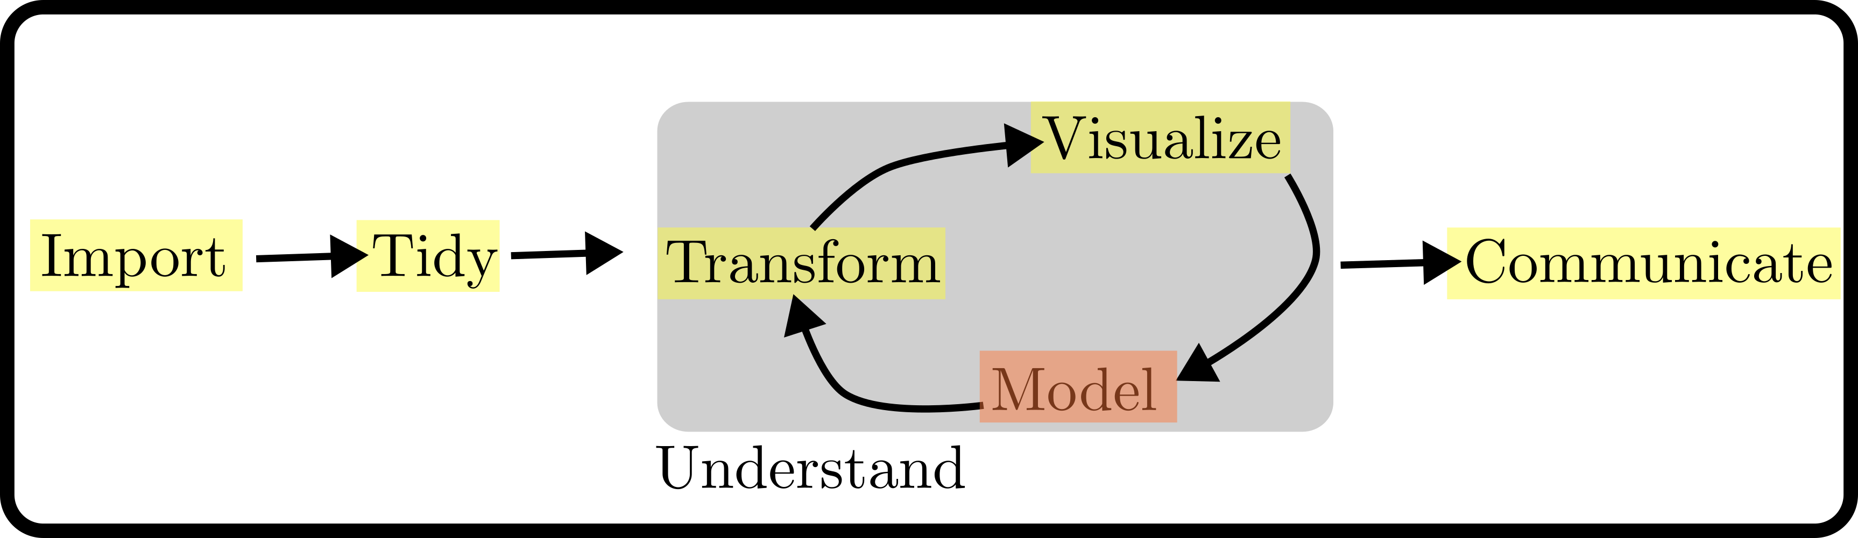
Data Science Workflow
This class will focus on everything but modeling, i.e. the part of Data Science that isn’t statistics
Consider this visualization of the process for converting raw data into knowledge:
Figure from text

Slide 11
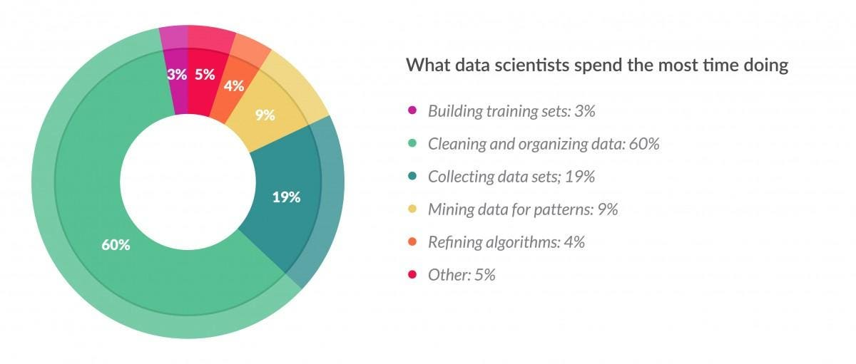
Modeling can be small part of Data Science projects
Please forgive the Pie Chart
It is said that 80% of time in data science projects is spent on data mining, cleaning, tidying, exploratory data analsys, etc
Figure from Forbes

Slide 12
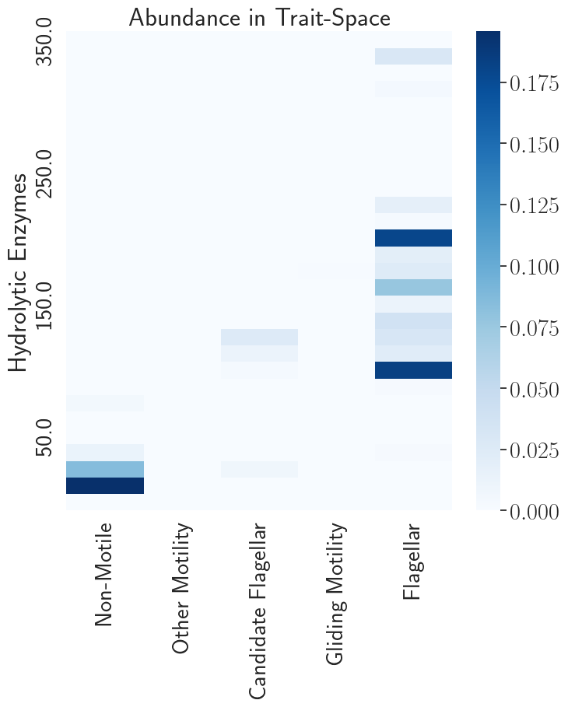
Intro/Case Study
Data on how bacteria get their food in the ocean
Getting data for this plot took months…..
Many sources, data formats, quality issues, processing
Trait Correlations in Marine Bacteria

Slide 13
Learning objectives
By the end of the course, you will have a foundation of skills in the Data Science Workflow
Find data you need and do all steps to prep it for analysis
Build expertise in R and the tidyverse
Use and understand relational databases and SQL
Collaborate with Git and GitHub
Introduce you to distributed computing and other tools for large datasets
Improve your programming ability

Slide 14
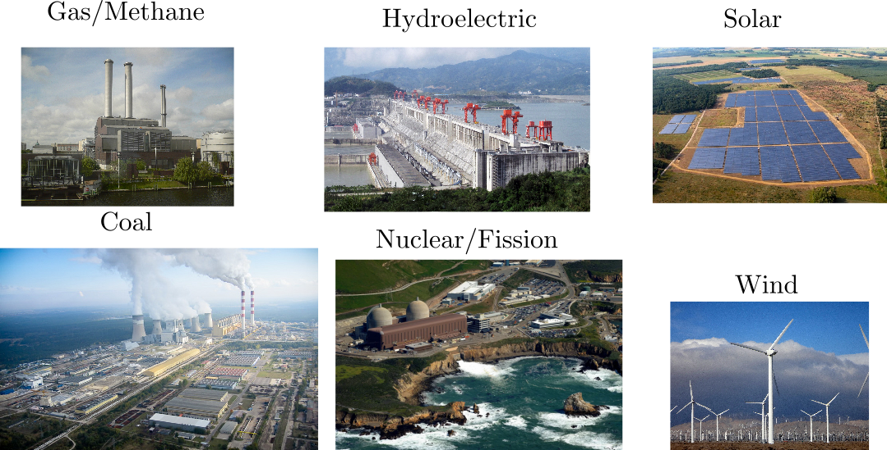
Vignette: Electricity and CO2
Sources of Power, refs last slide

Slide 15
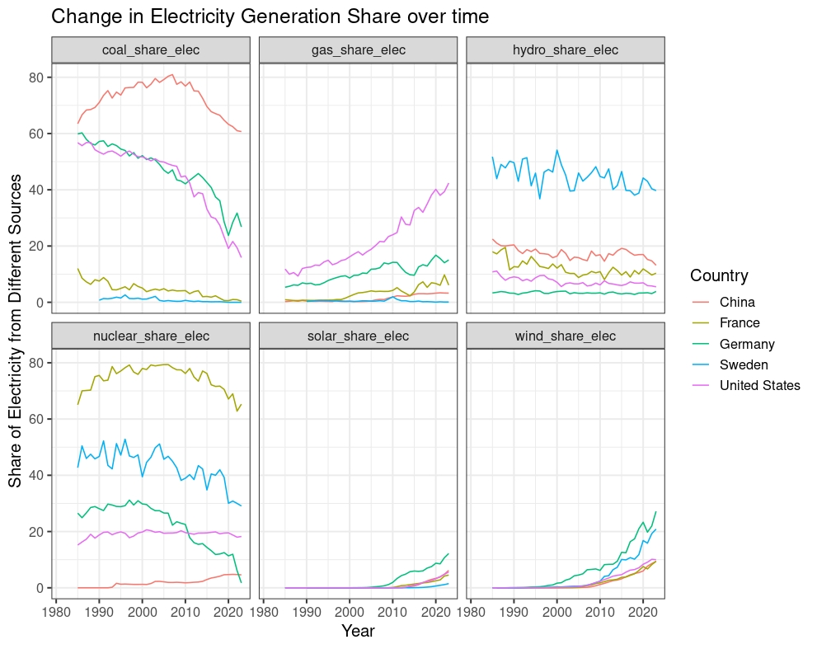
Electricity Generation Over Time
Source: Our World in Data

Slide 16
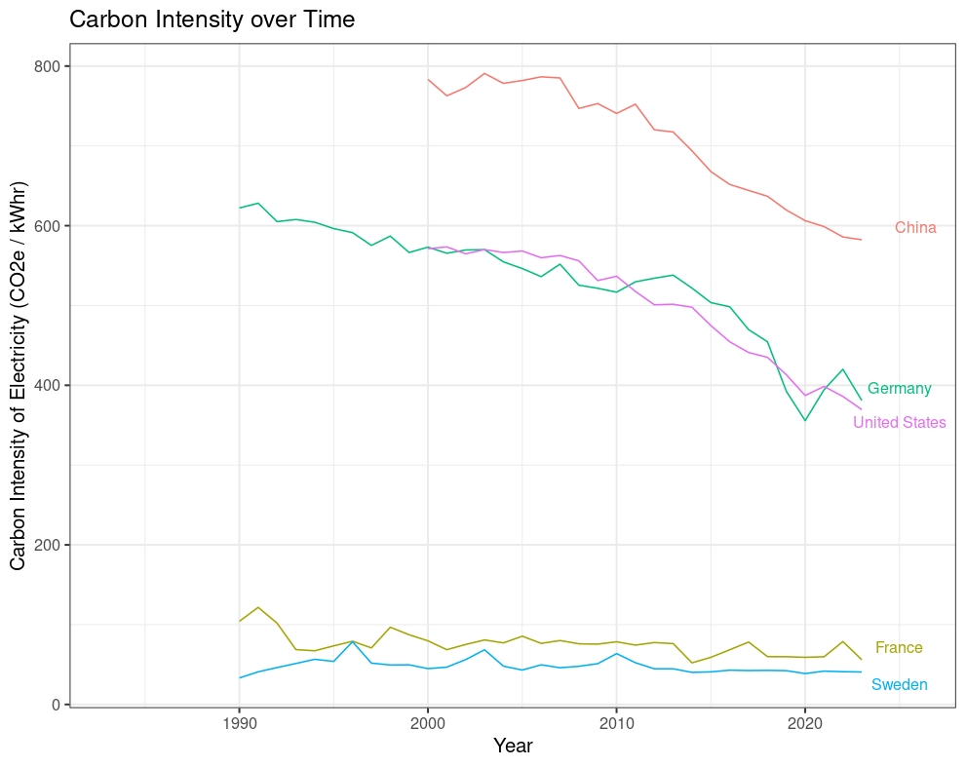
Carbon Intensity of Electricity
Source: Our World in Data

Slide 17
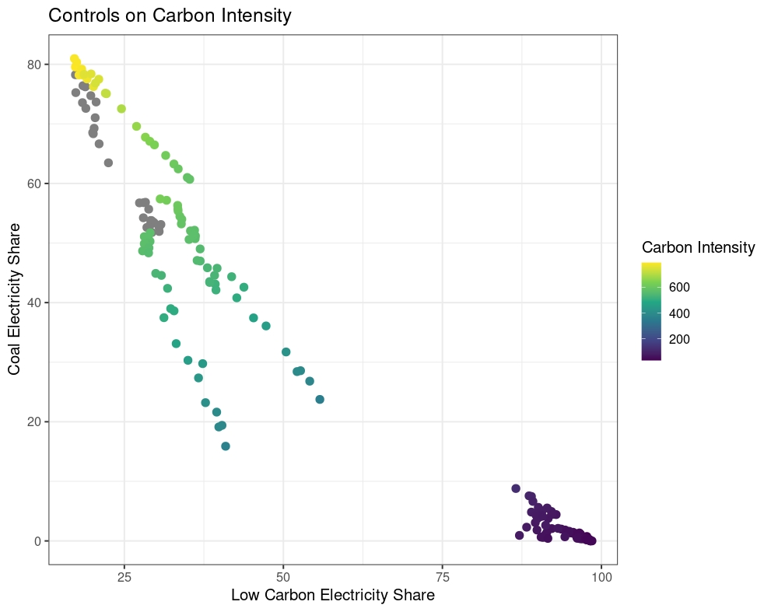
Controls on Carbon Intensity
Source: Our World in Data

Slide 18
Link to the Vignette
You can download the vignette from my github by clicking here
Remember to download the data if you want to render the file.

Slide 19
Syllabus and Course Site
Full Syllabus on the course website:
https://georgehagstrom.github.io/DATA607/
Course website contains links to weekly reading and homework assignments, meetup videos, course schedule, and other course materials
Use the Brightspace page to submit assignments, either in pdf format or a link to an html on some site I can access (ie github or rpubs)

Slide 20
Meetups
6:45-7:45 on Wednesday evening. Attending live preferred, watch video after if you can’t
Office Hours: On Zoom by appointment
Communication and collaboration: https://fall2024data607.slack.com

Slide 21
Assignments
Labs (50%): Weekly Programming assignments
TidyVerse Recipes (10%): Collaborative intro to Git
Project (25%)
Assemble and explore a data set of your choosing
Explore your interests, build your portfolio!
Data Science in Context Presentation (5%)
One 5 minute presentation, sign up for your presentation slot asap!
Meetup Reflections and Introduction (10%)

Slide 22
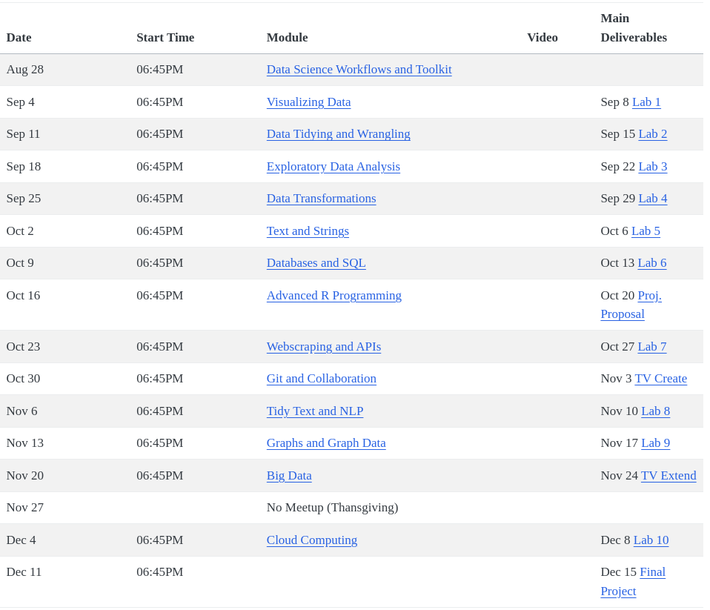
Schedule

Slide 23
Textbooks
Hadley Wickham, Mine Çetinkaya-Rundel, and Garrett Grolemund. (2023). R for Data Science (2e). O’Reilly
Jennifer Bryan. Happy Git and GitHub for the R User.
Julia Silge and David Robinson (2017). Text Mining with R. O’Reilly
Recommended: Wickham, H. Advanced R. Baca Raton, FL: Taylor & Francis Group.

Slide 24
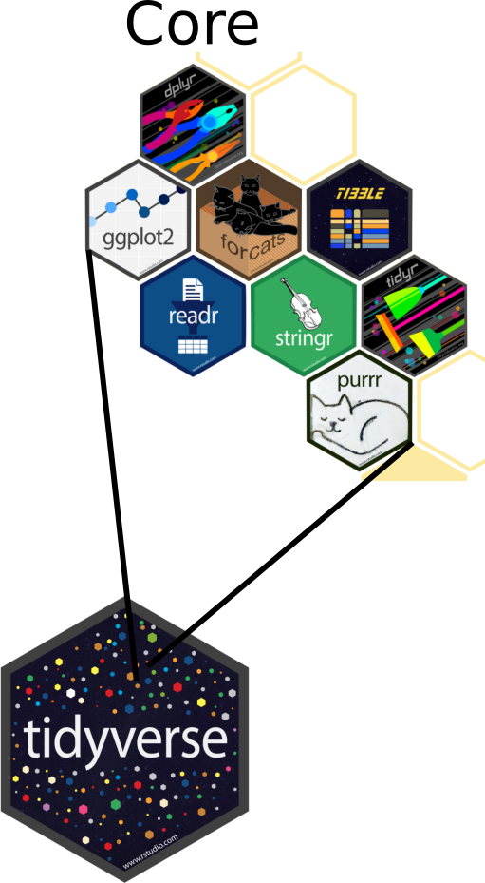
Tidyverse: Opinionated Ecosystem
Collection of compatible packages
Shared philosophy, common grammar
Strong Core, Many Extensions
Advantages and Disadvantages

Slide 25
What to do this week?
Readings:
Intro and Chapter 28 of R4DS
Sections 1-15 of Happy Git
Quarto Tutorial
Appendix on R Help Files
Get software installed and configured:
R, RStudio, git, latex
Write a post introducing yourself on Brightspace Discussions
Sign up for your Data Science in Context Presentation

Slide 26
Image References
Coal: By Morgre - Own work, CC BY-SA 3.0
Gas/Methane: By Georg Slickers - Self-photographed, CC BY-SA 3.0
Hydro: By Source file: Le Grand PortageDerivative work: Rehman - File:Three_Gorges_Dam,_Yangtze_River,_China.jpg, CC BY 2.0
Solar: By Parabel GmbH - Own work, CC BY-SA 3.0
Wind: By Erik Wilde from Berkeley, CA, USA - harvesting wind, CC BY-SA 2.0

