Slide 1

DATA 609: Mathematical Modeling Techniques for Data Analytics
Homework 2

Slide 2
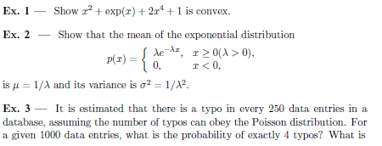
Module 2 Homework

