Slide 1
Spark & Distributed Computing
Subtitle

Slide 2
Agenda
01 | Framing
02 | Parallelism
03 | Spark
04 | Lazy Evaluation
05 | How to win the Spark Game
06 | Q&A

Slide 3
Introduction
“Without big data analytics, companies are blind and deaf, wandering out onto the web like deer on a freeway.”
-Geoffrey Moore

Slide 4
Framing
Imagine a typical analysis for a 4 Gb dataset
Load data onto one machine
Conduct analysis
Data processed in relation to your hardware
Notes:
Consider a typical analysis workflow
Load the data,
Conduct the analysis, make the charts, gain insights

Slide 5
Framing
Imagine a typical analysis for a 4 Gb dataset
Load data onto one machine
Conduct analysis
Data processed in relation to your hardware
Key Points:
Data moves at most once
Direct relationship between local hardware and processing speed
Largely sufficient

Slide 6
Framing
Imagine a typical analysis for a 120 Gb dataset
Load data onto one machine
Conduct analysis piece-by-piece
Significant hardware bottleneck
Key Points:
Data moves at most once
Direct relationship between local hardware and processing speed
Largely sufficient

Slide 7
Framing
Imagine a typical analysis for a 120 Gb dataset
Load data onto one machine
Conduct analysis piece-by-piece
  Eventual need to recombine the data
Significant hardware bottleneck

Slide 8
Framing
Imagine a typical analysis for a 120 Gb dataset
Load data onto one machine
Conduct analysis piece-by-piece
  Eventual need to recombine the data
Significant hardware bottleneck
Key Points:
Each row has same schema and similar properties is tabular data

Slide 9
Question
What if we had a fleet of computers to do the processing in parallel?
Notes:
This avoids the bottleneck of one piece of hardware and theoretically if we are careful we can do it in parallel

Slide 10
Definitions
Distributed Computing – “brings together multiple computers, servers and networks to accomplish computing tasks of widely varying sizes and purposes.” – Powell and Smalley, IBM
MapReduce – Spiritual predecessor of Spark. Parallel computing then recombination

Slide 11
Spark
Spark – “Apache Spark is a unified computing engine and a set of libraries for parallel data processing on computer clusters.” (Chambers 2018)
Goal: Unified platform for big data applications
Highly-optimized APIs
Lazy Evaluation
Usually associated with Parquet
Leverages multiple compute nodes
Notes:
Spark is designed to be very broad. Typically when people say spark they mean they distributed nature but it technically refers to all components such as the api

Slide 12
Aside: Parquet
Parquet – An open-source, columnar storage format
  Supported by query engines using partition pruning
  Schema stored in each file (footer metadata)
  Enables predicate pushdown: supports summary stats per row group
Partition – Splitting data into defined-value-driven buckets at the file storage level
  “partitioned” blocks of data

Slide 13
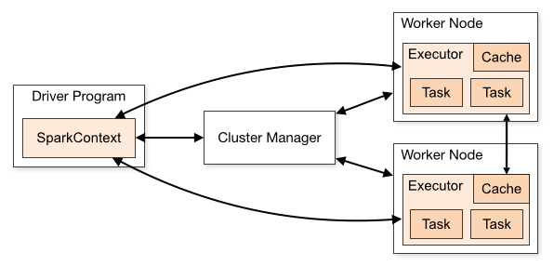
Spark: The most prominent
Notes:
Taken directly from the docs

Slide 14
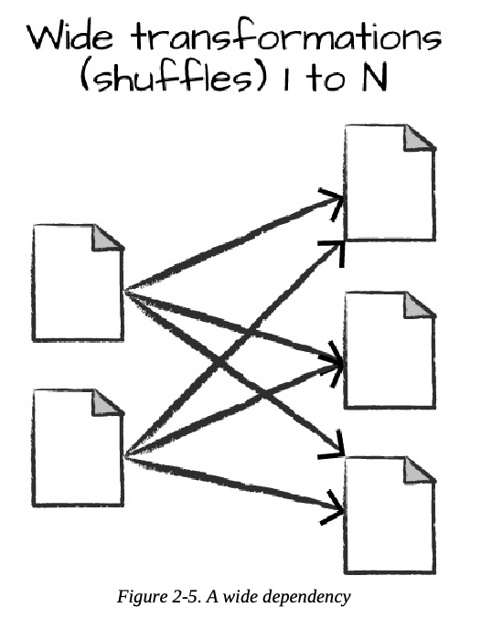
Shuffle
Shuffle – A state in Spark in which data must be re-partitioned between worker nodes
Very expensive operation
Unavoidable at times
Notes:
VERY expensive
Data is transferred to nodes for transformations, shuffle forces a lot of network activity between nodes
TODO: Insert diagram

Slide 15
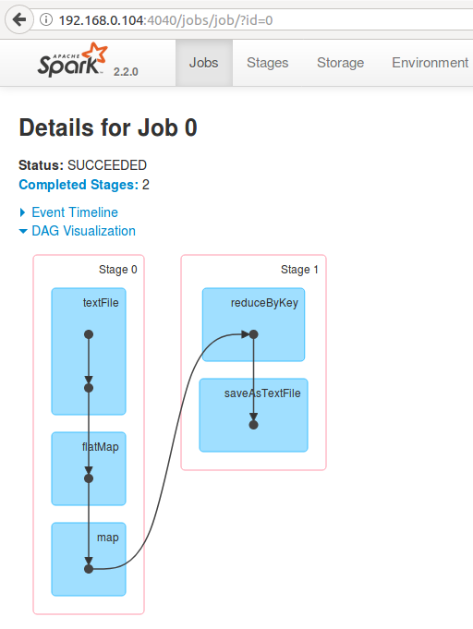
Lazy Evaluation
Lazy Evaluation – The concept of Spark not executing a query until absolutely necessary
Transformation – “[Operations] which create a new dataset from an existing one” (Spark 4.0.1 docs)
  Under the hood: Makes plans as a DAG
Action – An operation that returns a value. Forces execution

Slide 16
Aside: Catalyst, DAG Scheduler and Tungsten
Catalyst – Spark’s logical query optimizer
  Optimizes transformations for best execution order
  Examples:
    Predicate pushdown
    Column pruning
    Simplification
DAG Scheduler – Transforms the plan into stages
Stage – Formed by chaining as many narrow transformations as possible together between shuffles
  Tasks are generated from stages, 1 per partition

Slide 17
Lazy Evaluation
Lazy Evaluation – The concept of Spark not executing a query until absolutely necessary
Transformation – “[Operations] which create a new dataset from an existing one” (Spark 4.0.1 docs)
  Under the hood: Makes plans
  DAG
Action – An operation that returns a value. Forces execution
So what?
Structure operations to maximize transformations and end with an action
Transformations can be chained
Notes:
Edit RHS

Slide 18
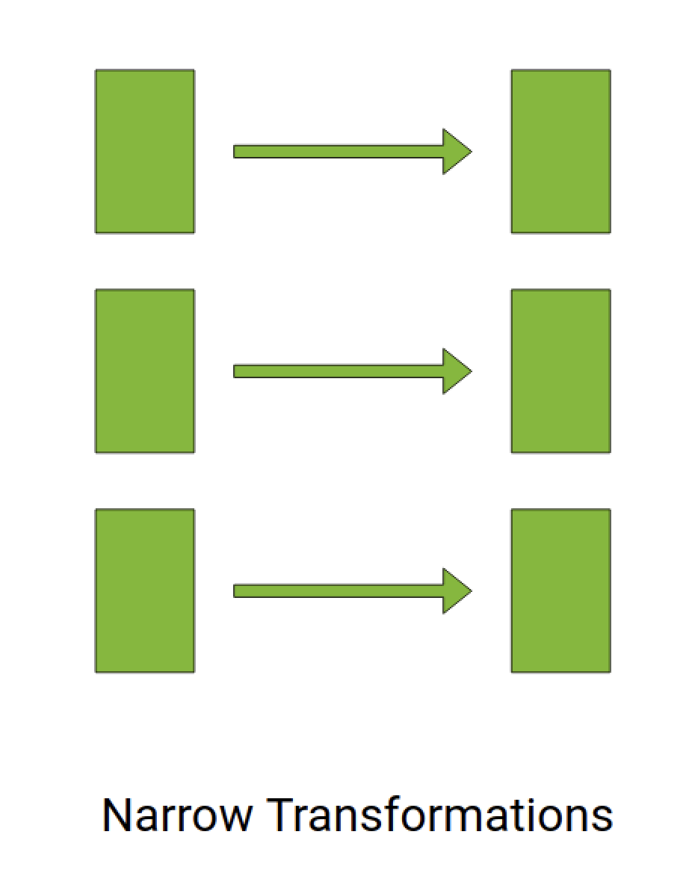
Narrow Transformation
Narrow transformations – Operations that can be computed row-wise
  1:1 between partition blocks
One input partition block is needed to produce one output
Notes:
Think of this in two ways:
One input partition is needed to get one output partition
Table-data – rows

Slide 19
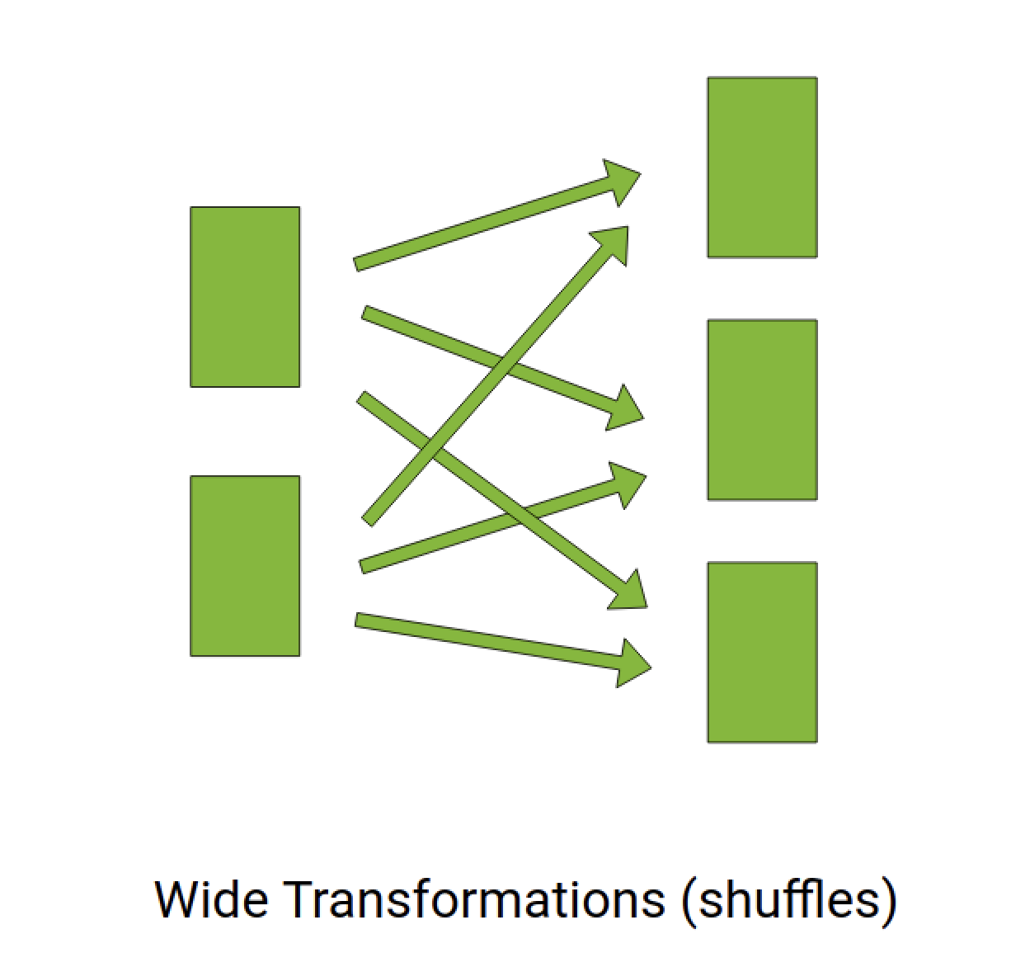
Wide Transformation
Wide transformations – Operations that cross between partition blocks
Data movement: Shuffle
Examples (mostly):
  GroupBy
  Join
Notes:
Think of this in two ways:
One input partition is needed to get one output partition
Table-data – rows

Slide 20
The Spark Game
Maximize parallelism
Minimize shuffles

Slide 21
How to Win the Spark Game
Smart partitioning Strategies
Caching
Broadcast Joins

Slide 22
Partitioning Strategies
Create partitions on disk that are:
  Evenly sized
  Commonly filtered on
  Commonly joined on
  Hit the sweet spot in terms of cardinality
Common patterns:
  Year / month / day
  Predictable categorical variable

Slide 23
Partitioning Strategies: Repartition
Repartition – An expensive transformation that repartitions the data on either node or disk
Fixed upfront vs. variable cost
Re-write to disk vs. cache: Reusability
Dangerous tool: Use when you have a good reason to
When to use:
  After a series of narrow transformations that do not require a shuffle
  Prior to immediately needing it repeatedly
  Fix data skew
  Prior to heavy groupBy / join operations
  Under or over parallelization
Notes:
Example: data skew

Slide 24
Example: Data Skew / Partitioning

Slide 25
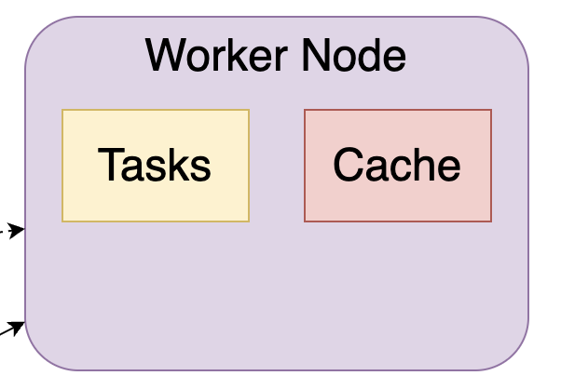
Caching
Caching – Maintaining a record of transformations for later use
“If you ever compute this, keep the partitions around”
When to use:
  Re-using common patterns
  Data is expensive
Notes:
Can store results on a node for later use
Looking at an example worker node we see that there is space for a cache – this saves operations to the node for later use
Avoid repeating history
Tied to the partition itself

Slide 26
Broadcast Joins
Joins often involve data mismatches
“A small dataset is copied to every node in a cluster allowing for local joins with the larger dataset on each node”
“Acceptable risk” for shuffle
Notes:
Avoids the dual shuffle action
Only less than half the data gets shuffled

Slide 27
Databricks
Managed Spark platform
R, Python, Scala, SQL
DBU billing
SaaS model
Homework!
Notes:
Add details about billing, model

Slide 28
Takeaways
Distributed computing, runs in parallel
The Spark Game
  Maximize parallelism
  Minimize Shuffles
Small optimizations go a long way
Actions vs. Transformations

Slide 29
QA

Slide 30
Thank you!
frkovacs@outlook.com
Frank-Kovacs.net
Linkedin.com/in/frank-r-kovacs

