Slide 1

Classification of Protein Ubiquitination Sites using MLP and GA
Group: 11
Jinny Lee
MASc Student under the supervision of Dr. Andy Adler, Dr. Eran Ukwatta
George Hanna
4th year Biomedical and Electrical Engineering Student.
The Pitch, April 3rd 2017
BIOM5405: Pattern Classification and Experiment Design

Slide 2
“Hidden Markov Models cannot be used”
Review
Review our Method/Implementation

Slide 3
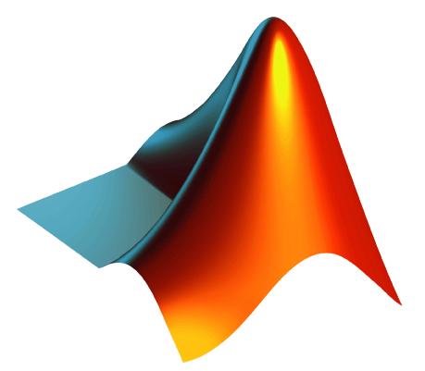

Method
Review
Review our Method/Implementation
Classifier : Multilayer Perceptron
Feature selection : Genetic search
Implementation
Work environment: Matlab 2017a NN Toolbox
Feature selection by WEKA

Slide 4
Processing
Processing Data
Pre-processing data
Normalization: Multilayer network creation functions such as “patternnet” include default processing functions such as “removeconstantrows” and “mapminmax”
1

Slide 5
Processing
Processing Data
Pre-processing data
Normalization: Multilayer network creation functions such as “patternnet” include default processing functions such as “removeconstantrows” and “mapminmax”
1
Missing Data: -9999 values are replaced with column medians.
2

Slide 6
Processing
Processing Data
Pre-processing data
Normalization: Multilayer network creation functions such as “patternnet” include default processing functions such as “removeconstantrows” and “mapminmax”
1
Missing Data: -9999 values are replaced with column medians.
2
Outlier Detection: Mean Absolute Deviation (MAD) used to replace values that are >10 deviations away with the median value.
3

Slide 7
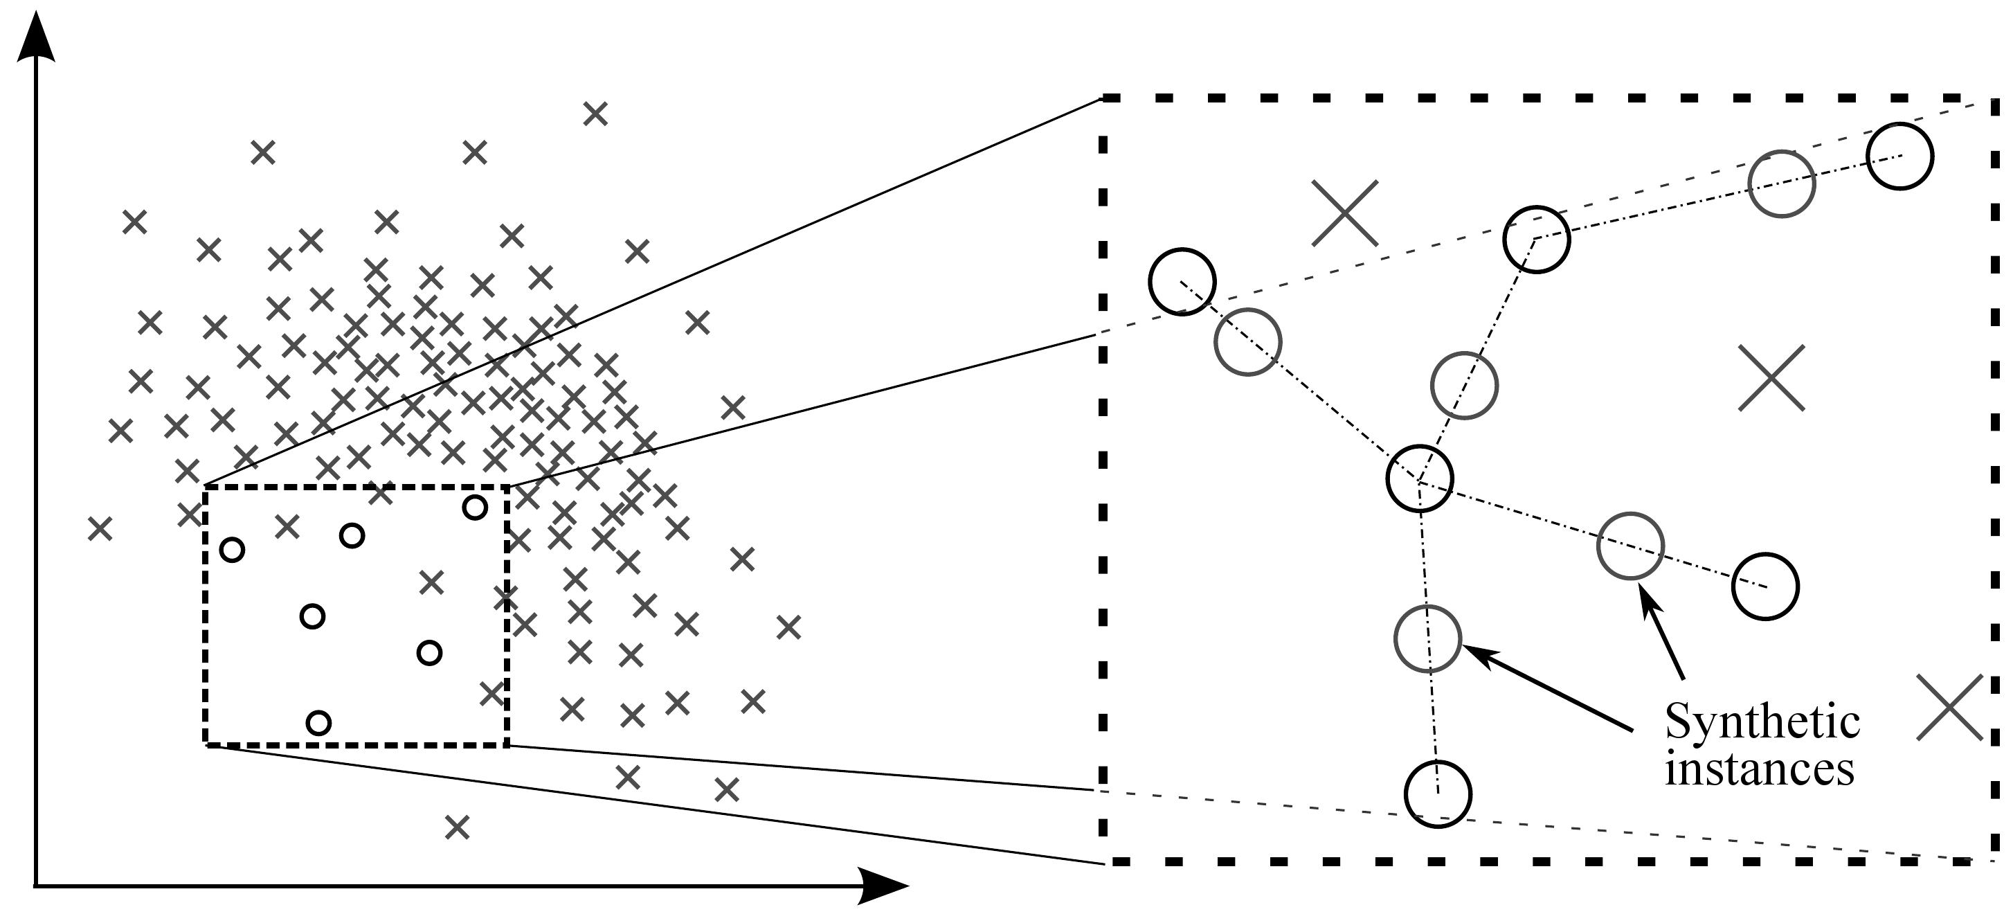
Processing
Processing Data
Mitigating Class Imbalance
Synthetic Sampling (SMOTE)
Adaptive SMOTE (AdaSyn)
Cost-sensitive classification
Undersampling
Sampling of Minority Class using K Neighbors

Slide 8
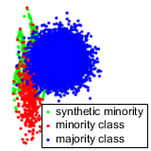
Processing
Processing Data
Mitigating Class Imbalance
Synthetic Sampling (SMOTE)
Adaptive SMOTE (AdaSyn)
Cost-sensitive classification
Undersampling
Sampling of Minority Class Near Border

Slide 9
Processing
Processing Data
Mitigating Class Imbalance
Synthetic Sampling (SMOTE)
Adaptive SMOTE (AdaSyn)
Cost-sensitive classification
Undersampling

Slide 10
Processing
Processing Data
Mitigating Class Imbalance
Synthetic Sampling (SMOTE)
Adaptive SMOTE (AdaSyn)
Cost-sensitive classification
Undersampling
N random subsets of size(positive)
P
N

Slide 11
Experiment Design
Feature Selection
Datasets : Split 60% for training and 40% for test set
Greedy Search
Genetic Search
Optimal Feature Set
Feature Selection Using WEKA:
CfsBestSubsetEval - Greedy search 10 - 60 features
Results used as initial state for Genetic Search, giving 10 - 60 features

Slide 12
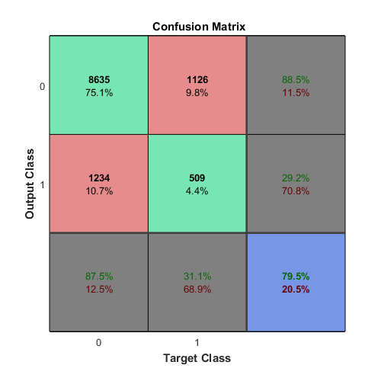
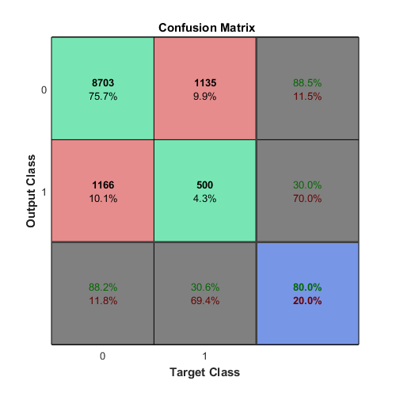
Experiment Design
Feature Selection
Feature Selection Using WEKA:

Slide 13
Experiment Design
Experiment
Training and Testing Protocol:
Train X NNs on X Bootstrap samples of training data
Samples have equal proportion of positives and negatives
NNs applied to hold-out test-set
Outputs of each NN are summed, averaged, thresholded.
Parameter Tuning
Learning Rate, Momentum, Hidden Layers
Training uses Early Stopping, Bayesian Regularization to lower risk of overfitting.

Slide 14
Advanced Techniques
Experiment Design
Meta Learning
Hybrid Learners:
Combine weak NN with decision trees and KNN classifiers. Weak improvement in classification precision/recall
Bagging:
Several tens of NNs are trained on bootstrap samples of training set. Could be combined with Hybrid Scheme to improve stability
GA-based Selective NN Ensemble:
Assign voting weights to NNs using GA.

Slide 15


Advanced Techniques
Experiment Design
Meta Learning

Slide 16
Advanced Techniques
Experiment Design
Active Learning
Voting-based Query Selection
1000 points are chosen where vote among X classifiers is closest. These points are deemed uncertain and should help in defining a more accurate classifier.

Slide 17

Advanced Techniques
Experiment Design
Active Learning

Slide 18
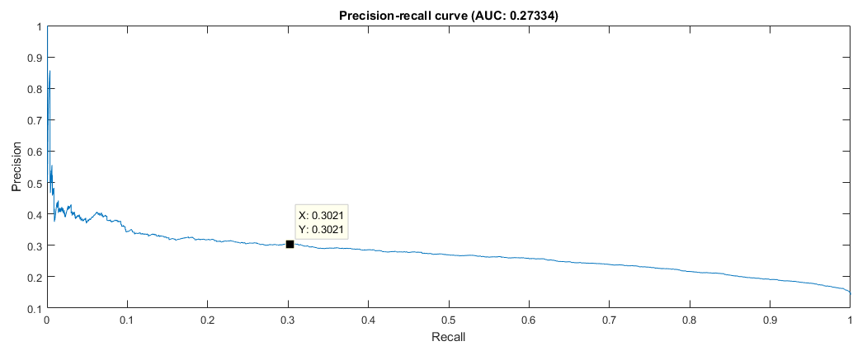
Results
Estimated Results
Min Sensitivity: 30%
Min Precision: 30%

Slide 19
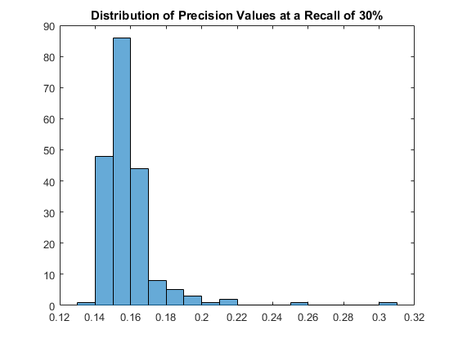
Results
Estimated Results
Accuracy: 0.15 +/- 0.05

