Slide 1

Properties in London
By George Horgan
Last updated : 18/06/2023

Slide 2
Objective
Introducing a journey of discovery into the renters market in London.

Slide 3
Objective
Introducing a journey of discovery into the renters market in London.
Where I identify trends and statistics using data from Rightmove.

Slide 4
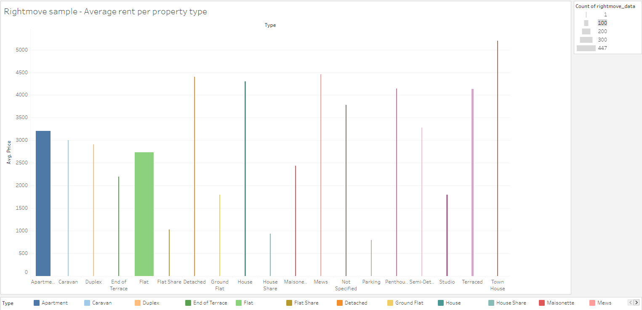
Average Rent Infographic
What is the average rent per property type?

Slide 5
Average Rent Infographic
What is the average rent per property type?
Flats and apartments are the biggest contributors to the data though both are used interchangeable to mean the same thing.

Slide 6
Average Rent Infographic
What is the average rent per property type?
Flats and apartments are the biggest contributors to the data though both are used interchangeable to mean the same thing.
From the sample, the average cost of rent is approximately £2,900.

Slide 7
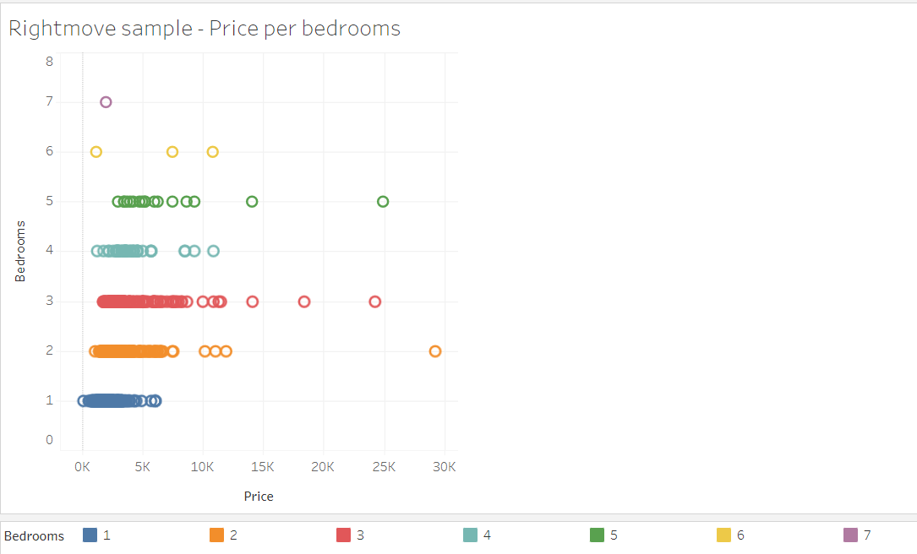
Bedrooms Pricing
What is the price of rent per number of bedrooms?

Slide 8
Bedrooms Pricing
What is the price of rent per number of bedrooms?
From the graph, 1 through 3 bedrooms seem to have a steady incline of average rent.

Slide 9
Bedrooms Pricing
What is the price of rent per number of bedrooms?
From the graph, 1 through 3 bedrooms seem to have a steady incline of average rent.
The graph overall shows little to no correlation.

Slide 10
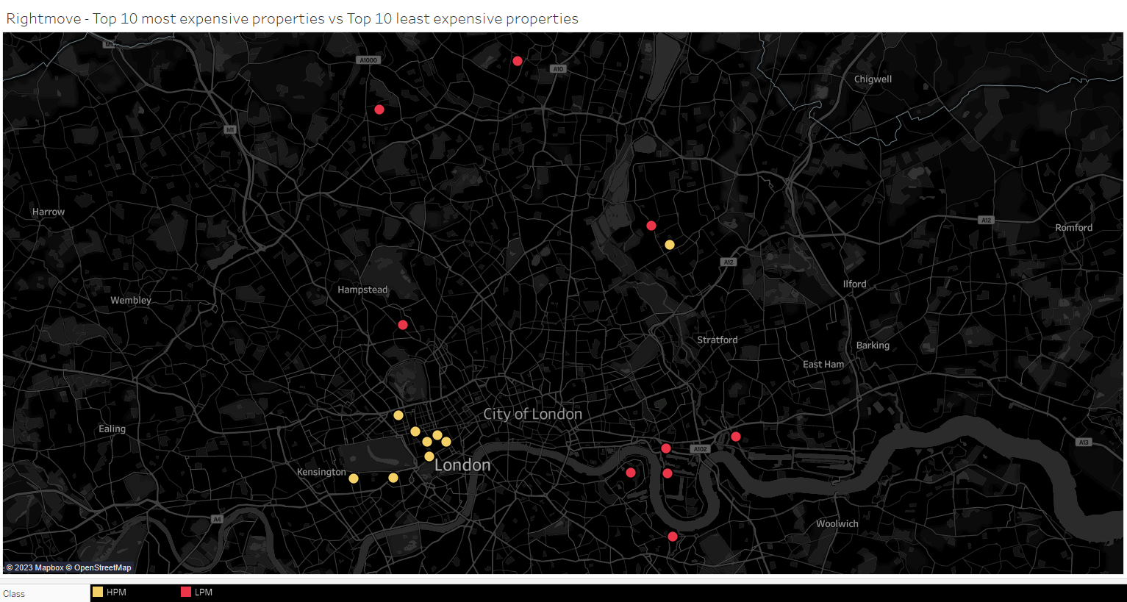
A Top 10 Classic
Where are the most expensive vs cheapest properties to rent in London?

Slide 11
A Top 10 Classic
Where are the most expensive vs cheapest properties to rent in London?
The richest places in the top 10 are more than £10,000 per month.

Slide 12
A Top 10 Classic
Where are the most expensive vs cheapest properties to rent in London?
The richest places in the top 10 are more than £10,000 per month.
While the cheapest are all under £1,000 per month.

Slide 13
A Top 10 Classic
Where are the most expensive vs cheapest properties to rent in London?
The richest places in the top 10 are more than £10,000 per month.
While the cheapest are all under £1,000 per month.
The pricier properties are much more concentrated together.

Slide 14
Conclusion
1
We found there are far more apartments/flats in London than any other type of living space and average at around £2,900.
https://public.tableau.com/app/profile/george.horgan

Slide 15
Conclusion
1
2
We found there are far more apartments/flats in London than any other type of living space and average at around £2,900.
We found little correlation between house prices and number of bedrooms, no relationship at all when reaching 4+ bedrooms.
https://public.tableau.com/app/profile/george.horgan

Slide 16
Conclusion
1
2
3
We found there are far more apartments/flats in London than any other type of living space and average at around £2,900.
We found little correlation between house prices and number of bedrooms, no relationship at all when reaching 4+ bedrooms.
Richer areas are more concentrated while cheaper areas are much widely scattered around the city.
https://public.tableau.com/app/profile/george.horgan

