Slide 1
Increasing Profits Through Good Customers
Final Project STAT 551 Predictive Analytics I
Yuchi Hu

Slide 2
Background/Outline
Premier Bankcard data
Credit card monthly billing statements
9,997 customers (unique ID’s) and 26 variables
Focus on good customers
Create the model dataset
Models
Logistic regression
MARS
Good Customer Score
Model evaluation
ROC/AUC
KS
Gains table
Lift
Profit (are we making money?)

Slide 3
Creating the Model Dataset
Removed 4,167 risky customers
A customer is deemed risky if their month 1 satisfies any of these conditions:
Days Deliq > 0 (more than 0 days delinquent)
non-blank External Status
Opening Balance > Credit Limit
Ending Balance > Credit Limit
Definition of Bad (outcome variable)
A customer is defined as bad if they satisfy any of these conditions:
Days Deliq ≥ 90 (90 or more days delinquent) in the final month
External Status other than blank or "C" in month 7 or later
Kept only month 1 (Row Num = 1) for each remaining customer
Bad | Frequency
0 | 5072
1 | 753

Slide 4
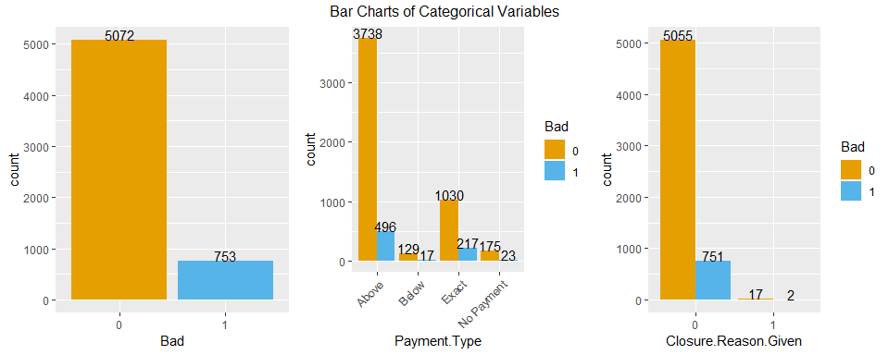
Exploratory Data Analysis

Slide 5
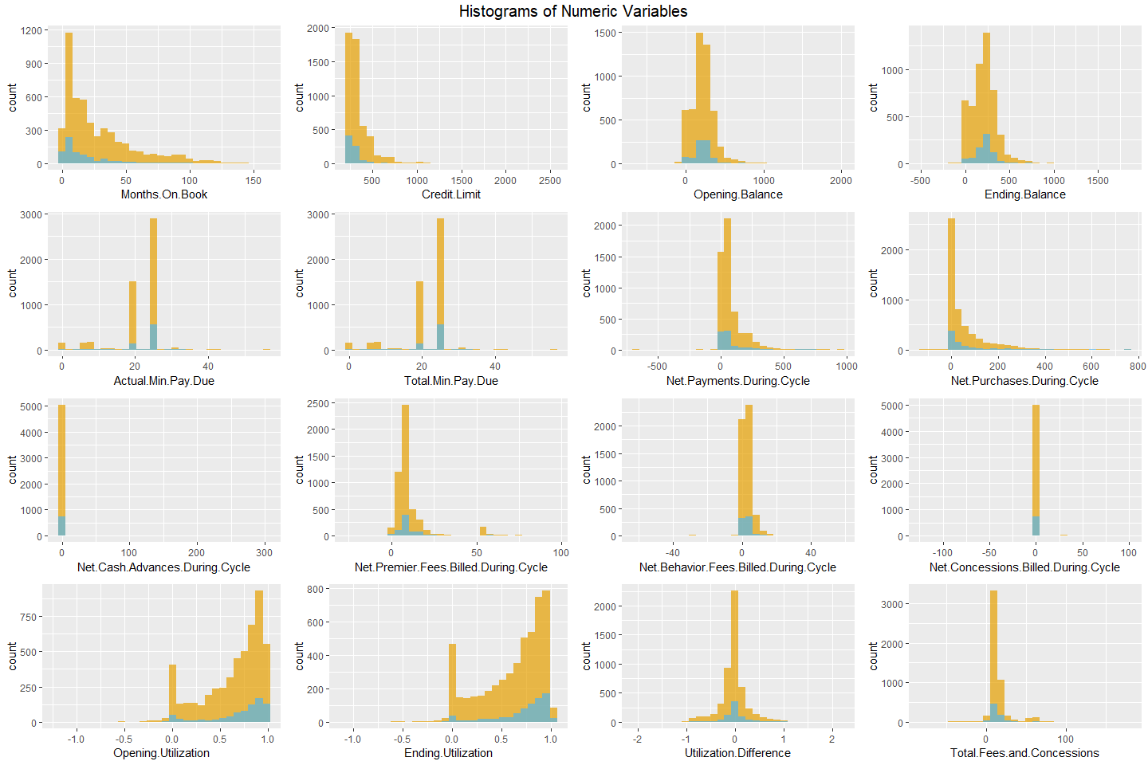

Slide 6
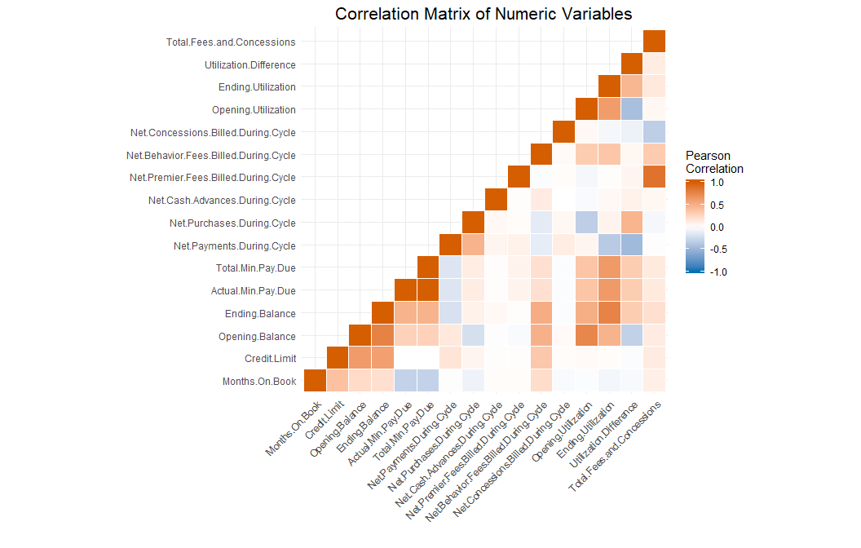

Slide 7
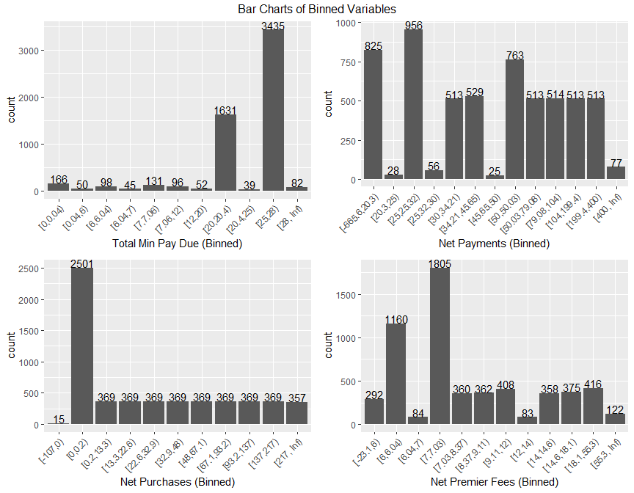

Slide 8
Input Variables
Months On Book
Credit Limit
Opening Balance
Ending Balance
Actual Min Pay Due
Total Min Pay Due (binned)
Net Payments During Cycle (binned)
Net Purchases During Cycle (binned)
Net Cash Advances During Cycle
Net Premier Fees Billed During Cycle (binned)
Net Behavior Fees Billed During Cycle
Net Concessions Billed During Cycle
Opening Utilization
Opening Balance / Credit Limit
Ending Utilization
Ending Balance / Credit Limit
Utilization Difference
Ending Utilization - Opening Utilization
Total Fees and Concessions
Net Premier Fees Billed During Cycle + Net Behavior Fees Billed During Cycle - Net Concessions Billed During Cycle
Payment Type
index of whether a customer paid above, below, or exactly their total minimum payment due or if they made no payment
Closure Reason Given
index of whether or not a closure reason was given
Removed Variables
Row Num
External Status
Days Deliq and Over limit Amount
Good Customer Score, Behavior Score, and Quarterly Fico Score
ClosureReason
Open Date, Last Statement Date, Cycle Date, Month End Date, and Last Payment Date

Slide 9
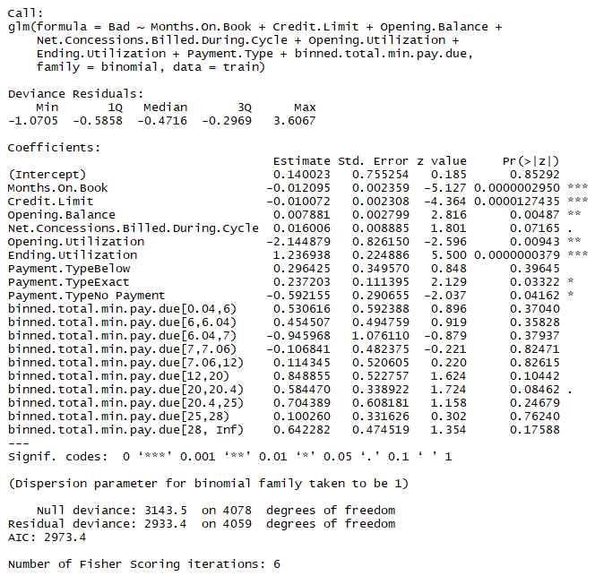
Logistic Regression
Training (70%), validation (30%)
Stepwise variable selection
Final model
8 inputs
AIC = 2973.4

Slide 10
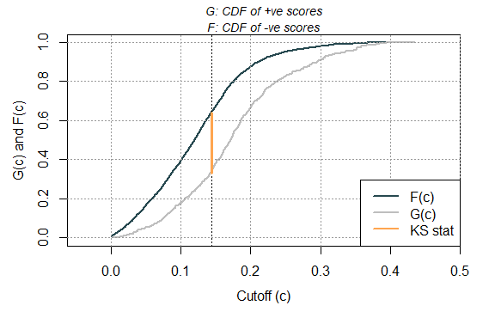
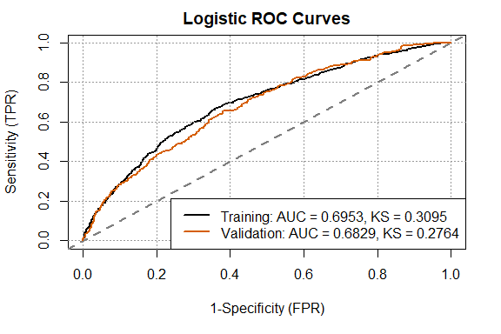
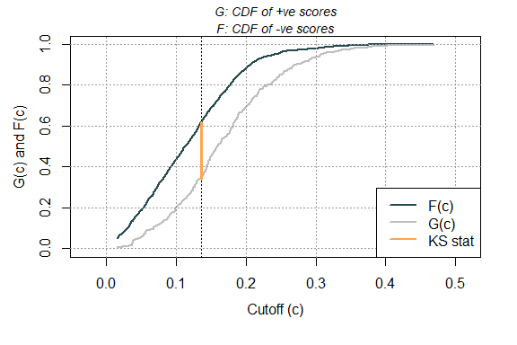
Logistic Regression
KS (Training)
KS (Validation)

Slide 11
Logistic Regression Gains Table (Validation)
Bucket | # Customers | Cumulative # Customers | Cumulative % Customers | # Bad | Cumulative # Bad | Bad Rate | Cumulative Bad Rate | Cumulative % Bad | Lift | Cumulative Lift | Profit | Loss | Net Profit
1 | 175 | 175 | 10 | 57 | 57 | 0.33 | 0.33 | 25 | 2.53 | 2.53 | $72,720 | $22,798 | $49,922
2 | 174 | 349 | 20 | 29 | 86 | 0.17 | 0.25 | 38 | 1.29 | 1.91 | $89,359 | $11,599 | $77,760
3 | 175 | 524 | 30 | 26 | 112 | 0.15 | 0.21 | 50 | 1.15 | 1.66 | $91,824 | $10,399 | $81,425
4 | 174 | 698 | 40 | 30 | 142 | 0.17 | 0.2 | 63 | 1.34 | 1.58 | $88,743 | $11,999 | $76,744
5 | 175 | 873 | 50 | 21 | 163 | 0.12 | 0.19 | 72 | 0.93 | 1.45 | $94,906 | $8,399 | $86,506
6 | 175 | 1048 | 60 | 18 | 181 | 0.1 | 0.17 | 80 | 0.8 | 1.34 | $96,754 | $7,199 | $89,555
7 | 174 | 1222 | 70 | 17 | 198 | 0.1 | 0.16 | 88 | 0.76 | 1.26 | $96,754 | $6,799 | $89,955
8 | 175 | 1397 | 80 | 9 | 207 | 0.05 | 0.15 | 92 | 0.4 | 1.15 | $102,301 | $3,600 | $98,701
9 | 174 | 1571 | 90 | 15 | 222 | 0.09 | 0.14 | 99 | 0.67 | 1.1 | $97,987 | $5,999 | $91,988
10 | 175 | 1746 | 100 | 3 | 225 | 0.02 | 0.13 | 100 | 0.13 | 1 | $105,998 | $1,200 | $104,799

Slide 12
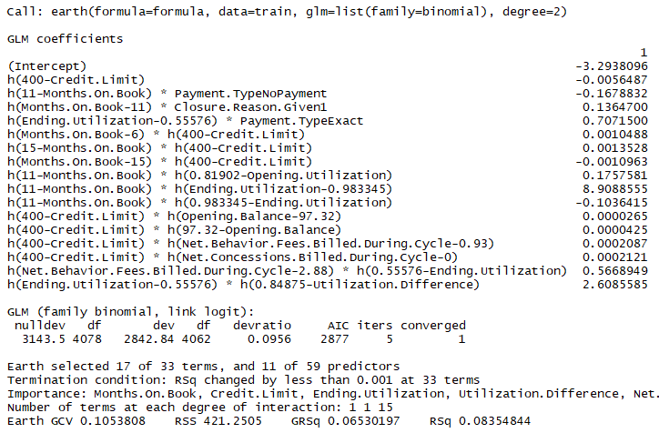
MARS
Training (70%), validation (30%)
Automatic variable and knot selection
Degree of interaction: 2
Final model
17 terms and 11 inputs
AIC = 2877

Slide 13
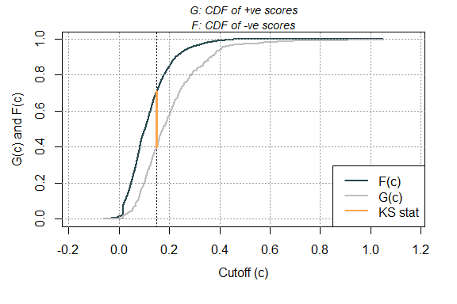
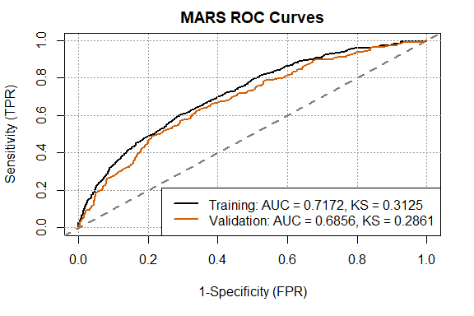
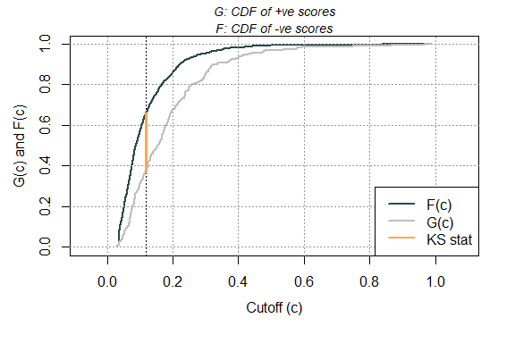
MARS
KS (Training)
KS (Validation)

Slide 14
MARS Gains Table (Validation)
Bucket | # Customers | Cumulative # Customers | Cumulative % Customers | # Bad | Cumulative # Bad | Bad Rate | Cumulative Bad Rate | Cumulative % Bad | Lift | Cumulative Lift | Profit | Loss | Net Profit
1 | 175 | 175 | 10 | 54 | 54 | 0.31 | 0.31 | 24 | 2.39 | 2.39 | $74,569 | $21,598 | $52,971
2 | 174 | 349 | 20 | 35 | 89 | 0.2 | 0.26 | 40 | 1.56 | 1.98 | $85,662 | $13,999 | $71,663
3 | 175 | 524 | 30 | 30 | 119 | 0.17 | 0.23 | 53 | 1.33 | 1.76 | $89,359 | $11,999 | $77,360
4 | 174 | 698 | 40 | 25 | 144 | 0.14 | 0.21 | 64 | 1.11 | 1.6 | $91,824 | $9,999 | $81,825
5 | 175 | 873 | 50 | 18 | 162 | 0.1 | 0.19 | 72 | 0.8 | 1.44 | $96,754 | $7,199 | $89,555
6 | 175 | 1048 | 60 | 17 | 179 | 0.1 | 0.17 | 80 | 0.75 | 1.33 | $97,371 | $6,799 | $90,571
7 | 174 | 1222 | 70 | 20 | 199 | 0.11 | 0.16 | 88 | 0.89 | 1.26 | $94,906 | $7,999 | $86,906
8 | 175 | 1397 | 80 | 9 | 208 | 0.05 | 0.15 | 92 | 0.4 | 1.16 | $102,301 | $3,600 | $98,701
9 | 174 | 1571 | 90 | 11 | 219 | 0.06 | 0.14 | 97 | 0.49 | 1.08 | $100,452 | $4,400 | $96,052
10 | 175 | 1746 | 100 | 6 | 225 | 0.03 | 0.13 | 100 | 0.27 | 1 | $104,150 | $2,400 | $101,750

Slide 15
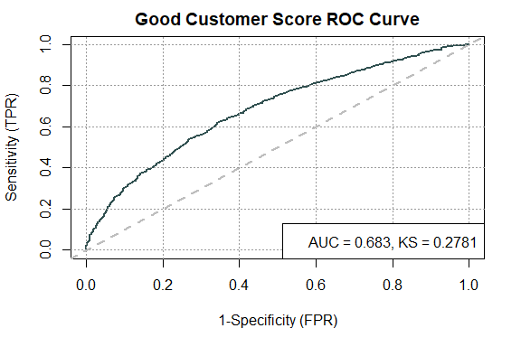
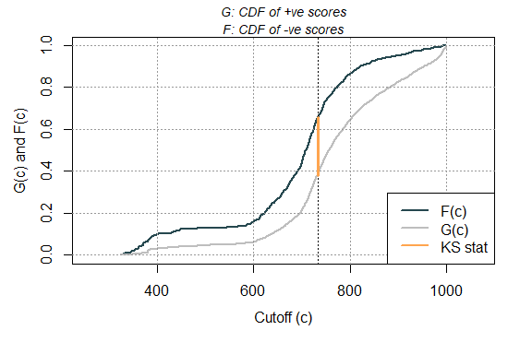
Good Customer Score
KS

Slide 16
Good Customer Score Gains Table
Bucket | # Customers | Cumulative # Customers | Cumulative % Customers | # Bad | Cumulative # Bad | Bad Rate | Cumulative Bad Rate | Cumulative % Bad | Lift | Cumulative Lift
1 | 554 | 554 | 10 | 148 | 148 | 0.27 | 0.27 | 20 | 2.02 | 2.02
2 | 554 | 1108 | 20 | 124 | 272 | 0.22 | 0.25 | 37 | 1.70 | 1.86
3 | 554 | 1662 | 30 | 109 | 381 | 0.20 | 0.23 | 52 | 1.49 | 1.74
4 | 554 | 2216 | 40 | 84 | 465 | 0.15 | 0.21 | 64 | 1.15 | 1.59
5 | 554 | 2770 | 50 | 71 | 536 | 0.13 | 0.19 | 73 | 0.97 | 1.47
6 | 554 | 3324 | 60 | 53 | 589 | 0.10 | 0.18 | 81 | 0.73 | 1.34
7 | 554 | 3878 | 70 | 55 | 644 | 0.10 | 0.17 | 88 | 0.75 | 1.26
8 | 554 | 4432 | 80 | 42 | 686 | 0.08 | 0.15 | 94 | 0.57 | 1.17
9 | 554 | 4986 | 90 | 27 | 713 | 0.05 | 0.14 | 98 | 0.37 | 1.08
10 | 554 | 5540 | 100 | 18 | 731 | 0.03 | 0.13 | 100 | 0.25 | 1.00
Total | 5540 |  |  | 731 |  | 0.13

