Slide 1
An attempt to model the language of life using DisCoCat
Yanying Wu & Quanlong Wang
University of Oxford
SYCO 5, Sept. 2019
Birmingham, UK

Slide 2
Motivation and background
DisCoCat for proteins
Summary and future work
Notes:
In motivation, I will explain what is our major topic, where we are in the field, why is it important.

Slide 3
Natural Language
Processing
Applied Category
Theory
Computer Science
Quantum
Physics
System
Biology

Slide 4
System biology is an approach in biomedical research to understand the larger picture—be it at the level of the organism, tissue, or cell—by putting its pieces together. It’s in stark contrast to decades of reductionist biology, which involves taking the pieces apart.
https://irp.nih.gov/catalyst/v19i6/systems-biology-as-defined-by-nih

Slide 5

What is life?
Robert Rosen, 1945
(M, R) systems
Robert Rosen, 1964~1966
https://www.pinterest.com/
Notes:
Rosen argued that the fundamental question "What is life?" cannot be adequately addressed from within a scientific foundation that is reductionistic. Approaching organisms with reductionistic scientific methods and practices sacrifices the functional organization of living systems in order to study the parts. The whole, according to Rosen, could not be recaptured once the biological organization had been destroyed. By proposing a sound theoretical foundation for studying biological organisation, Rosen held that, rather than biology being a mere subset of the already known physics, it might turn out to provide profound lessons for physics, and also for science in general.
Robert Rosen’s Metabolism-Replacement, or (M,R), system can be represented as a compact network structure with a single source and three products derived from that source in three consecutive reactions. (M,R) has been claimed to be non-reducible to its components and algorithmically non-computable, in the sense of not being evaluable as a function by a Turing machine. If (M,R)-like structures are present in real biological networks, this suggests that many biological networks will be non-computable, with implications for those branches of systems biology that rely on in silico modelling for predictive purposes.
Rosen said that organization must be independent from the material particles which seemingly constitute a living system. As he put it:
The human body completely changes the matter it is made of roughly every 8 weeks, through metabolism, replication and repair. Yet, you're still you --with all your memories, your personality... If science insists on chasing particles, they will follow them right through an organism and miss the organism entirely.
— Robert Rosen, (as told to his daughter, Ms. Judith Rosen^{[2]})

Slide 6
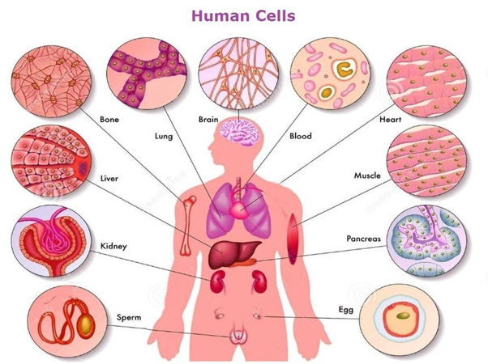
Memory Evolutive Systems
Ehresmann, A.C. & Vanbremeersch, J.P., 2007
https://www.quora.com/How-many-cells-are-there-in-the-human-body

Slide 7
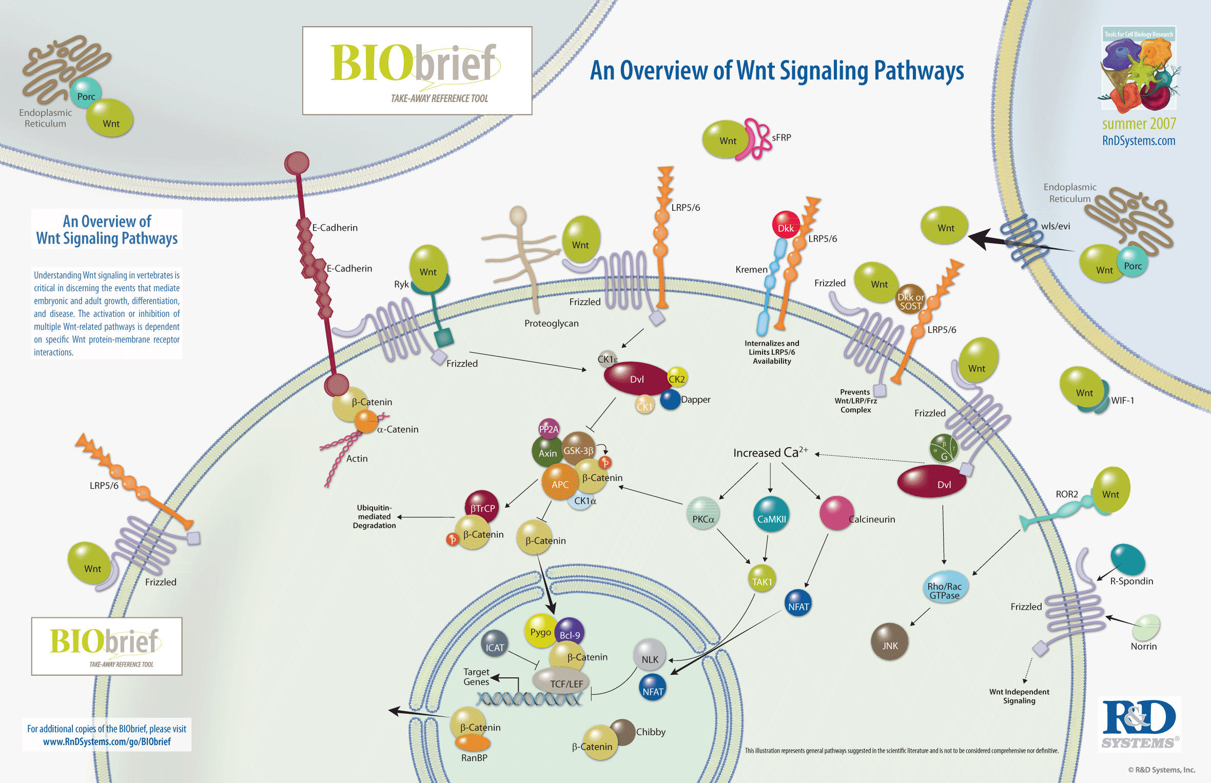
The Kappa platform
Jean Krivine, Walter Fontana et al., since 2007
https://www.rndsystems.com/resources/posters/overview-wnt-signaling-pathways

Slide 8
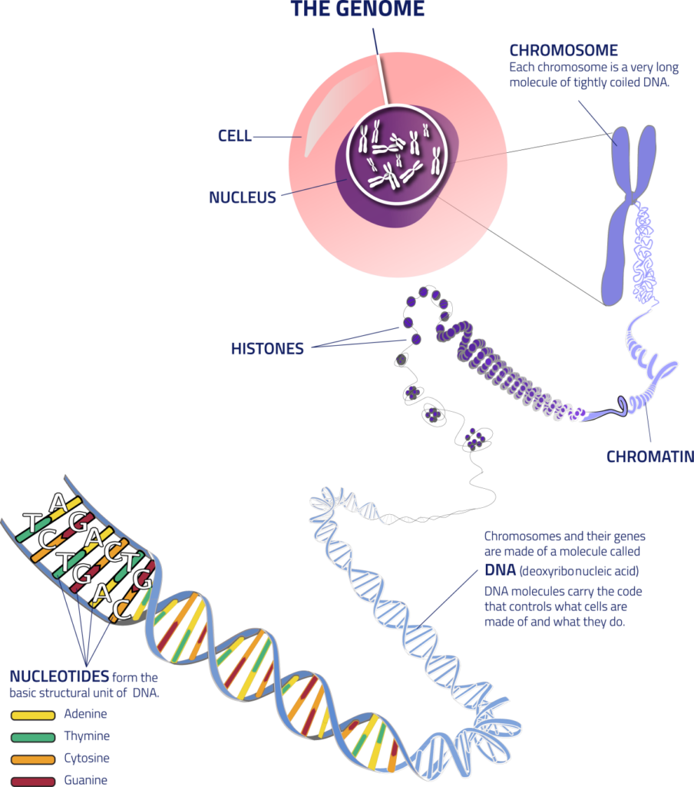
Categorical Genomics
Category Theory for Genetics
Remy Tuyeras, 2018
https://www.genomebc.ca/why-genomics/understanding-genomics/

Slide 9
For me, …, the uncovering of the human genome sequence held additional significance…I felt an overwhelming sense of awe in surveying this most significant of all biological text. Yes, it is written in a language we understand very poorly, and it will take decades, if not centuries, to understand its instructions, but we had crossed a one-way bridge into profoundly new territory.
P123-124, The language of GOD Francis Collins, 2007

Slide 10
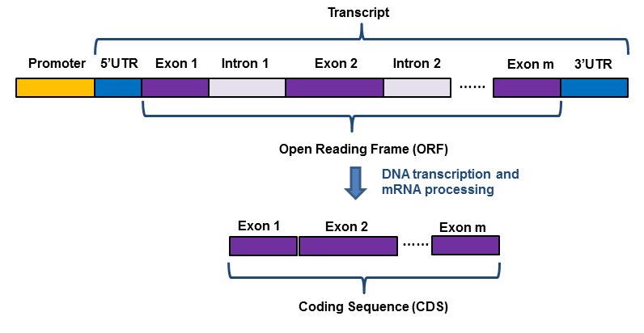
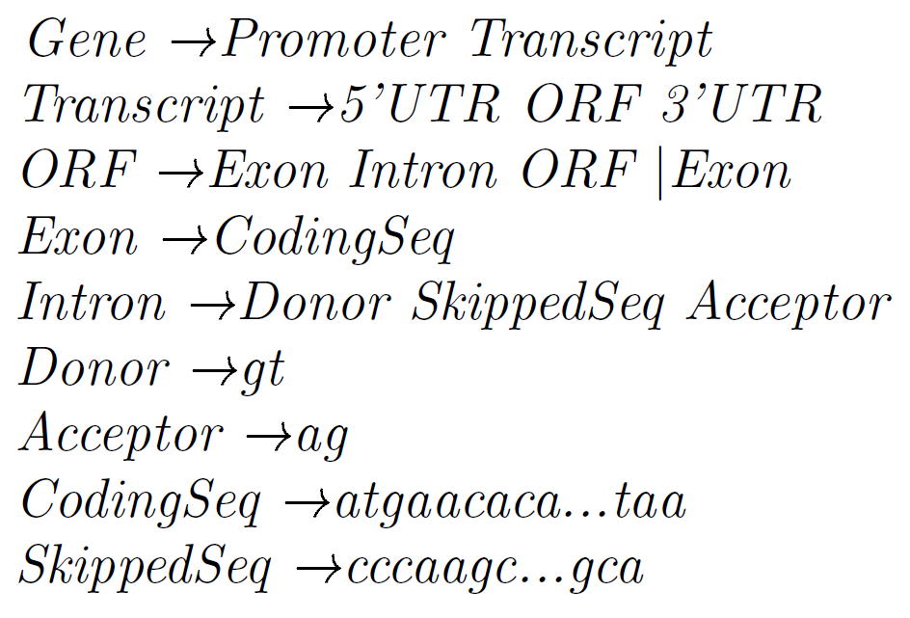
A typical eukaryote gene structure

Slide 11
The Chomsky hierarchy and formal language theory
The language of genes David Searls, Nature 2002

Slide 12
The DisCoCat Model
Mathematical Foundations for a Compositional Distributional Model of Meaning
Bob Coecke, Mehrnoosh Sadrzadeh, Stephen Clark, 2010

Slide 13
Natural language
Biological language
A, B, C, …, Z
Word
Sentence
Meaning
A, C, T, G
?
Gene
Function
-> Domain
-> Protein

Slide 14
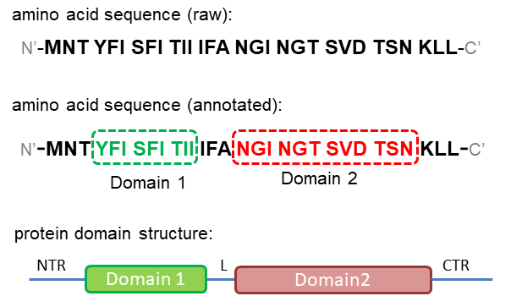
The modular structure of proteins

Slide 15
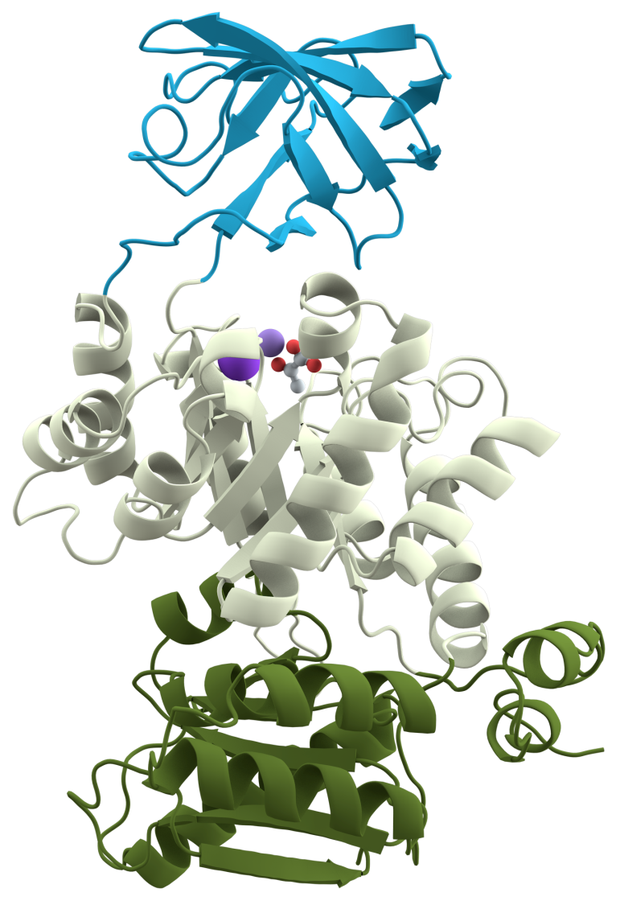
The 3D structure of Pyruvate kinase
By Thomas Splettstoesser (www.scistyle.com)

Slide 16
DisCoCat for protein?
domain 1
domain 2
. . .
domain n
protein
=
P
process depending on
grammatical structure
P
A Categorical Compositional Distributional Modelling for the Language of Life
Yanying Wu, Quanlong Wang, arXiv:1902.09303 2019

Slide 17
The DisCoCat Model
DisCoCat Coecke et al., 2010
Notes:
Distributional theory of meaning in terms of vector space models
Compositional theory of grammatical types, which relies on the algebra of Pregroups, introduced by Lambek

Slide 18
ProtVec – a vector space representation for domains

Slide 19
The pregroup grammar for natural language
DisCoCat Coecke et al., 2010

Slide 21

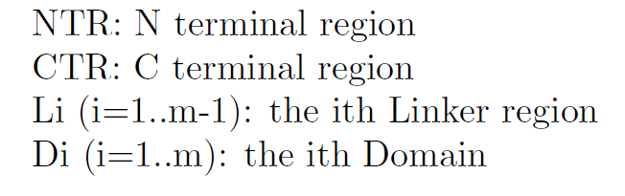
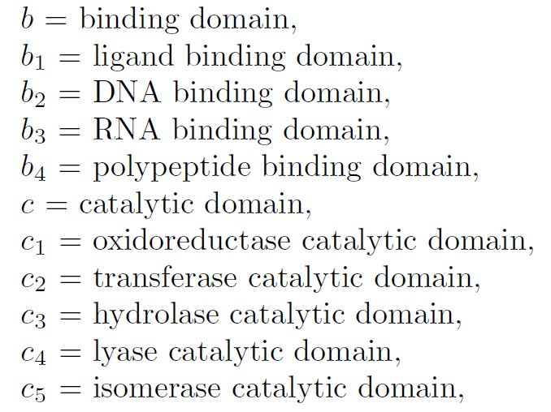
Typing of protein domains

Slide 22
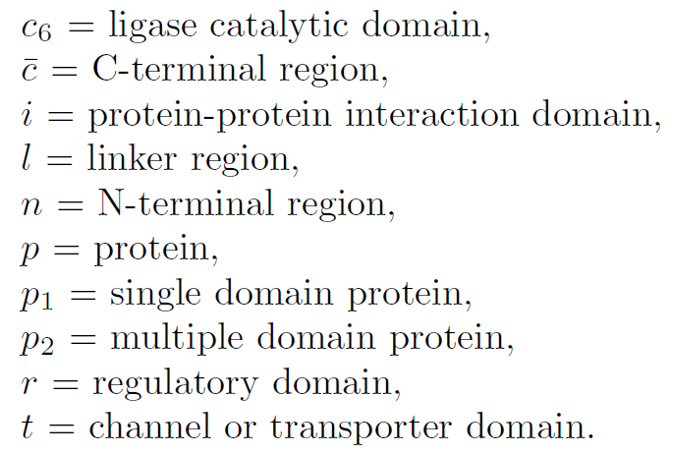
Typing of protein domains (cont.)

Slide 23

From domain to protein function – an example
Protein structure of FoxP:
Typing of the domains:
Typing of the protein:
Type reduction:
Notes:
FoxP encodes a transcription factor, the Coiled-coil domain modulates
the dimeric associations of FoxP transcription factors, and the Fork-head domain
is a conserved DNA-binding domain.

Slide 24


From domain to protein function – an example
(cont.)
Protein structure of FoxP:
Mapping to the vector space:
Notes:
FoxP encodes a transcription factor, the Coiled-coil domain modulates
the dimeric associations of FoxP transcription factors, and the Fork-head domain
is a conserved DNA-binding domain.

Slide 25
From domain to protein function – an example
(cont.)
Protein structure of FoxP:
Calculating the vector representation:
What is applied category theory? Tai-Danae Bradley, 2018
Notes:
FoxP encodes a transcription factor, the Coiled-coil domain modulates
the dimeric associations of FoxP transcription factors, and the Fork-head domain
is a conserved DNA-binding domain.

Slide 26
Summary
Categorical Genomics
DisCoCat for the language of life
DisCoCat for proteins
ProtVec
Pregroup for Protein grammar
Notes:
Distributional theory of meaning in terms of vector space models
Compositional theory of grammatical types, which relies on the algebra of Pregroups, introduced by Lambek

Slide 27
Future work
Typing of protein, is pregroup grammar suitable?
How to represent the compositional structure of a protein?
From sentence to text

Slide 28
Thank you!

Slide 29
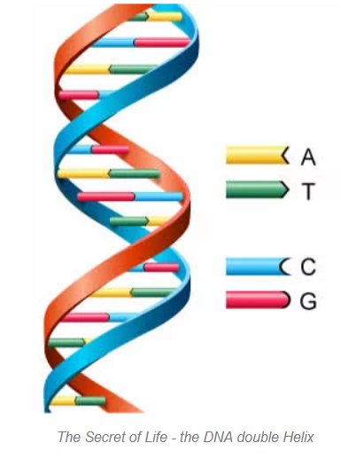

Apply Category Theory to Genomics
Apply Category Theory to Genomics
https://owlcation.com/academia/explaining-dna-to-a-six-year-old

Slide 30
Genetics vs. Genomics
Genetics is the study of heredity, or how the characteristics of living organisms are transmitted from one generation to the next via DNA, the substance that comprises genes, the basic unit of heredity.
Genetics involves the study of specific and limited numbers of genes, or parts of genes, that have a known function.
Genomics, in contrast, is the study of the entirety of an organism’s genes – called the genome.
https://www.jax.org/.../genetics-vs-genomics
Notes:
Distributional theory of meaning in terms of vector space models
Compositional theory of grammatical types, which relies on the algebra of Pregroups, introduced by Lambek

Slide 31
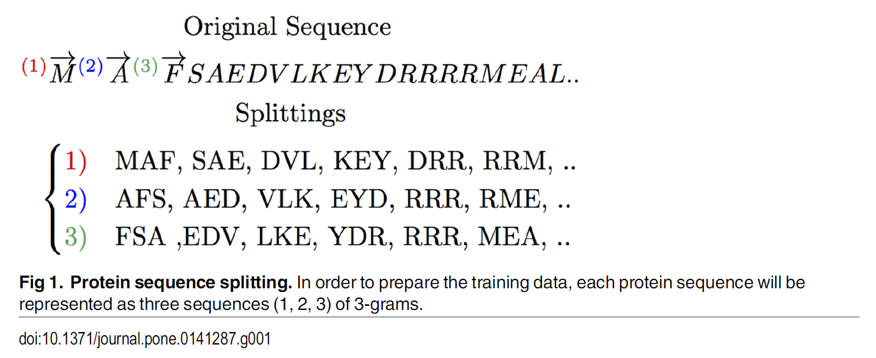

Slide 32
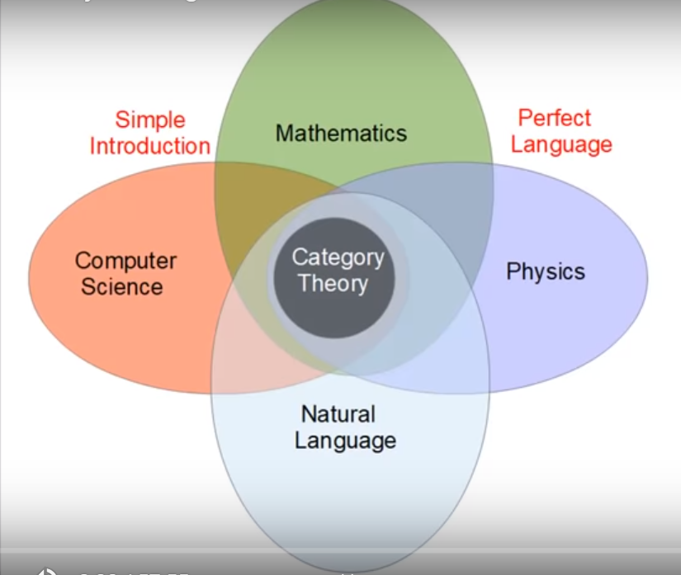
Motivation
Richard Southwell

