Slide 1
NEXUS CLEAN
Smart Waste Management & Predictive Intelligence Platform
Don't Just Report Waste. Predict It.

Slide 2
The Waste Management Challenge
Traditional waste collection is reactive and inefficient.
Overflowing Bins
Inefficient Routes
Lack of Visibility
Missed pickups cause unhygienic conditions
Trucks waste fuel checking empty zones
City admins struggle to identify hotspots

Slide 3
Introducing Nexus Clean
Smart Waste Platform
(Data + AI + Analytics)
Citizens
(Report & Monitor)
Operations
(Intelligent Action)

Slide 4
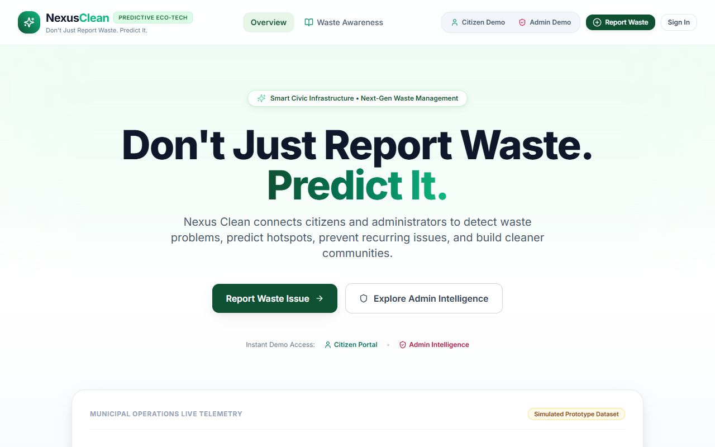
How Nexus Clean Works
Citizen Web Client -> React/Vite Frontend -> Express/Node API -> PostgreSQL/Gemini AI

Slide 5
Built for Different Users
Citizen
Admin / Operations
? Report waste issues
? Request pickups
? View resolution status
? Track Eco-Score
? Monitor reports
? Dispatch trucks
? Predictive analytics
? Resolve hotspots

Slide 6
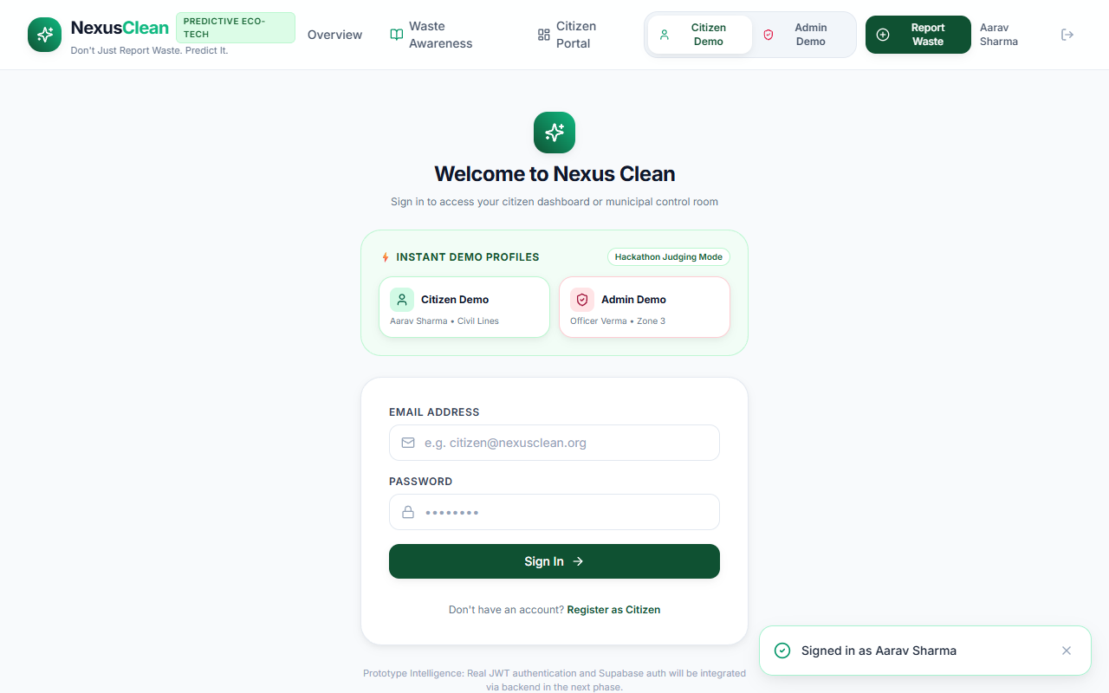
Citizen Experience

Slide 7
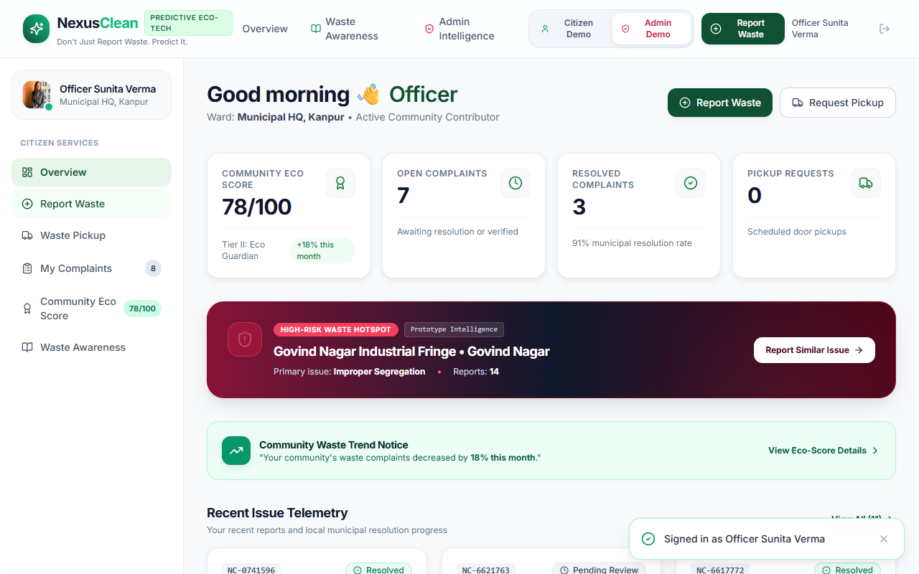
Operations & Admin Intelligence

Slide 8
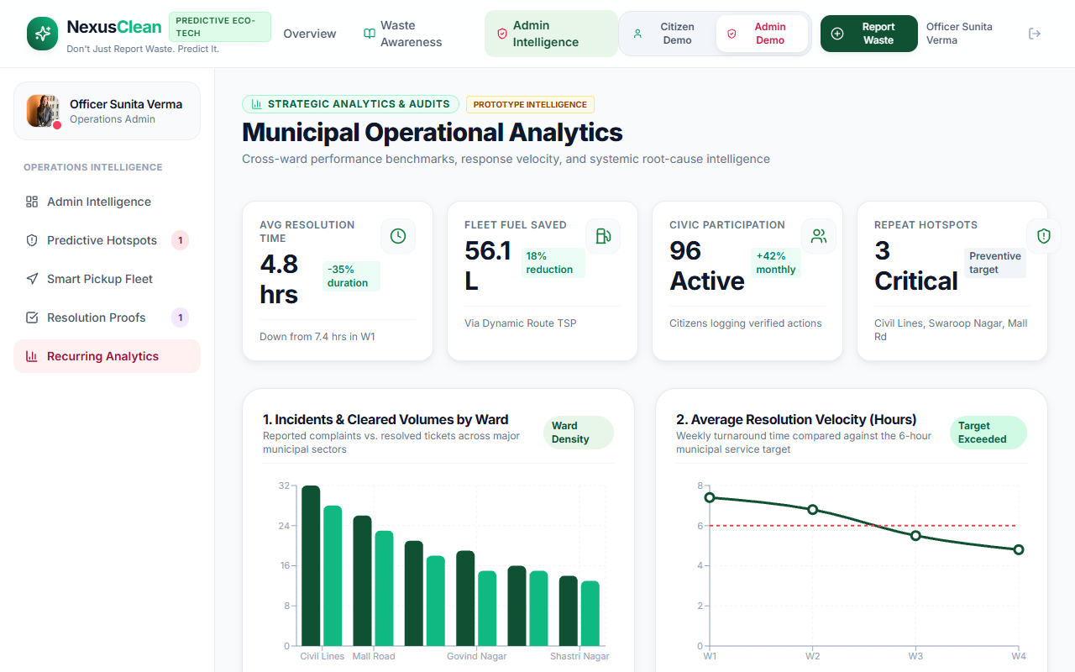
From Data to Decisions

Slide 9
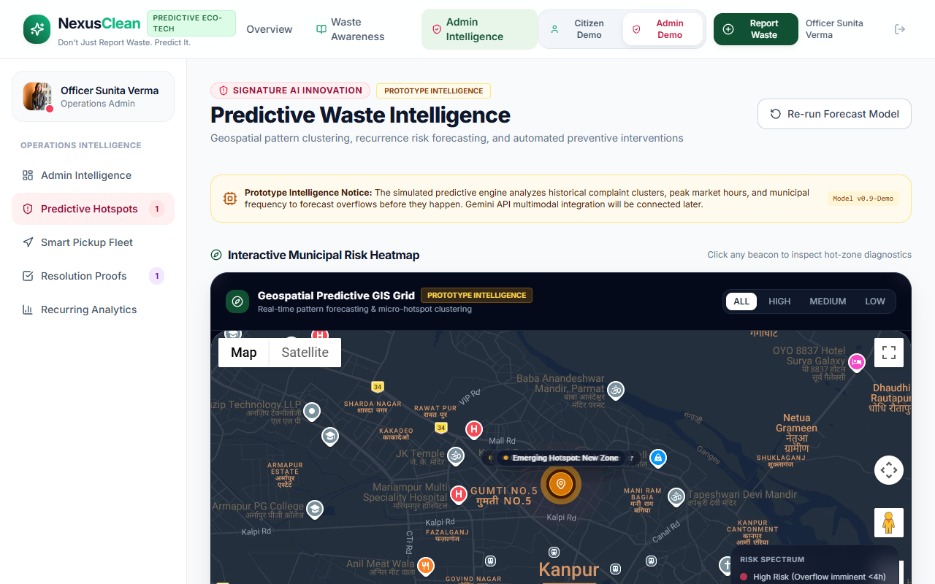
Predictive Intelligence
Powered by Google Gemini AI
? Image Analysis: Identifies waste types
? Resolution Verification
? Historical Data Processing
? Hotspot Forecasting

Slide 10
Technology Behind Nexus Clean
Frontend
Backend
Data & AI
? React 18
? Vite
? Tailwind CSS
? Recharts
? Node.js
? Express
? JWT Auth
? Rate Limiting
? Supabase
? PostgreSQL
? Google Gemini
? GenAI SDK

Slide 11
System Architecture
Citizen Web Client (React)
REST API (Node / Express)
Database (Supabase / PG)
AI Service (Gemini)

Slide 12
Key Features at a Glance
Complaint Management
Predictive Hotspots
Report and track waste issues with photos
Identify recurring zones before they overflow
AI Image Vision
Eco-Score
Automated analysis of waste using Gemini
Gamified civic engagement for citizens
Smart Pickups
Admin Analytics
Request pickups for bulk waste
Deep insights into operational efficiency

Slide 13
Built for Secure & Reliable Operation
? Authentication & Authorization
JWT tokens and bcrypt password hashing
? API Protection
Strict rate-limiting and Helmet HTTP security headers
? Network Security
CORS configured for designated frontend origins
? Resilient Architecture
Graceful fallbacks to prototype intelligence if AI is down

Slide 14
Why Nexus Clean Matters
BEFORE
NEXUS CLEAN
? Unreported waste
? Blind routing
? High fuel costs
? Frustrated citizens
? Data-driven routing
? Faster reporting
? Smart resource use
? Engaged communities

Slide 15
What's Next? (Future Scope)
1. IoT Smart-Bin Integration
Connecting physical fill-level sensors to the platform
2. GPS-Enabled Collection Optimization
Real-time turn-by-turn navigation for drivers
3. Mobile Application
Native iOS and Android apps for on-the-go reporting
4. Multi-City Deployment
Scaling the architecture to support state-wide operations

Slide 16
Let's Build Cleaner, Smarter Cities.
NEXUS CLEAN
Smart Waste Management + Predictive Intelligence + Citizen Engagement
Live Demo Ready

