Slide 1
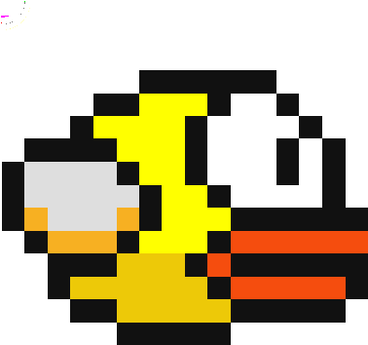
Playing Flappy Bird with Q-Learning
COMP 412
Georgios Klioumis
2017030116

Slide 2
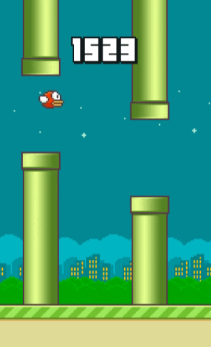
The game
Actions:
Flap to go up
No Flap to free fall
Targets:
Don’t hit the pipes
Don’t hit the ground
Beware pipes are constantly coming to get you

Slide 3
Q-Learning
States:
X-distance to next bottom pipe
Y-distance to next bottom pipe
Y-velocity of the bird
Y-distance to second next bottom pipe
Weights:
Flap
Do nothing

Slide 4
Q-Learning
Rewards:
10 if you did not die
-1000 to the last to actions before dying
Focus on staying alive, non ending game
Remember:
You should penalise bad flaps, especially when they made you hit the top pipe

Slide 5
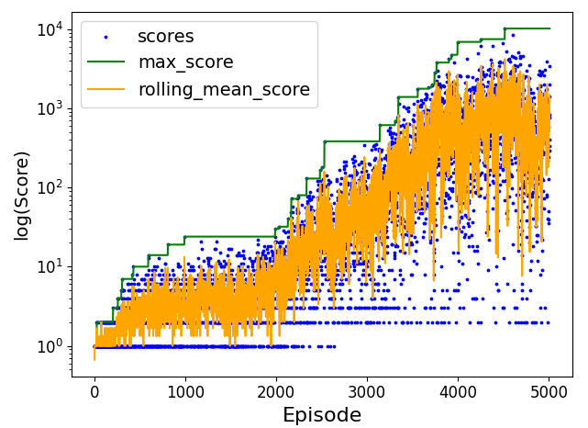
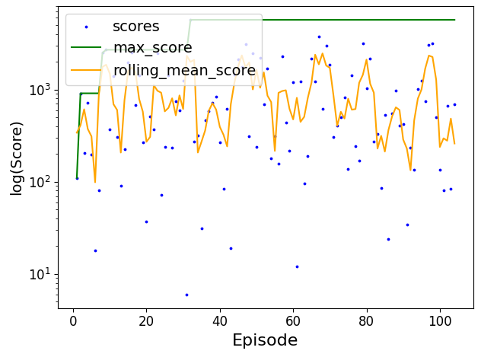
Q-Learning Results
Training for 5000 episodes (bird deaths)
Implementation:
Fixed α=0.9 , γ=0.95
Best Performance, hit 10000 score
Training
Testing

Slide 6
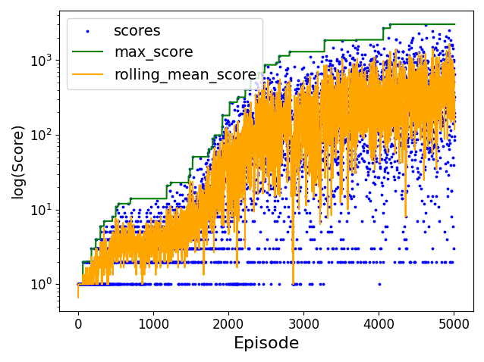
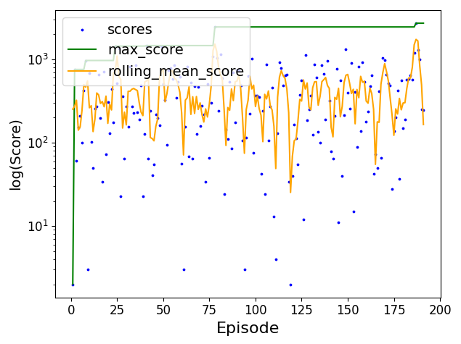
Q-Learning Results
Training for 5000 episodes (bird deaths)
Implementation:
Decaying α from 0.9 to 0.75 , γ=0.95
Slightly worst but more stable, hit 3000 score
Training
Testing

Slide 7
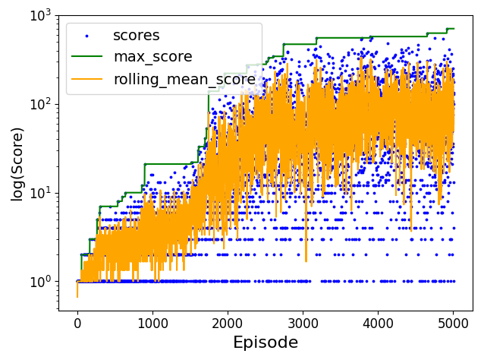
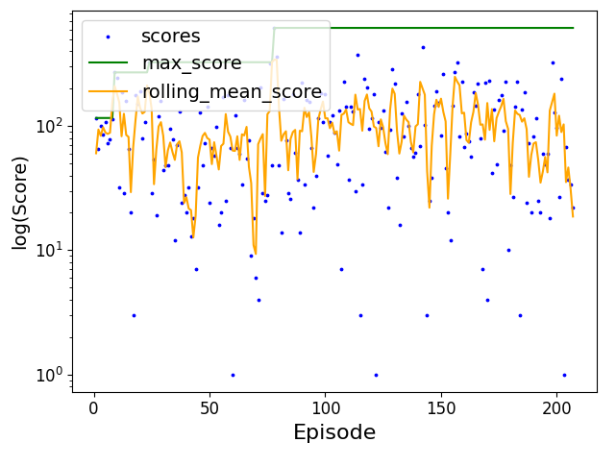
Q-Learning Results
Training for 5000 episodes (bird deaths)
Implementation:
Decaying α from 0.9 to 0.1 , γ=0.95
Not that great for this number of training episodes, worst performance of all
Training
Testing

Slide 8
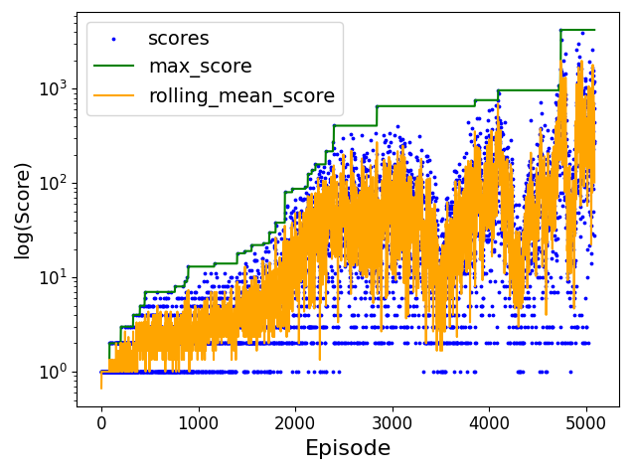
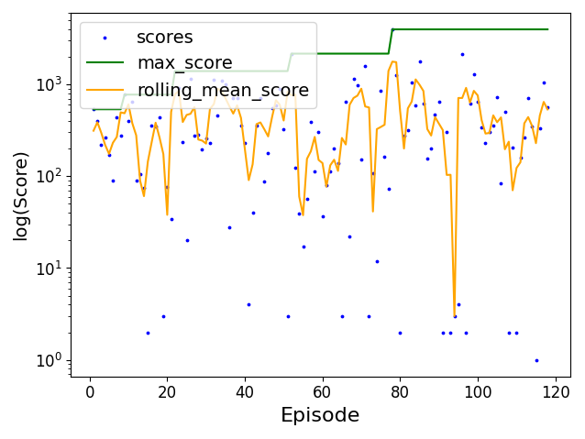
Q-Learning Results
Training for 5000 episodes (bird deaths)
Implementation:
ε-Greedy with ε=0.1 , α=0.9 , γ=0.95
Quicker learning in the beginning than Fixed implementation and comparable performance
Training
Testing

Slide 9
Further Work
Train for even more episodes
Spawn multiple birds in the same game and pass the Q-Table of the fittest to the next generation (weighted)
Thread for every bird to further decrease training time

