Slide 1

Pharmaceutical Products
Platorel

Slide 2
Data overview - DISCOVERING AND PROFILING
PRODUCTS (dimension)
GEOGRAPHY (dimension)
SALES UNITS (fact)
10 attributes (columns)
98 records (before transformation)
Category fields:
Product
Molecule
Classification
ATC_Class
Numeric fields:
Price
5 attributes (columns)
70 records
3 level of geographical analysis:
National
Area
Territory
Pivot table with main attributes : PRODUCT_ID, TERRITORY_ID
Date columns starting from
October 2017 up to
March 2020
Values: Units

Slide 3
Data transformation & cleansing
PRODUCTS (dimension)
GEOGRAPHY (dimension)
SALES UNITS (fact)
Remove duplicated records/products.
Check for invalid prices ( < 0)
After the deletion of duplicated products the new count was:
49 unique product IDs
Cast the numeric fields such as Product_id, Internal_code, Price
Create unique clustered index on Product_id
Check for Uniqueness on Territory ID
Convert Territory ID from character to integer
Check for uniqueness of the combination product_id and territory_id
Unpivoting the table
Delete records Where UNIT <= 0. 4123 records were deleted.
Round the sales units to zero decimal.
Break out the Sales date into new columns YEAR and MONTH NAME

Slide 4
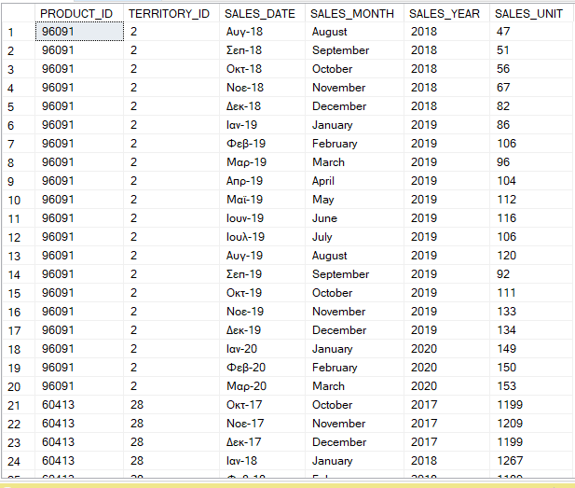
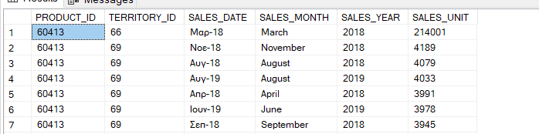
Sales unit table
After the transformation:
69.227 rows of sold units
Total aggregation of Sold units: 33.499.288
Starting date of counting: October 2017
Ending date of counting: March 2020
Minimum sales unit per product, territory: 1
Maximum sales unit per product, territory: 214,001

Slide 5
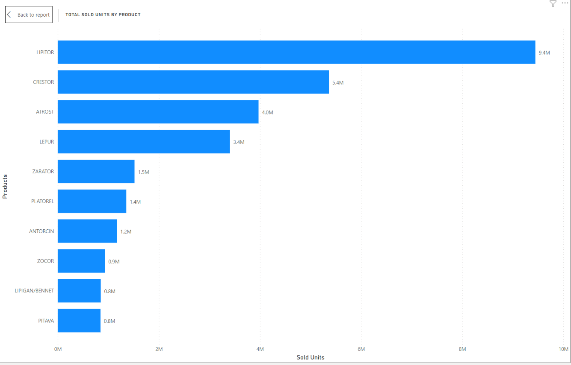
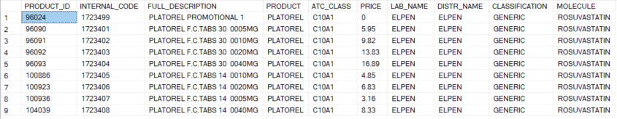
Platorel
8 + 1 Unique Product IDs
ATL Class: C10A1
Lab Origin: ELPEN
Distributor: ELPEN
Classification: GENERIC
Molecule: ROSUVASTATIN
Launch date: February 2018
Data up to: March 2020

Slide 6
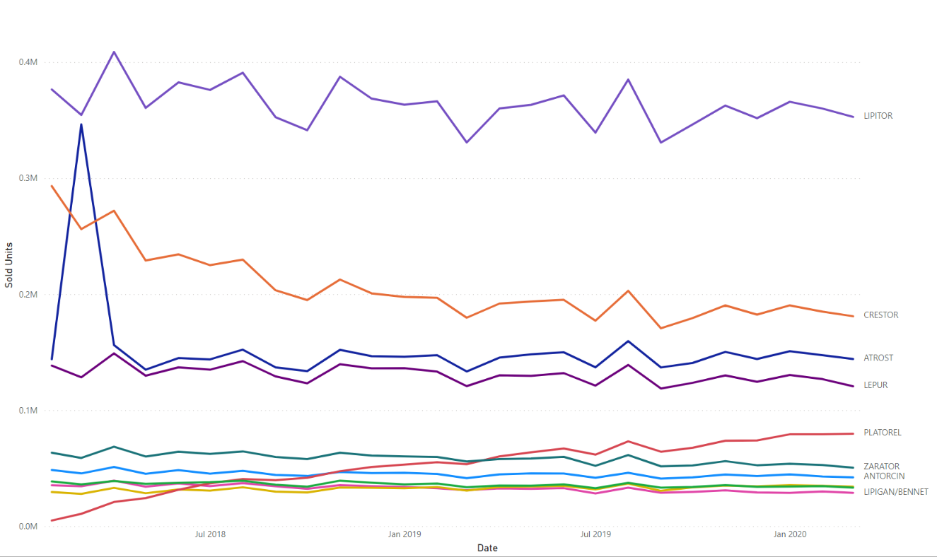
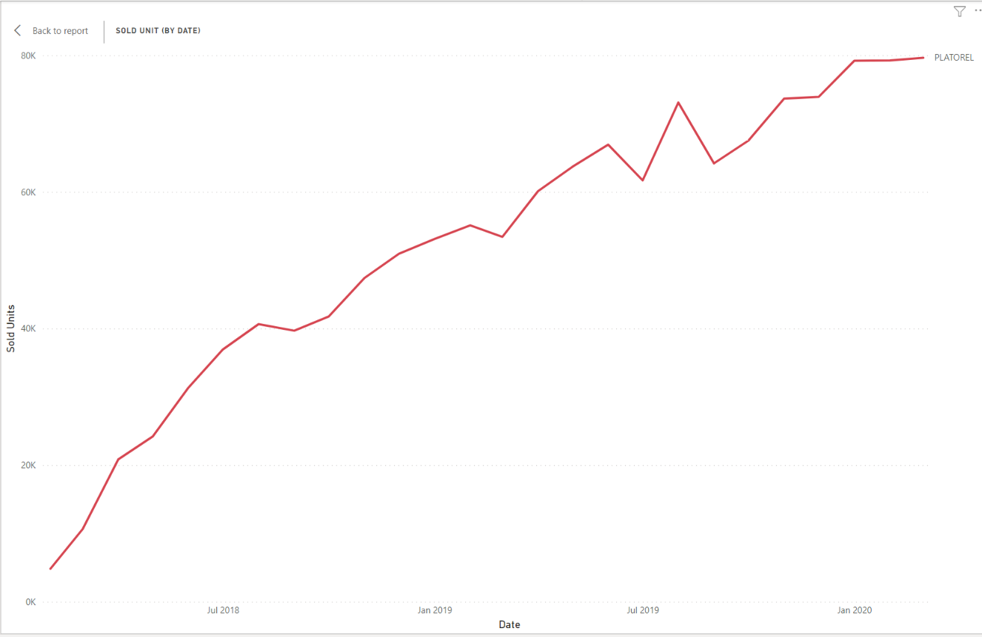
Platorel
Sold Units by all products throughout the time
Sold units by Platorel products throughout the time

Slide 7
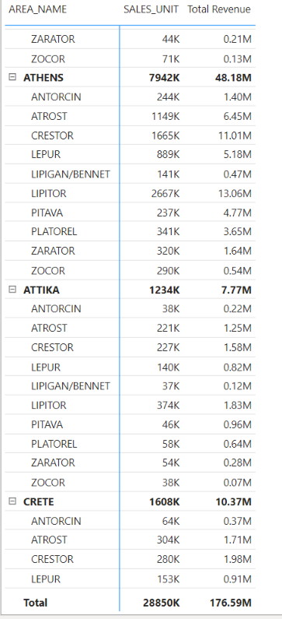
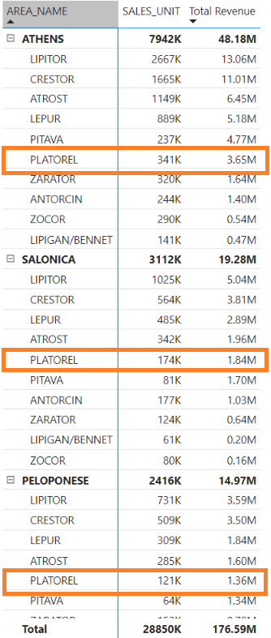
Market definition
The Market definition is a group of products used in the same area as the client’s product. Hence will be direct competitors of the client’s product when it will be launched.
All Product Codes of Product PLATOREL have launched in all given Territories and Areas.
As we can see from the matrix right, PLATOREL product codes has an average revenue behavior compared to their competitors.

Slide 8
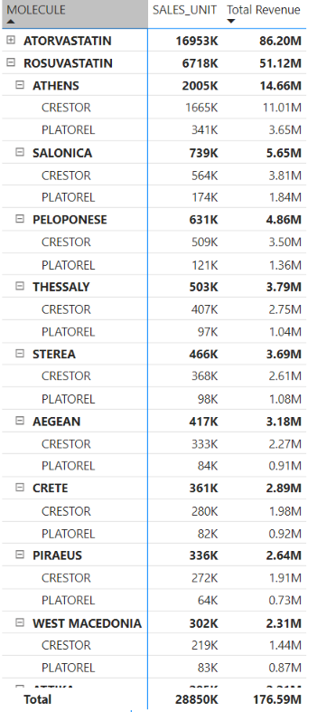
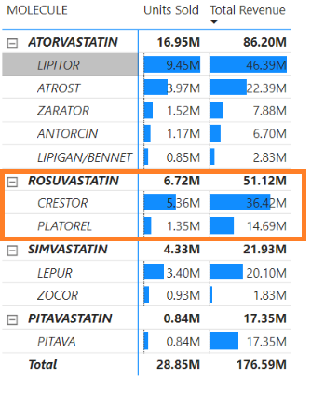
Platorel
Regarding the launch, to identify the competing products of Platorel looking at the molecule.
The main competitor based on the Molecule is the CRESTOR.
CRESTOR leads the race compared to PLATOREL

Slide 9
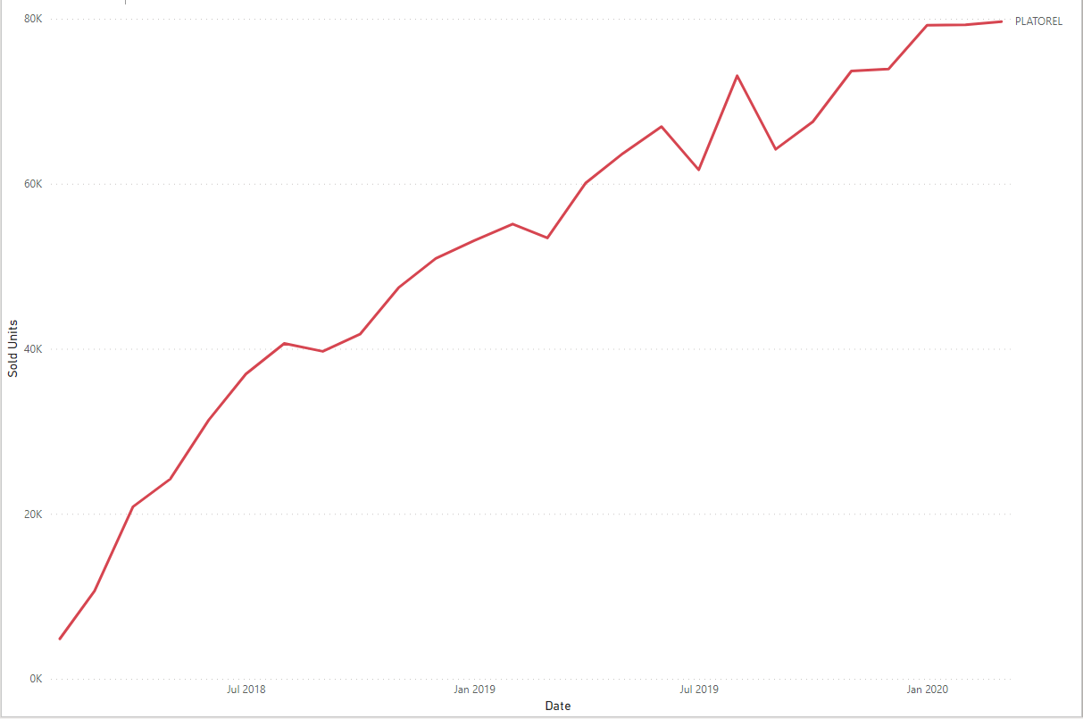
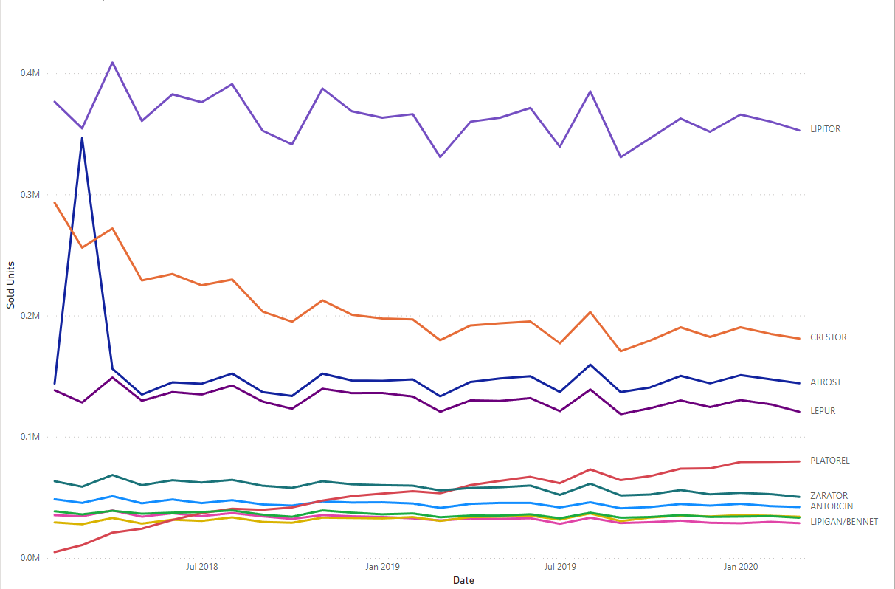
Brand level analysis vs platorel brand

Slide 10
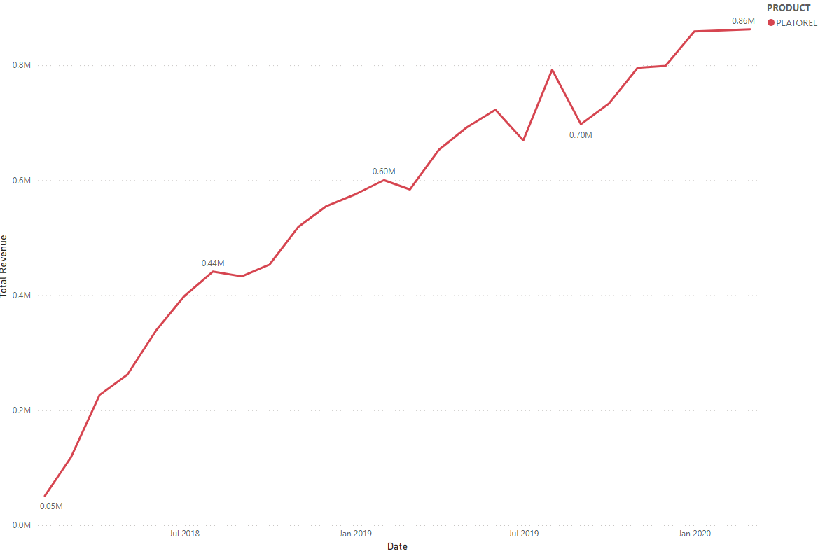
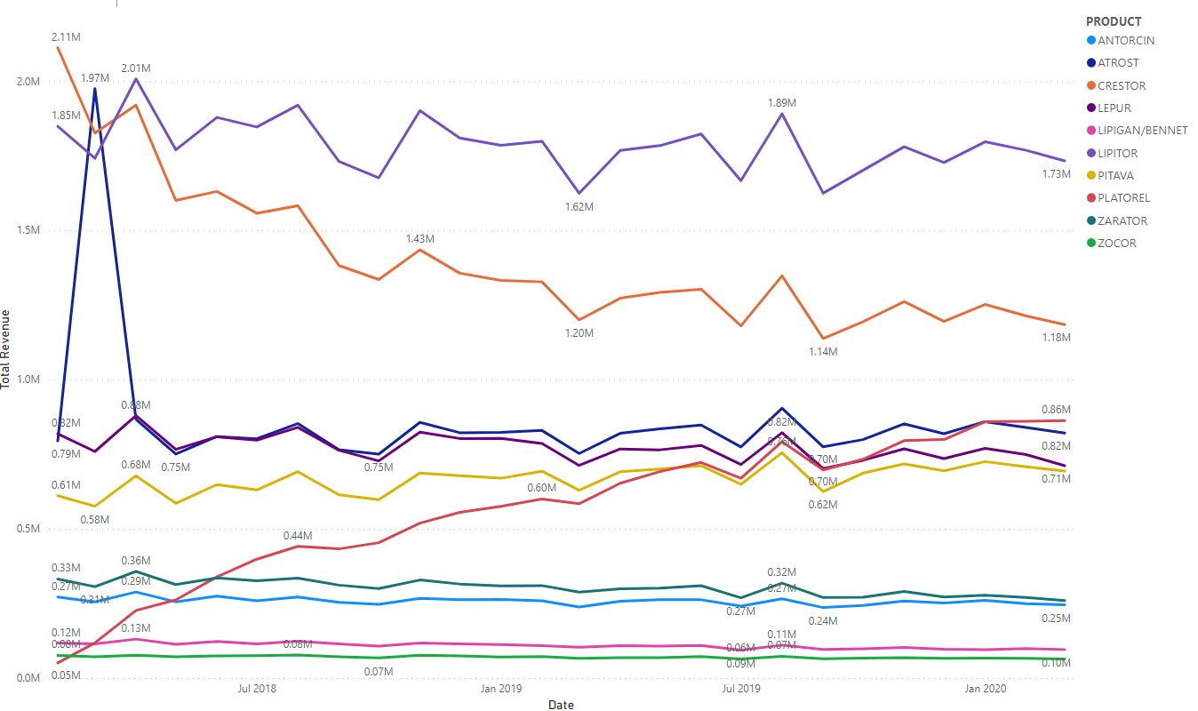
Brand level sales revenue analysis vs platorel brand

Slide 11
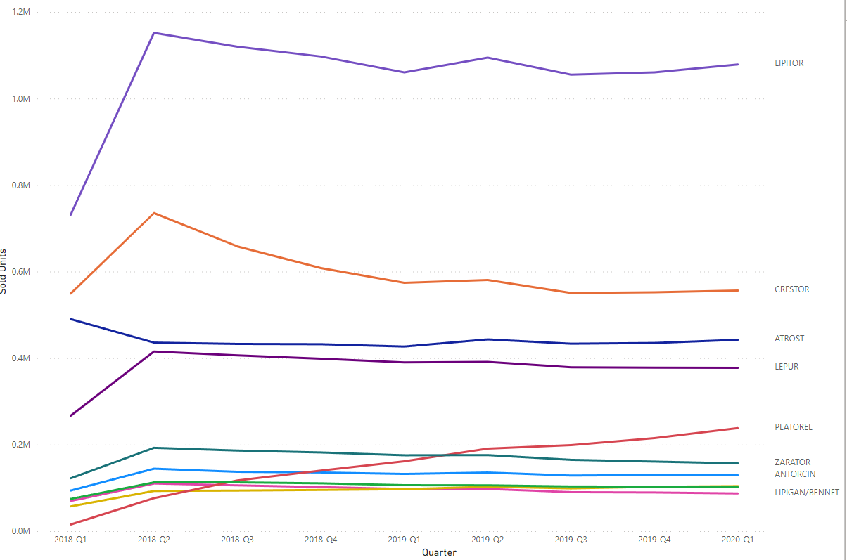
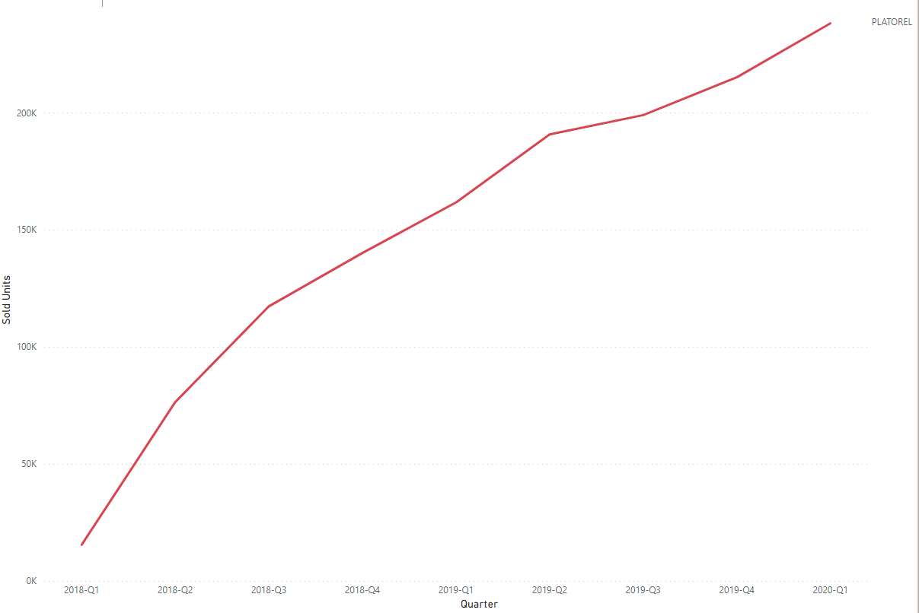
Brand level analysis vs platorel brand (quarter analysis)

Slide 12
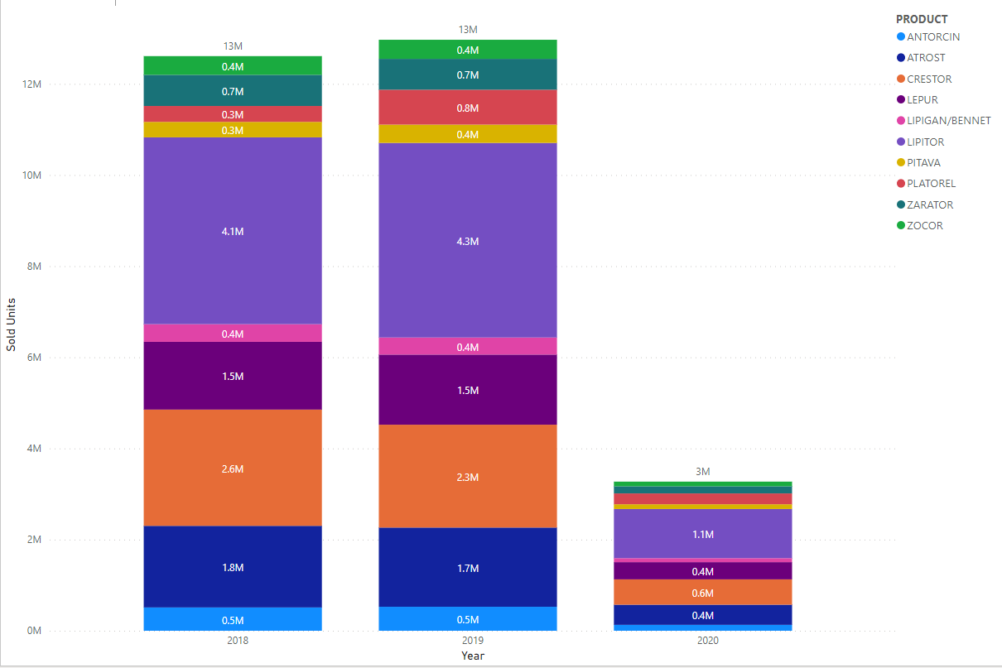
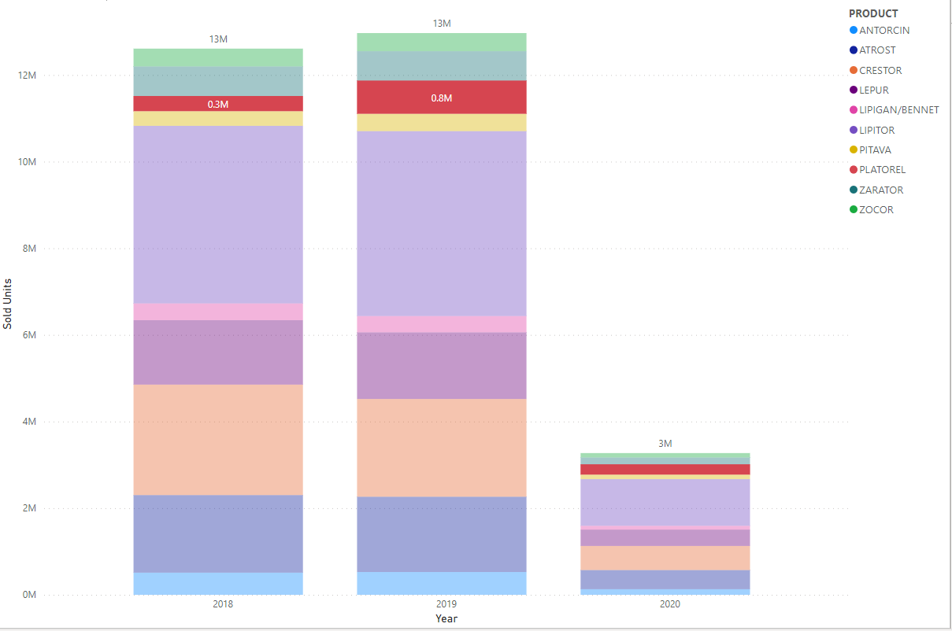
Brand level analysis vs platorel brand (year analysis)

Slide 13
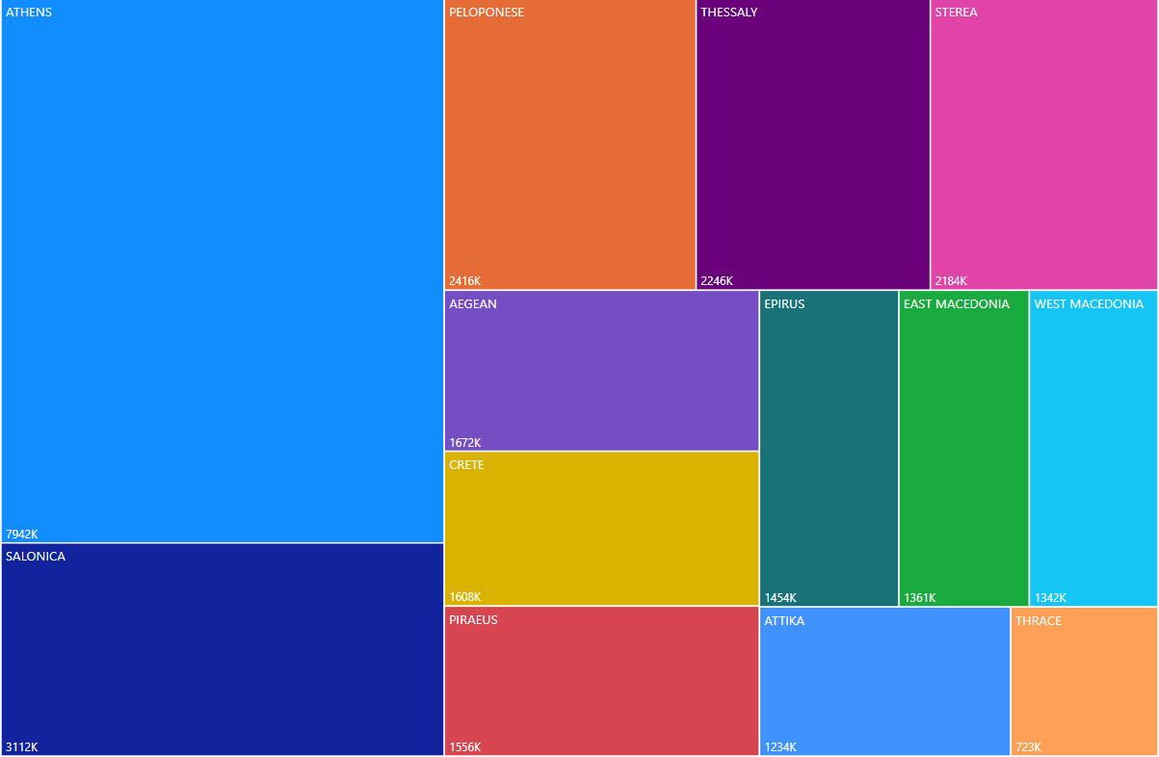
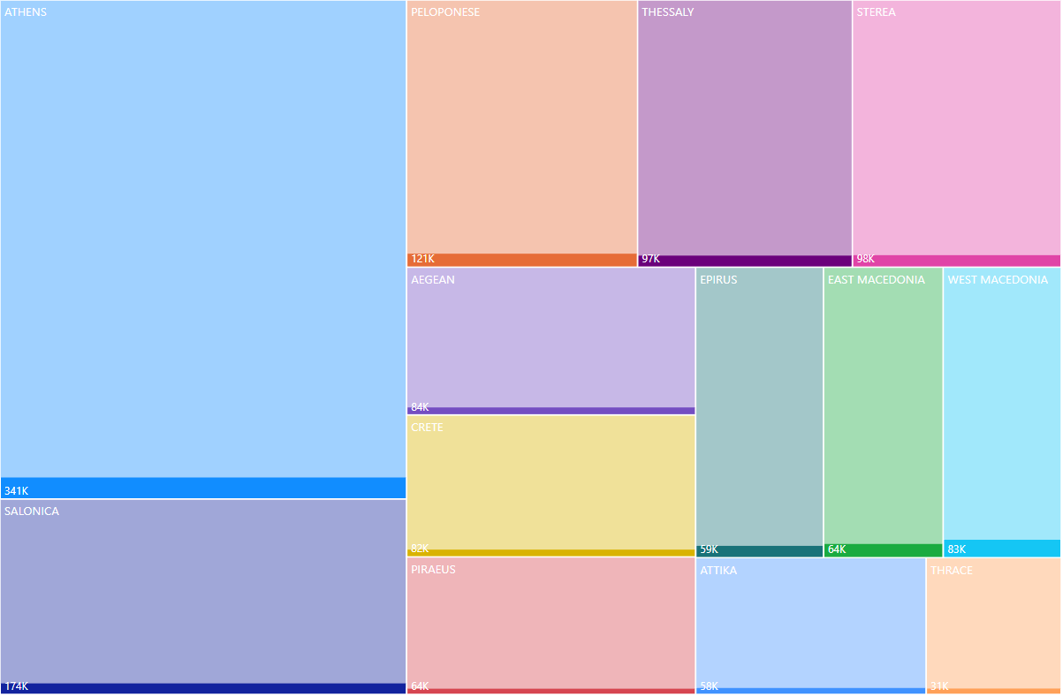
Brand level analysis vs platorel brand (area analysis)

Slide 14
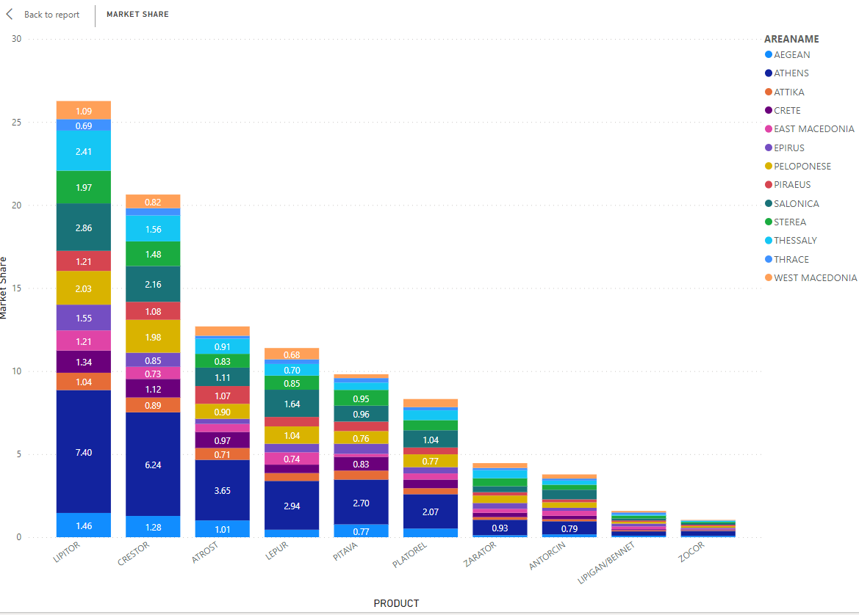
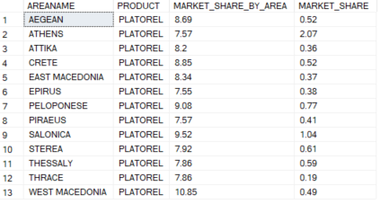
Market share
The Market share represents the % ratio of a product Sales to the total market sales (sales of client product plus all the competitor product in the same disease area). The formula is: (Product / Total Market *100).

Slide 15
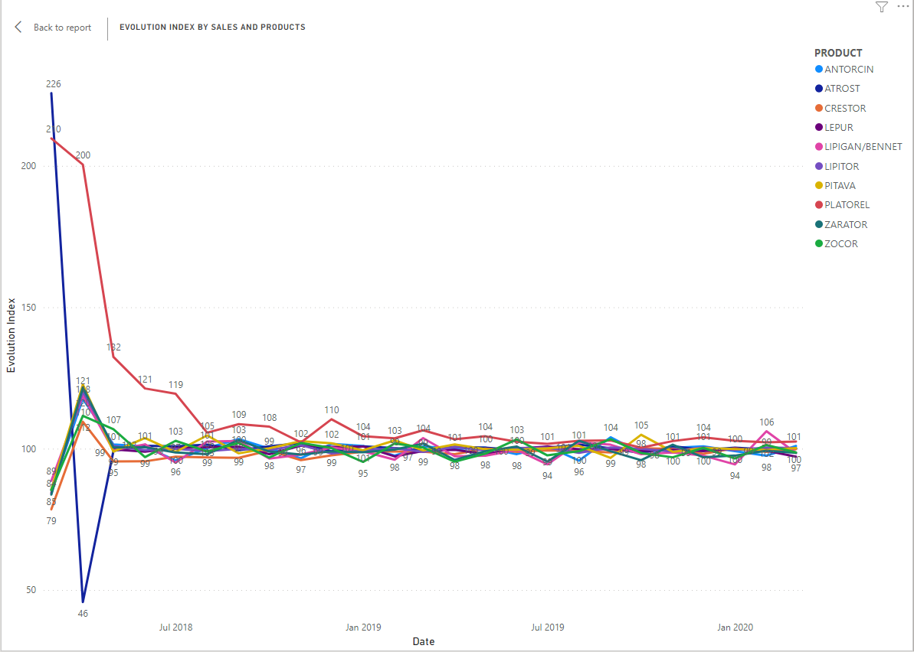
Evolution Index
The Evolution Index represent the Product growth vs Market Growth. The formula is: ((100 + Product Growth%) / (100 + Market Growth%)) x 100.
Once PLATOREL launched, we can see the Evolution Index got started at 210 which means an instant Growth. ATROST had also high growth at the beginning.

Slide 16
Proof of concept
How can we increase the sales so as to beat the competitor “Crestor”?
How can we increase the sales in specific market areas?
Taking into consideration the time period of increased sales, how can we promote the “PLATOREL” in order to increase our profits?
Specific questions should be done after the proof of concept done

Slide 17
THANK YOU!

