Slide 1
Anypoint Platform Development: DataWeave 2.0 Start time: 9:00am EST Instructor: George K Mute your mic please

Slide 2
Instructor introduction
George Karabotsos
george.karabotsos@mulesoft.com
MuleSoft
Technical Instructor
Wilmington NC
Background
14+ years, Software Development
4+ years, Academia
7+ years, Professional Training

Slide 3
Student introductions
What is your name?
Company, role, and location
Have you taken the Fundamentals class?
How long ago?
Any functional programming experience?
E.g. Lisp, Haskell, ML, etc. (Purely functional)
Scala, JavaScript (functional/OO hybrids)
Do you know what Lambda expressions are?
When was the last time you written Dataweave expressions?
map, mapObject, pluck, reduce
Your main objectives for the class

Slide 4
Course logistics
Time
2 days
1 hour lunch/mid-class break each day
~15 minute break each morning and afternoon
We know you have two jobs to do this week!
If you have scheduled meetings, please let me know
We can try to schedule breaks around them

Slide 5
How the course will work
Is primarily hands-on
Consists of
Short lectures (PPT) to introduce a concept
Walkthroughs
The bulk of class
Exercises we do together to learn the content

Slide 6
Using WebEx

Slide 7
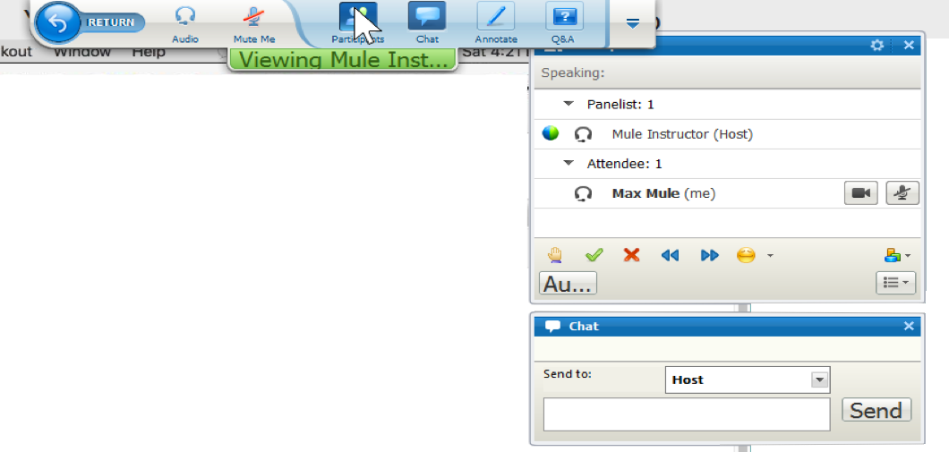
Using WebEx
Locate the Participants Panel and Chat Panel
Menu drops down from top of your screen
Participants Panel and Chat Panel are hidden every time someone shares their desktop
Give feedback
Feedback options

Slide 8
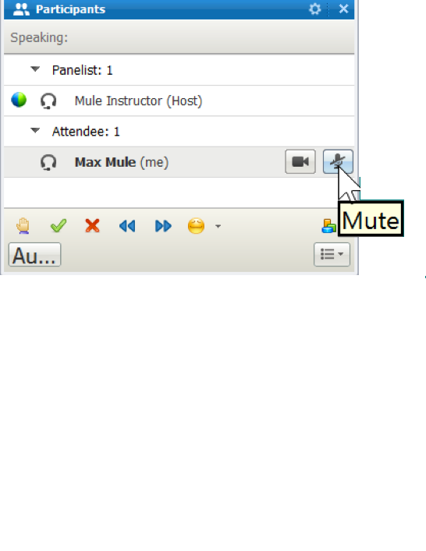
Managing your WebEx audio
Use an external headset/microphone to avoid feedback
Mute your microphone when you are not talking

Slide 9
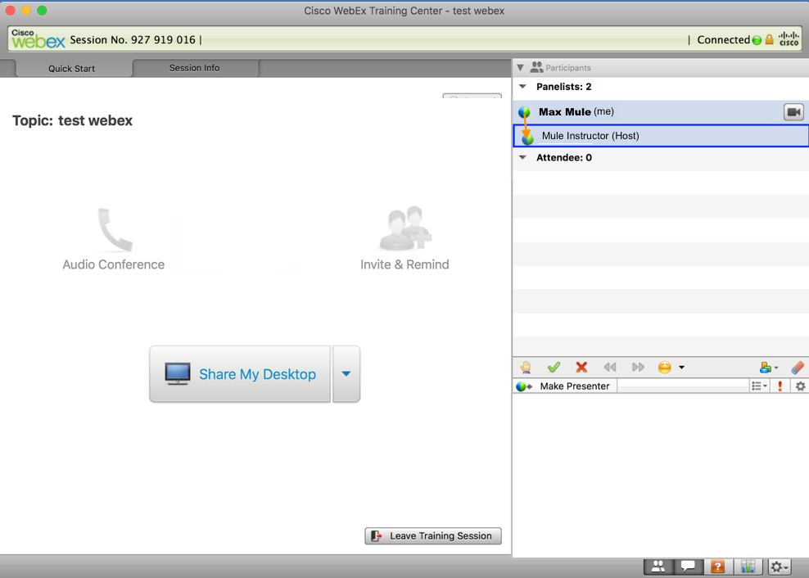
Sharing your desktop
Click Share My Desktop or use the Share menu
Drag the WebEx ball back to the instructor when you are finished
(2) Drag WebEx ball
back to Host
(1) Click here to share
your Desktop

Slide 10

Recommendations for the walkthroughs
Use a second monitor to watch the WebEx session while you work

Slide 11
Introducing the course

Slide 12
Pre-requisites
Completion of one of the following courses
Anypoint Platform Development: Fundamentals (Mule 4) instructor-led course
MuleSoft.U Development Fundamentals (Mule 4) self-study course
Anypoint Platform Development: Mule 4 for Mule 3 Users instructor-led course
MuleSoft.U Development Mule 4 for Mule 3 Users self-study course
OR Equivalent knowledge from 6+ months Mule development
Passing of the MCD - Level 1 (Mule 4) exam
You should already know how to
Use Anypoint Studio
Write DataWeave transformations for basic XML, JSON, and Java transformations
Write DataWeave transformations for data structures with repeated elements

Slide 13
Course goal
Extend the skills you gained in Development Fundamentals by
writing more complex and
powerful transformations that
are not possible with the drag-and-drop GUI through
a different and new (for some) programming paradigm know as
Functional Programming

Slide 14
Course objectives
Write, use, and reuse transformations using variables, functions, DataWeave modules and mappings
Build up complex transformations from smaller testable steps
Build more robust and testable functions and expressions using strong typing, match operators, error handling, etc
Create, transform, filter, combine, shuffle, select from, and reduce complex data structures
Recursively replace or format every element or a list of elements in a nested data structure

Slide 15
Course outline
Module 1: DataWeave Fundamentals—Review++
Module 2: Use Case: XML Flights to JSON
Module 3: Defensive Programming
Module 4: Use Case: Flights and Airports
Module 5: Recursion

Slide 16
Use Case: XML flights to JSON
As a developer I want to receive XML flight records and generate a JSON data structure with the corresponding flights so that I communicate them with a third party system.
The JSON data structure contains:
the flights from the XML inputs
total seating capacity per flight that is a function of the plane type
prices adjusted across a number of currencies
important KPIs

Slide 17
Use Case: Flights and Airports
As a developer I want to combine two sets of data, (1) A list of JSON flights and (2) a list of CSV airports, into a JSON data structure so that I communicate them with a third party legacy system.
The JSON data structure contains:
dynamically renaming fields based upon a provided map
destination airport details injected per flight
reordering the fields of each object to meet the legacy system requirements.
optimizing the performance of our algorithm
fixes to bad data

Slide 18
Course materials
Available on MuleSoft Learning Management System
http://training.mulesoft.com/login.html
Student files (ZIP)
Starting files needed to complete some of the exercises
Solution files
Student manual (PDF) with steps for walkthroughs
Course slides (ZIP of PDFs)

Slide 19
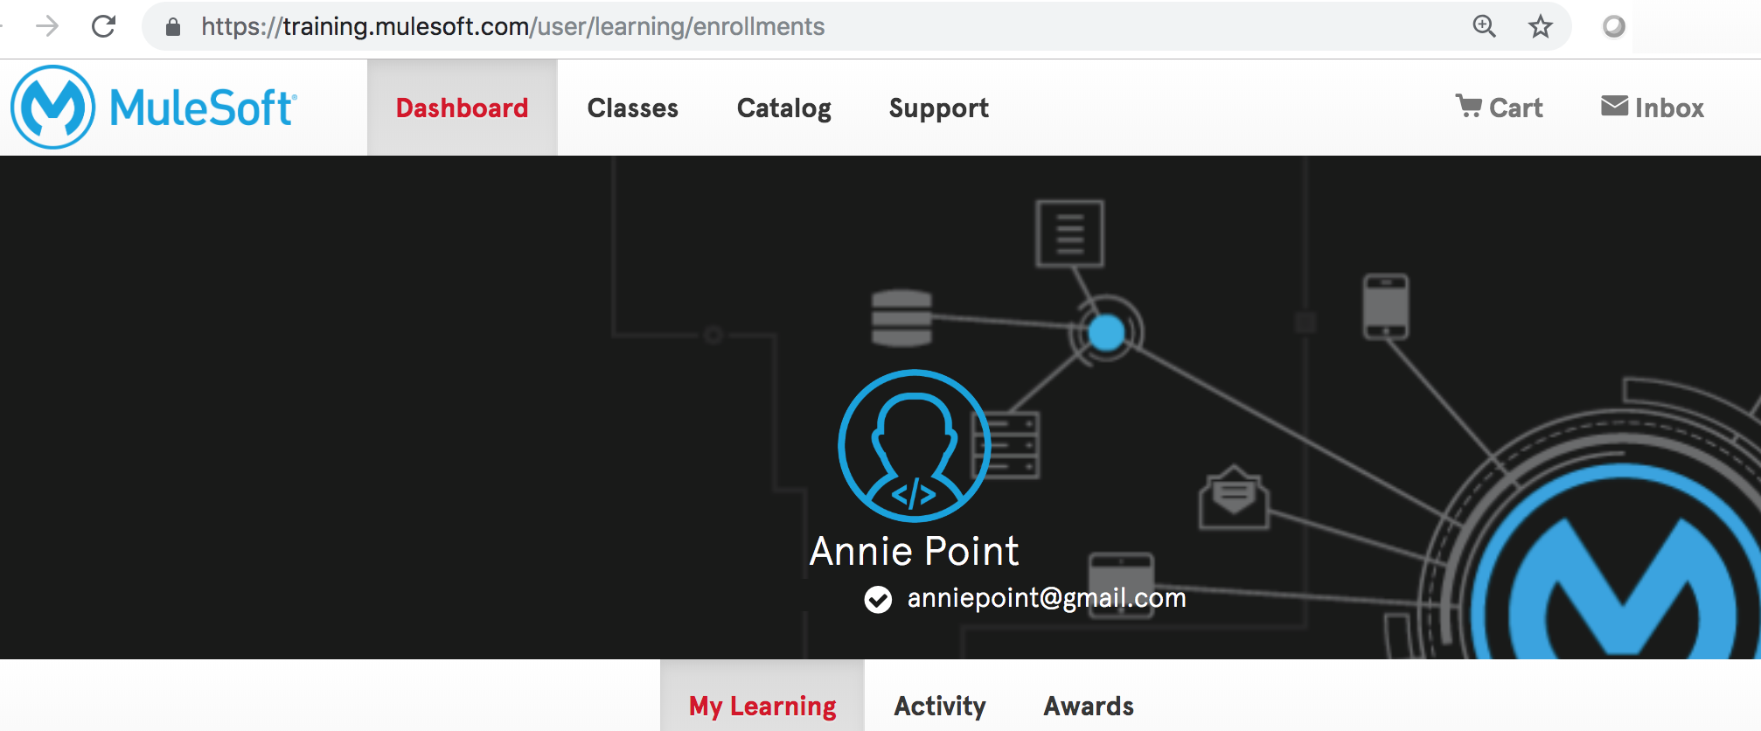
Walkthrough: Set up your computer for class
Download the course files from the MuleSoft Training Learning Management System
Make sure you have JDK 1.8 and that it is included in your PATH environment variable
Make sure Anypoint Studio starts successfully
Install Advanced Rest Client (if you did not already)

