Slide 1
Nettrix-Start_from_device
2022年2月

Slide 2
Using the 'start_from_device' and 'end_on_device' flag
On some systems, it is possible that you can use the `start_from_device` and `end_on_device` flags to improve your end-to-end inference performance results. When `start_from_device` is enabled, the QSL is loaded on GPU memory, and any Host-to-Device memcpy is skipped. This behavior of this flag, however, **requires approval from the MLPerf Inference committee** and the submitter **must provide proof** that their system has a NIC directly attached to each GPU, and the data from the network can be inserted into device memory *without* going through the host (CPU). MLPerf Inference ***requires*** the following as proof:
- A system architecture diagram showing direct connection between the network and accelerator, without going through the CPU.
- Bandwidth measurements for this connection that show they are sufficien
t for the benchmark
- Example of software that supports this data connection (i.e. GPUDirect).

Slide 3
command
$Benchmark = ib_write_bw , ib_read_bw, ib_send_bw,
Unidirectional bandwidth
Server 端
• $benchmark -F -a -d $ib_device--report_gbits -R
Client 端
• $benchmark -F -a -d $ib_device --report_gbits $ip--use_cuda=<gpu_index> –R
bidirectional bandwidth
Server 端
• $benchmark -F -a -b -d $ib_device --report_gbits -R
Client 端
• $benchmark -F -a -b -d $ib_device --report_gbits $ip --use_cuda=<gpu_index> -R

Slide 4
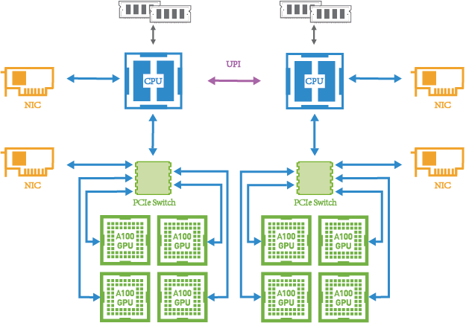
Nettrix X640 G40 system topology
Hardware
• GPU : NVIDIA A30 *8
• NIC : MCX653105A-HDAT 200Gb *2
Software
• NVIDIA Driver : 510.47.03
• IB Drvier : 5.5-1.0.3
• Nv_peer_mem : 1.2-0
• Perftest：4.5-0.2

Slide 5
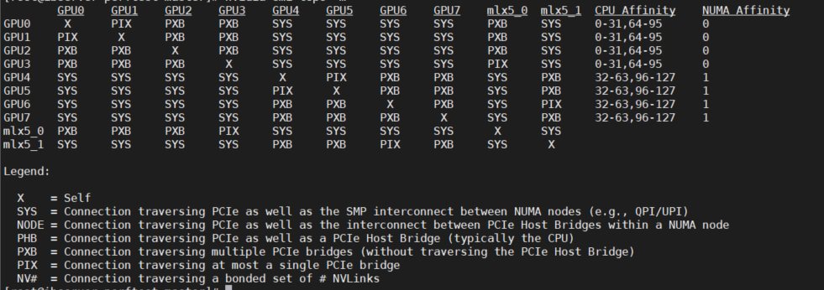
nvidia-smi topo
nvidia-smi topo -m

Slide 6
Perftest Performance Results
Benchmarks | IB_device | unidirectional | bidirectional
ib_write_bw | mlx5_0 | 194.94 | 388.57
 | mlx5_1 | 194.01 | 390.17
ib_read_bw | mlx5_0 | 196.03 | 390.03
 | mlx5_1 | 195.03 | 390.17
ib_send_bw | mlx5_0 | 194.4 | 388.16
 | mlx5_1 | 194.07 | 388.35

Slide 7
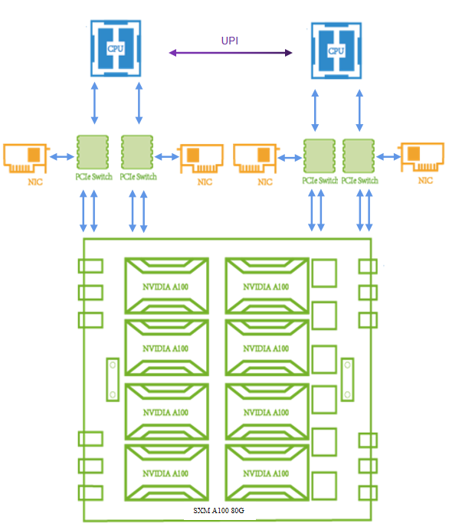
Nettrix X660 G45 system topology
Hardware
• GPU : NVIDIA A100_SXM_80GB *8
• NIC : MCX653105A-HDAT 200Gb *4
Software
• NVIDIA Driver : 510.47.03
• IB Drvier : 5.5-1.0.3
• Nv_peer_mem : 1.2-0
• Perftest：4.5-0.2

Slide 8
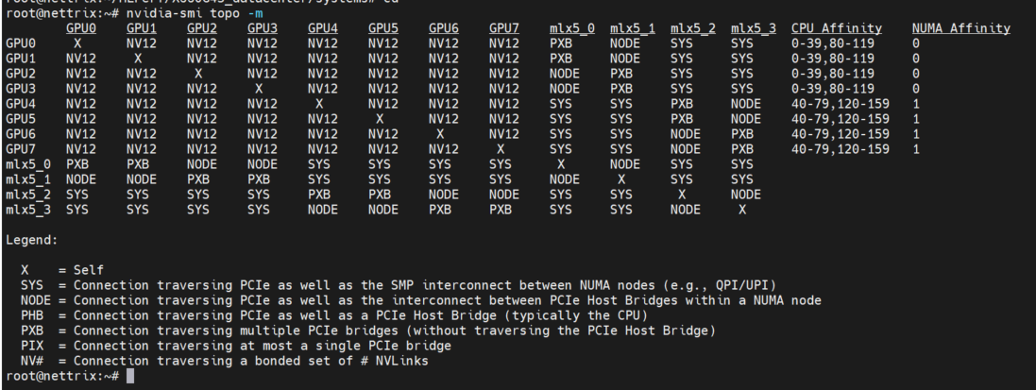
nvidia-smi topo
nvidia-smi topo -m

Slide 9
Perftest Performance Results
Benchmarks | IB_device | unidirectional | bidirectional
ib_write_bw | mlx5_0 | 194.94 | 388.57
 | mlx5_1 | 193.93 | 388.03
 | mlx5_2 | 194.2 | 388.35
 | mlx5_3 | 195.9 | 387.95
ib_read_bw | mlx5_0 | 196.03 | 390.03
 | mlx5_1 | 195.42 | 388.88
 | mlx5_2 | 194.06 | 387.8
 | mlx5_3 | 194.06 | 387.63
ib_send_bw | mlx5_0 | 195.87 | 388.88
 | mlx5_1 | 194.07 | 387.8
 | mlx5_2 | 195.13 | 387.63
 | mlx5_3 | 195.22 | 387.96

