Slide 1
Graduation Project Presentation
Team Names:
- Yossef Magdy Shebl (Manual testing) - Ahmed Adel (Manual testing) - George Magdy (API testing) - Yossef Samy (Manual testing) - Osama (Manual testing)
Track: software development – software testing
Supervisor name: George Nafady
Date:17/10/2024

Slide 2
Introduction
Overview of the project
Problem statement
Objectives
Motivation for the project

Slide 3
API Testing

Slide 4
Overview:
This project aims to implement the technical topics learned in this course; it specifically targets the topic of API testing to a hosted website called Natours implemented as part of a popular large back-end course made by Jonas Schmedtmann.
Problem statement:
As this is a highly popular course accessed by thousands (maybe more) and it is about building API for a website, it is very beneficial to provide a decent test suite to those APIs to validate the importance of this course, also it will be used by every student who implements this project to validate their work.

Slide 5
Objectives:
The objectives are to ensure proper functionality of the APIs, check integrity of both request and response data, ensure high performance, also to act as a documentation of how to use those APIs and what to expect of them.
Motivation for the project:
As pointed earlier, many students interested in back-end development using node.js this is their go to course, so it would be of great help to them to validate their work and improve course validity, also help the creator of the course to improve his content and fix any issues.

Slide 6
Manual Testing

Slide 7
Overview:
This project aims to apply the manual testing techniques covered in this course. Specifically, it focuses on creating detailed test scenarios and test cases for a hosted website called Natours
Problem statement:
Given the widespread popularity of this course, which focuses on building APIs for a website, there is a clear need for a comprehensive manual test suite. With thousands of students participating, a robust test suite would not only validate the importance of the course content but also provide students with a practical tool to assess their own API implementations. By developing a structured manual test suite, students will be able to confidently verify the functionality, reliability, and quality of their APIs, ensuring they meet industry standards and reinforcing their understanding of manual testing practices in backend development.

Slide 8
Objectives:
The objective is to validate the functionality, usability, and performance of various features on the site through rigorous manual testing method
Motivation for the project:
This project targets the many students who rely on this popular Node.js back-end course, focusing specifically on creating manual test scenarios and test cases for API validation. Providing a detailed manual test suite will enable students to thoroughly validate their implementations, ensuring functionality and helping them build confidence in their testing skills. Moreover, this suite will aid the course creator in refining content and addressing any identified issues, ultimately improving the course’s quality and reliability for future students.

Slide 9
Testing process
Definition of API endpoints
Types of testing
Tools used in testing
Test cases design

Slide 10
API Testing

Slide 11
API endpoints:
Natours ideas is to view different tours to a variety of places and with many activities, so the endpoints focuses on providing data about:
Tours.
Users.
Reviews.
Bookings.
Authentication (login, etc.…).
Endpoints focus on providing way to do CRUD operations on this data.
Specific Endpoints can not be tested because the owner of the website blocked this functionality on demo users also you need to get an admin user which is blocked, some of these endpoints like create tour, delete tour, delete user and many more.

Slide 12
APIs provided are as follows:(official documentation)
Tours:
GET🡪 All Tours (With Query Parameters), Tour By Id, Top 5 Cheap Tours, Monthly Plan, Tour Stats, Tours Within Radius, Distances To Tours From A Certain Location.
POST🡪 Create New Tour.
DELETE🡪 Delete Tour.
PATCH🡪 Update Tour.
Users:
GET🡪 All Users, Single User, Current User.
POST🡪 Included In Auth APIs.
DELETE🡪 User, Current User.
PATCH🡪 Update User, Update Current User.

Slide 13
Authentication:
POST🡪 Sign Up, Login, Forgot Password.
PATCH🡪 Reset Password, Update Current User Password.
Reviews:
GET🡪 All Reviews, Single Review.
POST🡪 Create New Review.
DELETE🡪 Delete Review.
PATCH🡪 Update Review.
Write a review on a specific tour
GET🡪 All Reviews on a Tour.
POST🡪 Create New Review on a Tour.
Bookings:
GET🡪 All Bookings, Single Booking.

Slide 14
Types of testing:
Testing will be split mainly into 2 types:
Functional testing: testing the functionality if the API includes:
Verify response and request body structure and schema.
Check URL structure is as expected.
Check request method.
Security testing:
Test cookies.
Test heading “authorization”.
Test “JWT” token.

Slide 15
Tools used in testing:
Main tool used in API testing is Postman.
Postman is an API platform which helps with building APIs and testing them.
It provides an environment for running JavaScript code to write and execute test cases.

Slide 16
Test cases design:
Test cases will focus on functional testing and security testing, testing the positive test cases only (valid input, valid output).
Some endpoints were tested against negative cases.
Each test case includes:
URL call (API call).
Expected result.
Actual result.
Testing function (pm.test).
Features that will be the focus of our test cases design are outlined in the first point.

Slide 17
Manual Testing

Slide 18
Test Types
Functional testing:
Verify response and request body structure and schema.
Check URL structure is as expected.
Check request method.
Test level :
system testing :focuses on the overall behavior and capabilities of an entire system
as of this combination we are in the Quadrant Q2 (business facing, support the team)

Slide 19
Bugs report
it is the output of Test execution work products
https://docs.google.com/spreadsheets/d/1FD4GfIxYiHe4mjwLjyDubYJdF5PuHK4a/edit?gid=660306602#gid=660306602
in the end they are in test progress report it asldo help sd in Traceability

Slide 20
API Testing

Slide 21
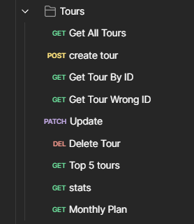
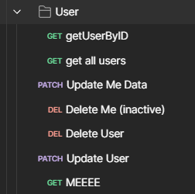
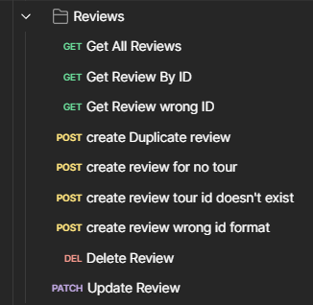
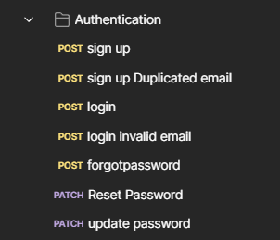
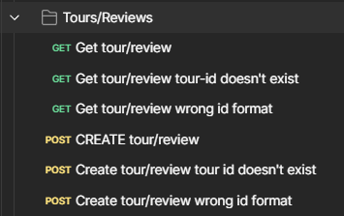
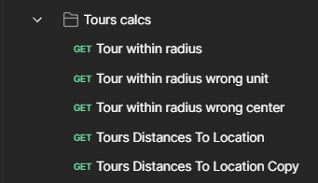

Demonstration of the system:
The system consists of a set of APIs to manipulate various data within the system, and they are listed as follows:

Slide 22
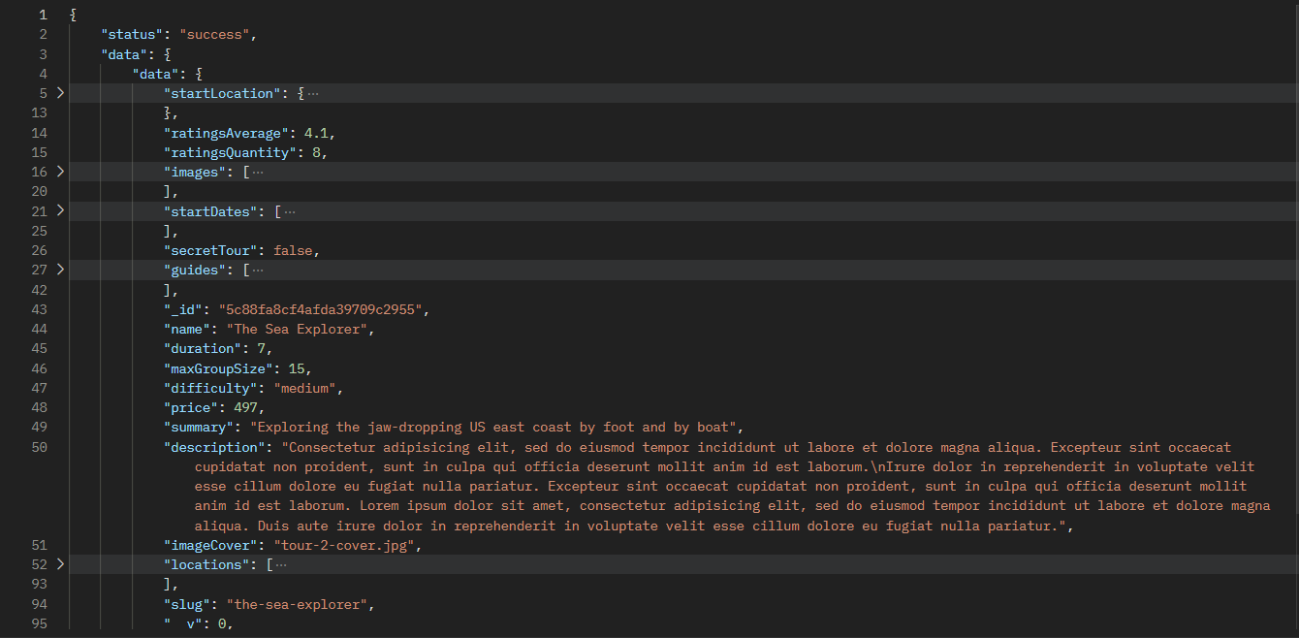
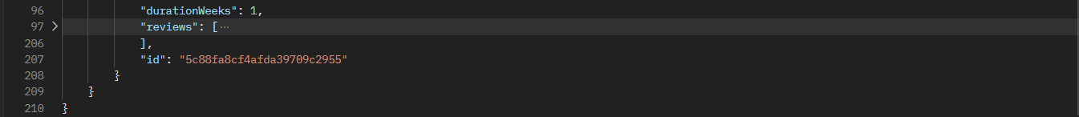
Examples of APIs response:
Get single tour

Slide 23
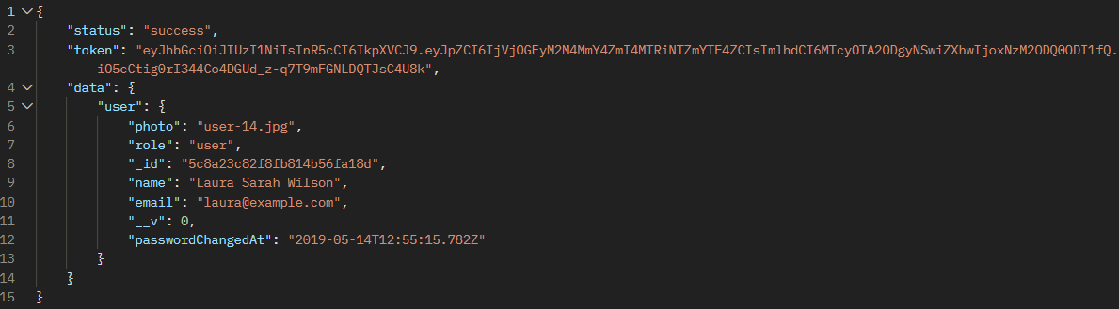
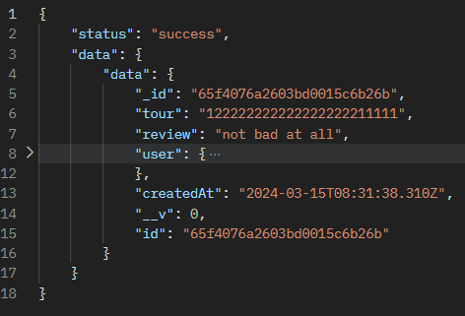
Examples of APIs response:
Login
Get Review By ID

Slide 24
Code snippets (with output):
Code for API testing is repetitive, so the same code snippet that tests the Json response schema will be the same for all APIs except for the schema itself, also testing the request method, Authorization header, URL structure.
They will only differ in slight change depending on the need of each request.

Slide 25
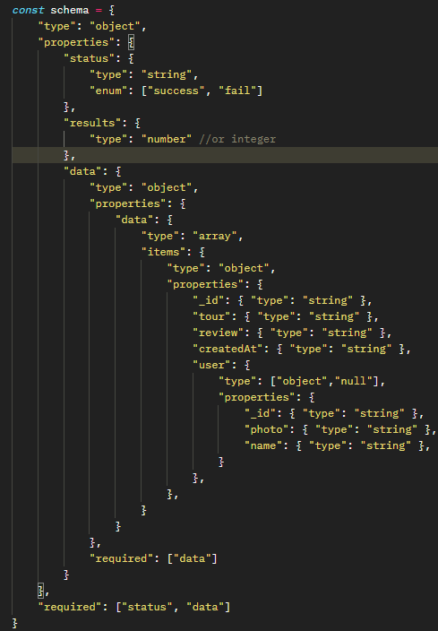

Testing schema

Slide 26


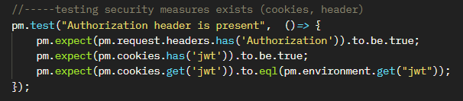
Testing Response Status
Testing Response Format Is Json
Testing Request Method
Testing Authorization header and JWT token

Slide 27
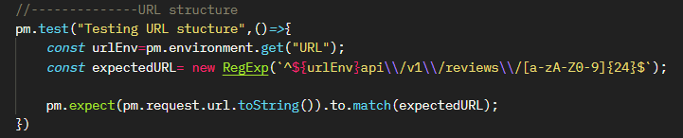

Testing URL structure
Testing Environment variable exists

Slide 28
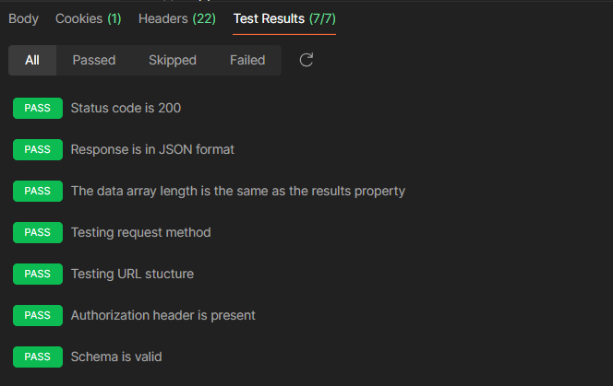
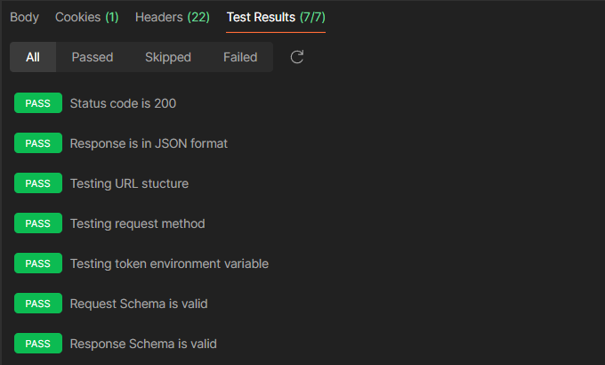
Output example for 2 endpoints test
Get All Reviews
Login

Slide 29
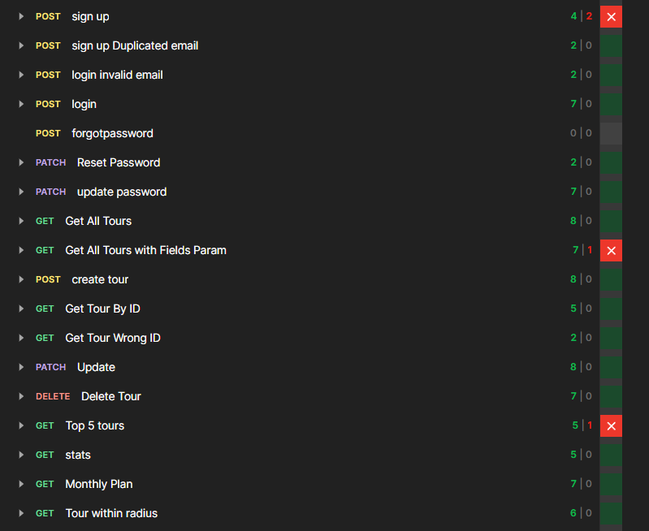
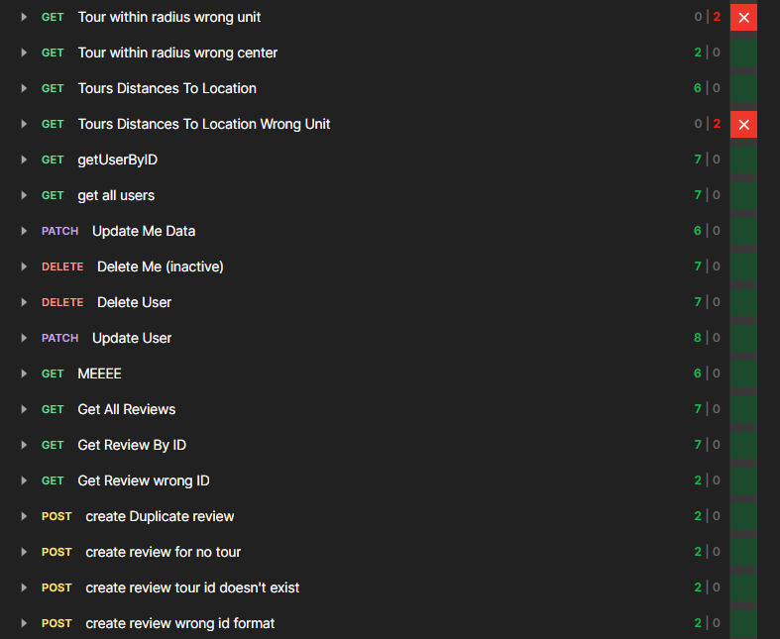
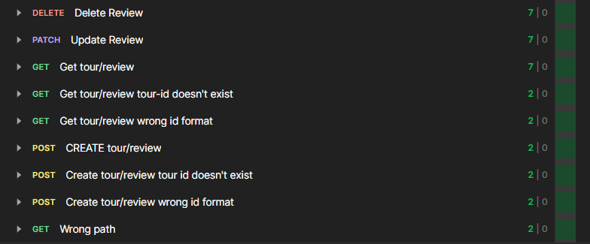
Test run for all endpoints (bugs will be identified in next section)

Slide 30
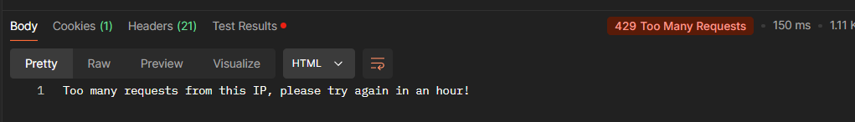
A stress test was done, by sending too many requests, and the test, returning status (429 Too Many Requests), passed by blocking the IP for an hour.

Slide 31
Bugs identified:
The bugs identified are mostly due to expectations on the schema response, like not filling a virtual variable so they are minor bugs.
Some bugs were due to wrong response to using the URL in wrong format (expected “bad request” but got “ok”).

Slide 32
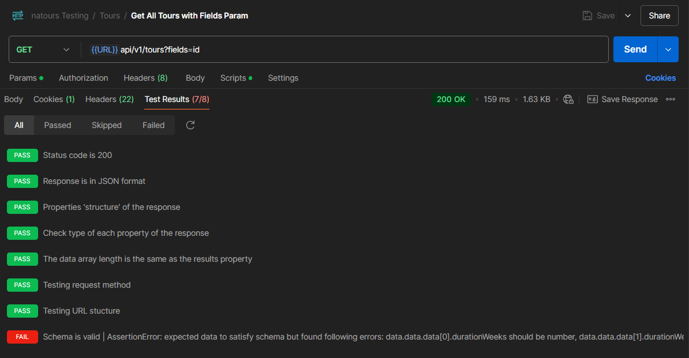

Examples of bugs:
Get all tours with fields param:
This API request should result in response body with some fields, one of them is “durationWeeks” and it should be a number, but it returned as null.

Slide 33
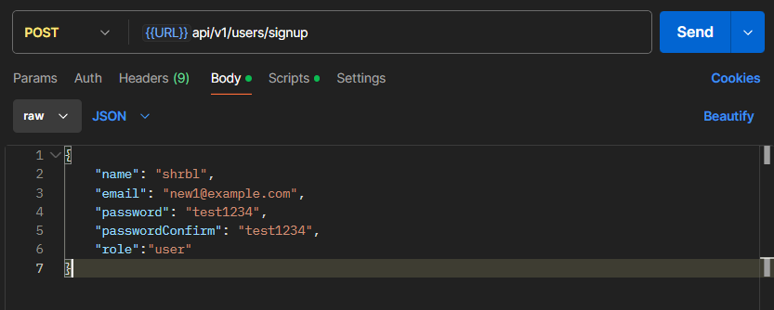
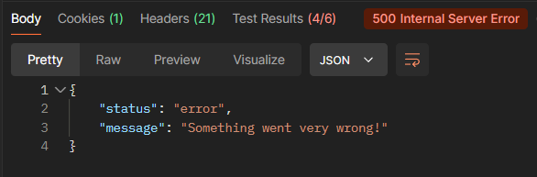
Sign up:
This API request should result in user logged in with a token for the session, and the response be user details and the token, instead it returned 500 error code.
Yet user can log in later with these credentials.

Slide 34
Manual Testing

Slide 35
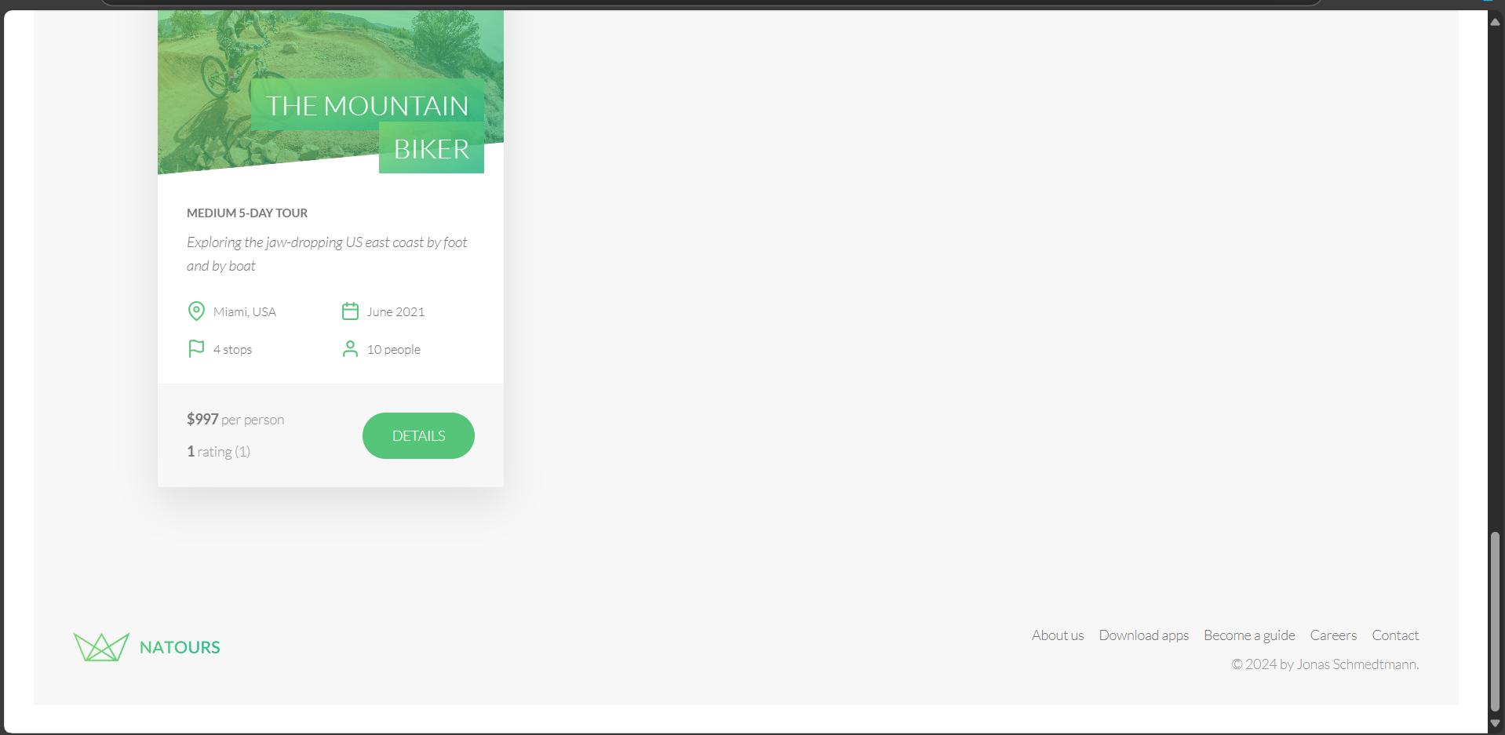
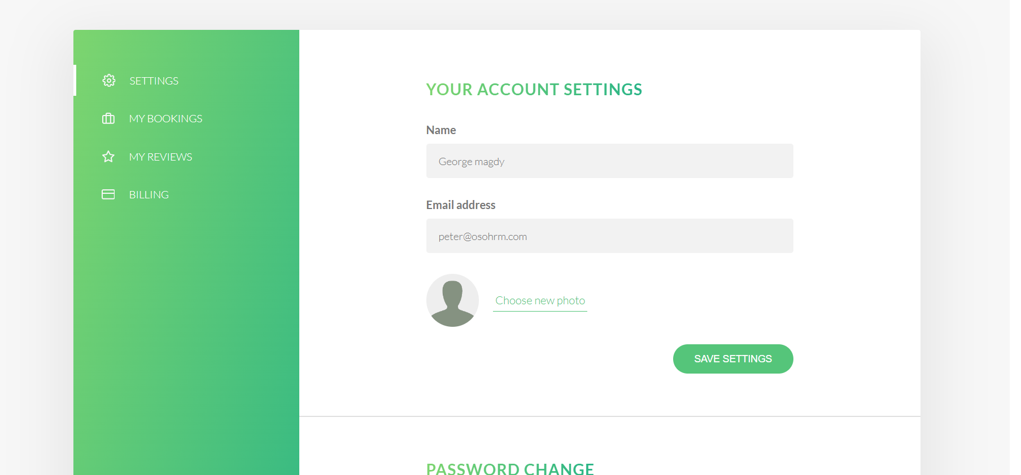
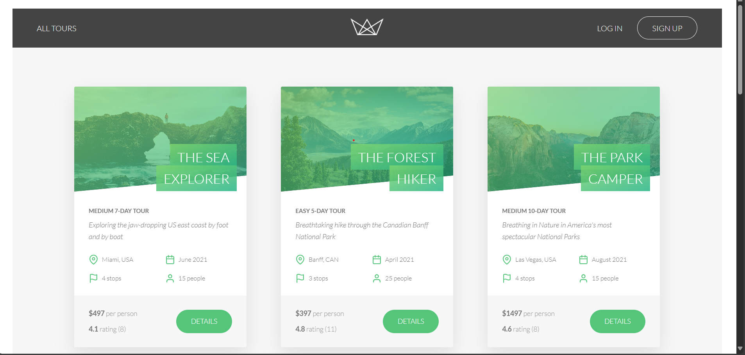
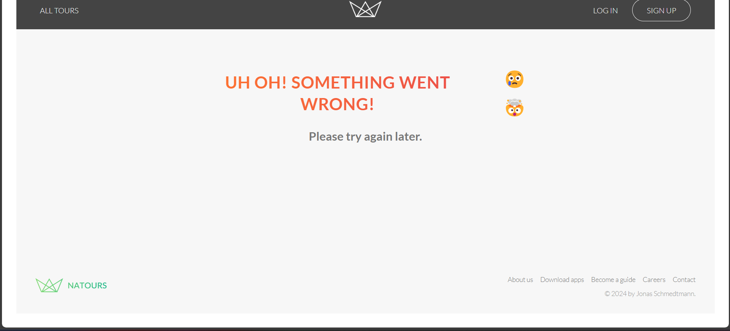
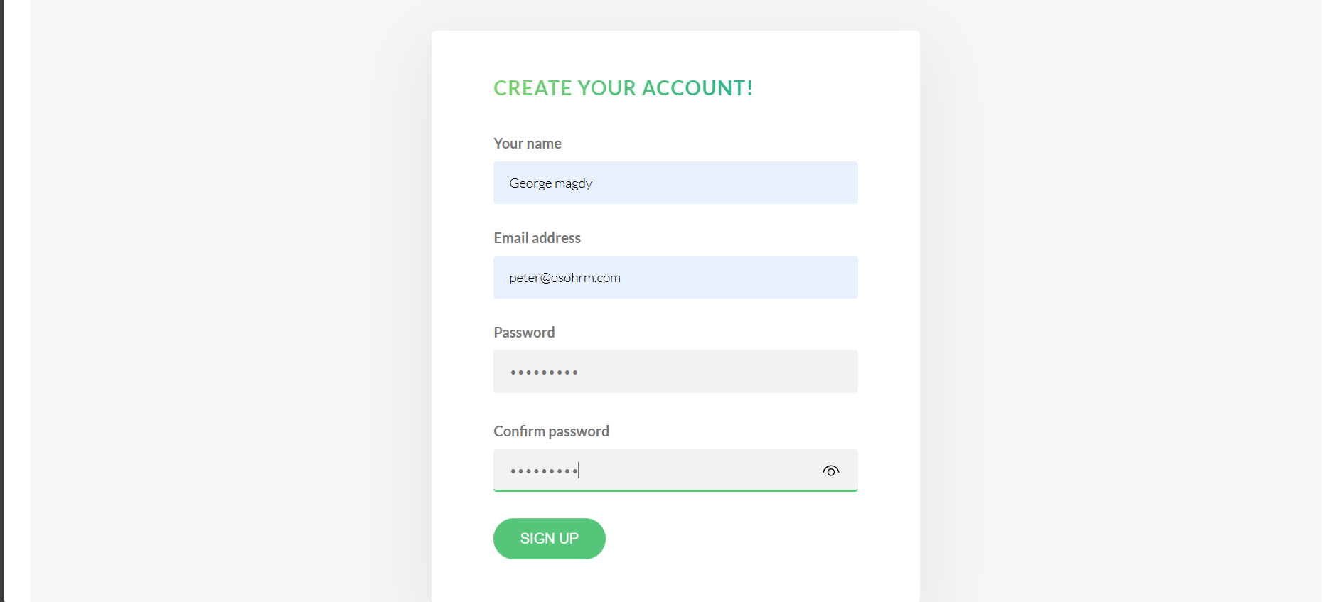
Demonstration of the system:
The system consists of , and they are listed as follows:

Slide 36
Examples of APIs response:
Login
Singup

Slide 37
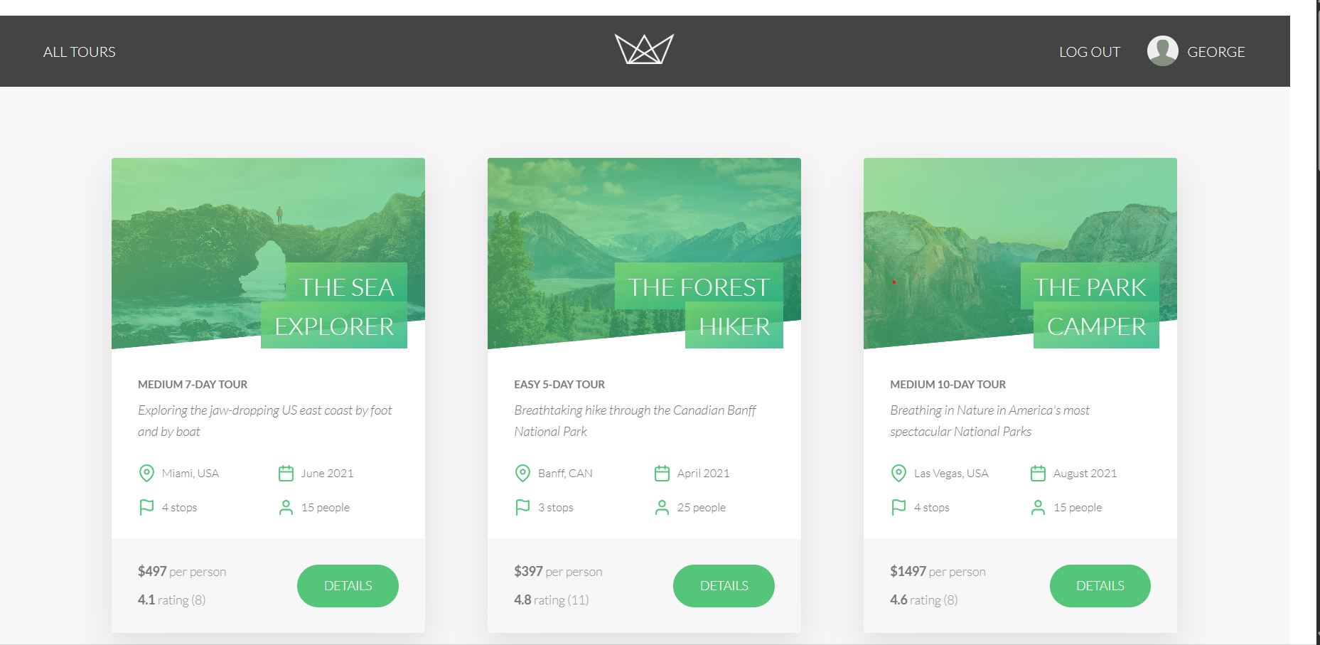
Examples of APIs response:
Profile
page after login

Slide 38
Bugs identified:
The bugs identified are mostly due to expectations on the schema response, like not filling a virtual variable so they are minor bugs.
Some bugs were due to wrong response to using the URL in wrong format (expected “bad request” but got “ok”).

Slide 39
Challenges and Solutions
Challenges encountered
Solutions implemented

Slide 40
API Testing

Slide 41
Challenges encountered:
Most of the challenges faced were easy and solvable like:
understanding the APIs responses and setting up the collection variables.
Also determining the order of running APIs so all the requests would rum smoothly with no unexpected results.
The most difficult one was some APIs required an admin email to log in which wasn’t provided, also there was provided only a demo email for testing which some APIs were blocked for.

Slide 42
Solutions implemented:
The first 2 challenges were solvable:
Looking for API documentation and comparing the output to his course content and also to convention. (like when to use 400 or 200 as the response status).
Understanding the order was easy to solve.
The third challenge remains unsolved as it needs to contact the owner of the website to allow full access to the APIs.

Slide 43
API Testing

Slide 44
Future enhancement:
Adding a more comprehensive test suite testing real depth in the API response body.
The Json response body form a very deep tree containing image extension and real data existing in the system, such as reviews, users, tour and more.
Collecting repeating test cases as checking the request method, auth header and URL structure to the pre-collection script.

Slide 45
Areas for expansion:
Contacting the website owner to give access to run a more comprehensive test suite that covers 100% of the endpoints.

Slide 46
Manual Testing

Slide 47
Conclusion
Summary of achievements
Reflection on impact
Final remarks

Slide 48
Summary of achievements:
The project involved developing a simple website dedicated to showcasing various products. Throughout the process, we encountered several challenges that highlighted the importance of addressing certain issues that ultimately affected the website's overall functionality and user experience.
Despite its straightforward nature, we realized that several crucial features that should have been implemented either were not functioning as intended or were overlooked entirely. This oversight hindered the potential effectiveness of the website, limiting user engagement and satisfaction

Slide 49
Reflection on impact:
The project involved creating a simple website dedicated to showcasing various products. While the initial goal was to provide users with an accessible and engaging platform, we encountered several challenges that significantly impacted the website's effectiveness.
Final remarks:
In conclusion, the development of this simple product showcase website has been a valuable journey filled with learning experiences and insights. While our initial goal was to create a straightforward platform for presenting products, we encountered several challenges that ultimately impacted the website's functionality and overall user experience.

Slide 50
Acknowledgments
We would like to thank our course instructor Eng.george for their guidance and support throughout this project.
A big thanks to all our team members for their collaboration and hard work, as well as to our peers for their valuable feedback.
This project was a great learning experience, and we appreciate everyone who contributed to its success.

Slide 51

Questions
Invite questions from the audience

