Slide 1
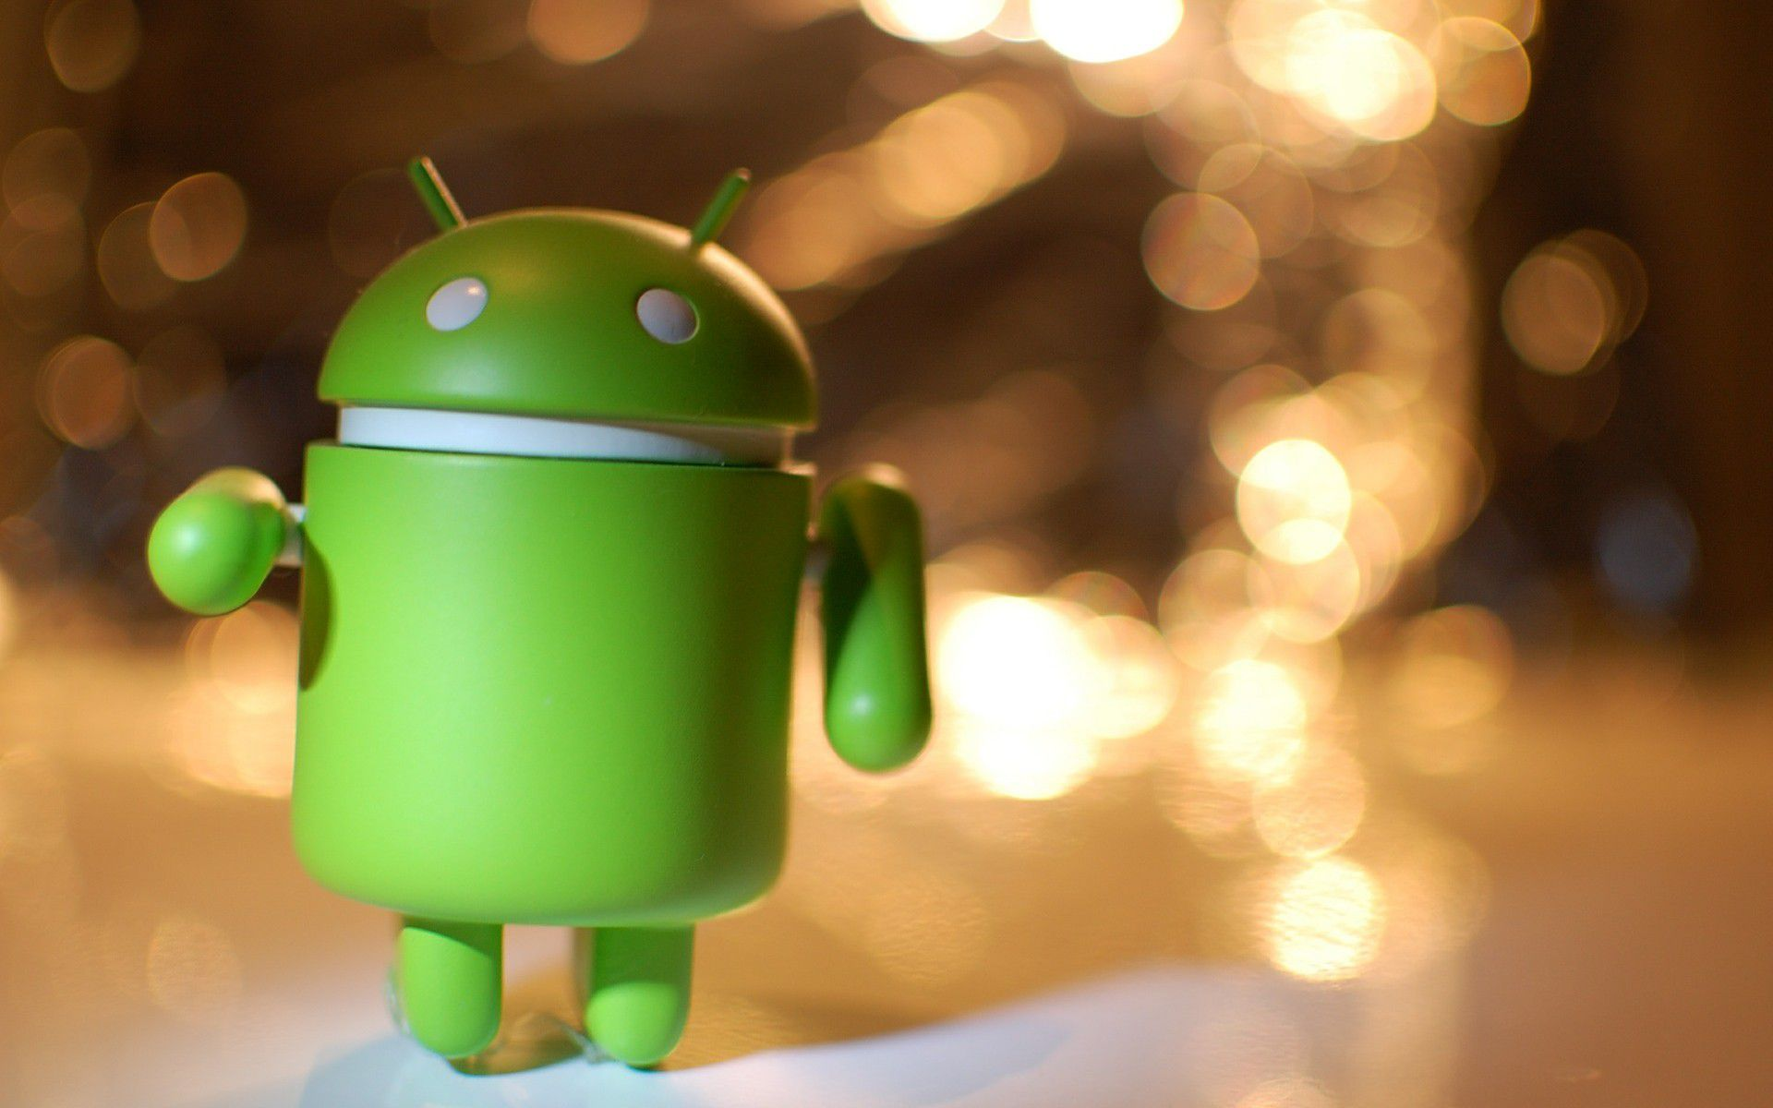
Android Development
Presented by George Makrakis
November 2016
Template taken from: http://powerpoint.sage-fox.com/android-powerpoint-template/
Free PowerPoint Templates
Free PowerPoint Templates

Slide 2
What is Android?
Android is an operating system for smart mobile devices (smartphones) based on Linux kernel.
The biggest part of Android source code is published from Google under Apache License.
Free PowerPoint Templates

Slide 3
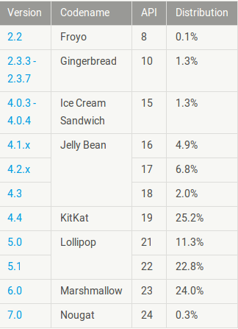
Android Versions
Free PowerPoint Templates

Slide 4
Developer Tools
In December 2014, Google released Android Studio, based on IntelliJ IDEA, as its primary IDE for Android application development. Other development tools are available, including a native development kit (NDK) for applications or extensions in C or C++, Google App Inventor, a visual environment for novice programmers, and various cross platform mobile web applications frameworks. In January 2014, Google unveiled an framework based on Apache Cordova for porting Chrome HTML 5 web applications to Android, wrapped in a native application shell.
Free PowerPoint Templates

Slide 5
Why choose Android as a developer?
2.200.00 (2016) apps in play Play Store.
A lot of choices for devices that run Android.
Modification of platform using custom ROMS.
Plethora of advertisements. (advantage or disadvantage);​
Free PowerPoint Templates

Slide 6
What are we gonna see today?
Free PowerPoint Templates

Slide 7
Sensors
The Android platform supports three broad categories of sensors:
Motion sensors – Includes accelerometers, gravity sensors, gyroscopes, and rotational vector sensors.
Environmental sensors - Includes barometers, photometers, and thermometers.
Position sensors - Includes orientation sensors and magnetometers.
Free PowerPoint Templates

Slide 8
Any questions so far?
Free PowerPoint Templates

