Slide 1
Example 4C-Readmission Health Data Analysis
George Melrose AMRSB MBCS MSc(Bham.) BSc(Hons)(Glas.)
Research Information Analyst – University of Cambridge

Slide 2
ISARIC4C Readmission Project Working Package 3 – Trajectory Modelling Analysis and Building Cause-Specific Readmission Models
Aim of 4C Readmission project – generate a risk prediction model for patients with a primary Covid-19 admission to hospital, calculating their % likelihood of readmission. Precursor tool, 4C Mortality Score - https://isaric4c.net/risk/4c/
Objectives -
Descriptive statistics of the cohort: how many patients are in the cohort; how many were readmitted, readmitted within 90 days; how many patients died, died within 90 days; how many patients died and how many patients died before readmission? Visualise events over time. Understand our patient cohort.
Finding the frequency diagnosis codes on readmissions and deaths – tabulate causes of events by ICD-10 code.
Survival analysis part 1 – generate Kaplan-Meier graphs of survival probability for deaths before readmission and all deaths for key risk factors. Generate CI plots for events, for key risk factors. Observe time dependent probability of survival or remaining event –free, compare survival rates of different groups.
Survival analysis part 2 – generate Cox regression models for all causes of readmission and specific conditions – identify statistically significant risk factors for different types of readmission.
Notes:
Cumulative Incidence (CI) Plots
Definition:
Cumulative Incidence: The cumulative incidence function (CIF) estimates the probability of experiencing a particular event by a certain time in the presence of competing risks. Unlike the Kaplan-Meier (KM) estimate, which is used for overall survival probabilities, cumulative incidence accounts for the possibility that different types of events (competing risks) can preclude the occurrence of the primary event of interest.
Usage in Studies of COVID-19 Outcomes:
Competing Risks:
Multiple Outcomes: In a study of COVID-19 outcomes, patients might face several competing risks (e.g., death and readmission). Cumulative incidence helps to estimate the probability of each specific type of event occurring over time while considering the competing nature of other events.
Accurate Risk Estimation: For instance, if the primary interest is in readmissions, the occurrence of death acts as a competing risk because it precludes the possibility of a readmission.
Differentiation from KM Curves:
KM Curves: Estimate the probability of being event-free over time without explicitly accounting for the competing risks.
CI Plots: Specifically measure the probability of the event of interest occurring, adjusted for the competing risks. This provides a more accurate reflection of the real-world probability of different outcomes.

Slide 3


Slide 4
100K Dummy Data Patient Cohort– Readmission & Death Rates
Original data gathered from NHS England HES-APC data from 2020-22 with the following conditions: Aged >18; COVID-19 positive; Discharged alive; An APC spell matches to an ISARIC admission; An APC spell matches to an ISARIC admission; Community-acquired infection (date of onset of first symptom =< 5 days after admission).
Dummy patient data used, an approximation of English APC data. 100K rows, 38 variables. 26 Variables based on the 4C_mortality_score/01_data_prep.R script. For example: dialysis; age(factor); hypertension. Remaining 12 variables generated by memory and ICD package, such as dates and causes of first readmission. Date range, 1st March 2020 - 1st March 2022.
Readmission rates – 13,500, 13.5% overall during study period and 8,554, 8.5% within 90 days. Of patients readmitted, 63.4% are readmitted within 90 days of discharge. Not too dissimilar to Ramzi 2022 meta-analyses, 9.79% prevalence of 90-day readmissions. Docherty 2023 (Scottish data) is much higher at 35.6% of patients after 1 year.
Death rates – 11,800, 11.8% of patients died in total and 4,294, 4.29% died within 90 days of discharge. Of those patients that died, 36.4% died within 90 days. Ramzi 2022 90-day post-discharge all-cause mortality rate is 7.63%. Docherty 2023 11.7% all-cause mortality at 1 year after index admission.

Slide 5
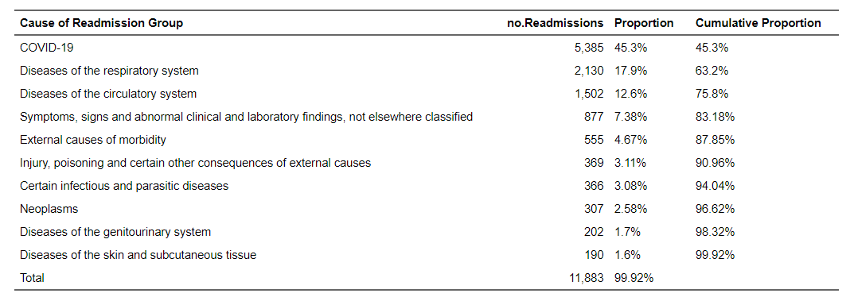
Top 10 Causes of Readmission
Docherty 2023 has the following results for NHS Scotland data –
“Median time to first readmission was 38 days (IQR 8–131) and the most common cause was COVID-19 (1471 [17·7%] of 8301), followed by respiratory causes (996 [12·0%]) and circulatory causes (855 [10·3%]…”
I have purposefully wrangled the dummy data to concur with real life findings and my own experience!

Slide 6
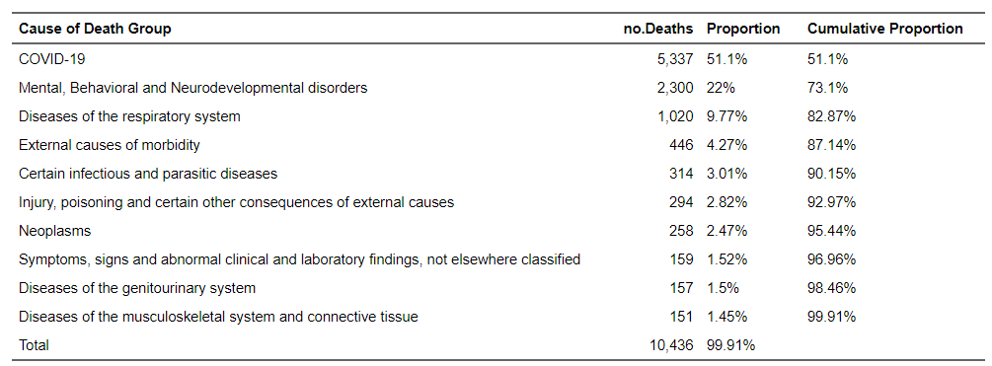
Top 10 Causes of Death
Docherty 2023 has the following results for NHS Scotland data –
“Among patients overall who died after index discharge, 1015 (37·6%) of 2699 patients died during
subsequent readmission to hospital, and 1684 (62·4%) patients died in the community. COVID-19 was the most common underlying cause of death (488 [18·1%]), followed by neoplasm (602 [22·3%]) and circulatory
causes (571 [21·1%]…”.

Slide 7
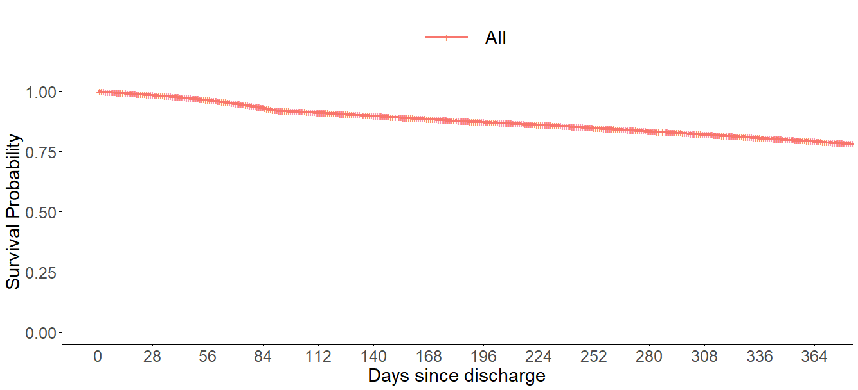
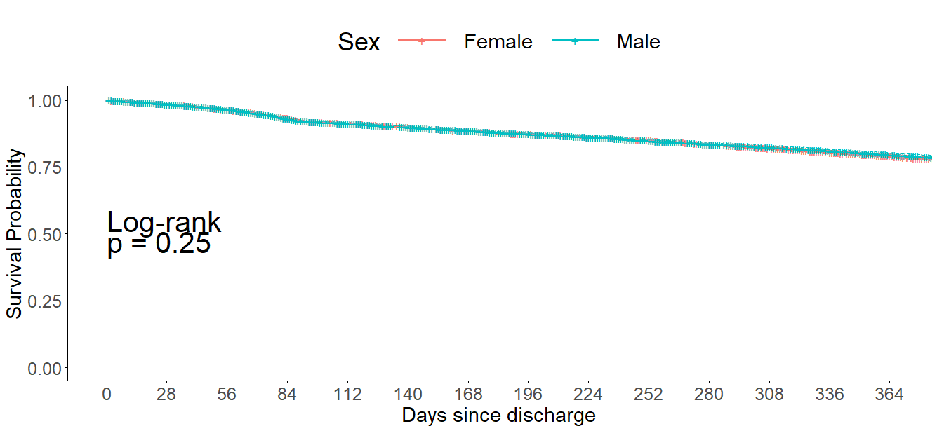
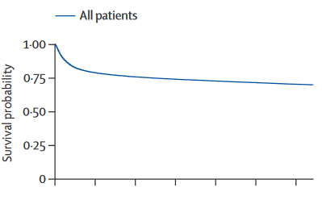
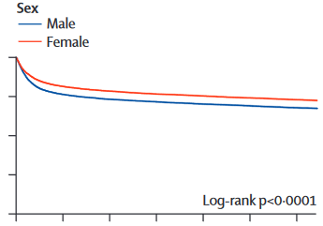
Survival at 1 year into study – Whole Cohort and stratified by Sex
Figure 1: Adapted from Docherty et al. (2023). "Patient emergency health-care use before hospital admission for COVID-19 and long-term outcomes in
Scotland: a national cohort study”, Lancet Digital Health, Vol5, e446-e457. DOI: 10.1016/S2589-7500(23)00051-1
Notes:
Used to report mortality.
Comparison Between Groups -
Comparative Effectiveness - KM curves allow researchers to compare survival experiences between different patient groups, such as those receiving different treatments, varying age groups, or those with different comorbidities.
Visualization - They provide a visual representation of how the risk of an event accumulates over time for different groups.

Slide 8
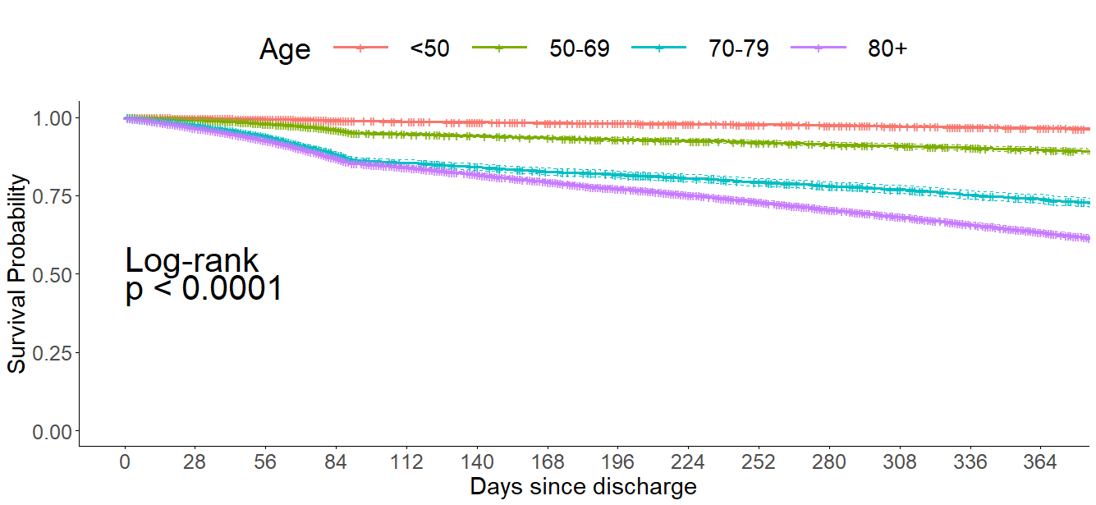
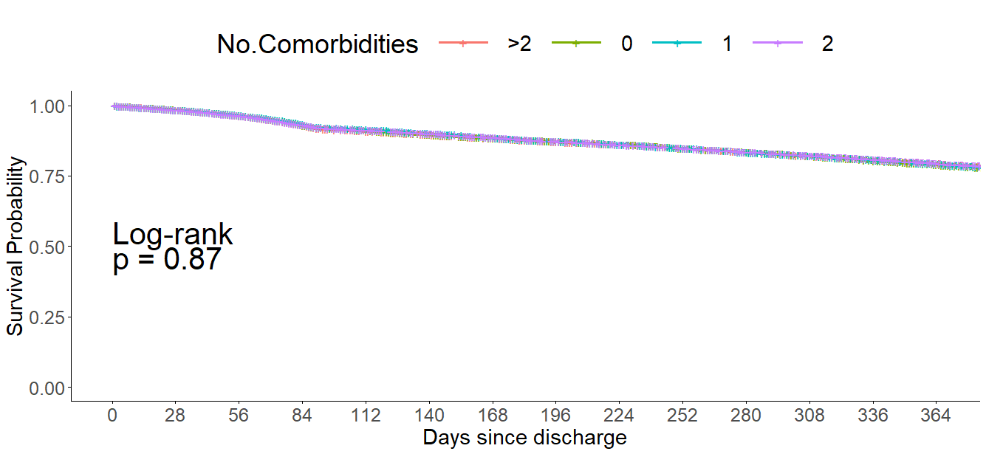
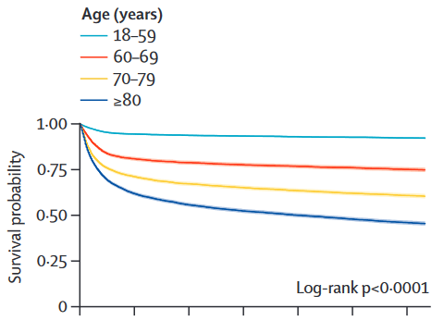
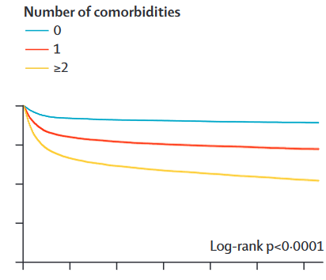
Survival at 1 year into study – stratified by Age and No.Comorbidities
100K dummy data
Figure 1: Adapted from Docherty et al. (2023). "Patient emergency health-care use before hospital admission for COVID-19 and long-term outcomes in
Scotland: a national cohort study”, Lancet Digital Health, Vol5, e446-e457. DOI: 10.1016/S2589-7500(23)00051-1

Slide 9
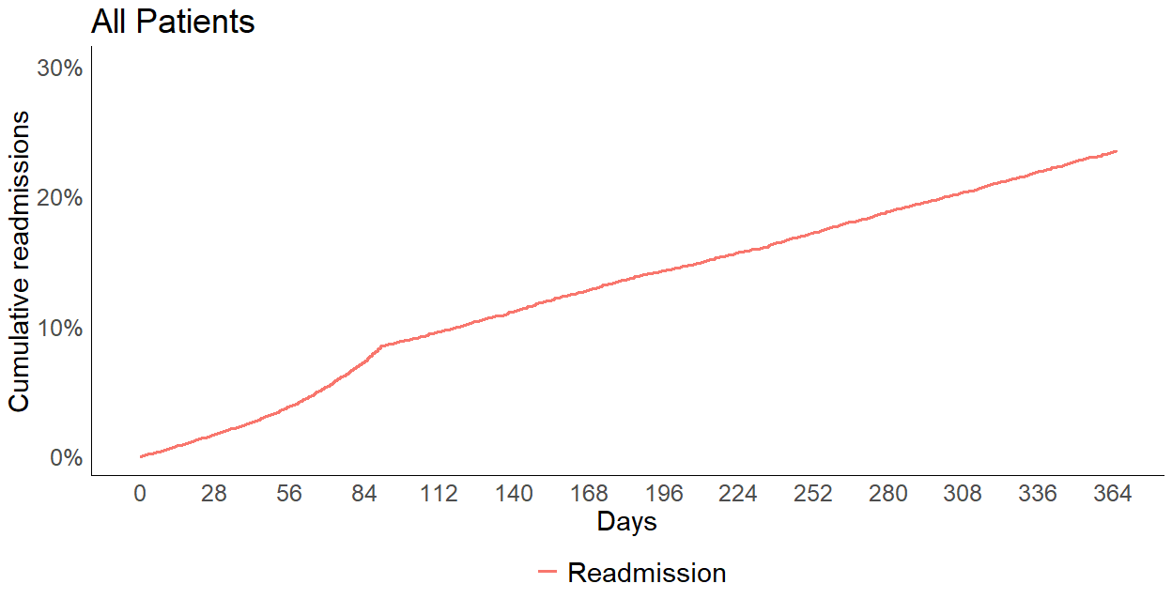
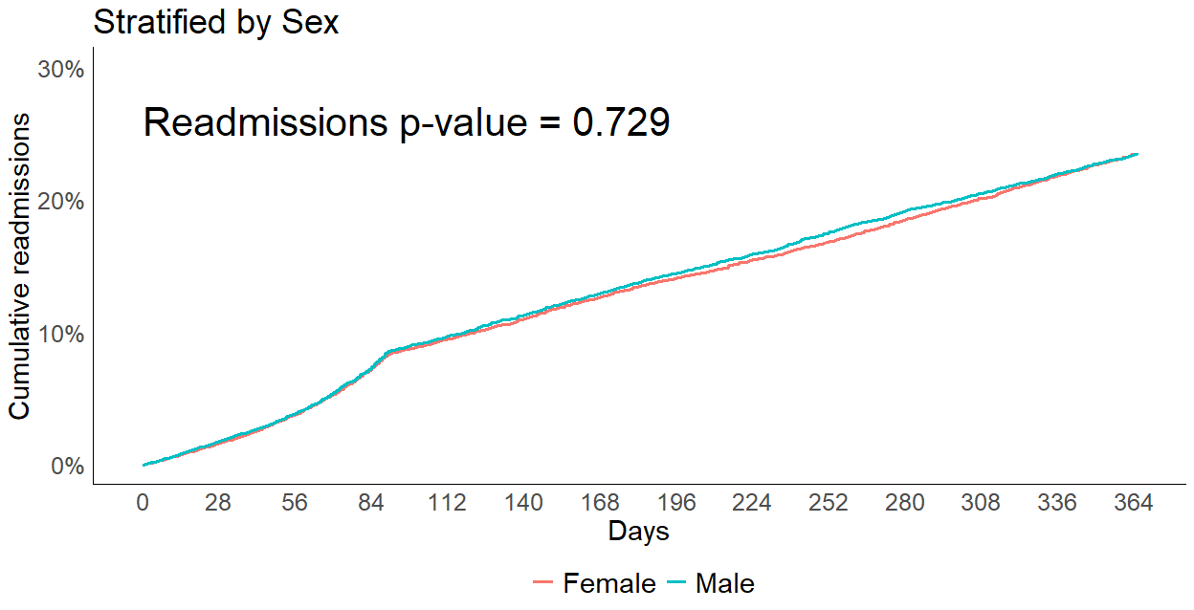
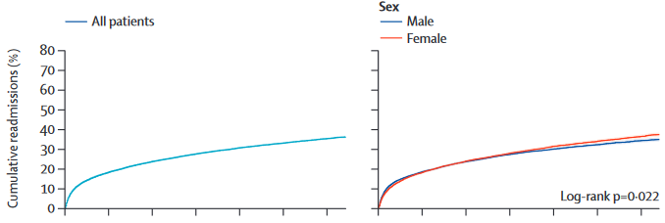
Cumulative Readmissions – Whole Cohort and stratified by Sex
100K dummy data
Figure 3: Adapted from Docherty et al. (2023). "Patient emergency health-care use before hospital admission for COVID-19 and long-term outcomes in
Scotland: a national cohort study”, Lancet Digital Health, Vol5, e446-e457. DOI: 10.1016/S2589-7500(23)00051-1
Notes:
Used to report first readmission

Slide 10
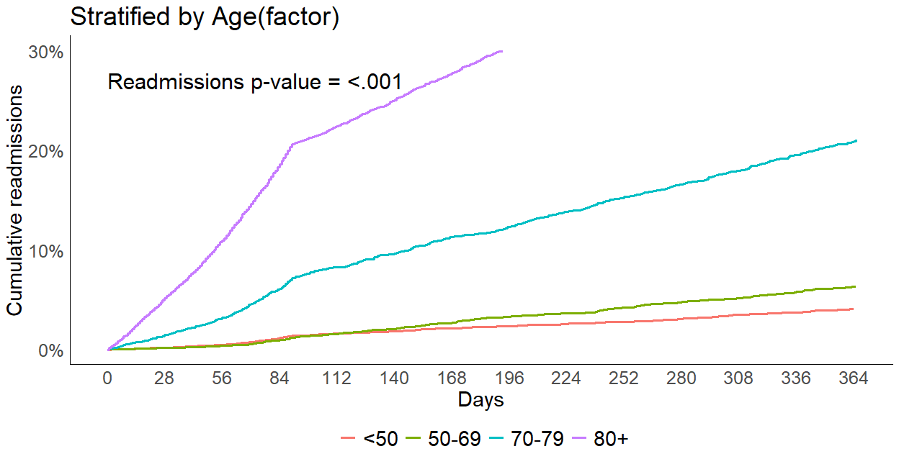
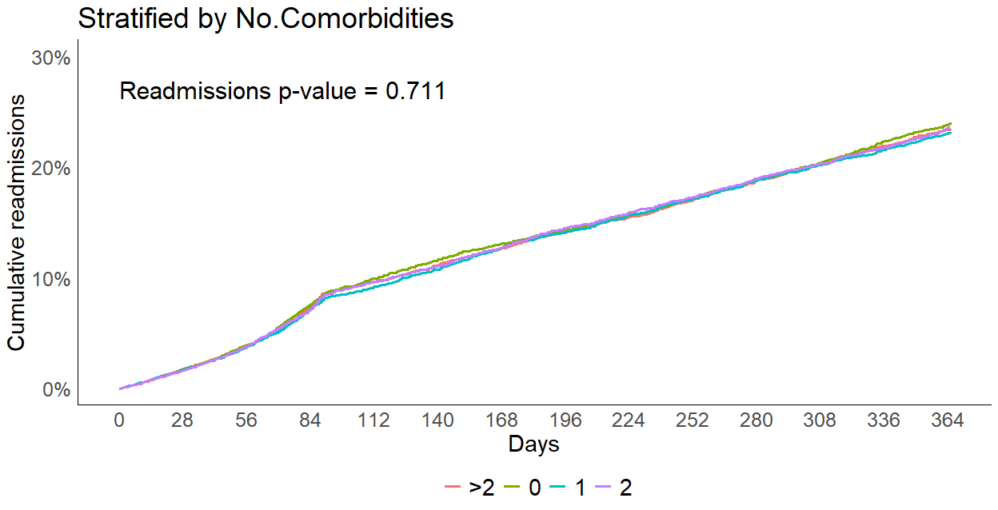
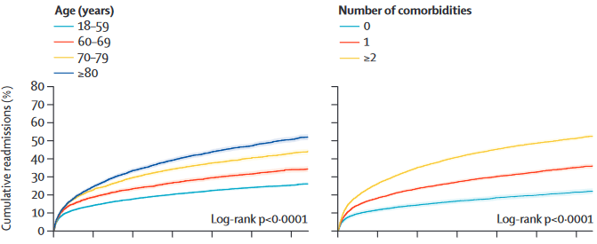
Cumulative Readmissions – stratified by Age and No.Comorbidities
100K dummy data
Figure 3: Adapted from Docherty et al. (2023). "Patient emergency health-care use before hospital admission for COVID-19 and long-term outcomes in
Scotland: a national cohort study”, Lancet Digital Health, Vol5, e446-e457. DOI: 10.1016/S2589-7500(23)00051-1

Slide 11
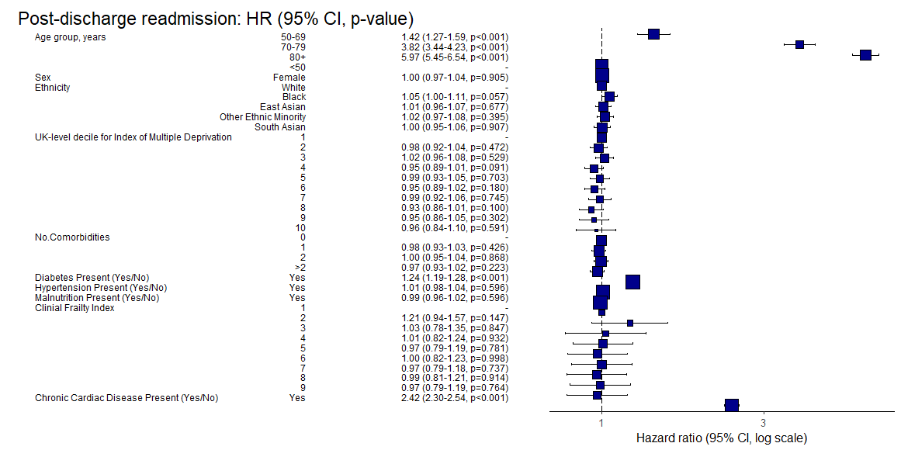
Modelling Readmission Outcomes – Large Model with key Variables
Number in dataframe = 100000, Number in model = 25169, Missing = 74831, Number of events = 13500, Concordance = 0.692 (SE = 0.003), R-squared = 0.253( Max possible = 1.000), Likelihood ratio test = 7342.699 (df = 32, p = 0.000)
100K dummy data
Notes:
LRTs test the null hypothesis that the simpler model is as good a representation of the data as the more complex one, and therefore should be adopted since it is more
parsimonious. If we reject the null hypothesis we instead adopt the more complex model.
DLL = LL(complex) – LL(simpler)
19.751 = 7342.699 - 7322.948
1-pchisq(2DLL, dfc-dfs)
P ~ pchisq(2x19.751 , (32-10) ) = 0.01235358
0.0123 < 0.05 therefore reject the null hypothesis and adopt the more complex model

Slide 12
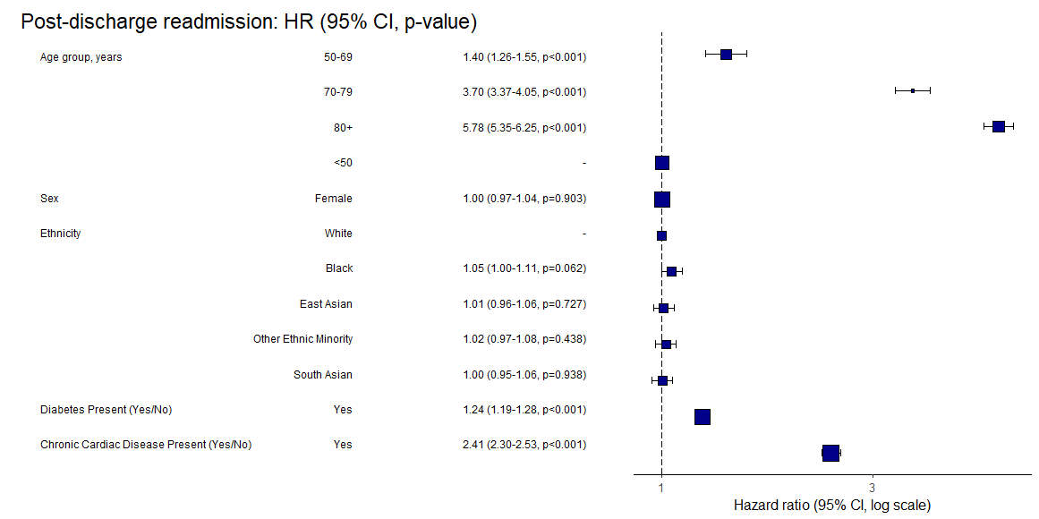
Modelling Readmission Outcomes – Slimmed down model WO statistically insignificant variables
100K dummy data
Number in dataframe = 100000, Number in model = 25169, Missing = 74831, Number of events = 13500, Concordance = 0.691 (SE = 0.003), R-squared = 0.252( Max possible = 1.000), Likelihood ratio test = 7322.948 (df = 10, p = 0.000)
Notes:
Model 1 is better than Model 2 based on the likelihood ratio test, as it has a higher value (7342.699 compared to 7322.948), indicating a better fit despite having more variables.
Both models have similar concordance indices (0.692 for Model 1 and 0.691 for Model 2), showing comparable discrimination ability.
Concordance indices in Cox regression are similar to AUROC in that they both measure the ability of a model to correctly rank the order of events, with values closer to 1 indicating better discrimination. Specifically, the concordance index represents the probability that, for a pair of individuals, the one who experiences the event first had a higher predicted risk, similar to how AUROC assesses the probability that a randomly chosen positive instance is ranked higher than a negative one.
The standard error (SE) by the concordance index in Cox regression represents the variability or precision of the concordance estimate. A smaller SE indicates more precise estimation of the concordance index, suggesting that the reported value is reliable and would be similar if the study were repeated. In your models, the SE of 0.003 means the concordance index estimate is precise, with a small margin of error around the reported values (0.692 and 0.691). 1. When we estimate a parameter, we estimate its mean
and we do so with error
2. The error is assumed to be normally distributed –
Central Limit Theorem
3. GLMs supply us with an estimate of this error
4. This is conventionally referred to as a Standard Error
5. Standard Errors are Standard Deviations of
parameters
Model 1 has a slightly higher R-squared value (0.253 versus 0.252), suggesting it explains a marginally greater proportion of the variation in the data. However, Model 1 includes more variables (32 vs. 10), which increases its complexity. The improvement in fit, as shown by the likelihood ratio test, justifies the additional complexity in Model 1. Overall, Model 1 provides a significantly better fit without a substantial loss in model simplicity.

Slide 13
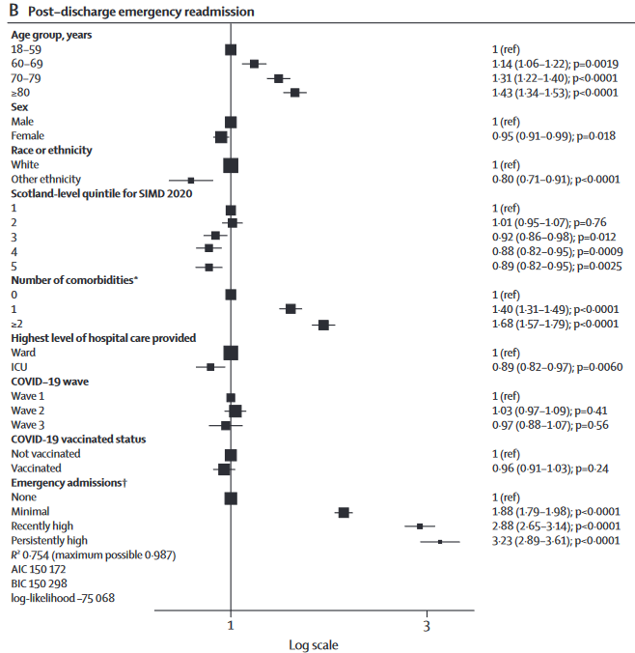
Modelling Readmission Outcomes – Docherty et al., 2023 – Figure 2
Figure 2: Adapted from Docherty et al. (2023). "Patient emergency health-care use before hospital admission for COVID-19 and long-term outcomes in
Scotland: a national cohort study”, Lancet Digital Health, Vol5, e446-e457. DOI: 10.1016/S2589-7500(23)00051-1
“B) Cox regression for emergency
readmission to hospital of index-admission survivors…
AIC=Akaike information criterion. BIC=Bayesian information criterion. ICU=intensive care unit. SIMD=Scottish
Index of Multiple Deprivation. *We included only comorbidities listed in the Charlson Comorbities Index.12
†Refers to the number of half-days in a hospital emergency bed during the 2 years before index submission;
minimal admissions=0·5−7·0 days; recently high=7·5–20·5 days; persistently high=21·0 or more days.”
Notes:
For survivors of hospitalisation for COVID-19, we used Cox proportional hazards regression analysis to account for differential follow-up, with results presented as HRs. We used a cause-specific Cox proportional hazards approach to competing risk to model emergency hospital readmission, accounting for the competing risk of death. We included vaccination as a time-varying covariate to allow for effects in patients vaccinated after the index discharge.

Slide 14
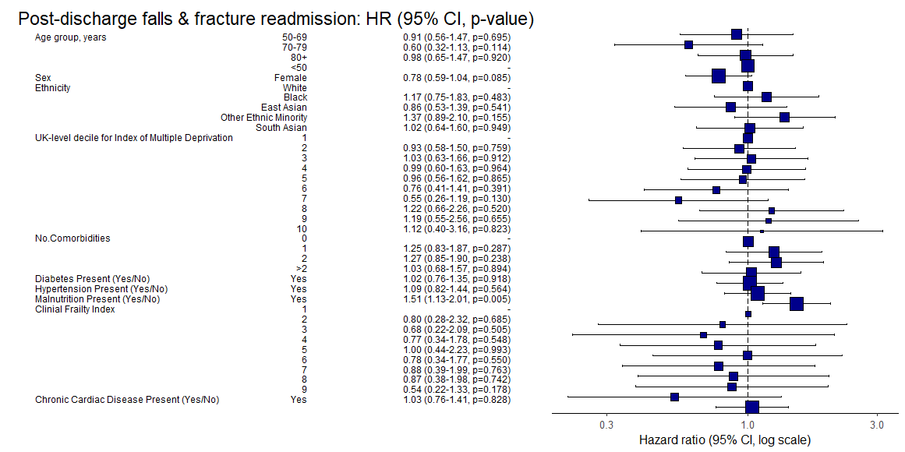
Modelling Readmission Outcomes – Falls & Fractures Cause-Specific Readmission Model
100K dummy data
Number in dataframe = 100000, Number in model = 25169, Missing = 74831, Number of events = 194, Concordance = 0.598 (SE = 0.025), R-squared = 0.001( Max possible = 0.132), Likelihood ratio test = 32.133 (df = 32, p = 0.460)

