Slide 1
A brief introduction to Prediction Modelling & a Past WSIC Prediction Model – Transformer deep learning to diagnosis suspected lung cancer
George Melrose MSc(Bham.) BSc(Hons)(Glas.) MBCS AMRSB,
Research Assistant - Mohn Centre for Children's Health and Wellbeing, School of Public Health, Imperial College London
Notes:
https://pubmed.ncbi.nlm.nih.gov/39536394/
“Transformer-based deep learning model for the diagnosis of suspected lung cancer in primary care based on electronic health record data”
Lan Wang ¹ , Yonghua Yin ² , Ben Glampson ³ , Robert Peach ⁴ , Mauricio Barahona ¹ , Brendan C Delaney ⁵ , Erik K Mayer ⁶

Slide 2
Why use Prediction models? – Prognostic & Diagnostic
“I never make predictions, and I never will.” – Paul Gascoigne
Prognosis – The risk of future health outcomes in people with given diseases or health conditions.
Prognosis Research – investigation of future outcomes (“endpoints”) in patients with given baseline health (“startpoints”), to improve their health.
Summarise, understand and predict health outcomes in clinically relevant populations → inform clinical practice.
Prediction (prognostic) model – model to provide the risk(probability) of a clinically relevant outcome (death, readmission) for a patient with a particular disease, condition, medical history (primary inpatient admission once).
Practical uses: treatment decisions: monitoring strategies; NICE cost effectiveness analysis; improving trial design.
Diagnosis– ”the art or act of identifying a disease from its signs and symptoms” - risk of disease, condition being present, e.g. diagnosis of T2DM for those with suspected T2DM
For example, logistic regression models can be used for both whereas Cox-regression for prognosis.
Cross-sectional data = Diagnosis , Follow-up data = Prognosis
Regression is a fundamental tool – generates a transparent equation that can be easily reported and applied to new patients.

Slide 3
Individualised risk prediction through multivariable models
Prediction models may provide many other things aside from absolute risk predictions :
  Population-level summaries and predictions – birth rates, death rates.
  Whether a prognostic factor is causal
  Individual-level predictors of interactions with different treatment regimes.
Multivariable= multiple predictors.
“…sociodemographic, geographic, clinical characteristics, patient self-management ability and healthcare service utilisation)…” – Neves et al., T2 Diabetes WSIC-model
Directive prediction models, linked to clinical decisions –
  If risk of recurrence of venous thromboembolism (blood clots in a vein) is above a threshold (like 5%), may keep patients on anti-coagulation therapy like warfarin (Ensor et al., 2016)
  If risk of hypocalcaemia (blood calcium levels too low) by 48 hours is low following a thyroidectomy (remove part of or all of the thyroid), may send patient home early (Noordzij et al., 2007).
Passive prediction models – patient counselling or research.
Notes:
Multivariate = multiple outcome variables, like repeated measurements, not the same as multivariable!!
Predictors have synonyms like risk factors, variables, covariates, explanatory factors and whatnot.

Slide 4
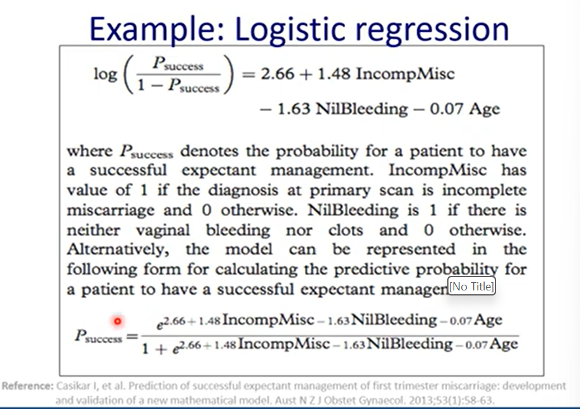
Notes:
https://www.youtube.com/watch?v=fIsNM0stAz0

Slide 5
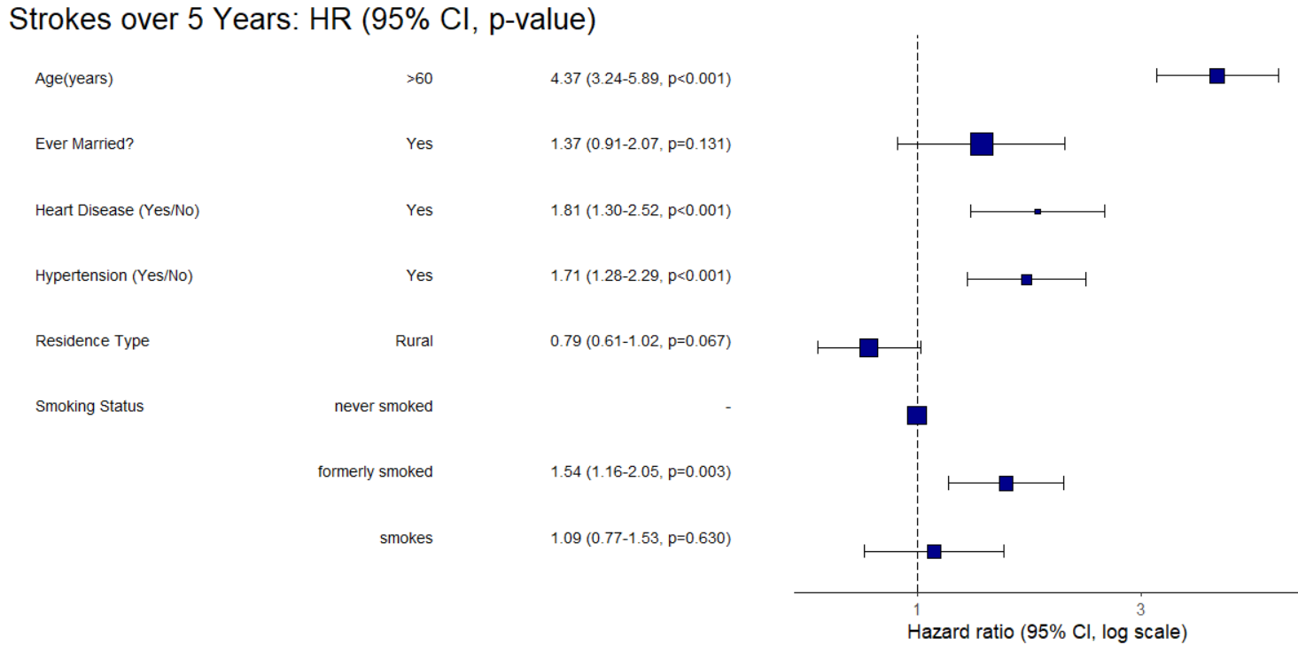
Survival Analysis – Cox-Regression Modelling
Notes:
Cox regression & prediction modelling
Cox regression is a survival analysis method that estimates how predictors (e.g., clinical or biological factors) influence the time until an event (e.g., death, relapse).
In prediction modelling, it helps identify risk factors and quantify their impact while accounting for censored data (patients who haven’t yet experienced the event).
The model outputs hazard ratios (HRs), showing the relative risk of the event for different groups or per unit increase in a predictor.
HR plot (Forest plot)
A hazard ratio (HR) plot visually displays the effect size (HR) and confidence intervals for each predictor.
HR > 1: higher risk; HR < 1: lower risk; HR = 1: no effect.
The plot allows quick comparison of which predictors are significant and their direction/strength of association.
Prognostic modelling aims to estimate the risk of a future outcome (e.g., survival, relapse) based on baseline characteristics.
Cox regression is one of the most common methods because it models time-to-event outcomes, accounts for censoring, and produces hazard ratios that quantify how predictors influence prognosis.
If the model includes only baseline predictors, it’s prognostic. If it also incorporates treatment effects or interactions, it can cross into predictive modelling (e.g., predicting differential benefit of treatments).

Slide 6
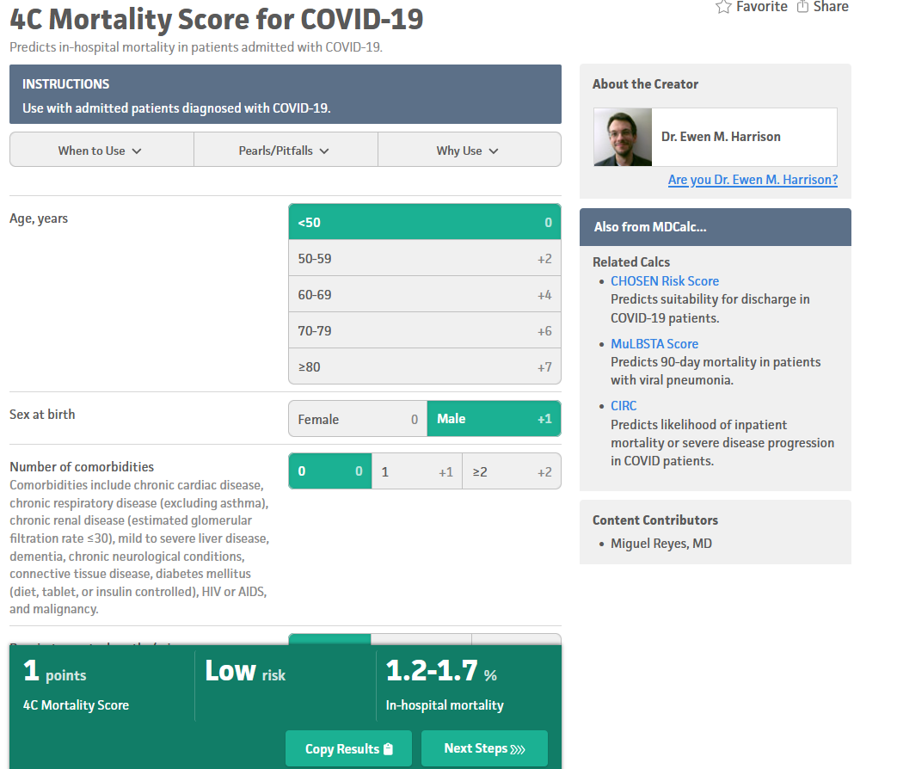
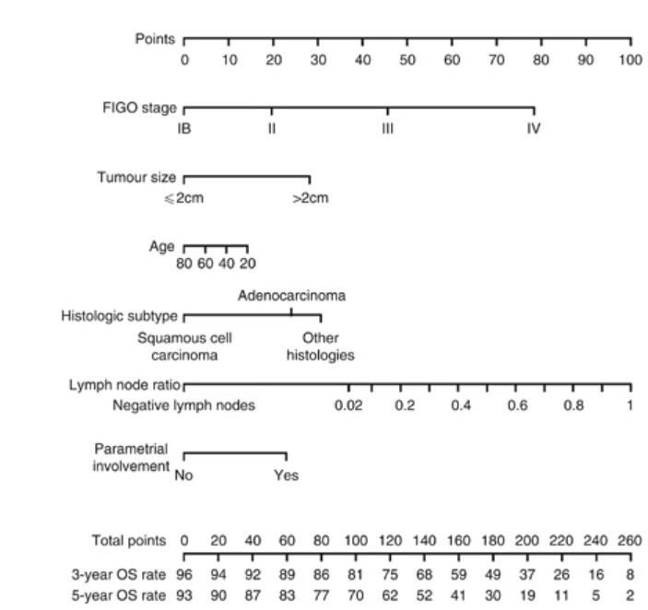
Nomogram prediction for overall survival of patients diagnosed with cervical cancer (Polterauer et al., 2012)
https://isaric4c.net/risk/4c/
https://www.mdcalc.com/calc/10338/4c-mortality-score-covid-19
Notes:
The equation can be simplified further to ‘simple scores’ (regression coefficients rounded to the nearest integer to sum them) or nomograms (graphical representations of prediction models).
The formulae are very often hidden nowadays, in web apps, calculators
Nomogram to predict 3- and 5-year overall survival using six clinical characteristics. Locate patient’s variable on the corresponding axis; draw a line to the points axis, sum the points, and draw a line from the total points axis to the 3-year OS probability axis.

Slide 7
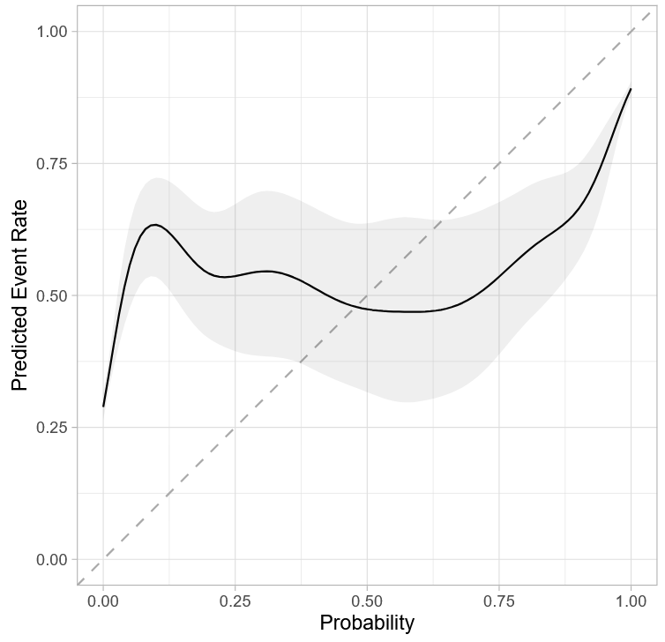
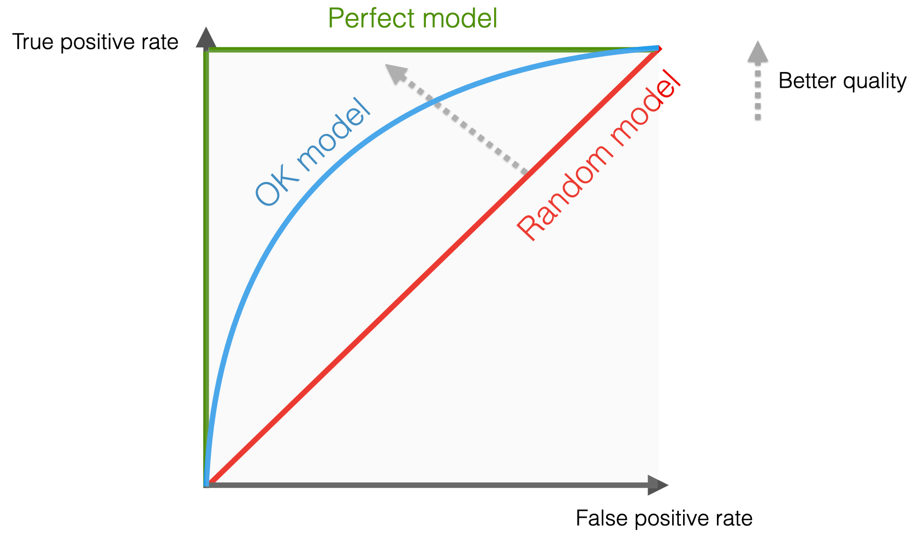
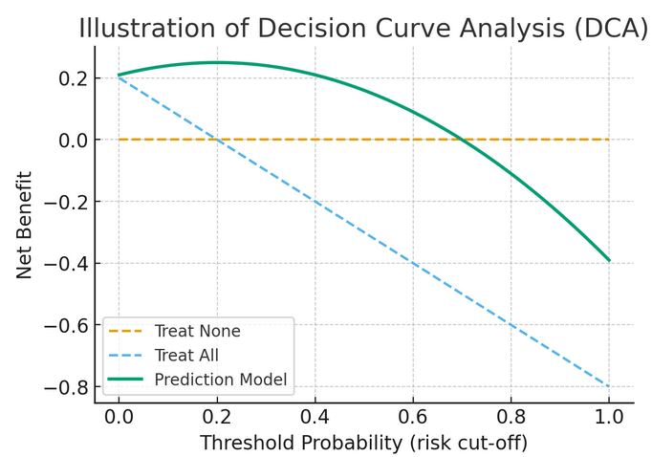
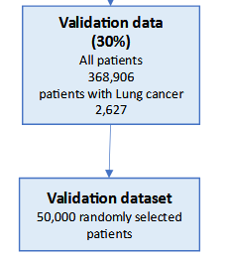
Prediction Model Requirements
Predicted risks should be accurate and clinically useful
Does a model give predicted risks that -
  Calibrate closely with observed risks? → Use a calibration plot
  Discriminate those who do and do not develop the outcome? → Assess performance through the C-statistics/AUC
  Provide clinical utility to guide clinical decisions? → Decision Curve Analysis
  Have the models been shown to work in the intended populations and settings of interest? Validate in external datasets from target populations
  Does the model have beneficial impacts on clinical practice when rolled out? Test in randomised controlled trials
Notes:
Calibration plots: Graphical tools comparing predicted risks with observed outcomes across risk groups. Good calibration means predicted probabilities closely match actual event rates.
AUROC / C-statistic: Measures how well a model distinguishes between those with and without the outcome. A value of 0.5 means no discrimination, while 1.0 means perfect separation.
Decision curve analysis (DCA): Assesses whether using a model provides more benefit than harm at different risk thresholds. It accounts for clinical consequences by balancing true positives against false positives.
External validation: Testing the model in new populations, settings, or time periods beyond the development dataset. This shows if the model generalizes well in real-world use.
Randomized controlled trials (RCTs): Experiments where patients are randomized to care with or without the model’s guidance. They provide the strongest evidence on whether the model improves clinical outcomes.

Slide 8
‘Transformer-based deep learning model for the diagnosis of suspected lung cancer in primary care based on electronic health record data’ , Wang et al., 2024 – Background
Present models have ‘Positive Predictive Values’ (PPVs) (probability that a positive test result is a true positive) of less than 10%.In the UK, annually, 45,000 patients are diagnosed with lung cancer – only 1/3 at an early stage (I-II), contributing to an age-standardised 5-year cancer survival rate of 21%.
Only 4% of patients present in primary care with a ‘red flag’ symptom like haemoptysis (coughing blood from part of the lungs) but rather a cough, weight lost.
Models don’t consider the temporal evolution of EHR codes (symptoms) leading up to lung cancer diagnosis.Current models either: ID prevalent risk factors like age, smoking history; or utilise incident symptoms to use in diagnosis of suspected cancer. Systematic review of incident symptoms found the greatest DOR in haemoptysis 6.39(3.32 – 12.28), dyspnoea (shortness of breath) 2.73 (1.54 – 4.85), and cough 2.64(1.24 – 5.64) (Okoli et al., 2018).
Current predictions models like QCancer Lung, are classic regression-based and don’t fully capture complex sequential relationships.
The sequential relationships amongst presenting symptoms, tests, and referrals will be different between lung cancer + & lung cancer - .
Handling sequences of EHR data as an NLP problem provides different tools to use. The temporal context of our problem, e.g. long-standing cough, repeated chest infection, and persistent breathlessness means the models needs long-term memory.
Notes:
DOR = Diagnostic Odds Ratio. A statistical measure of a diagnostic test’s ability to discriminate between the presence and absence of a disease.
DOR = OR of a positive test in a diseased patient / OR of a positive test in a non-diseased patient
DOR = (True Positive / False Negative) / (False Positive / True Negative)
DOR = LR+ / LR-
DOR = 1 → no discriminatory power
DOR combines sensitivity and specificity
Unlike predictive values like PPVs, it is not influenced by the prevalence of the disease in the population, therefore useful for comparing a test across settings.

Slide 9
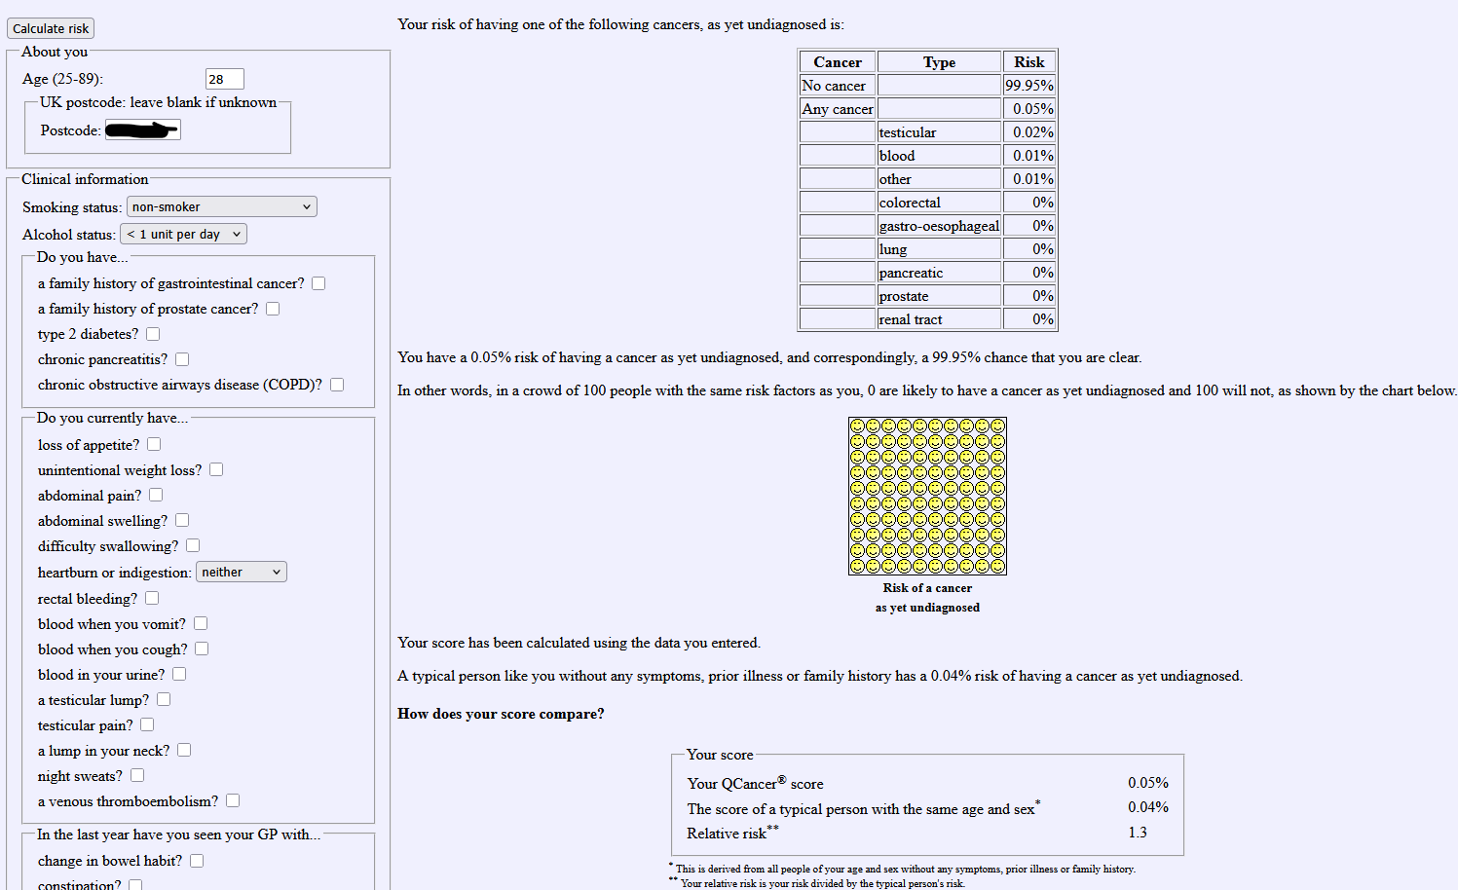
Notes:
https://www.qcancer.org/male/

Slide 10
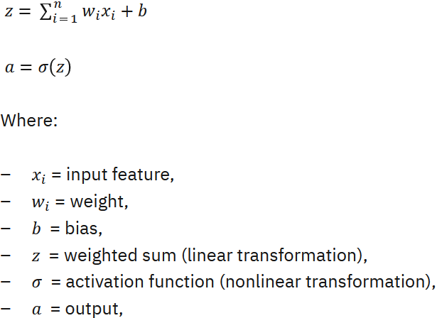
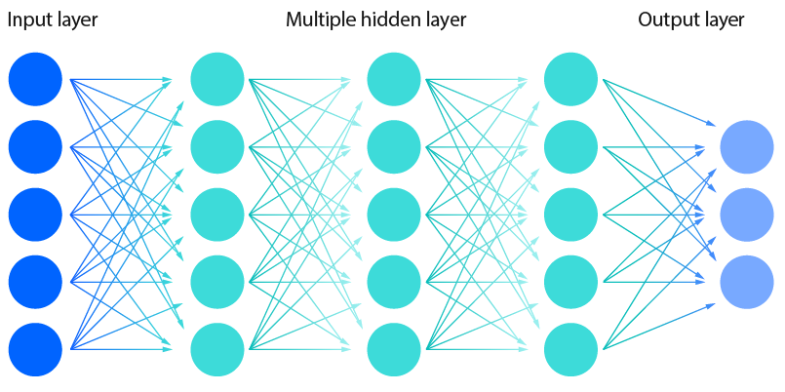
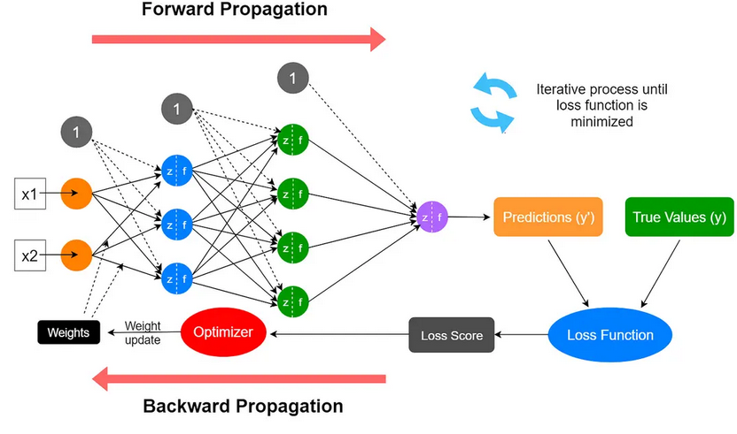
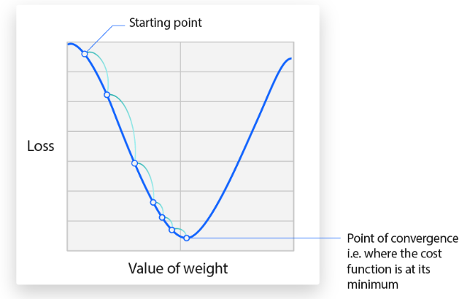
Neural Networks Simply Explained
A single neuron computes:
https://www.alation.com/blog/what-is-a-neural-network/
Notes:
Artificial Neural Network – An AI model inspired by the human brain, that learns to perform tasks by processing data through interconnected neurons.
Structure –
Input Layer – Receives the raw data (READ codes).
Hidden Layers – One or more layers where data processing happens.
Output Layer – Generates the result.
Each node = a linear regression model
Neurons & Weights – Each neuron receives an input, makes a calculation, propagates information forward. The strength of the neuronal connections is represented by “weight”, that the network adjusts during training (Σwᵢxᵢ). A bias term b is added to the weighted sum, generating a new value. Bias allows more model flexibility, shifting the activation function left or right. Allows the model to fit the data better, enabling the neuron to fire even when Σ(wᵢxᵢ) is low.
Σ(wᵢxᵢ) + b is passed to an activation function like sigmoid. The bias determines how easily the neuron will reach activation threshold or not, firing or not.
- Activation function = a mathematical function applied to the output of each layer of neurons in the network to introduce nonlinearity and allow the network to learn more complex patterns in the data.
Training – Supervised learning. The network is trained on training data with known outcomes. There is ‘error adjustment’ to adjust for any wrong predictions, through backpropagation.
A cost or loss function measures the error between the model’s predictions and true values, with lower cost
indicating higher accuracy. For example, mean squared error MSE = (1/n) * Σ(actual_i - predicted_i)²
To minimise loss, the network can use an algorithm called backpropagation.
Training happens in 4 steps (using a feedforward network/FNN/multilayer perceptron/MLP as an example):
(1) Forward pass of inputs, computing linear combinations, passing through the nonlinear activation function like
sigmoid and then producing an output prediction; (2) Error calculation with the loss function calculating the difference between the predicted and actual values; (3) Backward Pass/backpropagation where the error is passed backward through the network. At each neuron the algoithim calculations how much each weight, bias contributed to the error using chain rule of calculus dy/dx = f'(g(x)) * g’(x); (4) Weights are updated in the direction that reduces error using an optimisation method like gradient descent
Iteration, repeating the process, also improves the network’s accuracy.
Once trained the network can work on new data, using the learned weights.

Slide 11
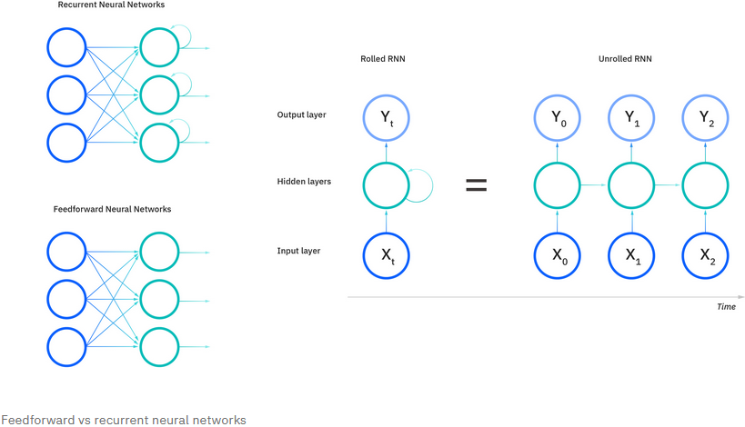
Recurrent Neural Networks
Recurrent Neural Network (RNN) = ANN trained on sequential, time series data to make sequential predictions. E.g. Predicting heart failure. Could also be involved in natural language processing (NLP).
RNNs differ by having “memory”, taking info. from prior inputs to influence current the current input, output.
For example, “feeling under the weather”. The phrase only makes sense in that order. RNNs account for each word’s position, using that knowledge to predict the next word in the sequence.
Notes:
An RNN tracks a sequence’s context by maintaining a hidden state at each time step. A feedback loop is generated by passing the hidden state from one-time step to the next. Hidden state = memory storing info. about previous inputs.
At each time step, the RNN processes the current input AS WELL AS the hidden state from the previous time step. The RNN “remembers” the previous data points and uses that info. to influence the current output.
RNNs are also distinguished by sharing parameters across each network layer. FNNs have different weights across each node whilst RNNs share the same weight parameter within each network layer. Nonetheless, the weights are still adjusted through backpropagation and gradient descent to improve the mode/ do reinforcement learning.

Slide 12
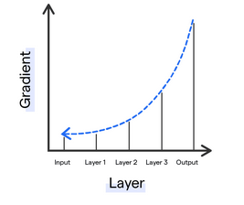
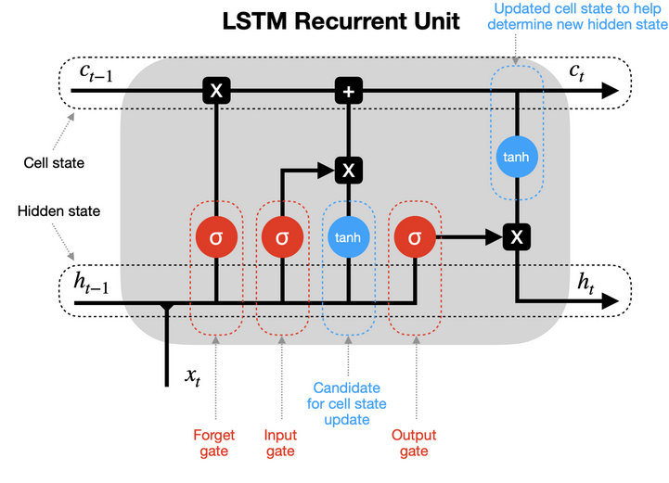
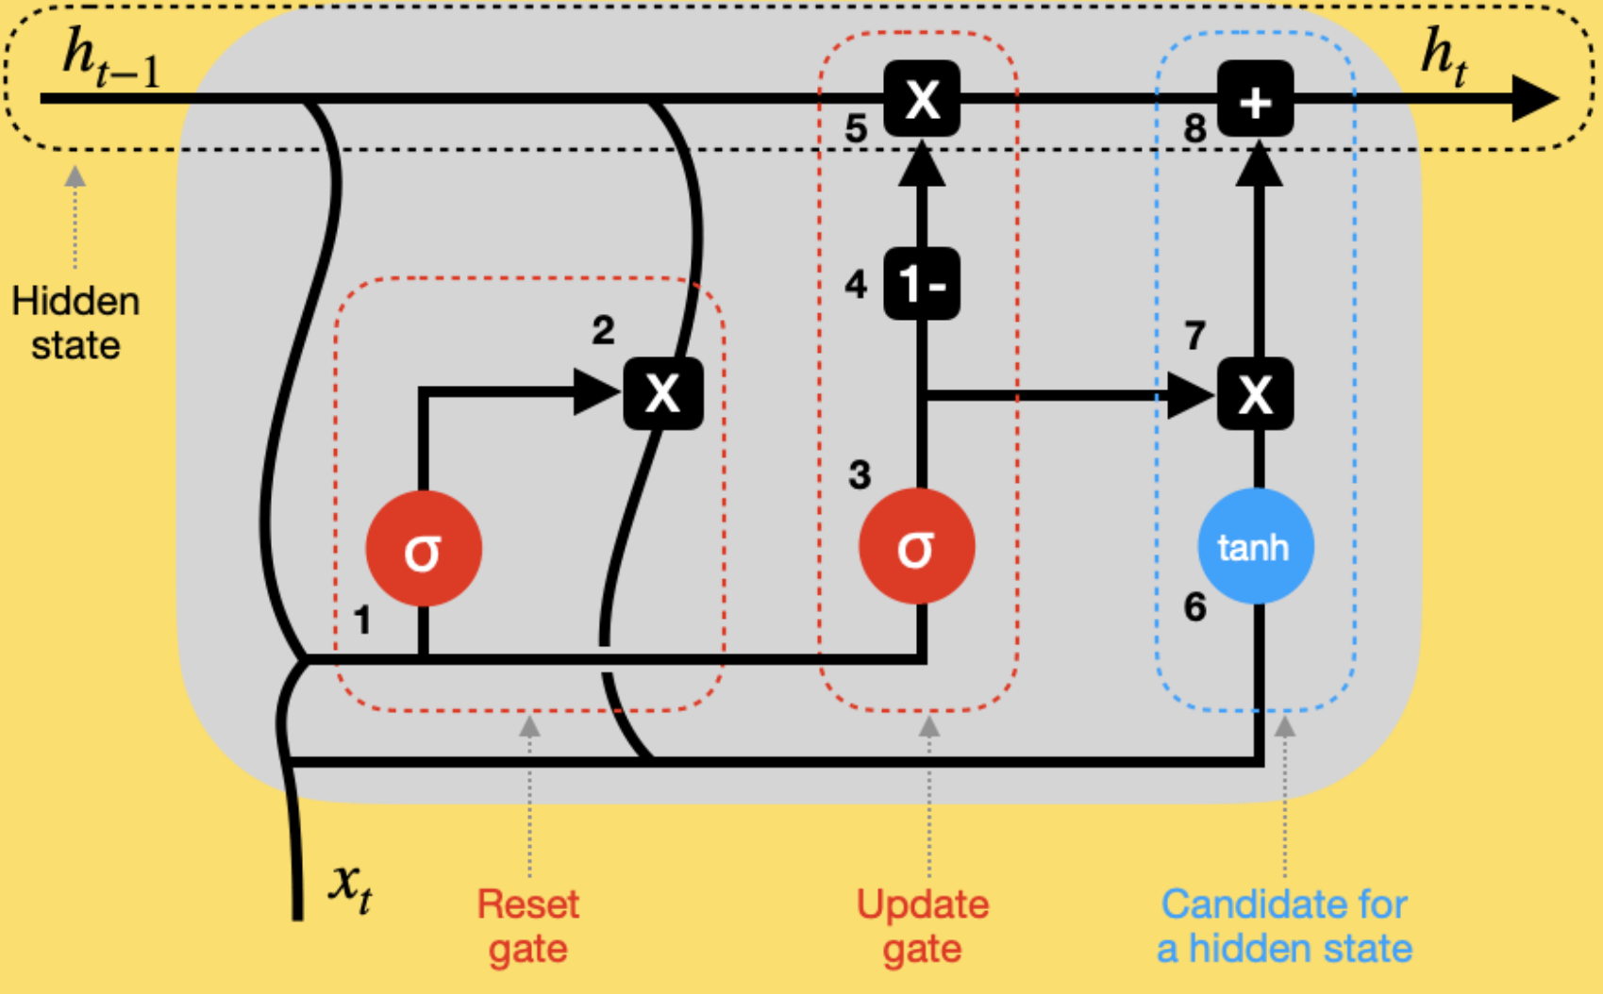
RNN Variants - Gated Recurrent Neural Networks, Long Short-Term Memory
RNNs have problems like that of the ‘Vanishing Gradient’ – gradients (error signals) become very small as they’re backpropagated through many layers, causing earlier layers to learn very slowly.
Long Short-Term Memory (LSTM) – Addresses the problem of long-term dependencies in RNNs. If the previous state influencing the current prediction is not in the recent past, the RNN may not be able to accurately predict the current state.
Gated recurrent units (GRUs) – Also addresses the short-term memory problem of RNNs. A ‘quick and dirty’ spin on LSTMs – just 2 gates, reset and update, so more computationally efficient.
Disadvantages: process data sequentially, training is slow; don’t remember long dependencies well; high computational and memory cost.
Transformers are the answer!
Notes:
An example of the long-term dependency problem. “Alice is allergic to nuts. She can’t eat peanut butter.” The nut allergy context ensures we know Alice shouldn’t eat peanut butter. However, if that context was several sentences prior, it would make it difficult, even impossible for the RNN to connect the information.
LSTMs have “cells” in the hidden layers of the ANN, with 3 gates: an input, an output, and a forget.
These 3 gates control the flow of information needed to predict the network output. For example, if gender pronouns like “she” are repeated many times in prior sentences, that might be excluded from the cell state.

Slide 13
Transformer Models
A neural network that excels at processing sequential data.
Transformer’s central feature is the ‘self-attention mechanism’, whereby they detect the relationships in the input sequence.
Unlike RNNs, the architecture of transformer models only has attention layers and standard feedforward layers.
Before transformer models, NLP tasks relied on RNNs. RNN process sequential data in a serial fashion: ingesting the input sequence one elements at a time, in a specific order. RNNs cannot properly capture long-range dependencies (though LSTMs somewhat helped).
Attention mechanism – algorithms that determine which parts of a sequence a model should “pay attention to”.
Attention mechanisms can examine an entire sequence simultaneously and make decisions about how, when to focus on time steps of the sequence.
Transformers allow for parallelisation, performing many computing steps simultaneously. Transformer models can be trained on massive datasets through self-supervised learning.
Notes:
First described in the seminal paper “Attention is All you Need” by Vaswani et al. .
Associated with large language models. LLMs like GPT-3 (Generative Pre-trained Transformer) that powered ChatGPT.
Self-supervised learning - a machine learning technique that uses unsupervised learning for tasks that conventionally require supervised learning. Rather than relying on labelled datasets for supervisory signals, self-supervised models generate implicit labels from unstructured data.

Slide 14
Self-attention
“…on Thursday, Mr Smith was seen by a respiratory consultant.”
The title “Mr” proceeding “Smith” implies this is a patient.
“respiratory” proceeding consultant suggests this patient may have a serious respiratory, so this sentence is important perhaps in finding lung cancer + patients.
There are 4 steps to a transformer’s attention layer:
  The model reads data sequences. Makes them into vector embeddings → each element in the sequence has a numeric vector reflecting their semantic meaning.
  The model determines the relationships between vectors. In transformer models, the relative importance of one vector to another is determined by computing the dot product between vectors. Well aligned vectors → larger dot product. Non-aligned vectors → small, negative dot product.
  Alignment scores become attention weights. A ‘softmax’ function makes all values between 0-1, adding up to 1 in total. I.e. weight of 0 between “Vector A” and “Vector B” means that Vector B should be ignored when making predictions about Vector A.
  The above is how a model focuses or ignore specific information.

Slide 15
Tokenisation, Input Embeddings, Positional encoding, Vectors
Tokens & Input Embeddings –
  We use letters, numbers as the base unit of language. AI models use tokens.
  Each token is assigned an ID number, reducing computational power needed the process text.
  To generate vector to feed into attention layers, the model gets an initial, contextless vector embedding for each token.
Positional encoding –
  Transformer models add positional info. for the attention mechanism to consider, relative to its position. The closer the tokens, the more similar the positional vectors, the higher the alignment score.

Slide 16
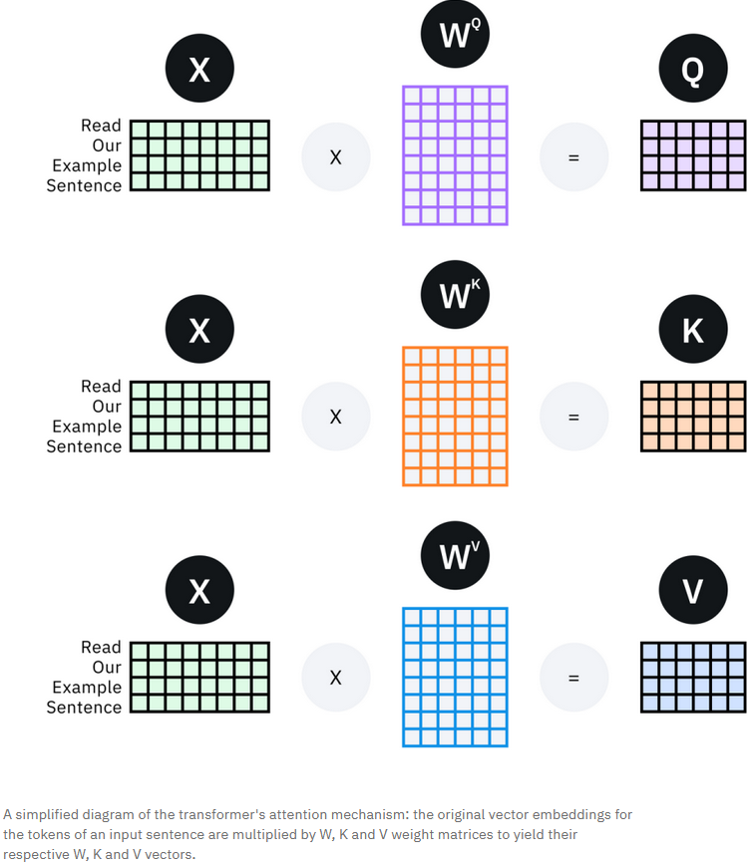
Vectors-
  Query Vector – the info. a token is seeking; how other tokens influence its’ meaning.
  Key Vectors – the info. Of the token. Alignment between query and key = attention weight .
  Value Vector – the info. From each key vector, scaled by respective attention weight.
  All vectors generated by passing token embeddings through 3 parallel FNNs, proceeding the first attention layer.
  The attention mechanism assigns attention weights to each *query vector-key vector* pair → value vector
  Σ (Value vectors) = aggregated contextual info. provided to a certain token by other tokens.
Notes:
https://www.ibm.com/think/topics/transformer-model
https://www.ibm.com/think/topics/attention-mechanism

Slide 17
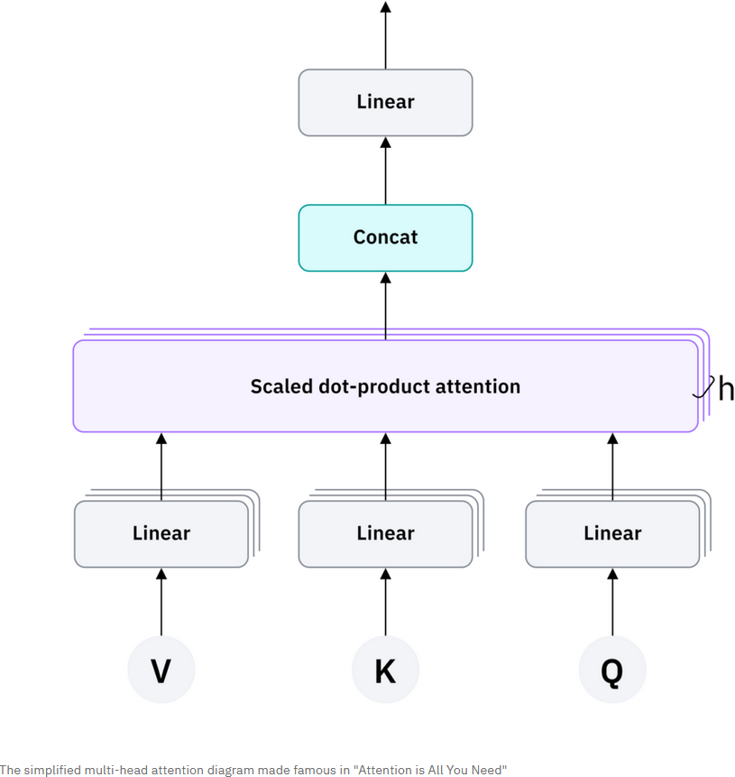
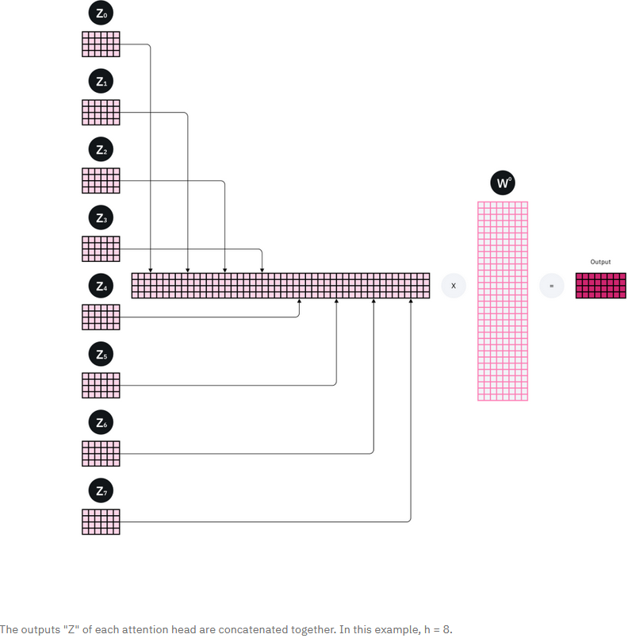
Multi-head attention -
Notes:
Captures the multifaceted meanings of words(tokens) and their relationships to one another.
“The patient has a |40-pack-year smoking history|, |presents with persistent cough| and unintentional weight loss, and a CT scan revealed a |spiculated nodule in the right upper lobe|.”
Before being fed into the first FNN layer, each original input token, after embedding, is split into h evenly sized subsets.
Each piece of embedding goes into the h parallel matric of Q, K, and V weights – query head, key head, value head.
Each of these parallel triplets are fed into the attention head.

Slide 18
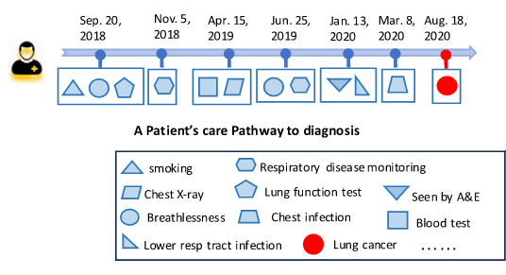
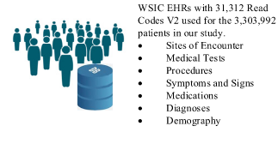
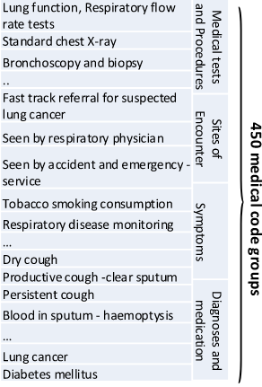
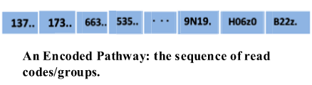
‘Transformer-based deep learning model for the diagnosis of suspected lung cancer…’ – Methods – Data Preprocessing
Notes:
Patient-level pathways to diagnosis developed using medical codes appearing over 3 years before diagnosis, with a temporal order.
End point = index lung cancer diagnosis. Lung cancer took precedence over other cancers.
Control group = patients with codes for ‘cancers not lung’, with date of first cancer diagnostic code.
Of 3.3mil patients, 11.8K with lung cancer, 31.3K unique read codes were collected.
‘Clinically guided’ mapping of codes to higher terms generated 450 Read code groups.
Encoded pathways were generated to reduce noise, excluding patients with <10 read codes/groups in the 3 years before diagnosis.

Slide 19
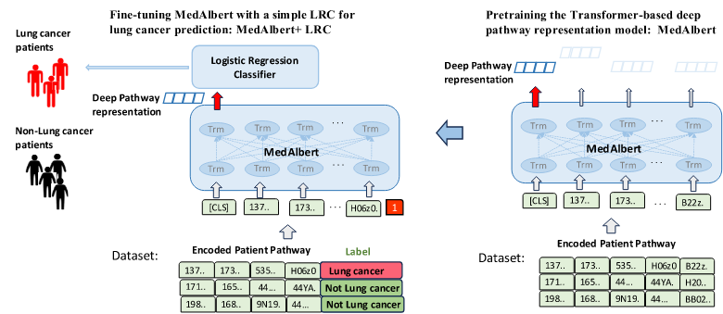
‘Transformer-based deep learning model for the diagnosis of suspected lung cancer…’ – Methods – Statistics
Notes:
A new model, MedAlbert, based on ALBERT was used. This model has fewer parameters and lower memory consumption than BERT.
BERT = Bidirectional Encoder Representations from Transformers. A transformer model that understand language in context.
BERT read text both left-to-right and right-to-left. It uses self-attention to see how words in a sentence relate to other words.
BERT uses ‘Masked Language Modelling’ to randomly hide words and trains the model to guess them.
BERT uses Next Sentence Prediction to teach sentence relationships.
MedAlbert is a 6-layer transformer with 12 attention heads to learn the representations for each medical code at each layer by integrating long range contextual information in a pathway.
There are 6x12 attention calculations allow many relationships and dependencies to be captured!
Fine tuned with a logistic regression classifier, simple and efficient technique. Using a neural net instead would result in a slower, more memory-hungry model that could overfit data.

Slide 20
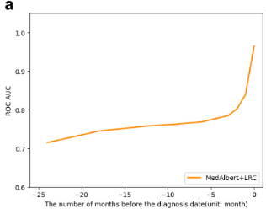
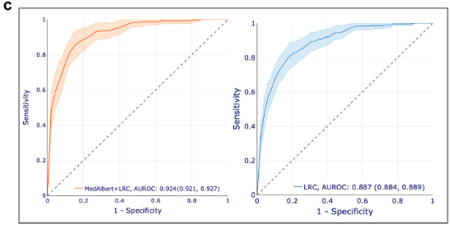
‘Transformer-based deep learning model for the diagnosis of suspected lung cancer…’ – Methods – Model Performance
Notes:
Precision, Recall and AUROC used for evaluation.
Precision/ Positive Predictive Value = proportion of the patients with predicted lung cancer by the model that actually have lung cancer
Recall/Sensitivity - the proportion of actual patients with lung cancer that are correctly predicted as lung cancer as a proportion of lung cancer cases

Slide 21
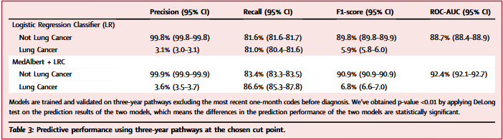
‘Transformer-based deep learning model for the diagnosis of suspected lung cancer…’ – Methods – Model Performance
Notes:
Precision= proportion of the patients with predicted lung cancer by the model that actually have lung cancer. Precision = TP / (TP + FP)
Recall/Sensitivity - the proportion of actual patients with lung cancer that are correctly predicted as lung cancer as a proportion of lung cancer cases. Recall = TP / (TP + FN)
F1 = 2 * (Precision * Recall) / (Precision + Recall). The harmonic mean of Precision and Recall
MedAlbert + LRC > LRC alone. 1%-6% absolute improvement in all metrics.
“In the UK, NICE accept a PPV of 3% as a threshold for fast-track investigation of suspected cancer.”

Slide 22
‘Transformer-based deep learning model for the diagnosis of suspected lung cancer…’ – Discussion Points
  Population-based lung cancer risk models built using ML techniques like random forests and vector boost exist, but they are static. They don’t account for temporal relationships in EHR data!
  This MedAlbert +LRC model is a predictive model for symptomatic patients NOT a population risk model.
  MedAlbert +LRC has a PPV of 3.6% and sensitivity of 86.6%.
  QCancer Lung has a PPV of 1.34% at its maximum sensitivity of 77.3%.
  Limitations –
    “Static demographic features such as sex” (it’s going to be static for the overwhelming majority of patients?)
    No lab.test results to map results to normal/abnormal.
    Time not considered – the care pathways are time insensitive.
    Primary care EHR data is quite sparse regarding symptom codes and won’t contain results of secondary care investigations. (Could they not do secondary care linkage?)
  MedAlbert ≠ an LLM. However, a pre-trained LLM could be an alternative to a pre-trained ALBERT model!

