Slide 1
Patient Stroke Outcome Data Analysis – EDA, Survival Analysis, Prediction Modelling
George Melrose AMRSB MBCS MSc(Bham.) BSc(Hons)(Glas.)
Most recently Research Information Analyst – Research Information Office (RIO), University of Cambridge

Slide 2
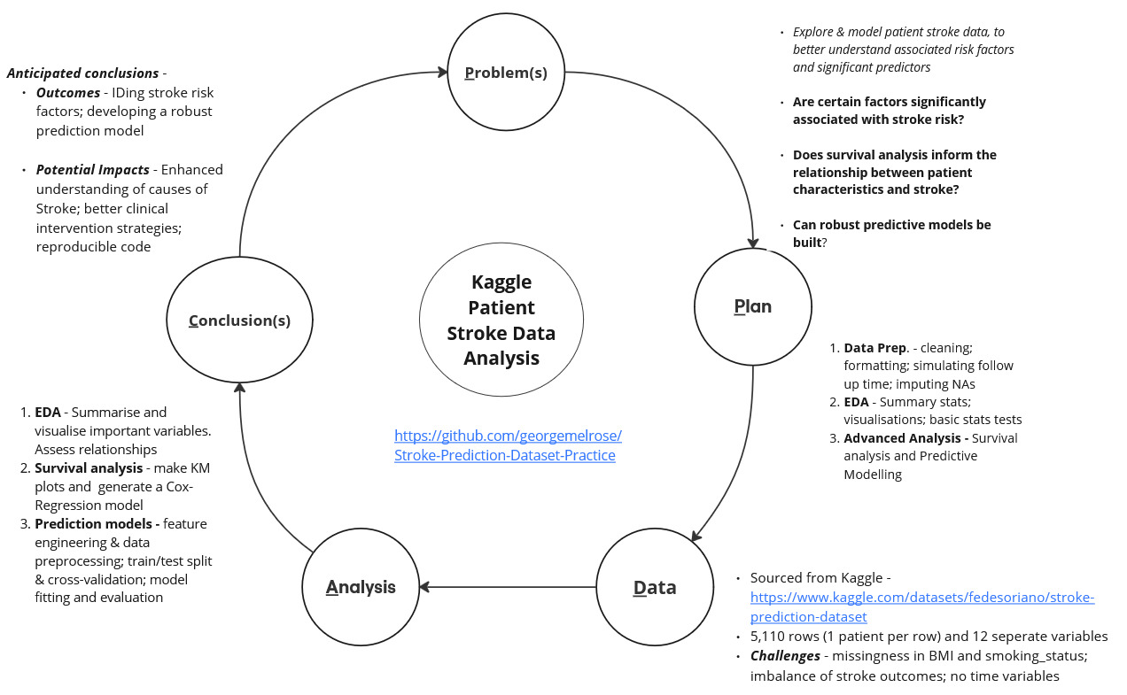

Slide 3
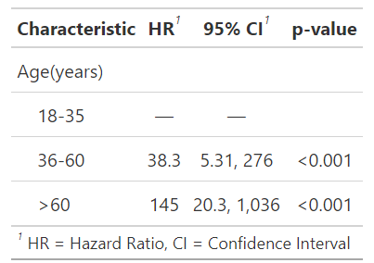
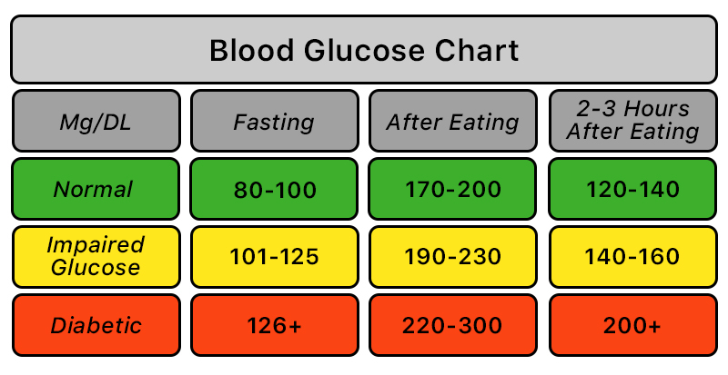
Data Preparation Part 1 – Formatting Data
Children (patients with age <18) were removed as lifestyle factors are far less connected to paediatric stroke. 5,110 patients – 856 children → 4,254 adult patients.
Create categorical version of binary 1,0 variables – hypertension_yn, heart_disease_yn, stroke_yn .
Relevel factor variables: ‘No’ for hypertension_yn, heart_disease_yn, stroke_yn; ‘Private’ for ‘Work_Type’; ‘Urban’ for ‘Residence_Type’; ‘never smoked’ for ‘smoking_status’ .
Create categorical variables for ‘age’ - age <= 60 and age >60 . For ‘BMI’ - bmi < 18.5 "Underweight“, bmi >= 18.5 & bmi <= 24.9 "Normal weight", bmi >= 25 & bmi <= 29.9 "Overweight", bmi >= 30 "Obese“.
Remove ‘avg_glucose_level’ variable as WO knowing the conditions under which the glucose levels were measured, it becomes difficult to meaningfully interpret.
Simulate follow up times over 5 years.
Cox-Proportional Hazards Regression results for stroke incidence over 5-year study period when patients aged 18-35 are a separate category – only 1 incidence of stroke in this category.
Lark Health Company Blood Glucose Chart

Slide 4
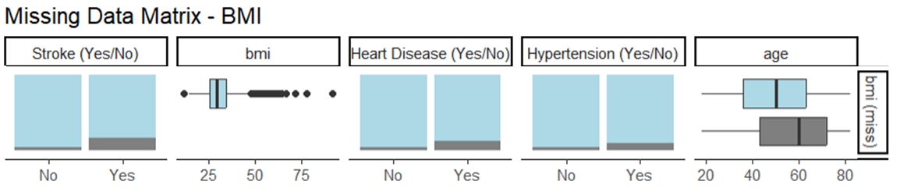
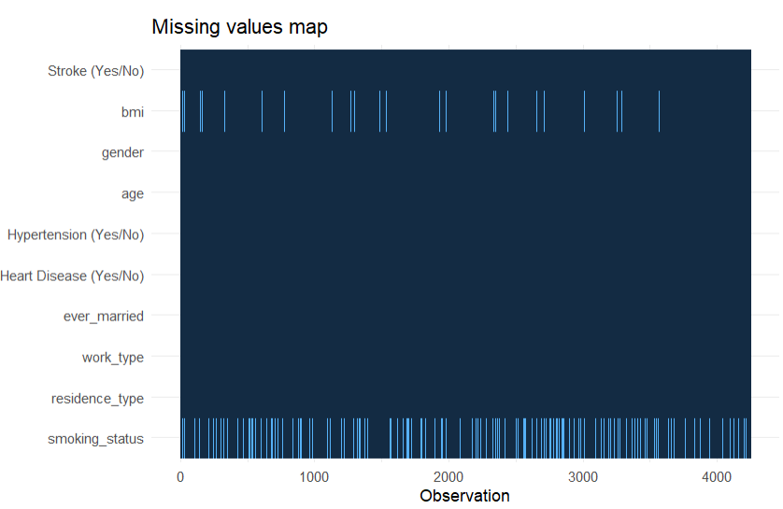
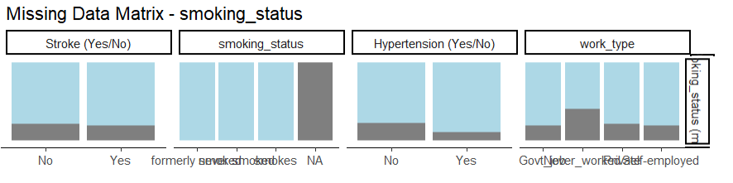
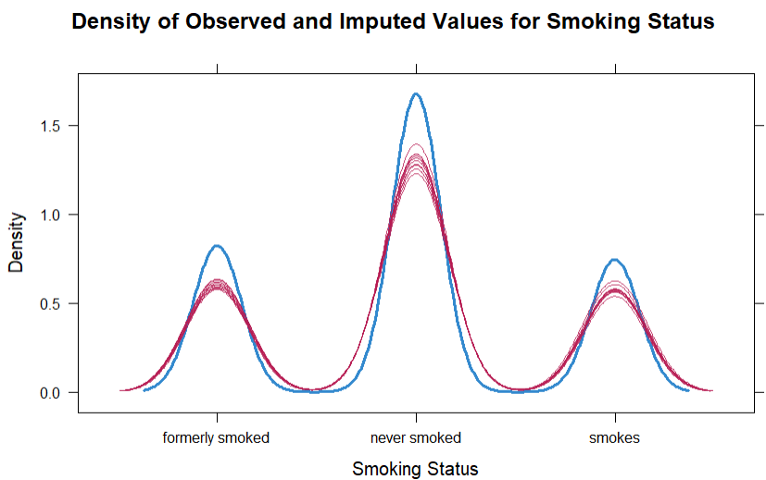
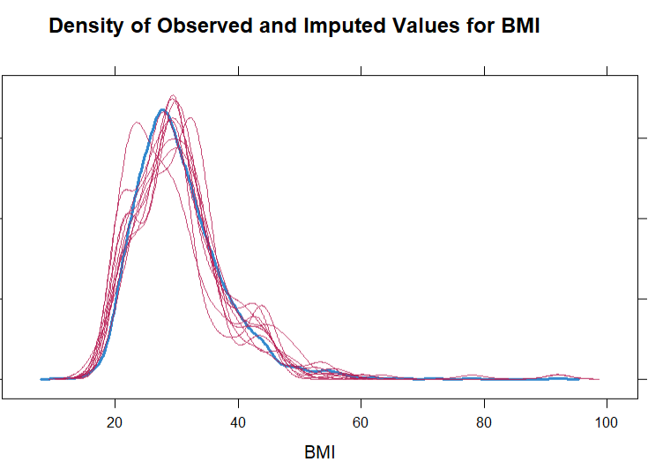
Data Preparation Part 2 – MICE on MAR ‘BMI’ and ‘smoking_status’ Data
Using mice(), 10 imputed sets were made using the above variables showing an association with NAs.
Log. Regression run on each imputed set, results pooled together AUC of 0.818 – imputations successfully maintained predictive relationships in the data.
Notes:
explanatory <- c("id","bmi","gender","age","hypertension_yn","heart_disease_yn","ever_married", "work_type","residence_type","smoking_status")dependent <- "stroke_yn“
#Choosing variables to not be imputed but still used by the mice function# stroke_data %>% select(dependent, explanatory) %>% missing_predictorMatrix( drop_from_imputed = c("gender","age","hypertension_yn","heart_disease_yn","ever_married", "work_type","residence_type","stroke_yn","id"), drop_from_imputer = c("gender","ever_married","residence_type","smoking_status", "id") ) -> predM

Slide 5
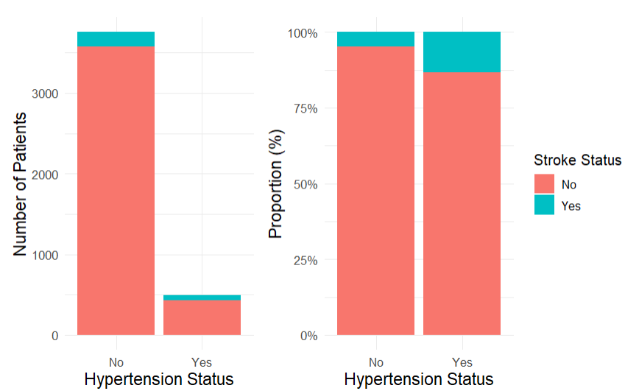
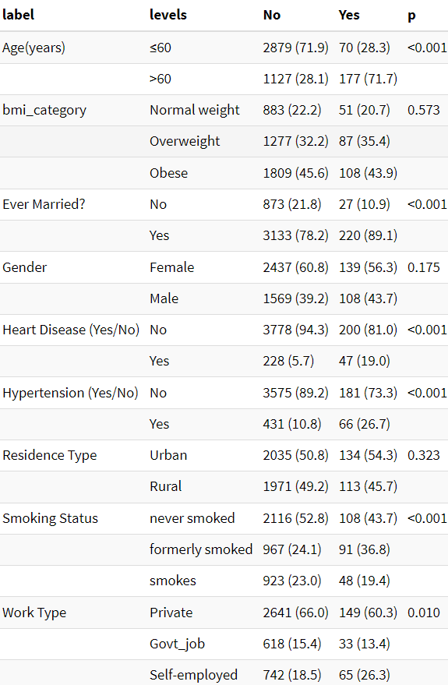
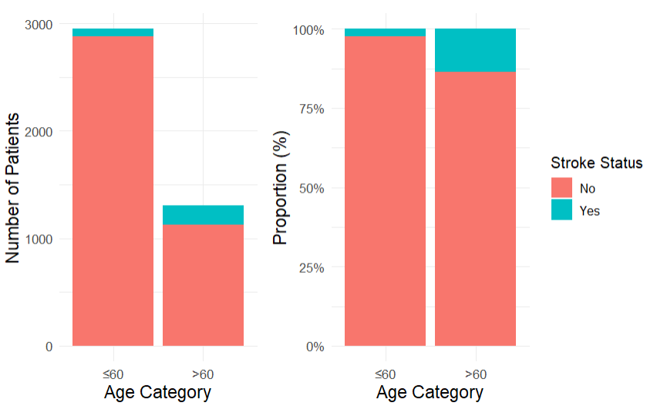
Exploratory Data Analysis – Visualising & Testing Relationships

Slide 6
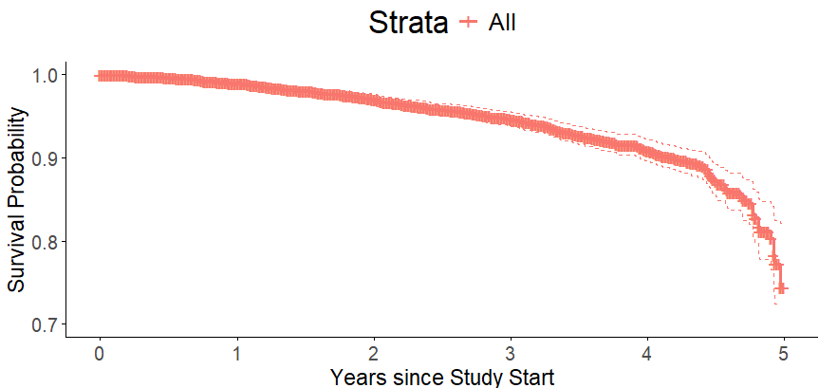
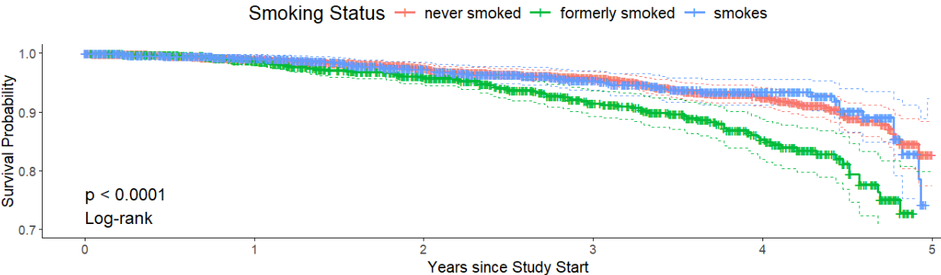
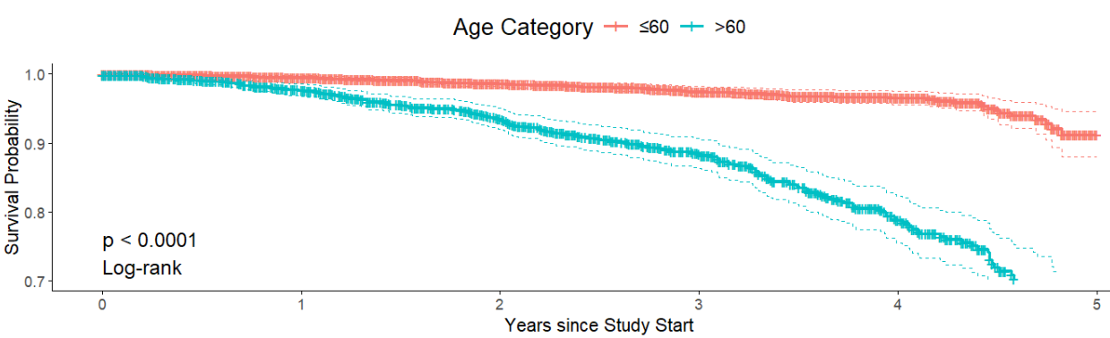
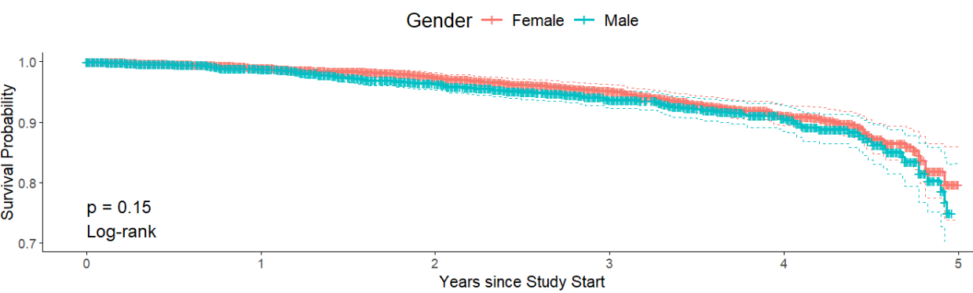
Survival Analysis – Survival Curves and Cox-Regression Modelling
Notes:
explanatory <- c("id","bmi","gender","age","hypertension_yn","heart_disease_yn","ever_married", "work_type","residence_type","smoking_status")dependent <- "stroke_yn“
#Choosing variables to not be imputed but still used by the mice function# stroke_data %>% select(dependent, explanatory) %>% missing_predictorMatrix( drop_from_imputed = c("gender","age","hypertension_yn","heart_disease_yn","ever_married", "work_type","residence_type","stroke_yn","id"), drop_from_imputer = c("gender","ever_married","residence_type","smoking_status", "id") ) -> predM

Slide 7
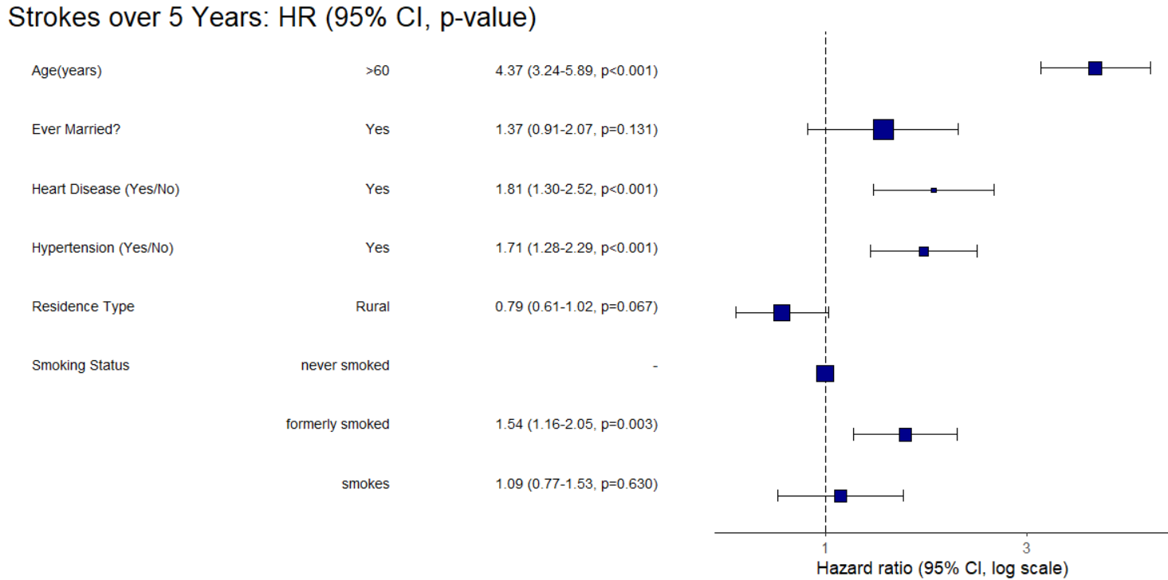
Survival Analysis – Cox-Regression Modelling
Number in dataframe = 4253, Number in model = 4253, Missing = 0, Number of events = 247, Concordance = 0.754 (SE = 0.017), R-squared = 0.050( Max possible = 0.576), Likelihood ratio test = 216.670 (df = 7, p = 0.000)
Cox regression model of all variables with a at least 1 level having a statistically significant HR (ever_Married nearly!) (bar ‘Residence Type, kept because of the interesting result implying Rural almost leads to a statistically significant lower risk of stroke over 5 years).

Slide 8
Prediction Modelling – Random Forest (RF), Naïve Bayes (NB), K-Nearest Neighbours (KNN)
KNN
Naïve Bayes
Random Forest
Simple, non-parametric method that works well for smaller datasets with a straightforward decision boundary.
Testing Data Confusion Matrix -
Simple and quick although stroke_data violates assumption that features don’t influence each other
Testing Data Confusion Matrix -
Provides high accuracy, works well with both categorical and numerical data, and is less sensitive to outliers or noise., see feature importance
Testing Data Confusion Matrix -
Predicted | Actual | 0 – No Stroke | 1 - Stroke
 | 0 – No Stroke | 809 | 0
 | 1 - Stroke | 38 | 2
Predicted | Actual | 0 – No Stroke | 1 - Stroke
 | 0 – No Stroke | 811 | 40
 | 1 - Stroke | 0 | 0
Predicted | Actual | 0 – No Stroke | 1 - Stroke
 | 0 – No Stroke | 811 | 39
 | 1 - Stroke | 0 | 1
F1 Score (training) – 0.0096
F1 Score (testing) – 0
AUROC (training) - 0.191
AUROC (testing) - 0.173
F1 Score (training) – 0.208
F1 Score (testing) – 0.0488
AUROC (training) - 0.773
AUROC (testing) - 0.193
F1 Score (testing) – 0.095
AUROC (testing) - 0.815
Results -
KNN has some discriminatory power as shown by a good AUROC – low F1 score probably due to class imbalances.
NB has poor metrics across both training and test– underfitting. Predictors too correlated.
RF much poorer in testing – overfitting. Need to tune hyperparameters
Further Work –
KNN – experiment with no.neighbours, scale features. NB – rework input parameters. RF – Test different no. trees, generate more stroke cases via SMOTE.
Notes:
Feature Importance
age 73.1805542
Bmi 69.7011743
smoking_status 11.3268734
work_type 11.3188035
gender 6.6495576
heart_disease 6.492479
F1 score = 2( (Precision * Recall) / (Precision + Recall))
Precision = True Positive / (True Positive + False Positive)
Recall = True Positive / (True Positive + False Negative)

Slide 9
