Slide 1

Machine Learning for Heliophysics
09:00–10:00 Solar & heliospheric physics: activity cycles, solar wind, CMEs
10:00–11:00 SOHO, SDO, Solar Orbiter, OMNI datasets
11:15–12:30 ML methods: solar image classification, CME forecasting, solar wind prediction
13:30–17:00 Hands‑on: Solar image segmentation, predictive modeling, project time
Ekaterina Dineva, George Miloshevich, Panagiotis Gonidakis
CmPA, KU Leuven

Slide 2
Gaussian Process Regression

Slide 3
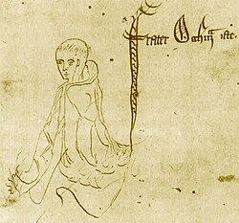
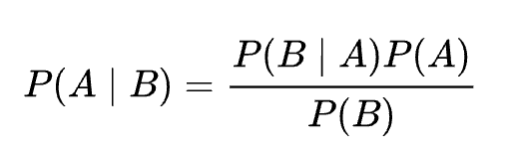
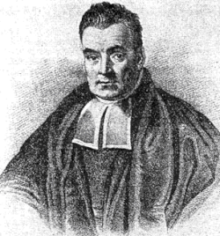
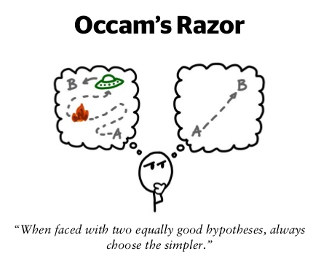

Occam’s razor: Frequentist vs Bayesian statistics
Posterior = Likelihood × Prior ÷ Evidence
Bayes
Occam's razor is attributed to William Occam
C.E.Rasmussen C.K.I.Williams, Gaussian Processes for Machine Learning, the MIT Press,2006, www.GaussianProcess.org/gpml

Slide 4
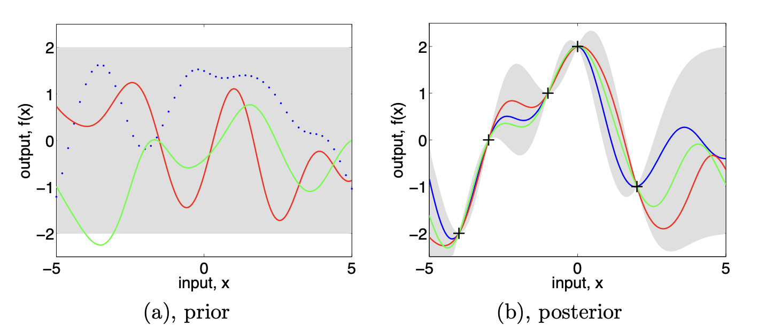

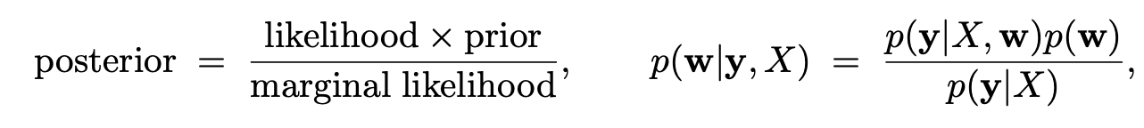
Gaussian Process regression for Machine Learning
Bayes Theorem
C.E.Rasmussen C.K.I.Williams, Gaussian Processes for Machine Learning, the MIT Press,2006, www.GaussianProcess.org/gpml

Slide 5


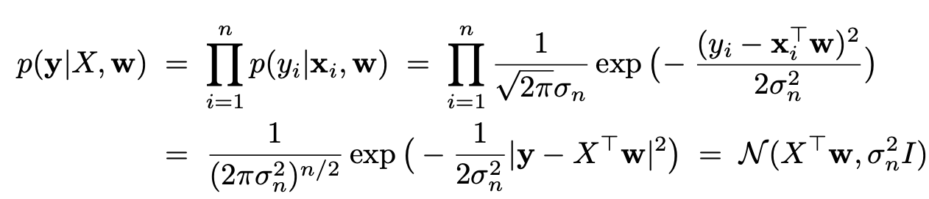
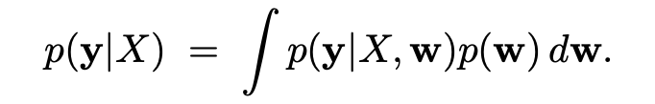
Standard Linear model with Gaussian probability
Bayes Theorem:
C.E.Rasmussen C.K.I.Williams, Gaussian Processes for Machine Learning, the MIT Press,2006, www.GaussianProcess.org/gpml

Slide 6
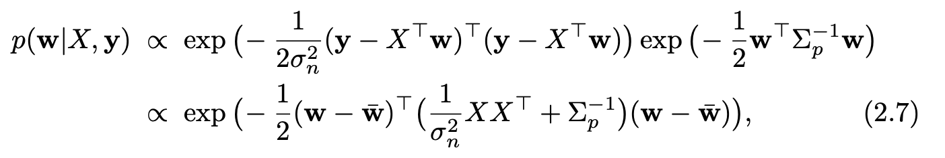


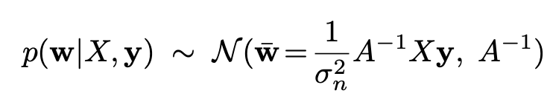
maximum a posteriori (MAP) estimate
ridge regression
Covariance matrix
C.E.Rasmussen C.K.I.Williams, Gaussian Processes for Machine Learning, the MIT Press,2006, www.GaussianProcess.org/gpml

Slide 7


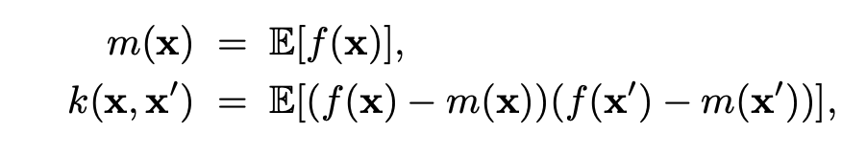
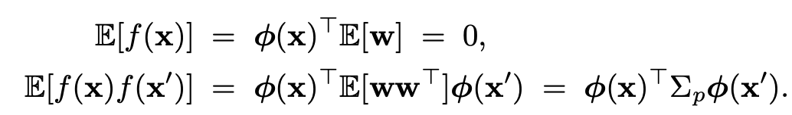
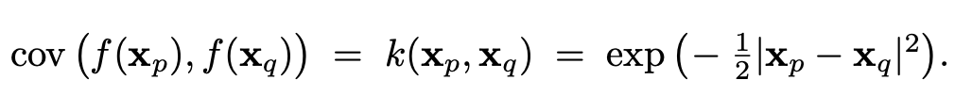
Function space view
Covariance matrix:
Squared Exponential
(kernel)
C.E.Rasmussen C.K.I.Williams, Gaussian Processes for Machine Learning, the MIT Press,2006, www.GaussianProcess.org/gpml

Slide 8



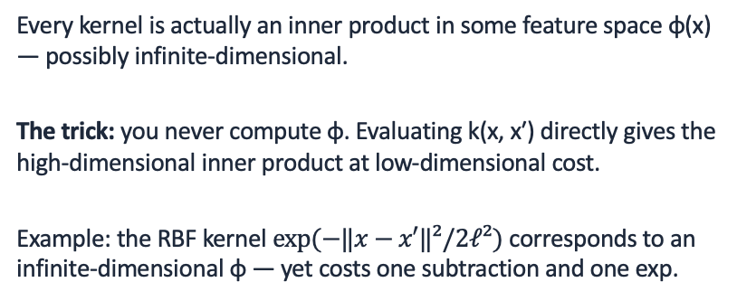

Kernel methods
The big idea
The kernel trick
A kernel k(x, x′) is a similarity function: it says how alike two inputs are, and that is all many algorithms ever need.
If an algorithm touches data only through inner products ⟨x, x′⟩, you can swap in any kernel — and instantly get a nonlinear version of it.
A valid kernel must be symmetric and positive semi-definite (Mercer's condition) — then the Gram matrix Kᵢⱼ = k(xᵢ, xⱼ) behaves like a covariance.
$$k(x, x′) = ⟨ φ(x), φ(x′) ⟩$$
Every kernel is actually an inner product in some feature space φ(x) — possibly infinite-dimensional.
The trick: you never compute φ. Evaluating k(x, x′) directly gives the high-dimensional inner product at low-dimensional cost.
Example: the RBF kernel $exp⁡(−‖x−x′‖²/2ℓ²)$ corresponds to an infinite-dimensional φ — yet costs one subtraction and one exp.
A small kernel zoo: linear ⟨x, x′⟩ · polynomial (⟨x, x′⟩ + c)ᵈ · RBF (infinitely smooth) · Matérn (tunable smoothness ν)
Build your own: sums and products of kernels are kernels — e.g. amplitude × Matérn + noise from the last lecture.
Where you'll meet them: SVMs, kernel ridge regression, kernel PCA, and Gaussian processes — where k doubles as the covariance function.
Notes:
Teaching flow: start from linear regression/classification and ask 'what if the relationship is not linear?' Old answer: hand-craft features phi(x). Kernel answer: skip phi entirely and specify similarity directly. Emphasize the two readings of a kernel: (1) computational — a cheap shortcut to an inner product in a huge feature space (kernel trick, SVM lineage); (2) probabilistic — a covariance function encoding prior beliefs about smoothness and scale (GP lineage). The same object, two communities. Mercer/PSD condition: needed so the Gram matrix is a valid covariance / so the feature space exists. Quick check students can do: a kernel matrix with a negative eigenvalue is not a kernel. Closure properties (sum, product, scaling) are what make kernel DESIGN possible — connect directly to the ConstantKernel * Matern + WhiteKernel construction from the previous lecture: amplitude times correlation plus noise. Good homework hook: show that the polynomial kernel with d=2 corresponds to an explicit phi containing all pairwise products of coordinates, then note the RBF case where phi is infinite-dimensional.

Slide 9


When to use Gaussian Process Regression vs Neural Networks
Choose GPR when…
Choose a neural network when…
Data is small or expensive — 10–10k points; the kernel prior makes every sample count
Calibrated uncertainty matters — posterior error bars drive Bayesian optimization, active learning, safety margins
Inputs are low-dimensional (≲ 20 dims), and the response is smooth-ish / stationary
Few knobs, no validation set — 5–10 hyperparameters tuned by marginal likelihood;
Surrogate modeling of costly simulators or experiments
Data is large — exact GPs cost 𝑂(n³);
SGD scales near-linearly past 10⁴–10⁵ points
Inputs are high-dimensional or structured — images, text, graphs: the network learns the representation
Non-stationary behavior — sharp regime changes defeat a single global kernel
Fast inference at scale matters more than principled uncertainty
Notes:
Framing for the audience: the costs are dual. GPR spends its compute at inference time (O(n^3) in the number of training points), while neural networks spend it at training time. Likewise the inductive bias: a GP's prior is CHOSEN explicitly via the kernel, while an NN's bias is LEARNED through weights and architecture. Rules of thumb: below ~10k points and ~20 input dimensions with a need for error bars, GPR is usually the right default — this is exactly the surrogate-modeling regime of notebook 04 (expensive arrival-time evaluations, Bayesian optimization needs calibrated posteriors). Above that scale, or with raw images/text/graphs, NNs dominate because they learn the representation instead of relying on a hand-picked distance. If asked about the middle ground: sparse/inducing-point GPs stretch GPR to ~10^5-10^6 points; deep kernel learning and 'NN backbone + GP head' combine learned features with calibrated uncertainty; Bayesian NNs and deep ensembles approximate uncertainty on the NN side but are less calibrated than a GP posterior.

Slide 10
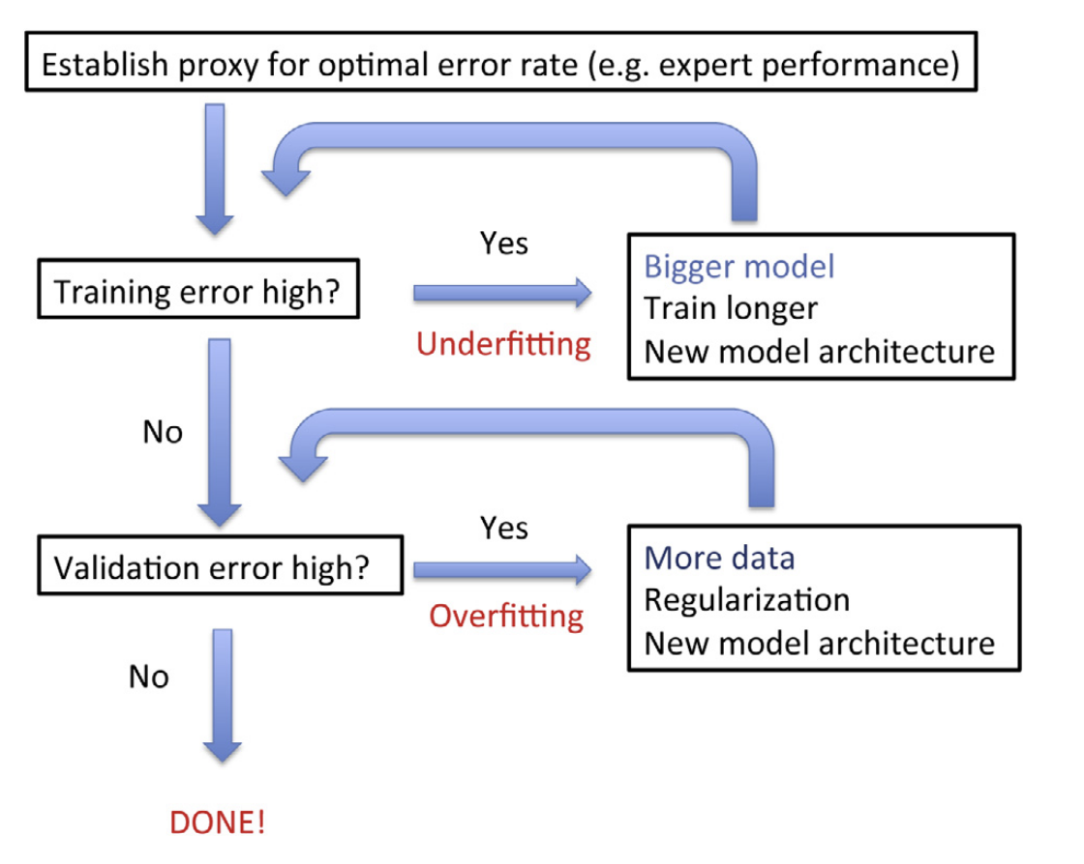
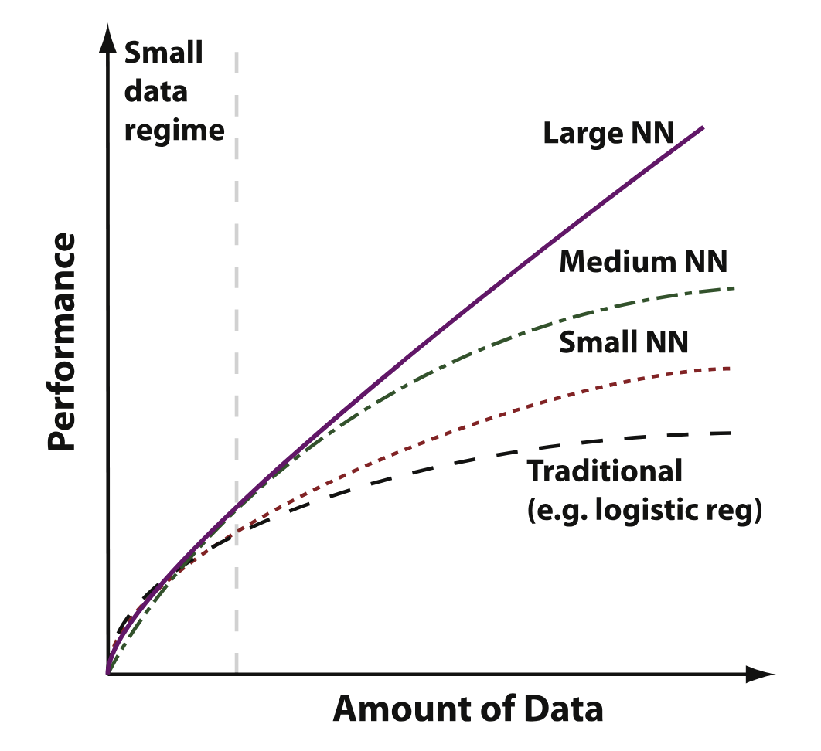
Model parsimony: complexity vs expressivity

Slide 11
Solar wind and Coronal Mass Ejection (CME) modelling

Slide 12
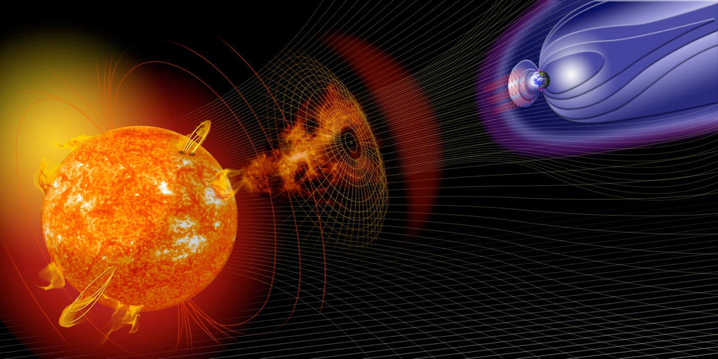
VSWMC models (operational (17) and operational soon (5))
Magnetosphere models:
GUMICS-4
GORGON-Space
Inner heliosphere wind and CME evolution models :
EUHFORIA
ICARUS
Inner magnetosphere models:
CTIP (limited)
NARMAX-SNRB
BPiM (Plasma sphere)
NARMAX-SNGI (Kp + Dst)
Dst, Kp, magnetopause stand-off distance
MCM-DTM
DICTAT & IMPTAM
CTIP extended
SEP models :
SPARX
PARADISE (/ PARASOL?)
Solar corona models:
Multi-VP
Wind-Predict
EUHFORIA-corona (WSA)
COCONUT
COCONUT-TDm/RBSL
www.nasa.gov
artist’s impression
Notes:
First I would like to outline the need for integrated Space Weather model frameworks that will be covered tomorrow by Christine Verbeke, so please don’t skip that talk. SW needs to be predicted so that mitigation is possible
Physics based models are needed as empirical & semi-empirical models do not always work satisfactorily. Simple (G)UI needed for easy of use of (often very complicated) simulation models. Here you see collection of models that we can provide in VSWMC, such as solar corona models, inner heliosphere models, solar energetic particles and magnetospheric models.

Slide 13
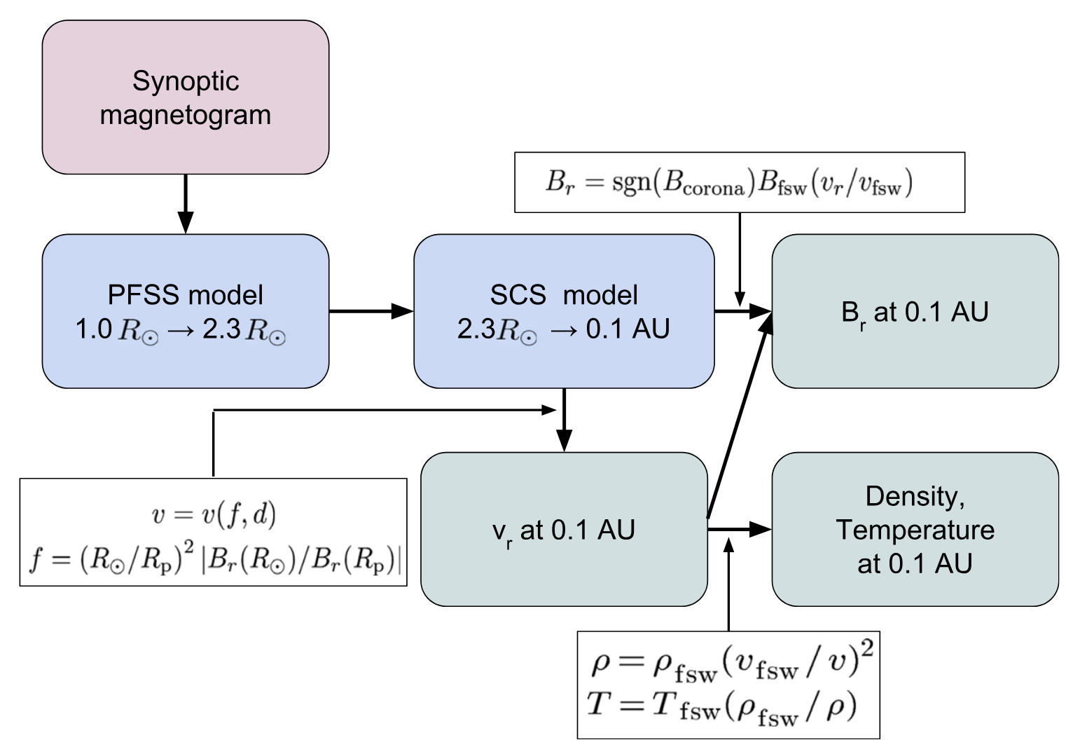
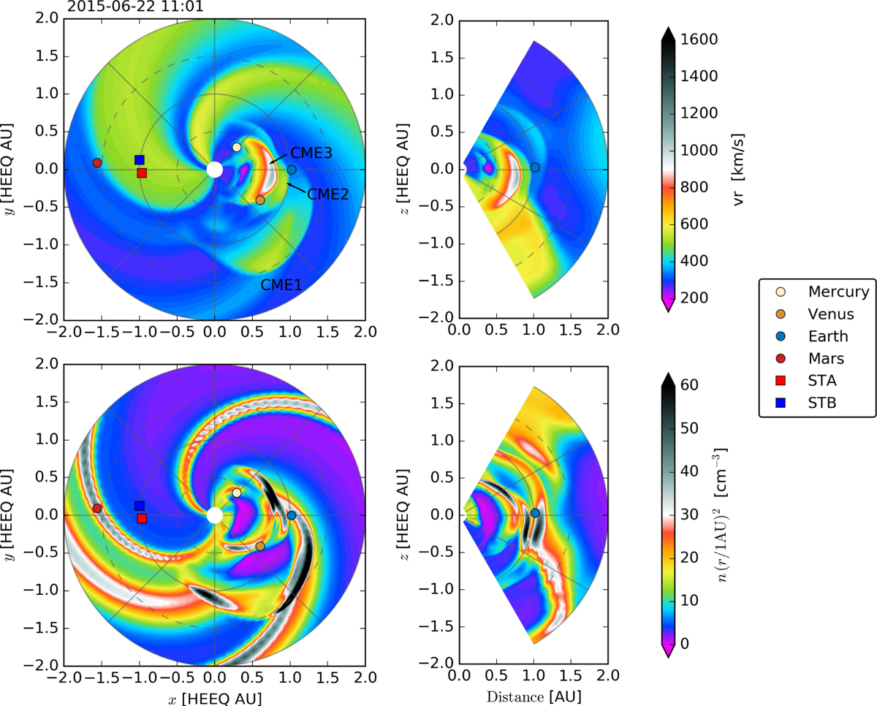
EUHFORIA: European heliospheric forecasting information asset
Pomoell, Jens, and S. Poedts. “EUHFORIA: European Heliospheric Forecasting Information Asset.” Journal of Space Weather and Space Climate 8 (2018): A35. https://doi.org/10.1051/swsc/2018020.

Slide 14
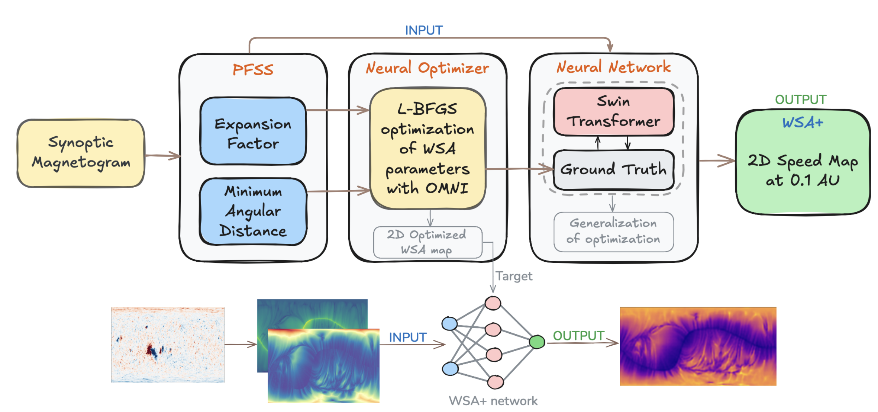
WSA and WSA+ models for 0.1 AU solar wind
Mayank, Prateek, Enrico Camporeale, Arpit K. Shrivastav, Thomas E. Berger, and Charles N. Arge. “Neural Enhancement of the Traditional Wang–Sheeley–Arge Solar Wind Relation.” The Astrophysical Journal Letters 994, no. 1, 2025

Slide 15
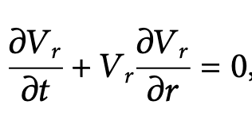
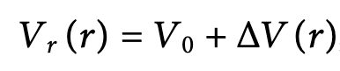
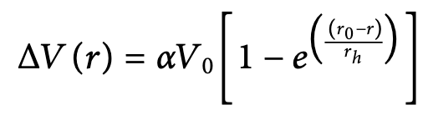
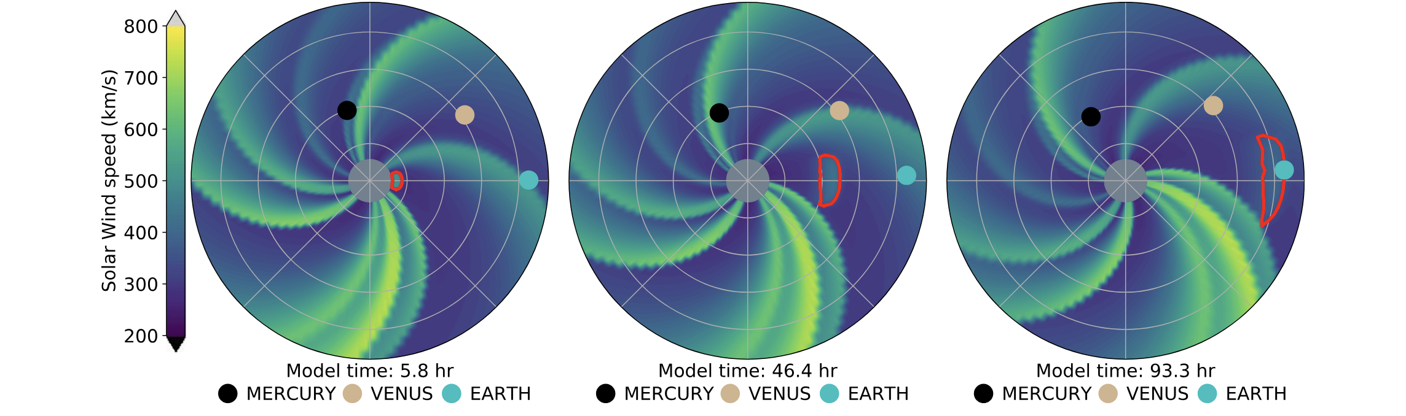
Heliospheric Upwind eXtrapolation (HUX) + time
Solar wind modelled by inviscid Burger’s equation
radial solar wind speed
residual acceleration,
Courant–Friedrichs–Lewy (CFL) condition:
Δt ≤ Δr vmax, with vmax = 2000 km/s => Δt = 8.70 min

Slide 16
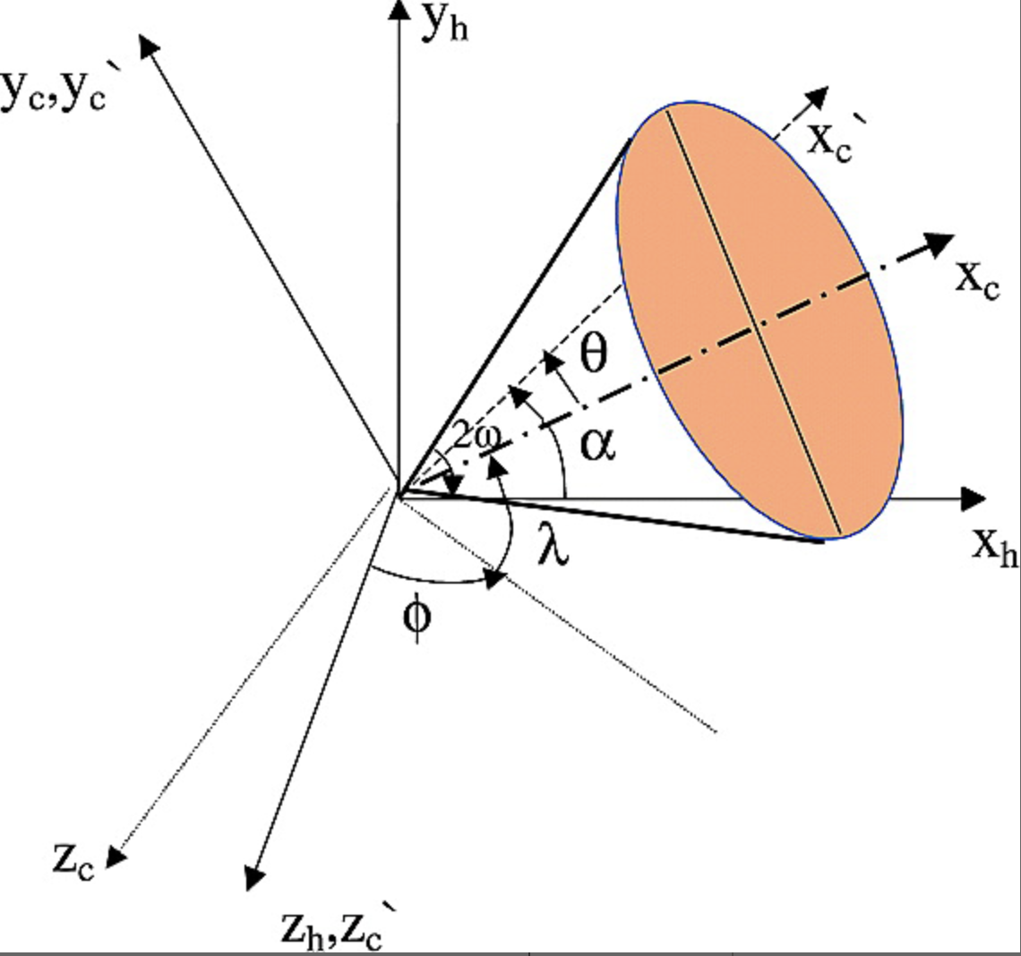
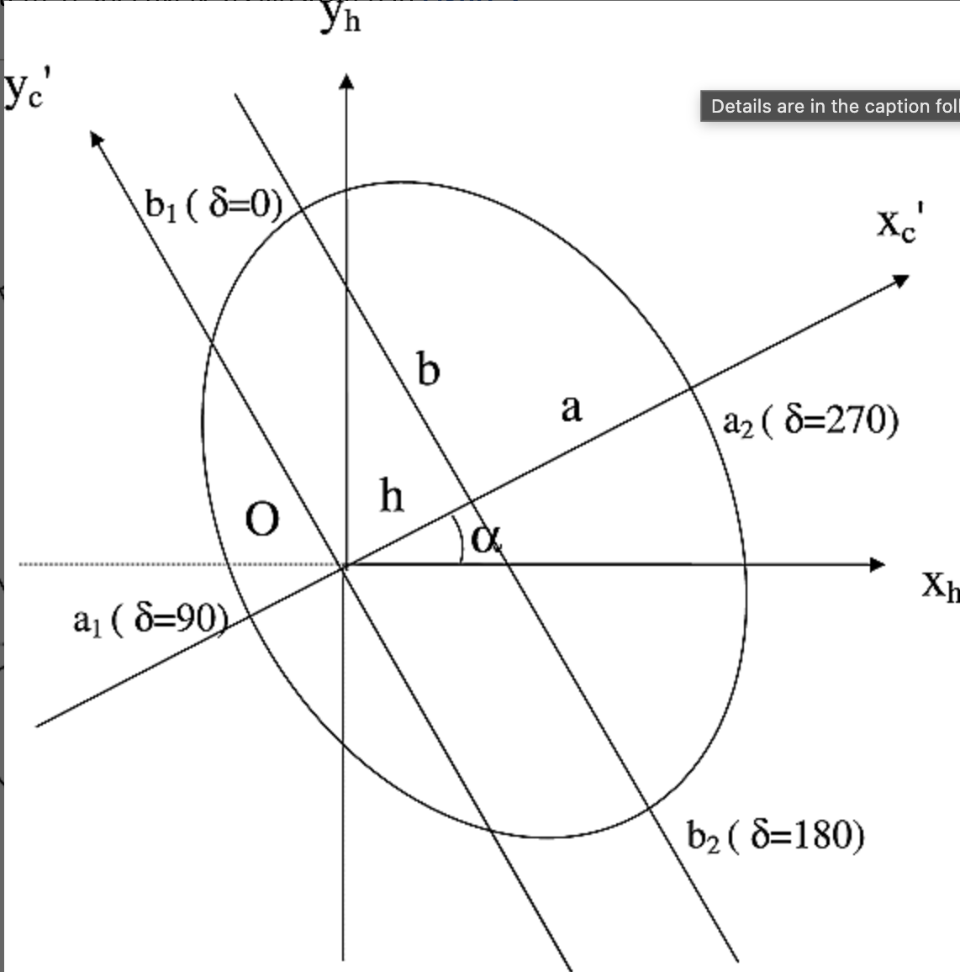
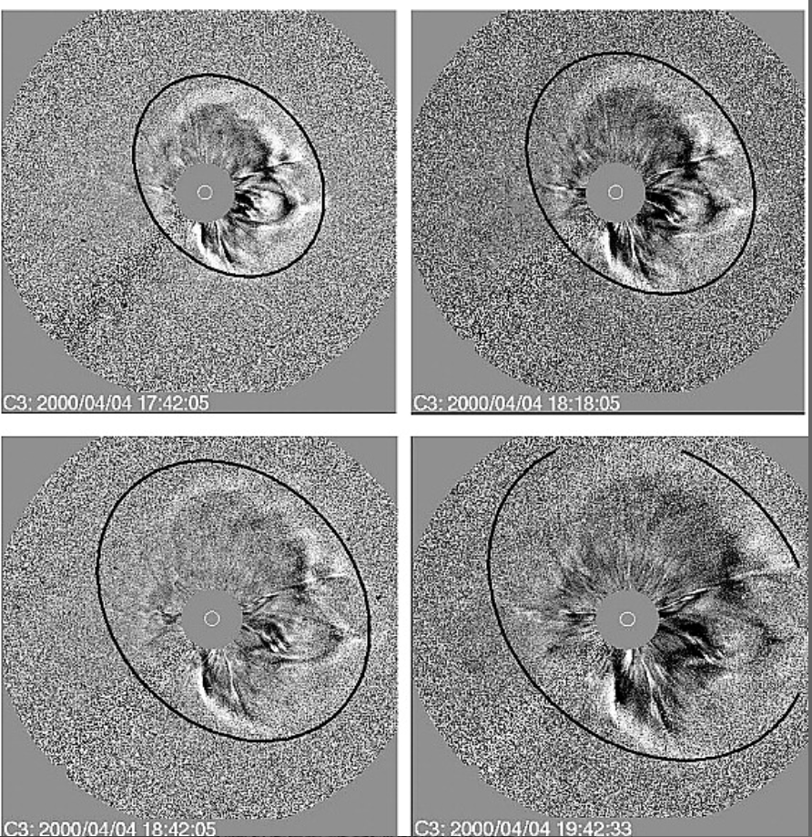
The cone Coronal Mass Ejection (CME) model
Topology of the cone model and transformation of coordinate systems.
Elliptical projection of the circular cross section of the cone on the plane of the sky.
Comparison of modeled halos (black circles) and LASCO images for the 4 April 2000 event.
Xie, Hong, Leon Ofman, and Gareth Lawrence. “Cone Model for Halo CMEs: Application to Space Weather Forecasting.” Journal of Geophysical Research: Space Physics 109, 2004

Slide 17
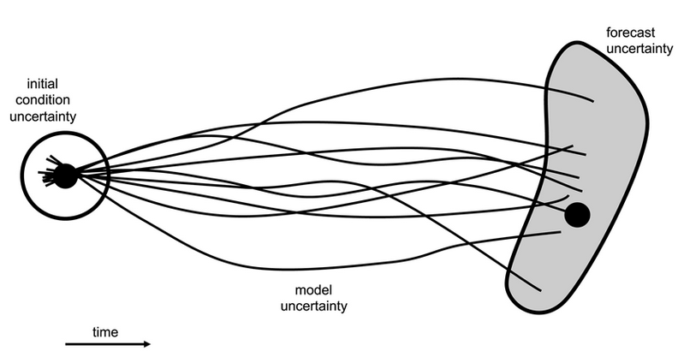
The NEED for SPEED
Ensemble modelling forecasting to deal with uncertainty
Schematic of an ensemble forecast where the lines represent trajectories of individual forecasts that diverge from each other owing to uncertainties in the initial conditions. The gray envelope highlights that there are range of forecast states, not just the state that arises from a single deterministic forecast (as indicated by the black circle). Credit: Murray [2018], Figure 5
17

Slide 18
Gaussian Process Regression for CME forecasting

Slide 19
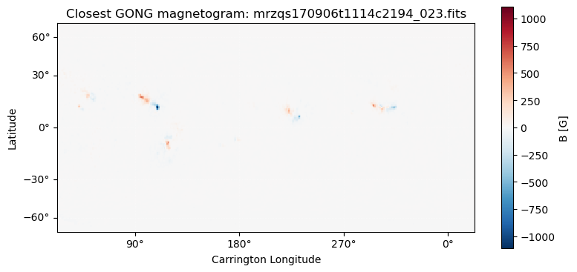
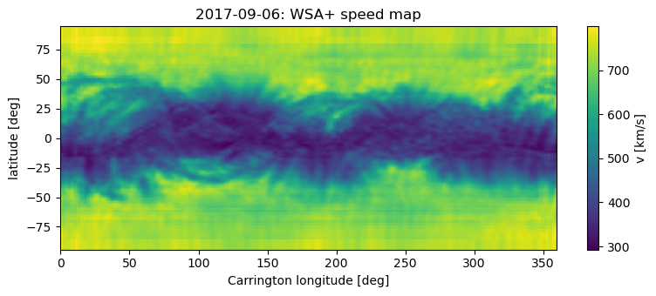
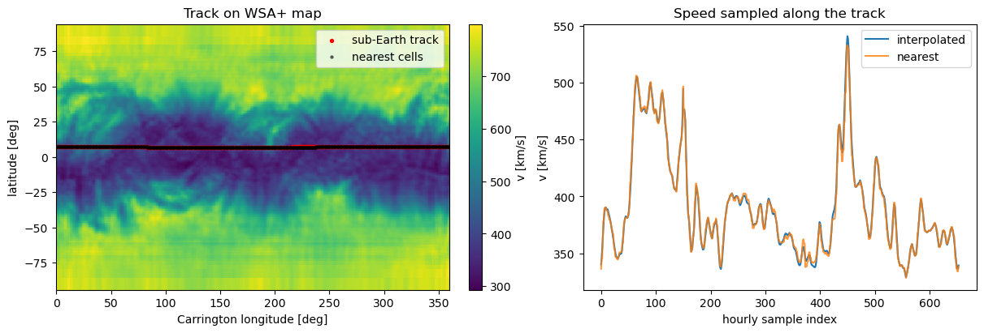
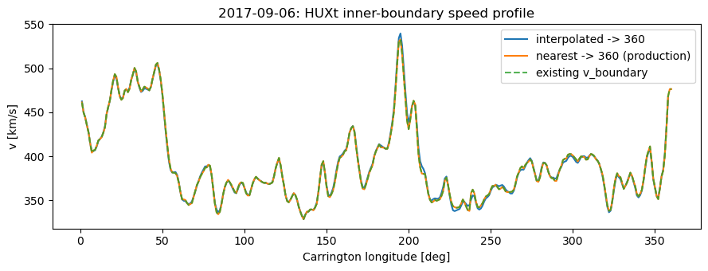
HUXt pipeline in the exercises

Slide 20
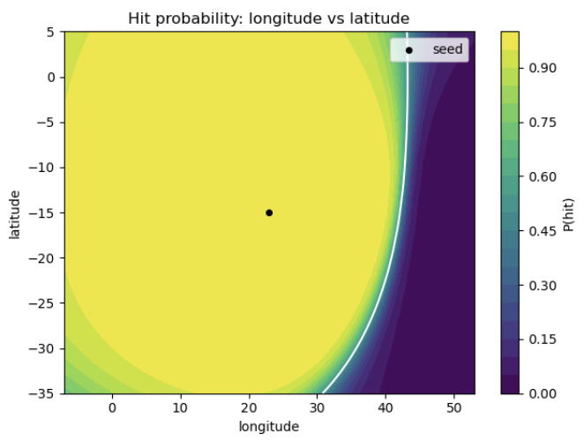
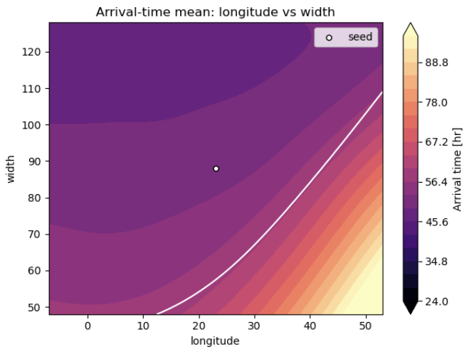
Hands‑on: Using Gaussian Process Regression in HUXt
Predicting hit times and time of arrival of CMEs on Earth given cone parameters of CMEs.
See CONECAST project and its tutorials:
https://georgemilosh.github.io/projects/conecast/

Slide 21
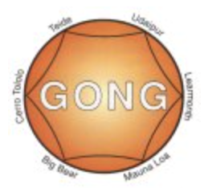
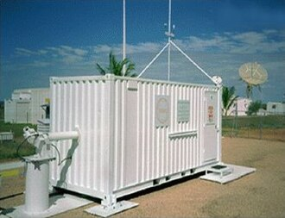
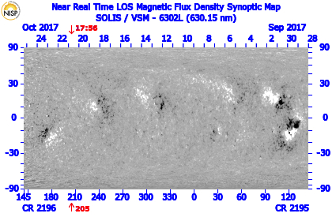
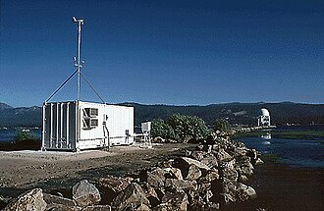
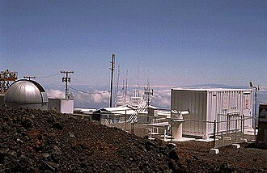

GONG magnetograms
six identical telescopes
magnetograph shows the strength, polarity, and location of the magnetic fields

Slide 22

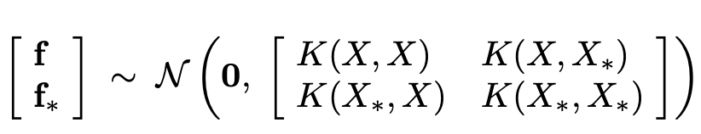
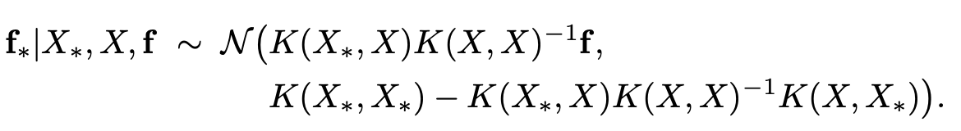
Prediction with noise-free observations
The joint joint prior distribution of the training outputs, f ,and the test outputs f∗ according
n training points and n∗ test points then K(X,X∗) denotes the n×n∗ matrix of the covariances evaluated at all pairs of training and test points
Function values f∗ (corresponding to test inputs X∗) can be sampled from the joint posterior distribution by evaluating the mean and covariance matrix

Slide 23


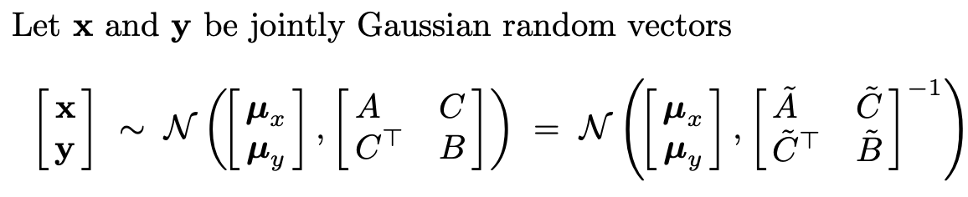
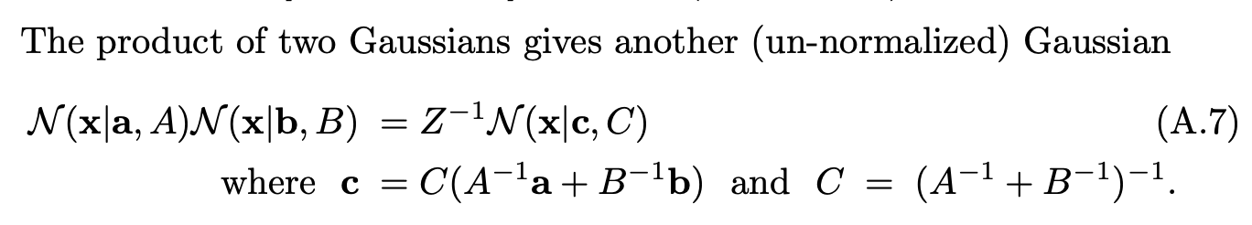
Gaussian Identities
covariance matrix (of size D×D)
C.E.Rasmussen C.K.I.Williams, Gaussian Processes for Machine Learning, the MIT Press,2006, www.GaussianProcess.org/gpml

Slide 24
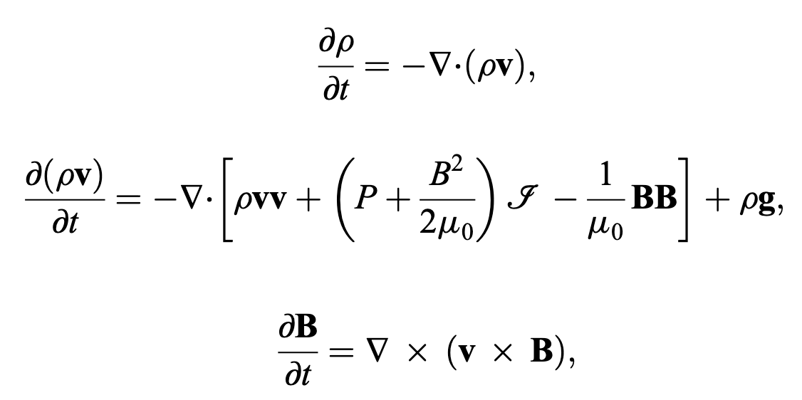
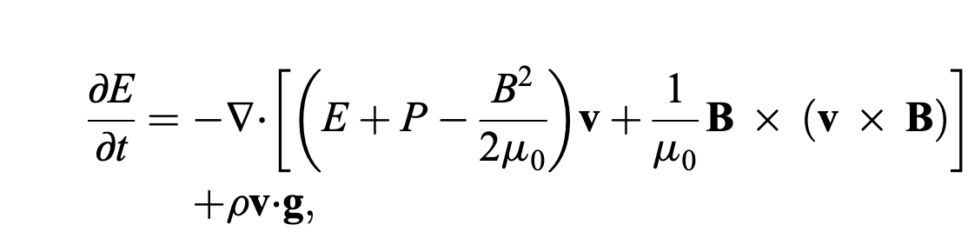
EUHFORIA: Solving magnetohydrodynamics (MHD) equations
Pomoell, Jens, and S. Poedts. “EUHFORIA: European Heliospheric Forecasting Information Asset.” Journal of Space Weather and Space Climate 8 (2018): A35. https://doi.org/10.1051/swsc/2018020.

Slide 25
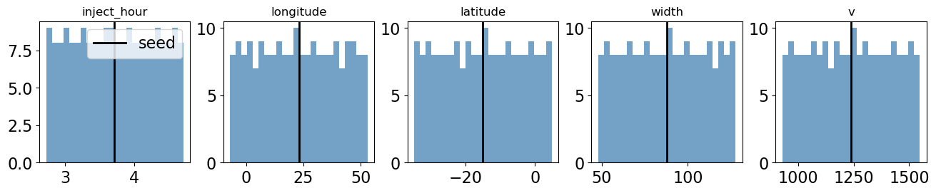
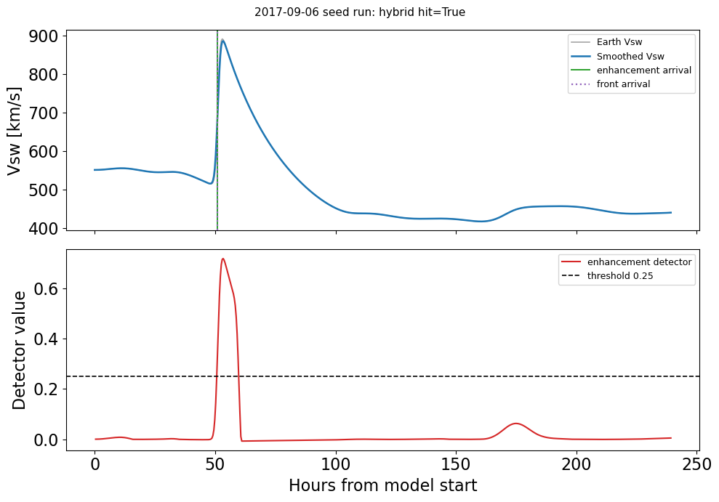
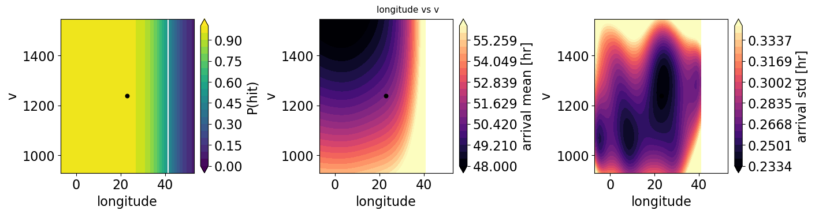
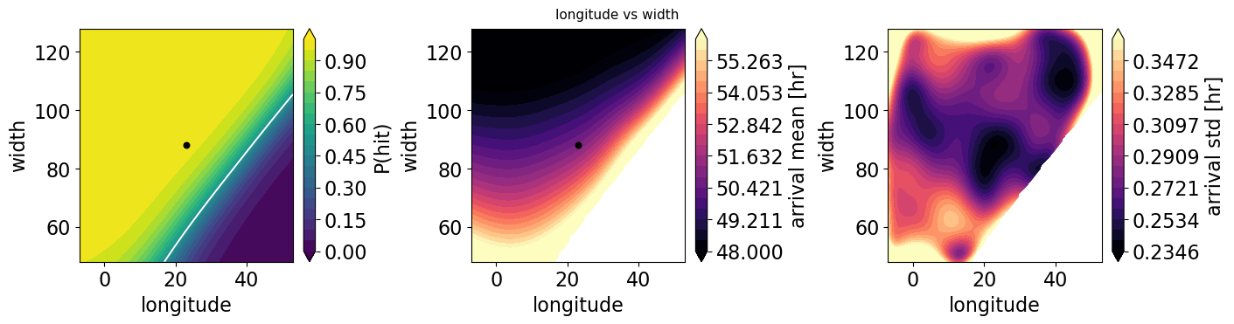
Sample 100s of runs and fitting Gaussian process

Slide 26
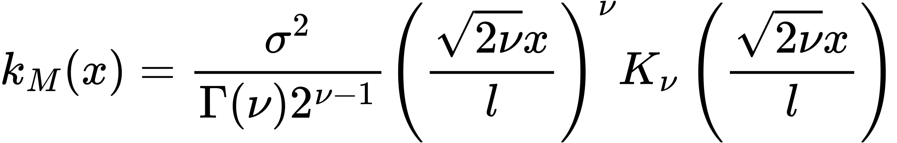

Màtern covariance
Amplitude: Controls the output's scaling along the y-axis. This parameter is just a scalar multiplier and is therefore usually left out of implementations of the Matèrn function (i.e., set to one)
Roughness: controls the sharpness of ridges in the covariance function, which ultimately affects the roughness (smoothness) of realizations.
Bessel Function
Lengthscale: complements the amplitude by scaling realizations on the x-axis. Larger values push points closer together along this axis.
Gamma function
If you choose optimizer, you are maximizing log marginal likelihood (empirical Bayes)

