Slide 1
P-values What do they mean?

Slide 2
How do we answer research questions?
Most questions are of the form:
Does X affect Y?
Which metabolites are affected by my intervention?
Does treatment improve outcome?
Can the microbiome predict Alzheimer’s disease
Etc…
Are these questions answerable by our methods?
But.. our collaborators want answers and do not like uncertainty
p<0.05
The arbiter of truth!
Sometimes it feels like this is all we need

Slide 3
Why should we care about p-values?
Question
Experiment
Data
P-value(s)
Conclusion
Impact
We can’t be too rude about p-values. Everything we do pivots on them.
(Confidence intervals are just many many p-values)
(Bayesian statistics is just sparkling frequentism.)

Slide 4
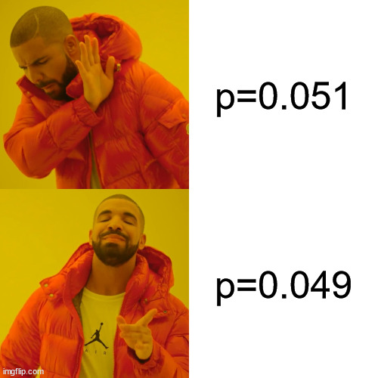
(Data) science central paradigm
Research question (does X affect Y?)
Observe the joint distribution of X and Y
Test their association

Slide 5
Fun quiz (part 1)!!
Suppose an observational study compared disease incidence between a group of people who took a probiotic compared to a group who did not.
“…disease incidence was lower (RR=0.5) in the probiotic group (p<0.05)…”
Which of these statements is true?
The probability that there is no effect of probiotics on disease incidence is less than 5%
If there was truly no effect of probiotics then there was a less than 5% chance of seeing an effect of similar size or greater.
At this threshold, the chance of missing a true effect is less than 5%
At this threshold of statistical significance at most 5% of positive conclusions drawn from studies like this will be false

Slide 6
Fun quiz!!
Which of these statements is true?
The probability that there is no effect of probiotics on disease incidence is less than 5%
(No, we can’t make probability statements about unknowns without more (prior) info.)
If there was truly no effect of probiotics then there was a less than 5% chance of seeing an effect of similar size or greater.
(Yes! this is the definition of a p-value)
At this threshold the chance of missing a true effect is less than 5%
(No, this statement is related to the power of the study, which we don’t know.)
If we accept this threshold of statistical significance, then at most 5% of positive conclusions drawn from studies like this will be false
(This is the false discovery rate, not directly related to the p-value)

Slide 7
Fun quiz (part 2)!!
Suppose an observational study compared disease incidence between a group of people who took a probiotic compared to a group who did not.
“…disease incidence was lower (RR=0.5) in the probiotic group (p<0.05)…”
How about these statements?
e. The treatment is the most likely explanation for the difference in disease rates
f. We should start administering probiotics to prevent disease

Slide 8
Definition
P-value
The probability of the ‘data’ being at least as extreme as that observed, if the null hypothesis was true.
A low p-value: The data we saw was improbable under H0.
A high p-value: This data could easily have happened under H0.

Slide 9
P-value
“…disease incidence was lower in the probiotic group (p<0.05)…”
A low p-value: The data we saw was improbable under H0.
A high p-value: This data could easily have happened under H0.
But…. (Why is this not an automatic truth-finding device regarding H0?)
Unlikely things can still happen (particularly if you keep looking)
The alternative hypothesis could be very unlikely in itself.
Studies can be underpowered
The data may be just as unlikely under an alternative hypothesis!
We might have calculated this probability incorrectly.

Slide 10
Inference
?
Data was unlikely under H0
So H0 is unlikely to be true
“Philosophical pseudoscience”
Fisher, Neyman-Pearson or NHST? A tutorial for teaching data testing
https://www.frontiersin.org/articles/10.3389/fpsyg.2015.00223/full
Perezgonzalez (2015)

Slide 11
Important ways in which p-values can mislead

Slide 12

Wrong model
The p-value will be wrong if the probability under H0 is calculated incorrectly.
Can be very wrong.
Wrong distribution of count data
Ignoring experimental design
Ignoring test assumptions
Meaningless results
How often do we check test assumptions in bioinformatics?

Slide 13
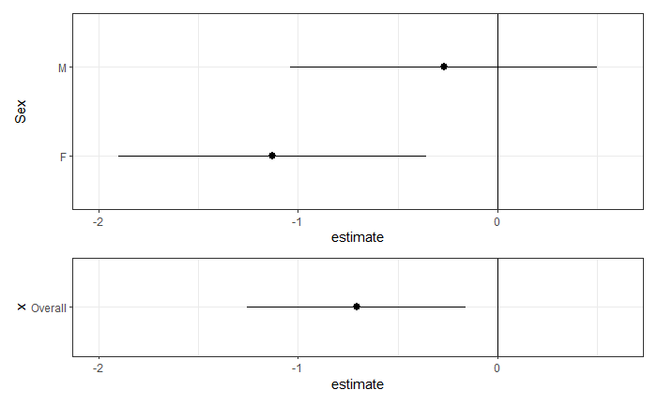
Power, estimates, subgroups and CIs
Suppose we are reporting a clinical trial
The treatment worked in women (p=0.005) but not in men (p=0.48)
Would you offer men the treatment?
Better?
There was a treatment effect
No evidence for a sex difference in effects.

Slide 14
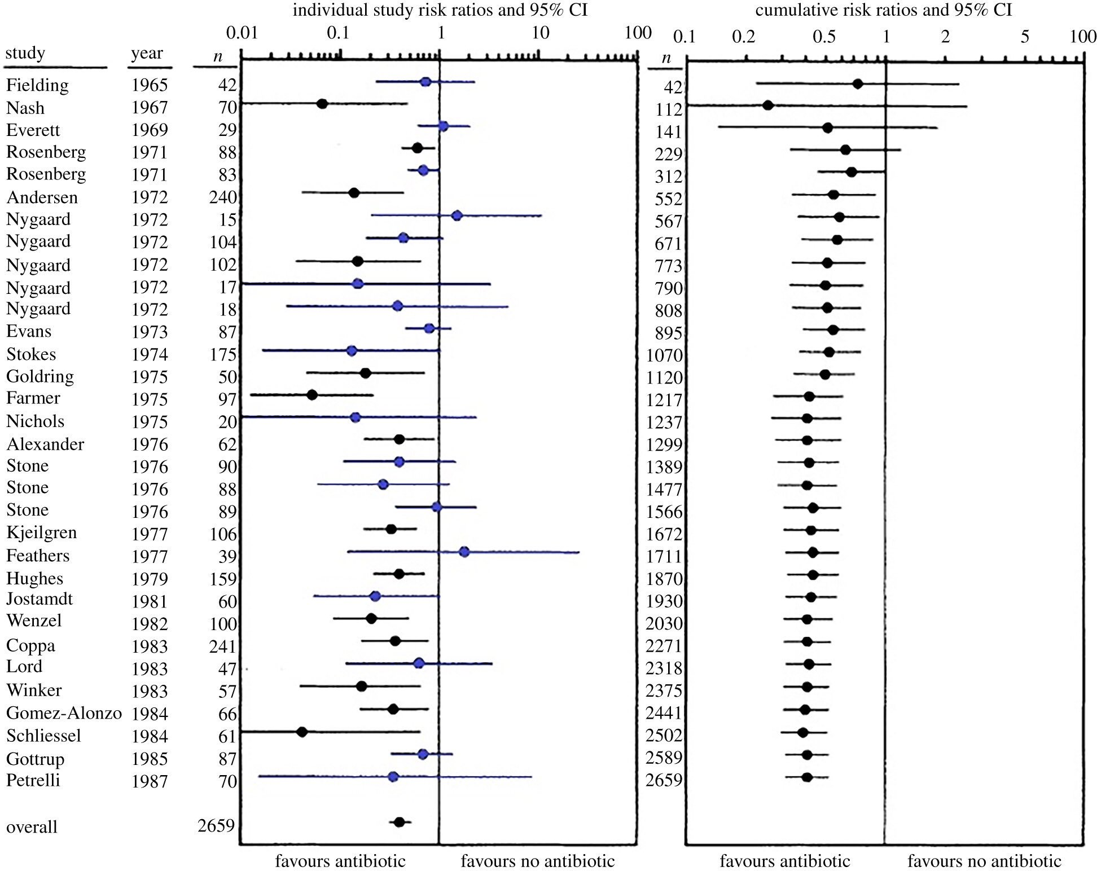
A life or death situation
Between 1965 and 1987,
30 clinical trials tested antibiotics for colon infection following surgery
16 showed no benefit (p>0.05)
14 showed benefit (p<0.05)
Inconsistent?
With proper reporting and review of evidence we could have stopped in 1972!
All these studies have completely consistent findings.

Slide 15
A life or death situation
A reliance on p-values to learn from each trial leads to apparent ‘inconsistency’ from completely consistent reports
A failure to conduct a systematic review and meta-analysis before embarking on new and wasteful research.
But it’s what we still do!

Slide 16
The garden of forking paths: Multiplicity of analysis options
Illustrate the problem
A simulation study using R
Show some statistical thinking and how I try to understand the implications of different statistical procedures.
No answers, sorry!

Slide 17
Even in the simplest cases, an analysis can get messy
Research question (wheat genotype affect glycaemic response)
Clinical trial (experiment)
Measure glycaemic response with each genotype
Test for the difference between genotypes

Slide 18
Analysis plan (as written / primary)
“Compare maximum glucose in 120 minutes after meal between genotypes, subtracting baseline glucose measurement.”
What didn’t we specify?
Decision | Options | Running total # of possible answers
Covariate adjustment | ANCOVA vs ANOVA | 2
Exactly how to define ‘baseline’ glucose | At least three options | 6
Exactly where the start of the meal is taken from | Two possibilities | 12
Post-processing of the glycaemia curve | Smoothing or not? | 24
The precise statistical model | Random intercept vs random slope? | 48
Data-driven exclusions | Some curves look be unreliable. Exclude or not? | 96 reasonable analyses, each provides a different p-value
“A combinatorial explosion of possible data analyses” –
Gelman and Loken (2013)

Slide 19
This was not an exploratory fishing expedition, but do we still have a multiplicity problem?
This is as clear a hypothesis testing study as we can have.
But there are still many choices for the analyst.
In biology data science, how many choices do we make that affect results?
How many decisions have no ‘correct’ or single widely accepted answer?
Plus some published and widely used methods clearly do not work and often report statistical significance from noise.
Trying lots of things is a recommendation in many texts. Is this a problem?
(How) Do we deal with this or acknowledge in our work? When reviewing?

Slide 20
Using simulations to check how well a test is working
Simulate data under the null and alternative hypotheses
Check the p-values from your proposed analysis
This lets us directly find the Type-1 and Type-2 error rates and compare them to the nominal values

Slide 21
Possible approaches
Sensitivity analysis
“We tried a few different things, our results were robust”
What if it doesn’t work? (I think people tend to brush under the carpet)
Multiverse analysis
Present all the answers, try to understand the differences? Their average?
Example: https://explorablemultiverse.github.io/examples/frequentist/
Review: https://onlinelibrary.wiley.com/doi/full/10.1111/cgf.14443
Pre-specify better (so that no step of the analysis is contingent on patterns in the observed data)
OK, but why should one of these be preferred to another. Is picking one reasonable analysis effectively at random OK?
Is this possible?
What would you like to see in the papers you read?

Slide 22
Is multi-phase research the only real answer?
Really go back to the exploratory vs confirmatory paradigm?
Rather than just paying it lipservice.
Multi-phase studies, registered reports etc.
Should be easy in basic biological sciences
An exploratory phase followed by a completely pre-registered and powered replication following exactly the same protocol on brand new data.
How feasible is this?
How should we approach large observational studies?
Data split exploratory then confirmatory? I don’t like this much.

Slide 23
Conclusion
P-values dominate our statistical inferences
But they are very limited measures of truth.
‘Garden of forking paths’ can massively increase false positive rates.
Even without multiple outcomes and if every analysis is individually correct.
Impossible to spot? No, it can be done..
Try to guard against it in your own work.

