Slide 1

R and RStudio for statistics
George Savva QIB Institute Statistician

Slide 2
Online Lesson Plan
Short talk
Demo of an R analysis
Q&A and discussion on the handout.
Worked examples
Exercises with support

Slide 3
Aims
Introduction to R
Walk through basics of language and environment
Walk through typical analysis workflow
Q&A
Enough for you to go on Stats courses and continue self-directed learning.

Slide 4
My R history
Taught computational statistics using R in 2000-2001 and used R a lot in my PhD (2001-2004).
Mostly Stata user between 2004 and 2017
On moving to QIB in October 2017, I looked at options for statistics packages for general use at QIB.
People use SPSS / GenStat / R / GraphPad / Matlab / Stata / python
I was initially package agnostic
Now I think R is currently the best option for most analyses for most people.
R is the lingua franca of scientific computing

Slide 5
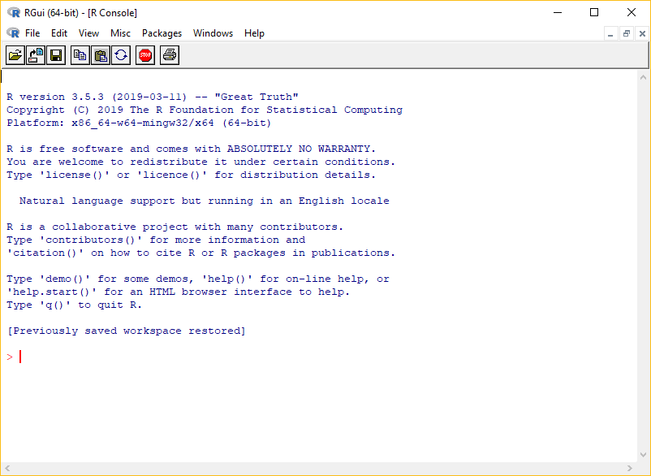
What are R and RStudio
R – Statistics package
R – Also the ‘language’ that you use to describe your analysis
‘R’ comes with the R console interface only.

Slide 6

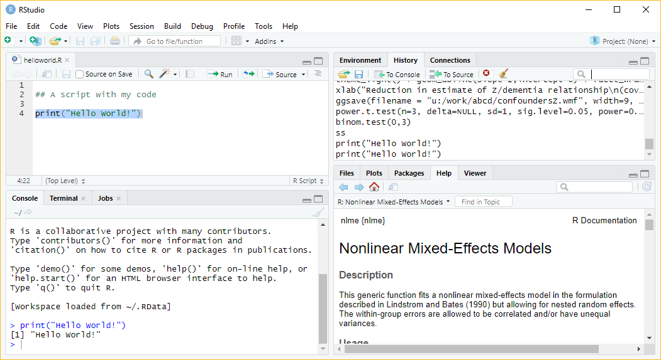

Slide 7
R and RStudio Demo

Slide 8

Why use R?
Free and open source
Flexible and powerful: if it’s possible then it’s possible with R
Excellent graphical outputs
Great for sharing and reproducibility
Enormous friendly online community

Slide 9
R is different to Graphpad Prism / SPSS etc
For users of other packages:
You cannot use R without the documentation!
Everything is done in code using the R language
The code you write is the analysis
This is essential for reproducibility
For programmers:
R has its own quirks – spend some time learning it.

Slide 10
R is different to Graphpad / SPSS etc
R is for data cleaning / coding / analysis / reports
Workflow (https://rstats.wtf/)
You keep data in its raw form (or as close as possible)
We write R code to take raw data, wrangle, clean, code, analyse and report
Keep the original data and the code!
We typically don’t keep the processed data, or even results. At least we don’t need to.
Corollary – R is not for data entry or storage.

Slide 11
How to learn R
To learn R you need to read and study R. There is no shortcut!
Use resources, books, websites, blogs, people and study the areas that you need.
Set aside time to learn.
Expect to use R with the documentation / community support open
Expect many error messages as you develop your code! This is normal!
Don’t ignore warnings!
Make sure you understand why R does what it does.
Learning R will improve your statistics – you will need to decide more things yourself, and using R promotes good practice (compared to other stats packages)

Slide 12
Packages - CRAN
‘Base’ R includes the language and basic statistics
The great strength of R is its user written extensions ‘packages’
Eg: ggplot2 / data.table / tidyverse / (Bioconductor) / lme4 / shiny / rmarkdown
If somebody develops a new statistical idea, they’ll implement it in R.
If anyone has ever wanted to do anything, there’s an R package for it. Probably several.
We’ll install and use the ‘readxl’ package today – to allow R to read data from Excel files
Installing packages is trivial from inside RStudio

Slide 13
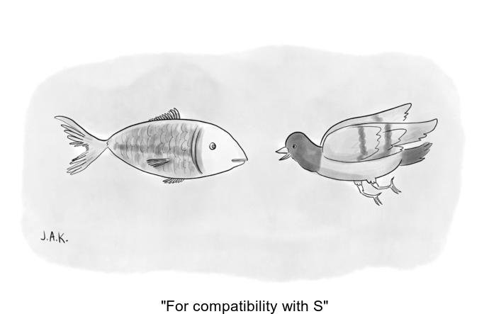
The ugly
R has been developed with user written add-ons since the 1990s
(Based on ‘S’ language written in the 70s)
It’s quite easy to make a mess with the code.
Mess of packages, sometimes odd code, can be (literally) hundreds of ways to do the same thing, some abandoned packages..
Eg ‘tidyverse’ vs ‘base’ vs ‘data.table’ ways of doing things.
Credit: @whydoesR

Slide 14
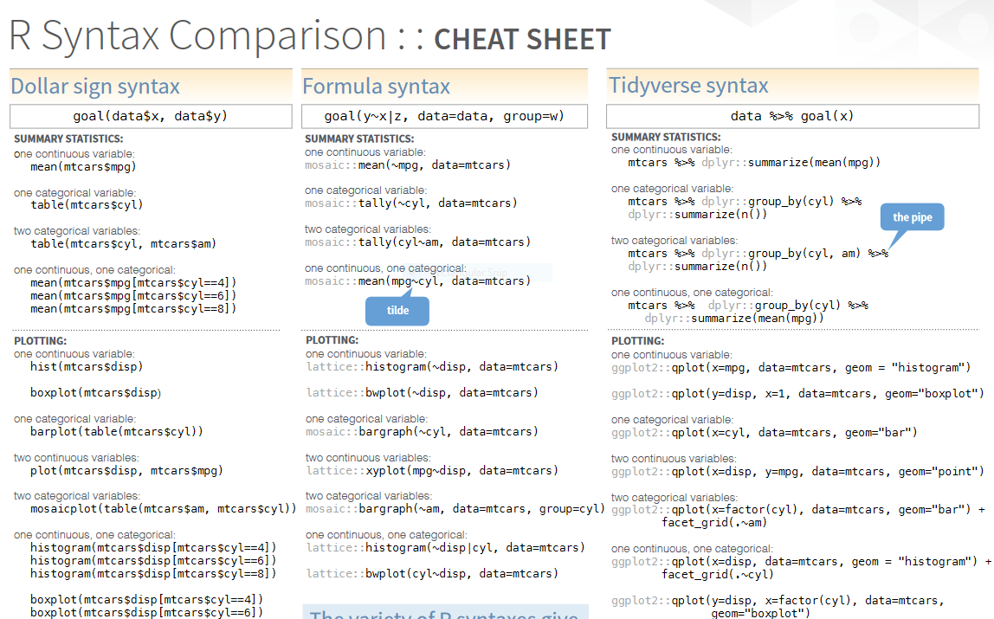
R syntax comparison
Credit: Amelia McNamara
http://www.amelia.mn/

Slide 15

Getting help

Slide 16
Sources of help 1 – R fundamentals
Start your RStudio session.
Type
> help.start()
The manual has detail of the language, structures
Also documentation for each ‘base’ package and function.
Appendix A is a useful walkthrough of common stats tasks

Slide 17
Sources of help 2 – Online resources
Hadley Wickham’s books:
R4DS – R for Data Science https://r4ds.had.co.nz/
Advanced R https://adv-r.hadley.nz/
Danielle Navarro has made a lot of excellent resources available for free, including this book:
https://learningstatisticswithr.com/
Modern Statistics for Modern Biologists (not an R book as such, but a lot of interesting uses of R throughout)
https://www.huber.embl.de/msmb/
Software Carpentry – R for Reproducible Scientific Analysis
https://swcarpentry.github.io/r-novice-gapminder/
R Cookbook:
http://www.cookbook-r.com/
Big Book of R – 150 free online (or very cheap) R books
https://www.bigbookofr.com/
https://rstats.wtf/ - Some very good tips for workflow development

Slide 18
Sources of help 3 – Online resources
Cheat Sheets:
https://rstudio.com/resources/cheatsheets/
CRAN Task View
https://cran.r-project.org/web/views/

Slide 19
Other sources of help
Package vignettes
>vignette(“packagename”)
StackExchange (family of Q&A websites),
Stackoverflow.com for high quality R questions and answers
Crossvalidated (stats.stackexchange.com) for statistics queries
Twitter #rstats @rstudiotips
Rbloggers
Me
Each other

Slide 20
Where next?
RMarkdown reports and presentations
Git
version control
Tidyverse or data.table data wrangling
Bio-conductor
ggplot2 for graphics
R programming

Slide 21
Citing statistics software
For basic stuff, the answers will (hopefully) come out the same across packages.
For more complex things they may not
Each makes different assumptions, different algorithms
There are many ways to get confidence intervals, standard errors in complex cases.
ANOVA in R for unbalanced designs may be reported differently
Syntax changes with package versions
So always specify which software you have used
And always cite the software and extra packages you used

Slide 22
Starting a project – and getting started
If you don’t have a new ‘project’ open, start one now in a new directory
Download and save the IntroStat.xlsx data file into the directory you created.
Look at where the RStudio claims the working directory is, or use getwd()
Get going with handout!

Slide 23
Additional notes

Slide 24
1 Simple objects
Notice that RStudio completes object names and function names if they exist in your environment.
What happens if you type:
x>5
Extra exercise (for later): use a common function to further demonstrate functions and accessing attributes of objects: power.t.test()

Slide 25
1 – functions and names arguments
Type:
> ?log
What are the ‘arguments’ of the ‘log’ function?
You can specify them by name or in order

Slide 26
2 Vectors
Sometimes there are missing values. How are these represented, what happens if we ignore them in functions?
Most datasets have missing data.
This is represented by ‘NA’ in R.
Different functions treat missing data differently – be aware of what they will do.

Slide 27
2 - Vectors
Subsetting, removing or cleaning elements:
We have seen a[1] to access the first element.
a[c(2,3)] returns elements 2 and 3
a[-1] returns a without element 1
a[1] <- 4 sets element 1 to be 4.
a[a==4] returns all the elements of a where the condition in the brackets is TRUE
See extraScript.R for how this could be used for cleaning
If you do data cleaning in code you get a better audit trail than if you manipulate raw data.

Slide 28
3 Help files
Named arguments and defaults:
read_excel(path, sheet = NULL, range = NULL, col_names = TRUE, col_types = NULL, na = "", trim_ws = TRUE, skip = 0, n_max = Inf, guess_max = min(1000, n_max))
If you don’t supply an argument, its default (as shown in the help file) will be used.
So here: – col_names will be TRUE unless you say otherwise.
It’s good practice to name arguments when you are calling a function.

Slide 29
4 Loading data – good practice
Tidy data – all (most) stats packages want data to be ‘tidy’.
Good practice for naming variables
Informative, short, no spaces or special characters
R does not do ‘variable labels’ very well
Add-on packages do exist: web search ‘R variable labels’
But you’ll likely need to keep a separate codebook or very good documentation in your code

Slide 30
5 Using ‘with()’
Use of ‘with()’
with( data , ... ) executes whatever code is in … using the specified dataset.
Eg:
with( TreeData , table(species.name, health) )
Instead of:
table(TreeData$species.name, TreeData$health)
This is a good habit to get into
Not using ‘attach()’

Slide 31
5 Better ways to specify descriptives
We used a ‘formula’ in aggregate. Formulae are how R represents relationships between variables:
Health ~ Species
Means ‘Health by species’. Different functions use formulas in different ways.
There are lots of add-ons that will produce different aggregations or summaries of data. Eg:
describeBy() in package ‘psych’
table1() in package ‘table1’

Slide 32
5 – I’m not finished!
R will keep reading across lines if a command if it isn’t finished.
Try entering (at the console):
> 1+
R prompts you for the next bit of the code.
This is very useful in scripts to make long complex commands more readable
Eg with ggplot
See extraScript.R for some examples.

Slide 33
7 - Tests
The t-test returned a ‘htest’ object.
If we just run ‘t-test’ it is printed on the console
We can access its attributes if we want to extract specific elements

Slide 34
8. Scripts and error messages
Errors in scripts don’t always stop things in predictable ways. Like SPSS, a script might just carry on and you won’t notice.
You can find yourself in a ‘debug’ mode, which can be helpful but is often confusing. Quit it if necessary.
You will see Errors and Warnings all the time.
You will make mistakes and see error messages, don’t worry about this, go back and fix it!
Don’t ignore warnings – R is telling you that something invalid or unexpected is happening.

Slide 35
10. Dispatch
How did plot know to draw the regression diagnostics for the regression model?
R functions can see the type of object they are being given, and act accordingly.
plot() realises it’s being passed a lm object.
If you give plot() two vectors, it will draw a scatter plot.
Other functions work similarly eg summary(), print() change behaviour depending on their arguments

Slide 36
Final thoughts
What would you like to know more on? ggplot2?
What did you find difficult / easy?
Please complete the feedback
Keep using R – I’m happy to help
Thanks for coming!

