Slide 1
R and Rstudio for statistics Day 2/3 Data management / Linear models
George Savva (QIB)
April 2024

Slide 2
Cleaning and coding using R scripts
Your data is likely to need some cleaning and coding before analysis
Do not change your raw data if you can help it.
Do your management, cleaning and coding in your R script, not in the data file itself
But do record your data sensibly, remembering that you’ll need to import it into a stats package.
This means:
You have a clear audit trail with explanations in comments
And you can easily undo if you make a mistake

Slide 3
Combing and cleaning – extract from my own code
## Load and combine the data
preData <- read_excel(path="NEC4.xlsx", sheet="Pre probiotics", range="A1:AD470")
postData <- read_excel(path="NEC4.xlsx", sheet="Post probiotics", range="A1:AD514")
# Combine data from pre- and post- together.
allData <- rbind(preData, postData)
## These were the two that Paul said he
## changed to not VON. Currently set to VON
allData$NEC_VON[allData$id==391] <- 0
allData$NEC_VON[allData$id==1493] <- 0
Loading data into two data frames
Combining the two data frames into one ‘longer’ one
Fixing some values that the CI said needed to be changed

Slide 4
Some unhelpful but common practices
Things to avoid in data entry..
Colour coding.
Leaving text notes in numerical fields.
Repeating variable names
Multiple rows of column header
Merged cells
Spaces in column names
How can we describe relationships between variables in terms of the column names?
Patient | Pre-treatment |  | Post-treatment
Number | Pain | Quality of life | Pain | Quality of life
1 | 2 | 1 | 4 | 3
2 | 3 | 3 | 2 | 4
3 | 2 | DK | 4 | 2
4 | 4 | about 2 | 5 | 1
5 | 5 | 2 | 3 | 5
6 | 2 | 1 | 3 | 6
7 | 1 | 5 | 5 | 3
 |  |  |  | Female

Slide 5
Some unhelpful but common practices
Tidy data
One cell per value
One row per observation
One column per characteristic
Some untidy data..
Patient | Pre-treatment |  | Post-treatment
Number | Pain | Quality of life | Pain | Quality of life
1 | 2 | 1 | 4 | 3
2 | 3 | 3 | 2 | 4
3 | 2 | DK | 4 | 2
4 | 4 | about 2 | 5 | 1
5 | 5 | 2 | 3 | 5
6 | 2 | 1 | 3 | 6
7 | 1 | 5 | 5 | 3
 |  |  |  | Female

Slide 6
Better (tidy) data entry setup
Bad
Patient | Pre-treatment |  | Post-treatment
Number | Pain | Quality of life | Pain | Quality of life
1 | 2 | 1 | 4 | 3
2 | 3 | 3 | 2 | 4
3 | 2 | DK | 4 | 2
4 | 4 | about 2 | 5 | 1
5 | 5 | 2 | 3 | 5
6 | 2 | 1 | 3 | 6
7 | 1 | 5 | 5 | 3
 |  |  |  | Female
Better – long
(unit of observation is the occasion)
PatNo | Sex | Time | Pain | QOL | Notes
1 | M | Pre | 2 | 1
2 | M | Pre | 3 | 3
3 | M | Pre | 2 |  | QOL score don't know
4 | M | Pre | 4 | 2 | QOL score is approximate
5 | M | Pre | 5 | 2
6 | F | Pre | 2 | 1
7 | F | Pre | 1 | 5
1 | M | Post | 4 | 3
2 | M | Post | 2 | 4
3 | M | Post | 4 | 2
4 | M | Post | 5 | 1
5 | M | Post | 3 | 5
6 | F | Post | 3 | 6
7 | F | Post | 5 | 3
Better – wide
(unit of observation is the patient)
PatNo | Sex | Pain1 | QOL1 | Pain2 | QOL2 | Notes
1 | M | 2 | 1 | 4 | 3
2 | M | 3 | 3 | 2 | 4
3 | M | 2 | DK | 4 | 2
4 | M | 4 | 2 | 5 | 1 | QOL1 is approximate
5 | M | 5 | 2 | 3 | 5
6 | F | 2 | 1 | 3 | 6
7 | F | 1 | 5 | 5 | 3

Slide 7
Tidy data
Tidy data principles:
All information we need for analysis in one rectangle of data:
One row per unit of observation
One column per variable
Tidy data allows us to describe relationships between our variables in simple terms for modelling or graphing:
Pain ~ Sex + Time
Pain ~ Sex + Time + (1|PatNo)
https://cran.r-project.org/web/packages/tidyr/vignettes/tidy-data.html
PatNo | Sex | Time | Pain | QOL | Notes
1 | M | Pre | 2 | 1
2 | M | Pre | 3 | 3
3 | M | Pre | 2 |  | QOL score don't know
4 | M | Pre | 4 | 2 | QOL score is approximate
5 | M | Pre | 5 | 2
6 | F | Pre | 2 | 1
7 | F | Pre | 1 | 5
1 | M | Post | 4 | 3
2 | M | Post | 2 | 4
3 | M | Post | 4 | 2
4 | M | Post | 5 | 1
5 | M | Post | 3 | 5
6 | F | Post | 3 | 6
7 | F | Post | 5 | 3

Slide 8
Reshaping (long <--> wide) (both might be necessary)
To correlate pre- and post- scores we would need this form
PatNo | Sex | Pain1 | QOL1 | Pain2 | QOL2
1 | M | 2 | 1 | 4 | 3
2 | M | 3 | 3 | 2 | 4
3 | M | 2 |  | 4 | 2
4 | M | 4 | 2 | 5 | 1
5 | M | 5 | 2 | 3 | 5
6 | F | 2 | 1 | 3 | 6
7 | F | 1 | 5 | 5 | 3
tidyr::pivot_longer()
data.table::melt()
To build linear models we need this form
PatNo | Sex | Time | Pain | QOL
1 | M | Pre | 2 | 1
2 | M | Pre | 3 | 3
3 | M | Pre | 2
4 | M | Pre | 4 | 2
5 | M | Pre | 5 | 2
6 | F | Pre | 2 | 1
7 | F | Pre | 1 | 5
1 | M | Post | 4 | 3
2 | M | Post | 2 | 4
3 | M | Post | 4 | 2
4 | M | Post | 5 | 1
5 | M | Post | 3 | 5
6 | F | Post | 3 | 6
7 | F | Post | 5 | 3
tidyr::pivot_wider()
data.table::dcast()

Slide 9
tidyverse, data.table, etc
Data wrangling can be difficult in ‘base’ R, and slow with big datasets.
Package ‘data.table’ introduces a new operator [ , , ] and makes working with big data much easier.
‘tidyverse’ is a large collection of packages that provides a lot of new functions and a new syntax for writing R code.
base vs data.table vs tidyverse debates can get quite heated.

Slide 10
tidyverse
Some tidyverse packages are undoubtedly very useful
ggplot2: Plotting
readr / readxl / haven: Importing data in various formats
dplyr / tidyr: data wrangling functions
stringr / lubridate: working with strings and dates
But the insistence on rewriting almost the entire language using tidyverse functions is more controversial.
https://www.tidyverse.org/
https://github.com/matloff/TidyverseSkeptic

Slide 11
Base R vs tidyverse vs data.table: subsetting a data frame
To make a version of ‘walkingspeed’ dataframe, including only men (sex==“M”):
base
walkingspeed[ walkingspeed$sex==“M”, ]
or
subset(walkingspeed, sex==“M”)
data.table
walkingspeed[ sex==“M” ]
tidyverse
walkingspeed %>% filter(sex==“M”)
https://wetlandscapes.com/blog/a-comparison-of-r-dialects/

Slide 12
%>% pipes
Tidyverse package ‘magrittr’ introduces the pipe operator:
R version 4.1 includes a pipe operator in 'base'
x <- c(1,2,3,4)
mean(x)
x %>% mean
x %>% mean()
x |> mean()
Many people prefer this syntax, and I sometimes use it if I need to chain a lot of functions together.
a %>% fun(…)
Is the same as
fun(a,…)

Slide 13
%>% pipes ( now |> )
Make a cross-table of proportions (of health trees by species), rounded to 1dp
t1 <- table(treedata$species, treedata$health)
prop1 <- prop.table(t1, margin = 1)
round(prop1, 1)
Or
round(prop.table(
table(treedata$species, treedata$health),
margin=1),1)
Same code with pipes:
table(treedata$species, treedata$health) |>
prop.table(margin=1) |>
round(1)
Some real code:
data_family_compositional <-
data_family |>
transform("compositional") |>
subset_samples(Time != "Time 1")

Slide 14
Combining datasets
Our data often comes in different pieces that we’ll need to combine, or in a different shape to what we ideally need:
So 'data wrangling', cleaning and coding are important skills to have
Merge (join) or combine (bind) data sources
Reshape (melt/dcast) (pivot) data
Subset (filter) data, ie extract a certain subgroup
Transform (mutate) or create new variables
Which syntax of R you learn is up to you.
But you should be aware of the base, tidyverse and data.table options.
Personally, I use a mix of the three depending on the task.

Slide 15
Combining datasets
Three main ways to combine datasets
rbind() / bind_rows() – ‘row bind’ adding more observations
cbind() / bind_cols() – ‘column bind’ adding more columns
merge() / join() – combining data based on IDs

Slide 16
rbind / bind_rows - row binding, appending
rbind() / bind_rows():
Adding rows together to make a longer dataset
Column headings must be exactly the same in both frames

Slide 17
merge / join
Adding new columns based on matching ‘key’ columns

Slide 18
Data wrangling cheat sheets etc
https://www.rstudio.com/wp-content/uploads/2015/02/data-wrangling-cheatsheet.pdf
https://raw.githubusercontent.com/rstudio/cheatsheets/master/datatable.pdf
https://hbiostat.org/R/data.table/
https://wetlandscapes.com/blog/a-comparison-of-r-dialects/
If you think “there must be an easy way to do this..” then there probably is!

Slide 19
Exercise – Data management
Typical scenario.
Data is in two excel sheets, with mismatched names.
Important meta-data is in a third sheet
We need it all in a single data frame for analysis
Tasks to get the data ready for analysis
Load both outcome datasets into separate data frames
Rename the columns to make them consistent
Bind rows of the data sets into a single frame
Load the meta-data and merge it into the main data
Transform a variable
Data for this exercise is in walkingspeed.xlsx

Slide 20
Exercise: bind_rows() and merge()
Open ‘walkingspeed.xlsx’ in Excel and look around.
Treatment and control participants are on separate sheets.
Meta-data is in a third sheet
Which functions do we need to get these into a single usable sheet?
You’ll ‘bind_rows()’ the data into a single dataframe
Then ‘merge()’ in the meta data.

Slide 21
Linear models
Review the ‘lm’ in the walkingspeed data
Model and diagnose

Slide 22
Linear models
Much of our analysis can be expressed as asking whether/how an outcome depends on one or more predictors
In R, we can model these relationships:
lm( data = walkingDat , time ~ sex + treatment )

Slide 23
Common statistical tests as linear models
Correlation between x and y:
lm( time ~ age )
Comparison between two groups (height by health):
lm( time ~ treatment )
One way ANOVA
lm( time ~ department ) |> anova()
So most analysis workflows:
Get the data into the correct shape
Clean and code
Describe / visualise
Estimate the model
Check that the model fit is OK.
Interpret the coefficients

Slide 24
Extensions of simple lm’s
Multivariable models (equiv. of 2-way ANCOVA)
lm( time ~ age + sex + department )
Repeated measures models (RM-ANCOVA) with package lme4:
lmer( time ~ treatment + (1|patid) )
Comparing proportions (binary data) with generalised linear models.
glm( health ~ Tree.species , family=“binomial”)

Slide 25
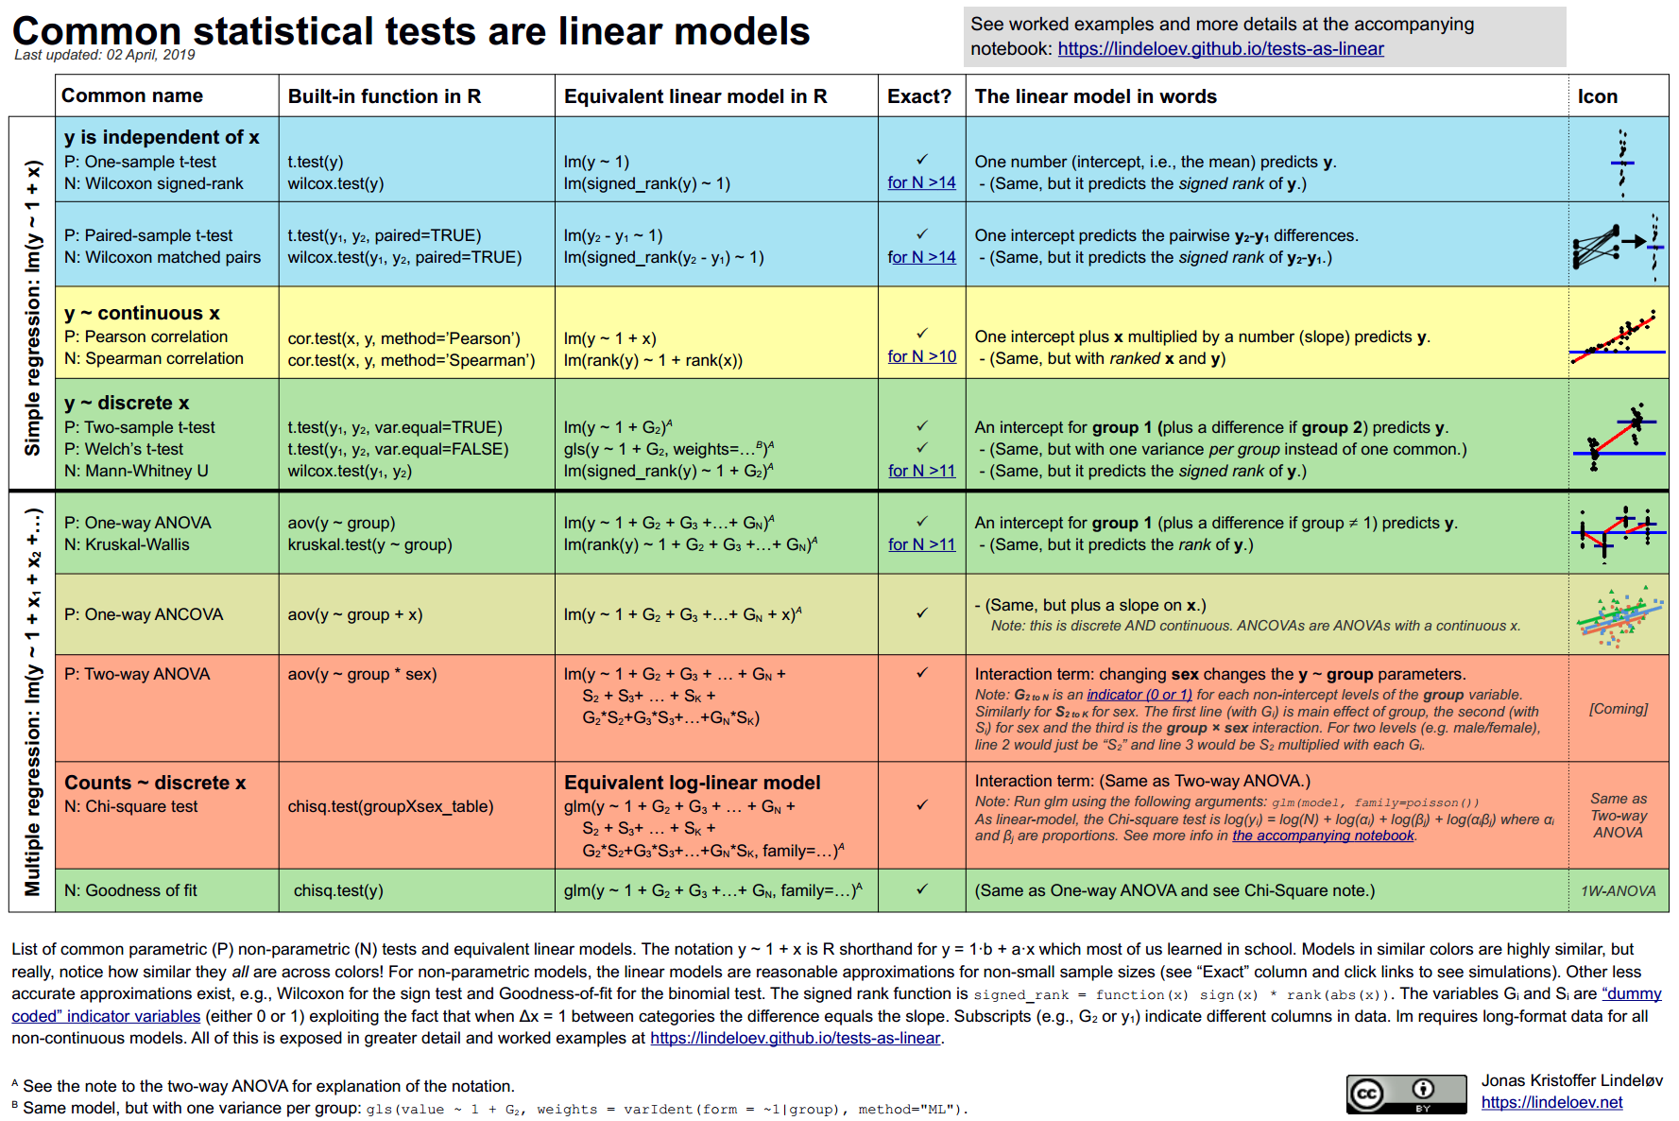
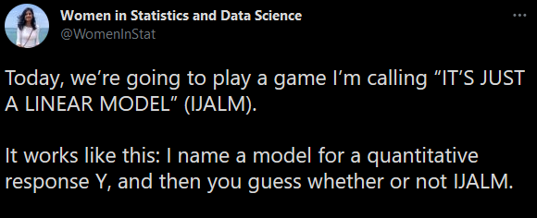
Everything is a linear model
https://lindeloev.github.io/tests-as-linear/
Almost every analysis can be represented like:
Pain ~ Sex + Time
Y ~ X1 + X2 + …
Or some extension of it. So we only need to learn this one paradigm!
https://twitter.com/WomenInStat/status/1286420597505892352

