Slide 1

R and Rstudio for statistics
George Savva QIB Institute Statistician

Slide 2
Lesson Plan
Short talk (~20mins)
Coffee + You work through the handout
Help each other!
Talk on common issues
Handout / further exercises
Q&A throughout

Slide 3
Aims
Introduction to R
Walk through basics of language and environment
Walk through typical analysis workflow
Q&A
Enough for you to go on Stats courses and self-directed learning.

Slide 4
Files
Introduction to R2.docx
Introstat.xlsx
TutorialScript.R
walkingSpeed.xlsx
AdditionalRExercise.docx
extraExercises.R
rStatsJuly19.pptx (talks)
extraScript.R
Tutorial work you got ahead of time
Next exercises
These slides / other stuff

Slide 5
My R history
Taught computational statistics using (base) R in 2000-2001 and used R a lot in early years of my PhD (2001-2004).
Mostly Stata user between 2004 and 2017
On moving to QIB in October 2017, I looked at options for statistics packages for general use at QIB.
People use SPSS / GenStat / R / GraphPad / Matlab / Stata
Initially package agnostic
Now I think R is the best option for most things for most people.

Slide 6
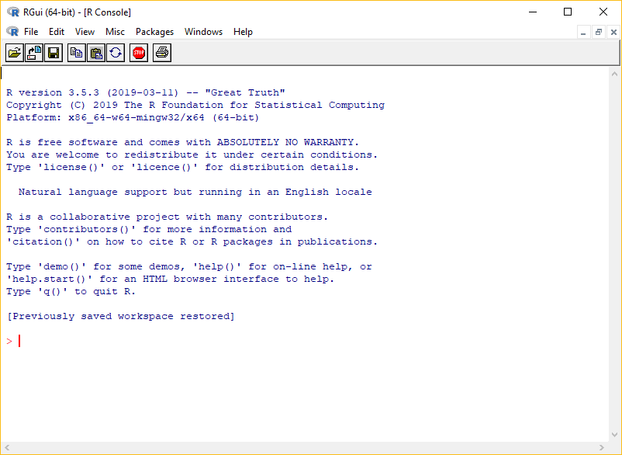
What are R and RStudio
R – Statistics package
R – Also the ‘language’ that you use to describe your analysis
R comes with the R console interface only.

Slide 7

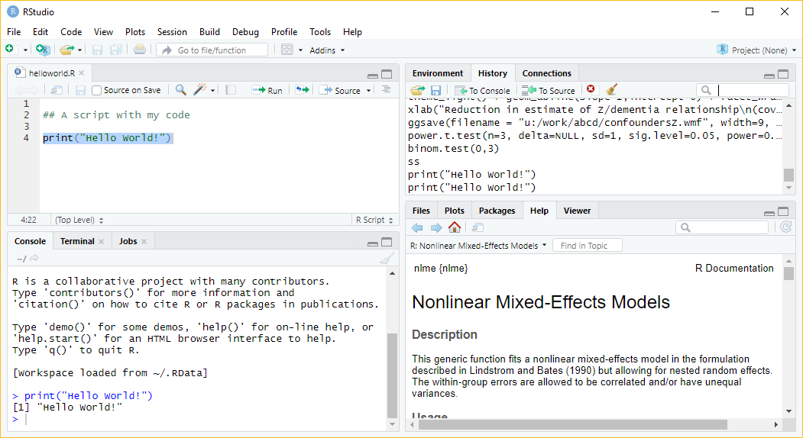

Slide 8

Why use R?
Free and open source
Flexible and powerful: if it’s possible then it’s possible with R
Excellent graphical outputs
Great for sharing and reproducibility
Enormous friendly community

Slide 9
R is different to Graphpad Prism / SPSS etc
For users of other packages:
You cannot use R without the documentation!
Everything is done in code using the R language
This is essential for reproducibility
For programmers:
R has its own quirks – spend some time learning it.

Slide 10
R is different to Graphpad / SPSS etc
R is for data cleaning / coding / analysis / reports
Workflow
Data is kept in its raw form
We write R code to take raw data, clean, code, analyse and report
Keep the original data and the code!
We typically don’t keep the processed data. At least we don’t need to.
Corollary – R is not for data entry or storage.

Slide 11
How to learn R
To learn R you need to read and study R. There is no shortcut!
Use resources, books, websites, blogs, people and study the areas that you need.
Set aside time to learn.
Expect to use R with the documentation / community support open
Expect many error messages as you develop your code! Don’t ignore warnings!
Make sure you understand why R does what it does.
Learning R will improve your statistics – you will need to decide everything youself

Slide 12
Packages - CRAN
‘Base’ R includes the language and basic statistics
The great strength of R is its user written extensions ‘packages’
Eg: ggplot2 / tidyverse / bioconductor / lme4 / shiny / rmarkdown
If somebody develops a new statistical idea, they’ll implement it in R.
If anyone has ever wanted to do anything, there’s an R package for it. Probably several.
We’ll install and use the ‘readxl’ and ‘table1’ packages today
Installing packages is trivial from inside RStudio

Slide 13
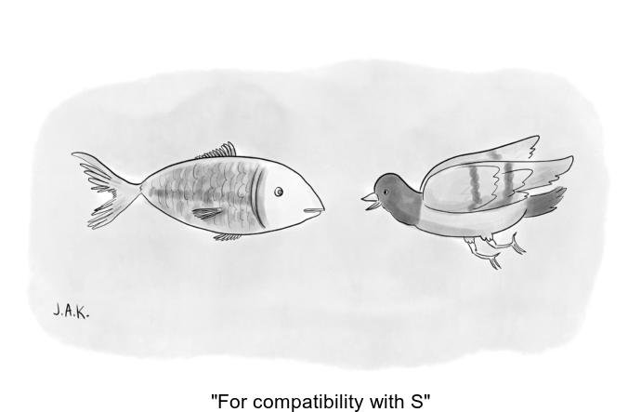
The ugly
R has been developed with user written add-ons since the 1990s
(Based on ‘S’ language written in the 70s)
Recent ‘Cambrian explosion’ of packages
Mess of packages, sometimes odd code, can be (literally) hundreds of ways to do the same thing, some abandoned packages..
Eg recent ‘tidyverse’ row
Credit: @whydoesR

Slide 14

Getting help

Slide 15
Sources of help 1 – R fundamentals
Start your RStudio session.
Type
> help.start()
The manual has detail of the language, structures
Also documentation for each ‘base’ package and function.
Appendix A is a useful walkthrough of common stats tasks that will supplement this.

Slide 16
Sources of help 2 – Stats etc with base R
Lots of books/websites etc available:
https://www.statmethods.net/stats/index.html
Use them as you need them..

Slide 17
Other sources of help
CRAN package vignettes
Stackexchange (Q&A website)
Twitter #rstats
Rbloggers etc
Me
Each other!

Slide 18
Where next?
RMarkdown reports and presentations
Git
version control
Tidyverse data management
Bio-conductor
GGplot2 for graphics
R programming

Slide 19
Starting a project – and getting started
If you don’t have a new ‘project’ open, start one now.
Save the IntroStat.xlsx data file in the directory you created.
Look at where the Rstudio claims the working directory is, or use getwd()
Then get going!

Slide 20
Additional notes for each exercise

Slide 21
1 Simple objects
Notice that RStudio completes object names and function names if they exist in your environment.
What happens if you type:
x>5
Extra exercise (for later): use a common function to further demonstrate functions and accessing attributes of objects: power.t.test()

Slide 22
1 – functions and names arguments
Type:
> help(log)
What are the ‘arguments’ of the ‘log’ function?
You can specify them by name or in order

Slide 23
2 Vectors
Sometimes there are missing values. How are these represented, what happens if we ignore them in functions?
Most datasets have missing data.
This is represented by ‘NA’ in R.
Different functions treat missing data differently – be aware of what they will do.

Slide 24
2 - Vectors
Subsetting, removing or cleaning elements:
We have seen a[1] to access the first element.
a[c(2,3)] returns elements 2 and 3
a[-1] returns a without element 1
a[1] <- 4 sets element 1 to be 4.
a[a==4] returns all the elements of a where the condition in the brackets is TRUE
See extraScript.R for how this could be used for cleaning
If you do data cleaning in code you get a better audit trail than if you manipulate raw data.

Slide 25
3 Help files
Named arguments and defaults:
read_excel(path, sheet = NULL, range = NULL, col_names = TRUE, col_types = NULL, na = "", trim_ws = TRUE, skip = 0, n_max = Inf, guess_max = min(1000, n_max))
If you don’t supply an argument, its default (as shown in the help file) will be used.
So here: – col_names will be TRUE unless you say otherwise.
It’s good practice to name arguments when you are calling a function.

Slide 26
4 Loading data – good practice
Tidy data – all (most) stats packages want data to be ‘tidy’.
Good practice for naming variables
Informative, short, no spaces or special characters
R does not do ‘variable labels’ very well
Add-on packages do exist: web search ‘R variable labels’
But you’ll likely need to keep a separate codebook or very good documentation in your code

Slide 27
5 Summary statistics
Use of ‘with()’
with( data , ... ) executes whatever code is in … using the specified dataset.
Eg:
with( TreeData , table(species.name, health) )
Instead of:
table(TreeData$species.name, TreeData$health)
This is a good habit to get into
Not using ‘attach()’

Slide 28
5 Better ways to specify descriptives
We used a ‘formula’ in aggregate. Formulae are how R represents relationships between variables:
Health ~ Species
Means ‘Health by species’. Different functions use formulas in different ways.
There are lots of add-ons that will produce different aggregations or summaries of data. Eg:
describeBy() in package ‘psych’
table1() in package ‘table1’

Slide 29
5 – I’m not finished!
R will keep reading across lines if a command if it isn’t finished.
Try entering (at the console):
> 1+
R prompts you for the next bit of the code.
This is very useful in scripts to make long complex commands more readable
Eg with ggplot
See extraScript.R for some examples.

Slide 30
7 - Tests
The t-test returned a ‘htest’ object.
If we just run ‘t-test’ it is printed on the console
We can access its attributes if we want to extract specific elements

Slide 31
8. Scripts and error messages
Errors in scripts don’t always stop things in predictable ways. Like SPSS, a script might just carry on and you won’t notice.
You can find yourself in a ‘debug’ mode, which can be helpful but is often confusing. Quit it if necessary.
You will see Errors and Warnings all the time.
You will make mistakes and see error messages, don’t worry about this, go back and fix it!
Don’t ignore warnings – R is telling you that something invalid or unexpected is happening.

Slide 32
10. Dispatch
How did plot know to draw the regression diagnostics for the regression model?
R functions can see the type of object they are being given, and act accordingly.
plot() realises it’s being passed a lm object.
If you give plot() two vectors, it will draw a scatter plot.
Other functions work similarly eg summary(), print() change behaviour depending on their arguments

Slide 33
R Markdown (https://rmarkdown.rstudio.com/)
You may see .Rmd files including both R code and marked-up narrative text.
I did starting using these, but have changed back to R scripts and separate files for writing up.
The reason is that I think the step of having to extract your results and place them into your report is important.
With R Markdown you can present results you have never actually seen.

Slide 34
Some chat about statistics packages
For basic stuff, the answers will come out the same across packages.
For more complex things they may not
Each makes different assumptions, different algorithms
There are many ways to get confidence intervals, standard errors in complex cases.
ANOVA in R for unbalanced designs may be reported differently
So always specify which software you have used

Slide 35
Final thoughts
What would you like to know more on? ggplot2?
What did you find difficult / easy?
Please complete the feedback
Keep using R – I’m happy to help
Thanks for coming!

