Slide 1
Introdução a FIR
Capítulos 14 e 16 do livro DSPGuide

Slide 2
Principais características desejáveis
Procedimentos para obter outros filtros partindo do filtro PB

Slide 3
Principais características
Every linear filter has an impulse response, a step response and a frequency response.
They describe how the filter will react under different circumstances.
To find the impulse response of a recursive filter, simply feed in an impulse, and see what comes out.
Information is represented in the time domain and in the frequency domain.
The step response describes how information represented in the time domain is being modified by the system.
The frequency response shows how information represented in the frequency domain is being changed.

Slide 4
Principais características
Is not possible to optimize a filter for both time domain and frequency domain.
Good performance in the time domain results in poor performance in the frequency domain, and vice versa.

Slide 5
Principais características
In time domain, the filter need to be as fast as possible with low risetime, without overshooting and with linear phase.
In frequency domain, the filter must have a fast-roll-off, no riplle and a good stopband attenuation

Slide 6
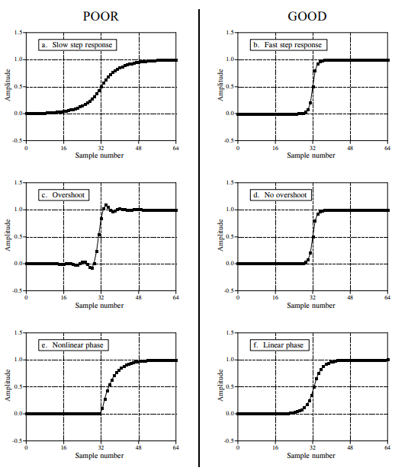
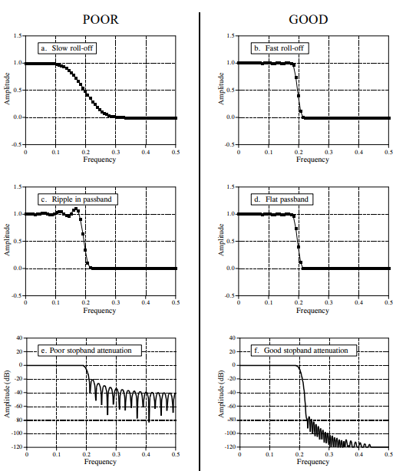

Slide 7
Procedimentos para obter um filtro PB
High-pass, band-pass and band-reject filters are designed by starting with a low-pass filter, and then converting it into the desired response.
There are two methods for the low-pass to high-pass conversion: spectral inversion and spectral reversal.

Slide 8
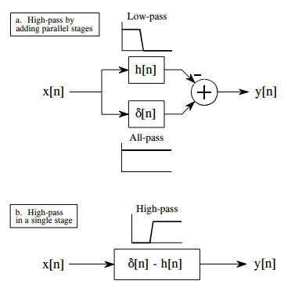
PB para PA com inversão espectral
First, change the sign of each sample in the filter kernel.
Second, add one to the sample at the center of symmetry

Slide 9
Explicação
Since the low frequency components are subtracted from the original signal, only the high frequency components appear in the output.
For this technique to work, the low-frequency components exiting the low-pass filter must have the same phase as the low-frequency components exiting the all-pass system.
Two restrictions on the method: (1) the original filter kernel must have left-right symmetry (i.e., a zero or linear phase), and (2) the impulse must be added at the center of symmetry.

Slide 10
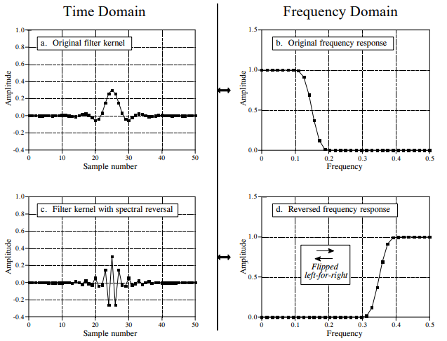
PB para PA com reversão espectral
The high-pass filter kernel is formed by changing the sign of every other sample in the low-pass filter kernel.

Slide 11
Explicação
This action in the time domain results in the frequency domain being flipped left-for-right, resulting in the high-pass frequency response

Slide 12
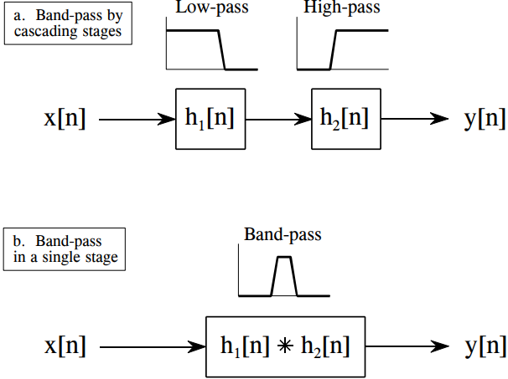
Passa Faixa
A band-pass filter can be formed by cascading a low-pass filter and a high-pass filter. Or, can be formed by the convolution of the low-pass and high-pass filter kernels.

Slide 13
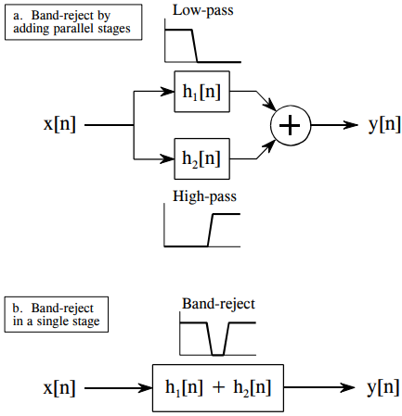
Rejeita Faixa
A band-reject filter is formed by the parallel combination of a low-pass filter and a high-pass filter with their outputs added. Or, can be formed by adding the low-pass and high-pass filter kernels.

Slide 14
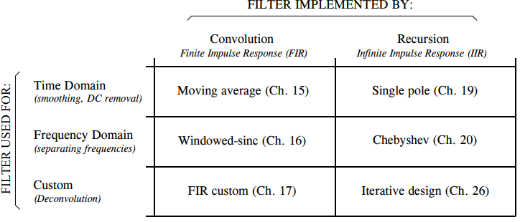
Classificação dos filtros

Slide 15
Considerações finais
Digital filters can be implemented in two ways, by convolution (also called finite impulse response or FIR) and by recursion (also called infinite impulse response or IIR).
Filters carried out by convolution can have far better performance than filters using recursion, but execute much more slowly

