Slide 1
Progress Report: Optimizing Photovoltaic Output Through Adaptive Tilt Angles to Mitigate Thermal Losses
DWTGEO002
Supervisor: Prof. KA Folly.

Slide 2
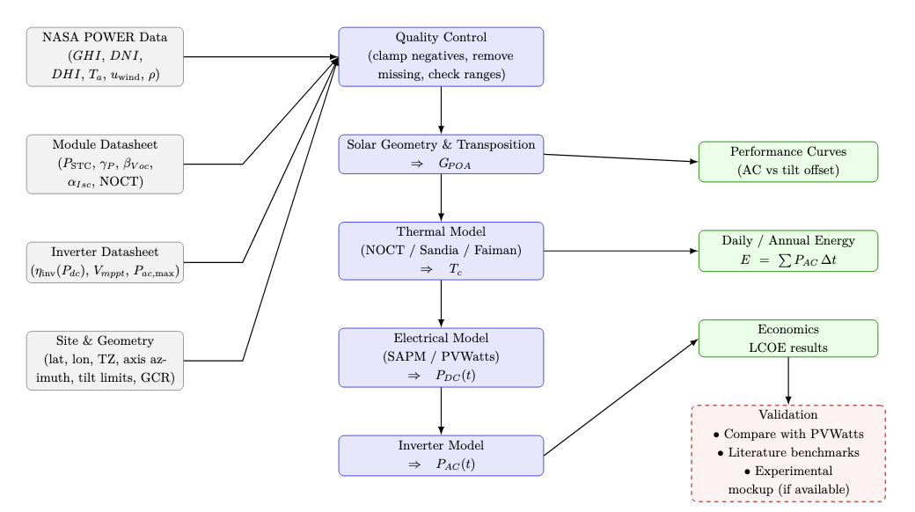
Methodology Pipeline

Slide 3


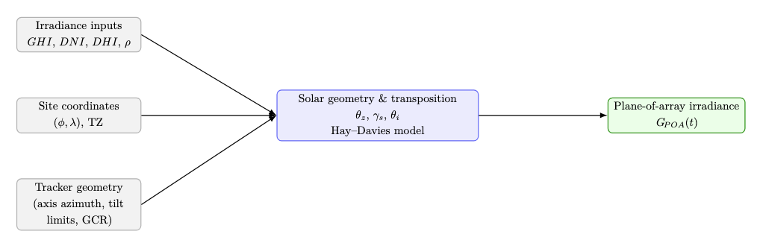

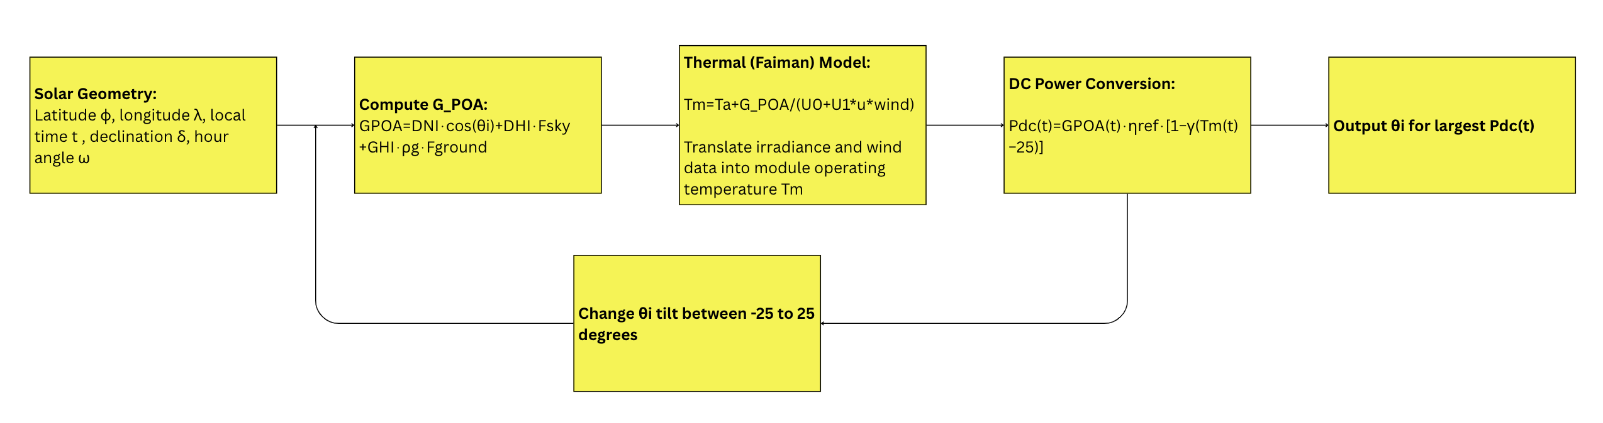
Mathematical Model for Adaptive Tilt Optimisation
Single-Axis Tracking Setup:
Rotation about a north–south axis, following the Sun’s apparent east–west path.
The tracker angle θt​ is optimised to maximise plane-of-array irradiance (G_{POA}).

Slide 4
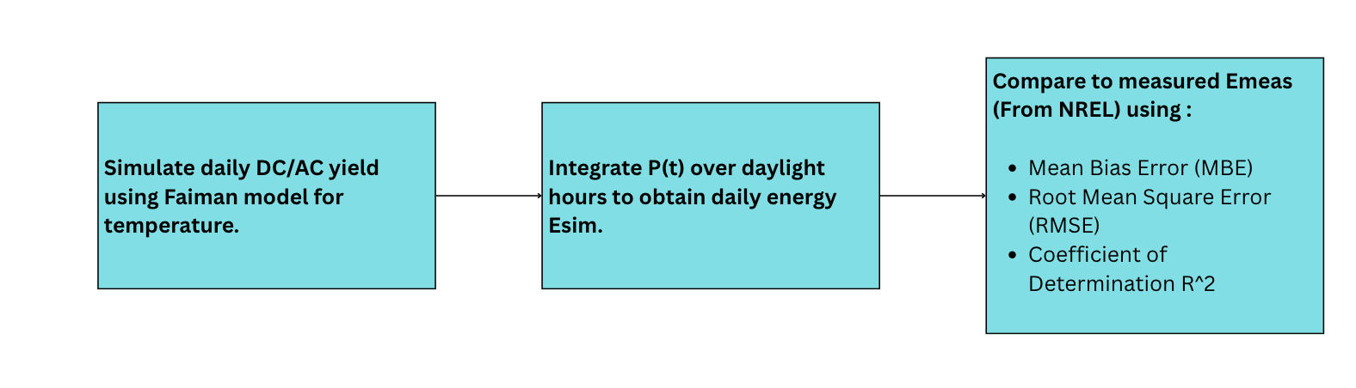
Comparing Simulated vs Measured Data (Model Validation)
PVDAQ 1430 (Mesa, Colorado, USA) — single-axis tracker system with known geometry.
Data: SCADA-measured AC energy (kWh) for 2017.

Slide 6
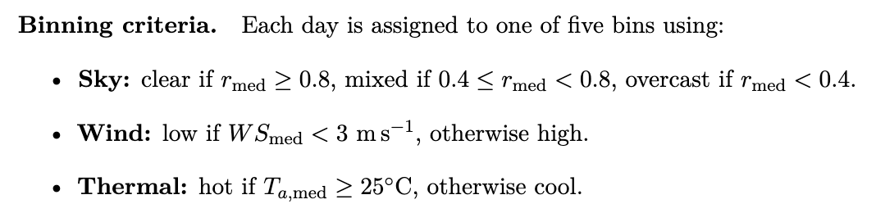
Bin Classification Concept
Days are clustered into bins based on meteorological similarity.
Each bin represents a typical day type (e.g., clear-hot, clear-cool, cloudy-mild).
Simulation then only needs to be run once per bin → annual yield extrapolated.
Allows testing of tilt offset strategies efficiently.
B1 (Clear/Low/Hot), B2 (Clear/High/Hot), B3 (Mixed/Low/Hot), B4 (Mixed/High/Cool), B5 (Overcast/Low/Cool).

Slide 7
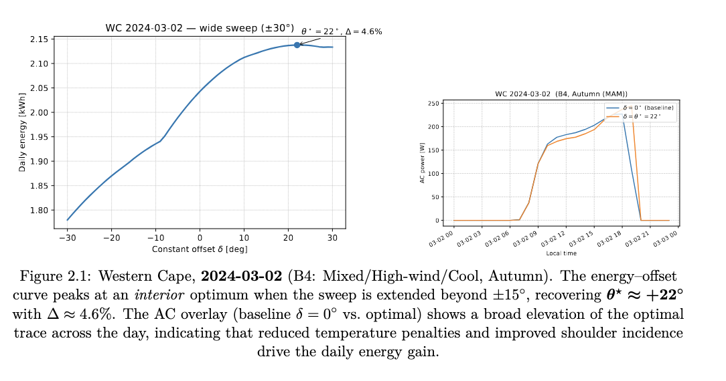
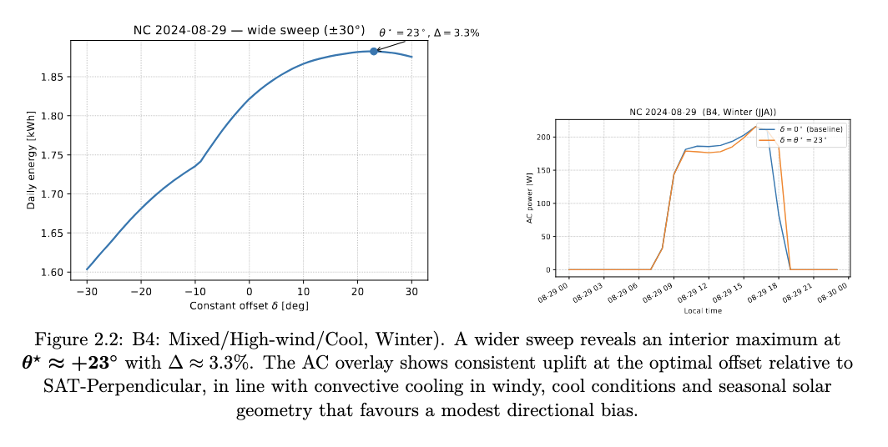
B4 reaction to angle optimization
Particular weather extreme days have been pulled and analysed.
B4 days in particular are affected by the off-pointing.
z

Slide 8
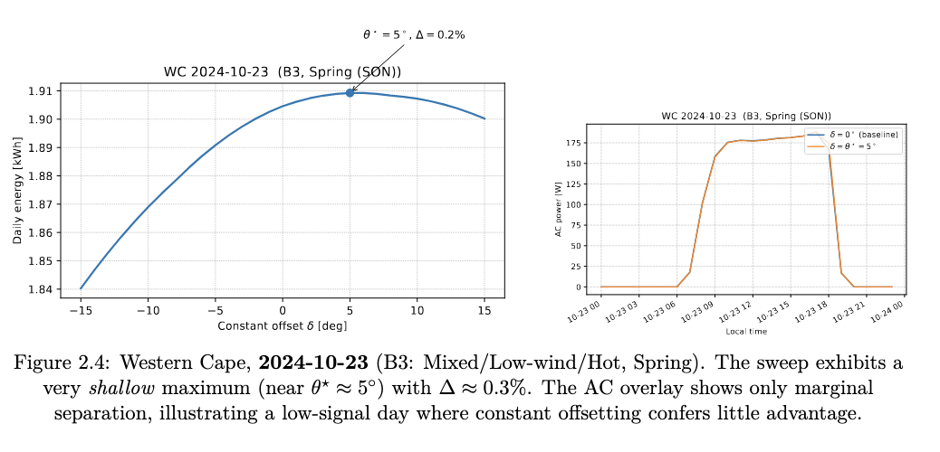
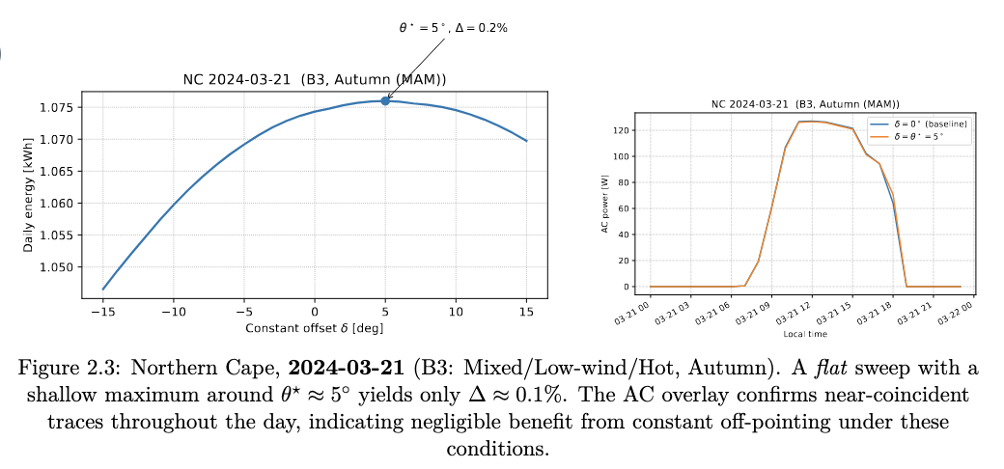
Whereas for example B3
z

Slide 9
Next Steps:
1. Annual Simulation (Direct Pointing Model):
Run the validated model for all days of 2024 using NASA POWER irradiance and temperature data for selected South African sites.
2. Average Offset Approach:
Compute an average optimal offset angle δˉδˉ from daily results and re-simulate the entire year with this fixed offset.
3. Conditional Offset Strategy:
Apply zero offset unless the day falls within “hot-clear” bins → dynamic selective offset model.
4. LCOE computation

Slide 10
Thank you
z

