Slide 1
Neurónové siete
Jakub Šóky

Slide 2
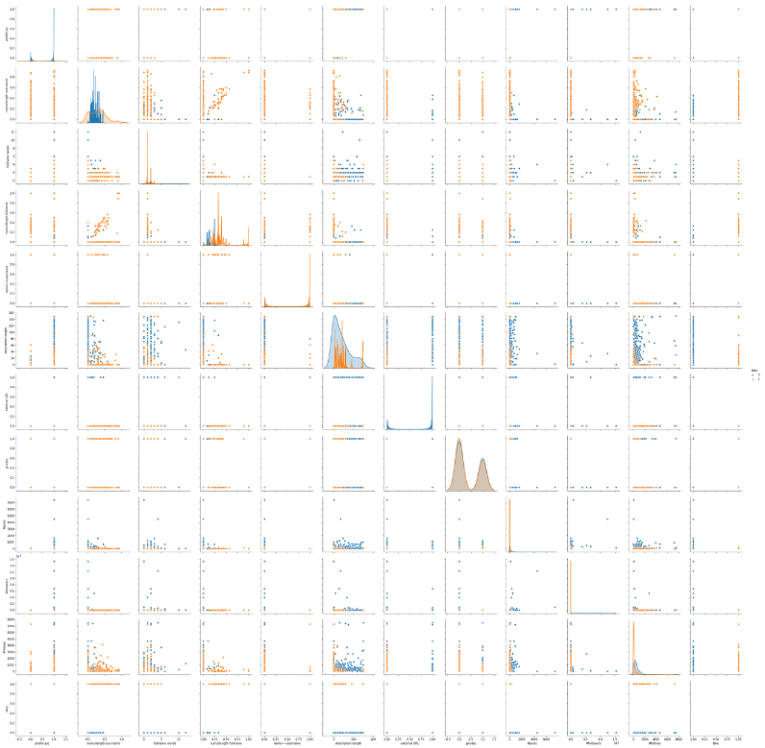
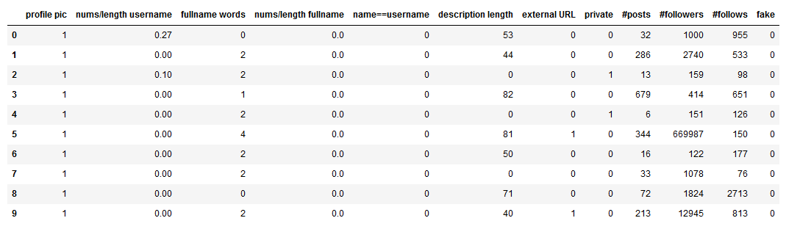
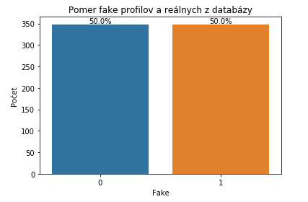
Dataset
Instagram fake spammer

Slide 3
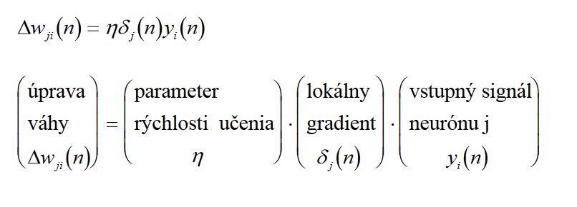
Viacvrstvový perceptrón (MLP, multilayer perceptron)

Slide 4
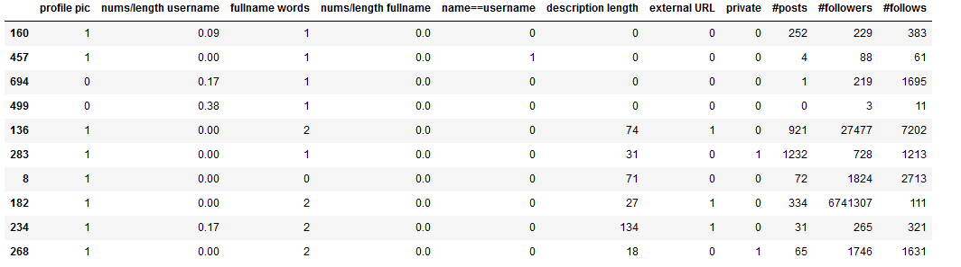
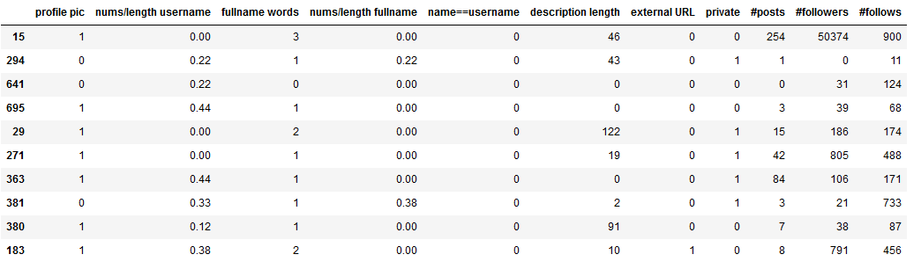
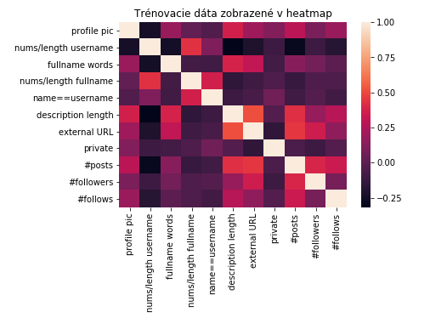
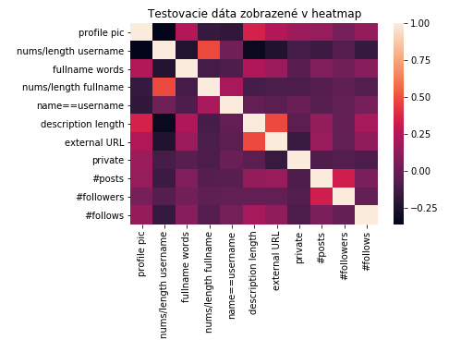
Dáta
Trénovacie X
Testovacie X

Slide 5
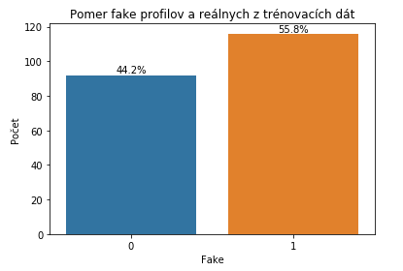
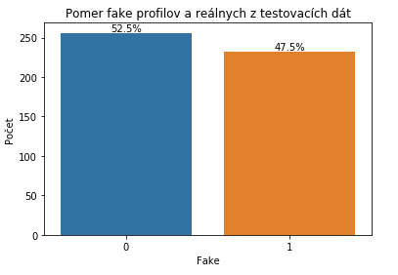
Dáta
Trénovacie y
Testovacie y

Slide 6
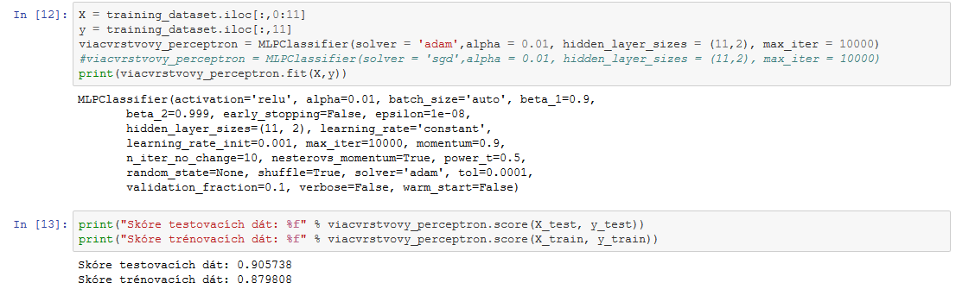
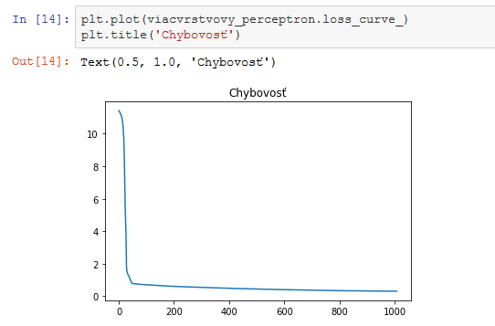
Algoritmus
Viacvrstvový perceptrón

Slide 7
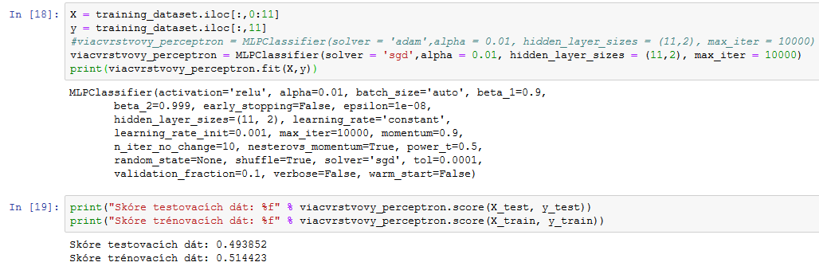
Porovnanie solveru Adam a SGD

Slide 8
Zdroje:
https://www.kaggle.com/free4ever1/instagram-fake-spammer-genuine-accounts
https://scikit-learn.org/stable/auto_examples/neural_networks/plot_mnist_filters.html#sphx-glr-auto-examples-neural-networks-plot-mnist-filters-py
https://seaborn.pydata.org/tutorial/distributions.html
https://medium.com/@annishared/build-your-first-neural-network-in-python-c80c1afa464
https://scikit-learn.org/stable/modules/neural_networks_supervised.html
https://stackoverflow.com/questions/33179122/seaborn-countplot-with-frequencies
http://ibooks.sk/publ/suns/PDF/Kap04-MLP.pdf

Slide 9
Ďakujem za pozornosť

