Slide 1
CNN BASICS
- RESHMI GHOSH & MANSI ANAND
Notes:
Re

Slide 2
What have we done so far?
A perceptron construct
Design a simple MLP structure
Think how patterns can be detected
Backpropagation
Learn how weights and biases are updated

Slide 3
TOPICS
1. Motivation – pitfalls of simple MLP?
2. Scanning MLPs
3. What is CNN?
4. What is filter, channel, stride, and the process of convolution?
5. Forward function of CNN, how does the filter convolve? Output formula
6. Downsampling techniques: Pooling – Max, Min, Average
7. Introduction to Backpropagation

Slide 4
Motivation:
Your network learns to detect a pattern at a certain region/subspace
Suppose at the 5th second of an utterance you hear the word – “HarryPotter”. What happens if the word appears elsewhere?
Same thing with memes, we want to detect the dog regardless of where it is placed.
Basically the location of pattern is not important, but detecting the pattern itself is important! – SHIFT INVARIANCE
Notes:
Till now we talked about a simple MLP structure,
We want to build a simple network that will be able to detect the word Potter regardless of the position of the word.
An MLP that can recognize dog in the first picture, can it be generalized to detect the dog in the second picture?
Conventional MLPs are sensitive to locations?
The network needs to be shift invariant: basically if the entire pattern shifts, the Network should be able to detect it!

Slide 5
Scanning MLPs:
How do you detect patterns in a shift invariant format?
Build a perceptron, scan the input area. Wait SCAN? – Yes!
1-D scan for sound; vs 2-D scan for images
Scan across the entire time if it is an audio clip or utterance
Or along length and breadth of an image
Special thanks: Mansi A. for helping me @12am last night with her free PS to refine this gif
Notes:
Move the network along the maximum dimension of the input
Now this can be convolved along 1-D for sound and
Shared parameter network

Slide 6
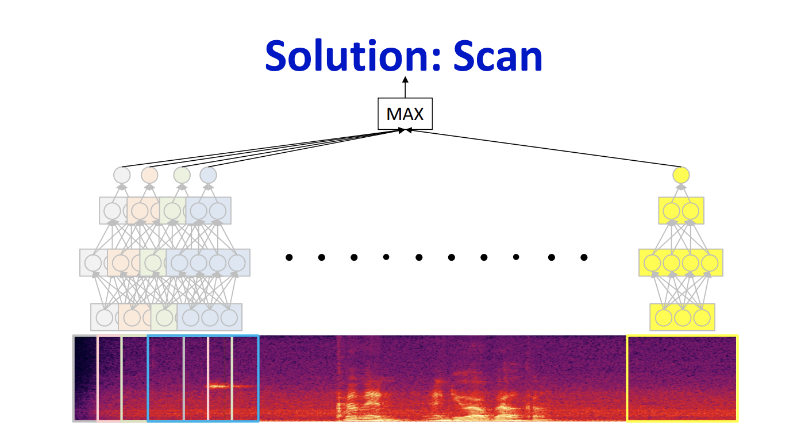
What is CNN? Scanning MLPs
Think of every ”window” of the input being scanned by a single MLP and to detect a pattern.
Ex: we want to detect which window of the input has the audio “Harry Potter”?
Now each MLP has weights that will create an output in the forward function, and since our pattern will have specific input values (like frequencies), we want to do a max() over all MLPs and see which one was able to detect it.
Basically a scanning MLP
Courtesy: Dr. Bhiksha’s slides

Slide 7
Images – what are these?
Each image is made up of a set of channels. Each channel comprises of several pixels
3 for a colored image, 2 for B&W.
The number of channels you encounter could even increase!
Image Source: Medium blogpost: A Comprehensive Guide to Convolutional Neural Networks — the ELI5 way

Slide 8
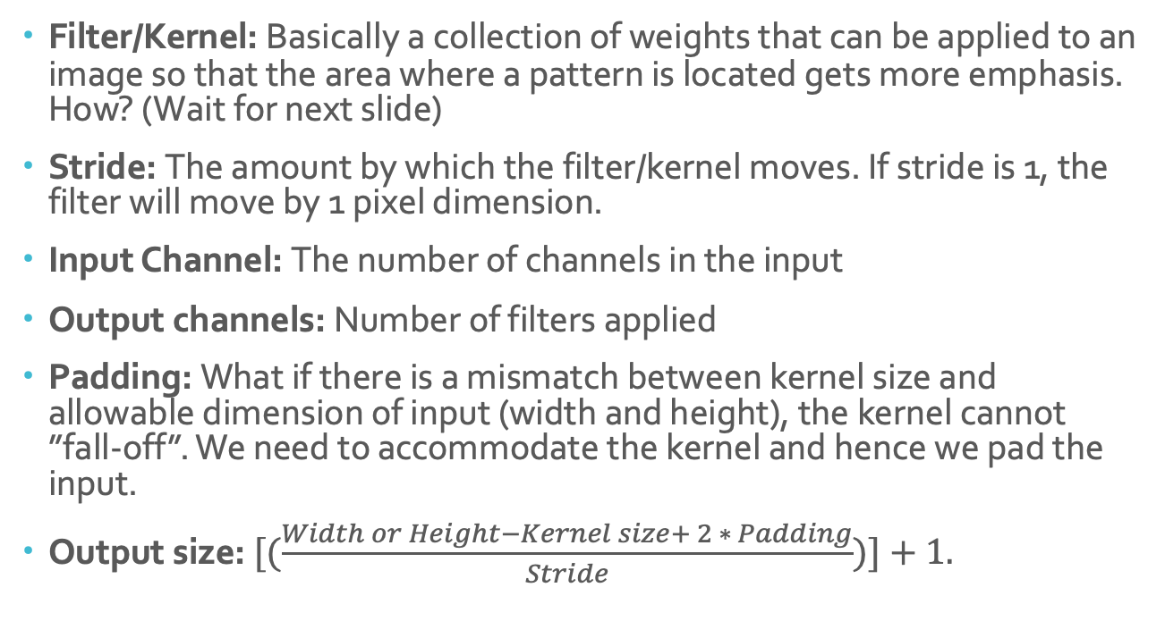
Basic Definition:
Filter/Kernel: Basically a collection of weights that can be applied to an image so that the area where a pattern is located gets more emphasis. How? (Wait for next slide)
Stride: The amount by which the filter/kernel moves. If stride is 1, the filter will move by 1 pixel dimension.
Input Channel: The number of channels in the input
Output channels: Number of filters applied
Padding: What if there is a mismatch between kernel size and allowable dimension of input (width and height), the kernel cannot ”fall-off”. We need to accommodate the kernel and hence we pad the input.
Output size: $[(\frac{Width or Height−Kernel size+ 2 ∗ Padding}{Stride})]+1.$
Notes:
Convolution: A convolution process is basically how an input is modified by a filter.
Stride: what do you think the stride is? Ask this question: The filter only moves by one column or one pixel dimension above,
Outputs are also known as feature maps

Slide 9
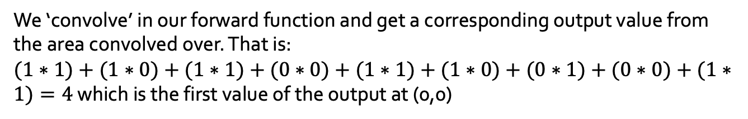
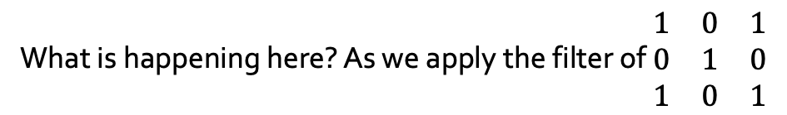
Convolution in the forward function:
Source: TDS blog post - A comprehensive guide to convolutional neural network the eli5way
What is happening here? As we apply the filter of $\begin{matrix}1 & 0 & 1 \\ 0 & 1 & 0 \\ 1 & 0 & 1\end{matrix}$
We ‘convolve’ in our forward function and get a corresponding output value from the area convolved over. That is:
$(1∗1)+(1∗0)+(1∗1)+(0∗0)+(1∗1)+(1∗0)+(0∗1)+(0∗0)+(1∗1)=4$ which is the first value of the output at (0,0)

Slide 10
Visualizing 2-D convolution with multiple filters in 3-D
Now visualize the same 2-D convolution process in 3-D.
Here kernel has same number of channels as input! - the red weights (kernel) is applied to the red channel and its pixel values.
Source: EECS251Leture UCBerkeley
Notes:
Convolution in 3d is just like 2d but you can imagine you are doing the 2d work 3 times, that is because each kernel can be considered a different set of weights which are applied to each input channel.
So

Slide 11
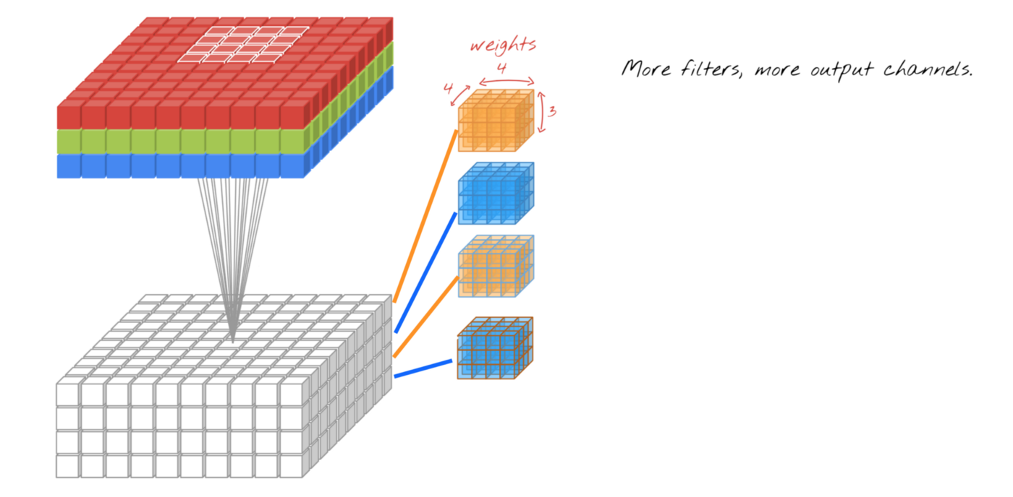
Convolution in 3-d with multiple kernels
Source: Towards Data Science blogpost on a beginners guide to CNN
Convolution in 3d is just like 2d but you can imagine you are doing the 2d work 4 times, that is because each kernel can be considered a different set of weights which are applied to input channels, and we obtain 4 output channels.
because # of kernels = output channels
Notes:
Number of channels: sometimes you want a fixed number of channels in your outputs

Slide 12
Padding:
Why padding?
Because a greater stride could lead to filter “falling off” the input dimension. And stride is our hyper-paramter!
Source: Medium blogpost - What is Padding in Convolutional Neural Network’s(CNN’s) padding
Notes:
Because you want a greater stride and convolving with greater slide will

Slide 13
Pooling
Why pooling?: It reduces the spatial size of the output by reducing the number of parameters
Pooling layer operates on each feature map independently.
Three main types of pooling:
Max pooling
Min Pooling
Average Pooling
Source: https://computersciencewiki.org/index.php/Max-pooling_/_Pooling

Slide 14
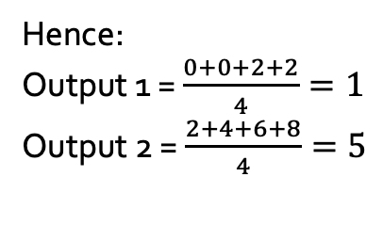
Pooling
Source: Avg pooling: Kaggle - https://www.kaggle.com/questions-and-answers/59502
Basically calculate the average of the output values over stride of 2
Hence:
Output 1 = $\frac{0+0+2+2}{4}=1$
Output 2 = $\frac{2+4+6+8}{4}=5$

Slide 15
Backpropagation
INPUT * WEIGHTS (KERNEL) + BIAS = OUTPUT
Forward function!
Remember chain rule?!
Source: Medium blog post - Backpropagation-for-convolution-with-strides
derivative of loss wrt to each output
Derivative of loss with each kernel weight
Notes:
Stride = 2
How does back prop happen?

Slide 16
Backpropagation
This is not an easy concept
Source: Medium blog post - Backpropagation-for-convolution-with-strides
Dilation: A process of adding zeros to your output so that you can use it as a “kernel” to convolve over input and find the updated weights in backprop
Reach out to me during Monday OH, if you are interested, so that we can work through this on pen and paper. If you understand this, it’s one of the most rewarding things in this course!

Slide 17
Backpropagation with stride = 2
A set of inputs will not contribute to every output (because we are SCANNING!) but a set of filters/kernels will contribute to every output!
Source: Medium blog post - Backpropagation-for-convolution-with-strides

Slide 18
THANK YOU!
Please don’t forget to submit your hw1p1 and p2.
After all “ it does not do to dwell on dreams and forget to live” (ahem submit hws)
Trivia: Where is this line from?

