Slide 1

Introduction to Deep Neural Networks
0. Logistics
Fall 2020

Slide 2
Outline
Introduction
Objectives and syllabus
Course logistics
Homeworks, quizzes, projects, grading, oh my!
Prep, teamwork and mentoring
And cheating…
Challenges

Slide 3
Outline
Introduction
Objectives and syllabus
Course logistics
Homeworks, quizzes, projects, grading, oh my!
Prep, teamwork and mentoring
And cheating…
Challenges

Slide 4
Neural Networks are taking over!
Neural networks have become one of the major thrust areas recently in various pattern recognition, prediction, and analysis problems
In many problems they have established the state of the art
Often exceeding previous benchmarks by large margins

Slide 5
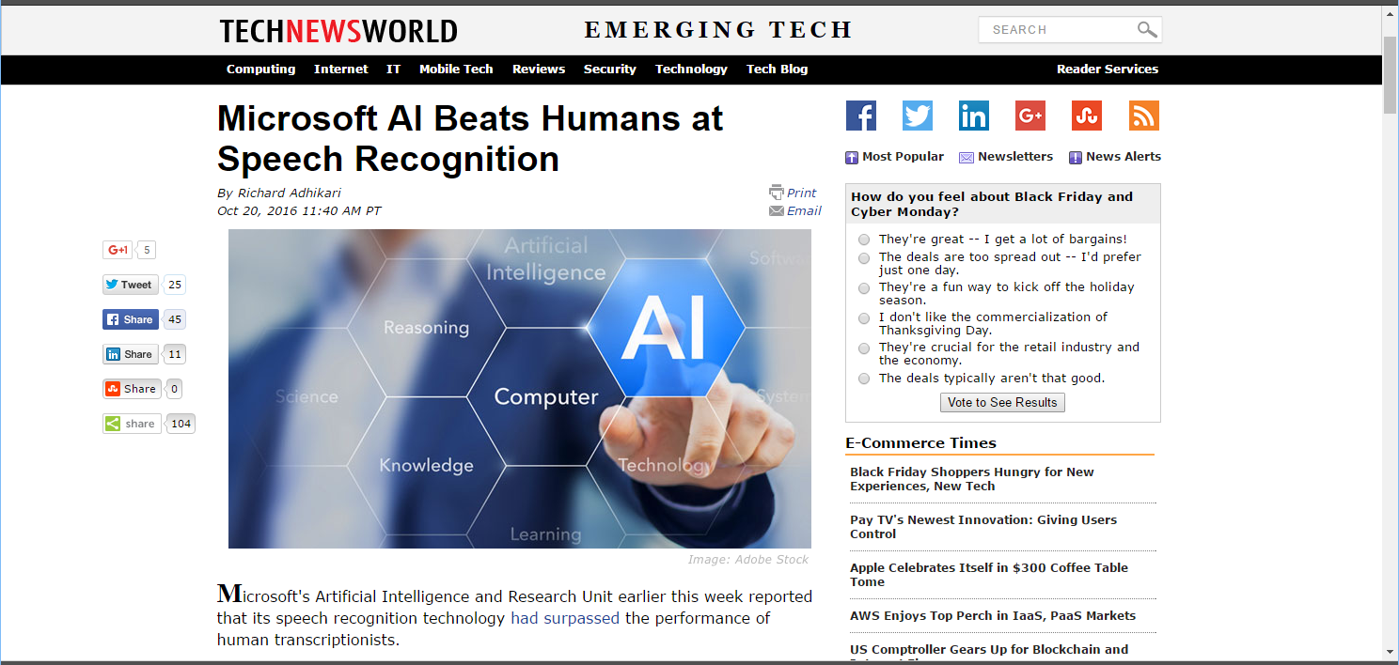
Breakthroughs with neural networks
Notes:
After more than half a century of frustration with automatic speech recognition, we suddenly have human-level performance on many tasks using neural networks. Microsoft was the first to report it in 2016, and even in the past 3 years the performance has improved rapidly as networks got better.

Slide 6

Breakthroughs with neural networks
Notes:
Prior to November 2015 most machine translation systems were horrible. You could translate from English to Spanish, and translate the translated Spanish back to English and what came back would be pure nonsense.
In November 2015 Google switched to neural-net based Machine translation, and we haven’t looked back. These days even foreign language experts often check their translations on automatic translation systems. Neural nets made it possible.

Slide 7
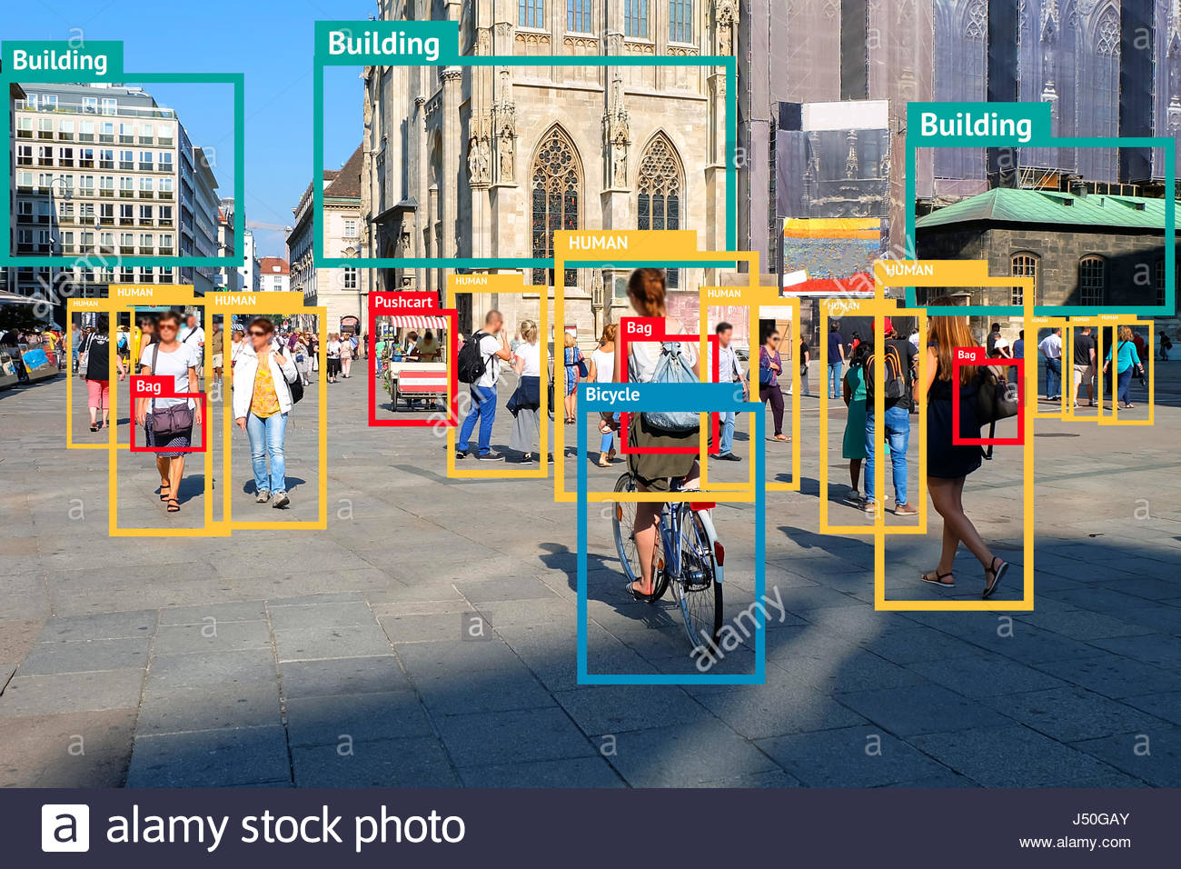
Image segmentation & recognition
Notes:
Accurate image segmentation used to be impossible. Now neural nets can do a fantastic job on even very complex images. Not only can they segment images; they can also label the segments.

Slide 8
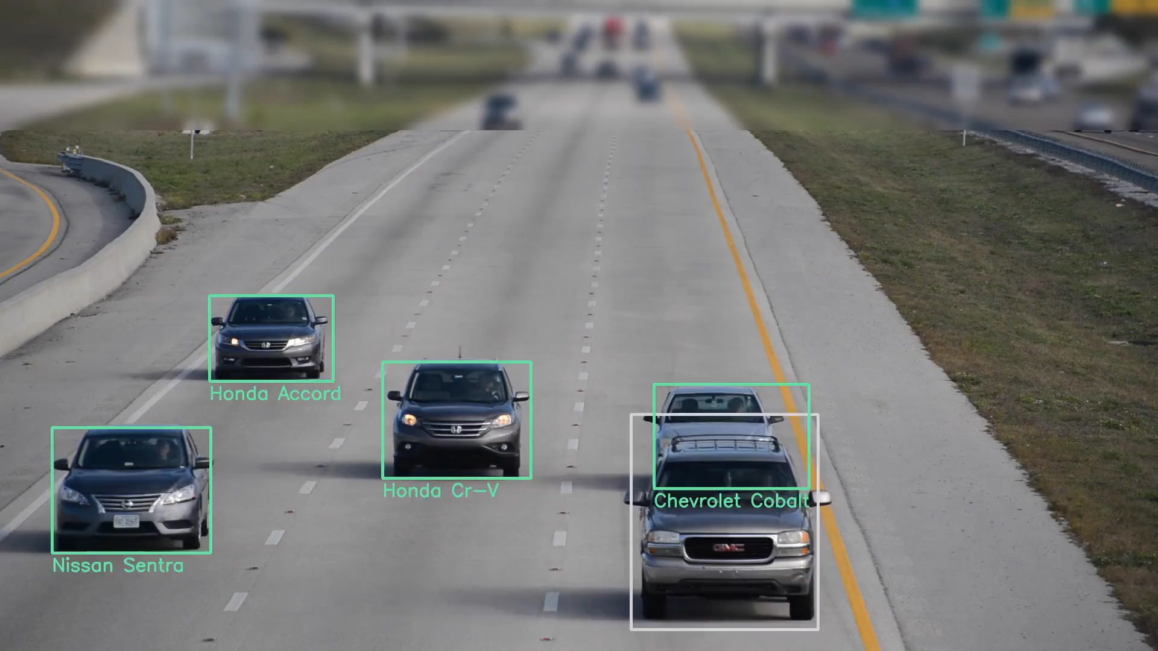
Image recognition
https://www.sighthound.com/technology/
Notes:
This video from sighthound.com (apparently) shows real-time detection and identification of cars on a highway. This wouldn’t be possible with pre-neural-net technology.

Slide 9


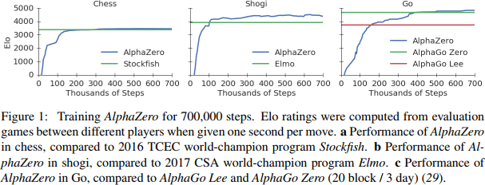
Breakthroughs with neural networks
Notes:
For the longest time Chess was considered the benchmark for intelligence until, in the late 80s, researchers at CMU built a system that could beat a grandmaster.
After that the next frontier was GO. As late as 2015, the best computer programs couldn’t match human experts. All that changed when neural networks came into the picture. We had the first system to beat a human expert in 2016. Today alphazero can begin from scratch and still manage to learn to beat the best human experts in a few hours.. Humans will never again be the world champions of go
And many other games, in fact.

Slide 10
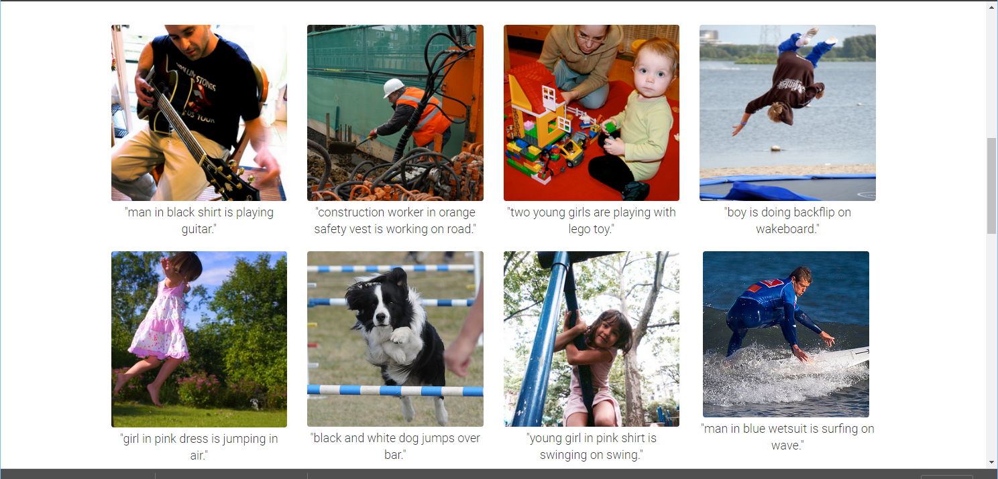
Breakthroughs with neural networks
Captions generated entirely by a neural network
Notes:
2015!!

Slide 11

Breakthroughs with neural networks
ThisPersonDoesNotExist.com uses AI to generate endless fake faces
https://www.theverge.com/tldr/2019/2/15/18226005/ai-generated-fake-people-portraits-thispersondoesnotexist-stylegan
Notes:
2015!!

Slide 12
Successes with neural networks
And a variety of other problems:
From art to astronomy to healthcare...
and even predicting stock markets!

Slide 13


Neural Networks and the Job Market
This guy didn’t know about neural networks (a.k.a deep learning)
This guy learned about neural networks (a.k.a deep learning)

Slide 14
Outline
Introduction
Objectives and syllabus
Course logistics
Homeworks, quizzes, projects, grading, oh my!
Prep, teamwork and mentoring
And cheating…
Challenges

Slide 15
Course Objectives
Understanding neural networks
Comprehending the models that do the previously mentioned tasks
And maybe build them
Familiarity with some of the terminology
What are these:
http://www.datasciencecentral.com/profiles/blogs/concise-visual-summary-of-deep-learning-architectures
Fearlessly design, build and train networks for various tasks
You will not become an expert in one course

Slide 16
Course objectives: Broad level
Concepts
Some historical perspective
Types of neural networks and underlying ideas
Learning in neural networks
Training, concepts, practical issues
Architectures and applications
Will try to maintain balance between squiggles and concepts (concept >> squiggle)
Practical
Familiarity with training
Implement various neural network architectures
Implement state-of-art solutions for some problems
Overall: Set you up for further research/work in your research area

Slide 17
Course learning objectives: Topics
Basic network formalisms:
MLPs
Convolutional networks
Recurrent networks
Boltzmann machines
Some advanced formalisms
Generative models: VAEs
Adversarial models: GANs
Topics we will touch upon:
Computer vision: recognizing images
Text processing: modelling and generating language
Machine translation: Sequence to sequence modelling
Modelling distributions and generating data
Reinforcement learning and games
Speech recognition

Slide 18
Reading
List of books on course webpage
Additional reading material will also appear on the course pages

Slide 19
Outline
Introduction
Objectives and syllabus
Course logistics
Homeworks, quizzes, projects, grading, oh my!
Prep, teamwork and mentoring
And cheating…
Challenges

Slide 20

Instructors and TAs
Instructor: Bhiksha Raj
bhiksha@cs.cmu.edu
x8-9826
TAs:
List of TAs, with email ids on course page
We have TAs for the
Pitt Campus
Kigali,
SV campus,
Please approach your local TA first
Office hours: On webpage
http://deeplearning.cs.cmu.edu/

Slide 21
Logistics: Lectures..
Class is entirely online
Lectures are held over zoom
Recordings will be posted
Important that you view the lectures
Even if you think you know the topic
Your marks depend on viewing lectures
We will monitor attendance (more on this later)

Slide 22
Additional Logistics
Discussions:
On Piazza
Compute infrastructure:
Everyone gets Amazon tokens
Initially a token for $50
Can get additional tokens of $50 up to a total of $150

Slide 23
Lecture Attendance
We will track lecture attendance
You must either be in class or watch the videos uploaded to mediatech
If you’re watching the videos on mediatech, we can track who watched what lecture and for how long,
If you’re in class, we assume you attended the entire class
We will report these numbers to you
With the primary objective of informing you about how much attention you’re paying to the class
We highly highly recommend greater than 75% attendance
We assume you’re in the class to learn

Slide 24
Lecture Schedule
On website
The schedule for the latter half of the semester may vary a bit
Guest lecturer schedules are fuzzy..
Guest lectures:
TBD
Scott Fahlman, Shinji Watanabe, Gerald Friedland, Graham Neubig
Or some subset thereof

Slide 25
Recitations
We will have 13 recitations
Possibly a 14th if TAs and students are still enthusiastic after 15 grueling weeks
Will cover implementation details and basic exercises
Very important if you wish to get the maximum out of the course
Topic list on the course schedule
Strongly recommend attending all recitations
Even if you think you know everything

Slide 26
Recitations Schedule
Every Friday of the semester
See course page for exact details!

Slide 27
Outline
Introduction
Objectives and syllabus
Course logistics
Homeworks, quizzes, projects, grading, oh my!
Prep, teamwork and mentoring
And cheating…
Challenges

Slide 28
Evaluation
Performance is evaluated based on 3 types of tests
Weekly Quizzes
Homeworks
Team Project

Slide 29
Weekly Quizzes
10 multiple-choice questions
Related to topics covered that week
On both slides and in lecture
Released Friday, closed Sunday night
This may occasionally shift, don’t panic!
There will be 14 total quizzes
We will consider the best 12
This is expected to account for any circumstance-based inability to work on quizzes
You could skip up to 2

Slide 30
Lectures and Quizzes
Slides often contain a lot more information than is presented in class
Quizzes will contain questions from topics that are on the slides, but not presented in class
Will also include topics covered in class, but not on online slides!

Slide 31
Homeworks
There will be one early homework (released before the start of the semester) and four in-term homeworks
Homework 0: Preparatory material for the course
Homeworks 1-4: Actual neural-net exercises
Homeworks 1-4 all have two parts:
Part 1: Autograded problems with deterministic solutions
You must upload them to autolab
Will include mandatory parts and “bonus” parts
“bonus” questions will not contribute to final grading curves and give you the chance to make up for marks missed elsewhere
Part 2: Open problems posted on Kaggle

Slide 32
Homeworks 1-4 – Part 1
Part 1 of the homeworks evaluate your ability to code in neural nets on your own from scratch
If you implement all mandatory and bonus questions of part 1 of all homeworks, you will, hopefully, have all components necessary to construct a little neural network toolkit of your own
“mytorch” ☺
The homeworks are autograded
Be careful about following instructions carefully
The autograder is setup on a computer with specific versions of various packages
Your code must conform to their restrictions
If not the autograder will often fail and give you errors or 0 marks, even if your code is functional on your own computer

Slide 33
Homeworks 1-4, Part 2
Part 2 of every homework tests your ability to solve complex problems on real-world data sets
These are open problems posted on Kaggle
You compete with your classmates on a leaderboard
We post performance cutoffs for A, B and C
If you achieved the posted performance for, say “B”, you will at least get a B
A+ == 105 points (bonus)
A = 100
B = 80
C = 60
D = 40
No submission: 0
Actual scores are linearly interpolated between grade cutoffs
Interpolation curves will depend on distribution of scores

Slide 34
Homework Deadlines
Multiple deadlines
Separate deadline for Autograded deterministic component
Kaggle component has multiple deadlines
Initial submission deadline : Making this is worth 5% of the marks of the HW
Full submission deadline: Your final submission must occur before this deadline to be eligible for full marks
Drop-dead deadline: Must submit by here to be eligible for any marks
Day on which solution is released
Homeworks: Late policy
Everyone gets up to 7 total slack days (does not apply to initial submission)
You can distribute them as you want across your HWs
You become ineligible for “A+” bonus if you’re using your grace days for Kaggle
Once you use up your slack days, all subsequent late submissions will accrue a 10% penalty (on top of any other penalties)
There will be no more submissions after the drop-dead deadline
Kaggle: Kaggle leaderboards stop showing updates on full-submission deadline
But will continue to privately accept submissions until drop-dead deadline
Please see course webpage for complete set of policies

Slide 35
Course project
If you’re taking 11-685/11-785/18-786, you will be required to do a course project
Projects are done by teams of students
Ideal team size is 4
You are encouraged to form your teams early
Projects are intended to exercise your ability to comprehend and implement ideas beyond those covered by the HWs
Project can range from
Implementing and evaluating cutting-edge ideas from recent papers
Verifying results from “hot” published work
“Researchy” problems that might lead to publication if completed well
Proposing new models/learning algorithms/techniques, with proper evaluation
Etc.

Slide 36
Course project
Project teams must be formed by the first week of October
If you don’t form your own teams, we will team you up
Each team must:
Submit a project proposal by the second week of October
Submit a mid-way report ¾ way through the semester (First week of November)
Submit a preliminary full report three days before the presentation due date
Make a 5 min video presentation of the project at the end of the semester
Can be presented by one, some, or all team members
Will be evaluated by the instructor, TAs, and your classmates
Ensure you explain the problem, proposed solution, and the evaluation clearly
Allocate enough time to make the presentation, it is not as easy as you think
Poor presentation can significantly affect your project score :)
Submit a final full report at the end of the semester
Templates for proposals and reports will be posted
Each team will be assigned a mentor from among the TAs, who will monitor your progress and assist you if possible.
More details on project evaluations will be posted towards the end of the sem
The project is often the most fun portion of the course

Slide 37
Grading
Weekly Quizzes 24% 14 Quizzes, bottom two dropped 24%
Assignments 51% HW0 – Preparatory homework (AL) 1% HW1 – Basic MLPs (AL + Kaggle) 12.5% HW2 – CNNs (AL + Kaggle) 12.5% HW3 – RNNs (AL + Kaggle) 12.5% HW4 – Sequence to Sequence Modelling (Kaggle) 12.5%
Team Project (Not for 11-485) 25% Proposal TBD Mid-term Report TBD
Preliminary Full Report TBD Project Presentation TBD Peer Reviewing TBD
Final report TBD

Slide 38
Homeworks
We have planned for a fifth homework to be released as a “make up” for incomplete projects, in the event of a catastrophe
Remember Spring 2020
If released it will
Be worth only 60% of full project score
Be released after the project deadline
You will get scored for either your project or HW5!

Slide 39
Outline
Introduction
Objectives and syllabus
Course logistics
Homeworks, quizzes, projects, grading, oh my!
Prep, teamwork and mentoring
And cheating…
Challenges

Slide 40
Preparation for the course
Course is implementation heavy
A lot of coding and experimenting
Will work with some large datasets
Language of choice: Python
Toolkit of choice: Pytorch
You are welcome to use other languages/toolkits, but the TAs will not be able to help with coding/homework
Some support for TensorFlow
We hope you have gone through
Recitation zero
HW zero
Carries marks

Slide 41

Teamwork
Learning happens best together
You will learn more from each other than you will from us
We encourage teamwork
But there are strict rules…

Slide 42

Study groups
Please form study groups
If you do not have a study group of your own, we will form one for you
Please register on Sean’s forms
Everyone must be part of a study group

Slide 43
Study groups
What study groups may do:
Discuss homework problems and solutions
Discuss papers
Discuss class work
Discuss quizzes
We encourage you to meet regularly to discuss IDL work
Study groups may also go on to form project teams
So what are the caveats? What may you not do

Slide 44
Study groups vs. cheating
Every student must solve their quizzes by themselves
You may discuss the questions with your study groups/friends, but when you solve the quiz, isolate yourself and do it alone
Every student must solve every homework by themselves
You may discuss the homeworks with your friends, but when you finally solve it, every line of your code (except libraries that have been okayed by course staff) must be written by you
Your solution must be yours
Plagiarizing code from the web or your friends constitutes cheating
And submitting solutions not obtained by you constitutes cheating

Slide 45
Cheating
You are here to learn DL yourself, not to demonstrate how well your friend, or that guy on the web has learned DL
You are at CMU – which means you are among the brightest and best students in the world
You probably were among the top students in your peer group all your life, before you came here
It will be an insult to yourself and everything you ever stood for in your life to lower yourself from your own standards and start cheating
So don’t!!!
If you are unsure whether something you’re doing constitutes cheating or not, check with us

Slide 46
Mentoring
Every study group will be assigned a TA mentor
We will track your progress and reach out to you if you appear to be in trouble
If in trouble, reach out to your TA mentor and/or the instructor
If you feel you’re falling behind, reach out
If you feel you are struggling, reach out
If you feel pressured/unable to cope, reach out
We will try our best to help you
We aim to make this a successful course for all of you
In our ideal world, everyone performs well enough to get an A
Without lowering our standards – i.e. we would like to bring you all up to where we believe you deserve an A
Everything about this course is geared to that objective

Slide 47
Outline
Introduction
Objectives and syllabus
Course logistics
Homeworks, quizzes, projects, grading, oh my!
Prep, teamwork and mentoring
And cheating…
Challenges

Slide 48
This course is not easy
A lot of work!
A lot of work!!
A lot of work!!!
A LOT OF WORK!!!!
Mastery-based evaluation
Quizzes to test your understanding of topics covered in the lectures
HWs to teach you to implement complex networks
And optimize them to high degree
Target: Anyone who gets an “A” in the course is technically ready for a deep learning job

Slide 49
This course is not easy
A lot of work!
A lot of work!!
A lot of work!!!
A LOT OF WORK!!!!
Mastery-based evaluation
Quizzes to test your understanding of topics covered in the lectures
HWs to teach you to implement complex networks
And optimize them to high degree
Target: Anyone who gets an “A” in the course is technically ready for a deep learning job

Slide 50
This course is not easy
A lot of work!
A lot of work!!
A lot of work!!!
A LOT OF WORK!!!!
Mastery-based evaluation
Quizzes to test your understanding of topics covered in the lectures
HWs to teach you to implement complex networks
And optimize them to high degree
Target: Anyone who gets an “A” in the course is technically ready for a deep learning job

Slide 51

This course is not easy
A lot of work!
A lot of work!!
A lot of work!!!
A LOT OF WORK!!!!
Mastery-based evaluation
Quizzes to test your understanding of topics covered in the lectures
HWs to teach you to implement complex networks
And optimize them to high degree
Target: Anyone who gets an “A” in the course is technically ready for a deep learning job
Not for chicken!

Slide 52

This course is not easy
A lot of work!
A lot of work!!
A lot of work!!!
A LOT OF WORK!!!!
Mastery-based evaluation
Quizzes to test your understanding of topics covered in the lectures
HWs to teach you to implement complex networks
And optimize them to high degree
Target: Anyone who gets an “A” in the course is technically ready for a deep learning job
But somewhat calibrated (over the years) to ensure it is doable
Over 60% of students got some flavor of A each of the past three semesters and they deserved it

Slide 53
This course is not easy
A lot of work!
A lot of work!!
A lot of work!!!
A LOT OF WORK!!!!
Mastery-based evaluation
Quizzes to test your understanding of topics covered in the lectures
HWs to teach you to implement complex networks
And optimize them to high degree
Target: Anyone who gets an “A” in the course is technically ready for a deep learning job

Slide 54
HW0 / Recitation 0
Please, please, please, please, please go through the videos for recitation 0, and complete HW0.
These are essential for you to gain comfort with the coding require in the following homeworks
HW1 part 1 also has many components intended to help you later in the course
So if it seems a bit dense, please bear with it, its worth it
HW1 is the easiest HW!

Slide 55
Questions?
Please post on piazza

