Slide 1
11-485/685/785
Recitation 0.9, Fall 2026
Google Cloud Platform (GCP)
Presented by
Anurag Aryal

Slide 2
Content
Requirements
1
GCP Account Setup
IDE with SSH support (VS code)
Credit/Debit Card with about 2 USD
2
How to request quota increase
3
How to create a VM instance
4
How to connect to a VM from your device

Slide 3
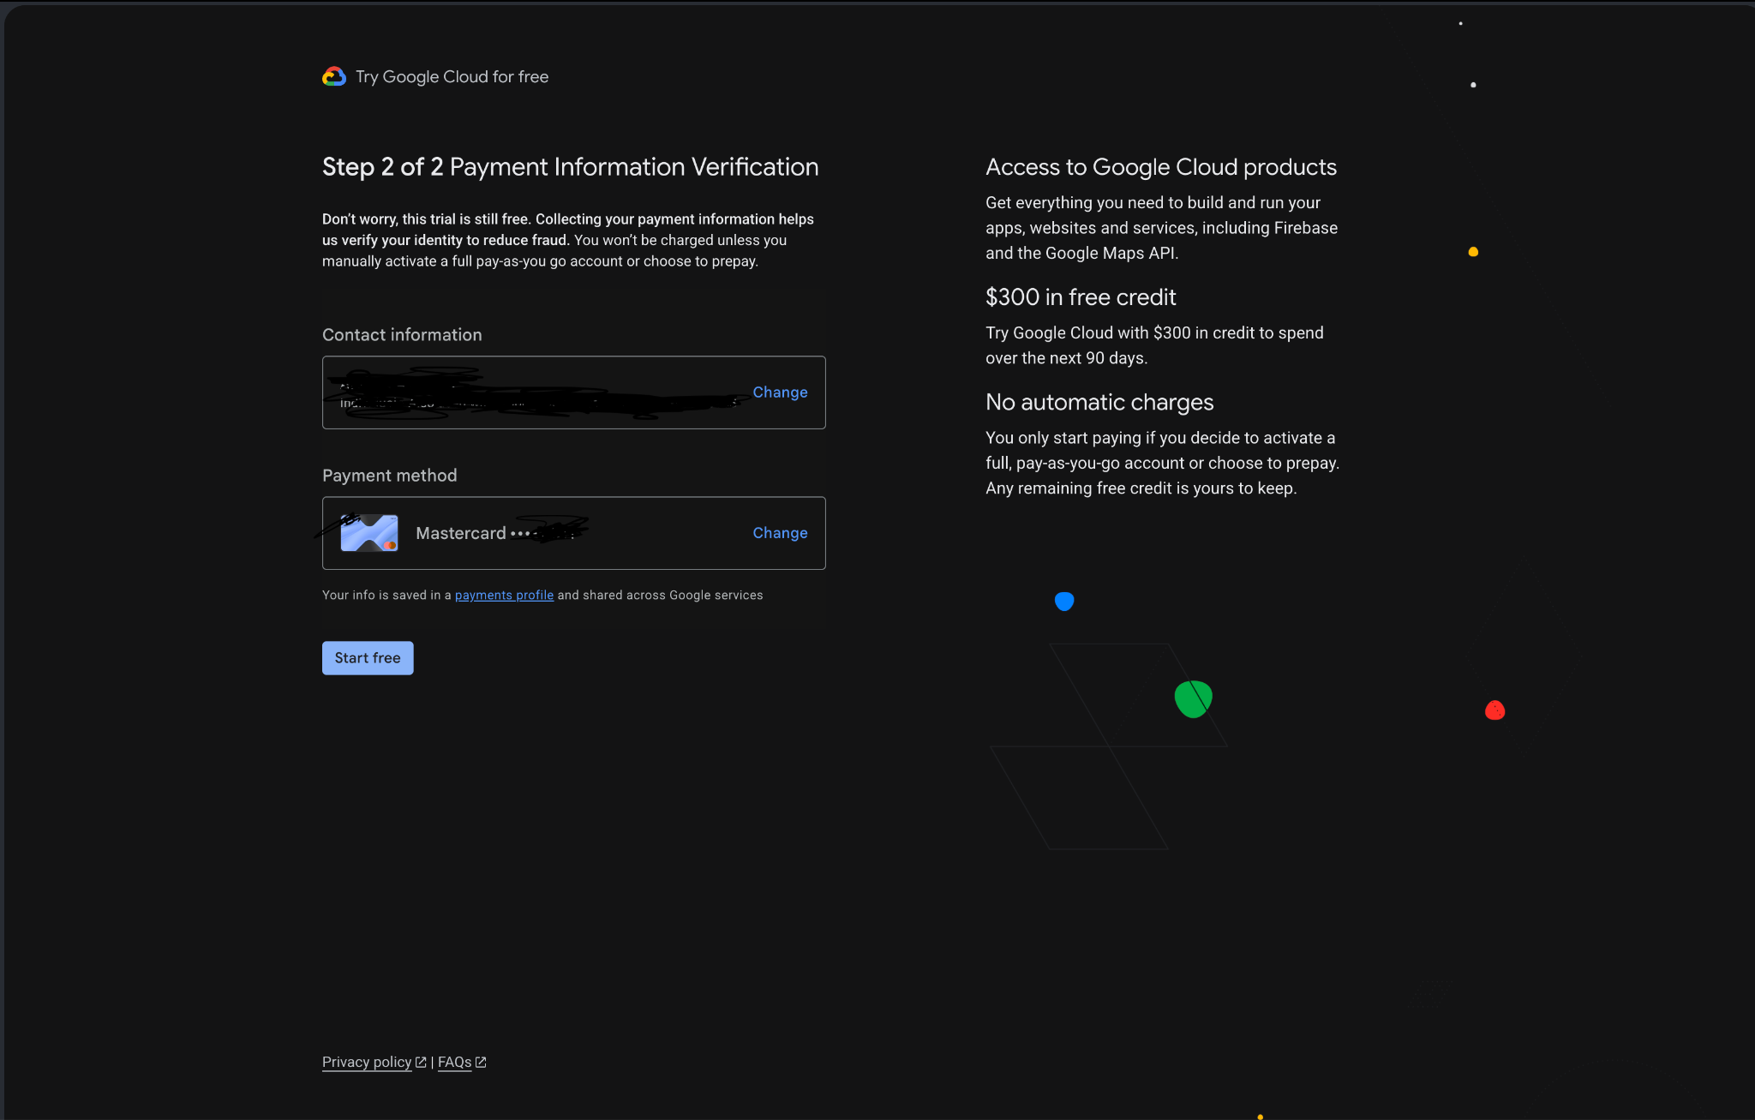
How to create GCP Account
Go to https://cloud.google.com/
Fill out the Credit card info

Slide 4
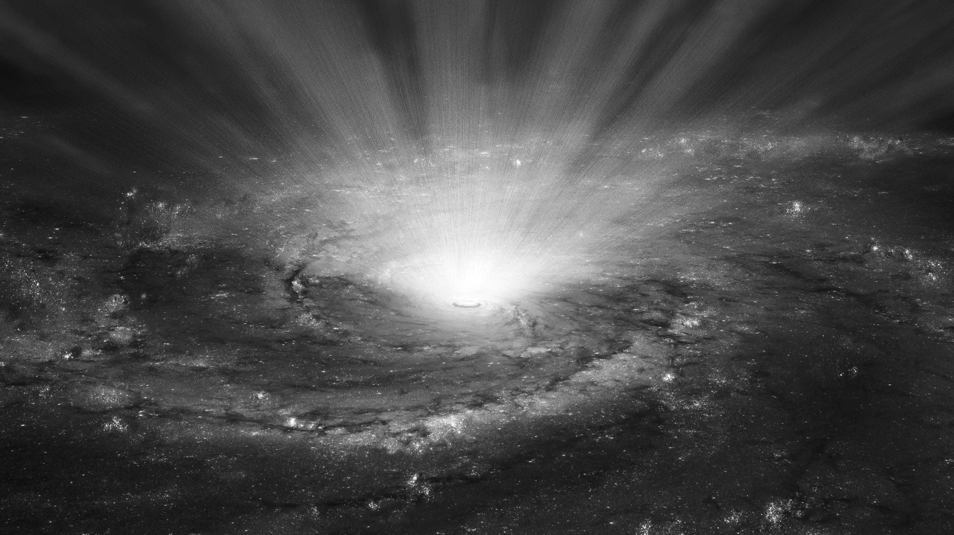
HOW TO REQUEST QUOTA INCREASE

Slide 5
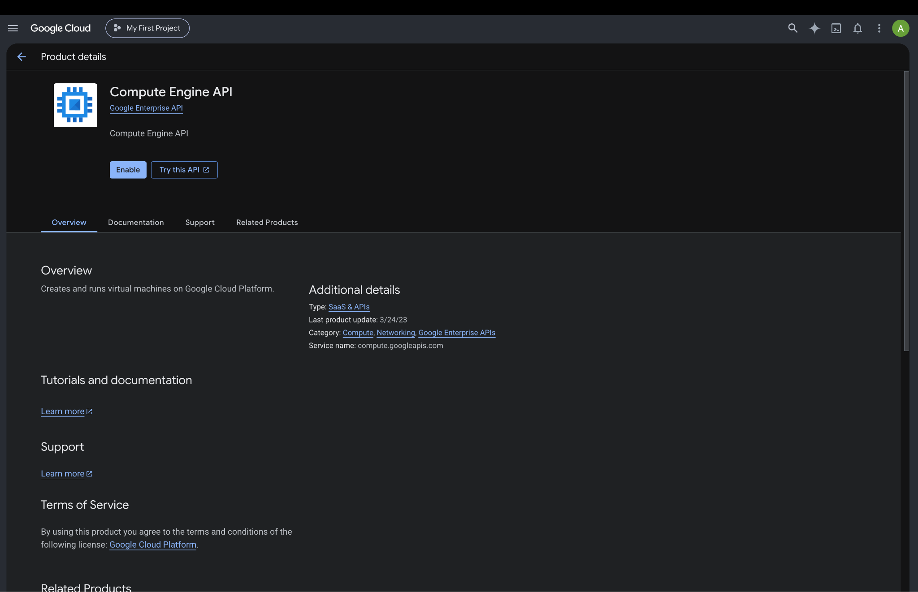

Slide 6
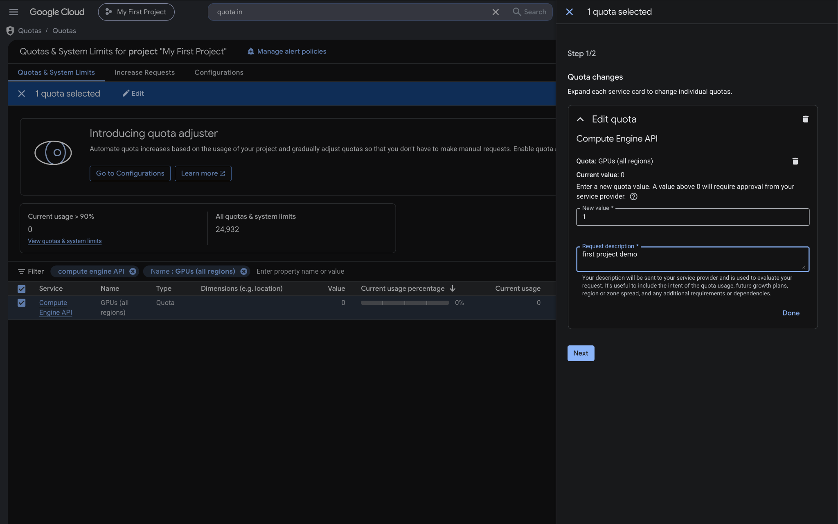

Slide 7
SSH SETUP
Stands for Secure Shell
Protocol (and a tool) to securely connect to another computer over a network
SSH allows you to:
Log into a remote computer’s terminal
Run commands on that machine as if you are physically there
Transfer files securely
Set up port forwarding, tunneling amongst other usecases

Slide 8
Move to your local terminal and execute below commands. Remove the comments when pasting. (Powershell for windows, terminal for mac/linux)
• $ cd ~ # Go to your home directory
• $ mkdir .ssh # Create a .ssh folder if you don’t have it
• $ cd .ssh
• $ ssh-keygen -t rsa -b 4096 # This is to create a private key
• $ Enter file to save the key: IDL_GCP # This will create a file IDL_GCP.pub, passphrase isn’t
necessary but you can add it if you want.
• $ cat IDL_GCP.pub # To check contents of the file
Copy the contents and open SSH keys on GCP.
Note your username which can be found between “==” and the “@” in your public key.

Slide 9



CREATING VM INSTANCE
• You can also check for which GPU regions have what compute available from https://cloud.google.com/compute/docs/gpus/gpu-regions-zones
• This would be helpful in your later assignments and projects.
• We will be looking into VM instances. These are similar to EC2 instances provided by AWS.

Slide 10
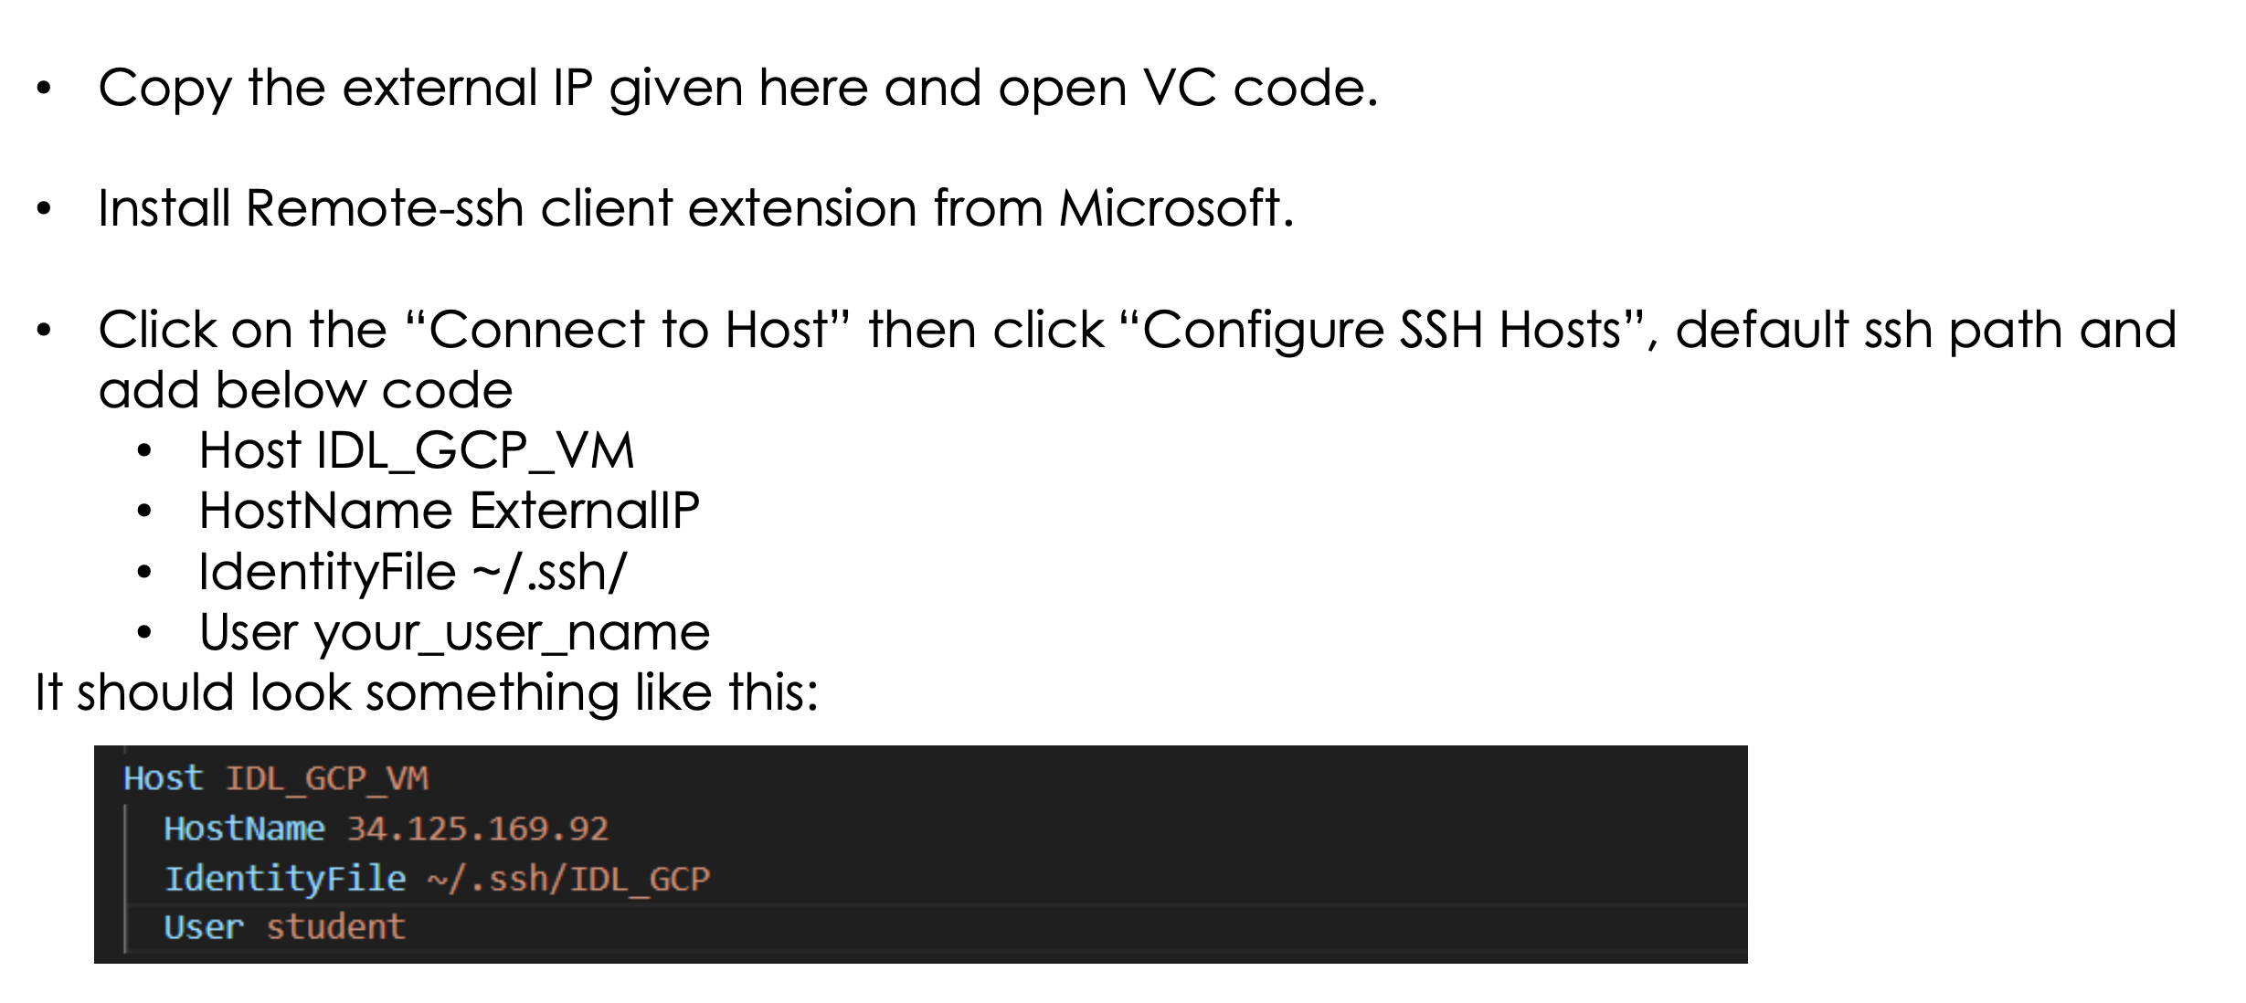

Slide 11
KEEP AN EYE ON THAT CREDIT BILL
DON’T FORGET TO DELETE YOUR INSTANCE
THANK YOU

