Slide 1

Introduction to Deep Learning
0. Logistics
Spring 2021
Notes:
Hello and welcome to the Spring 2021 offering of the course Introduction to Deep Learning. I am your TA Anurag Katakkar and today I will give a brief introduction to the topic and talk about several important course logistics and policies

Slide 2
Outline
Introduction
Objectives and syllabus
Course logistics
Homeworks, quizzes, projects, grading, oh my!
Prep, teamwork and mentoring
And cheating…
Challenges

Slide 3
Outline
Introduction
Objectives and syllabus
Course logistics
Homeworks, quizzes, projects, grading, oh my!
Prep, teamwork and mentoring
And cheating…
Challenges

Slide 4
Neural Networks are taking over!
Neural networks have become one of the major thrust areas recently in various pattern recognition, prediction, and analysis problems
In many problems they have established the state of the art
Often exceeding previous benchmarks by large margins
Notes:
Since you are enrolled in this course and/or are watching this video, I am sure that the great and growing popularity of Deep Learning is no surprise to you. Though the field is not new by any standards, there has been a resurgence in interest over the last decade or so. This is mainly due to the fact that with the availability of huge amounts of data, coupled with powerful compute resources such as GPUs and TPUs, Deep Learning methods have quickly surpassed traditional Machine Learning methods and established the state-of-the-art in several domains.

Slide 5
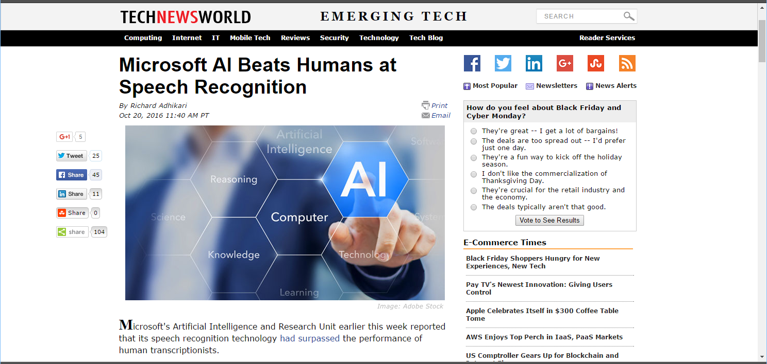
Breakthroughs with neural networks
Notes:
As further motivation for studying this subject in greater detail, let us quickly discuss a few ground-breaking applications of Deep Learning.
Automatic Speech Recognition or ASR is the task of converting speech data into text. This is quite a challenging task since the same text can be spoken in several different ways depending on gender, accent, emotion, and other factors. Traditionally, ML applications involved multi-stage pipelines for ASR. In 2016, MSFT announced that they had successfully developed a DL model that surpassed the performance of human transcriptionists on this task. ASR technology is widely used in digital personal assistants such as Siri, Alexa, and Coratana. YouTube may even be using this technology to generate captions for this very video.

Slide 6
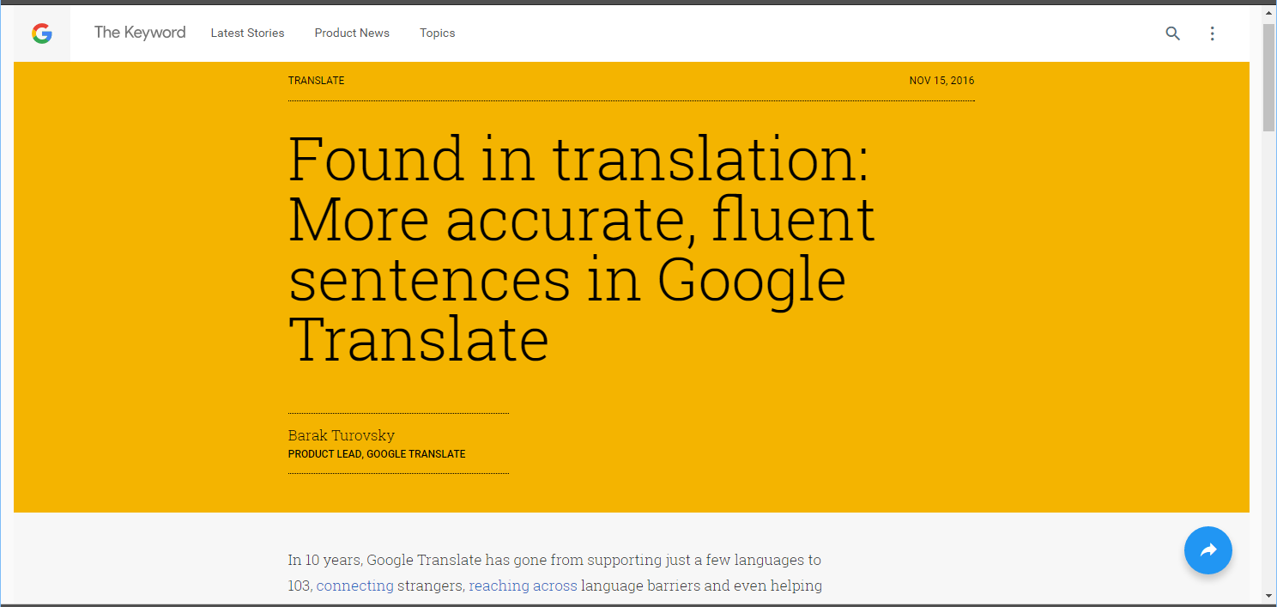
Breakthroughs with neural networks
Notes:
Another extremely useful application is translating text from one language to another. Also in 2016, Google announced that it was moving its Google Translate platform from using statistical machine translation models to neural machine translation models because of their ability to generate more accurate, fluent translations. The next time you find yourself using Google Translate in a foreign country I am sure you will think back to Prof. Bhiksha's upcoming lectures in this class.

Slide 7
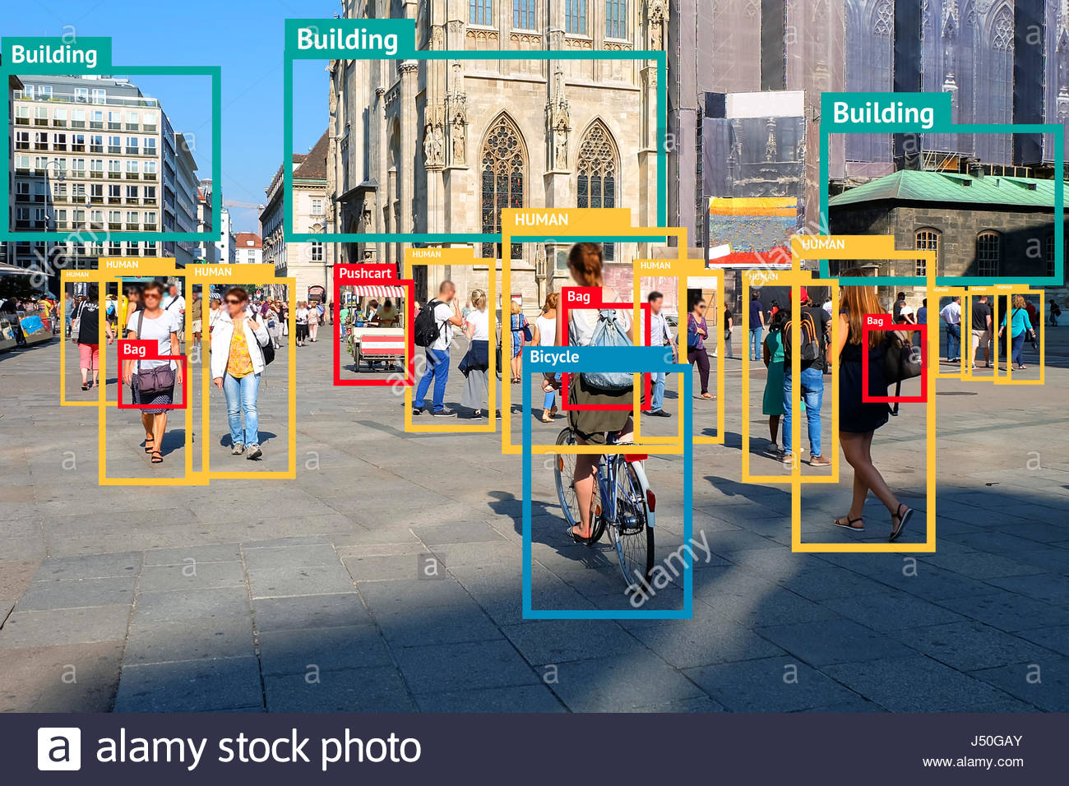
Image segmentation & recognition
Notes:
In the field of computer vision too, deep learning has made a huge impact. In this picture we see an example of a model that has accurately identified the locations of several objects in the scene, as well as accurately predicted their labels.

Slide 8
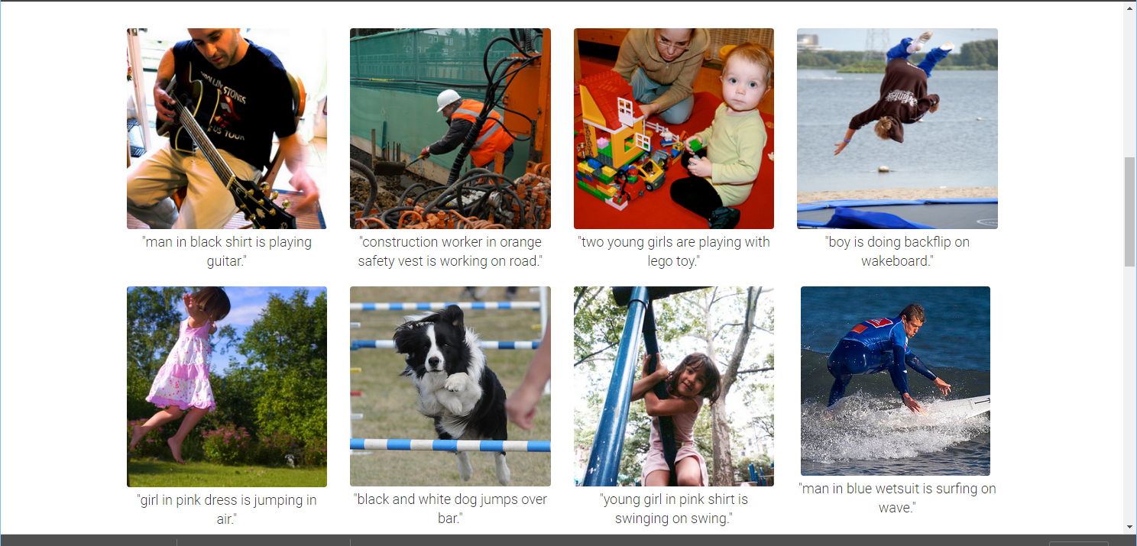
Breakthroughs with neural networks
Captions generated entirely by a neural network
Notes:
As it turns out, Deep Learning models excel at multimodal tasks as well. Here is an example of a model that accurately generates captions for provided images - this task requires the model to "understand" the scene in that it must correctly identify various objects in the scene such as this man and his guitar, the relationship between the objects - the man playing the guitar, and generate coherent text captions for the image - "man in black shirt is playing guitar"

Slide 9
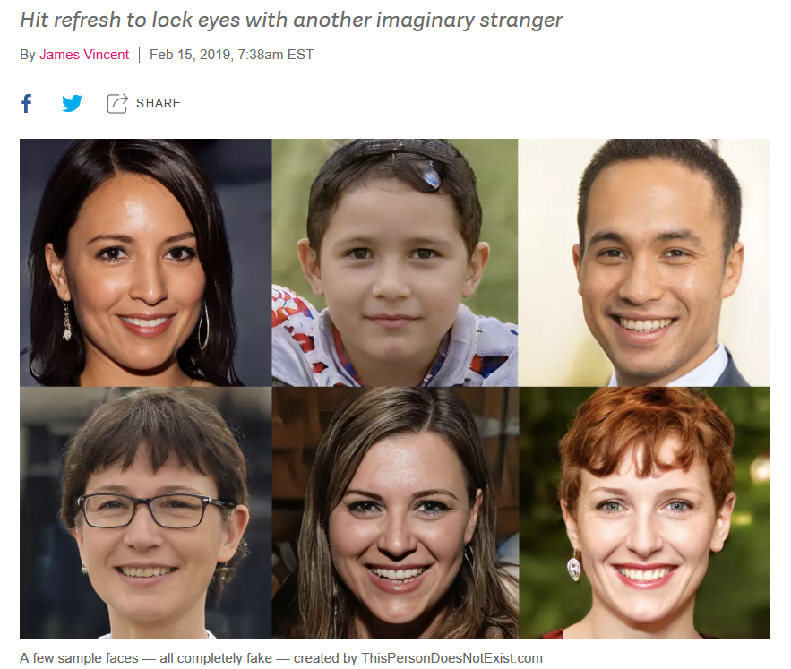
Breakthroughs with neural networks
ThisPersonDoesNotExist.com uses AI to generate endless fake faces
https://www.theverge.com/tldr/2019/2/15/18226005/ai-generated-fake-people-portraits-thispersondoesnotexist-stylegan
Notes:
Here is an application of DL that uses a class of models called "Generative" models. All the people in these pictures are in fact fake - they do not exist, the model came up with these pictures. Visit this person does not exist dot com to see more such examples for yourself,

Slide 10
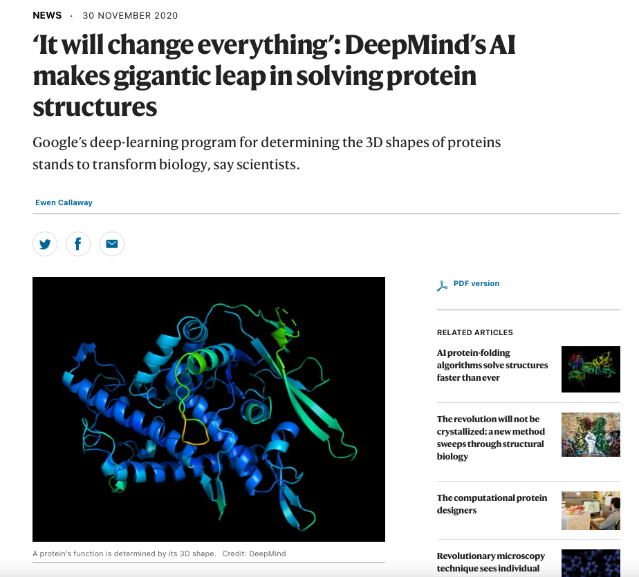
Breakthroughs with neural networks
https://www.nature.com/articles/d41586-020-03348-4
Notes:
Deep Learning has become so pervasive that applications now exist in domains far beyond traditional ML. In biology, for example, DeepMind's AlphaFold2, a Deep Learning based model, solved the 50 year old challenge of Protein Folding. This is a huge breakthrough with experts claiming that this will change the way we develop vaccines and drugs for future generations

Slide 11
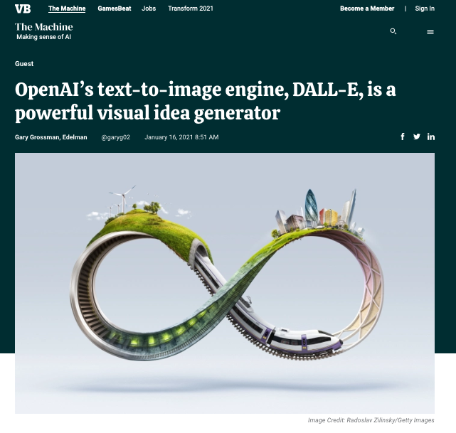
Breakthroughs with neural networks
https://venturebeat.com/2021/01/16/openais-text-to-image-engine-dall-e-is-a-powerful-visual-idea-generator/
Notes:
We conclude with another multimodal application. Text-to-Image synthesis, the task of feeding text captions as input to a model which then generates relevant images from scratch. OpenAI's model DALL-E recently made headlines for generating very realistic looking images for even very vague text sequences such as "an armchair in the shape of an avocado". It is so good in fact that it has spurred conversation on the creativity of AI.

Slide 12
Successes with neural networks
And a variety of other problems:
From art to astronomy to healthcare...
and even predicting stock markets!
Notes:
In fact, the entire ecosystem has developed so much over the last 5 years that hardware manufacturers now build specialised hardware just for Deep Learning applications, and several software libraries and frameworks have sprung up to support research, development, and deployment of Deep Learning models.

Slide 13


Neural Networks and the Job Market
This guy didn’t know about neural networks (a.k.a deep learning)
This guy learned about neural networks (a.k.a deep learning)
Notes:
Naturally, being well versed in such a powerful and transformative technology is very desirable in the job market. The material presented in this course will be a great resource not only in helping you prepare for a variety of internship and job interviews, but also in developing a thorough understanding of deep learning concepts that enables you to use it effectively in industry or in academia.

Slide 14
Outline
Introduction
Objectives and syllabus
Course logistics
Homeworks, quizzes, projects, grading, oh my!
Prep, teamwork and mentoring
And cheating…
Challenges

Slide 15
Course Objectives: High level
Understanding neural networks
Comprehending the models that do the previously mentioned tasks
And maybe build them
Familiarity with some of the terminology
What are these:
http://www.datasciencecentral.com/profiles/blogs/concise-visual-summary-of-deep-learning-architectures
Fearlessly design, build and train networks for various tasks
You will not become an expert in one course

Slide 16
Course objectives: Mid level
Concepts
Some historical perspective
Types of neural networks and underlying ideas
Learning in neural networks
Training, concepts, practical issues
Architectures and applications
Will try to maintain balance between squiggles and concepts (concept >> squiggle)
Practical
Familiarity with training
Implement various neural network architectures
Implement state-of-art solutions for some problems
Overall: Set you up for further research/work in your research area

Slide 17
Course learning objectives: Topics
Basic network formalisms:
MLPs
Convolutional networks
Recurrent networks
Boltzmann machines
Some advanced formalisms
Generative models: VAEs
Adversarial models: GANs
Topics we will touch upon:
Computer vision: recognizing images
Text processing: modelling and generating language
Machine translation: Sequence to sequence modelling
Modelling distributions and generating data
Speech recognition
Wish list: Reinforcement learning and games

Slide 18
Reading
List of books on course webpage
Additional reading material will also appear on the course pages

Slide 19
Outline
Introduction
Objectives and syllabus
Course logistics
Homeworks, quizzes, projects, grading, oh my!
Prep, teamwork and mentoring
And cheating…
Challenges

Slide 20

Instructors and TAs
Instructor: Bhiksha Raj
bhiksha@cs.cmu.edu
x8-9826
TAs:
List of TAs, with email ids on course page
We have TAs for the
Pitt Campus
Kigali,
Doha,
China/India time zones
Please approach your local TA first
Office hours: On webpage
http://deeplearning.cs.cmu.edu/

Slide 21
Logistics: Lectures..
Class is entirely online
Lectures are held over zoom
Recordings will be posted
Important that you view the lectures
Even if you think you know the topic
Your marks depend on viewing lectures
We will monitor attendance (more on this later)

Slide 22
Additional Logistics
Discussions:
On Piazza
Compute infrastructure:
Everyone gets Amazon tokens
Initially a token for $50
Can get additional tokens of $50 up to a total of $150

Slide 23
Lecture Attendance
You get marks for attendance
Our performance metrics over the semesters show a distinct correlation between attendance and course scores
We also note a distinct inverse correlation between attendance and the amount of help you require on piazza and during office hours
To encourage attendance, we assign 1 mark for attendance
1% of your total grade for 11685/11785/18786
1.3333% of your total grade for 11485
This can be the difference between a B and an A
We will track lecture attendance
You must either attend the zoom lectures in real time or watch the videos uploaded to mediatech
If you’re watching the videos on mediatech, we can track who watched what lecture and for how long,
If you’re in class, we get stats from zoom and from your participation in in-class polls

Slide 24
Lecture Attendance: Rules
If you’re in Section A you are expected to attend the zoom lectures
We will tag you as having attended the lecture if you are present for at least 60 minutes of the duration of the lecture
If you are in any of the other (out-of-timezone) sections, you may either watch the real-time zoom lectures or the recorded lectures on mediatech
If viewed on mediatech, the lectures of each week must be viewed before 8AM of the Monday following the following week
Otherwise, it doesn’t count
At the end of the semester, we will select a random subset of 50% of the lectures and tabulate attendance
If you have attended at least 70% of these (randomly chosen) lectures, you get the attendance point

Slide 25
Lecture Schedule
On website
The schedule for the latter half of the semester may vary a bit
Guest lecturer schedules are fuzzy..
Guest lectures:
TBD
One or more of: Scott Fahlman, Shinji Watanabe, Gerald Friedland, Graham Neubig

Slide 26
Recitations
We will have 13 recitations
Possibly a 14th if TAs and students are still enthusiastic after 14 grueling weeks
Will cover implementation details and basic exercises
Very important if you wish to get the maximum out of the course
Topic list on the course schedule
Strongly recommend attending all recitations
Even if you think you know everything

Slide 27
Recitations Schedule
Every Friday of the semester
See course page for exact details!

Slide 28
Outline
Introduction
Objectives and syllabus
Course logistics
Homeworks, quizzes, projects, grading, oh my!
Prep, teamwork and mentoring
And cheating…
Challenges

Slide 29
Evaluation
Performance is evaluated based on 3 types of tests
Weekly Quizzes
Homeworks
Team Project

Slide 30
Weekly Quizzes
10 multiple-choice questions
Related to topics covered that week
On both slides and in lecture
Released Friday, closed Sunday night
This may occasionally shift, don’t panic!
There will be 14 total quizzes
We will consider the best 12
This is expected to account for any circumstance-based inability to work on quizzes
You could skip up to 2

Slide 31
Lectures and Quizzes
Slides often contain a lot more information than is presented in class
Quizzes will contain questions from topics that are on the slides, but not presented in class
Will also include topics covered in class, but not on online slides!

Slide 32
Homeworks
There will be one early homework (released before the start of the semester) and four in-term homeworks
Homework 0: Preparatory material for the course
Homeworks 1-4: Actual neural-net exercises
Homeworks 1-4 all have two parts:
Part 1: Autograded problems with deterministic solutions
You must upload them to autolab
Will include mandatory parts and “bonus” parts
“bonus” questions will not contribute to final grading curves and give you the chance to make up for marks missed elsewhere
Part 2: Open problems posted on Kaggle

Slide 33
Homeworks 1-4 – Part 1
Part 1 of the homeworks evaluate your ability to code neural nets on your own from scratch
If you implement all mandatory and bonus questions of part 1 of all homeworks, you will, hopefully, have all components necessary to construct a little neural network toolkit of your own
“mytorch” ☺
The homeworks are autograded
Be careful about following instructions carefully
The autograder is setup on a computer with specific versions of various packages
Your code must conform to their restrictions
If not the autograder will often fail and give you errors or 0 marks, even if your code is functional on your own computer

Slide 34
Homeworks 1-4, Part 2
Part 2 of every homework tests your ability to solve complex problems on real-world data sets
These are open problems posted on Kaggle
You compete with your classmates on a leaderboard
We post performance cutoffs for A, B and C
If you achieved the posted performance for, say “B”, you will at least get a B
A+ == 105 points (bonus)
A = 100
B = 80
C = 60
D = 40
No submission: 0
Actual scores are linearly interpolated between grade cutoffs
Interpolation curves will depend on distribution of scores

Slide 35
Homework Deadlines
Multiple deadlines
Separate deadline for Autograded deterministic component
Kaggle component has multiple deadlines
Initial submission deadline : Making this is worth 5% of the marks of the HW
Full submission deadline: Your final submission must occur before this deadline to be eligible for full marks
Drop-dead deadline: Must submit by here to be eligible for any marks
Day on which solution is released
Homeworks: Late policy
Everyone gets up to 7 total slack days (does not apply to initial submission)
You can distribute them as you want across your HWs
You become ineligible for “A+” bonus if you’re using your slack days for Kaggle
Once you use up your slack days, all subsequent late submissions will accrue a 10% penalty (on top of any other penalties)
There will be no more submissions after the drop-dead deadline
Kaggle: Kaggle leaderboards stop showing updates on full-submission deadline
But will continue to privately accept submissions until drop-dead deadline
Please see course webpage for complete set of policies

Slide 36
Course project
If you’re taking 11-785/18-786, you will be required to do a course project
11-685 students can choose to do the project instead of HW5 (more on this later)
Projects are done by teams of students
Ideal team size is 4
You are encouraged to form your teams early
Projects are intended to exercise your ability to comprehend and implement ideas beyond those covered by the HWs
Project can range from
Implementing and evaluating cutting-edge ideas from recent papers
Verifying results from “hot” published work
Past projects gallery : http://deeplearning.cs.cmu.edu/shared/project.html
“Researchy” problems that might lead to publication if completed well
Proposing new models/learning algorithms/techniques, with proper evaluation
Etc.

Slide 37
Course project
Project teams must be formed by the first week of March
If you don’t form your own teams, we will team you up
Each team must:
Submit a project proposal by the second week of March
Submit a mid-way report ¾ way through the semester (First week of April)
Submit a preliminary full report three days before the presentation due date
Make a 5 min video presentation of the project at the end of the semester
Can be presented by one, some, or all team members
Will be evaluated by the instructor, TAs, and your classmates
Ensure you explain the problem, proposed solution, and the evaluation clearly
Allocate enough time to make the presentation, it is not as easy as you think
Poor presentation can significantly affect your project score :)
Submit a final full report at the end of the semester
Templates for proposals and reports will be posted
Each team will be assigned a mentor from among the TAs, who will monitor your progress and assist you if possible.
Teams will have 15 min. check-ins with their assigned TAs 2x through the semester
More details on project evaluations will be posted towards the end of the sem
The project is often the most fun portion of the course

Slide 38
Grading
Weekly Quizzes 24 14 Quizzes, bottom two dropped 24
Assignments 50 HW1 – Basic MLPs (AL + Kaggle) 12.5 HW2 – CNNs (AL + Kaggle) 12.5 HW3 – RNNs (AL + Kaggle) 12.5 HW4 – Sequence to Sequence Modelling (Kaggle) 12.5
Team Project (Not for 11-485) 25 Proposal - Mid-term Report 5
Preliminary Full Report - Project Presentation 10 Peer Reviewing binary multiplier
Final report 10
Don’t forget: There is also 1 mark for attendance

Slide 39
Homework 5
We will have a 5th Homework, meant primarily for 11-685 students
This will have the same weight as a complete 11-785/18-786 Course Project,
11-685 students can choose to do a Project instead of HW5
11-785/18-786 students can use HW5 as a “make up” for incomplete projects, in the event of a catastrophe
Remember Spring 2020
You will get scored for either your project or HW5!

Slide 40
Outline
Introduction
Objectives and syllabus
Course logistics
Homeworks, quizzes, projects, grading, oh my!
Prep, teamwork and mentoring
And cheating…
Challenges

Slide 41
Preparation for the course
Course is implementation heavy
A lot of coding and experimenting
Will work with some large datasets
Language of choice: Python
Toolkit of choice: Pytorch
You are welcome to use other languages/toolkits, but the TAs will not be able to help with coding/homework
Some support for TensorFlow
We hope you have gone through
Recitation zero
HW zero

Slide 42

Teamwork
Learning happens best together
You will learn more from each other than you will from us
We encourage teamwork
But there are strict rules…

Slide 43

Study groups
Please form study groups
If you do not have a study group of your own, we will form one for you
Please register on Akshat’s forms
Everyone must be part of a study group

Slide 44
Study groups
What study groups may do:
Discuss homework problems and solutions
Discuss papers
Discuss class work
Discuss quizzes
We encourage you to meet regularly to discuss IDL work
Study groups may also go on to form project teams
So what are the caveats? What may you not do

Slide 45
Study groups vs. cheating
Every student must solve their quizzes by themselves
You may discuss the questions with your study groups/friends, but when you solve the quiz, isolate yourself and do it alone
Every student must solve every homework by themselves
You may discuss the homeworks with your friends, and even help them debug their code, but when you finally solve it, every line of your code (except libraries that have been okayed by course staff) must be written by you
Your solution must be yours
Plagiarizing code from the web or your friends constitutes cheating
And submitting solutions not obtained by you constitutes cheating
Instances of cheating, as detected by MOSS, will be reported for AIV to the university. The university has a strict AIV policy and expels students after 2 AIVs, so please don’t take a chance
If you are unsure if what you are doing contributes to cheating by our rules, check with us

Slide 46
Cheating
You are here to learn DL yourself, not to demonstrate how well your friend, or that guy on the web has learned DL
You are at CMU – which means you are among the brightest and best students in the world
You probably were among the top students in your peer group all your life, before you came here
It will be an insult to yourself and everything you ever stood for in your life to lower yourself from your own standards and start cheating
So don’t!!!
If you are unsure whether something you’re doing constitutes cheating or not, check with us

Slide 47
Mentoring
Every study group will be assigned a TA mentor
We will track your progress and reach out to you if you appear to be in trouble
If in trouble, reach out to your TA mentor and/or the instructor
If you feel you’re falling behind, reach out
If you feel you are struggling, reach out
If you feel pressured/unable to cope, reach out
We will try our best to help you
We aim to make this a successful course for all of you
In our ideal world, everyone performs well enough to get an A
Without lowering our standards – i.e. we would like to bring you all up to where we believe you deserve an A
Everything about this course is geared to that objective

Slide 48
Outline
Introduction
Objectives and syllabus
Course logistics
Homeworks, quizzes, projects, grading, oh my!
Prep, teamwork and mentoring
And cheating…
Challenges

Slide 49
This course is not easy
A lot of work!
A lot of work!!
A lot of work!!!
A LOT OF WORK!!!!
Mastery-based evaluation
Quizzes to test your understanding of topics covered in the lectures
HWs to teach you to implement complex networks
And optimize them to high degree
Target: Anyone who gets an “A” in the course is technically ready for a deep learning job

Slide 50
This course is not easy
A lot of work!
A lot of work!!
A lot of work!!!
A LOT OF WORK!!!!
Mastery-based evaluation
Quizzes to test your understanding of topics covered in the lectures
HWs to teach you to implement complex networks
And optimize them to high degree
Target: Anyone who gets an “A” in the course is technically ready for a deep learning job

Slide 51
This course is not easy
A lot of work!
A lot of work!!
A lot of work!!!
A LOT OF WORK!!!!
Mastery-based evaluation
Quizzes to test your understanding of topics covered in the lectures
HWs to teach you to implement complex networks
And optimize them to high degree
Target: Anyone who gets an “A” in the course is technically ready for a deep learning job

Slide 52

This course is not easy
A lot of work!
A lot of work!!
A lot of work!!!
A LOT OF WORK!!!!
Mastery-based evaluation
Quizzes to test your understanding of topics covered in the lectures
HWs to teach you to implement complex networks
And optimize them to high degree
Target: Anyone who gets an “A” in the course is technically ready for a deep learning job
Not for chicken!

Slide 53

This course is not easy
A lot of work!
A lot of work!!
A lot of work!!!
A LOT OF WORK!!!!
Mastery-based evaluation
Quizzes to test your understanding of topics covered in the lectures
HWs to teach you to implement complex networks
And optimize them to high degree
Target: Anyone who gets an “A” in the course is technically ready for a deep learning job
But somewhat calibrated (over the years) to ensure it is doable
Over 60% of students got some flavor of A each of the past three semesters and they deserved it

Slide 54
This course is not easy
A lot of work!
A lot of work!!
A lot of work!!!
A LOT OF WORK!!!!
Mastery-based evaluation
Quizzes to test your understanding of topics covered in the lectures
HWs to teach you to implement complex networks
And optimize them to high degree
Target: Anyone who gets an “A” in the course is technically ready for a deep learning job

Slide 55
HW0 / Recitation 0
Please, please, please, please, please go through the videos for recitation 0, and complete HW0.
These are essential for you to gain comfort with the coding require in the following homeworks
HW1 part 1 also has many components intended to help you later in the course
So if it seems a bit dense, please bear with it, its worth it
HW1 is the easiest HW!

Slide 56
Questions?
Please post on piazza

