Slide 1
Generative Adversarial Networks
Lecture 2
Introduction To Deep Learning (11-785 / 685 / 485) Spring 2022
Fuyu Tang, Roshan Ram, Ameya Mahabaleshwarkar

Slide 2
Overview
GANs Quick Recap
GAN Training
Issues with GAN Training
Remedies for GAN Training Issues
GAN Architectures & Recent Progress

Slide 3
Discriminative models learn the conditional probability P(Y | X)
Generative models understand the joint probability P(X, Y) = P(X | Y) . P(Y)
GANs model P(X), the distribution of training data
Once sufficiently trained, GANs can generate new data from P(X)
Generative networks are used to generate samples from an unlabeled distribution P(X) given samples X₁, . . . , X_{n}. For example:
Generate images given sample images
Generate music given sample music
Generate realistic text given sample corpus

Slide 4
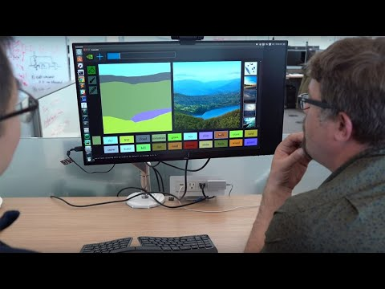

Slide 5
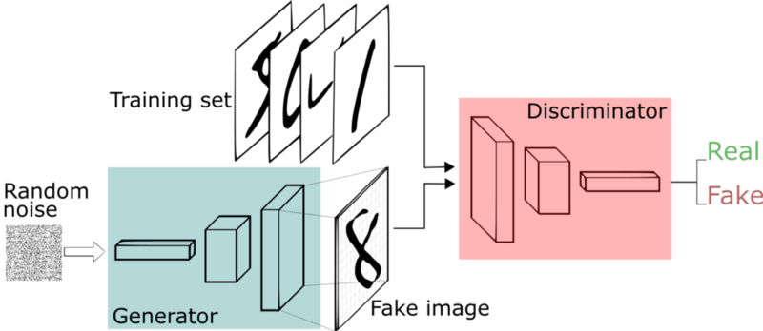
GAN Framework
https://www.freecodecamp.org/news/an-intuitive-introduction-to-generative-adversarial-networks-gans-7a2264a81394

Slide 6
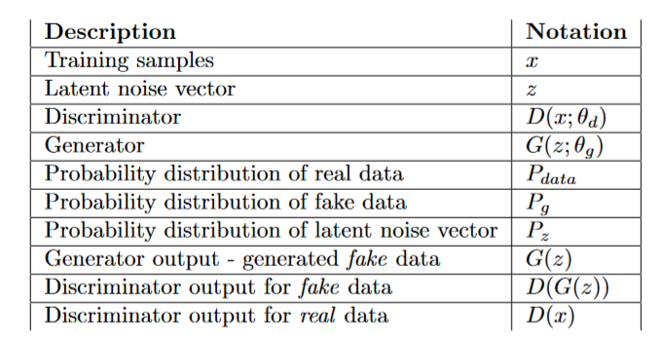
GAN Training

Slide 7
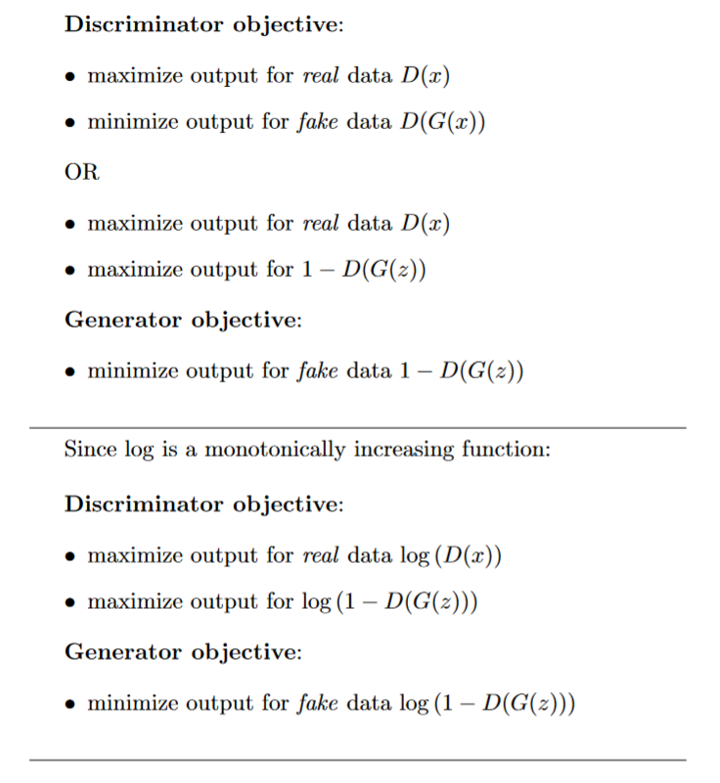
GAN Training

Slide 8
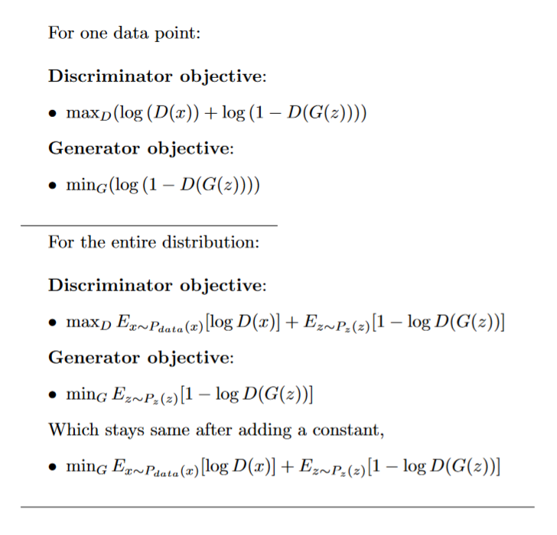
GAN Training

Slide 9
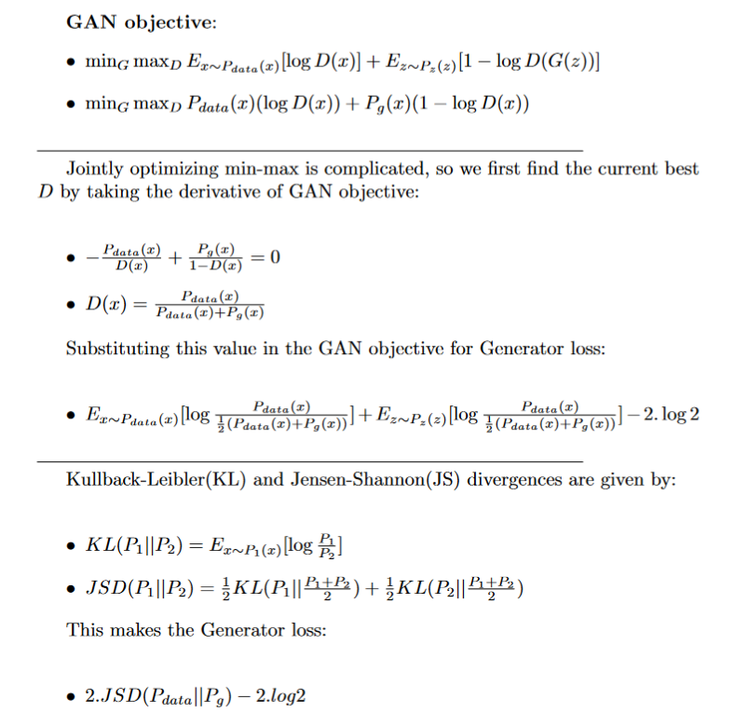
GAN Training

Slide 10
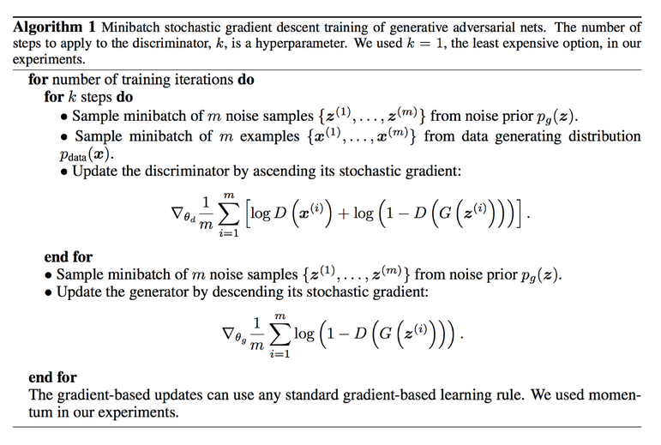
GAN Training Algorithm (Ian Goodfellow et al.)

Slide 11
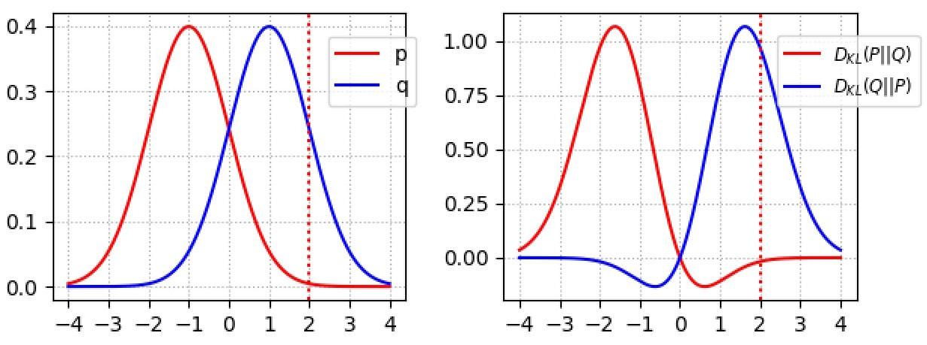
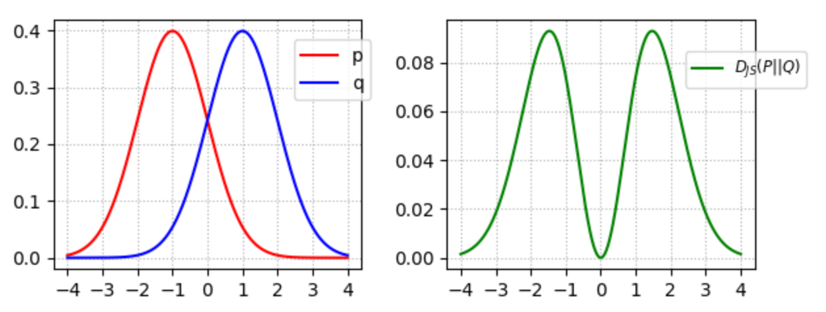
Qualitative Effects of JS-Divergence
The KL-divergence DL(p, q) penalizes the generator if it misses some modes of images: the penalty is high where p(x) > 0 but q(x) → 0. Nevertheless, it is acceptable that some images do not look real. The penalty is low when p(x) → 0 but q(x) > 0. (Poorer quality but more diverse samples)
JS-divergence is symmetrical. Unlike KL-divergence, it will penalize poor images badly, but can allow less diversity
https://jonathan-hui.medium.com/gan-why-it-is-so-hard-to-train-generative-advisory-networks-819a86b3750b

Slide 12
GANs Training Issues
Mode Collapse
Vanishing Gradients
Convergence and Oscillation

Slide 13
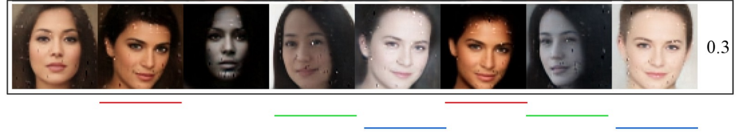
GANs Training Issues - Mode Collapse
If a generator produces an especially plausible output, the generator may learn to produce only that output
The Generator gets stuck at a point where it only produces a limited variety of samples or one sample repeatedly during or after training
Each iteration of Generator over-optimizes for a particular Discriminator, and the Discriminator never manages to learn its way out of the trap
https://jonathan-hui.medium.com/gan-why-it-is-so-hard-to-train-generative-advisory-networks-819a86b3750b

Slide 14
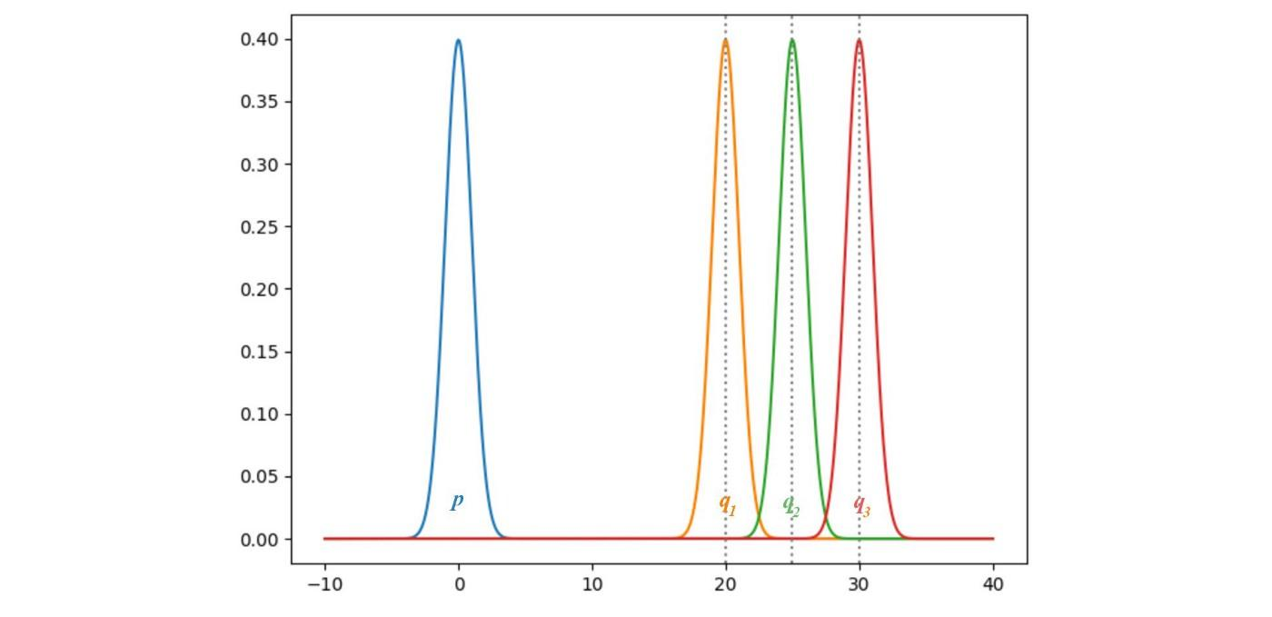
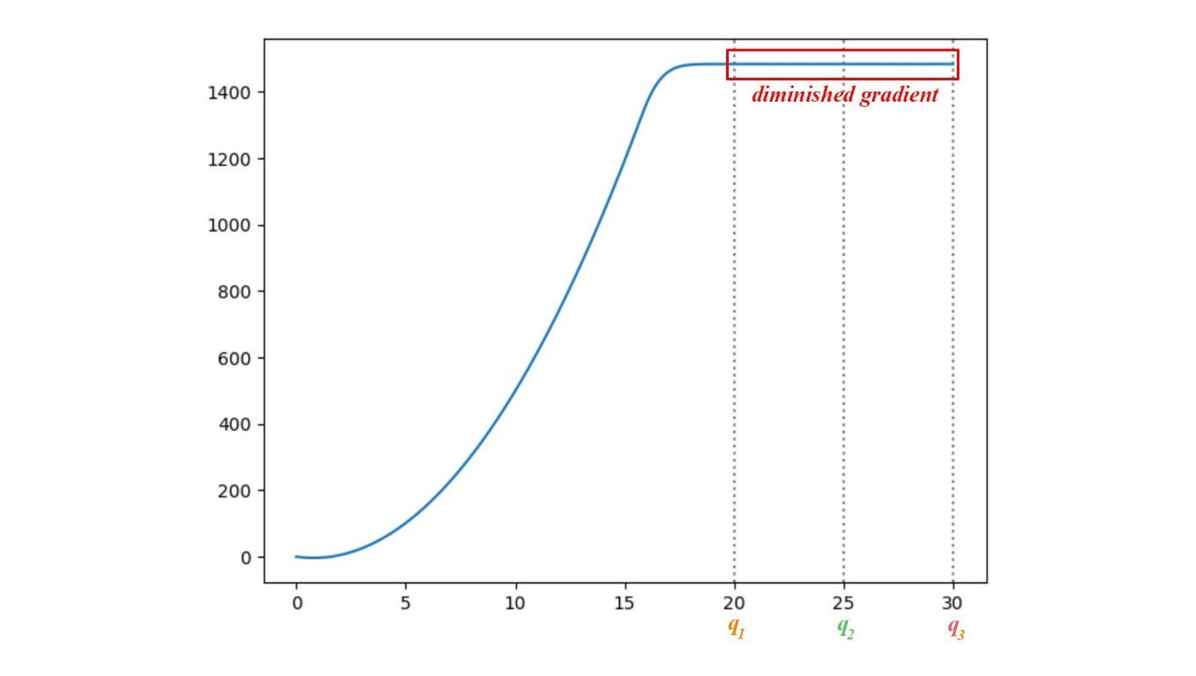
GANs Training Issues - Vanishing Gradients
If the Discriminator is too good, then the Generator training can fail due to vanishing gradients. An optimal Discriminator doesn't provide enough information for the Generator to make progress
Below image shows how gradients will vanish if the distribution of generated images (p) is too different than the distribution of real images (q1, q2, q3)
https://jonathan-hui.medium.com/gan-why-it-is-so-hard-to-train-generative-advisory-networks-819a86b3750b

Slide 15
GANs Training Issues - Convergence and Oscillation
GAN training is based on a zero-sum, non-cooperative, minmax game. In short, if one wins the other loses
In game theory, the GAN model converges when the discriminator and the generator reach a Nash equilibrium. This is the optimal point for the GAN objective
Simplified example: Consider two player A and B which control the value of x and y respectively. Player A wants to maximize the value xy while B wants to minimize it

Slide 16
GANs Training Issues - Convergence and Oscillation
We update the parameter x and y based on the gradient of the functions -
f(x) = xy, f(y) = -xy
∂f/∂x = y and ∂f/∂y = −x
x → x−α⋅y and y → y+α⋅x ( α is learning rate )

Slide 17
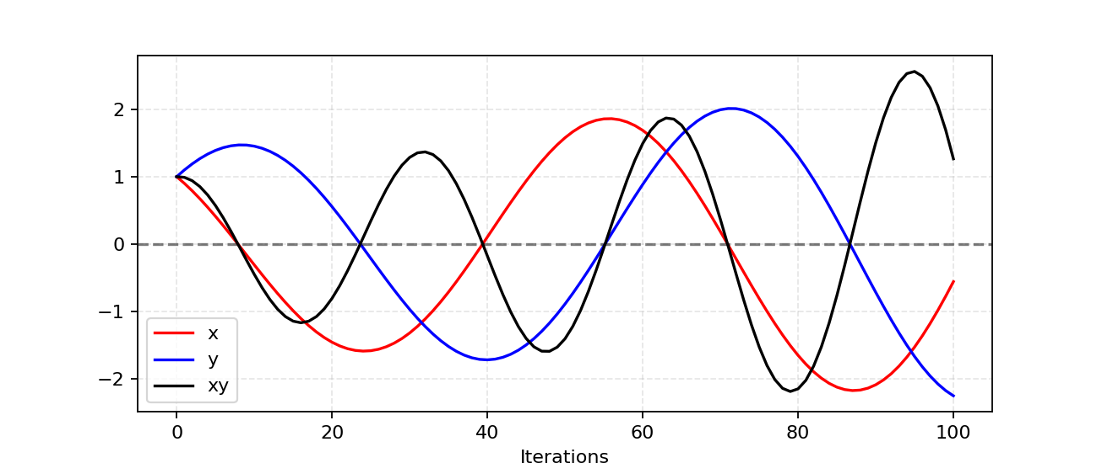
GANs Training Issues - Convergence and Oscillation
We update the parameter x and y based on the gradient of the functions f(x) = xy, f(y) = -xy
∂f/∂x = y and ∂f/∂y = −x
x → x−α⋅y and y → y+α⋅x ( α is learning rate)
The Nash equilibrium is x = y = 0. This is the only state where the action of your opponent does not matter. It is the only state that any opponents’ actions will not change the game outcome
https://medium.com/deep-math-machine-learning-ai/ch-14-general-adversarial-networks-gans-with-math-1318faf46b43

Slide 18
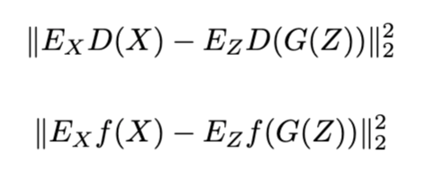
Feature Matching
Statistics of generated images should match statistics of real images.
Discriminator produces multidimensional output, a “statistic” of data.
Generator trained to minimize L2 between real and generated data.
Discriminator trained to maximize L2 between real and generated data.
Goal: matching features in real images
Tim Salimans, Ian J. Goodfellow, Wojciech Zaremba, Vicki Cheung, Alec Radford, and Xi Chen, Improved techniques for training gans, CoRR abs/1606.03498 (2016).
Notes:
TODO# change the objective formula
Case: optimization can turn too greedy / not converge + mode collapses.
regularizing objective for a generator <CHANGE THE OBJECTIVE>
we use the discriminator ONLY to specify the statistics that we think are worth matching
FEATURE MATCHING > COMPETE DISCRIMINATOR
Cons:

Slide 19
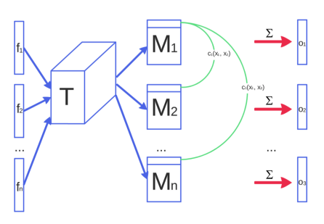
Minibatch Discrimination
Discriminator can look at multiple inputs at once and decide if those inputs come from the real or generated distribution.
GANs frequently collapse to a single point
Discriminator needs to differentiate between two distributions
Easier task if looking at multiple samples
Append the similarity between the image and other images in the same batch in one of the dense layers in the discriminator to classify whether this image is real or generated.
Tim Salimans, Ian J. Goodfellow, Wojciech Zaremba, Vicki Cheung, Alec Radford, and Xi Chen, Improved techniques for training gans, CoRR abs/1606.03498 (2016).
Notes:
Case: mode collapse
Similarity: transformation matrix T → matrix M + Calculate L1-norm (cross sample distance)

Slide 20
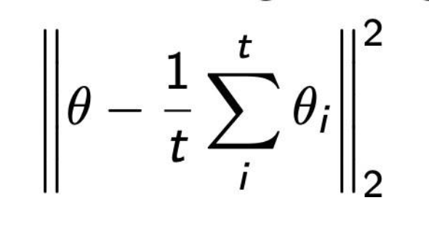
Historical averaging
Dampen oscillations by encouraging updates to converge to a mean.
GANs frequently create a cycle or experience oscillations
Add a term to reduce oscillations that encourage the current parameters to be near a moving average of the parameters
Tim Salimans, Ian J. Goodfellow, Wojciech Zaremba, Vicki Cheung, Alec Radford, and Xi Chen, Improved techniques for training gans, CoRR abs/1606.03498 (2016).
Notes:
Case: Oscillations / not converge
keep track of the model parameters for the last t models <Running avg>
add an L2 cost <Penalize the model differ from historical parameters>

Slide 21
One-sided Label Smoothing
Don’t over-penalize generated images
Label smoothing is a common and easy technique that improves performance across many domains
- Sigmoid tries hard to saturate to 0 or 1 but can never quite reach that goal
- Provide targets that are epsilon or 1- epsilon so the sigmoid doesn’t saturate and overtrain
- Experimentally, smooth the real targets but do not smooth the generated targets when training the discriminator.
Tim Salimans, Ian J. Goodfellow, Wojciech Zaremba, Vicki Cheung, Alec Radford, and Xi Chen, Improved techniques for training gans, CoRR abs/1606.03498 (2016).
Notes:
Case: overconfidence
penalize the discriminator when the prediction for any real images go beyond 0.9 (D(real image)>0.9). This is done by setting our target label value to be 0.9 instead of 1.0.
restrains the largest logit from becoming much bigger than the rest

Slide 22
Virtual Batch Normalization
Use batch normalization to accelerate convergence
Batch normalization accelerates convergence
However, hard to apply in adversarial setting
Collect statistics on fixed batch of real data and use to normalize other data.
Tim Salimans, Ian J. Goodfellow, Wojciech Zaremba, Vicki Cheung, Alec Radford, and Xi Chen, Improved techniques for training gans, CoRR abs/1606.03498 (2016).
Notes:
<Reference Batch>
each example x is normalized based on the statistics collected on a reference batch of examples that are chosen once and fixed at the start of training, and on x itself.
computationally expensive – only use in generator

Slide 23
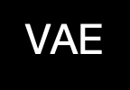
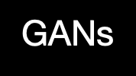
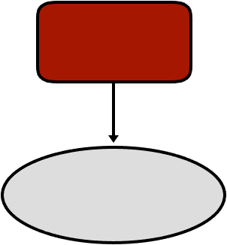
Recap
Jenson-Shanon
Divergence
KL Divergence

Slide 24
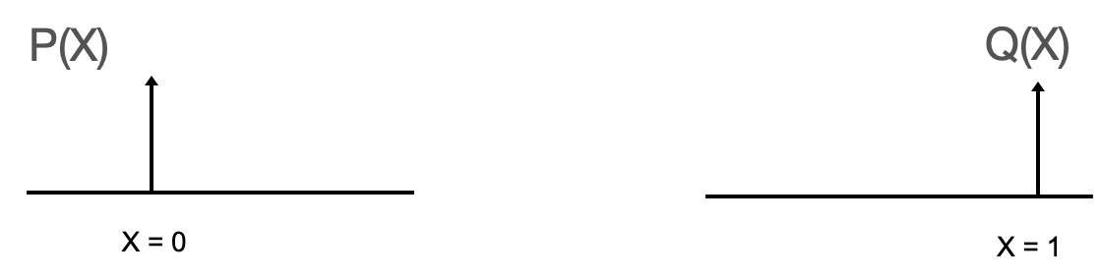
Special Case:

Slide 25
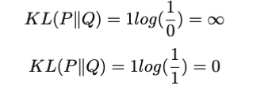
KL-Divergence:
Let θ be the distance between the two peaks of the distribution.
If θ ≠ 0,
If θ = 0,
Not differentiable w.r.t θ

Slide 26
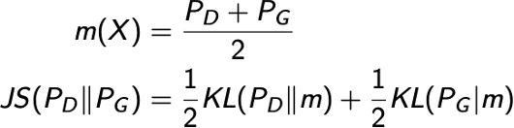
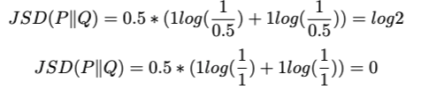
Jenson-Shanon-Divergence:
Let θ be the distance between the two peaks of the distribution.
If θ ≠ 0,
If θ = 0,
Constant to θ

Slide 27

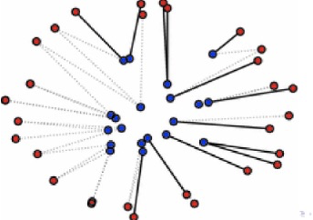
Wasserstein Distance:
Minimum cost of turning one pile of dirt into another pile of dirt, when both distributions are treated as pile of dirt.
The total Σ mass × mean distance required to transform one distribution to another
Red points, Blue points represent two different distributions.

Slide 28
Wasserstein Distance:
Let θ be the distance between the two peaks of the distribution.
W(P,Q) = | θ |
Differentialble w.r.t θ

Slide 29

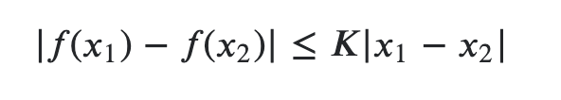
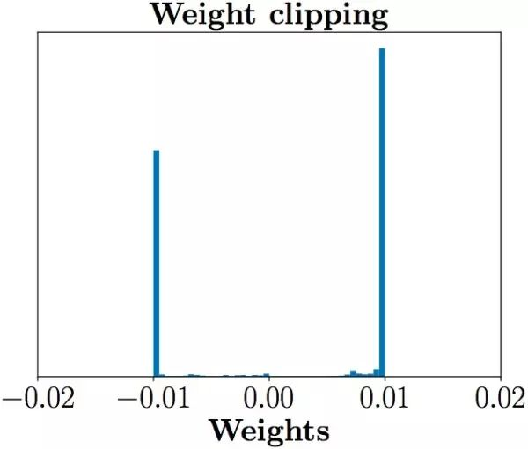
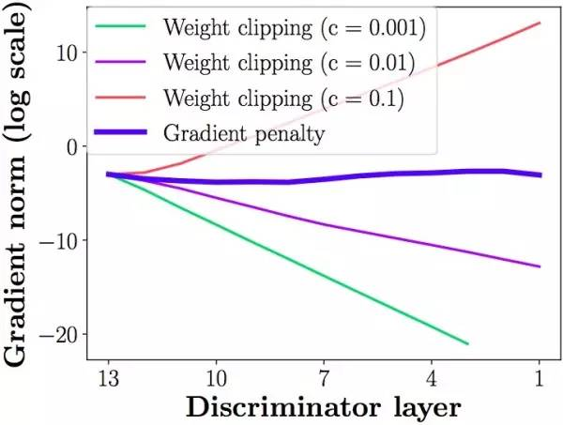
WGAN
D should be a 1-Lipschitz function:
A function is K-Lipschitz if its gradients are at most K everywhere.
→ W(Pr, Pg) is continuous everywhere, and differentiable almost everywhere
Restrict weights between [-c, c]
Weight Clipping
Arjovsky, Martin, Soumith Chintala, and Léon Bottou. “Wasserstein generative adversarial networks.” International conference on machine learning. PMLR, 2017.

Slide 30
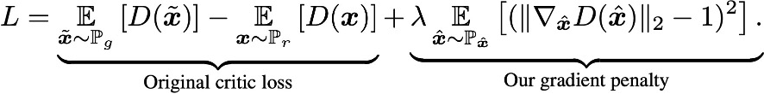
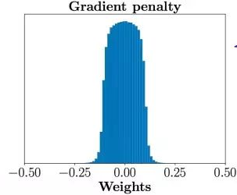
Gradient Penalty
Gradient penalty introduces a softer constraint on gradients
more stable training
requires very little hyper-parameter tuning
Gulrajani, Ishaan, et al. “Improved training of wasserstein gans.” arXiv preprint arXiv:1704.00028 (2017).
Notes:
enforce a constraint on the gradients of the critic’s output w.r.t the inputs to have unit norm
sample -wise gradient penalty → cannot use BN (use LN/IN instead)
Sample - uniform sampling eps (+real/generated pair) → interpolation <sample space btw real/generated dists> <avoid sampling in a high dimensional space>

Slide 31
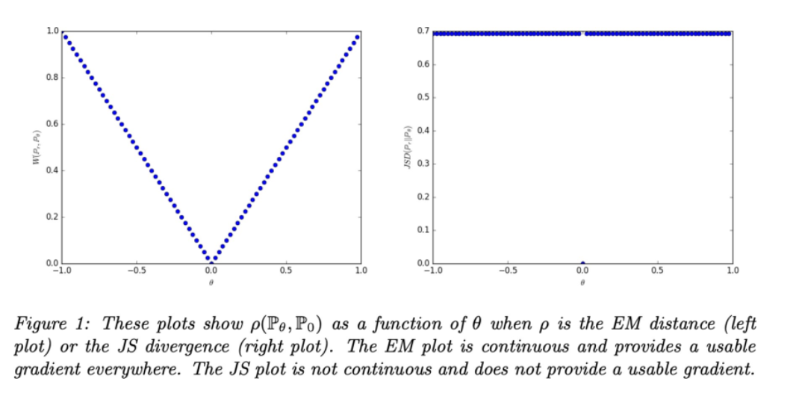
Wasserstein JSD KL
Differentiable
Meaningful Loss (θ ≠ 0)
Not Differentiable
Constant (θ ≠ 0)
Not Differentiable
Not symmetric

Slide 32
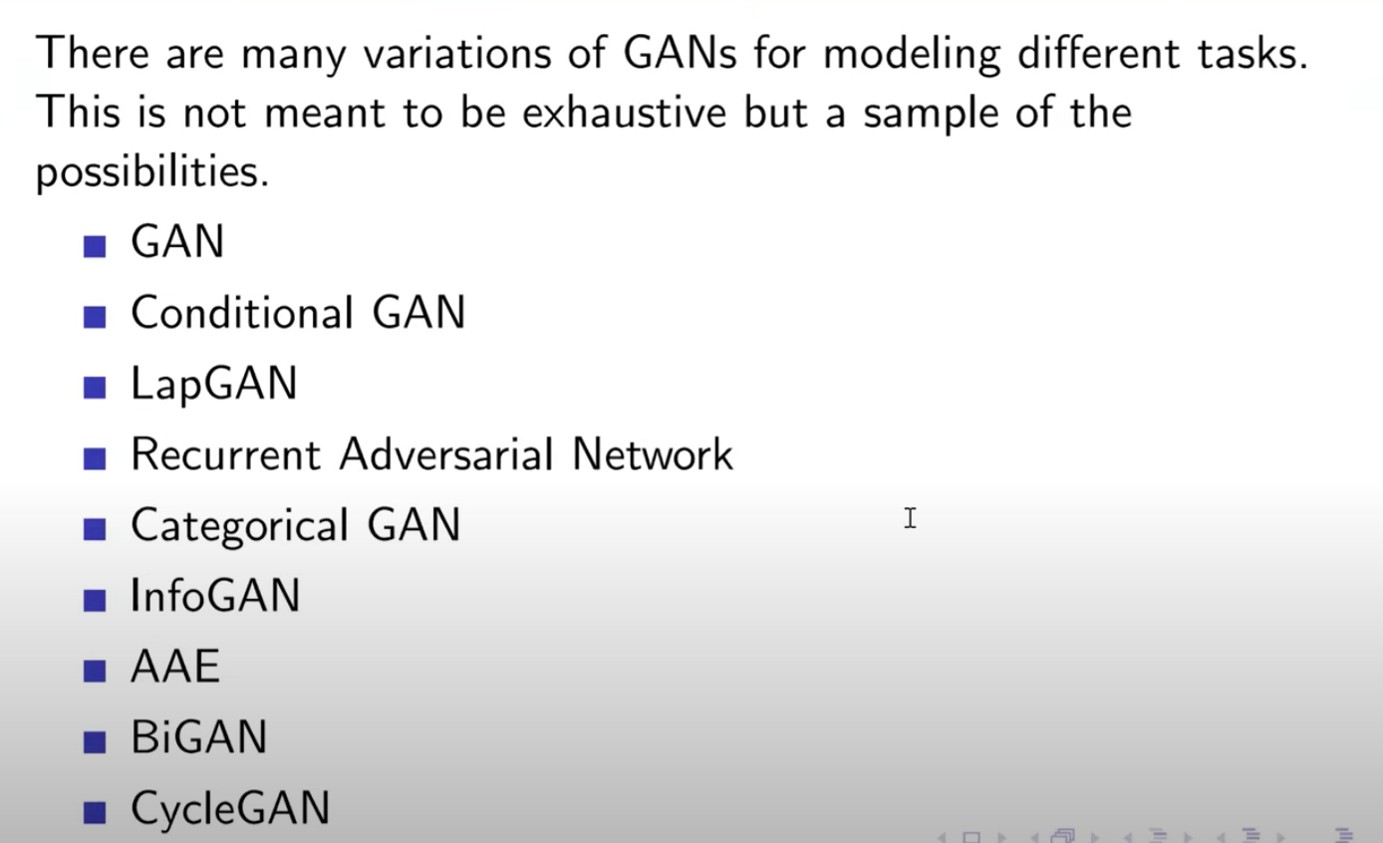
GAN Architectures

Slide 33
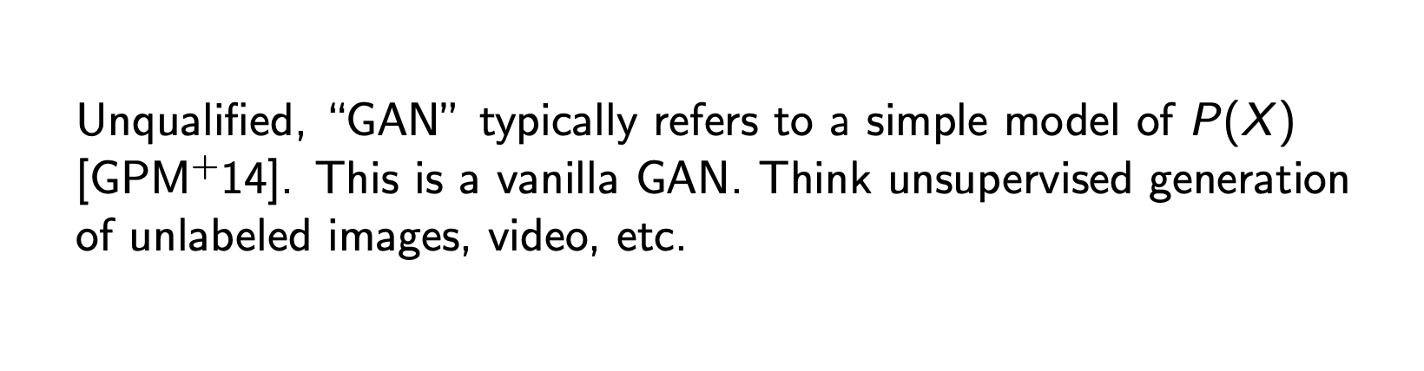
GAN
Notes:
Roshan’s slides start here

Slide 34
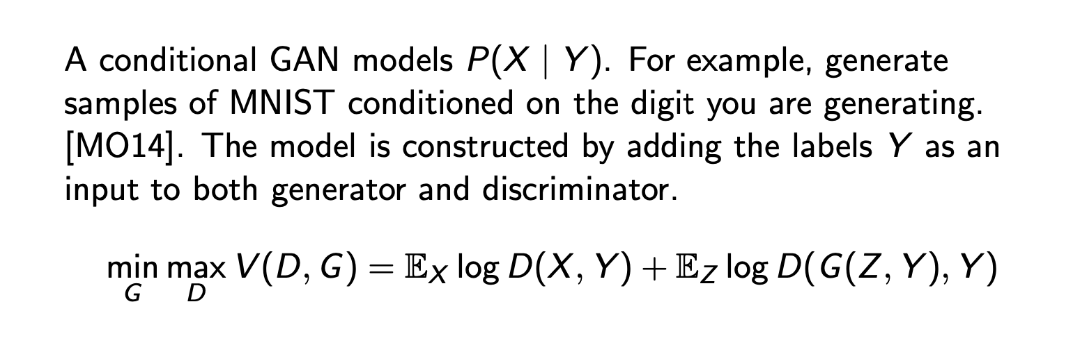
Conditional GANs

Slide 35
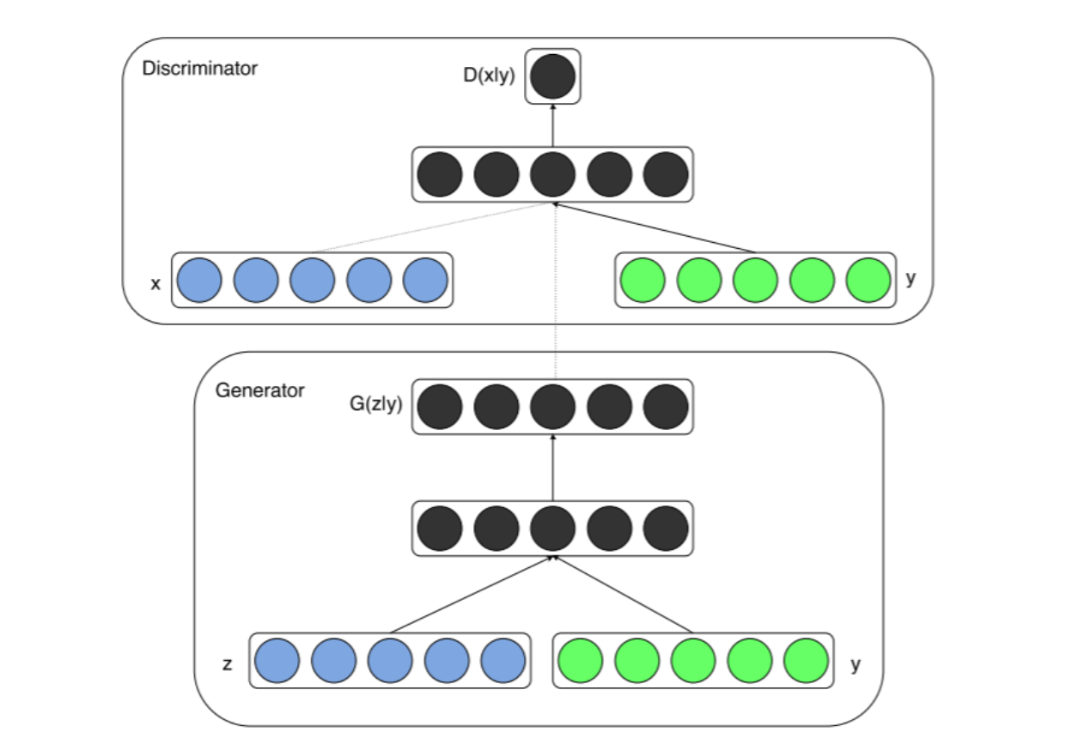
Conditional GAN Architecture

Slide 36
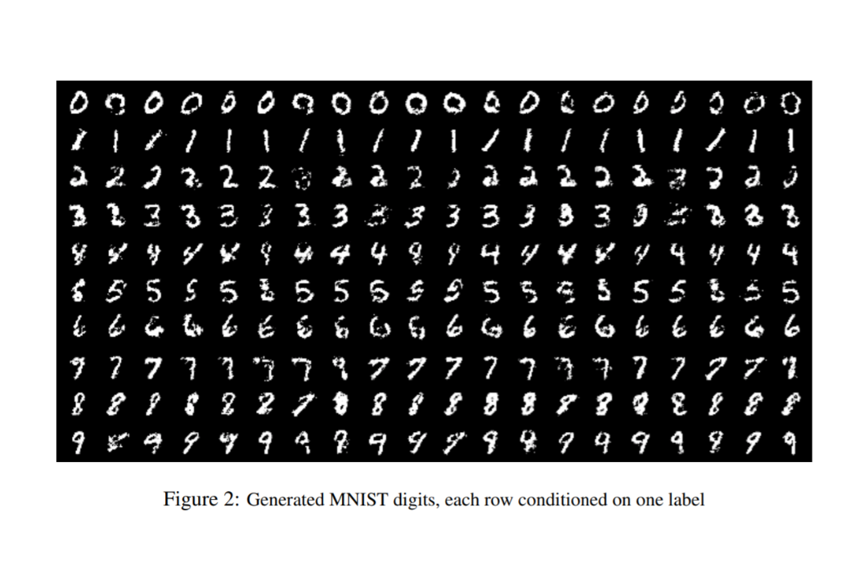
Conditional GAN Results

Slide 37
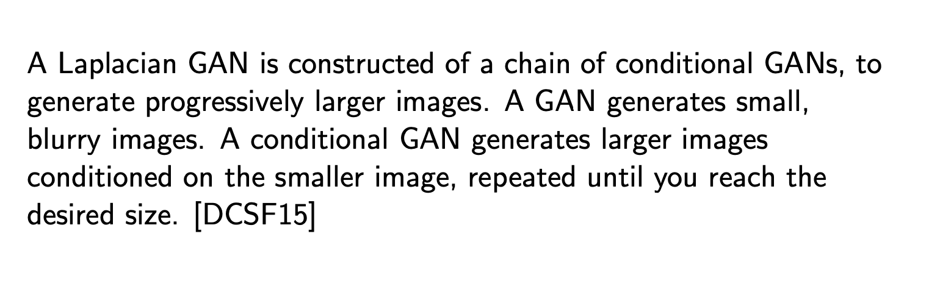
LapGAN

Slide 38
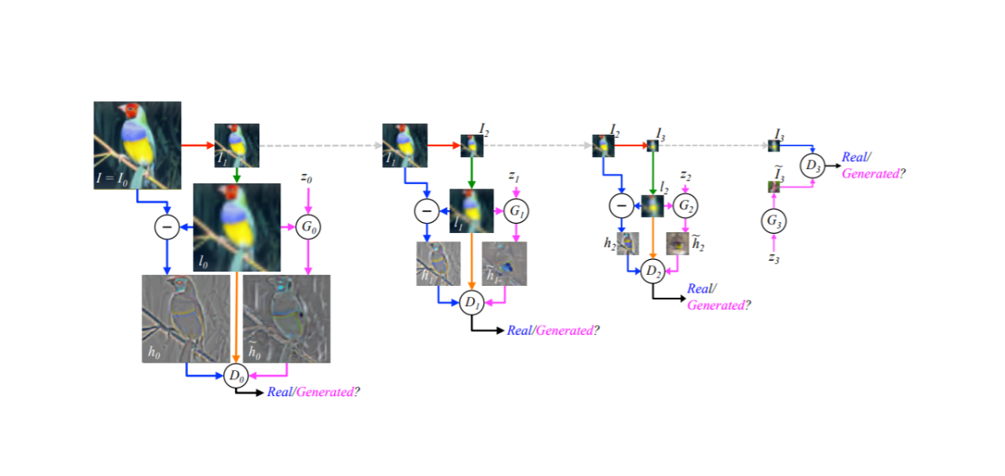
LapGAN Architecture

Slide 39
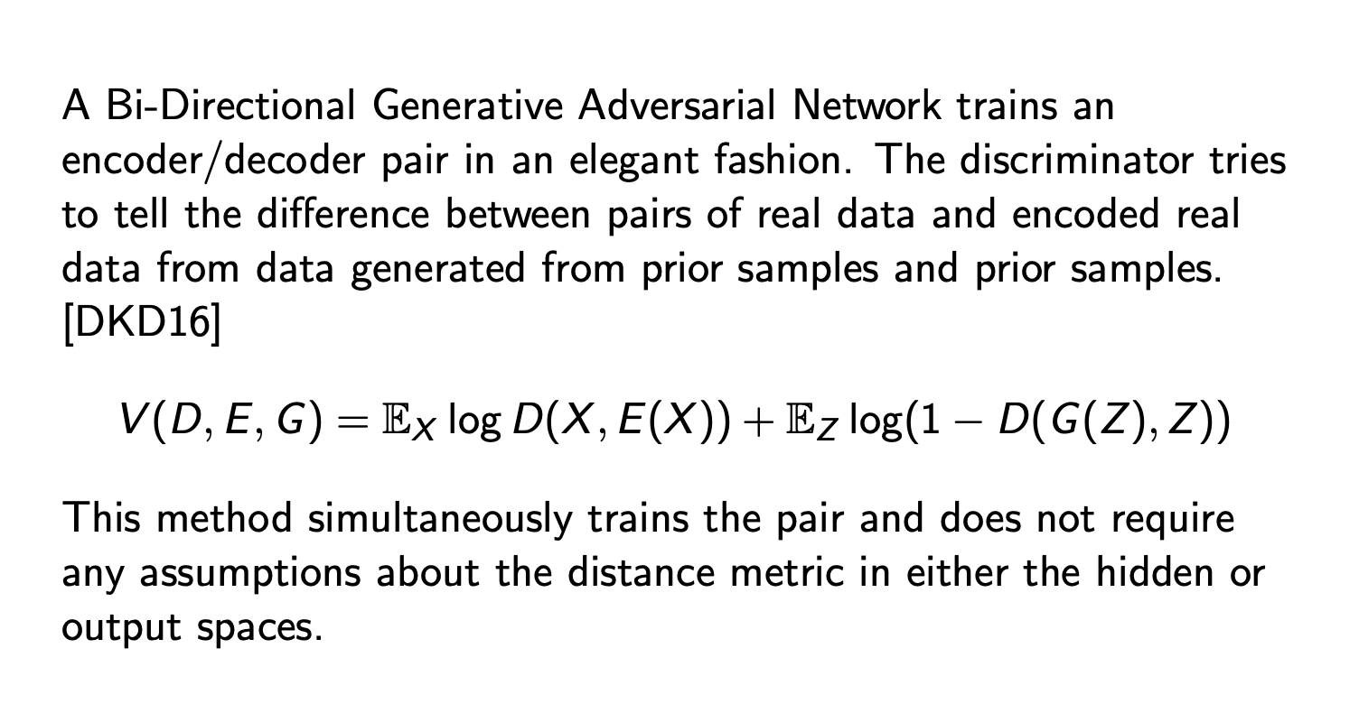
BiGANs

Slide 40
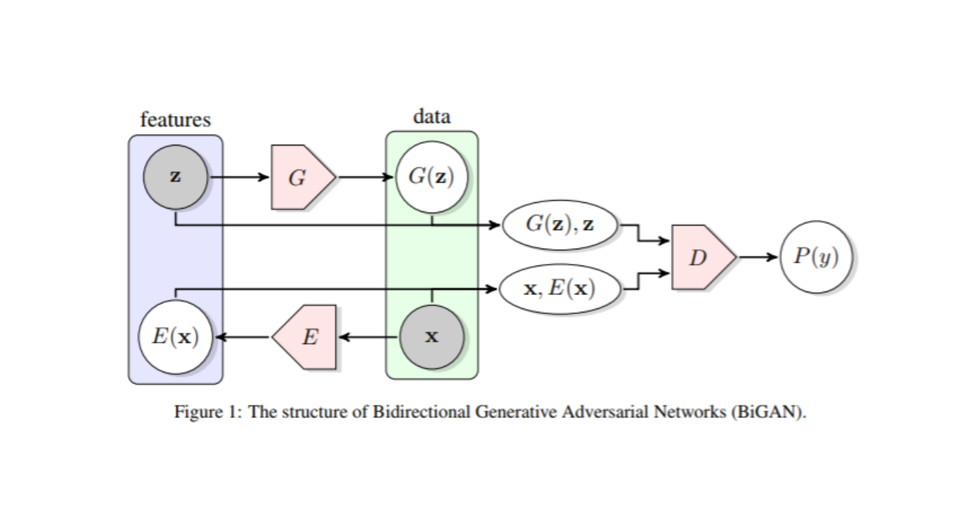
BiGAN Architecture

Slide 41
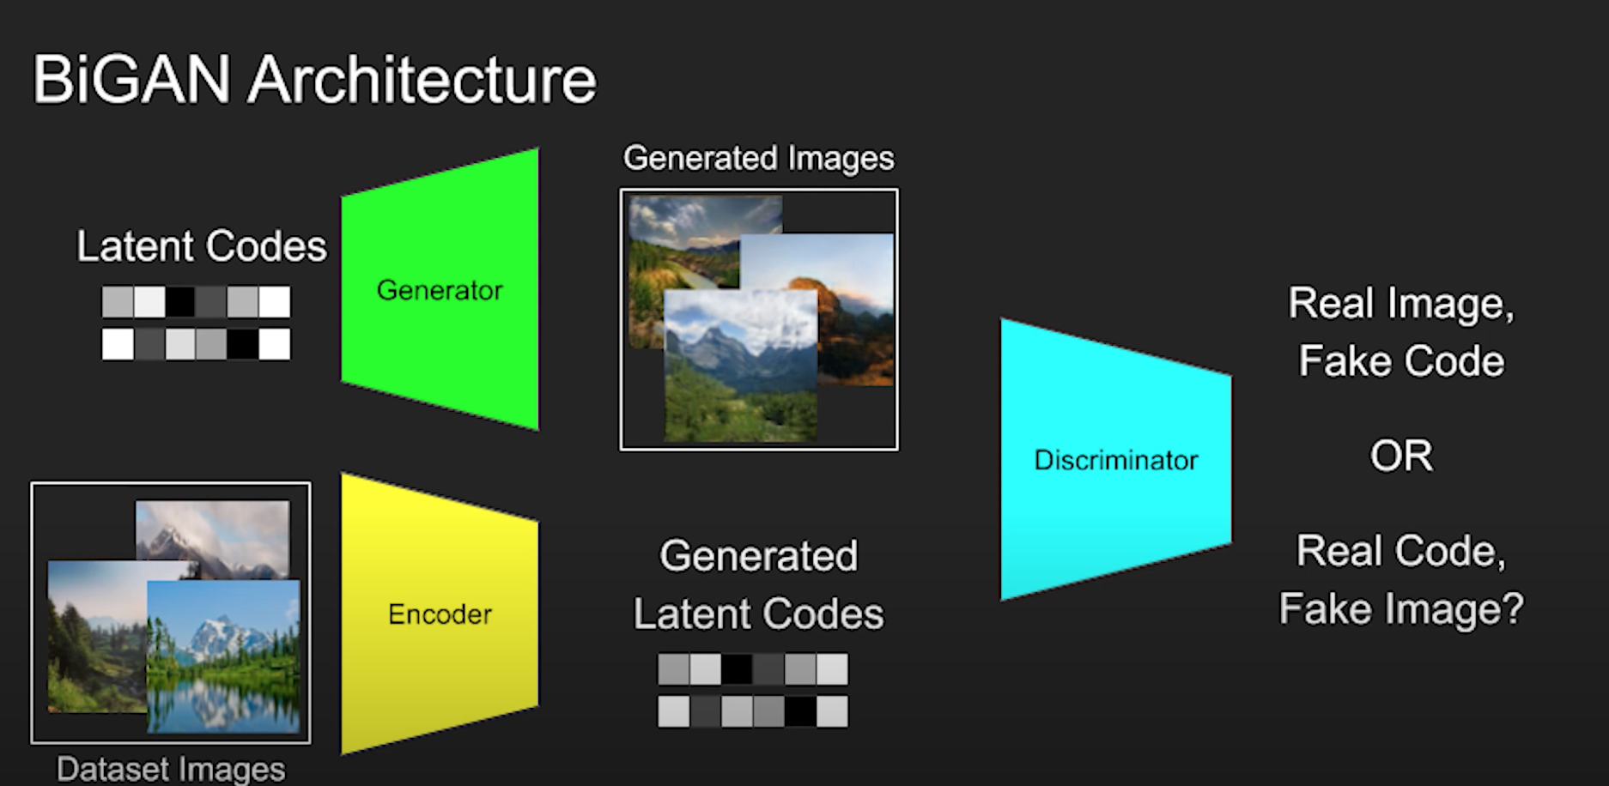
BiGAN Architecture

Slide 42
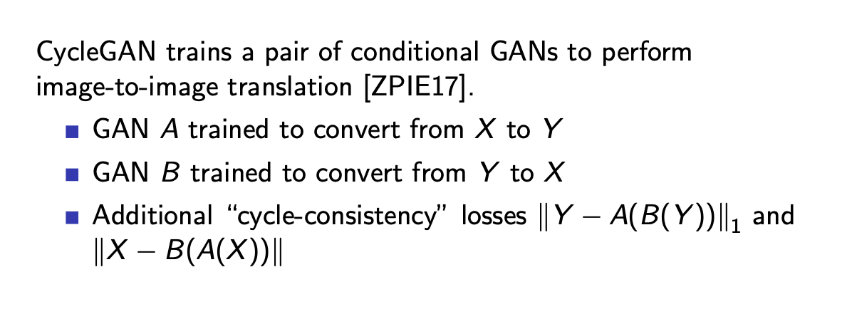
CycleGAN

Slide 43
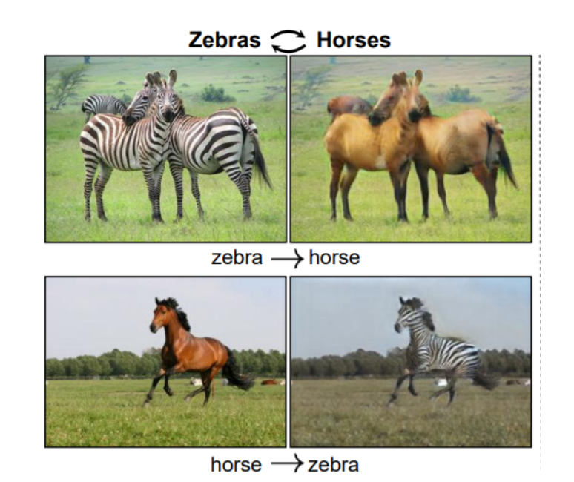
CycleGAN Results

Slide 44
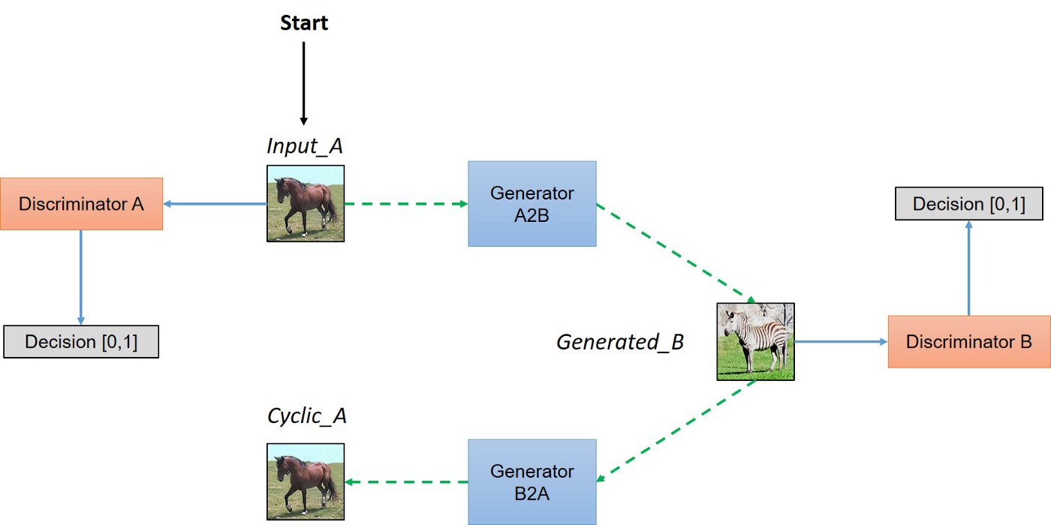
CycleGAN Architecture

Slide 45
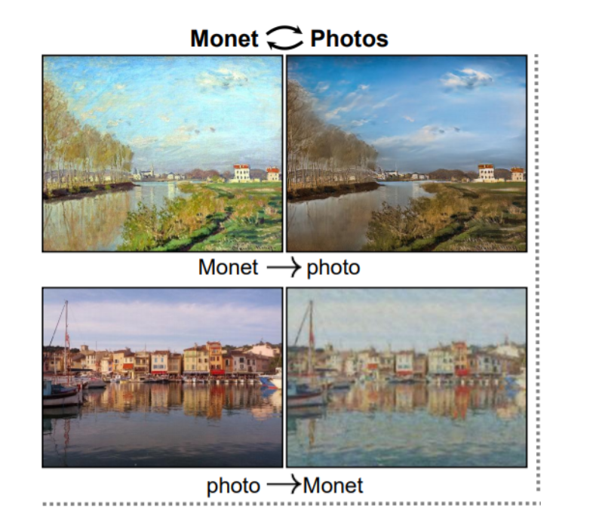
CycleGAN Results

Slide 46
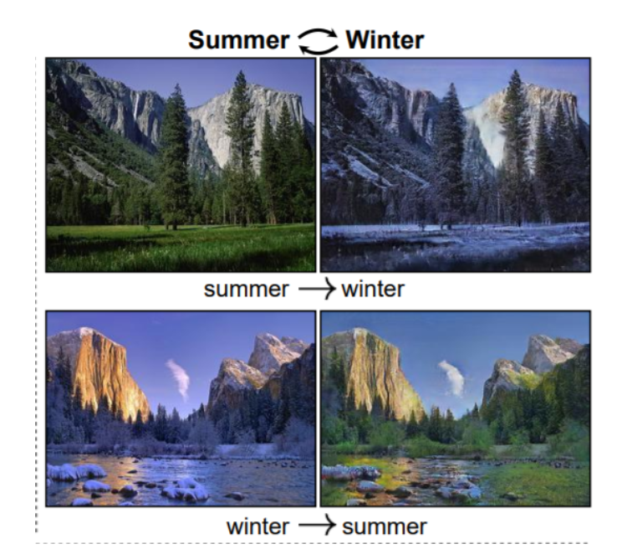
CycleGAN Results

Slide 47
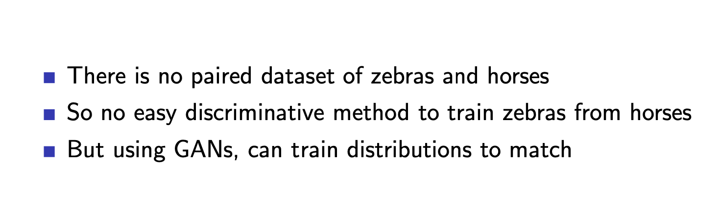
CycleGAN Lesson

Slide 48
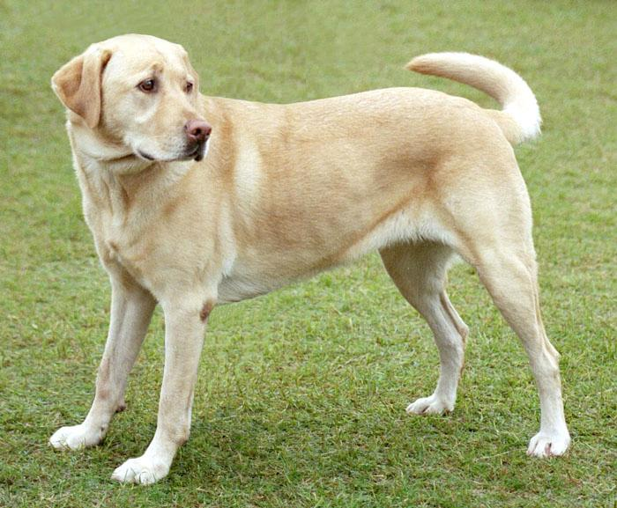
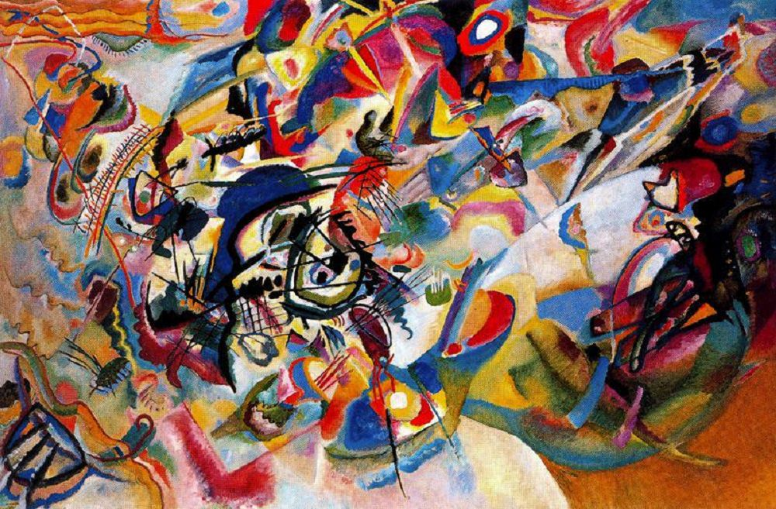
Neural Style Transfer Results

Slide 49
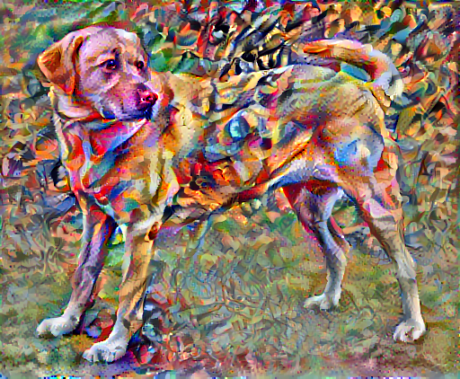
Neural Style Transfer Results

Slide 50
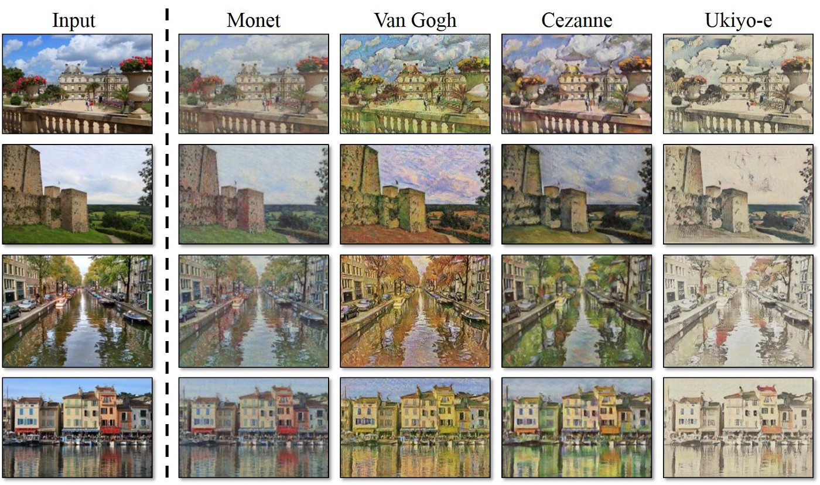
Style Transfer with CycleGAN

Slide 51
Neural Style Transfer vs CycleGAN
Neural Style Transfer
Need a content and style image
Specific & small number of images
More control
https://reiinakano.com/arbitrary-image-stylization-tfjs/
CycleGAN
Just need 2 domains of images. No need for specific content or style images
Many similar pictures
Specificity of images doesn’t really matter

Slide 52

[ADDITIONAL] Kaggle: CycleGAN for Monet Paintings
https://www.kaggle.com/code/dimitreoliveira/introduction-to-cyclegan-monet-paintings

Slide 53


