Slide 1
IDL S26 Computing Derivatives & Autograd Lab 4
By Khushee, Malihah and Anurag

Slide 2
What is derivative?
A rate of change (slope, gradient)
How quickly your position is changing right now?

Slide 3
Why do we need to compute derivatives?
When we train a neural network, we want to adjust the parameters so that the loss function gets smaller.
To do that, we need to know: if I nudge this parameter a little bit, how will the loss change?
That sensitivity is exactly what derivatives give us. Without derivatives, we couldn’t run gradient descent to optimize the model.

Slide 4
Problem!
Modern networks have millions of parameters! (way more than that)
Calculating derivatives by hand is impossible
Want to automatically calculate the derivatives of a function!

Slide 5



Raise your hand if you dislike a lot of unnecessary derivatives!!!!!!
Raise your hand if you like points!
Raise your hand if you like ***bonus*** points?
We can combine all those
interests!!!

Slide 6
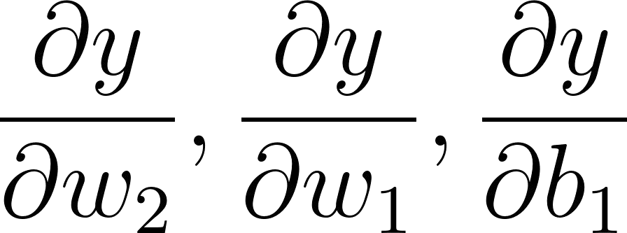
Method 1: Hand-Coding Derivatives
We use the deﬁnitions in calculus to calculate
Use the chain rule
, etc.
Pros:
Exact
Fast if well-implemented
Cons:
Error-prone
Wasteful in terms of generalizability
Time consuming to hand calculate and code.

Slide 7
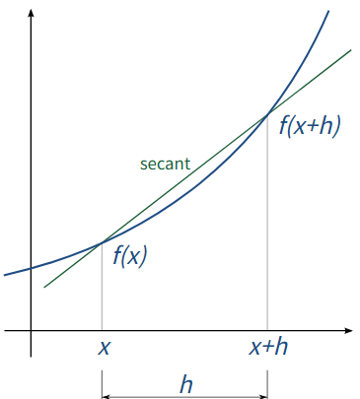

Method 2: Numerical Differentiation
Approximate derivatives with using ﬁnite differences
●
Consideration: epsilon value changes accuracy
Pros:
Easier to code (sorta)
Cons:
Computationally expensive for higher-dimensional problems
Can accumulate a lot of error.

Slide 8
Method 3: Auto Differentiation :)
What is primitive operation?
The smallest building blocks of computation in automatic differentiation
Examples: addition (+), subtraction (−), multiplication (×), division (÷)
Common nonlinear ops: exp, log, sin, cos, relu, etc.
Complex functions are composed of many primitive operations
Autograd tracks these operations to build the computation graph

Slide 9
Method 3: Auto Differentiation :)
Start with input x
Use Primitive Operations to incrementally create differentiation graph
Automatically track computations
Continuously Update parameters during gradient calculations
Pytorch uses an autodifferentiation engine called autograd that you have used!
Pros:
Backward is automatically if computation graph is correctly formed
Exact calculations
Cons:
Must be very careful while implementing the forward functions.
Makes brains hurt

Slide 10
Let’s start small

Slide 11
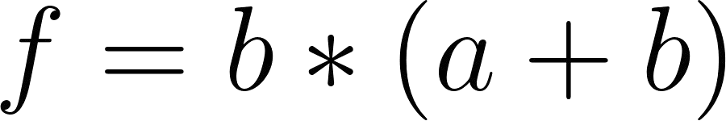
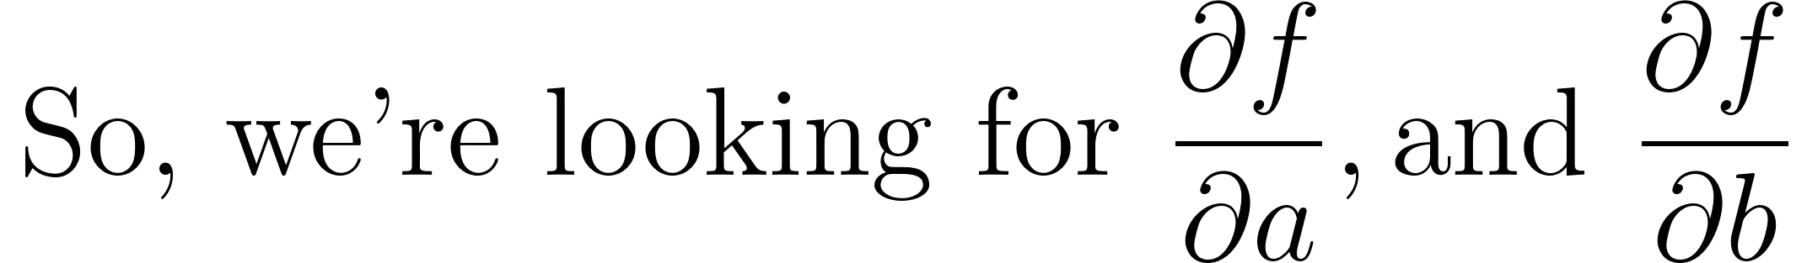
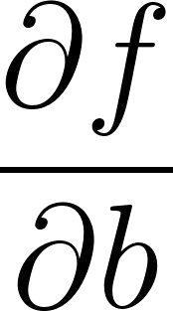
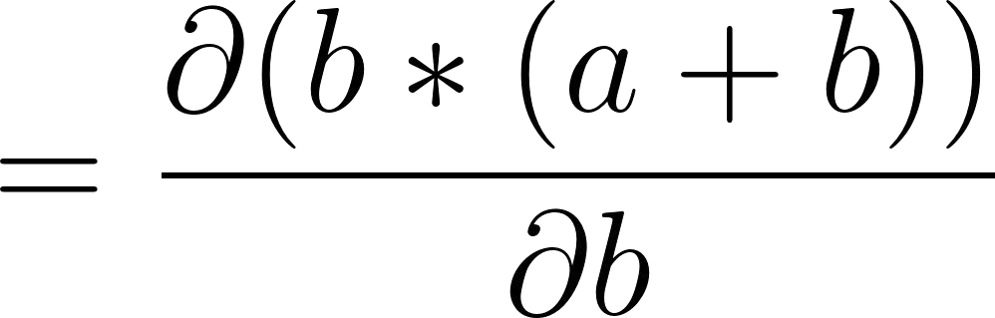
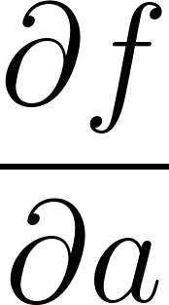
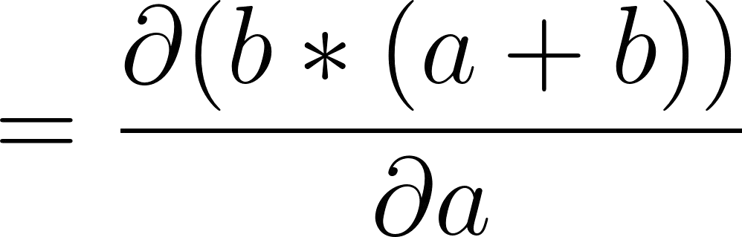
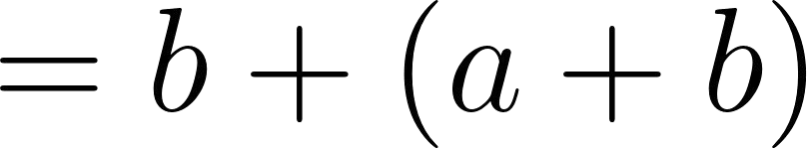
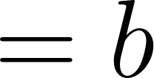
Take for example,

Slide 12






Let’s make a graph instead!

Slide 13
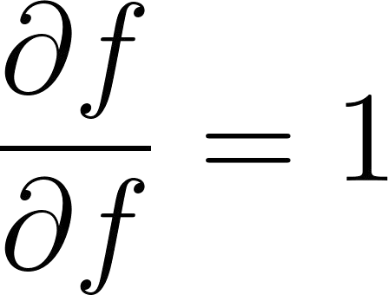
Let’s analyze how this works
For every node, use chain rule to calculate gradient!

Slide 14
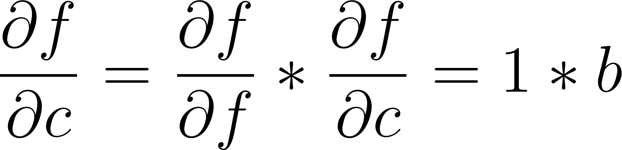
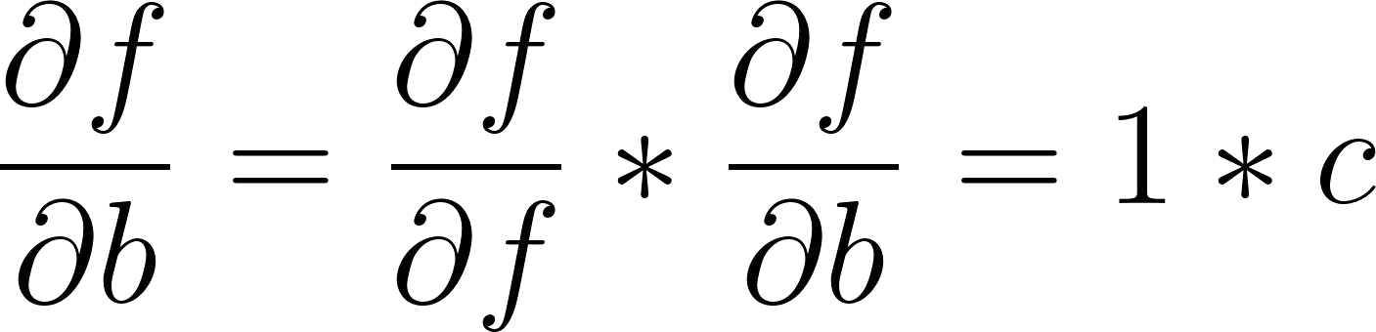
Let’s analyze how this works
f = b * c

Slide 15
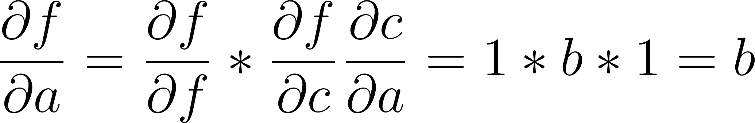
Let’s analyze how this works
What about dbdc?

Slide 16
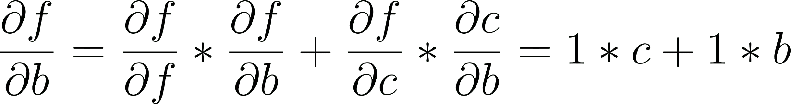
Let’s analyze how this works
Just add it on

Slide 17
Let’s analyze how this works

Slide 18

Let’s understand the autograd framework
Node class initialization:
Contains some data
I.e. node a contains its data input a
(tip: make this a numpy array holding data)
It also holds its gradient during backprop
Initialize it to a zero numpy array of the shape of the data.
tip: use np.zeros_like()
Also keep track of the parents of the node
Keep this as a set of parent nodes (so we don’t duplicate parent nodes accidentally)
I.e. node C has to know its parents are nodes a and b

Slide 19
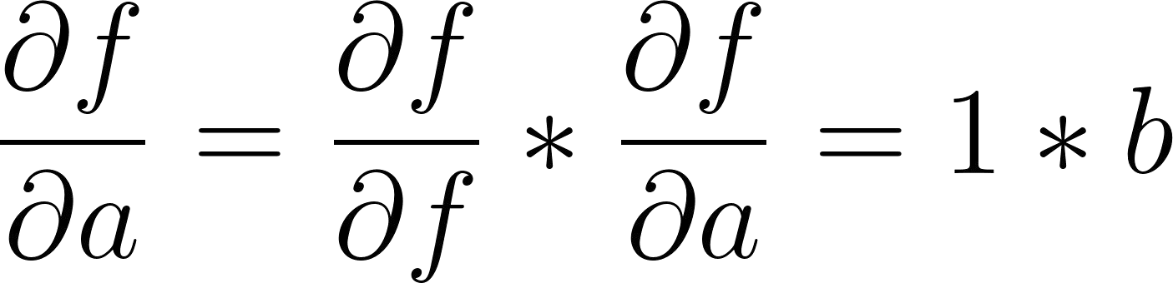
Let’s understand the autograd framework
class Node():
def init (self, data, _parents=()):
self.data = np.array(data) # Store data as NumPy array
self.grad = np.zeros_like(self.data) # Gradient initialized to zero self._parents = set(_parents) # Parent nodes in the computation graph
Transition 1

Slide 20
Let’s implement primitives!
Reminder: autograd works with a graph to incrementally perform backward operations.
We need to implement operation primitives to facilitate this.
Examples:
Addition
Multiplication
Matrix Multiplication
Subtraction
Log
Exponential
Division

Slide 21
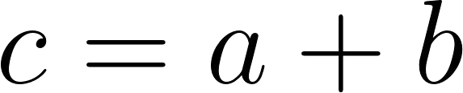
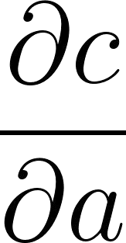
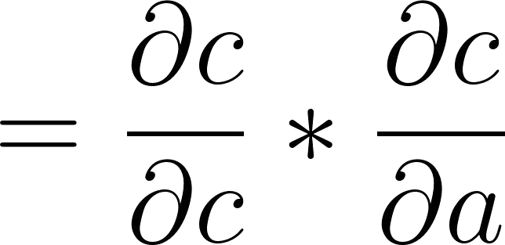
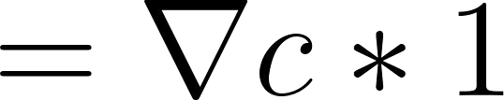
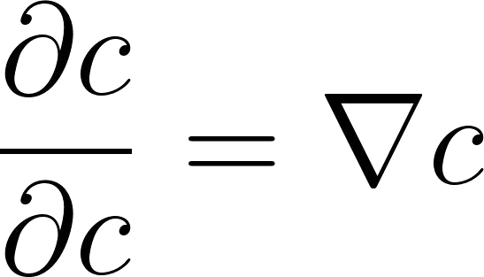
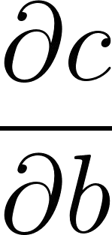
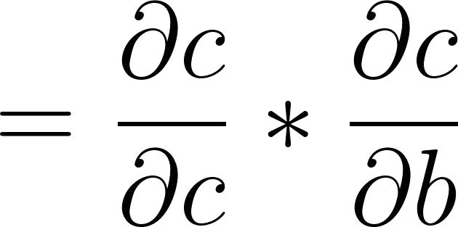
Primitives: Addition

Slide 22
Primitives: Addition
Addition primitive function:
Create a new out node
Add the data from the input nodes
Keep track of parents
Deﬁne a backward function
Manipulate the input nodes’ gradients from within the function
Set the node’s backward function to track it.

Slide 23
Primitives: Addition
def add_node(a_node, b_node):
out = Node(a_node.data + b_node.data, (a_node, b_node)) def add_backward():
a_node.grad += out.grad # dL/dA = dL/dC b_node.grad += out.grad # dL/dB = dL/dC
out.backward_fn = add_backward() return out

Slide 24
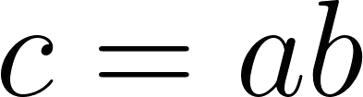
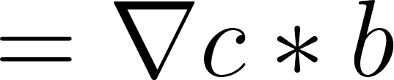

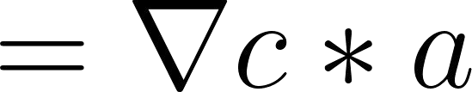
Primitives: Multiplication

Slide 25

Primitives: Multiplication
Addition primitive function:
Create a new out node
Multiply the data from the input nodes
Keep track of parents
Deﬁne a backward function
Manipulate the input nodes’ gradients from within the function
Set the node’s backward function to track it.

Slide 26
Primitives: Multiplication
def mul_node(a_node, b_node):
out = Node(a_node.data * b_node.data, (a_node, b_node)) def mul_backward():
a_node.grad += b_node.data * out.grad # dL/dA = B * dL/dC b_node.grad += a_node.data * out.grad # dL/dB = A * dL/dC
out.backward_fn = mul_backward() return out

Slide 27

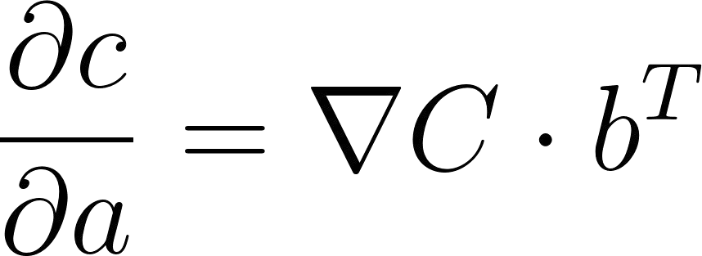
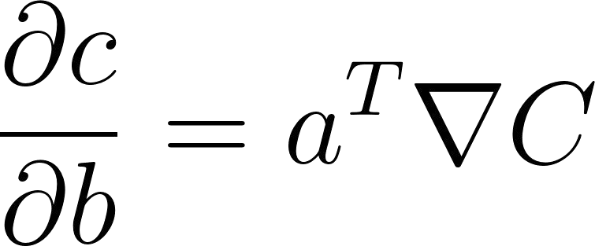
Primitives: Mat Mul (Challenge)
Notes:
Use @ for matmul in np
Use np.dot for dot product multiplication in np

Slide 28
Primitives: Mat Mul (Challenge)
def matmul_node(a_node, b_node):
out = Node(a_node.data @ b_node.data, (a_node, b_node)) def matmul_backward():
a_node.grad += np.dot(out.grad, b_node.data.T) # Gradient wrt a b_node.grad += np.dot(a_node.data.T, out.grad) # Gradient wrt b
out.backward_fn = matmul_backward return out

Slide 29

The Backward Method
backward_list:
[]
parents:
None Current:
None

Slide 30
The Backward Method
backward_list:
[f] parents:
c, b Current:
f

Slide 31
The Backward Method
backward_list:
[f, c]
parents:
a, b
Current:
c, b (for later)

Slide 32
The Backward Method
backward_list:
[f, c, b]
parents:
None Current:
b, a (for later)

Slide 33
The Backward Method
backward_list:
[f, c, b, a] parents:
None Current:
a

Slide 34

The Backward Method
backward_list:
[f, c, b, a]
Iterate through the backward list.
Note how we’re properly going backward now!

Slide 35

Backward Method Pseudocode
Initialize the current node’s grad to an array of all 1’s as a placeholder
initialize backward_list as an empty list
Recursively take in a node
If the node is already in the backward_list, skip Iterate through the node’s parents
recursively build the list from the parent nodes
Iterate through all the nodes in backward_list:
if the node has parents, call node.backward_fn()

Slide 36
Backward Method Code
class Node(Node):
def backward(self): backward_list = []
self.grad = np.ones_like(self.data) def build_backward_list(n):
if n not in backward_list: backward_list.appen(dn) for parent in n._parents:
build_backward_lis(tparent) build_backward_list(self)
for node in backward_list: if node._parents:
node.backward_fn()

Slide 37

Let’s make this computational graph now!
Set a to 7.0 Set b to 8.0
And call backward on it

Slide 38
How to use our basic autodiff engine
A= Node(7)
B = Node(8)
C = add_node(A, B) F = mul_node(C, B)
F.grad = 1.0 F.backward()
print(f"a_grad: {A}")
print(f"b_grad: {B}")
print(f"c_grad: {C}")
print(f"f_grad: {F}")

Slide 39
Notes!
For larger operations, you will want to use your primitives
All you simply have to do is call out.backward() and all the derivatives will be computed for you!
If you manually create new nodes, they must NOT rely directly on the data of the input.
If you want to use the data directly from the input, you must use the primitives so the input gets chained in with the rest of the graph.
You MAY create other matrices of a similar shape as the input. That’s ﬁne!
Transition 2

Slide 40
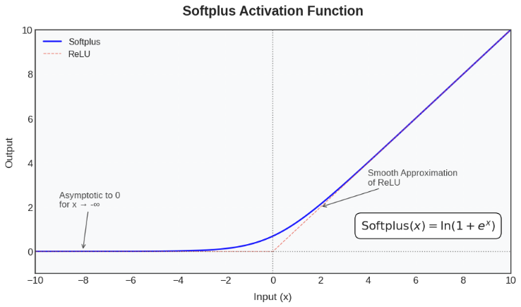
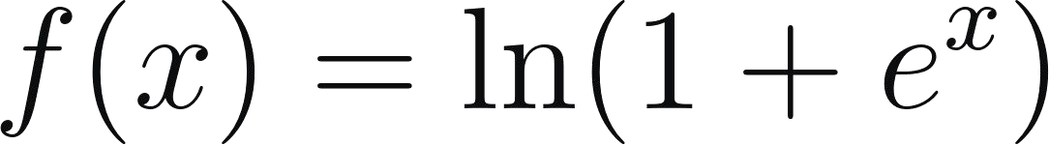
SoftPlus
Tips:
From our current framework, you must create a numpy array of 1’s with np.ones_like() to be a similar shape to x
We have provided you the ln and exp primitives :)

Slide 41
SoftPlus Node
def softplus_node(x): exp_x = exp_node(x)
one_exp_x = add_node(Node(np.ones_like(x.data)), exp_x) out = log_node(one_exp_x)
return out

Slide 42
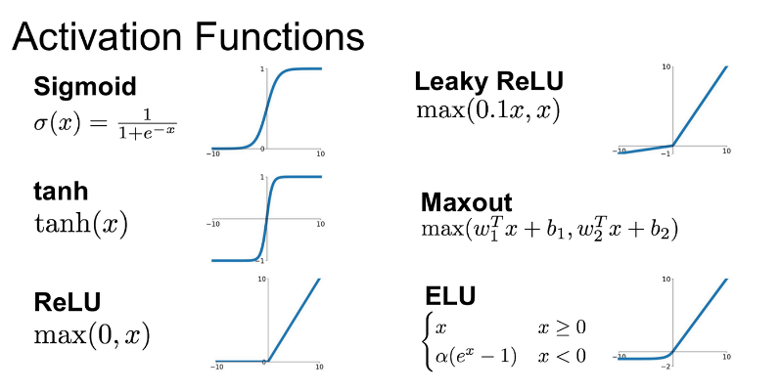
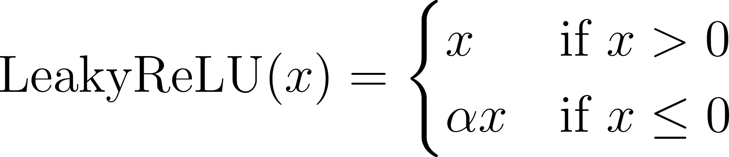
Leaky ReLU
Tips:
Create an node with a matrix of alpha values which has a similar shape to the input data
Create a mask of all the 0/positive values with np.where
Create a mask of all the negative values with np.where

Slide 43
Leaky ReLU Node
def leaky_relu_node(input, alpha=0.01):
alpha_node = Node(np.ones_like(input.data) * alpha)
positives_mask_node = Node(np.where(input.data >= 0., 1., 0.))
negatives_mask_node = Node(np.where(input.data < 0., 1., 0.))
alpha_mask_node = mul_node(alpha_node, negatives_mask_node)
positive_part = mul_node(input, positives_mask_node) negative_part = mul_node(input, alpha_mask_node)
out = add_node(positive_part, negative_part) return out

Slide 44
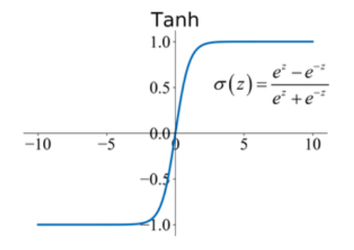
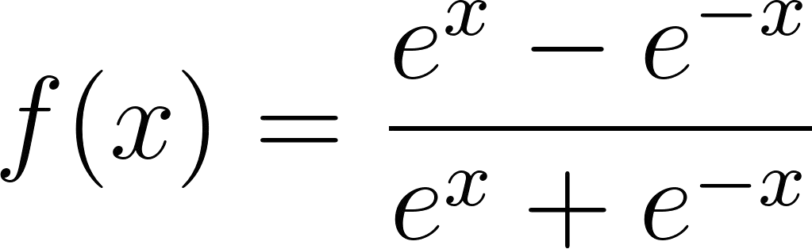
Tanh
Tips:
Incrementally build the graph for the numerator and denominator
Note how the numerator and denominator both have e^x
We recommend building separate graphs/separate instances of the intermediate variables needed for the numerator and denominator
This is because in our backward method, the gradient for intermediate values (such as e^(-x) and e^x) might only be updated by the numerator, or only be updated by the denominator. Thus, if you do them separately, they will update properly.
You can just do neg_x1 and negx_2, or exp_x1 and exp_x2, and just make the same node twice.

Slide 45
Tanh Node
def tanh_node(x):
neg_one = Node(-1.0 * np.ones_like(x.data))
neg_x1 = mul_node(neg_one, x) exp_x1 = exp_node(x) exp_neg_x1 = exp_node(neg_x1)
neg_exp_neg_x1 = mul_node(exp_neg_x1, neg_one)
num = add_node(exp_x1, neg_exp_neg_x1)
neg_input2 = mul_node(neg_one, x) exp_x2 = exp_node(x)
exp_neg_x2 = exp_node(neg_input2)
den = add_node(exp_x2, exp_neg_x2) out = div_node(num, den)
return out

Slide 46
Moving to Gradient Buffers (more like the homework bonuses ;)
Transition 3

