Slide 1



11-785 Introduction to Deep Learning
Recitation 12: Pittsburgh Supercomputing Cluster
1
What is PSC?
2
How to connect via terminal
3
How to connect via VSCode
4
PSC tips
TA: En Zheng (enzheng@andrew.cmu.edu)
Yixiong Fang (yixiongf@andrew.cmu.edu)
Pengyu Chang (pengyuch@andrew.cmu.edu)

Slide 2



11-785 Introduction to Deep Learning
Pittsburgh Supercomputing Cluster: No more GPU-shy!
A bit of trivia
It’s a computational research center
How can it help you: Grants
Founded in 1986
Joint venture between CMU & UPitt
Supported by many such as NSF, federal agencies and industry
Simply put, it’s a HUGE computer!
Train large-scale research projects
Multiple GPUs and large storage; undertake large projects
Empowering the next gen of research
Provides grants and resources
From a few hundred to few thousand GPU hours of grants available
What is PSC?
How to connect via terminal
How to connect via VSCode
PSC tips
Icons from flaticon.com

Slide 3
11-785 Introduction to Deep Learning
PSC User Policy
Please only use V-100 GPUs.
Do not download datasets or install environments locally — use shared resources.
For your homework, always work under /jet/home/username directory which has 25 GB of storage.
For your project, the directory will be: /ocean/projects/<project id>/<username>, which we will introduce in the next recitation:)
What is PSC?
How to connect via terminal
How to connect via VSCode
PSC tips
Icons from flaticon.com

Slide 4
11-785 Introduction to Deep Learning
PSC Connection via Terminal
What is PSC?
How to connect via terminal
How to connect via VSCode
PSC tips
TA: En Zheng (enzheng@andrew.cmu.edu) Yixiong Fang (yixiongf@andrew.cmu.edu)

Slide 5
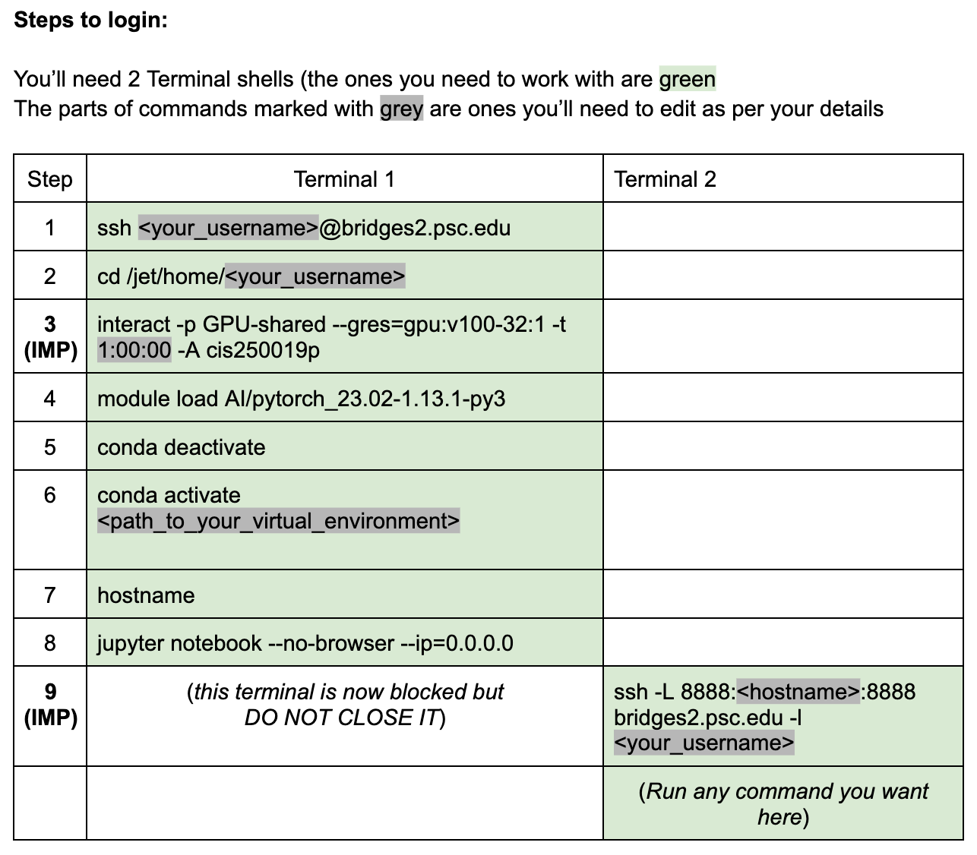
11-785 Introduction to Deep Learning
Connect via Terminal
Please watch the video for more details :)
What is PSC?
How to connect via terminal
How to connect via VSCode
PSC tips
TA: En Zheng (enzheng@andrew.cmu.edu) Yixiong Fang (yixiongf@andrew.cmu.edu)

Slide 6
11-785 Introduction to Deep Learning
PSC Connection via VSCode
What is PSC?
How to connect via terminal
How to connect via VSCode
PSC tips
TA: En Zheng (enzheng@andrew.cmu.edu) Pengyu Chang (pengyuch@andrew.cmu.edu)

Slide 7
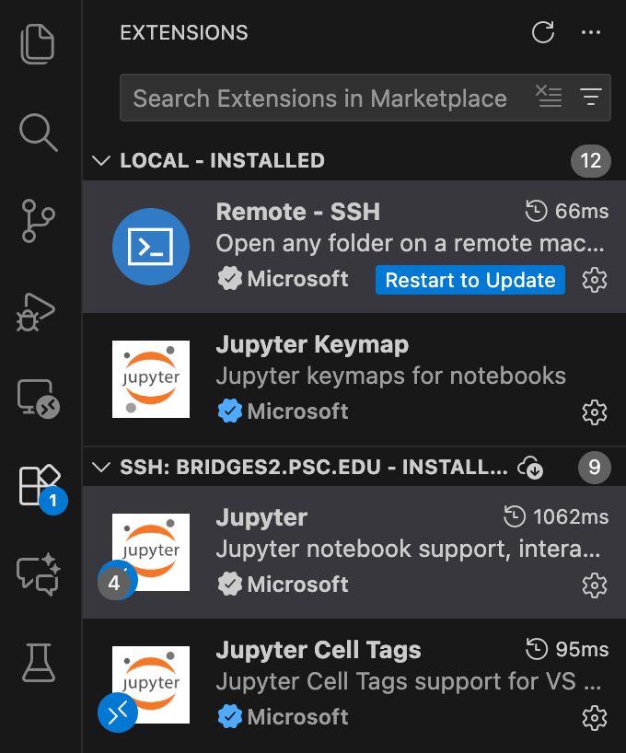
11-785 Introduction to Deep Learning
Connect via VSCode
Please watch the video for more details :)
1. SSH into Bridges2
1) Open VS Code and click on the `Extensions` icon in the left sidebar. Make sure the "**Remote - SSH**" extension is installed.
What is PSC?
How to connect via terminal
How to connect via VSCode
PSC tips
TA: En Zheng (enzheng@andrew.cmu.edu) Pengyu Chang (pengyuch@andrew.cmu.edu)

Slide 8
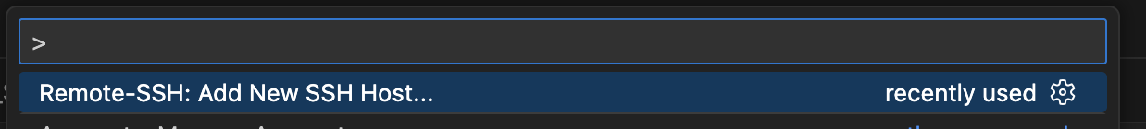
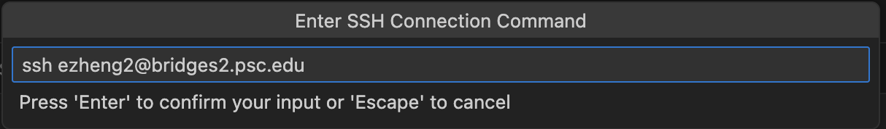
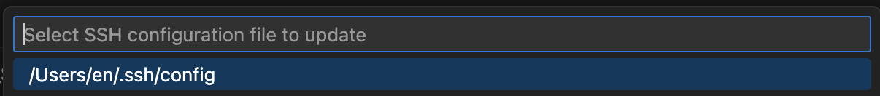
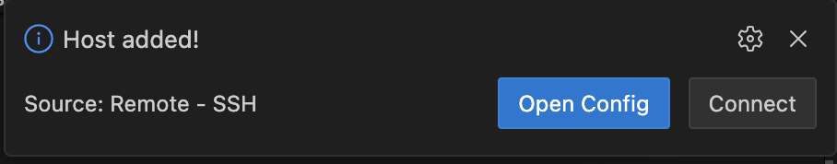
11-785 Introduction to Deep Learning
Connect via VSCode
Please watch the video for more details :)
2）Open the command palette (**Shift+Command+P** on Mac, **Ctrl+Shift+P** on Windows). A search box will appear at the top center. Choose “Remote-SSH: Add New SSH Host”, then enter:
ssh <your_username>@bridges2.psc.edu
Next, choose “/Users/<your_username>/.ssh/config” as the config file.
A dialog will appear in the bottom right saying “Host Added”. Click “Connect”, and then enter your password.
What is PSC?
How to connect via terminal
How to connect via VSCode
PSC tips
TA: En Zheng (enzheng@andrew.cmu.edu) Pengyu Chang (pengyuch@andrew.cmu.edu)

Slide 9
11-785 Introduction to Deep Learning
Connect via VSCode
SSH keygen and config files:
Visual Studio Code Tutorials: Remote development over SSH
Remote - SSH - Visual Studio Marketplace
Config Files would look like this:(ideally, you don’t need to generate this file yourself, the plugin would take care of it. Just use Add New SSH Host and input the command!) In C:/Users/<username>/.ssh/config (windows for example)
Host bridges2.psc.edu
HostName bridges2.psc.edu
User <your user name>
Please watch the video for more details :)
What is PSC?
How to connect via terminal
How to connect via VSCode
PSC tips
TA: En Zheng (enzheng@andrew.cmu.edu) Pengyu Chang (pengyuch@andrew.cmu.edu)

Slide 10
11-785 Introduction to Deep Learning
Connect via VSCode
Please watch the video for more details :)
Trouble shooting for SSH connection in VSCode:
Try ssh command in bash terminal (For Windows Users). If ssh isn’t found, install OpenSSH Client (Windows Settings → Optional features)
Make sure you have the correct username and password (which might not be the same as ACCESS ID & password and of course not the same as Andrew ID & password).
What is PSC?
How to connect via terminal
How to connect via VSCode
PSC tips
TA: En Zheng (enzheng@andrew.cmu.edu) Pengyu Chang (pengyuch@andrew.cmu.edu)

Slide 11
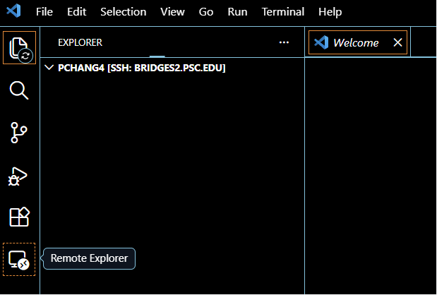
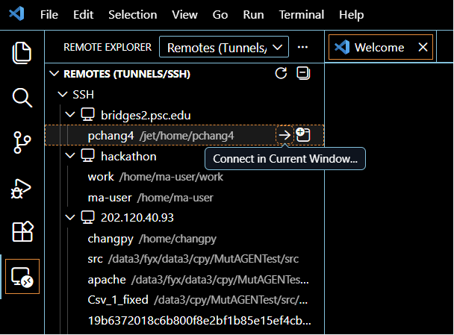
11-785 Introduction to Deep Learning
Connect via VSCode
Please watch the video for more details :)
Useful shortcut for connection:
What is PSC?
How to connect via terminal
How to connect via VSCode
PSC tips
TA: En Zheng (enzheng@andrew.cmu.edu) Pengyu Chang (pengyuch@andrew.cmu.edu)

Slide 12
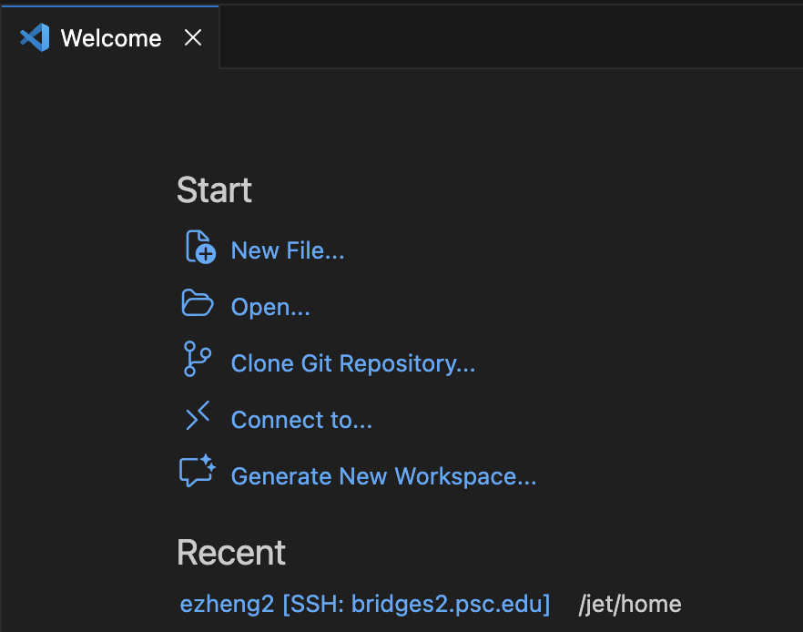
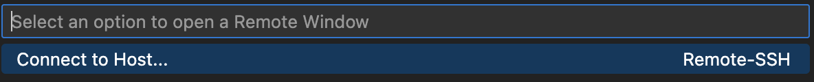

11-785 Introduction to Deep Learning
Connect via VSCode
Please watch the video for more details :)
Also, you can use "Remote-SSH: Connect to Host" and select "bridges2.psc.edu" from the list after adding the host once.
What is PSC?
How to connect via terminal
How to connect via VSCode
PSC tips
TA: En Zheng (enzheng@andrew.cmu.edu) Pengyu Chang (pengyuch@andrew.cmu.edu)

Slide 13
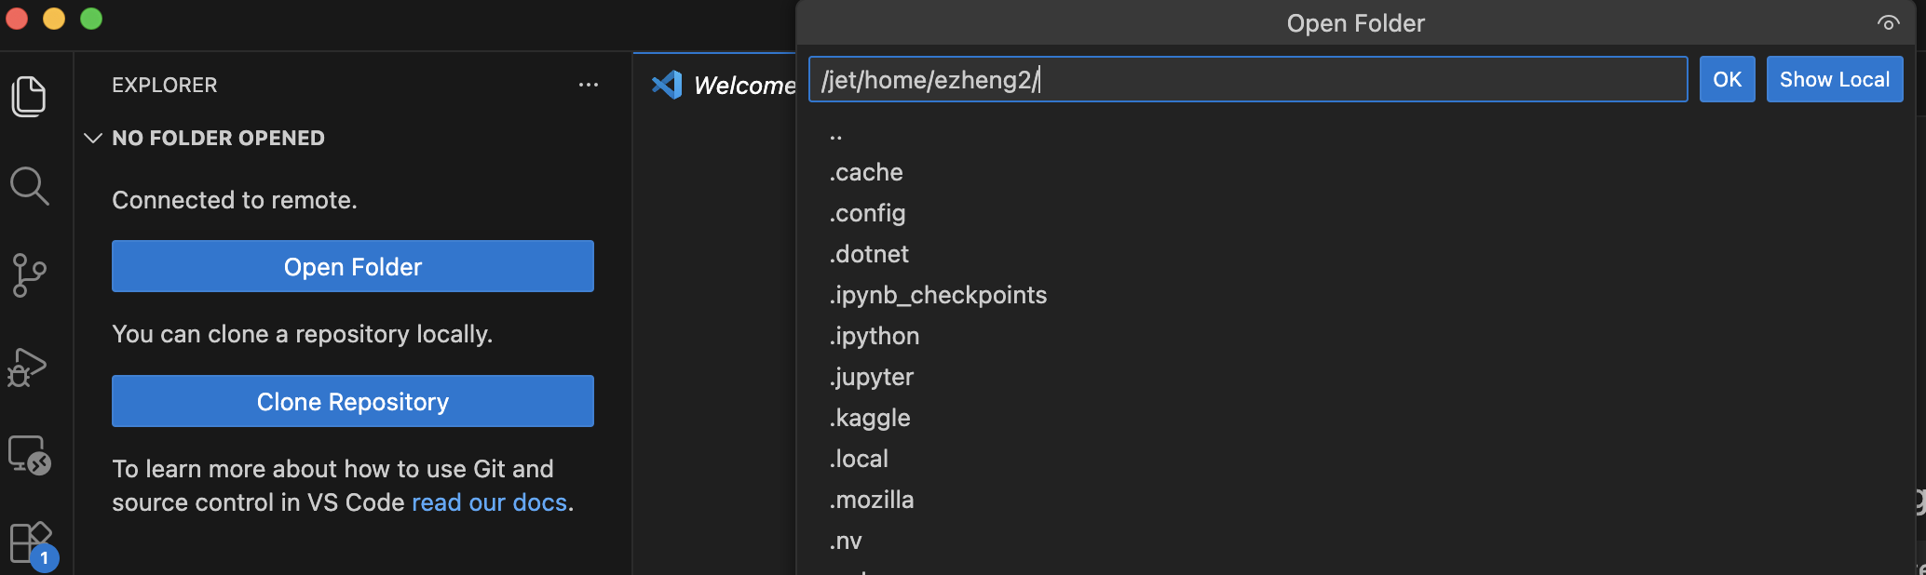
11-785 Introduction to Deep Learning
Connect via VSCode
Please watch the video for more details :)
3）Once connected, click “Explorer” in the left sidebar > “Open Folder”, and navigate to your home directory under the project grant:
/jet/home/<your_username>
What is PSC?
How to connect via terminal
How to connect via VSCode
PSC tips
TA: En Zheng (enzheng@andrew.cmu.edu) Pengyu Chang (pengyuch@andrew.cmu.edu)

Slide 14
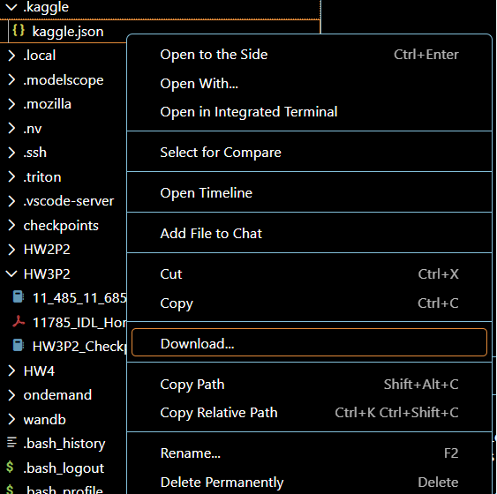
11-785 Introduction to Deep Learning
Connect via VSCode
Please watch the video for more details :)
4）You can now drag your notebook files directly into the right-hand pane (your remote home directory), or upload them using ‘scp’ into your folder.
Right click the file(Mouse2), you can download your file from PSC, which is useful when you try to handin your code.
What is PSC?
How to connect via terminal
How to connect via VSCode
PSC tips
TA: En Zheng (enzheng@andrew.cmu.edu) Pengyu Chang (pengyuch@andrew.cmu.edu)

Slide 15
11-785 Introduction to Deep Learning
Connect via VSCode
Please watch the video for more details :)
*You can simply enter the following commands which are given for each HWs in the terminal for operation.
2. Navigate to Your Directory
cd /jet/home/<your_username> #change <your_username> to your username
3. Request a Compute Node
interact -p GPU-shared --gres=gpu:v100-32:1 -t 8:00:00 -A cis250019p
4. Load the Anaconda Module
module load anaconda3
5. Activate the provided HW Environment**
conda deactivate # First, deactivate any existing Conda environment
conda activate /ocean/projects/cis250019p/mzhang23/TA/HW1P2/envs/hw1p2_env && export PYTHONNOUSERSITE=1
6. Start Jupyter Notebook
jupyter notebook --no-browser --ip=0.0.0.0
What is PSC?
How to connect via terminal
How to connect via VSCode
PSC tips
TA: En Zheng (enzheng@andrew.cmu.edu) Pengyu Chang (pengyuch@andrew.cmu.edu)

Slide 16
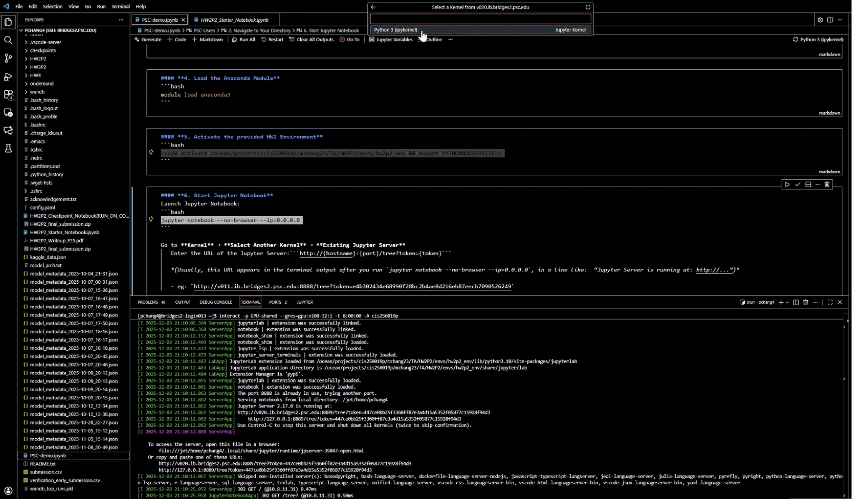
11-785 Introduction to Deep Learning
Connect via VSCode
Please watch the video for more details :)
What is PSC?
How to connect via terminal
How to connect via VSCode
PSC tips
TA: En Zheng (enzheng@andrew.cmu.edu) Pengyu Chang (pengyuch@andrew.cmu.edu)

Slide 17
11-785 Introduction to Deep Learning
PSC Tips
What is PSC?
How to connect via terminal
How to connect via VSCode
PSC tips
TA: En Zheng (enzheng@andrew.cmu.edu)

Slide 18
11-785 Introduction to Deep Learning
PSC tips
- To check your running jobs, use:
squeue -u $USER
This shows your current job status. The columns mean:
JOBID: your job ID (unique number)
PARTITION: which queue you are in (e.g. GPU-shared)
NAME: job name (e.g. Interact)
USER: your username
ST: status (R = running, PD = pending, etc.)
TIME: how long the job has been running
NODELIST: which compute node you are on (e.g. v002)
What is PSC?
How to connect via terminal
How to connect via VSCode
PSC tips
TA: En Zheng (enzheng@andrew.cmu.edu)

Slide 19
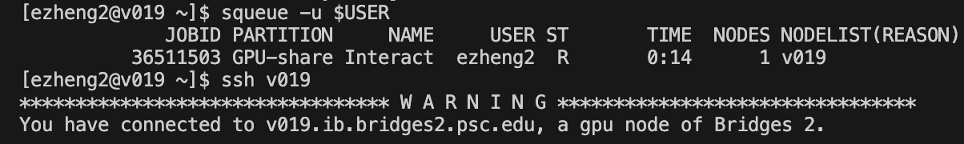
11-785 Introduction to Deep Learning
PSC tips
-If you get disconnected (e.g. network drop, terminal crash), your GPU job is still running in the background. Since you cannot start another GPU job before finishing the previous one, you can reattach by:
ssh <node>
For example, if squeue shows v019, then run ssh v019.
What is PSC?
How to connect via terminal
How to connect via VSCode
PSC tips
TA: En Zheng (enzheng@andrew.cmu.edu)

Slide 20
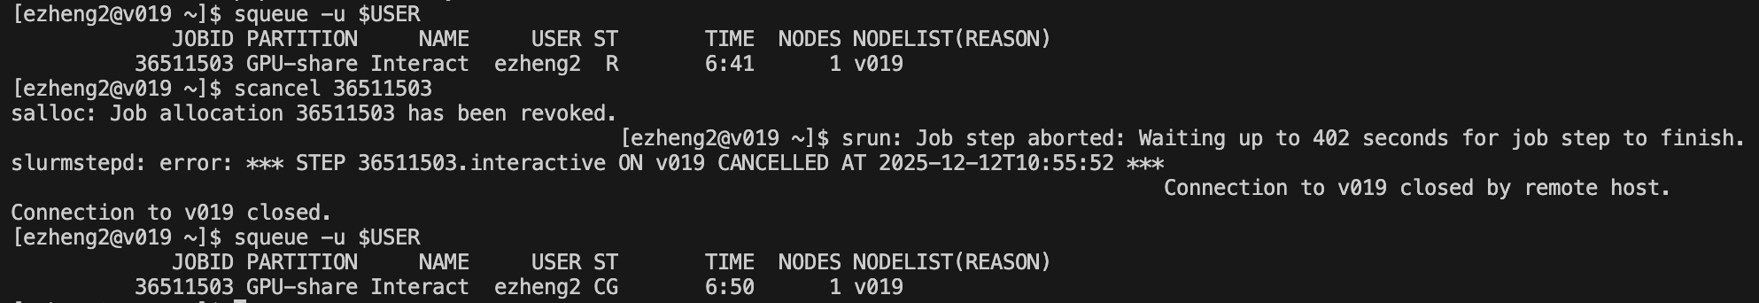
11-785 Introduction to Deep Learning
PSC tips
- If you are DONE with your work but still have GPU time left, please release the resource with:
scancel <JOBID>
What is PSC?
How to connect via terminal
How to connect via VSCode
PSC tips
TA: En Zheng (enzheng@andrew.cmu.edu)

