Slide 1



11-785 Introduction to Deep Learning
Recitation 13: Pittsburgh Supercomputing Cluster
1
Understanding your PSC dashboard
2
Apply for the Explore ACCESS Grant
3
Managing your grant
TA: En Zheng (enzheng@andrew.cmu.edu)

Slide 2
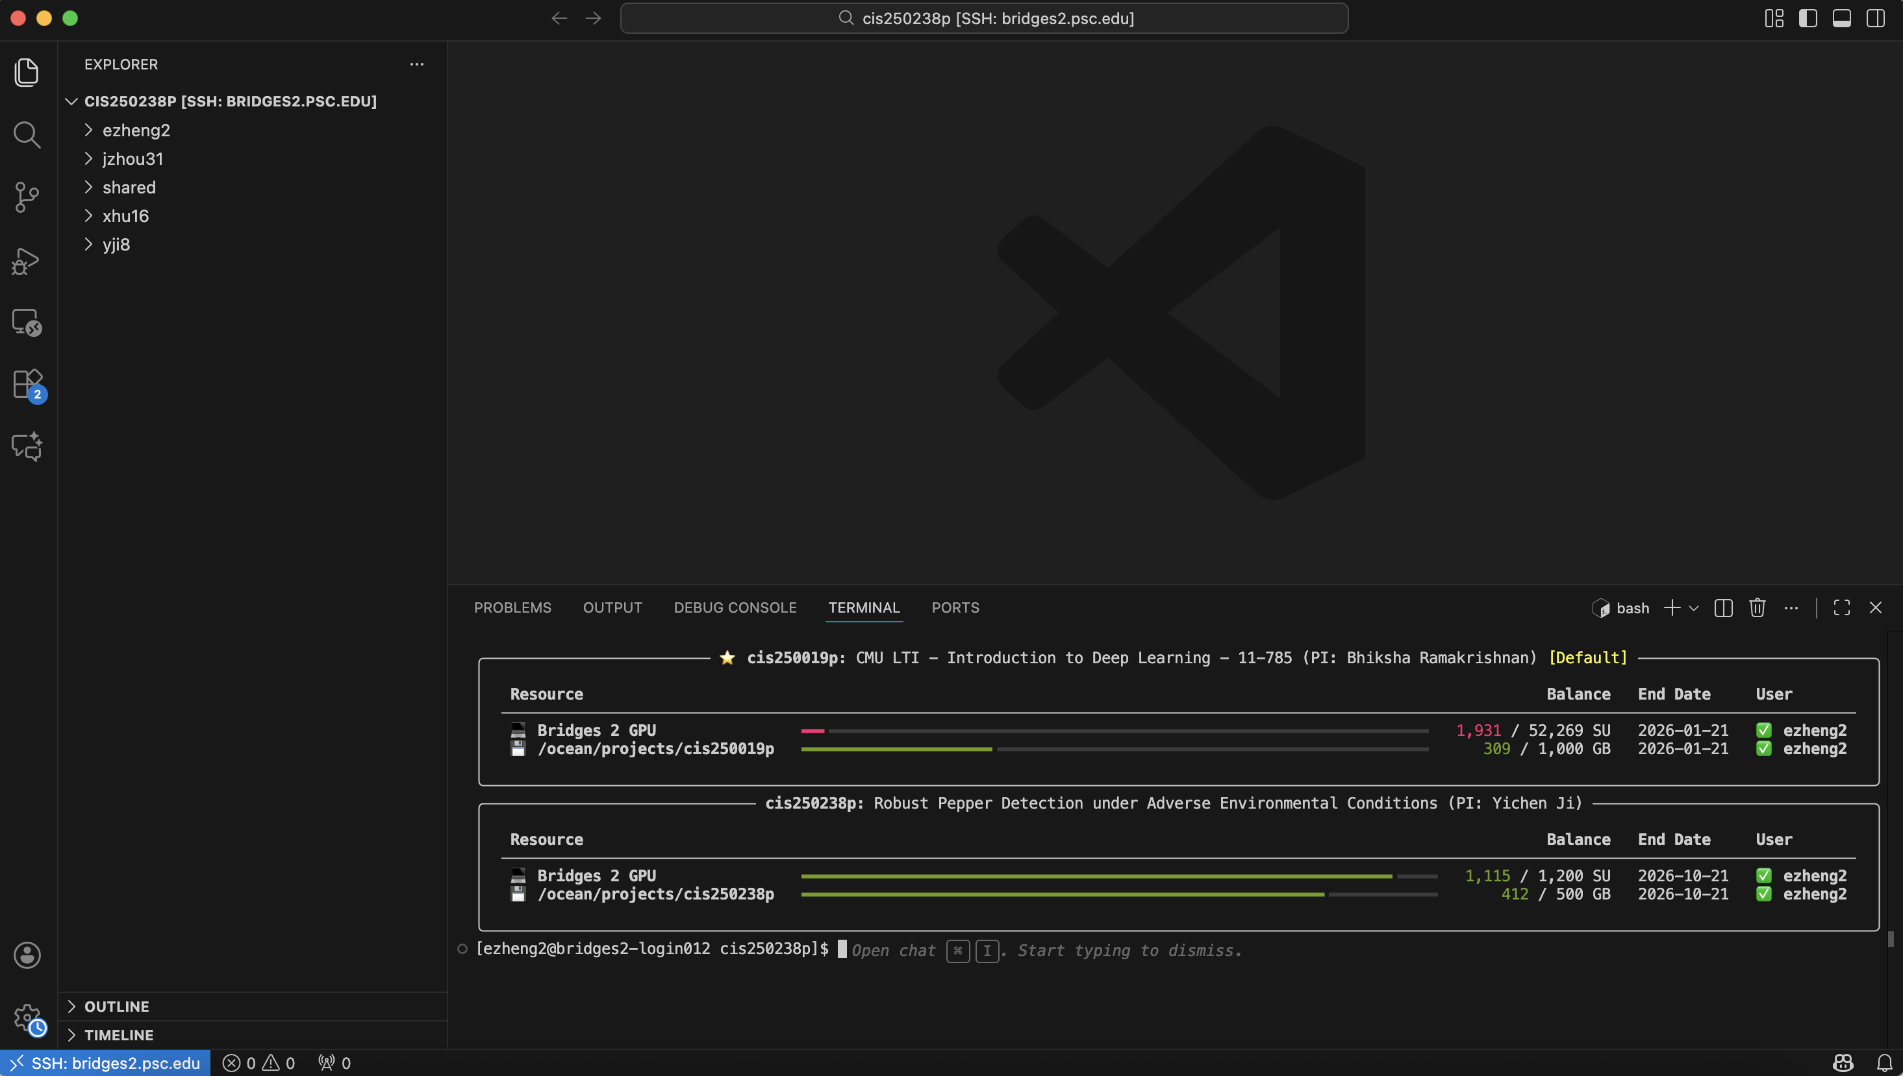
11-785 Introduction to Deep Learning
Understanding your PSC dashboard
/ocean/projects/<project id>/<username>, larger storage capacity
You can also move data& environment to the “shared” storage
CANNOT use the class PSC resources for projects!
PSC allocations for homework
PSC allocations for project
You can apply 4 types of GPU: v100-16, v100-32, l40s-48, or h100-80

Slide 3
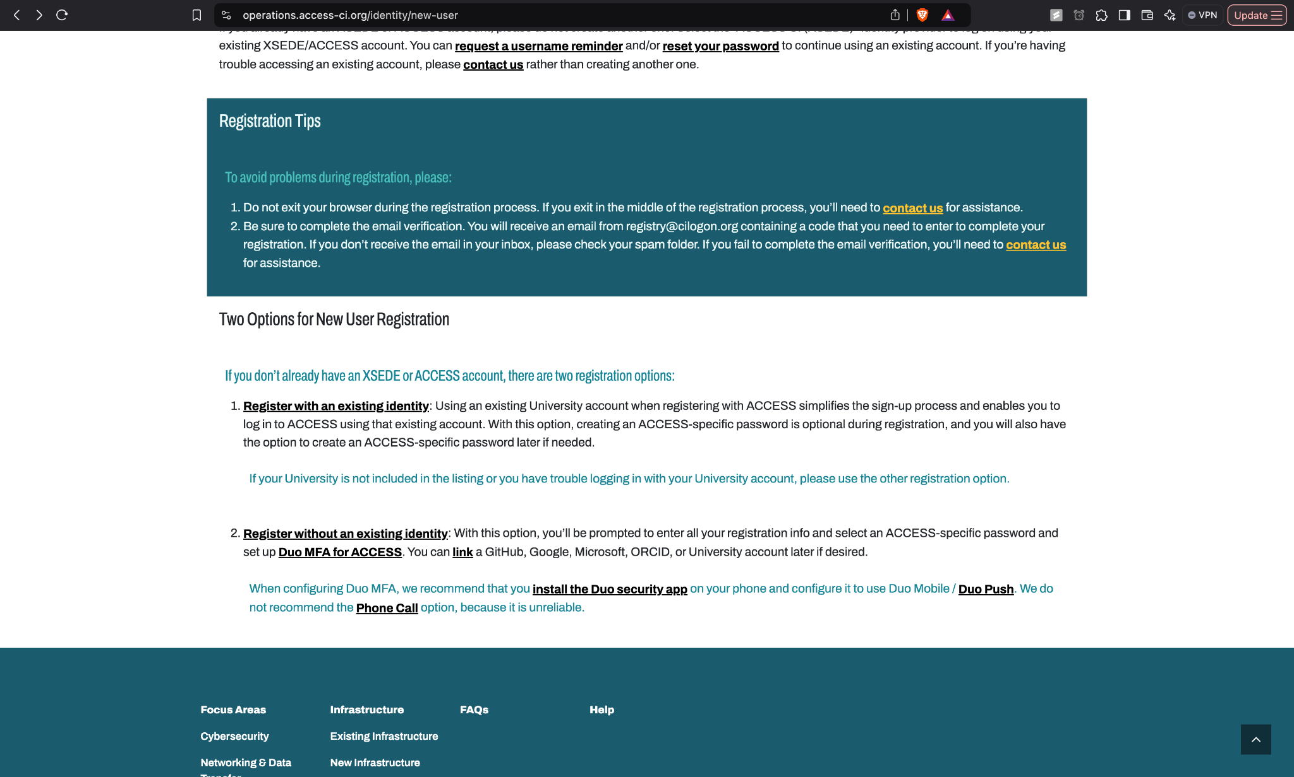
11-785 Introduction to Deep Learning
Apply for the Explore ACCESS Grant
Steps
Sign up on https://identity.access-ci.org/new-user
Sign up here
What is PSC? What are its Grants?
Applying for the ‘Explore’ grant
Managing your grant
Icons from flaticon.com

Slide 4

11-785 Introduction to Deep Learning
Apply for the Explore ACCESS Grant
Steps
The TA assigned to your project can provide you with the advisor letter
Sign up here
Ask TA for advisor letter
What is PSC? What are its Grants?
Applying for the ‘Explore’ grant
Managing your grant
Icons from flaticon.com

Slide 5
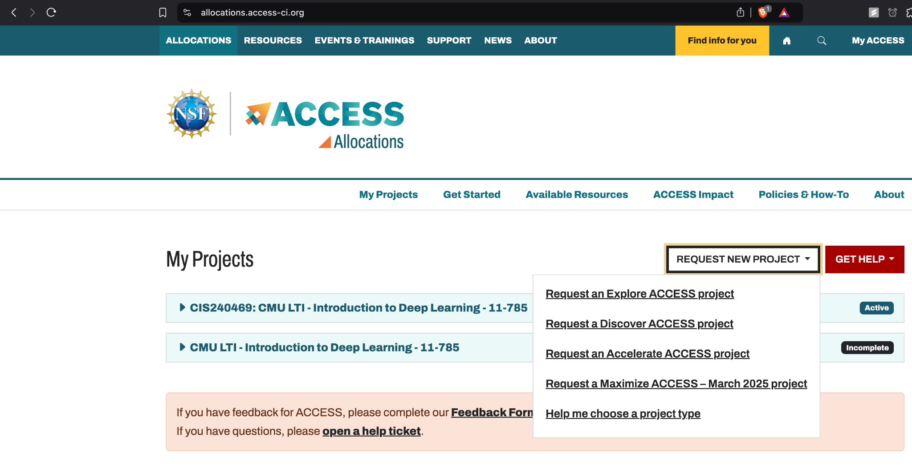

11-785 Introduction to Deep Learning
Apply for the Explore ACCESS Grant
Steps
On the dashboard, Request an Explore ACCESS Project
Sign up here
Ask TA for advisor letter
Request an Explore ACCESS Project
What is PSC? What are its Grants?
Applying for the ‘Explore’ grant
Managing your grant
Icons from flaticon.com

Slide 6
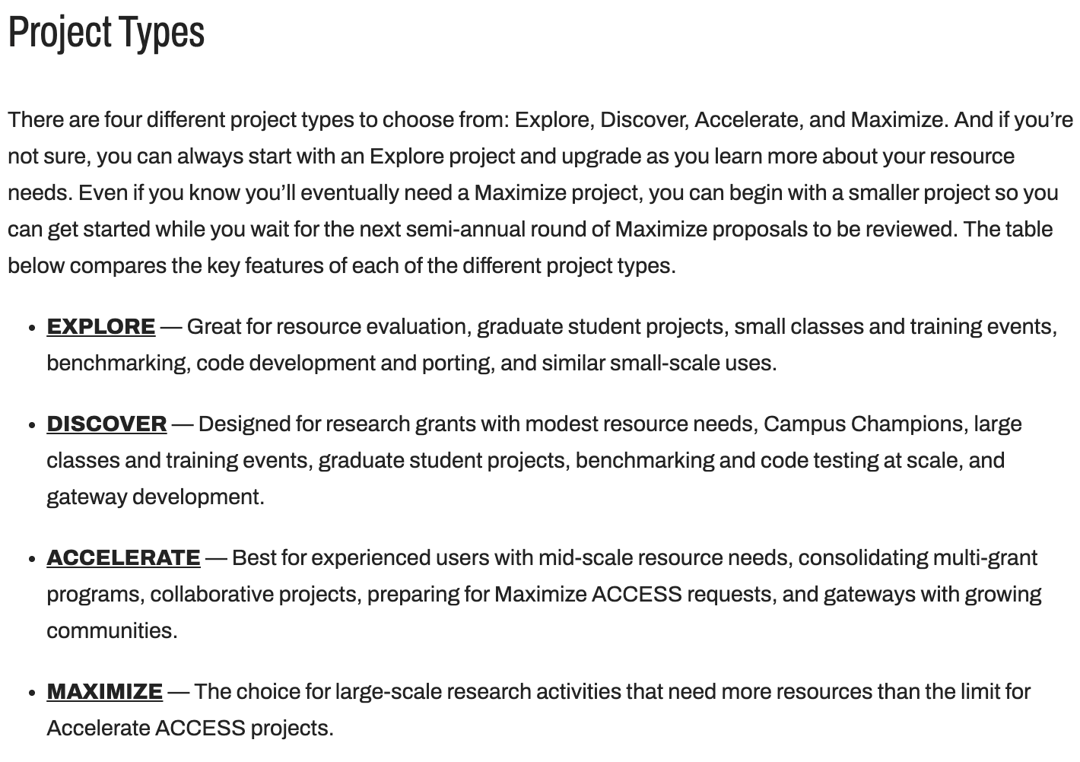
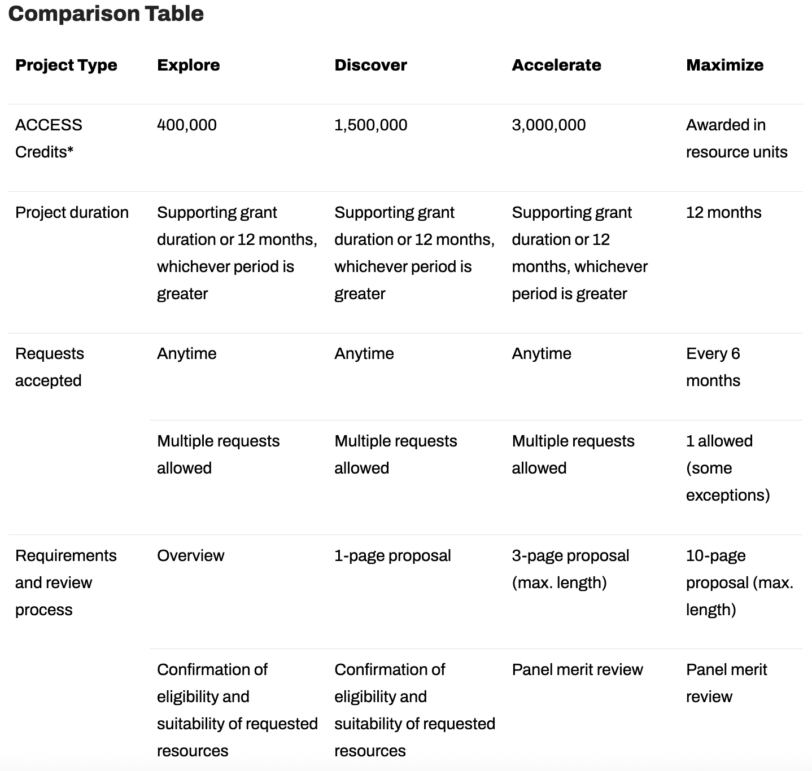
11-785 Introduction to Deep Learning
Apply for the Explore ACCESS Grant
What is PSC? What are its Grants?
Applying for the ‘Explore’ grant
Managing your grant
Icons from flaticon.com
https://allocations.access-ci.org/project-types

Slide 7
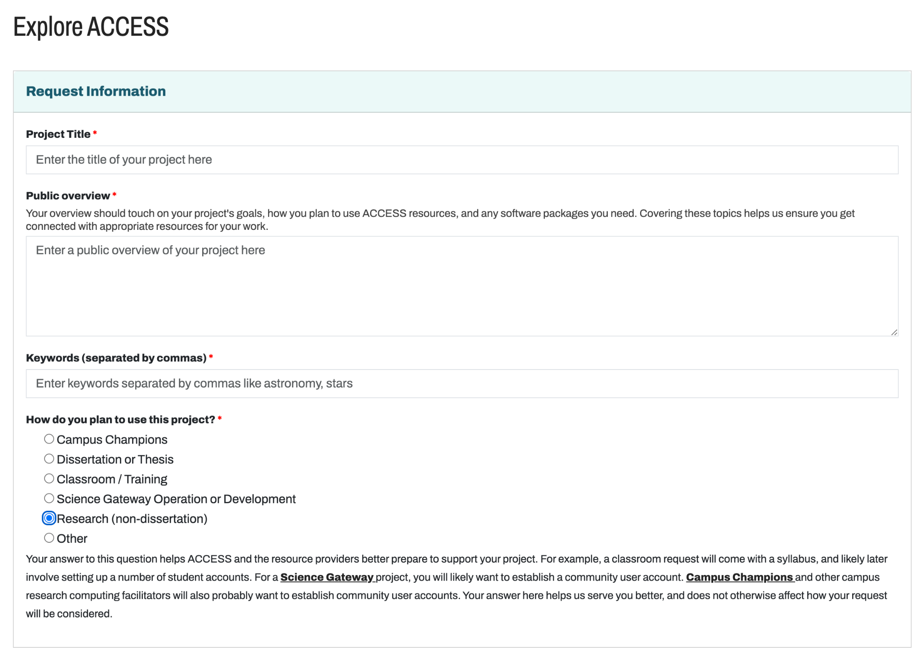
11-785 Introduction to Deep Learning
Apply for the Explore ACCESS Grant
Steps
Fill the details diligently; Public overview matters a lot, focus on it
Sign up here
Ask TA for advisor letter
Request an Explore ACCESS Project
Fill the details diligently
What is PSC? What are its Grants?
Applying for the ‘Explore’ grant
Managing your grant
Icons from flaticon.com

Slide 8
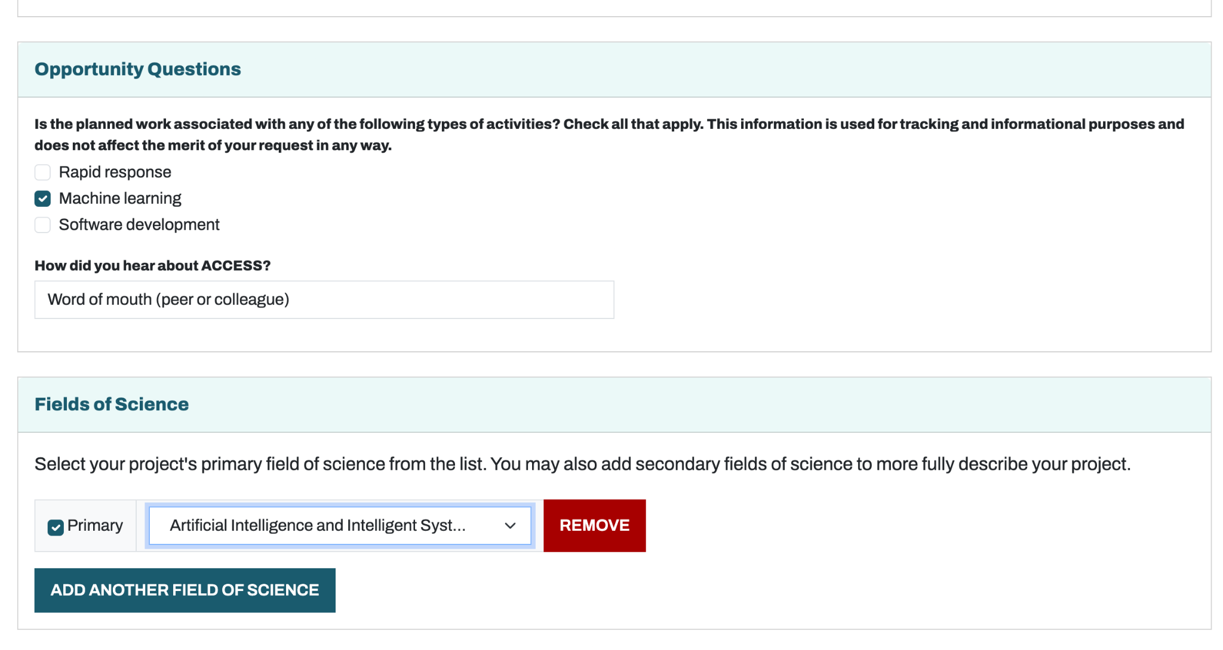
11-785 Introduction to Deep Learning
Apply for the Explore ACCESS Grant
Steps
Pick the following fields
Sign up here
Ask TA for advisor letter
Request an Explore ACCESS Project
Fill the details diligently
Pick the following fields
What is PSC? What are its Grants?
Applying for the ‘Explore’ grant
Managing your grant
Icons from flaticon.com

Slide 9
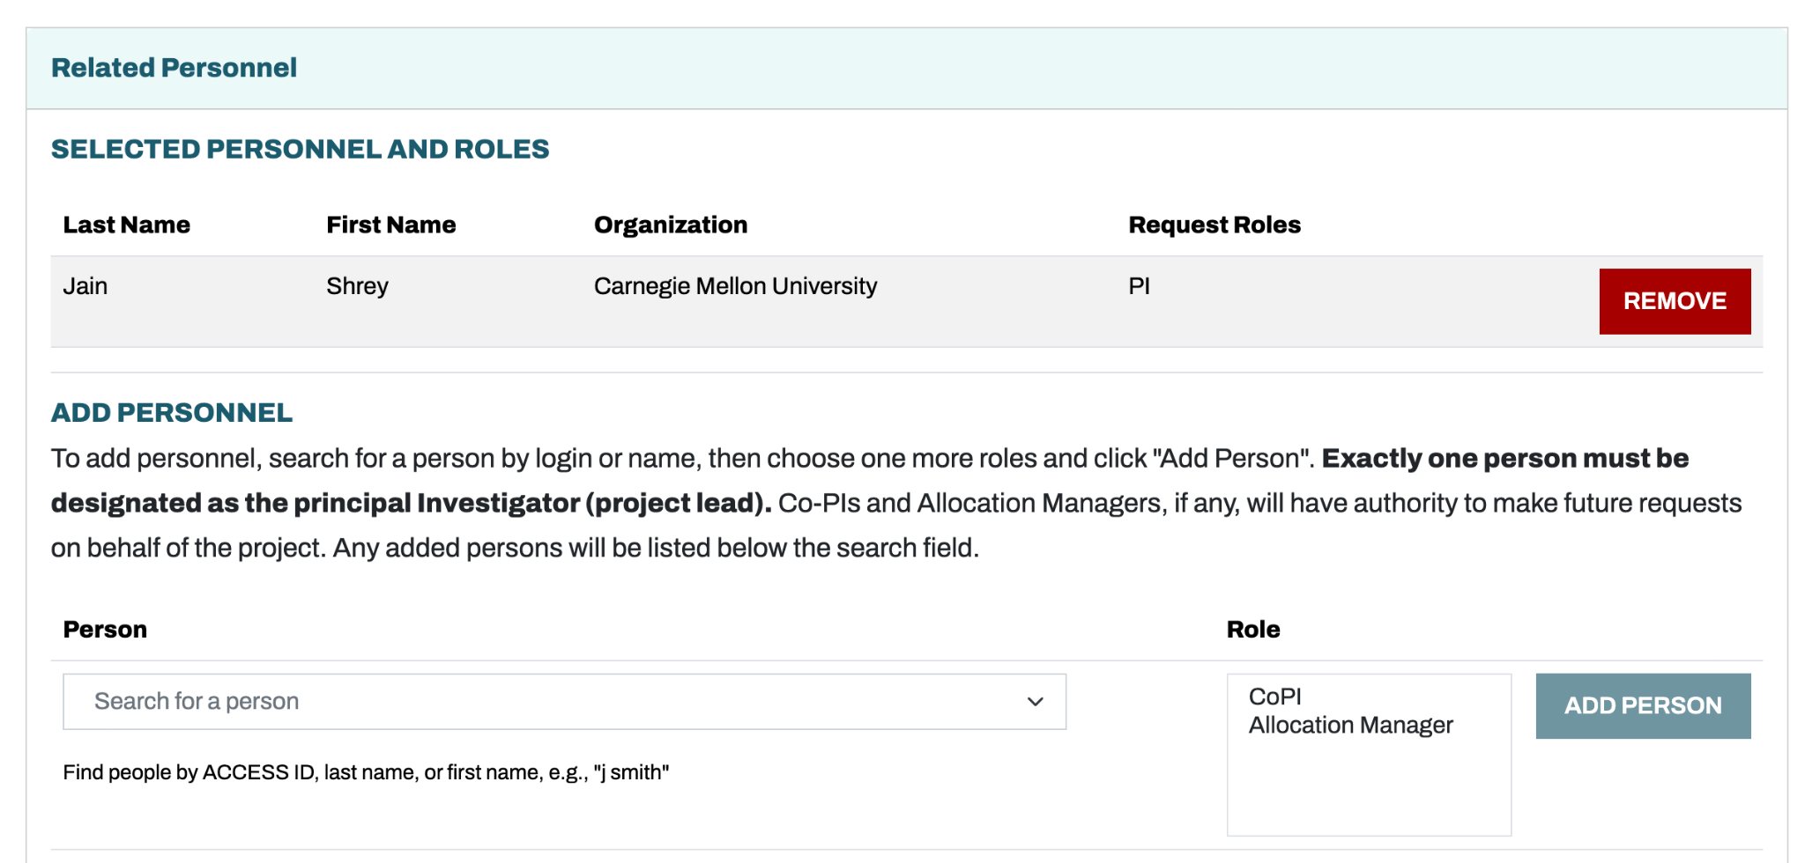
11-785 Introduction to Deep Learning
Apply for the Explore ACCESS Grant
Steps
Add teammates: get them to sign up too and add them
Sign up here
Ask TA for advisor letter
Request an Explore ACCESS Project
Fill the details diligently
Pick the following fields
Add teammates
Note: PI should be graduate-level and based in Pittsburgh
What is PSC? What are its Grants?
Applying for the ‘Explore’ grant
Managing your grant
Icons from flaticon.com

Slide 10
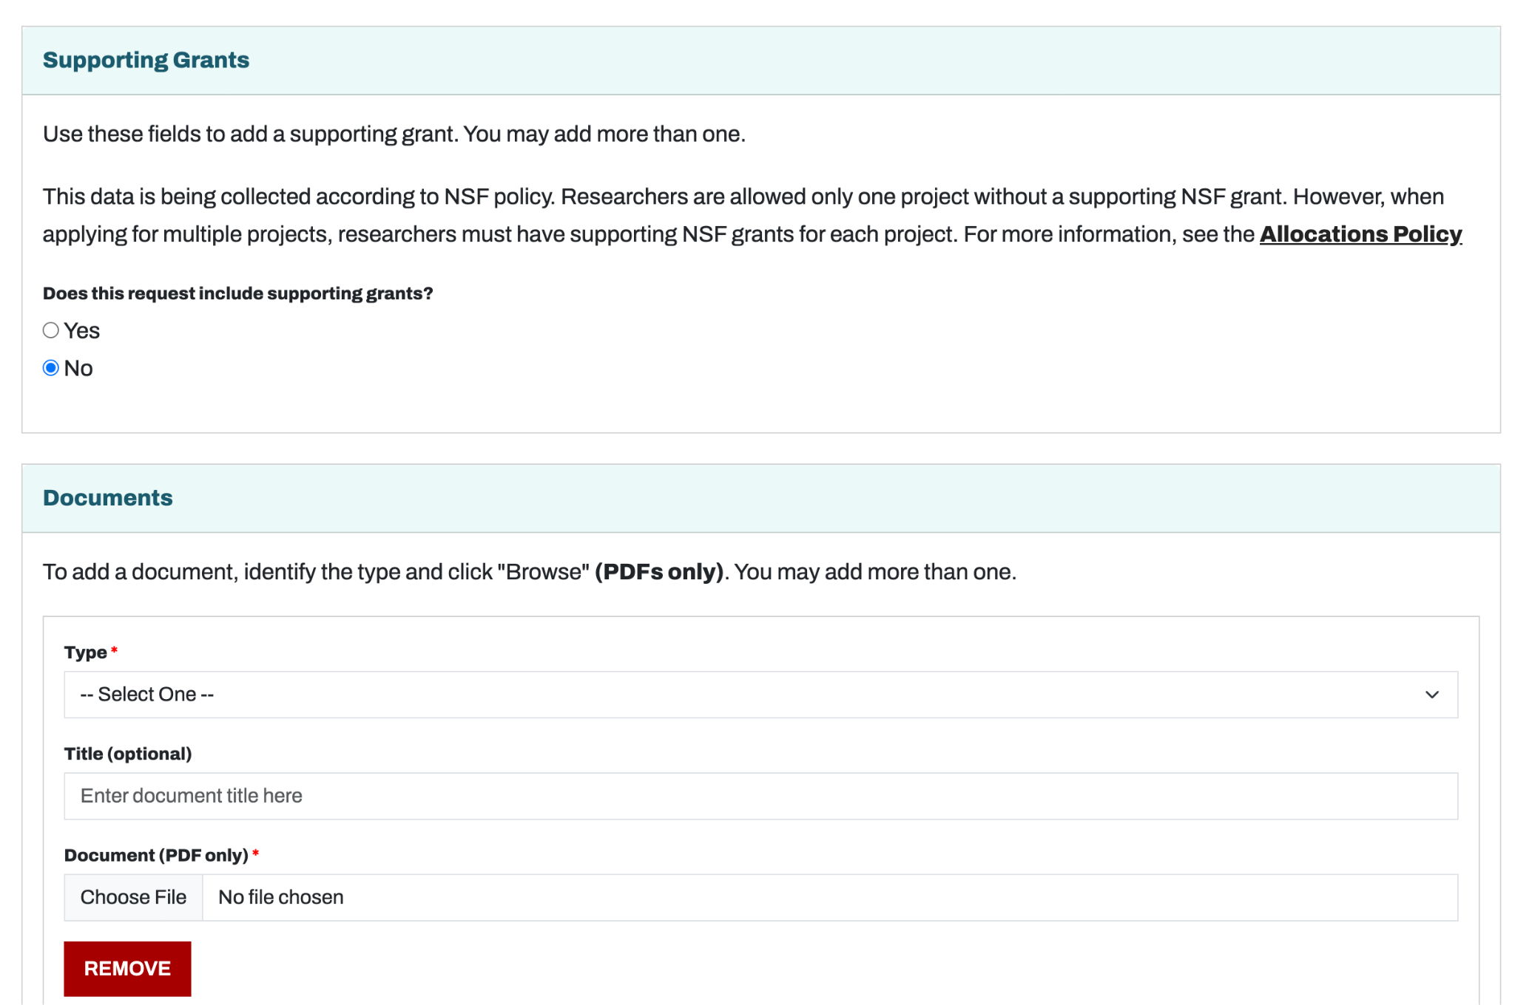
11-785 Introduction to Deep Learning
Apply for the Explore ACCESS Grant
Steps
Add PI Resumes: Add CV for PI and CoPIs (incl. Research projects)
Sign up here
Ask TA for advisor letter
Request an Explore ACCESS Project
Fill the details diligently
Pick the following fields
Add teammates
Add PI Resumes
What is PSC? What are its Grants?
Applying for the ‘Explore’ grant
Managing your grant
Icons from flaticon.com

Slide 11
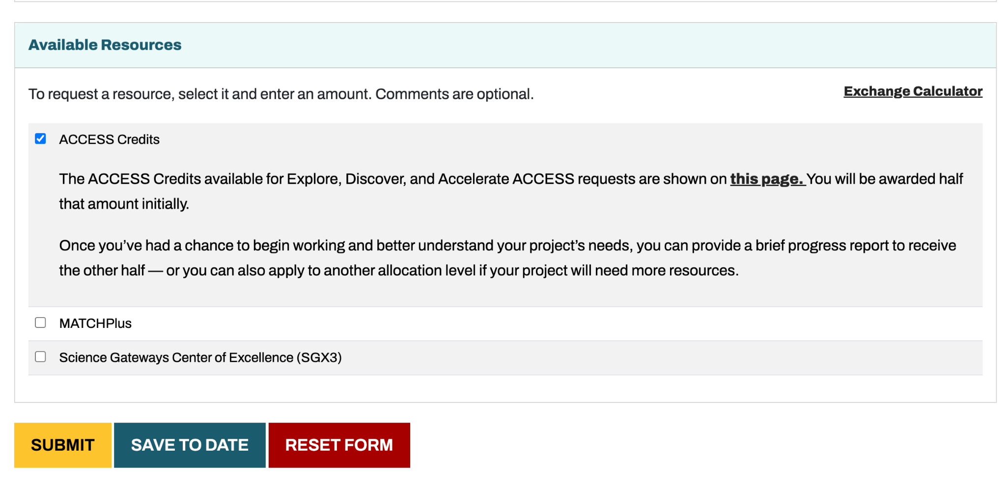
11-785 Introduction to Deep Learning
Apply for the Explore ACCESS Grant
Steps
Select ACCESS Credits
Sign up here
Ask TA for advisor letter
Request an Explore ACCESS Project
Fill the details diligently
Pick the following fields
Add teammates
Add PI Resumes
Select ACCESS Credits
What is PSC? What are its Grants?
Applying for the ‘Explore’ grant
Managing your grant
Icons from flaticon.com

Slide 12
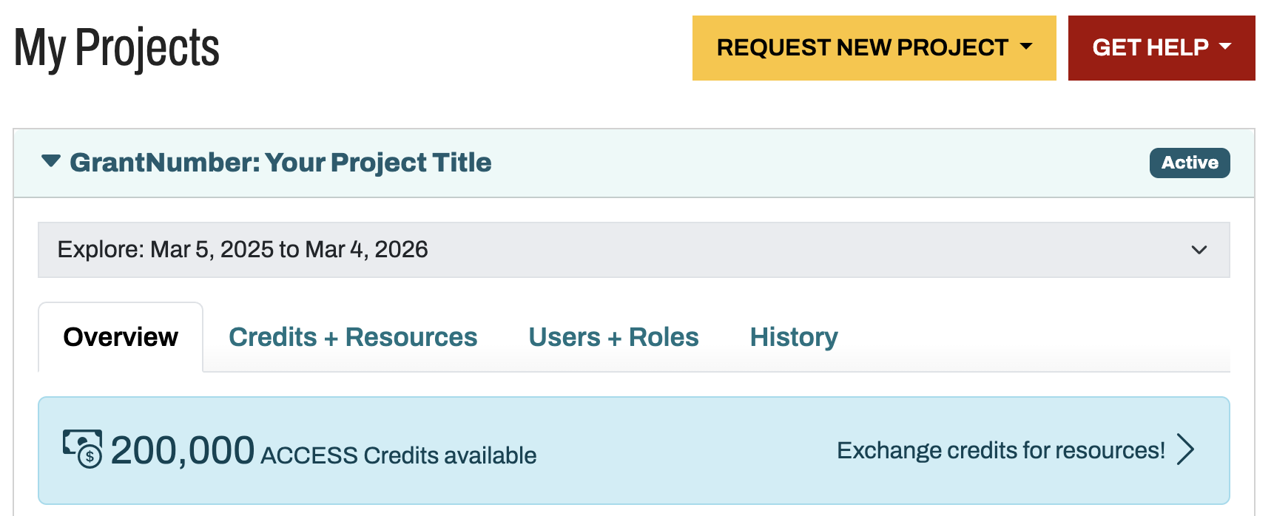

11-785 Introduction to Deep Learning
Managing the Grant: Use Credits to get GPU Hours and Storage
Once grant is given, dashboard shows 200k Credits.
Use these to get both Storage and GPU Hours.
GPU Hours needed = NumProjects * Ablations * NumEpochs * EpochTime
Quick estimate: 200K credits roughly equal to 3700 GPU Hours;
10K credits roughly equal to 1TB storage
What is PSC? What are its Grants?
Applying for the ‘Explore’ grant
Managing your grant
Icons from flaticon.com

Slide 13
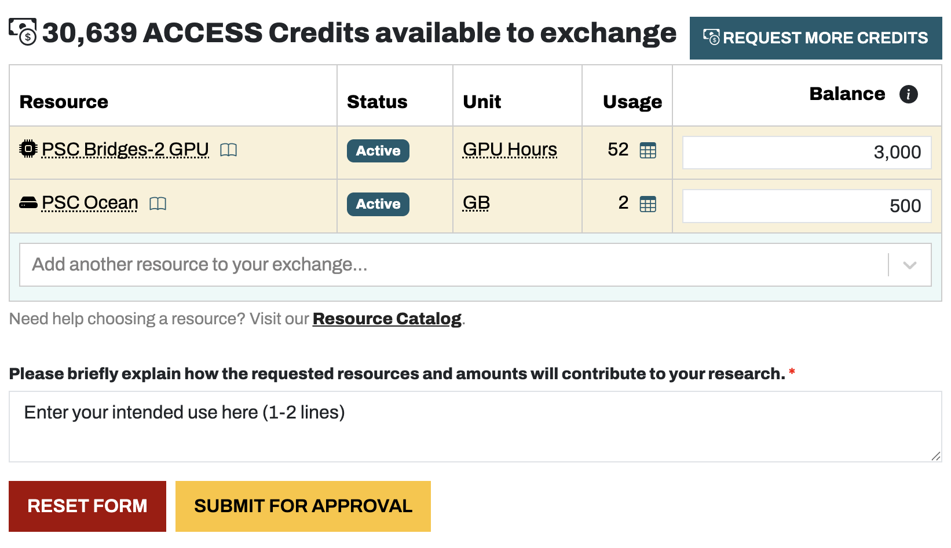
11-785 Introduction to Deep Learning
Managing the Grant: Use Credits to get GPU Hours and Storage
PI / CoPI manage the credits, use it to get GPU and storage
Add IPSC OceanI and IPSC Bridges-2 GPUI
Update your balance (can start with 1000+500)
Add resources
1-2 lines explaining your use case
What is PSC? What are its Grants?
Applying for the ‘Explore’ grant
Managing your grant
Icons from flaticon.com

