Slide 1

Parcel process week 6
G. Ottens
R. Hagenaar
L. vd. Stolpe
E. Açıkgöz
I. Bensaga
I. Böyükşimşek

Slide 2
Content
Accomplishments
Planning Schedule
Questions

Slide 3
Accomplishments
Different kinds of graphs
Number of packages per customer per monthdays
Number of packages per customer per yearmonths
Linear Regression

Slide 4
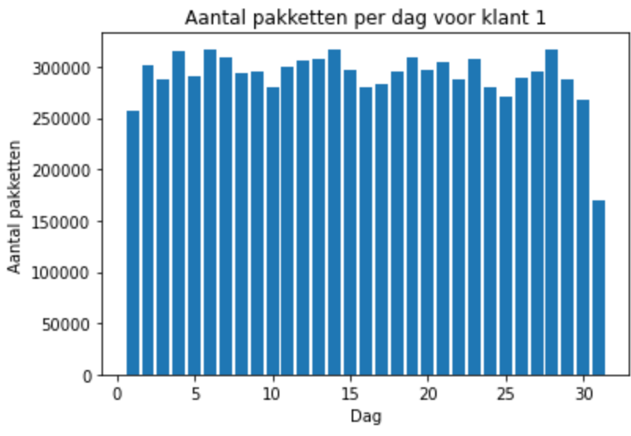
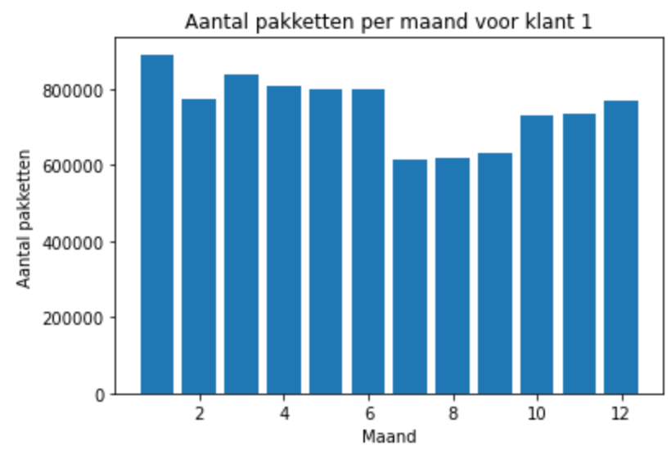

Graphs: monthdays and yearmonths

Slide 5
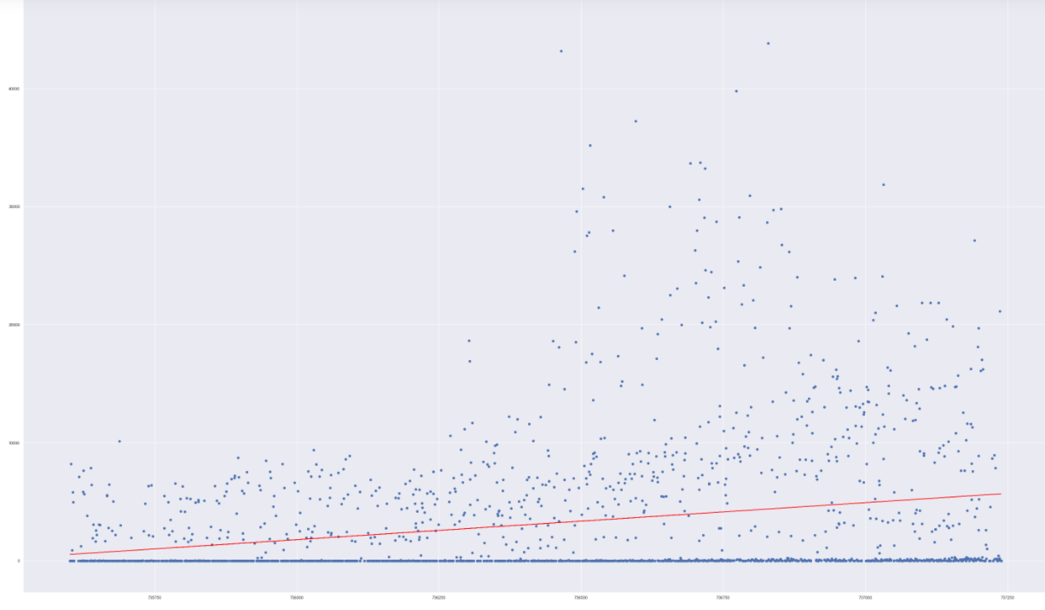
Linear Regression

Slide 6
Planning Schedule
Trello board
Divided in colours

Slide 7
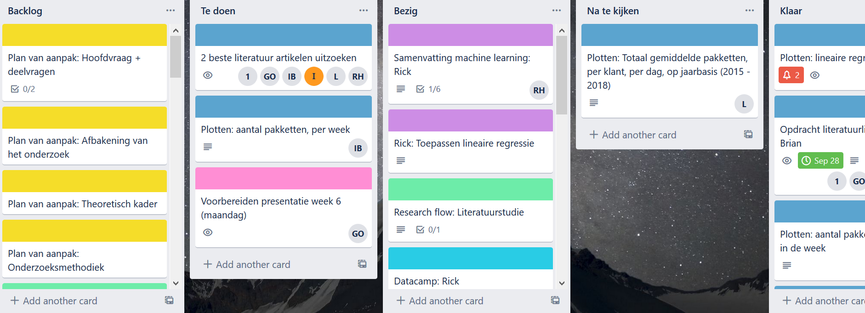
Trello Board

Slide 8

Questions

