Slide 1

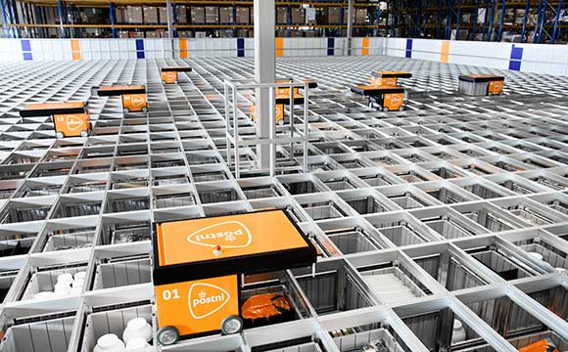
Parcel project
Rick Hagenaar – Software Engineering
Laurine van de Stolpe – Applied Mathematics
Idriss Bensaga – Business and Data Management
Emir Açikgoz – Information Security Management
Ismail Böyükşimşek – Information Security Management
George Ottens – Aviation Engineering

Slide 2
Content
Introduction
Accomplishments during this project
Conclusions
Recommendations
Questions

Slide 3
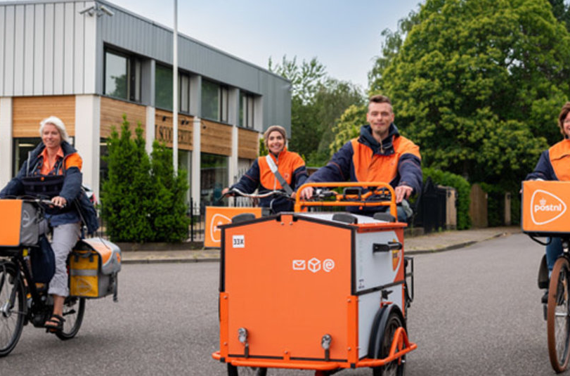
Introduction
Product owner: PostNL (Tim Ottens)
Data: Number of daily packages processed from 300 customers, over the past 5 years
“How can the number of processed packages for the next day be predicted with Machine Learning Models?”

Slide 4
Accomplishments during this project
Time Series: AR, ARMA, ARIMA, SARIMA
Linear Regression: Multivariate Linear Regression Model
Applying different techniques
Applying features to MVLR

Slide 5
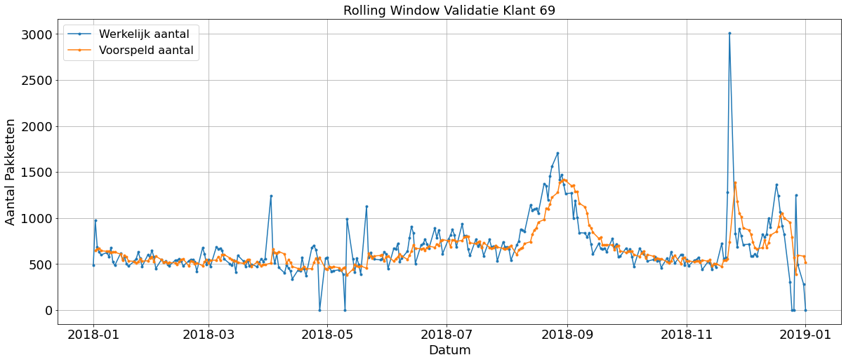
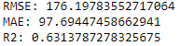
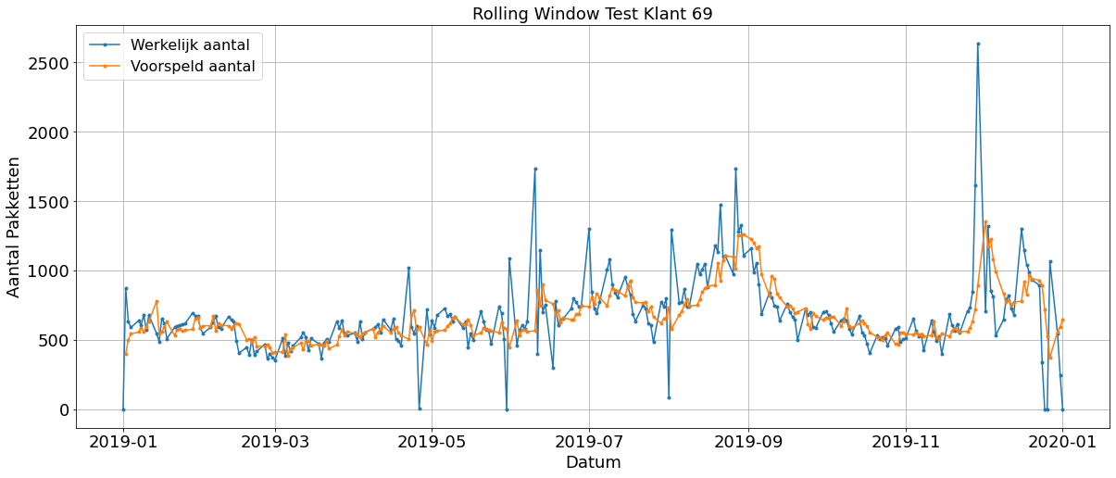
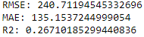
SARIMA

Slide 6
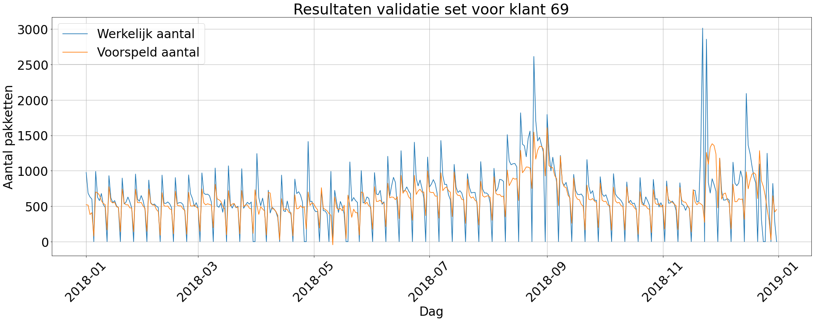

Multivariate Linear Regression

Slide 7
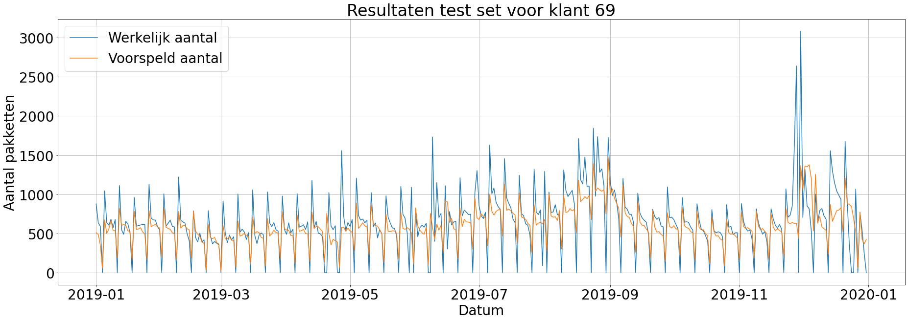

Multivariate Linear Regression

Slide 8
Conclusions
SARIMA:
Follows the trend of packages within basic boundaries
Keeps yearly peaks into account
Deviates from peaks because of the base trend and the 0 values when keeping weekends in
Cannot apply features into the model

Slide 9
Conclusions
MVLR:
Has a grasp on the overal (weekly) pattern of the data
Multiple features can be used for the prediction
Struggles at predicting the peaks, caused by weekends
Difficult to predict inconsistent dates, that deviate from the overal pattern

Slide 10
Recommendations
When applying a model on a Time Series Dataset without implying features, SARIMA is the one to use
When adding multiple features, Multivariate Linear Regression is the better option

Slide 11

Questions

