Slide 1
Web Scraping/Regression Presentation Slides
Predicting Final Sales Price for Single Family Homes in the West San Fernando Valley
George Pappy - 15 September 2021

Slide 2
Introduction
Motivation:
Historic rise in home sales during the COVID-19 pandemic
Prices are at all time highs and still climbing
Local realtors want a reasonably accurate price predictor
Provides a competitive advantage
Prices changing too fast: lack of confidence in their own estimates
→ Wanted: A Decision Support Tool

Slide 3
Methodology
Primary Data: Single Family Home Sales (Past 90 Days)
Excluded Condominiums and Multi-Family Dwellings (different market)
West San Fernando Valley only (18 zip codes covering 13 communities)
Data scraped from a well-known real estate website (10 predictors):
Target: Sale Price
Predictors: Beds, Baths, Square Footage, Lot Size, Year Built, Zipcode, Pool, Garage, Number of Stories (Floors), Average Schools Rating

Slide 4
Methodology (con’t.)
Supplemental Data: Downloadable csv (same website):
Homeowners Association Fee (HOA, monthly)
Number of Days on Market (could be an alternate target, NOT a predictor)

Slide 5
Methodology (con’t.)
Models: Linear Regression with & without Regularization
Lasso, Ridge, ElasticNet
Also tried tree-based regressors (Random Forest, XGBoost)
Extensive feature engineering to improve performance
Metrics
Primarily Mean Absolute Error (MAE, $)
Also, R² and Root Mean Square Error (RMSE, $)

Slide 6
Methodology (con’t.)
Tools
Requests/BeautifulSoup: web scraping
Pandas: clean, explore, engineer features and generate final modeling data
Statsmodels/ScikitLearn: build regression models as well as to perform cross validation, variable selection and regularization
Matplotlib/Seaborn: visualizing data exploration, modeling and final results
Python 3.8: to run all of the above

Slide 7
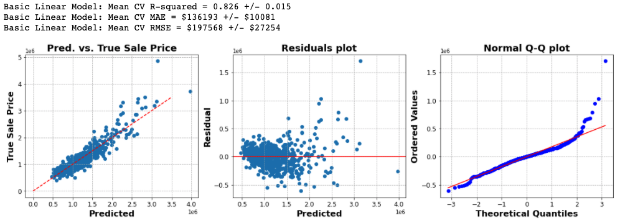
Cross Validation Results – (Model Selection)
Initial Linear Model (Baseline)
(11 predictors → 26 predictors after one-hot encoding the distinct zipcodes)
Should be able to do better than this

Slide 8
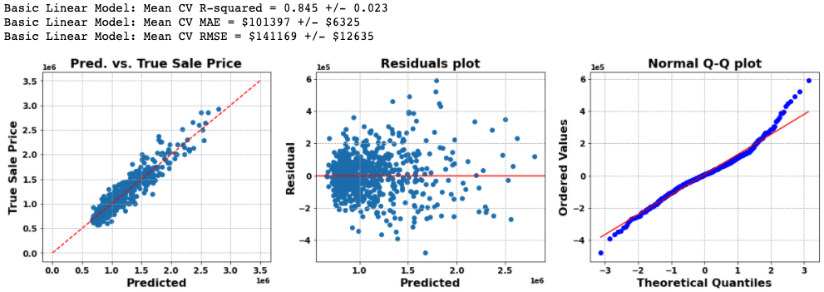
Cross Validation Results – (Model Selection)
Best Linear Model: ElasticNet
All 2nd-order terms & interactions filtered down to 58 Lasso-selected predictors; log(target)
Much better!

Slide 9
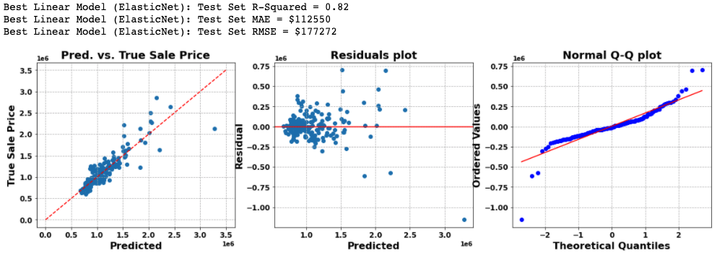
Test Set Results – Final Selected Model
Best Linear Model: ElasticNet
All 2nd-order terms & interactions filtered down to 58 Lasso-selected predictors; log(target)

Slide 10
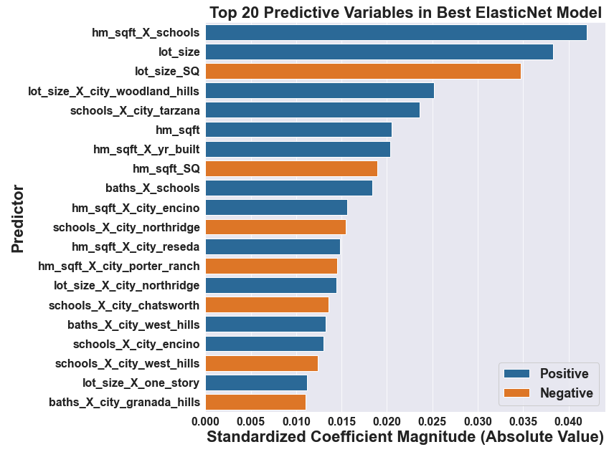
Test Set Results – Final Selected Model

Slide 11
Test Set Results – Final Selected Model
Square Footage, Lot Size & Schools Rating play very important roles in this model’s predictions
Initial Exploratory Data Analysis (EDA) showed high correlation to the target for Square Footage and Lot Size
Schools Rating had much weaker target correlation (0.36), so this is an interesting result

Slide 12
Test Set Results – Final Selected Model
Best Linear Model: ElasticNet
All 2nd-order terms & interactions filtered down to 58 Lasso-selected predictors; log(target)
Oops!

Slide 13
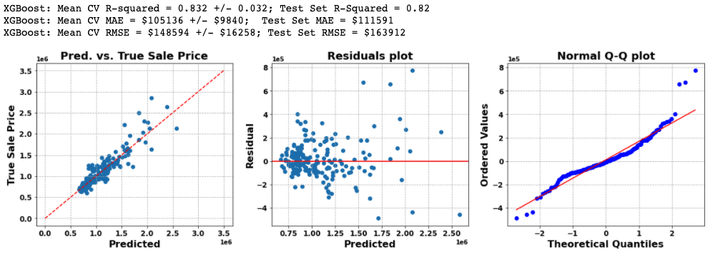
Test Set Results – Other Final Selected Model
Best Tree-Based Model: XGBoost
All 2nd-order terms & interactions filtered down to 58 Lasso-selected predictors; log(target)

Slide 14
Conclusions
Recommendations
If possible, use the XGBoost model in the short term
Longer-term, seriously consider funding the future work (see below)
Interesting Insights
Square Footage, Lot size, School Rating are the most important predictors
Square Footage is a proxy for Beds and Baths
Future Work
Create a Home Rating categorical predictor (e.g., {Poor, Fair, Good, Excellent})
Train, cross validate & test with more data (maybe scrape the entire Valley)
Consider narrowing the price range down even more (perhaps <= $2Mil)
Build a predictive model for the alternate target: Number of Days on Market

Slide 15
Appendix

Slide 16
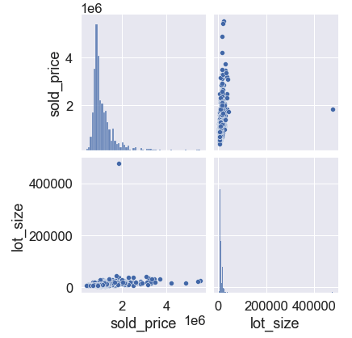
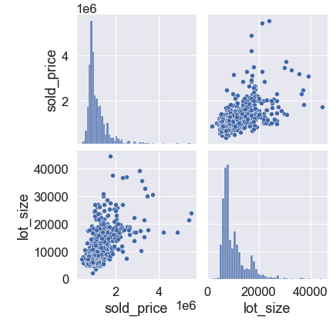
One Obvious Initial Outlier Was Dropped
One home (out of 1011) had a Lot Size more than 10x that of any other
Drop the outlier

Slide 17
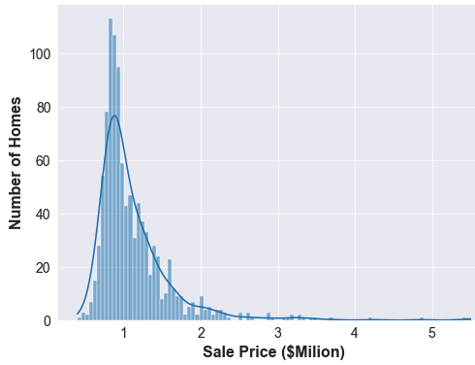
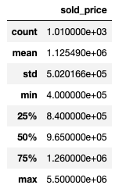
Distribution of Sale Prices in Dataset
Dropping prices outside of [$575k, $3.0M] is justified by this distribution (even dropping prices ≥ $2.0M is probably reasonable)

Slide 18
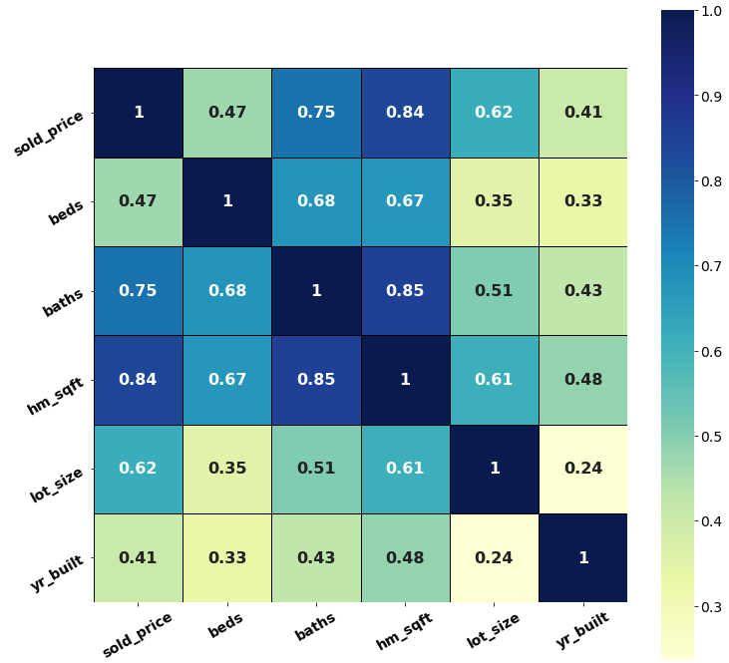
Original Data Correlations w/ Sales Price
Square Footage, Baths and Lot Size are by far the strongest correlations
Note strong correlations between:
Beds & Baths
Sq. Footage & Beds
Sq. Footage & Baths

Slide 19
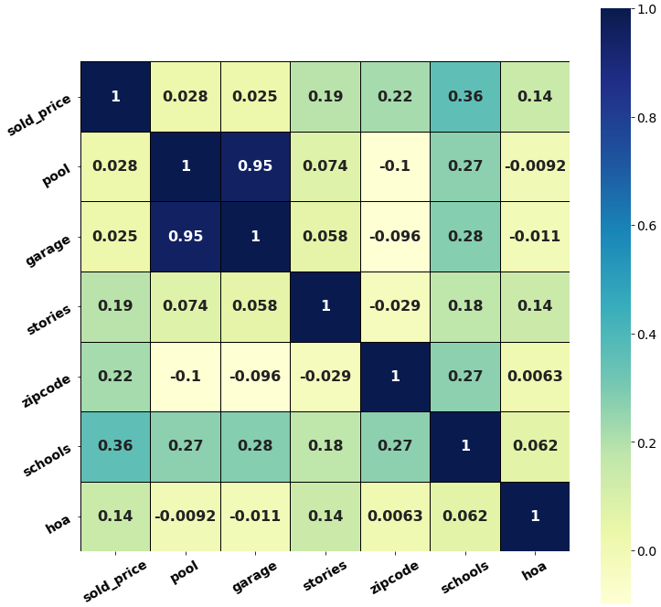
Original Data Correlations w/ Sales Price
Schools Rating has a fairly weak correlation with the target
All other correlations to the target are weak or very weak
Note: Pool and Garage are highly correlated with each other, leading to the decision to drop Pool from the modeling dataset

Slide 20
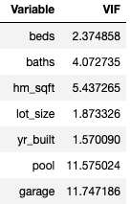
No Real VIF Issues w/ Beds/Baths/Sq. Feet
Despite strong correlations between Beds, Baths & Square Feet, their VIFs are not really an issue
Decision was made to accept VIF of 5.44 for Square Feet (barely > 5.0)
No surprise that Pool & Garage have such high VIFs given 0.95 correlation (justifying decision to drop Pool from the dataset)

Slide 21
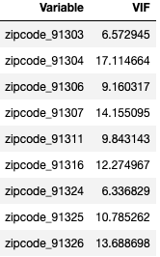
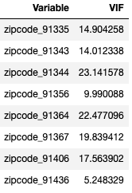
High VIFs in One-Hot Encoded Zipcodes
Variance Inflation Factors (VIFs) surprisingly high for the Zipcodes
Ideally want all VIFs < 5 (as is true for the other variables)
Idea: try reducing 18 Zipcodes down to 13 communities (some of which contain multiple Zipcodes)

Slide 22
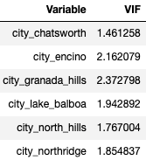
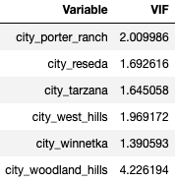
Zipcodes Mapped to Cities: VIFs Much Better!
Simply mapping 18 Zipcodes to their 13 associated city (community) names and one-hot encoding those variables solves the high VIF problem!

Slide 23
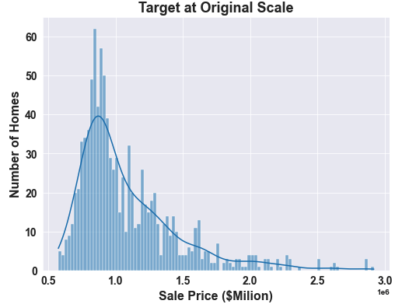
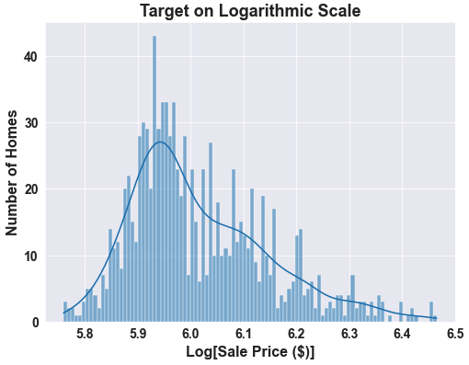
Log-Transforming Target Improved Model
Log-transformed target less skewed, improving model performance

Slide 24
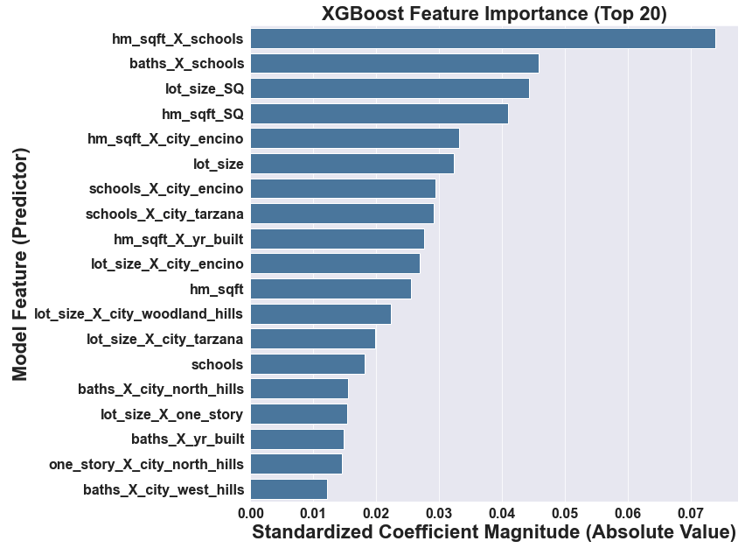
XGBoost Model– Variable Importance
Square Footage, Lot Size & Schools Rating also play very important roles in this model’s predictions
Initial Exploratory Data Analysis (EDA) showed high correlation to the target for Square Footage and Lot Size
Schools Rating had much weaker target correlation (0.36), so this is an interesting result

