Slide 1
MSAR Findings
By: George Phung

Slide 2
Introduction
I scrapped the Medical School Admission Requirements Report for Applicants and Advisors’ PDF file to extract the dataset and answer questions regarding online biochemistry.
I asked various questions about the PDF
I took notes on interesting things within the table

Slide 3
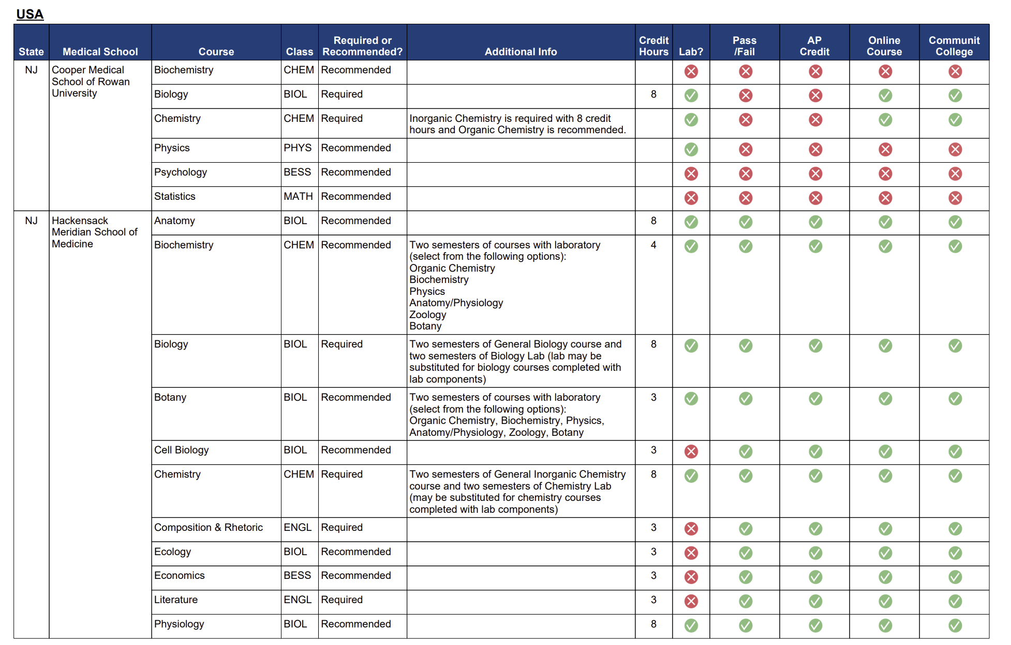
Data Parsing
The data was originally stored in PDF with tables
Steps taken to parse:
Took all images within the tables using pdfplumber
Extracted the RGB value of each image and assigned it to a value depending on the RGB values
Used Camelot to extract the text from the table
A key challenge was that some pages did not have a header above
Data outputted as a .csv containing its raw data and a .xslx with filtered data

Slide 4
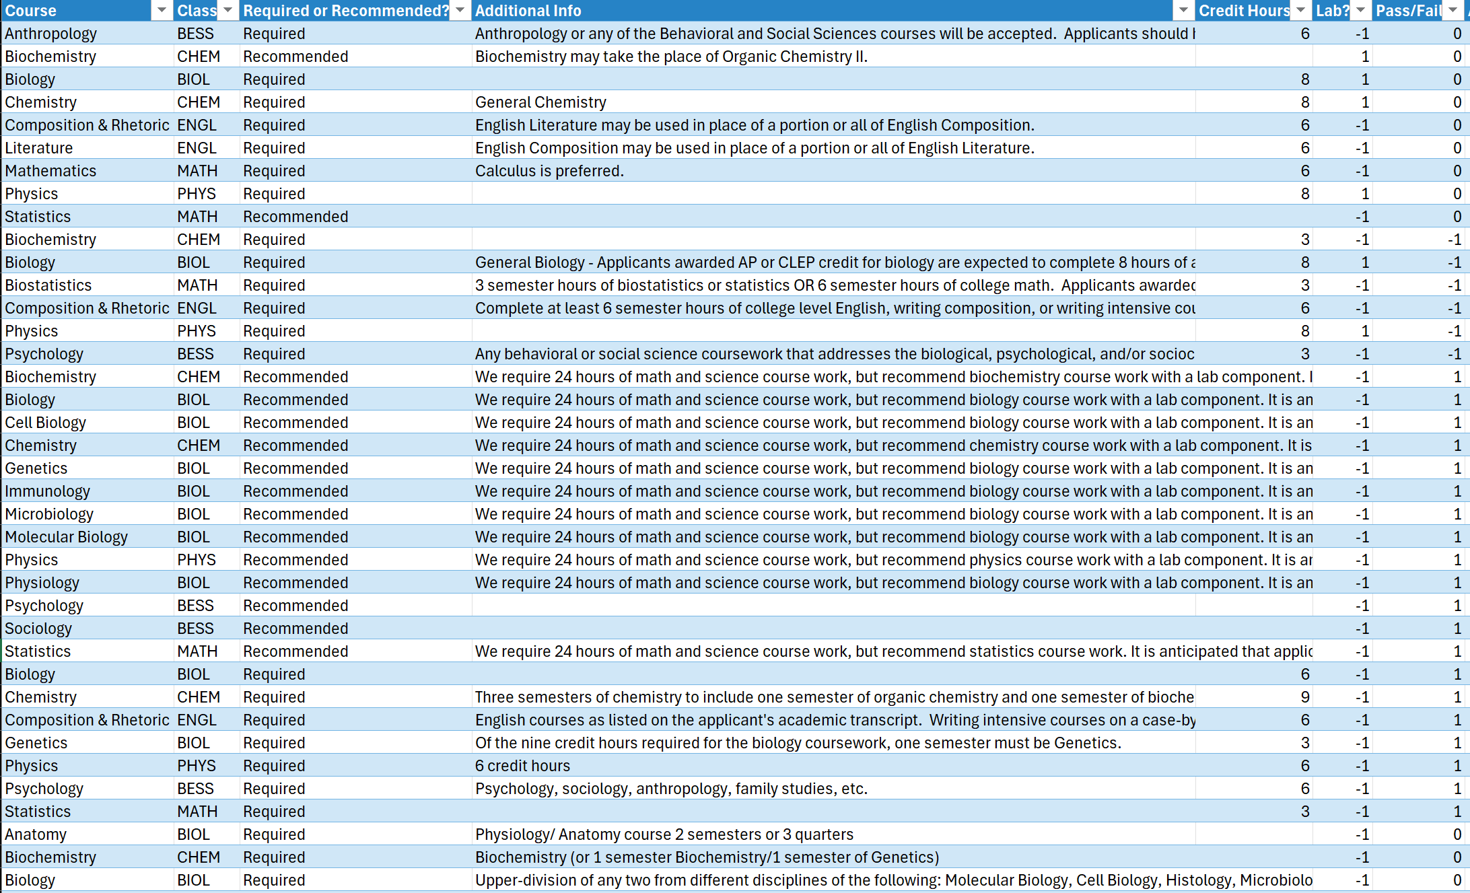
A look at the raw data extracted
Column names:
Course
Class
Required or Recommended?
Additional Info
Credit H0urs
Lab?
Pass/Fail
AP Credit
Online Course
Community College
This dataset contains 1170 rows and 12 columns

Slide 5
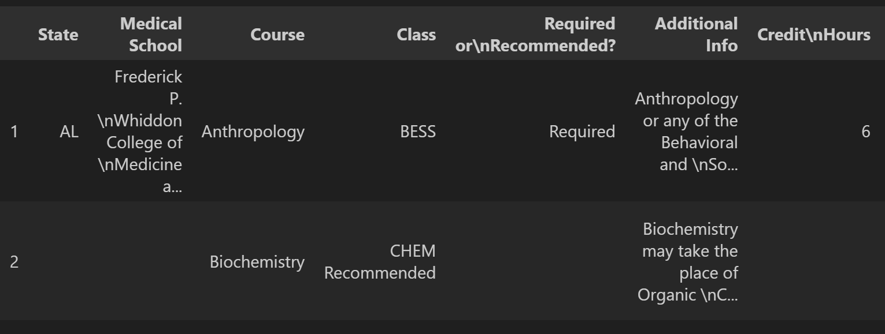
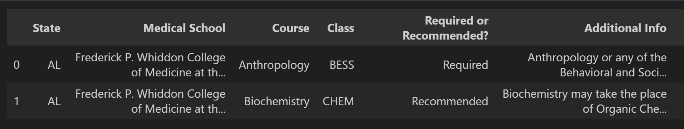
Data Cleaning
Before cleaning:
After cleaning:

Slide 6
Pre-Data Analysis findings
In the Additional Info section, a quarter refers to a 10-week academic “session” compared the semester where a session typically lasts for 15 weeks
“BESS” under the Class column denotes Behavioral and Social Sciences coursework
Some medical schools uses AMCAS guidelines to determine which courses are eligible are not
Some medical schools accept online course credit, given if it was during the COVID-19 pandemic
Most schools require 1 academic year of physics, English, chemistry, and biology
This dataset also includes medical schools that are in Canada and Puerto Rico

Slide 7
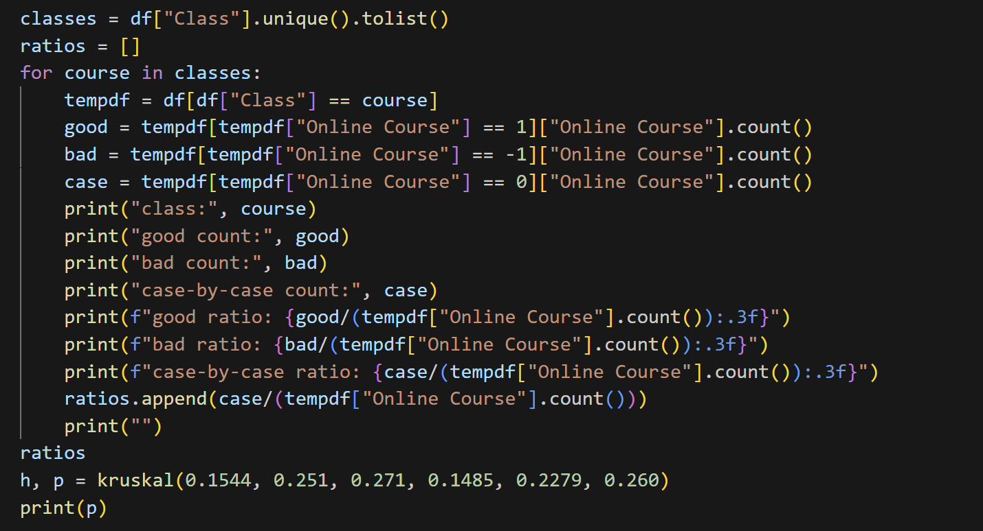
Data Analysis
I created code for the following statistics:
Mean
Comparison to states
Comparison across courses
Did a Kruskal-Wallis test on the courses

Slide 8
Basic statistics
Schools with online BCHM:
Schools that allow online BCHM: 76 (59.4%)
Schools that do not allow online BCHM: 24 (18.4%)
Case-by-Case: 28 (21.9%)
Schools with CC BCHM:
Schools that allow BCHM from CC: 101 (78.9%)
Schools that do not allow BCHM from CC: 16 (12.5%)
Case-by-Case: 11 (8.6%)

Slide 9
Other classes
Schools with online BESS:
Schools that allow online BESS: 10 (52.6%)
Schools that do not allow online BESS: 2 (10.5%)
Case-by-Case: 7 (36.8%)
Schools with online BIOL:
Schools that allow online BIOL: 200 (59.0%)
Schools that do not allow online BIOL: 47 (13.9%)
Case-by-Case: 92 (27.1%)
A Kruskal-Wallis test found no significant relationship between course type and medical-school acceptance ratios (p = 0.41)

Slide 10

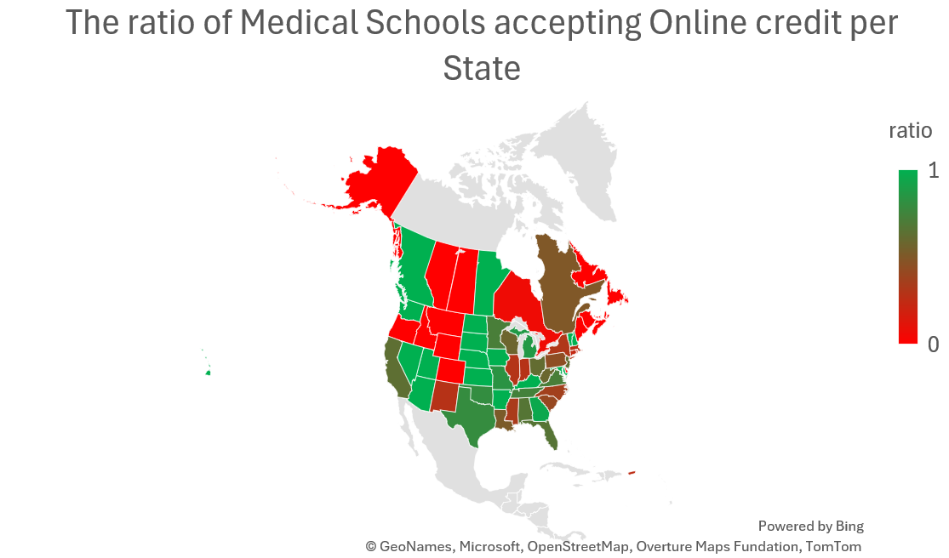
Visualizations

Slide 11
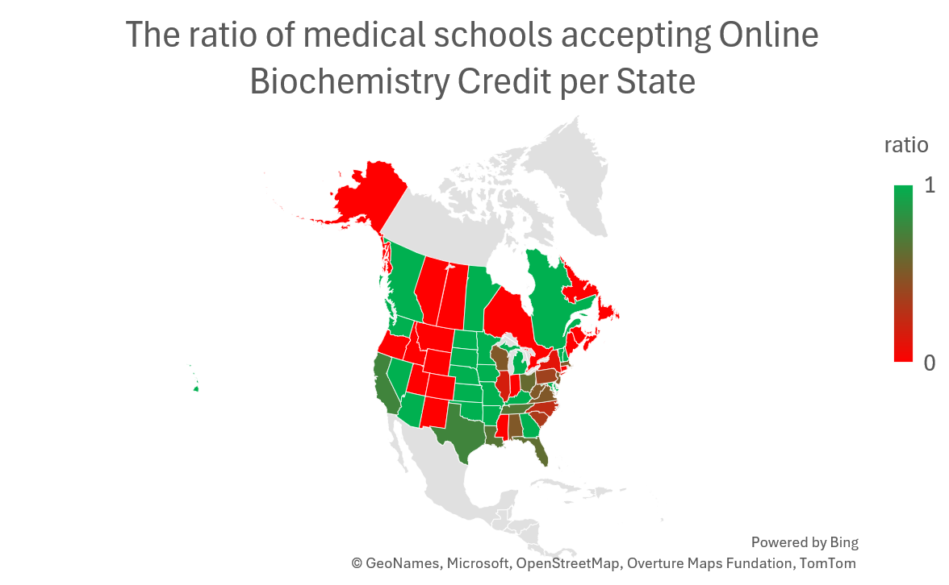

Slide 12
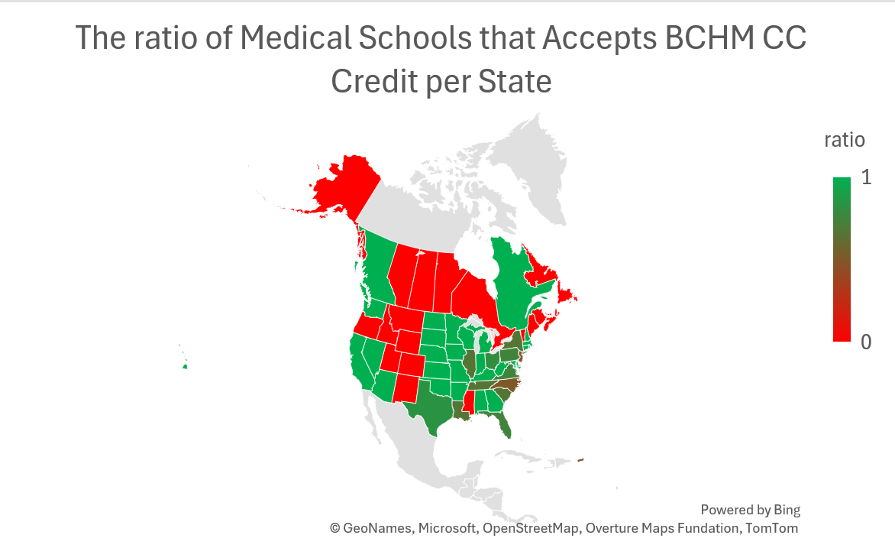

Slide 13
Key Insights and Findings
We can see that for online biochemistry credit, the ratio is lower in the East coast
There are many states in the Midwest that do not have any medical schools that accept both online and community college biochemistry credit
The general ratios of CC biochemistry credit is generally higher than online course biochemistry credit

Slide 14
Conclusion
Community College credit is generally more accepted for college credit compared to online credit
There exists a regional difference, students living in the Midwest does not have as many opportunities compared to students living in the East coast

Slide 15
Data Outputs
Data stored as
Excel file(s)
data_table.xlsx – has the raw data + some extra filtered tables
unique_courses.xlsx – counts of each unique course
CSV files
MSAR_table.csv – raw data
edited_MSAR_table.csv – raw data w/ edited class columns to be more specific

Slide 16
What’s next?
We can look at the Required or Recommended Column
We can join a data set containing the median MCAT score accepted
Do medical schools who accept AP credit for a class also accept AP credit for another class?

Slide 17
Thank you! Github repo: https://github.com/georgephung123/MSAR_Course_Consult

