Slide 1


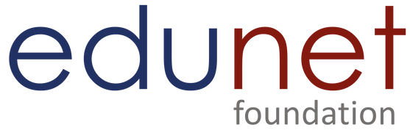

NEXT GEN EMPLOYABILITY PROGRAM
Creating a future-ready workforce
Team Members
College Name
Student Name : Balasanthosh
Info Institute of Engineering
Student ID : au711021205003

Slide 2

CAPSTONE PROJECT SHOWCASE
Next Gen Employability Program
Project Title
Notes Sharing Web Application using Django Framework
Abstract | Problem Statement | Project Overview | Proposed Solution | Technology Used | Modelling & Results | Conclusion

Slide 3
Next Gen Employability Program
Abstract
Spark your productivity with Spark, a dynamic notes app built with seamless collaboration in mind. Leverage the power of Django to create, organize, and share notes in a secure and intuitive environment. Register and log in with confidence, knowing your data is protected by robust user authentication.
Spark empowers you to organize your thoughts with ease. Create notes effortlessly, categorize them into folders for clarity, or tag them for lightning-fast retrieval. Unleash the power of real-time collaboration: work alongside your team on the same note, witnessing changes sync instantly. Never lose a thought again – version control meticulously tracks revisions, ensuring data integrity.
Source :

Slide 4
Next Gen Employability Program
Problem Statement
Firstly, existing note-taking apps often prioritize individual use over collaborative functionality. While they excel at capturing personal ideas and thoughts, they lack the necessary tools for real- time co-creation. Imagine a team brainstorming session where notes are scattered across individual devices, hindering the flow of ideas and hindering the ability to build upon each other's thoughts. This siloed approach stifles knowledge sharing and hinders collective productivity.
Secondly, traditional note-taking apps frequently suffer from inadequate organization structures.
Limited categorization options or clunky tagging systems can quickly lead to a digital graveyard of unorganized notes. Finding that crucial piece of information becomes a time-consuming treasure hunt, frustrating users and delaying progress. A truly effective note-taking solution should offer intuitive organization tools that allow for easy categorization, filtering, and retrieval, ensuring critical information is readily accessible.
Source :

Slide 5
Next Gen Employability Program
Project Overview
The modern workplace thrives on the exchange of ideas and collaborative efforts. Yet,
many note-taking applications remain stuck in a siloed past, hindering the very processes they're intended to support. Spark, a collaborative notes app built with the Django framework, emerges as a solution, aiming to ignite a new era of streamlined communication and knowledge sharing.
Current note-taking solutions often prioritize individual use over collaborative functionality.
Imagine a brainstorming session where ideas flit across a room, only to be captured on isolated devices. Spark bridges this gap by enabling real-time co-editing. Teams can work seamlessly on the same note, witnessing changes sync instantly. This fosters a dynamic environment where ideas build upon each other, fostering innovation and collective progress.
Source :

Slide 6
Next Gen Employability Program
Proposed Solution
Secure Login: The Foundation of Trust
Time Travel for Notes: The Power of Version Control Finding the Needle in the Haystack: Advanced Filtering Building a Fortress: Unwavering Security
Designed for Ease: Intuitive UsabilityCollaboration
A Symphony of Minds: Seamless Collaboration
Source :

Slide 7
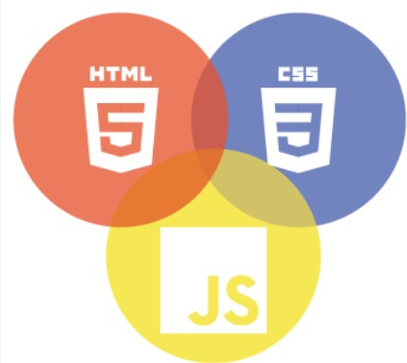
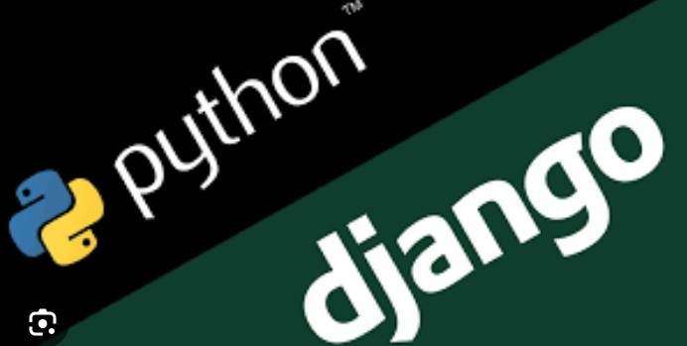
Next Gen Employability Program
Technology Used
Front-end
Back-end
Source :

Slide 8
Next Gen Employability Program
Modelling & Results
Imagine a bustling orchestra, each instrument playing its part to create a harmonious symphony. Similarly, Spark's data model functions as the silent conductor, orchestrating the intricate relationships between users, notes, collaboration features, and access controls. This essay delves into the core of Spark, exploring the design choices and their resounding results in creating a reliable and scalable platform for collaborative note-sharing.
At the heart of the symphony lies a well-defined data model, implemented using Django's Object-Relational Mapping (ORM) capabilities. This approach translates real-world entities like Users, Notes, Collaborations, Permissions, and Tags into a structured language understood by the database. Each entity plays a specific role, contributing to the overall functionality of the platform.
Source :

Slide 9
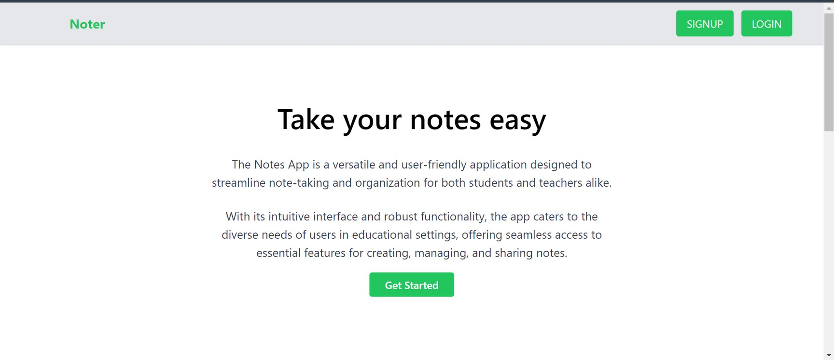
Next Gen Employability Program
Home-page

Slide 10
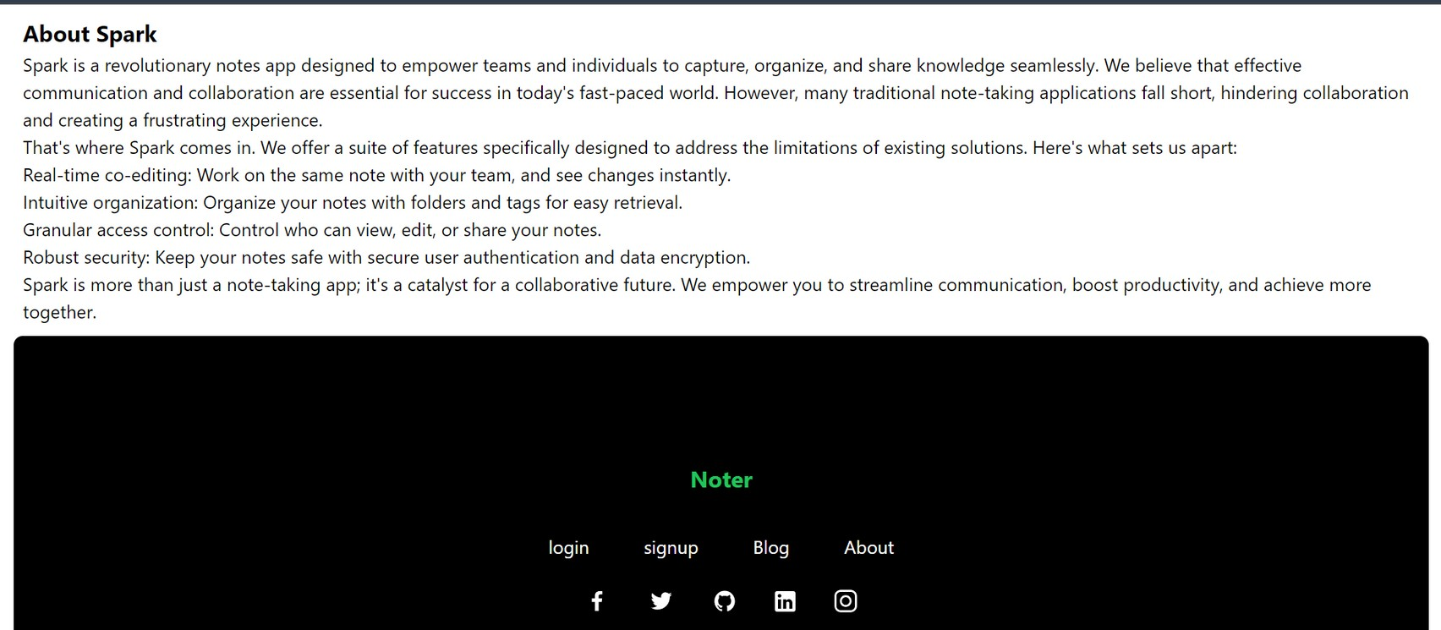
Next Gen Employability Program
About-Us-Page

Slide 11
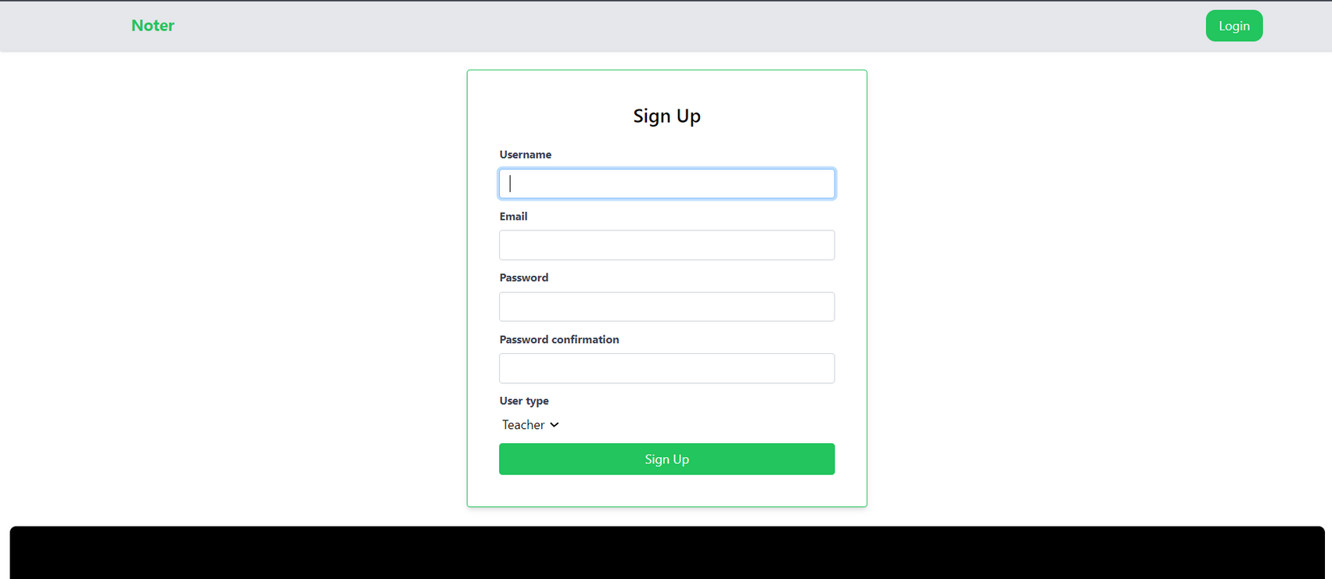
Next Gen Employability Program
Sign up-Page

Slide 12
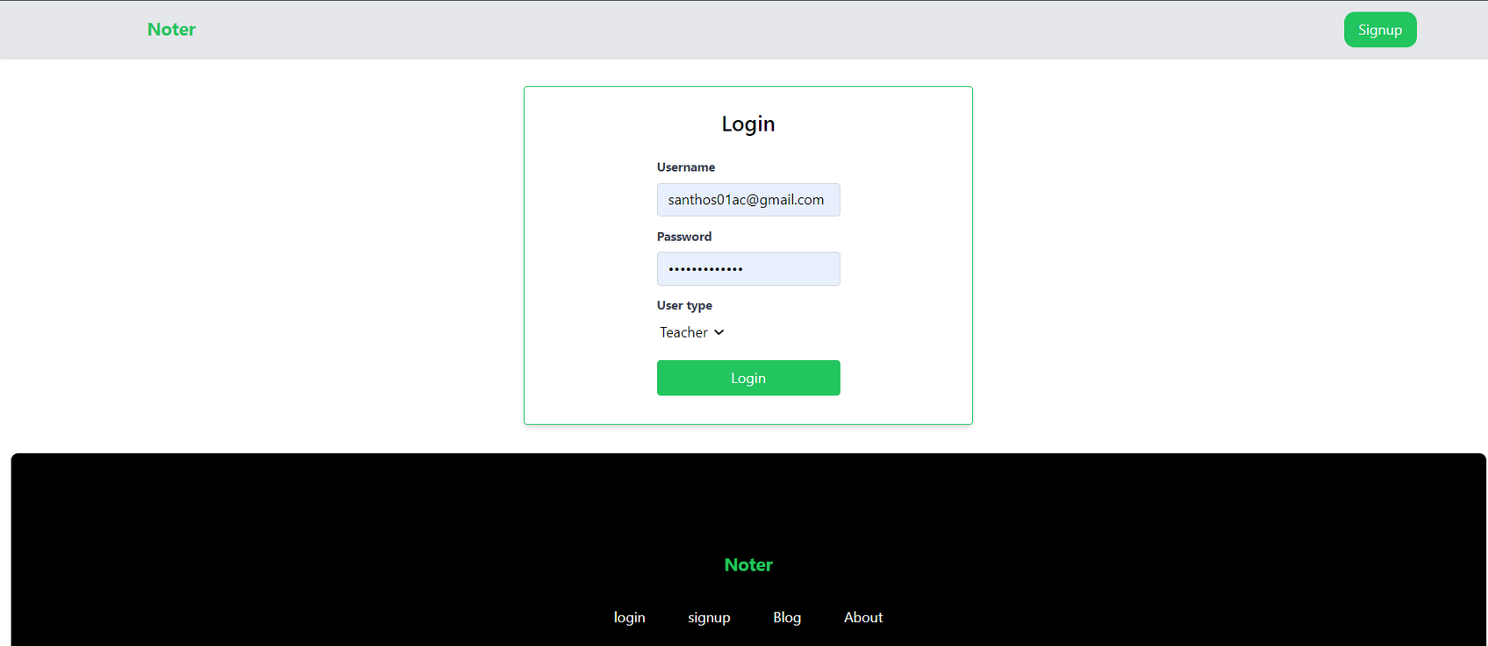
Next Gen Employability Program
Login-Page

Slide 13
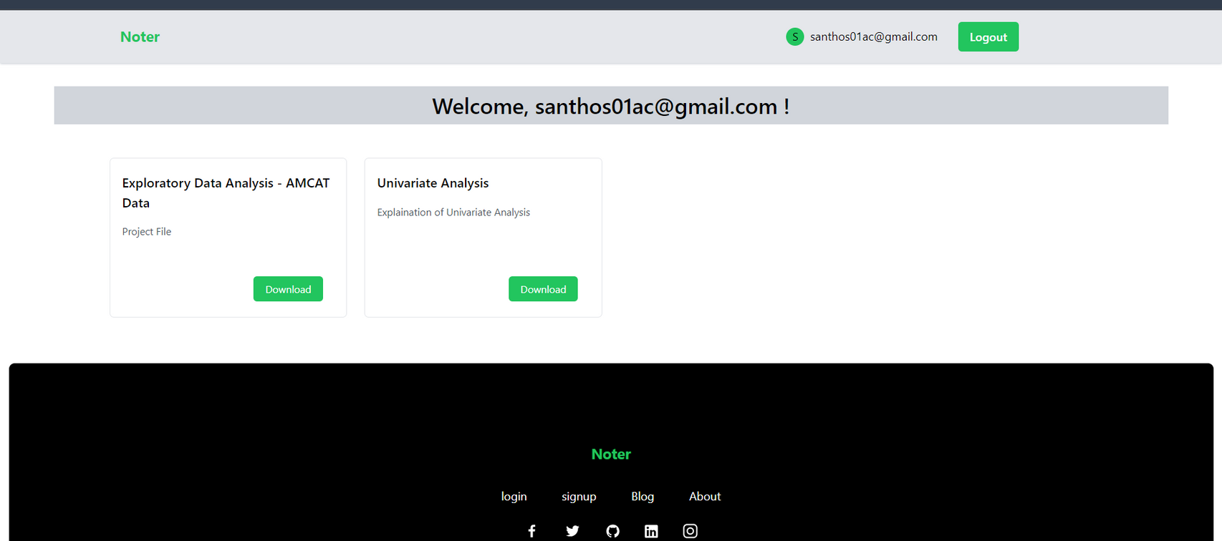
Next Gen Employability Program
Dashboard-Page

Slide 14
Next Gen Employability Program
Future Enhancements:
The collaborative note-taking landscape is constantly evolving, and Spark is committed to staying at the
forefront of this exciting journey. As we delve into the future, a world intertwined with Artificial Intelligence (AI) beckons, promising to transform the way we interact with information. This essay explores the transformative potential of AI in Spark, outlining the features poised to ignite a new era of intelligent note- taking and collaboration.
Firstly, we envision leveraging Natural Language Processing (NLP) algorithms to unlock the secrets of
comprehensive notes. Through AI-powered summarization, Spark will become adept at extracting the essence from lengthy documents. Imagine encountering a dense research paper; Spark will condense it into a concise summary, highlighting key points and allowing users to grasp complex information with ease. This intelligent assistant will empower them to focus on what truly matters, saving valuable time and ensuring critical details never slip through the cracks.

Slide 15
Next Gen Employability Program
Conclusion
However, we see this as just the beginning. We are committed to continuous innovation, and the future holds the promise of even more transformative features. By harnessing the power of Artificial Intelligence and other cutting-edge technologies, we envision a future where Spark becomes an intelligent assistant, offering functionalities like AI-powered summarization, sentiment analysis, and voice-to-text integration. These advancements will further streamline workflows, enhance communication, and unlock a new era of collaborative productivity.
Source :

Slide 16
Next Gen Employability Program
Thank You!

