Slide 1
Build for Everyone
EAA-Compliant Web Apps

Slide 2
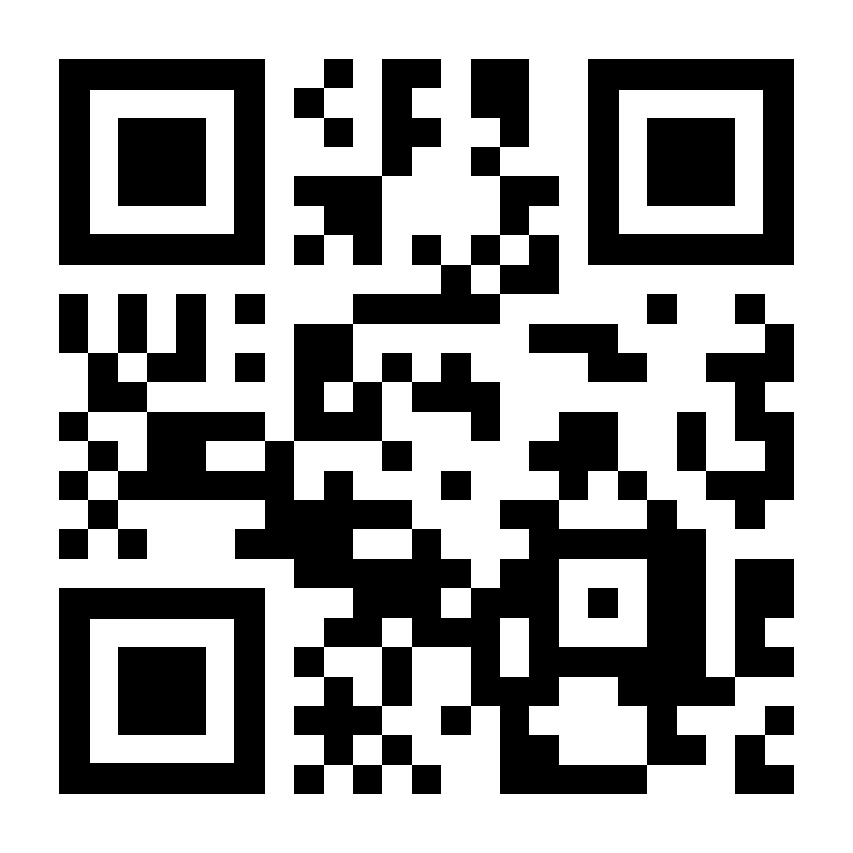
George Roubie
Senior Front-End Engineer @ efood Founder of GameNest
ex-Pobuca | ex-Skroutzer | ex-Workabler
https://gamenest.gr

Slide 3
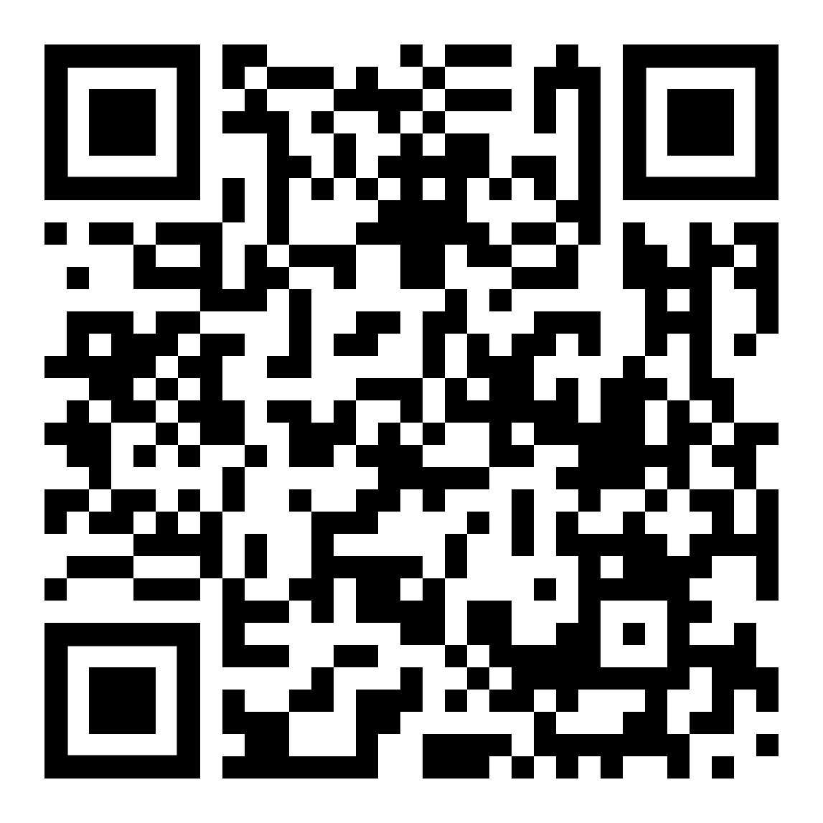
Download the Project & Code Along
Requirements:
Node.js version 20.19+, 22.12+
Yarn
VSCode or some other IDE

Slide 4
AccessibIlity
Accessibility aka a11y in Web is making websites and web apps usable for everyone.
Includes people with disabilities
Ensures content works well with tools like screen readers and keyboards
Creates a more inclusive and user-friendly web experience

Slide 5
A11y 🤔
Why should we care?
Because a11y is about people first
Because we want our apps to be usable by everyone
Because it’s the law (EAA compliance)

Slide 6
WCAG & EU Law
What is WCAG?
WCAG = Web Content Accessibility Guidelines (by W3C https://www.w3.org/TR/WCAG21/ )
Provides standards to make web content accessible to people with disabilities
Three conformance levels: A, AA, AAA
EU Law Requirements:
Public sector websites & apps must comply with WCAG 2.1 Level AA
Ensures essential accessibility features for users with disabilities
AAA is not required, but recommended for optimal accessibility

Slide 7
A11y Developer Tools
Chrome Extensions:
Wave Evaluation Tool
Silktide Accessibility Checker
Built-in Chrome features:
Lighthouse a11y checker
A11y tree
OS features:
macOS: VoiceOver - full-featured screen reader built into macOS
Windows: Narrator - built-in screen reader in Windows OS

Slide 8
User Settings
We always need to respect our user settings
Font Size: Honor user-chosen text size for readability
Color Scheme: Support light and dark modes
Reduce Motion: Minimize animations or transitions for users who prefer reduced motion
Direction: Adapt to user’s text direction preferences (e.g., rtl for right-to-left languages).

Slide 9
How To Build Experiences That Adapt
Your app should follow the user, not force them to adapt to it.
Use rem instead of px for font sizes
Use the prefers-color-scheme media query to match light or dark mode
Use prefers-reduced-motion to disable or simplify animations
Avoid left and right, use the logical start and end for direction-aware layouts

Slide 10
Semantic… what now?
Boring explanation:
Semantic HTML is a way of writing HTML where you use elements that describe the meaning of the content rather than just its appearance.
Using semantic HTML makes your site more accessible, search-friendly, and maintainable.
Helps screen readers understand page structure
Native HTML elements come with built-in keyboard and accessibility features
Improves SEO and developer clarity

Slide 11
Semantic HTML Best Practices
Use headings (<h1> - <h6>) in the correct order
Use <ul> / <ol> for lists
Use <p> for text
Use <main>, <nav>, <header>, <footer> for layout

Slide 12
Accessible Clickable Elements
Make interactions clear, consistent, and keyboard-friendly. Using buttons and links correctly ensures that everyone can interact with your site, including keyboard users and assistive technology users.
Use <button> for actions (e.g., submitting, toggling)
Use <a> for navigation (e.g., linking to another page)
Don’t nest clickable elements (e.g., a <button> inside an <a> or vice versa)
Ensure users can see which element is focused when using Tab
Don’t remove outlines, customize them instead

Slide 13
ARIA Attributes
Add meaning, only when native HTML isn’t enough.
What ARIA is:
ARIA stands for Accessible Rich Internet Applications
It provides extra accessibility information to assistive technologies (like screen readers)
Use it to describe roles, states, and properties that HTML alone can’t express
Examples:
role="dialog": defines an element as a dialog or modal
aria-label="Close": gives a readable label when there’s no visible text
aria-hidden="true": hides content from screen readers

Slide 14
ARIA Attributes Best Practices
No ARIA is better than Bad ARIA (W3C Accessibility Principle)
Use native HTML first, only use ARIA when no native element fits
Never change native semantics (e.g., don’t add role="button" to a real <button>)
Keep ARIA states in sync with UI behavior (e.g., toggle aria-expanded)
Every interactive element must be focusable (tabindex="0" if needed)
Use aria-label or aria-labelledby only when visible text isn’t available
Avoid hiding focusable elements with aria-hidden="true"

Slide 15
Monitoring Accessibility
Remember a11y isn’t a one-time task, it’s an ongoing process.
Check a11y regularly with tools like WAVE, Silktide, Lighthouse
Test your app using only the keyboard
Test with a screen reader and with the screen brightness turned down
Integrate Lighthouse a11y checks in your CI/CD pipeline
Add ESLint a11y rules to catch issues during development

Slide 16
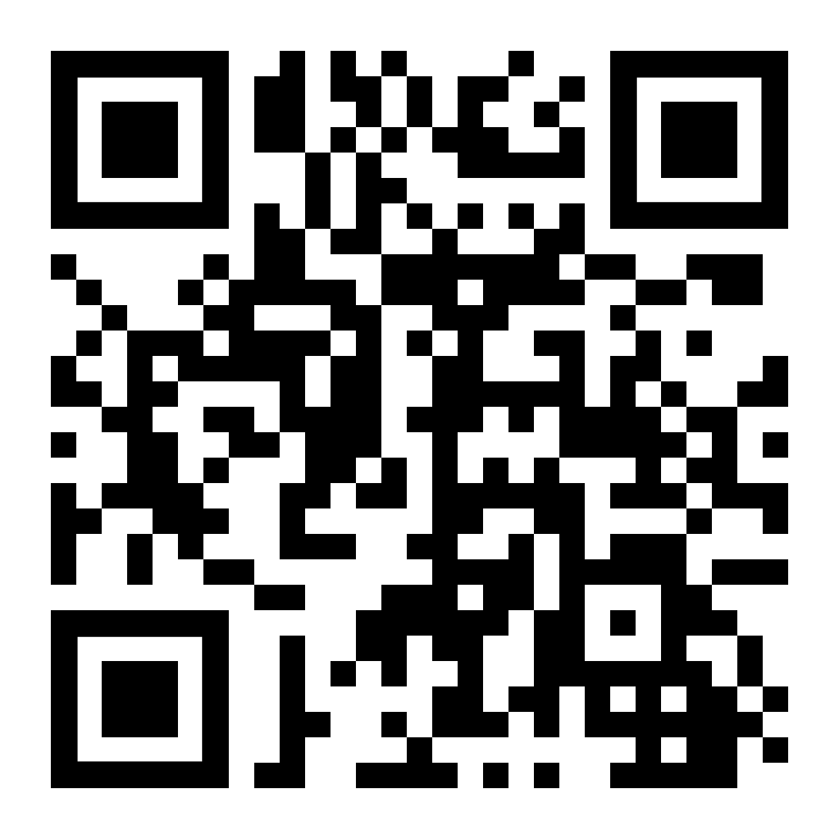
Thank you
🙌 Thanks for joining this workshop, I hope you enjoyed it!
Let’s stay in touch on LinkedIn.

