Slide 1
Unsupervised learning for local structure detection
Georgios Smyridis
Rimo Sarkar

Slide 2


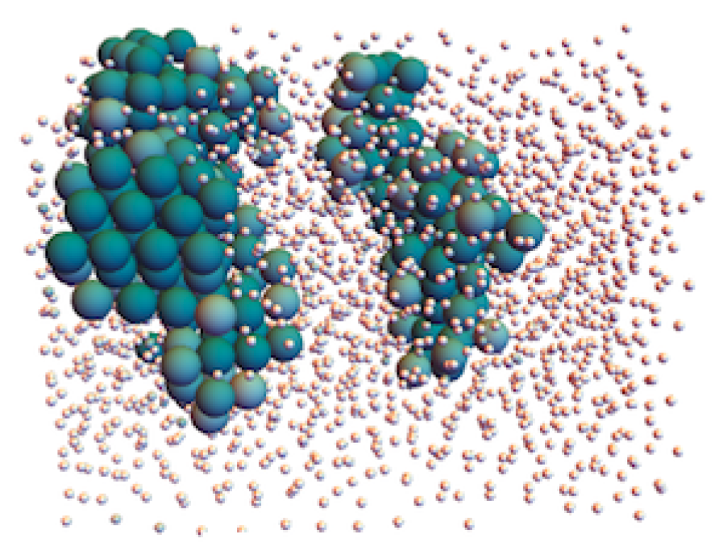
Goal
Detect self-assembly products in colloidal systems using unsupervised learning
Notes:
Colloidal systems are systems composed of small particles (colloids) dispersed in a medium (dispersing medium). The colloidal particles interact with the dispersing medium as well as other colloidal particles, with attractive or repuslive forces. Locally, when the repulsive forces dominate the particles remain dispersed, while when the attractive forces dominate, the particles spontaneously organise themselves into ordered structures like clusters, chains, crystalines etc. This is the phenomenon of self-assembly.
When these products are well-characterised, one can formulate order parameters in order to detect them. However, when one is exploring new material the exact final structure is unknown and the use of unsupervised learning which detects patterns in datasets is really helpful.

Slide 3
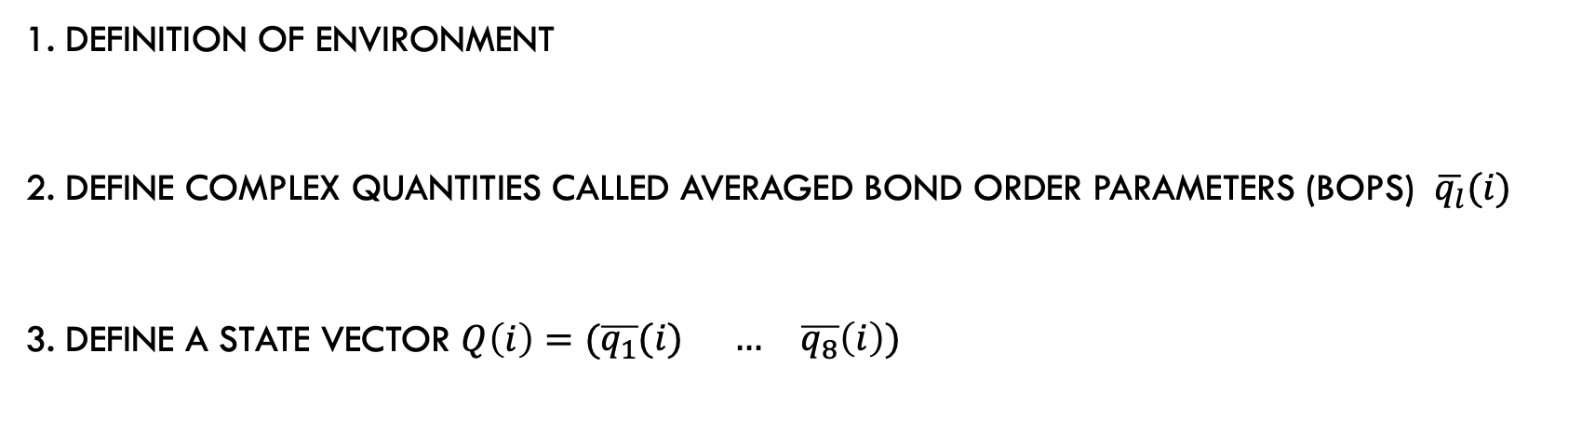
SINGLE PARTICLE Environment description
1. DEFINITION OF ENVIRONMENT
2. DEFINE COMPLEX QUANTITIES CALLED averaged BOND ORDER PARAMETERS (BOPS) $\overline{q_{l}}(i)$
3. Define a state vector $Q\left(i\right)=(\begin{matrix}\overline{q_{1}}(i) & … & \overline{q_{8}}\left(i\right)) \end{matrix}$
Notes:
1. We have to describe the environment of each particle and for this reason we introduce complex quantities called bond order parameters. This also requires the definition of the neighbourhood of each particle.
2. We perform a dimensionality reduction using feedforward neural-network base autoencoders. These are neural networks that perform a non-linear projection of the input and then try to reconstruct the

Slide 4
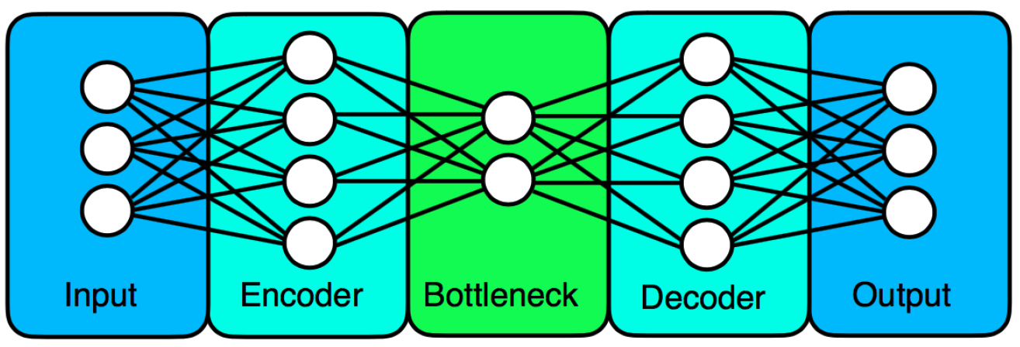
Dimensionality reduction
Use Feedforward neural-network based autoencoders

Slide 5
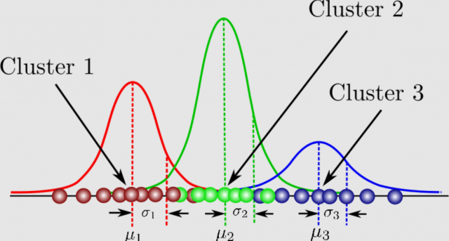
Clustering
CLUSTERING WITH GAUSSIAN MIXTURE MODEL

Slide 6
LEARNING FROM THE AUTOENCODER
CONTRIBUTION ANALYSIS: INPUT PERTURBATION AND IMPROVED SPEWISE METHODS A AND B
INPUT PERTURBATION: WE ADD A PERTURBATION IN A SINGLE INPUT NODE
STEPWISE METHODS: INCLUDE/DISCLUDE INPUT NODE(S)
WHEN THE COST FUNCTION (MSE) INCREASES THE DIMENSION IS IMPORTANT

Slide 7
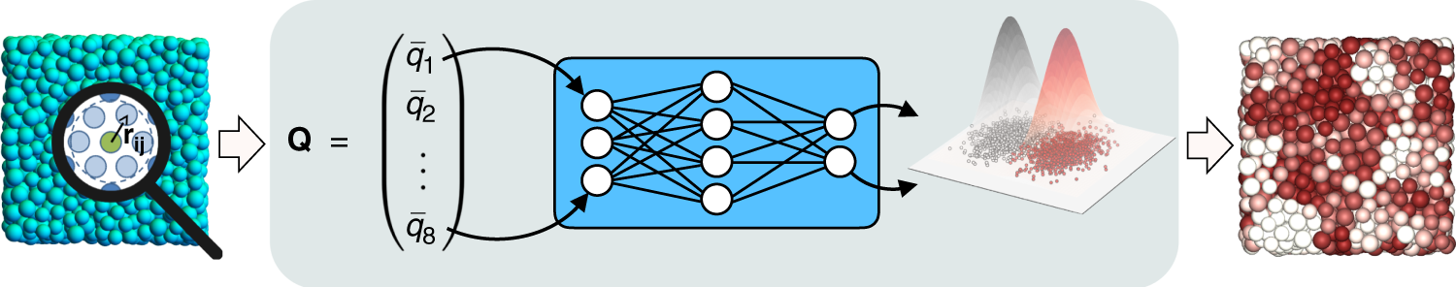
WORKFLOW

Slide 8
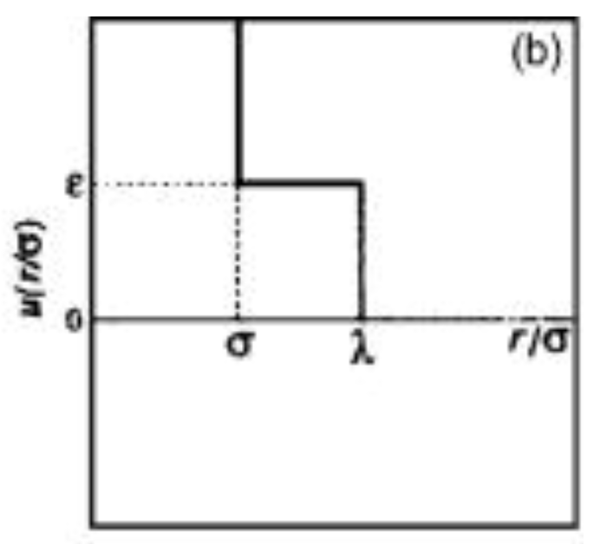
NEXT STEPS
NVT SIMULATION OF SQUARE SHOULDER PARTICLES IN 2D
APPLY THE ABOVE METHODOLOGY TO DETECT PHASES

