Slide 1
SQLite
Tutorial 3

Slide 2

What is Database?
It is a structure in which you can store, access, and manipulate data.
Notes:
A database is a structured way of storing, accessing, and manipulating data.

Slide 3
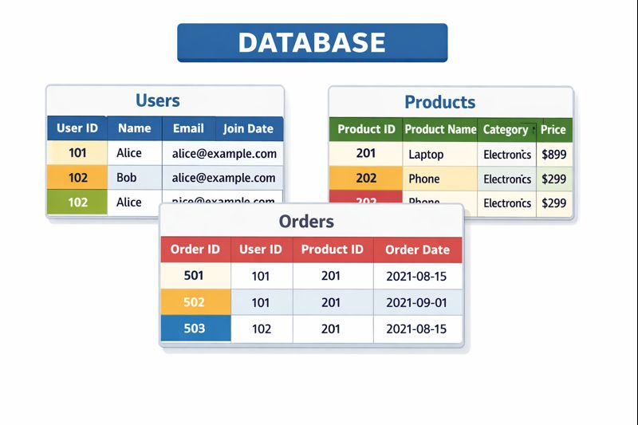
What is Database?
From a visual perspective, a database looks like a set of tables each having different column headers and rows.
Notes:
Visually, you can think of it as tables with columns and rows.

Slide 4

What is Database?
In order to work with a database, we make use of a Structured Query Language or SQL.
The operations we perform through SQL are called queries.

Slide 5

Excel is not a database !
It is a SPREADSHEET
Notes:
Excel is not a database – it is a spreadsheet. Databases are much more powerful because they allow us to use SQL (Structured Query Language) to ask questions about our data. These questions are called queries.
Example question a database can answer:
“Give me the names of all students with GPA above 3.0.”

Slide 6



Examples of Database Systems
Notes:
There are many database systems out there:
MS Access (the red A icon),
MySQL,
Oracle Database.
For today, we will focus on SQLite because it is:
Free,
Lightweight,
And can be used into Python.

Slide 7

Examples of Database Systems
Notes:
There are many database systems out there:
MS Access (the red A icon),
MySQL,
Oracle Database.
For today, we will focus on SQLite because it is:
Free,
Lightweight,
And can be used into Python.

Slide 8
SQLite3
01
02
03
04
Simple and light database systems that can be used with Python.
We need to import the library sqlite3 → we have to install it using pip if python version is old
We need to connect to the database in order to work with it and save the connection object.
We need to create a cursor that allows us to navigate the datbase and execute queries
It is a good practice to close the connection when we are done working with database.
Notes:
SQLite is a simple and light database system.
To use it with Python, we need the sqlite3 library.
We follow 4 steps to work with a database:
Connect to the database → creates or opens a file, using sqlite3.connect("filename.db").
Create a cursor → this allows us to navigate the database and execute SQL queries.
Work with the database → execute queries, fetch results.
Close the connection to free resources when done.
This is the basic workflow we will use all session.

Slide 9
Code example
import sqlite3
db = sqlite3.connect(name_of_your_database) #connecting
cursor = db.cursor() #creating a cursor
#code of your application where you work with the database
db.close() #closing the connection
#rest of the code
Note:
In the .connect() method, if the specified name does not exist, the code will automatically create one with that name.
To perform operations, we will use the .execute() method associated with the cursor and to which we will have to pass the desired query.
Notes:
If the database file name does not exist, .connect() will automatically create it.
To perform any operation, use:
cursor.execute("SQL_QUERY_HERE")

Slide 10
Operations
There is various operations that you can do in SQLite but the most common are:
  CREATE TABLE : make a new table
  INSERT : add rows
  SELECT : query data
  UPDATE : modify rows
  DELETE : remove rows

Slide 11
CREATE TABLE
A database consist of a set of tables → we need a query to create those tables.
We do that using the CREATE TABLE operation.
CREATE TABLE
A table is defined by its name and its attributes (column names). Each column has a specific data type (int, real, text, bool…)
You can have more than one table in a database.
The creation of a table will look as follows:
cursor.execute(“CREATE TABLE students(studentID int, stdname text, stdage int, stdGPA real)”)
Notes:
A table is defined by:
A name,
A set of columns, each with a name and a data type.
Example: A students table with 4 attributes.
cursor.execute("""
CREATE TABLE students(
studentID int,
stdname text,
stdage int,
stdGPA real
)
""")
Explanation:
int → whole numbers,
text → strings,
real → decimals.

Slide 12
INSERT
We must specify the name of the table and enter the data in the same order as specified earlier while making sure that the data types are matching.
After creating a table, we need to populate it with data. This is done using the INSERT command.
INSERT
The creation of a table will look as follows:
cursor.execute(“INSERT INTO students values(195487, ‘Dany Solh’, 20, 1.7)”)
or
cursor.execute(“INSERT INTO students values(?, ?, ?, ?)”, (var_id, var_name, var_age, var_GPA))
db.commit() # to save the changes in the database
Note: var_x is some variable input
Notes:
To add data into the table, use INSERT INTO.
Example with fixed values:
cursor.execute("INSERT INTO students VALUES(195487, 'Dany Solh', 20, 1.7)")
With variables:
student = (123456, "Mariam Fares", 21, 3.2)
cursor.execute("INSERT INTO students VALUES(?, ?, ?, ?)", student)
db.commit()
Note: Always call db.commit() to save changes.

Slide 13
SELECT
This statement allows us to get data from multiple tables in the database.
SELECT
We can be very creative with this command because it allows us to get data from and according to specific attributes, combine tables based on some conditions, order the displayed data, and many more.
Notes:
SELECT *
Concept:
SELECT * retrieves all columns and all rows from a table.
The * means "everything".
Be careful: if the table is huge, this could return thousands of rows.
Notes for Students:
Every column is shown: ID, Name, Age, GPA.
Order is the same as the table definition.
SELECT ... WHERE
Concept:
WHERE adds a condition (filter).
SQL only returns rows matching the condition.
Very powerful for searching.

Slide 14
SELECT
The common parts of this command are the following:
  FROM: select from which table we want to get data
  WHERE: allows to select the rows satisfying a certain condition
  JOIN: allows to temporarily combine tables based on an attribute
  GROUP BY: allows to group multiple rows based on an attribute’s value that can appear multiple times
  ORDER BY: specify the order of displaying the rows
Notes:
SELECT *
Concept:
SELECT * retrieves all columns and all rows from a table.
The * means "everything".
Be careful: if the table is huge, this could return thousands of rows.
Notes for Students:
Every column is shown: ID, Name, Age, GPA.
Order is the same as the table definition.
SELECT ... WHERE
Concept:
WHERE adds a condition (filter).
SQL only returns rows matching the condition.
Very powerful for searching.

Slide 15
SELECT (Examples)
cursor.execute(‘‘‘SELECT * from table1’’’) #selects all the attributes and all the data in table1
cursor.execute(‘‘‘SELECT att1, att2 from table1’’’) #selects only the first and second attribute from all the rows in table1
cursor.execute(‘‘‘SELECT * from table1 WHERE att1=x’’’) #select only the rows where first attribute is equal to x
cursor.execute(‘‘‘SELECT * from table1 join table2 ON table1.att1=table2.att4’’’) #combines table1 and table2 by merging the rows where the first attribute in table1 is equal to the fourth attribute in table2
cursor.execute(‘‘‘SELECT att1, COUNT(att2) from table1 GROUP BY att1’’’) #grouping the rows according to the first attribute and counting the number of rows where a specific value of attribute 1 appears. Note that we could have used any attribute, not necessarily the second.
cursor.execute(‘‘‘SELECT * from table1 ORDER BY att3’’’) #selects all the data from table1 and sorts it according to the third attribute
Notes:
SELECT *
Concept:
SELECT * retrieves all columns and all rows from a table.
The * means "everything".
Be careful: if the table is huge, this could return thousands of rows.
Notes for Students:
Every column is shown: ID, Name, Age, GPA.
Order is the same as the table definition.
SELECT ... WHERE
Concept:
WHERE adds a condition (filter).
SQL only returns rows matching the condition.
Very powerful for searching.

Slide 16
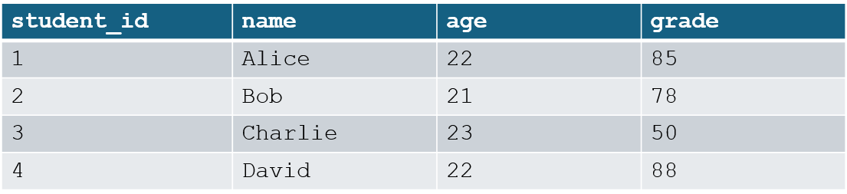
SELECT (Visual Example)
SELECT * FROM students
SELECT name, age FROM students
SELECT * FROM students WHERE age = 22;
SELECT age, COUNT(student_id) FROM students GROUP BY age
SELECT * FROM students ORDER BY grade DESC;

Slide 17
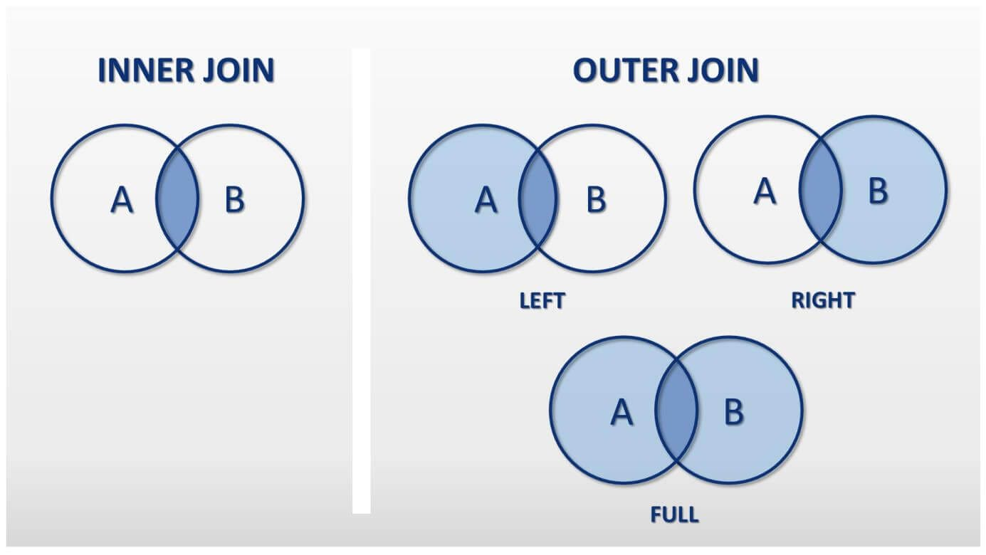
SELECT (more details)
To get the data, we must fetch it after executing the query → This is done using either cursor.fetchall() or cursor.fetchone().
GROUP BY command: groups the rows according to an attribute and typically show some data regarding those rows like their number as in the previous example, a max or a min or an average value, etc.
There are different types of JOIN that can be used. The one used in the previous slide is the default JOIN also known as the INNER JOIN. There is also the LEFT JOIN, RIGHT JOIN, CROSS JOIN and many others.
Notes:
. fetchall()
Returns all remaining rows of the result set at once.
It gives you a list of tuples.
If no rows remain → returns an empty list [].
Example:
cursor.execute("SELECT stdname FROM students")
rows = cursor.fetchall()
print(rows)
2. fetchone()
Returns the next single row of the result set.
It gives you just one tuple.
If no more rows remain → returns None.
Example:
cursor.execute("SELECT stdname FROM students") #say students contain 3 rows
print(cursor.fetchone()) # First row
print(cursor.fetchone()) # Second row
print(cursor.fetchone()) # Third row
print(cursor.fetchone()) # None (no more rows)
3. fetchmany(size)
Returns the next size rows as a list of tuples.
Useful for big tables to avoid loading everything at once.
Example:
cursor.execute("SELECT stdname FROM students")
print(cursor.fetchmany(2))
1. INNER JOIN (default JOIN)
Returns only rows that have matching values in both tables.
Example: students who are actually registered in at least one course.
SELECT student.name, courses.courseName
FROM student
JOIN registered_courses ON student.studentID = registered_courses.studentID;
2. LEFT JOIN
Returns all rows from the left table, and the matching rows from the right table.
If there’s no match, it fills with NULL.
Example: list all students, even those not registered in any course.
SELECT student.name, courses.courseName
FROM student
LEFT JOIN registered_courses ON student.studentID = registered_courses.studentID;
3. RIGHT JOIN
Opposite of LEFT JOIN → all rows from the right table, and matching from the left.
Note: SQLite itself does not support RIGHT JOIN directly, but it exists in other SQL systems (MySQL, PostgreSQL). You can simulate it using a LEFT JOIN with swapped tables.
4. CROSS JOIN
Returns the Cartesian product of the two tables → every row from table1 combined with every row from table2.
Example: every student combined with every course (even if not registered).
Usually not used unless for testing or generating combinations.
SELECT student.name, courses.courseName
FROM student
CROSS JOIN courses;
GROUP BY (with Aggregate Functions)
Groups rows based on a column and then performs calculations on each group.
Common aggregate functions:
COUNT() → number of rows in group
AVG() → average
MAX() → maximum
MIN() → minimum
SUM() → sum
Example 1: Count students per age
SELECT age, COUNT(studentID)
FROM student
GROUP BY age;
Example 2: Average grade per student
SELECT studentID, AVG(grade)
FROM grades
GROUP BY studentID;

Slide 18
UPDATE
This command is used whenever we want to modify the data in one or many rows of a table.
UPDATE
We must specify in which table we want to make the modification, to what value we want to set the columns and what specific rows
The command will look like this:
cursor.execute(‘‘‘UPDATE table SET column1=x, column2=y… where column1=var”’)
db.commit()

Slide 19
DELETE
Just like we can insert entries into table, we can delete certain entries.
DELETE
We must specify the table and the condition on the rows we want to delete
The command will look like this:
cursor.execute(‘‘‘DELETE FROM table1 WHERE att_x = y’’’)
db.commit()

Slide 20
Primary and Foreign keys
A primary key is an attribute or a set of attributes in a table that makes an entry unique.
A foreign key is an attribute in a table that references a primary key in another table.
When we specify a primary and foreign key when creating the tables, they will enforce:
uniqueness constraint
referential constraint
This how you specify a primary key and a foreign key when creating a table:
cursor.execute(‘‘‘CREATE TABLE table_name (att_x int primary key, att_x2 text, foreign key(att_x2) REFERENCES table2(att_y)’’’)
Notes:
Primary Key
A primary key is one (or more) column(s) in a table that uniquely identifies each row.
Rules of a primary key:
It must be unique → no two rows can have the same value.
It cannot be NULL → every row must have a value for it.
Each table can have only one primary key (but it can be made of multiple columns).
Example:
A table of students:
CREATE TABLE student(
studentID INT PRIMARY KEY,
name TEXT,
age INT
);
Here, studentID is the primary key.
This ensures no two students can have the same ID.
Foreign Key
A foreign key is a column (or set of columns) in a table that refers to the primary key of another table.
It is used to link tables together.
It ensures referential integrity, meaning that values in the foreign key column must already exist in the referenced primary key column.
Example:
Suppose we have a courses table and a registered_courses table:
CREATE TABLE courses(
courseID INT PRIMARY KEY,
courseName TEXT
);
CREATE TABLE registered_courses(
studentID INT,
courseID INT,
FOREIGN KEY(studentID) REFERENCES student(studentID),
FOREIGN KEY(courseID) REFERENCES courses(courseID)
);
studentID here is a foreign key referencing the student table.
courseID is another foreign key referencing the courses table.
This ensures:
You cannot register a student that does not exist in the student table.
You cannot register a course that does not exist in the courses table.
Why are Primary & Foreign Keys Important?
They organize data by making sure relationships between tables are correct.
They prevent mistakes (like having grades for a non-existent student).
They allow us to use JOIN operations to combine data from multiple tables.
Note: SQLite requires db.execute("PRAGMA foreign_keys=ON") to enforce foreign keys.

Slide 21
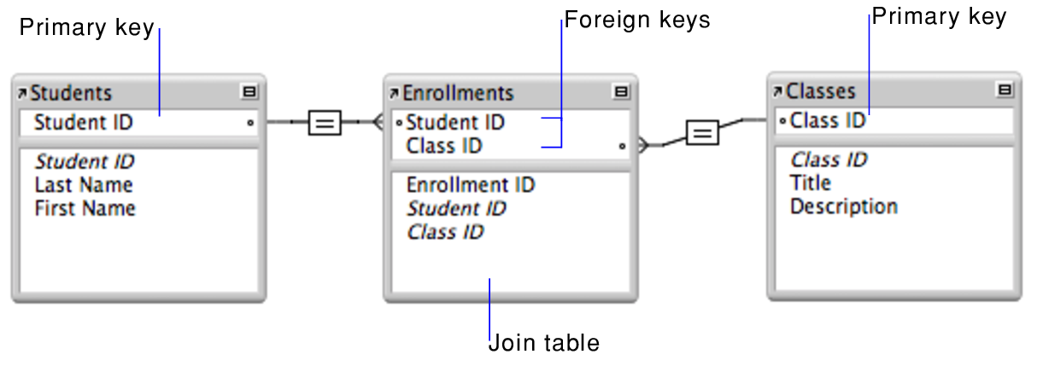
Primary and Foreign keys
A primary key is an attribute or a set of attributes in a table that makes an entry unique.
A foreign key is an attribute in a table that references a primary key in another table.
Notes:
Primary Key
A primary key is one (or more) column(s) in a table that uniquely identifies each row.
Rules of a primary key:
It must be unique → no two rows can have the same value.
It cannot be NULL → every row must have a value for it.
Each table can have only one primary key (but it can be made of multiple columns).
Example:
A table of students:
CREATE TABLE student(
studentID INT PRIMARY KEY,
name TEXT,
age INT
);
Here, studentID is the primary key.
This ensures no two students can have the same ID.
Foreign Key
A foreign key is a column (or set of columns) in a table that refers to the primary key of another table.
It is used to link tables together.
It ensures referential integrity, meaning that values in the foreign key column must already exist in the referenced primary key column.
Example:
Suppose we have a courses table and a registered_courses table:
CREATE TABLE courses(
courseID INT PRIMARY KEY,
courseName TEXT
);
CREATE TABLE registered_courses(
studentID INT,
courseID INT,
FOREIGN KEY(studentID) REFERENCES student(studentID),
FOREIGN KEY(courseID) REFERENCES courses(courseID)
);
studentID here is a foreign key referencing the student table.
courseID is another foreign key referencing the courses table.
This ensures:
You cannot register a student that does not exist in the student table.
You cannot register a course that does not exist in the courses table.
Why are Primary & Foreign Keys Important?
They organize data by making sure relationships between tables are correct.
They prevent mistakes (like having grades for a non-existent student).
They allow us to use JOIN operations to combine data from multiple tables.
Note: SQLite requires db.execute("PRAGMA foreign_keys=ON") to enforce foreign keys.

Slide 22
Primary and Foreign keys
If the primary key consists of multiple attributes, here is how we define it:
cursor.execute(‘‘‘CREATE TABLE table_name (att_x int, att_x2, att_x3 text, primary key(att_x, att_x2)’’’)
If we want to use foreign keys, we need to tell sqlite3 to enforce them, this is done in the following way:
import sqlite3
db = sqlite3.connect(name_of_your_database)
db.execute("PRAGMA foreign_keys=on")
cursor = db.cursor()
#code of your application where you work with the database
db.close() #closing the connection
Notes:
Primary Key
A primary key is one (or more) column(s) in a table that uniquely identifies each row.
Rules of a primary key:
It must be unique → no two rows can have the same value.
It cannot be NULL → every row must have a value for it.
Each table can have only one primary key (but it can be made of multiple columns).
Example:
A table of students:
CREATE TABLE student(
studentID INT PRIMARY KEY,
name TEXT,
age INT
);
Here, studentID is the primary key.
This ensures no two students can have the same ID.
Foreign Key
A foreign key is a column (or set of columns) in a table that refers to the primary key of another table.
It is used to link tables together.
It ensures referential integrity, meaning that values in the foreign key column must already exist in the referenced primary key column.
Example:
Suppose we have a courses table and a registered_courses table:
CREATE TABLE courses(
courseID INT PRIMARY KEY,
courseName TEXT
);
CREATE TABLE registered_courses(
studentID INT,
courseID INT,
FOREIGN KEY(studentID) REFERENCES student(studentID),
FOREIGN KEY(courseID) REFERENCES courses(courseID)
);
studentID here is a foreign key referencing the student table.
courseID is another foreign key referencing the courses table.
This ensures:
You cannot register a student that does not exist in the student table.
You cannot register a course that does not exist in the courses table.
Why are Primary & Foreign Keys Important?
They organize data by making sure relationships between tables are correct.
They prevent mistakes (like having grades for a non-existent student).
They allow us to use JOIN operations to combine data from multiple tables.
Note: SQLite requires db.execute("PRAGMA foreign_keys=ON") to enforce foreign keys.

Slide 23
Let’s Code !

Slide 24
Exercise
Create a database students made of 3 tables: student, registered courses, and grades tables
The student table should store a student’s ID which is unique, his name and his age.
The registered courses table should store the ID of the student and the ID of the courses he is registered in
The grades table should store the grades of students in courses they have completed. The table should contain the ID of the student, the ID of the course, and the received grade.
Get the maximum grade a student has obtained along with the corresponding course, his ID.
Get the average grade of a student.
Notes:
Now you will combine everything you learned.
Task:
Create a database with 3 tables:
student → ID (unique), name, age
registered_courses → student ID, course ID
grades → student ID, course ID, grade
Insert sample data: at least 3 students, 3 courses, and some grades.
Write queries:
Get the maximum grade a student obtained, along with course and student ID.
Get the average grade of each student.

