Slide 1
Object Detection
And semantic Segmentation
Georges Nasrallah inmind.ai ML Academy August 2024

Slide 2
Final Project ML Academy | Georges Nasrallah
How to choose a Model
Type of the problem (classification, object detection …)
Data Size and Data quality
Task Complexity
Model Complexity and Accuracy
Model Size and inference time
Balance Model Complexity and Accuracy vs Task Complexity vs Data Size

Slide 3
Object Detection

Slide 4
Final Project ML Academy | Georges Nasrallah
YOLO
 | YoloV7 | YoloV5 m | YoloV7 Tiny | YoloV8 s
Parameters (million) | 36.9 | 21.2 | 6.2 | 11.2
Layers | 104 | 25 | 78 | 150
Ap (%) | 51.4 | 44.5 | 38.7 | 44.9
Balance Model Complexity and Accuracy vs Task Complexity vs Data Size

Slide 5
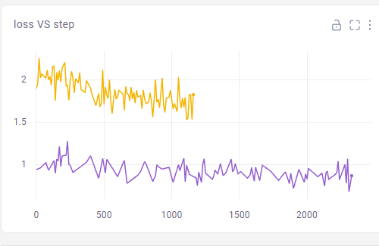
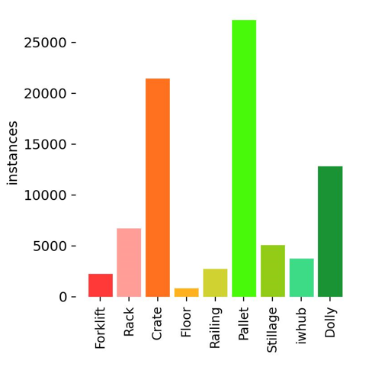
Final Project ML Academy | Georges Nasrallah
DataSet and Augmentation
And transfer learning
Fine tuning technique used:
Freeze layers and gradually unfreeze them
1. 50 epochs at 50 freezed layers
2. 100 epochs at 35 freezed layers
3. 100 epochs at 25 freezed layers
4. 100 epochs at 20 freezed layers
5. 200 epochs at 0 freezed layers
6. 150 epochs at 0 freezed higher

Slide 6
Semantic Segmentation

Slide 7
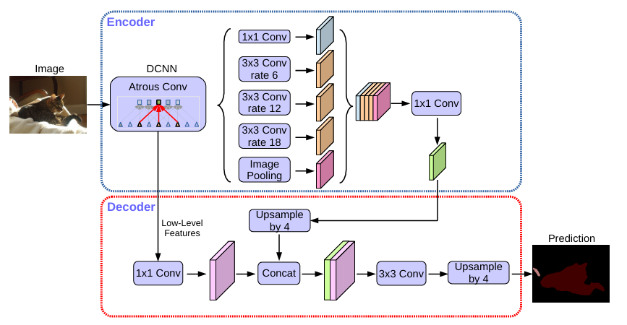
Final Project ML Academy | Georges Nasrallah
DeepLabV3+
Atrous Convolutions
Depthwise Separable Convolutions
Backbone integration
Less complex
Modified ResNet50 as a backbone
[1] The Effect of Resnet Model as Feature Extractor Network to Performance of DeepLabV3 Model for Semantic Satellite Image Segmentation
[2] Encoder-Decoder with Atrous Separable Convolution for Semantic Image Segmentation

Slide 8
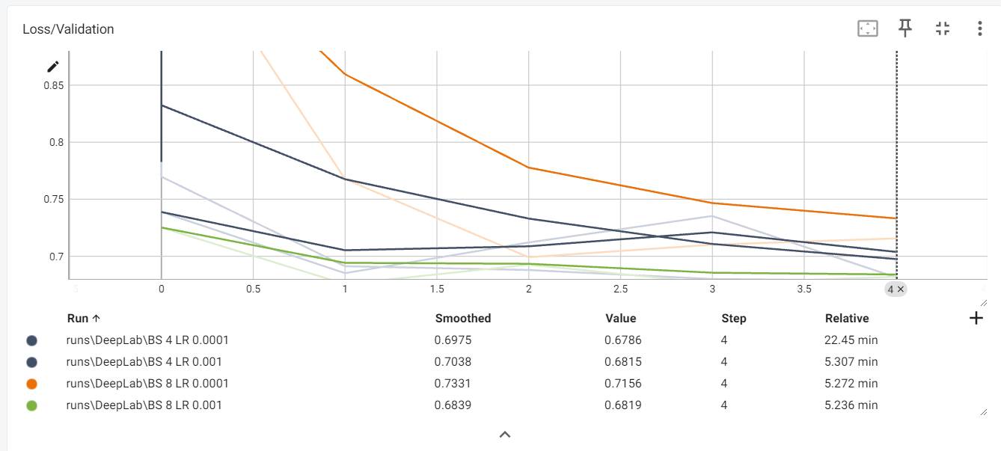
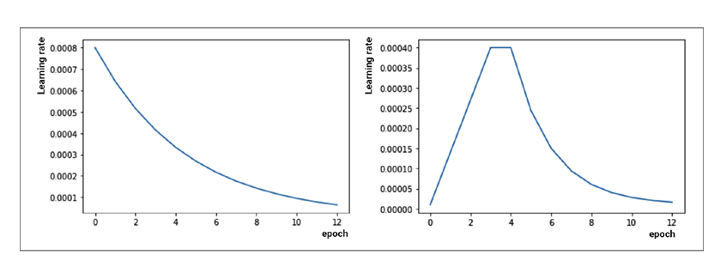
HyperParameter Tunning
Final Project ML Academy | Georges Nasrallah
Training Schedule
Optimizer AdamW
Batch Size 8
Image width 480 height 320
Learning scheduler OneCycleLR
Training with fine tuning
6 epochs backbone frozen no scheduler Lr=0.001
8 epochs learning scheduler with max Lr=0.0001

Slide 9
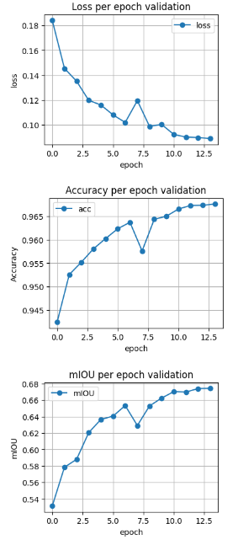
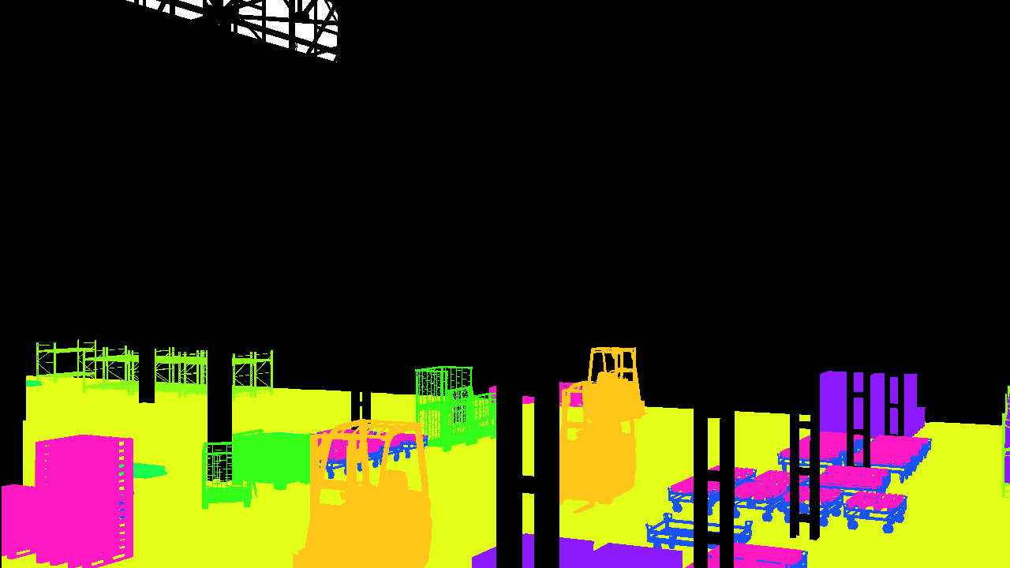
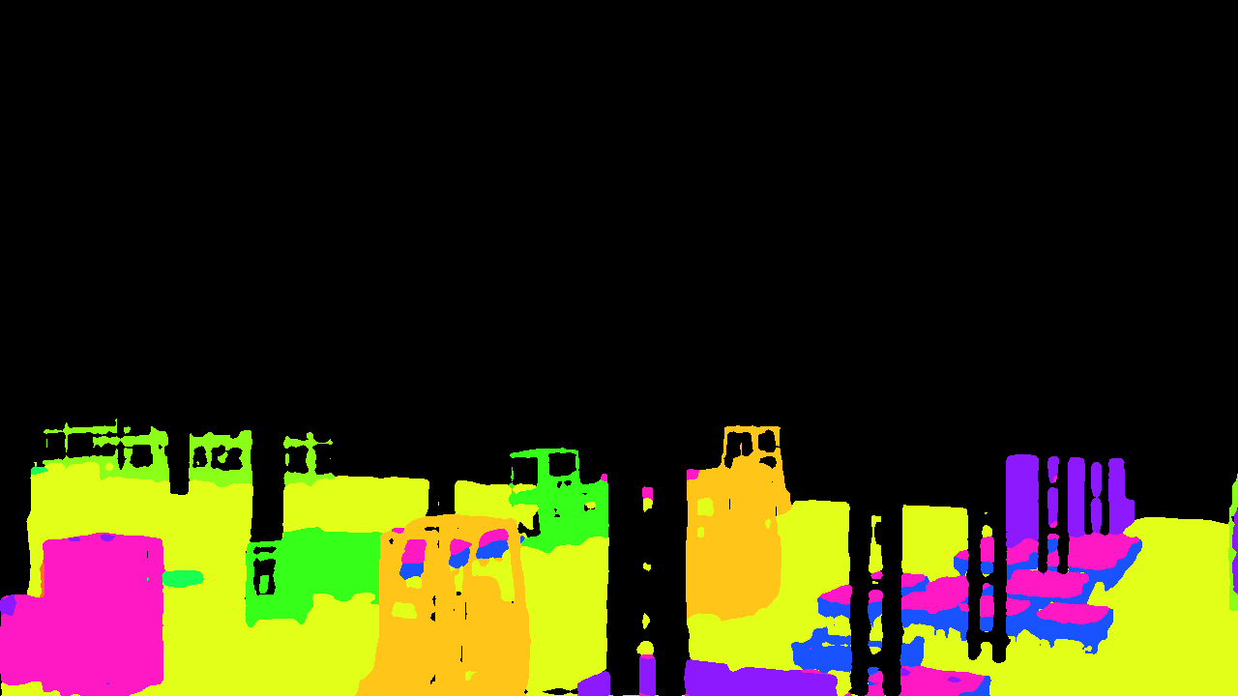
Final Project ML Academy | Georges Nasrallah
Training Results
Accuracy 0.9675925130208334, avg val loss 0.08884964682734929, mIOU 0.6742841970954901
Ground Truth
Prediction on test set

