Slide 1

Growth Team Overview
Created
Notes:
Thank you for joining me as I give a high level overview of The Growth Team at Cover Whale

Slide 2
Who is Cover Whale?
Growth Team Overview & Goals
What makes a Partner?
The roles of BDMs & BDAs
Team Metrics & Partner Reporting
AGENDA
Notes:
Throughout the presentation we will talk about Who is Cover Whale, what functions, responsibilities, and goals the Growth Team align to, what exactly makes a partner at cover whale, what are the essential responsibilities and job duties for two of The growth teams most critical positions the business development manager and the business development associate, as lastly speak a bit around some important metrics and KPI’s our department prioritizes.

Slide 3

WHO IS COVER WHALE
Cover Whale, an insurTech MGA founded in 2019, uses data and technology to provide a trucking platform that streamlines the application and quoting process to provide industry-leading 24/7 access to fast quotes, binders, and policy documents.
Our current product offerings for Commercial Auto include:
Auto Liability
Auto Physical Damage
Motor Truck Cargo
Truckers General Liability
Non-Trucking Liability
Notes:
To understand what we sell, it’s important to understand who we are.

Slide 4
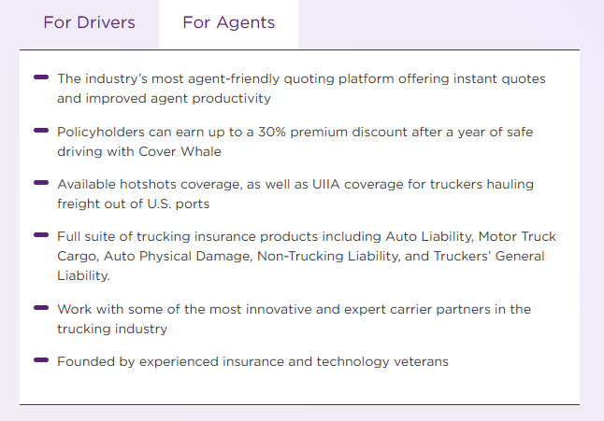
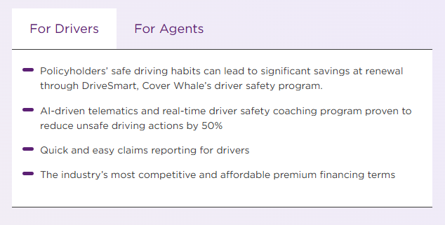
Better for Truckers. Faster for Agents.
Notes:
we are better for truckers - Our policyholders have a proven track record for safety thanks to our industry-leading telematics and real-time safety coaching, helping them get more done, and helping everyone get home safely.​
and better for agents:
We work with select insurance agents who are dedicated to finding and securing the best-fit, best-priced insurance coverage for their trucking clients.

Slide 5











The Cover Whale platform is the fastest, most efficient way to price and place transportation risks.
DOT, FMCSA &
Third-Party Data Integration
Binder Approved Digital Policy Issuance
Docusign Instant Bind
Instant quote or decline
(all quotes are price indication only based upon information keyed in)
Notes:
Agents working with Cover Whale are more productive because we offer the most agent-friendly quoting platform in the trucking insurance industry, providing instant policy quotes and same-day binding.

Slide 6

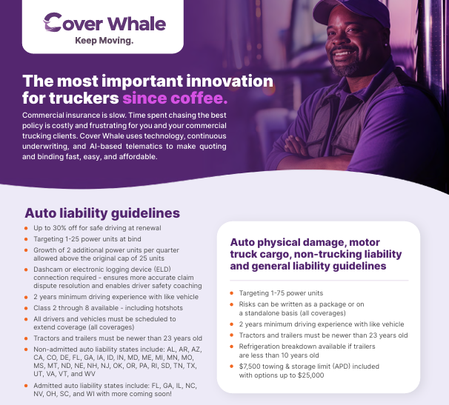
GUIDELINES
‹#›
Notes:
We ensure clients receive the best in trucking insurance coverage with our extensive range of options, including auto liability, motor truck cargo insurance, UIIA/intermodal insurance, and hotshots insurance.
we specifically target trucking clients that have 1-25 units

Slide 7
Growth Team Overview & Goals
Notes:
Now that you know who we are and what we sell, its time to introduce you to the Growth team and our role in the company.

Slide 8
GROWTH TEAM — LEADERSHIP OVERVIEW
Nyles Oppenheimer
Chief Revenue Officer
George Soteropoulos
Director Go to Market
Corbett (Cory) Arnette
Director Growth & Distribution
Kevin McKernan
VP Fleet Sales
Patrick Flood
Growth Marketing & Partnerships Manager
Ian Abrahamsen
CRM & Marketing Operations Specialist
DIRECT REPORTS
DISTRIBUTION CHANNELS
FLEET TEAM
MARKETING & COMMS
CRM & OPS
· Tamera Pfeiffer
Agency Success Lead
Onboarding Specialist
· Roland Massey
Retail Distribution Leader
· James Reid
Networks Distribution Leader
Natl. Partner Leader
→ Detail on Slide 9
· Dominic Purkett
PBRM
★ Sage Summers
PBRM Lead ★ New
PBRM
Individual contributor — no direct reports
Individual contributor — no direct reports
★ = New hire starting 3/23/2026 · As of March 2026
Notes:
The Growth team is comprised of several different business units and starts at the very top lead by our CRO and head of distribution who oversees and manages our different verticals in which the team align.
we take time to research and vet agents and agencies in different partner channels to understand the trucking space and add the personal touch and relationship aspect to pair with our technological innovation.
The largest channel we sell to is our retail partners which is broken down into regions and we also provide our online platform to wholesalers as well as having an increased focus and vertical for our largest national partners.

Slide 9
DISTRIBUTION TEAM — RETAIL CHANNEL
Roland (William) Massey
Retail Distribution Leader
reports to Corbett (Cory) Arnette — Director, Growth & Distribution Strategy
Derek Janssen
Sr. BDM / Deputy Retail Leader
Christopher Hayes
Senior Business Dev. Manager
Ronald Douglas II
BDM — Eastern Region
Christina Moldenhauer
BDM — Midwest
Derrick LeRoy
BDM — Central Region
BDA TEAM
· Cameron Brader
· Latoya Madlock
★ Taylor Sloan
BDA TEAM
★ Erika Cabrera
★ Portia Lewis
No BDA assigned
No BDA assigned
No BDA assigned
NETWORKS CHANNEL — James Reid, Networks Distribution Leader
NATIONAL PARTNERS · FLEET SALES — Kevin McKernan
· Antonio Reyes — BDM, Networks / Aggregators
★ Oreno Lantveld — BDA, Networks
○ Networks BDA — (Open)
· Westy McLaughlin — BDM, National Partners
· Dominic Purkett — PBRM
★ Sage Summers — PBRM Lead
★ = New hire starting 3/23/2026 · As of March 2026
Notes:
The Growth team is comprised of several different business units and starts at the very top lead by our CRO and head of distribution who oversees and manages our different verticals in which the team align.
we take time to research and vet agents and agencies in different partner channels to understand the trucking space and add the personal touch and relationship aspect to pair with our technological innovation.
The largest channel we sell to is our retail partners which is broken down into regions and we also provide our online platform to wholesalers as well as having an increased focus and vertical for our largest national partners.

Slide 10
GROWTH TEAM — FULL ROSTER
NAME | TITLE | CHANNEL | REPORTS TO
Nyles Oppenheimer | Chief Revenue Officer | Leadership | —
Corbett (Cory) Arnette | Director, Growth & Distribution Strategy | Leadership | Nyles Oppenheimer
George Soteropoulos | Director, Go to Market | Leadership | Nyles Oppenheimer
Kevin McKernan | VP, Fleet Sales | Fleet Sales | Nyles Oppenheimer
Patrick Flood | Growth Marketing & Partnerships Manager | GTM / Marketing | Nyles Oppenheimer
Ian Abrahamsen | CRM & Marketing Operations Specialist | GTM / Marketing | Nyles Oppenheimer
Tamera Pfeiffer | Agency Success Lead | Agency Success | George Soteropoulos
Roland Massey | Retail Distribution Leader | Retail Channel | Cory Arnette
James Reid | Networks Distribution Leader | Networks | Cory Arnette
Derek Janssen | Sr. BDM / Deputy Retail Leader | Retail Channel | Roland Massey
Christopher Hayes | Senior Business Development Manager | Retail Channel | Roland Massey
Ronald Douglas II | BDM, Eastern Region | Retail Channel | Roland Massey
Christina Moldenhauer | BDM, Midwest | Retail Channel | Roland Massey
Derrick LeRoy | BDM, Central Region | Retail Channel | Roland Massey
Antonio Reyes | BDM, Networks / Aggregators | Networks | James Reid
Westy McLaughlin | BDM, National Partners | Natl. Partners | Cory Arnette
Dominic Purkett | Production Business Relationship Manager | Fleet Sales | Kevin McKernan
Cameron Brader | BDA, Eastern Region | Retail Channel | Derek Janssen
Latoya Madlock | BDA, Central Region | Retail Channel | Derek Janssen
★ Taylor Sloan | BDA, Northwest | Retail Channel | Derek Janssen
★ Erika Cabrera | BDA, Southeast | Retail Channel | Christopher Hayes
★ Portia Lewis | BDA, Southeast | Retail Channel | Christopher Hayes
★ Oreno Lantveld | BDA, Networks | Networks | James Reid
★ Sage Summers | PBRM Lead | Fleet Sales | Kevin McKernan
TOTAL (FILLED ROLES) | 19 | 5 new · 24 total | ★ start date 3/23/2026
Notes:
The Growth team is comprised of several different business units and starts at the very top lead by our CRO and head of distribution who oversees and manages our different verticals in which the team align.
we take time to research and vet agents and agencies in different partner channels to understand the trucking space and add the personal touch and relationship aspect to pair with our technological innovation.
The largest channel we sell to is our retail partners which is broken down into regions and we also provide our online platform to wholesalers as well as having an increased focus and vertical for our largest national partners.

Slide 11

Team Goals
SELL INSURANCE PREMIUM
Premium
30% Growth YoY
Retention
60%
Submission Volume & Hit Ratio
5% Growth YoY & 12%
Notes:
The primary goal of the Growth team at its core is to get our partners to sell more insurance premium and bind trucking policies.
Some of the overarching goals we strive for in our partners are shown here.
We looks for, premium growth within their trucking book to be 30% year over year, their retention rate to be above 60%, and also look at the number of trucking quotes and % of binds.

Slide 12
What makes a Partner?
Notes:
In order to understand the growth teams goals it is important to have a baseline for what our partners look like.

Slide 13
Every agency is given a Tier
Criteria behind the categorization
Tier 1 - Hyper Growth
$100+ transportation portfolio and/or double-digit premium opportunity to Cover Whale
General rule of thumb: all “Enterprise” relationships fall into this category
Limited to 5 per region
Tier 2 - Maintain (Critical)
Top-10 producers in each region with limited upside
Exclusive of the Tier 1 agencies
Examples: LuckyTruck, MJ Hall
Optionality to include or exclude based on retention rates and loss ratios
Tier 3 - Maintain (Lower Priority)
$150k in production or more
Maximized penetration based on stated book value
Tier 4 - Up or Out
New agencies
Agencies under $150k in production
Notes:
Our whole goal is to have partners write premium with us and in order to prioritize our time in engaging and interacting with partners its essential that we Tier them based off production and upside.. Tier 1’s require the most attention and make up the majority of our premium where the lower tiers bring in less premium at the time. We revisit tiering after each year as agencies can move up and down based off performance.

Slide 14
The Role of BDMs & BDAs
Notes:
Now that you know a bit obout our partner makeup, lets talk about two individual roles on the growth team that are critical to our teams success…the business development manager and the business development associate.

Slide 15
Business Development Associate
Roles & Responsibilities
Mission:
To increase utilization of our platform by new and existing agents. The intent is for this role to be the “tip of the spear” for our business development efforts by getting new agencies and new users at existing agencies to productive members of our distribution network as quickly as possible.
Objectives:
To contribute to the company goal EBITDA
Execute against the defined agency/agent ramp up pipeline. Targets are:
Time to first quote: 3 days of activation
Time to first bind: 5 days of activation
Time to full ramp up (agency): $150k in premium in 90 days
This includes our current tier 4 agencies.
Reduce tickets for non-technical and non-financial issues to Customer Success by 20%
Support the execution of the business plans for the Tier 1 agencies you are assigned to. Activities could change month to month depending on the needs of the agency and the BDM. Objective is to achieve the target premium as defined in the business plan by year end.
Notes:
The intent is for this role to be the “tip of the spear” for our business development efforts by getting new agencies and new users at existing agencies to be productive members of our distribution network as quickly as possible.

Slide 16
Business Development Manager
Roles & Responsibilities
Mission:
To be the face of the organization with our distribution partners by improving perceptions and increasing the adoption of our organization, products, and capabilities. This person will live our values (friendly, helpful, and solution-oriented) with the ultimate goal of bringing in more opportunities for us to write business.
Objectives:
To contribute to the company goal EBITDA
Identify and onboard at least 2 new high value agency partners that will contribute to achieving your region’s new partnership goal. Production targets for the new partnerships by region are:
Achieve a renewal retention rate of 60% in your portfolio of agencies
Develop business plans for each agency partner in your portfolio. These plans are to be reviewed with appropriate region specific BDL each month and amended as the business evolves.
Notes:
To be the face of the organization with our distribution partners by improving perceptions and increasing the adoption of our organization, products, and capabilities. This person will live our values (friendly, helpful, and solution-oriented) with the ultimate goal of bringing in more opportunities for us to write business.

Slide 17
Team Metrics & Partner Reporting
Notes:
The old saying goes, if you can’t inspect it, you can’t respect it. The growth team is extremely data oriented and this glimpse is just a preview of what or metrics and reporting looks like.

Slide 18
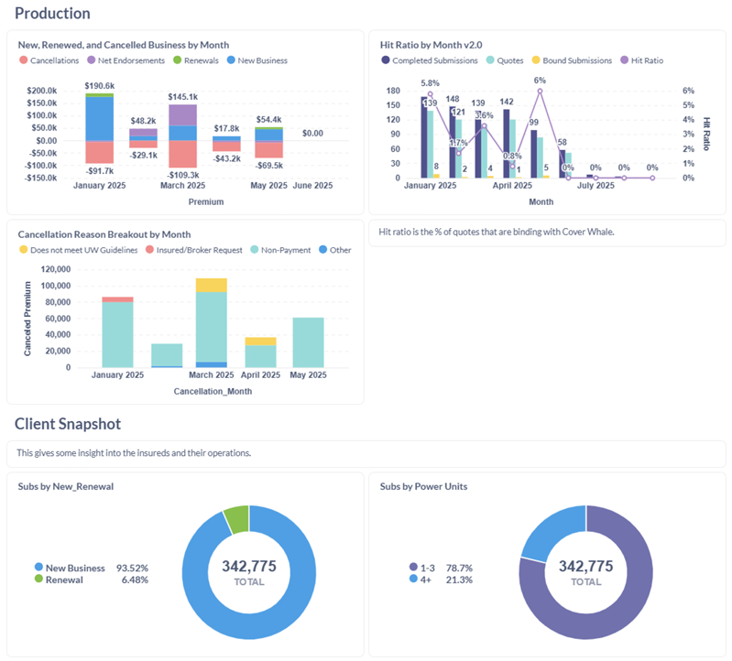
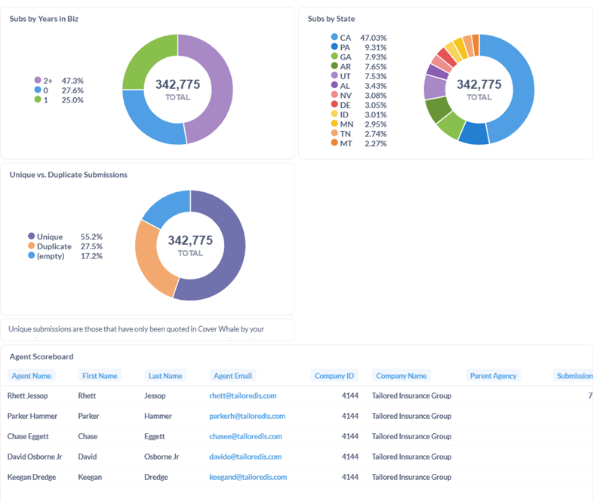
Partner Metrics
Analyzing Production
Notes:
We anazlye each individual parter to see what cobverages they are placing with us, in what states, and what their policy cancellations look like for some examples. These numbers are critical to know as we look at ways to support their agency, and help them achieve their growth goals.

Slide 19
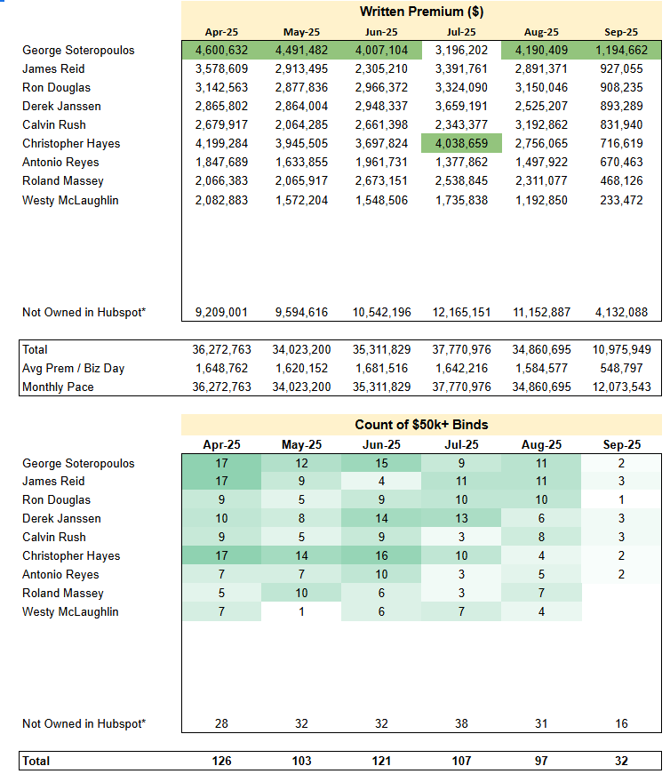
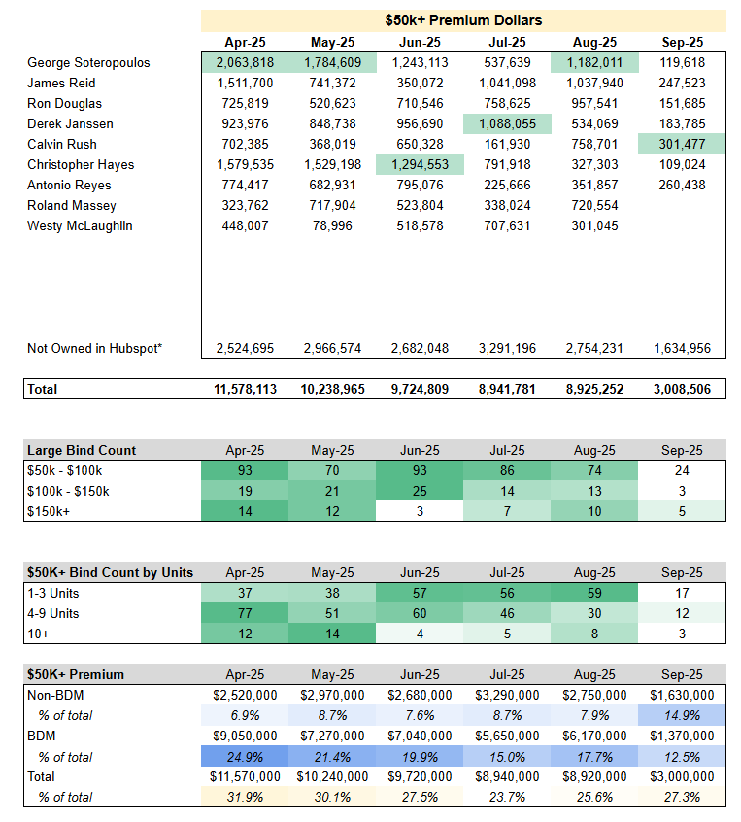
Growth Metrics
Business Development Leaderboard
Notes:
Similar to the way we look at our individual partners, we also track our teams goals. From how much premium is written in each vertical, to the size of the policies written. The more transparency and data our team has at its disposal, the better equipped we are to forecast and scale for the future.

