Slide 1
IAA 3D Weave Project
George Spackman, Mikhail Matveev, Louise Brown

Slide 2
Objectives
• To implement a user interface, as an add-on to TexGen software, which will enable users to easily select optimum textile architectures from a weaver’s product range to satisfy a given set of design parameters.
• To investigate and implement use of open-source optimisation frameworks so that users who do not have access to MATLAB (commercial software) can use the system.
• To extend export tools within TexGen to allow direct input to weaving machines of the selected textile, thus streamlining the manufacturing process.
• A case study performed for a textile manufacturer

Slide 3
Objectives Completed
Deliverables Completed:
Demonstration of optimisation system using MATLAB
New tool developed to allow users to select optimum textile architectures from a weaver’s product range to satisfy a given set of design parameters.
Deliverables to complete:
Database for storage of simulation results which can aid faster optimisation
Software documentation and user guide
Export function for weaving machine input
Webinar to inform potential users about new tool
Open source release of new tool

Slide 4
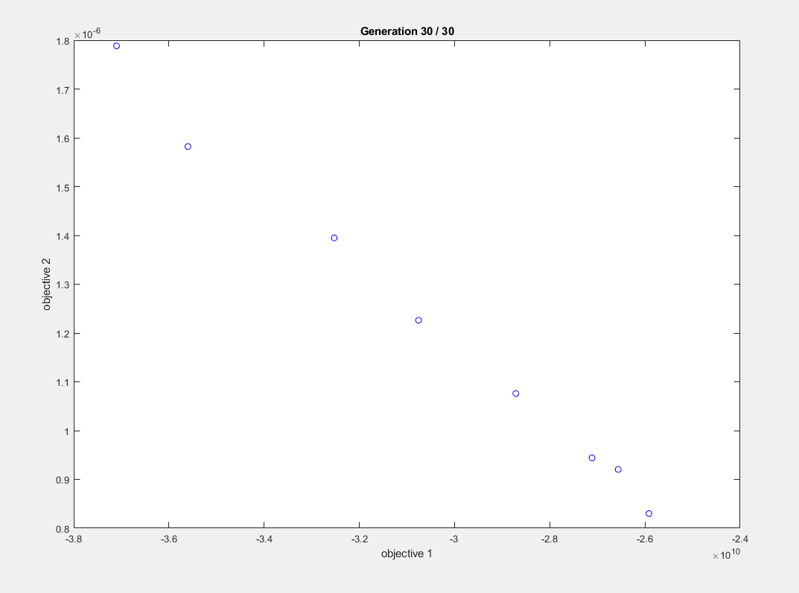
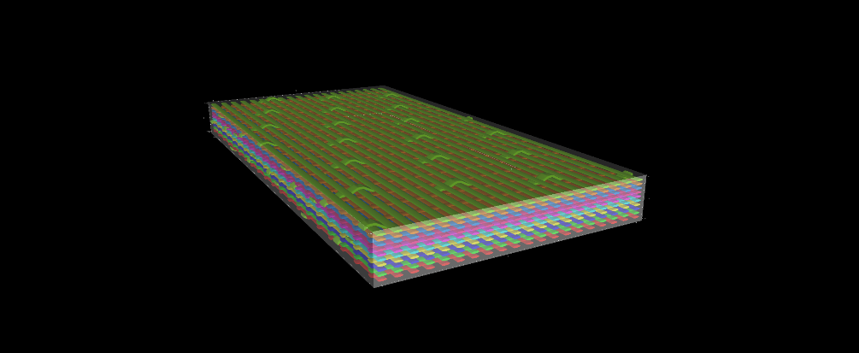
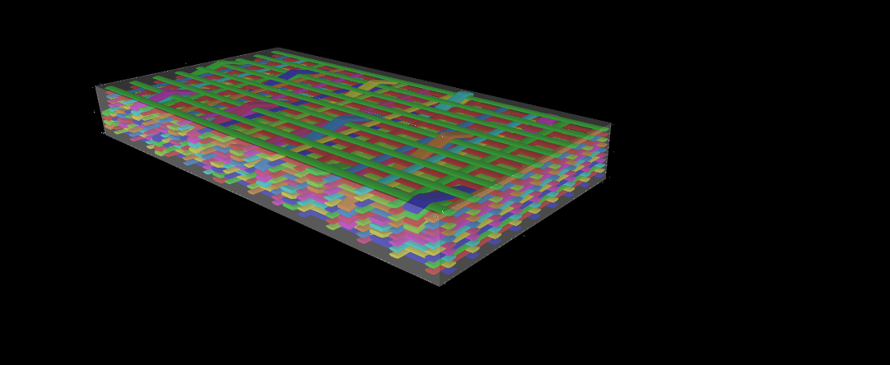
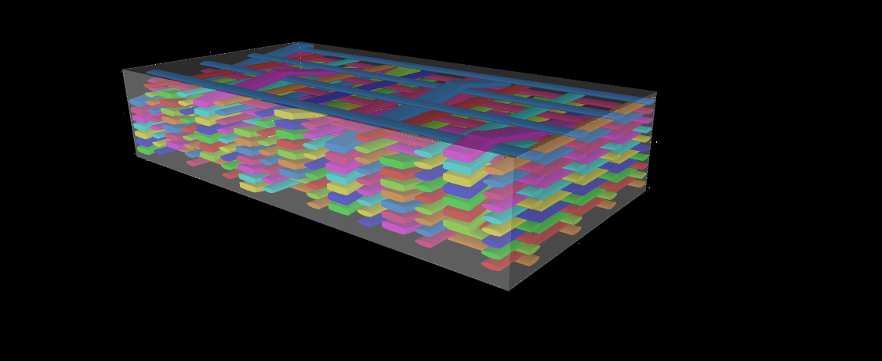
Optimisation 1 – 12k tows warp,weft and binder
Bottom right :
21116
Middle:
24115
Top left:
27113

Slide 5

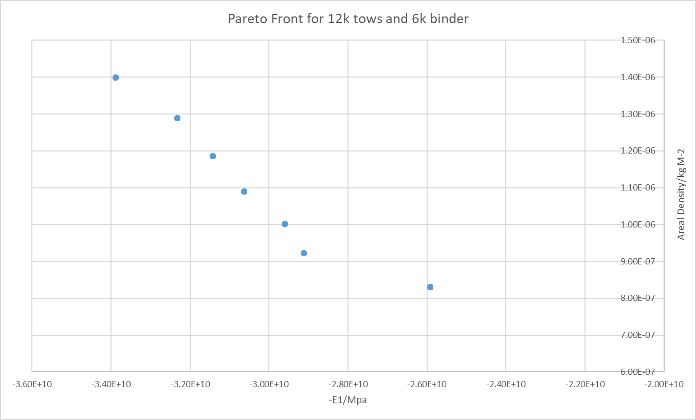

Optimisation 2 – 12k tows warp,weft and 6k binder
Bottom right :
2 1116
Middle:
24113
Top left:
27113

Slide 6
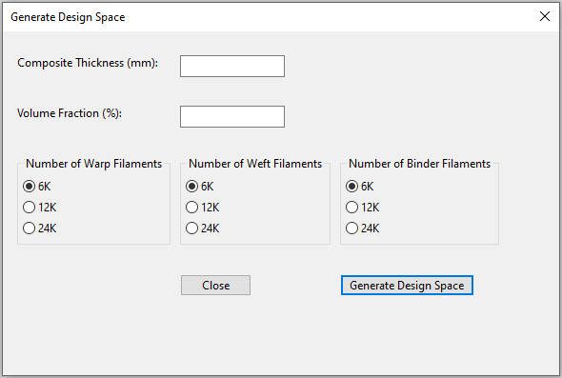
TexGen Interface
New TexGen dialog where users can select from a few options to set the design space for the optimisation.

Slide 7
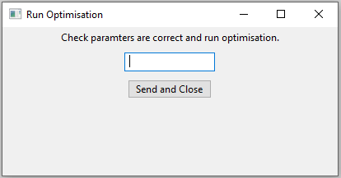
TexGen Interface

Slide 8
Questions

