Slide 1
FTP data Diode
Info-y113 Management of it security
Rusu George, Boulif Ilias, Orinx Cédric

Slide 2
Table of contents:
Introduction to the context
Project implementation
Overview on the network architecture
Live Demonstration
Questions?

Slide 3
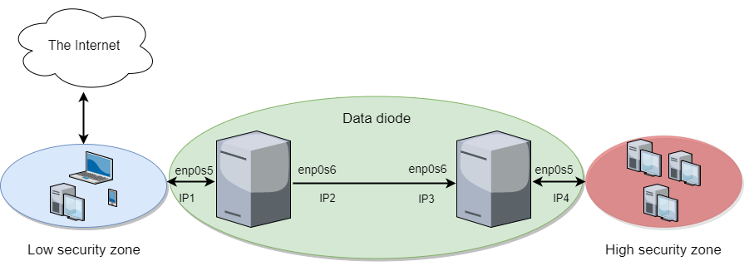
Context
Isolating the research labs: no confidential information leaking
Fighting against industrial espionage

Slide 4
Project Implementation
Linux machines within the data diode : Ubuntu 16.04 LTS.
Blind FTP over UDP protocol
Django framework = web framework for python
Bash command from python3 language : using the “os” python library

Slide 5
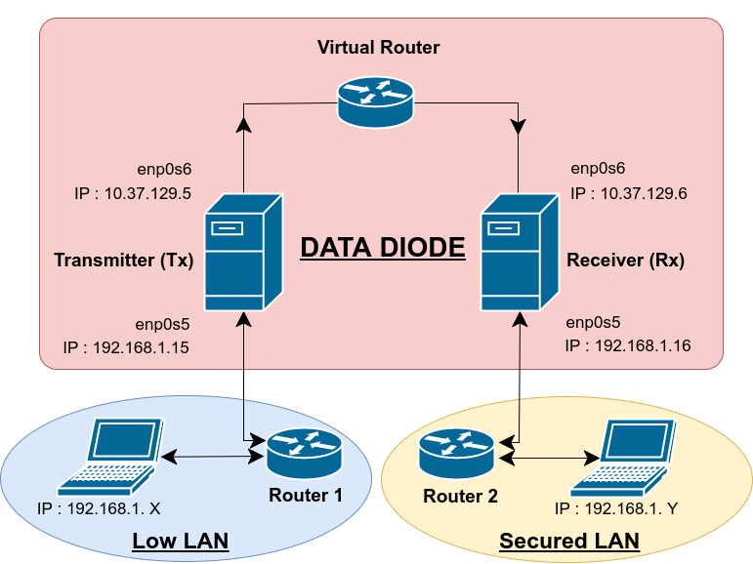
Overview on the Network architecture

Slide 6
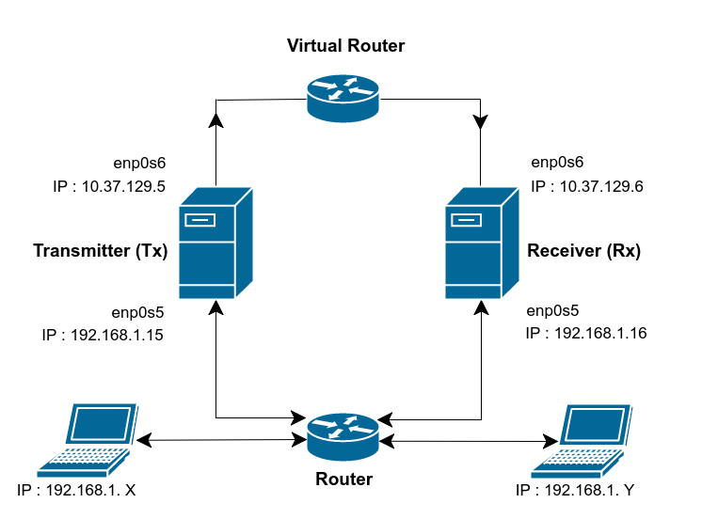
Live Demonstration
Data Diode

Slide 7
Thanks for your attention !
Questions?

Slide 8
Bibliography
[1] DEEP SECURE, How Does a Data Diode Work? Discussion Paper, February 2017.
[2] SANS Institute InfoSec Reading Room, Tactical Data Diodes in Industrial Automation and Control
Systems, January 2015.
[3] CS Risk Management and Compliance Ltd, Data Diode vs Firewall Feasibility, September 2016. [Online]. Available: https://csriskmanagement.co.uk/data-diode-vs-firewall-feasibility/ [Accessed: 30- Oct- 2017]
[4] BlindFTP, Blind ftp protocol[Online]. Available: https://www.decalage.info/fr/python/ blindftp [Accessed: 30- Oct- 2017]
[5] David Basin AND Patrick Schaller AND Michael Schlapfer, Applied Information Security, A hands-on Approach, Springer.
[6] Philippe Lagadec and Laurent Villemin, BlindFTP documentation Documentation, 16 August 2010.

