Slide 1



Web-Scraping Insider Trading Information
By Stanley S. George
This Photo by Unknown Author is licensed under CC BY-ND

Slide 2
Insider Trading
Insider – A person(s) with facts related to listed companies that are not yet released into public domain and could potentially impact the share price of the company.
Insider Trading – Go ahead and trade in the market (Buy or Sell ..)

Slide 3

Who Cares ??
“Insiders might sell their shares for any number of reasons, but they buy them for only one: they think the price will rise.” – Peter Lynch
As a general rule, insider buying shows management’s confidence in the company.
Learn and study these patters; An hobbyist might also make a good fortune if he understands these trends well.
Peter Lynch
Fidelity Investments

Slide 4
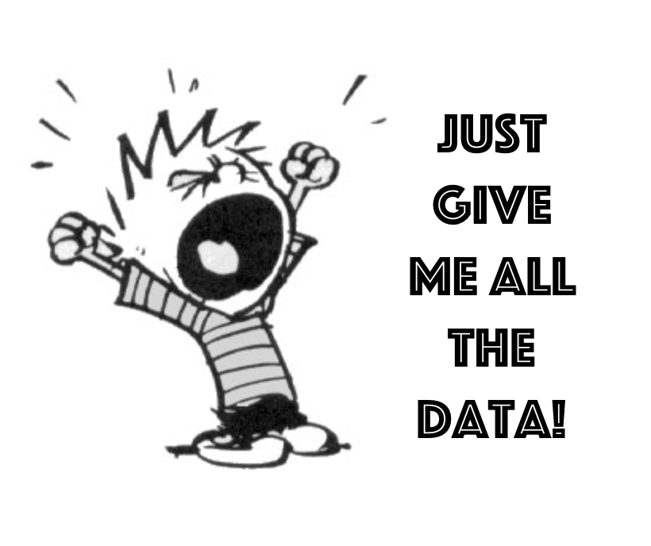

Data! Data! Data!
Web scraping is the process of collecting structured web data in an automated fashion.
If you own the data, you can modify, transform and work on it your way e.g. Customised tracking of share price vs insiders’ activity three quarters ago.
Notes:
You can definitely rely on external websites, but they organise it as per a general standard. No as per your custom standards

Slide 5
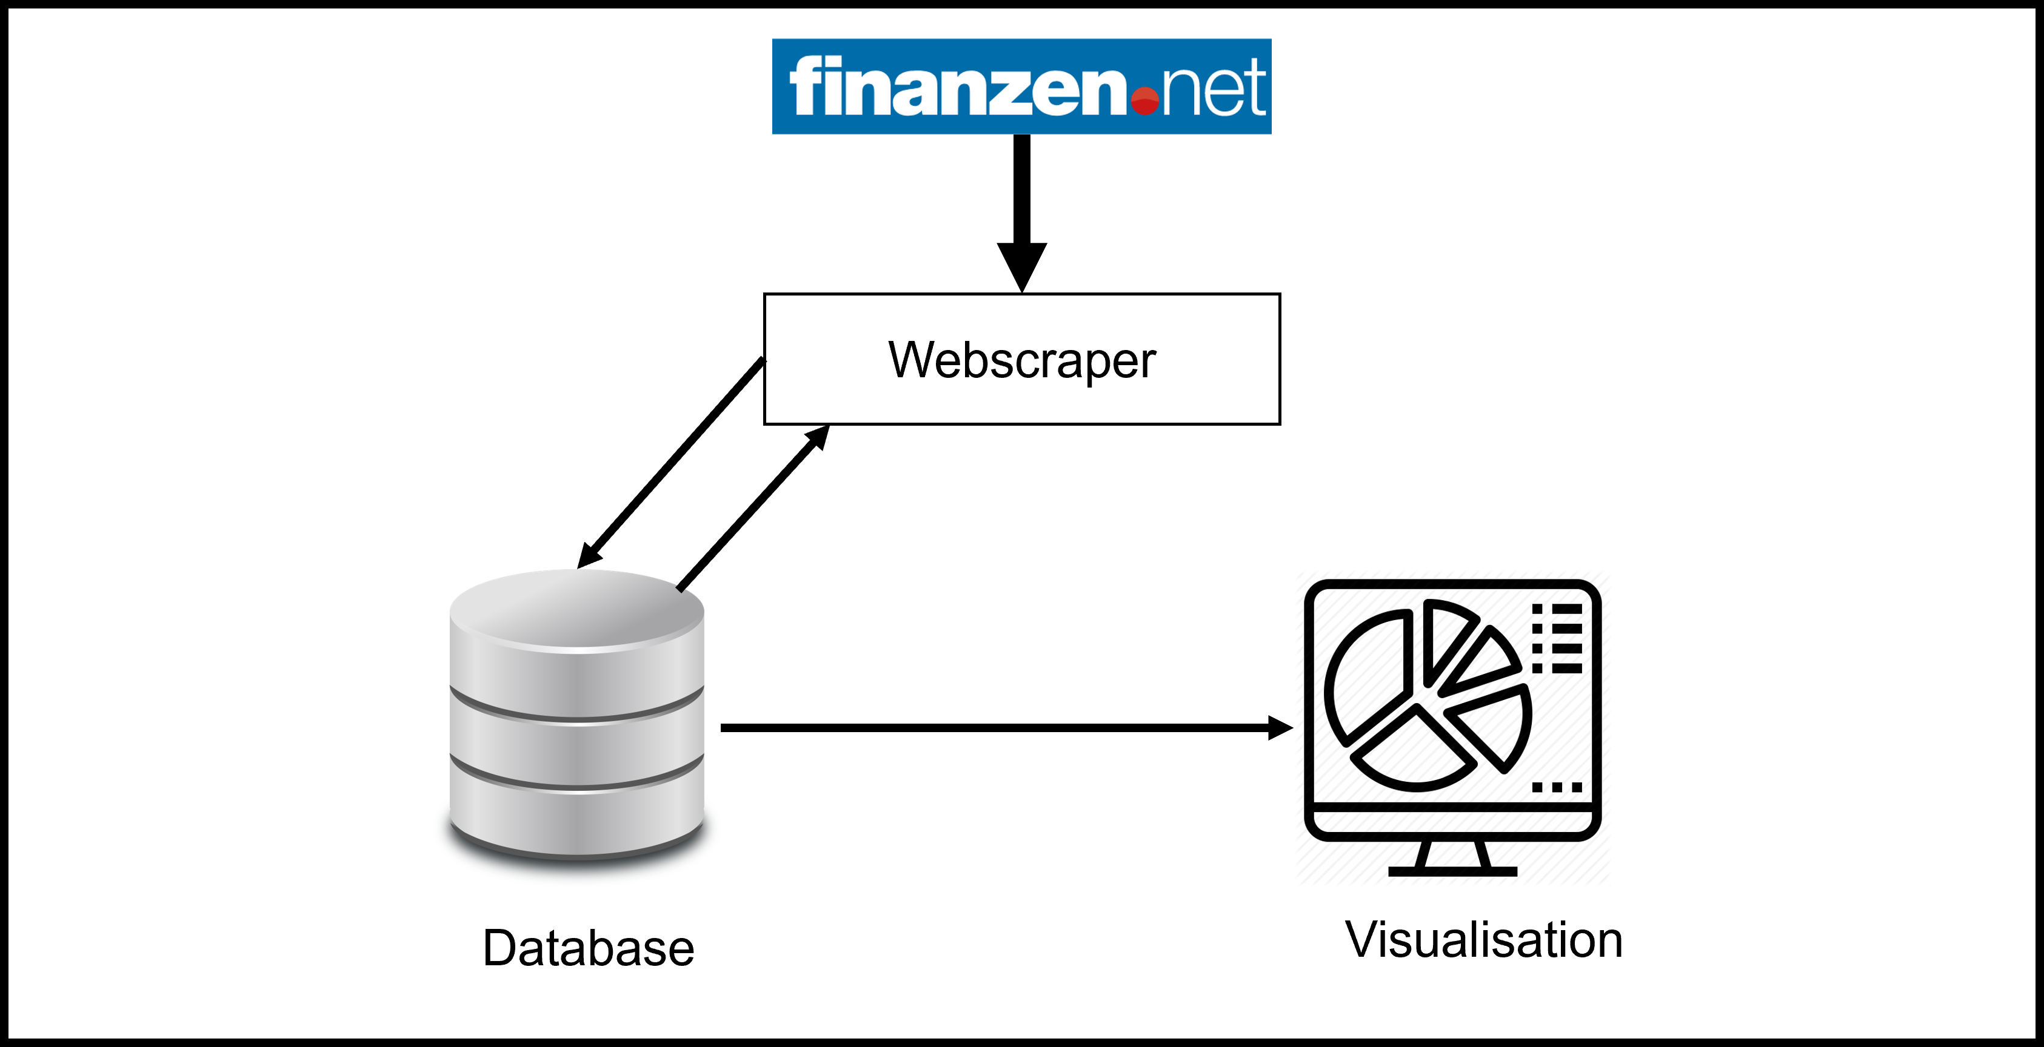


Project Ecosystem

Slide 6

